Slide 1
Proposal writing: Tips for maximizing your chances of getting beam time
Suzanne G.E. te Velthuis
Materials Science Division
Argonne National Laboratory
instrument scientist
proposal writer
proposal reviewer
Supported by the U.S. Department of Energy, Office of Science, Materials Sciences and Engineering Division.

Slide 2
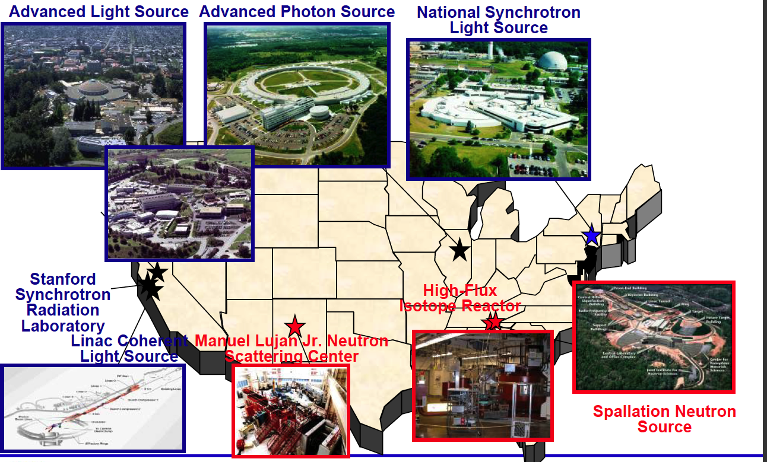
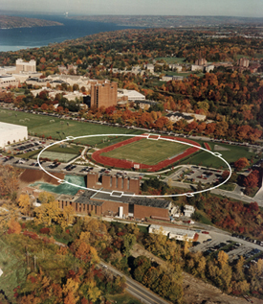
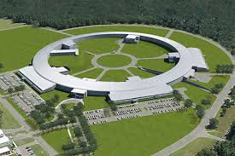
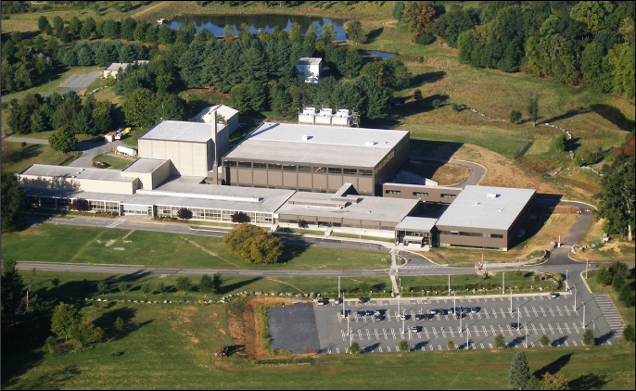
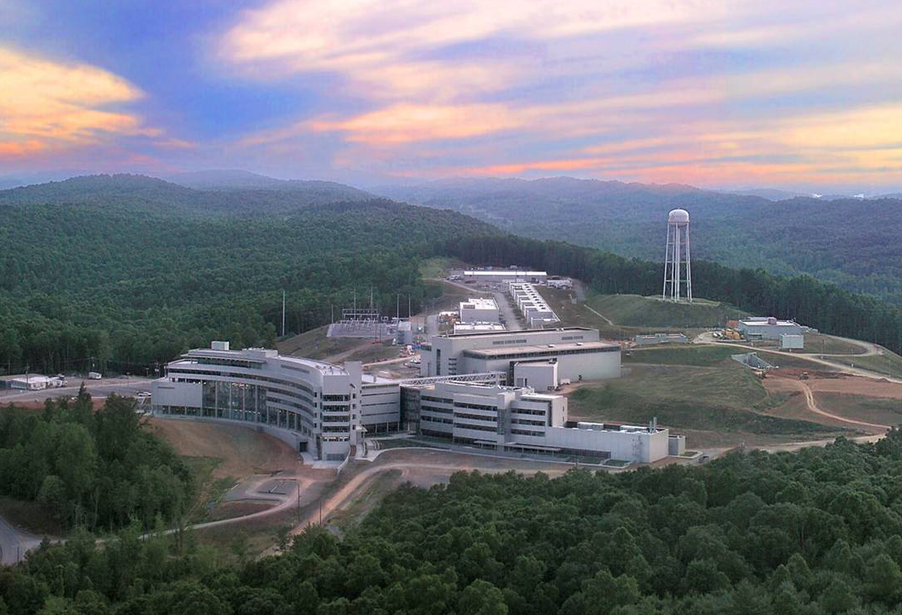
X-ray and Neutron Sources (most DOE-Basic Energy Sciences)
CHESS
-II
NIST NCNR
Also
5 DOE Nanoscience Centers (BNL, SNL/LANL, ORNL, ANL, LBNL)
3 DOE Electron Microscopy Centers (ANL, LBNL, ORNL)

Slide 3
X-ray and Neutron Sources Available Worldwide
Light Sources summarized at www.lightsources.org
~60 facilities: 47 synchrotrons + 13 free electron lasers (FELs)
European Synchrotron Radiation Facility (ESRF), Grenoble, France
SPRING-8, Japan
PETRA III, Germany
CLS, SLS, Shanghai, DIAMOND, BESSYII, SOLEIL, Taiwan, Pohang, …
XFEL.EU, SACLA, FLASH, …
Neutron Sources summarized at www.neutronsources.org
~48 research centers:
Institut Laue-Langevin (ILL), Grenoble, France
ISIS UK
JSNS at J-PARC, Japan
China Spallation Neutron Source, Dongguan (~2018)
European Spallation Source (ESS), Lund, Sweden (~2019)

Slide 4
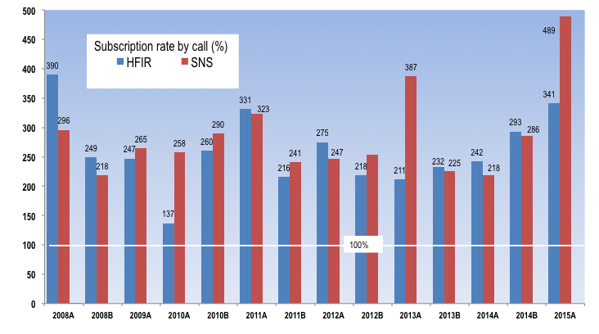
Both SNS and HFIR are oversubscribed

Slide 5
Basics of the facility proposal systems
All the DOE (NIST & NSF) neutron and x-ray sources offer access to beam time through an experimental proposal system. “General Users (GU)”.
Proposal submission is done through a web-based application. When and how often proposals are submitted varies by facility.
APS and NSLS-II three times (“cycles”) per year.
SNS/HFIR and ALS two times per year
All proposals are peer-reviewed and rated, and beam time is allocated using the scores of these reviews. Once time has been allocated, the beamline staff schedule the proposals.

Slide 6
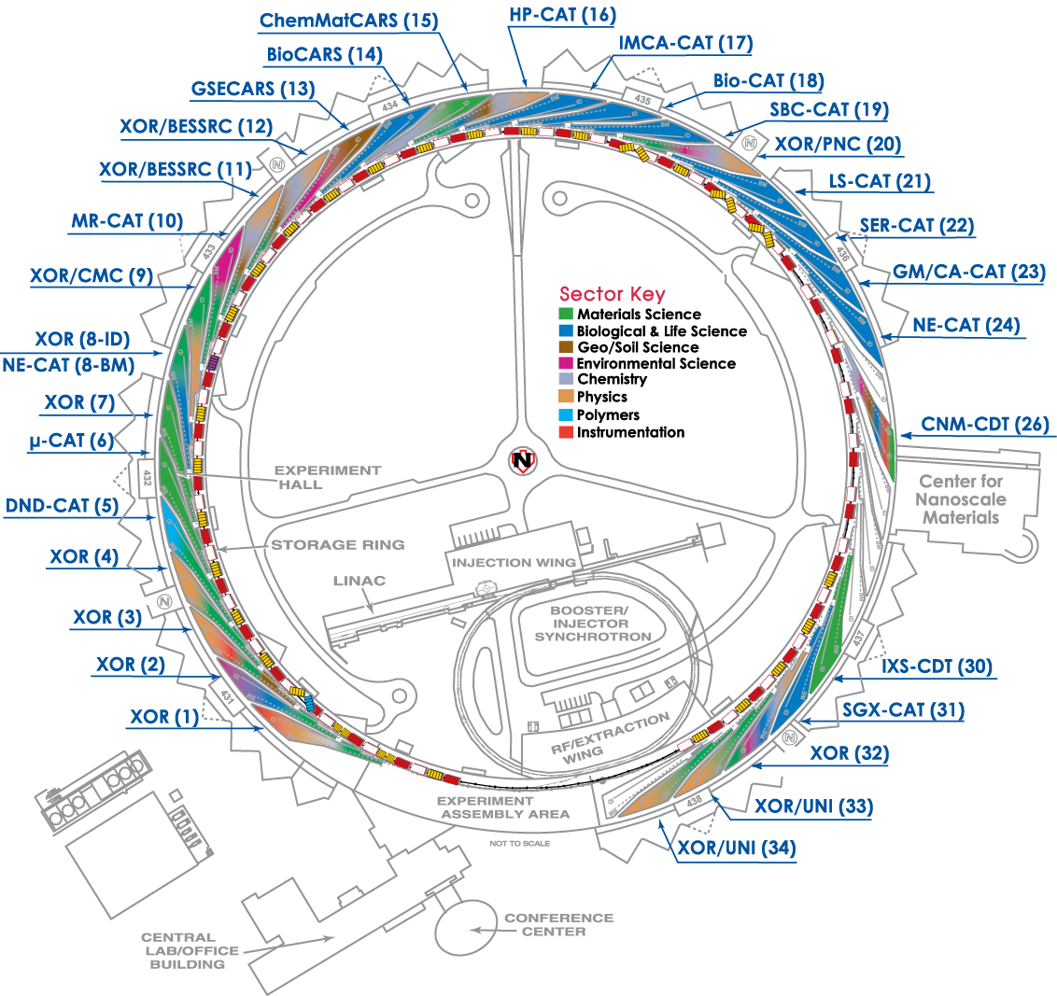
Amount of general user time available
APS/NSLS/SSRL/ALS
All beamlines offer GU beam time.
Most DOE/NSF funded beamlines provide 80-100% of their time to general users.
SNS/HFIR
Amount varies by instrument.
~75% of time will be for general users.
For most, you can search facility websites by technique or by beamline. Quality of proposal websites varies.

Slide 7
Upcoming Proposal Deadlines:
X-ray sources (cycles/yr) Deadlines
APS (3) October 28, 2016
ALS (2) September 7, 2016
(first Wednesday in September and March)
NSLS-II (3) September 30, 2016
LCLS (~2) November 7, 2016
Neutron sources
HFIR/SNS (2) October 5, 2016
NIST-NCNR (~2) September 22, 2016
These are generally hard deadlines.
APS always at Friday midnight (12:05 → next cycle)
Inside Tip: Starting APS application process early (without submitting) gives you a lower ID #.

Slide 8


Users Get Started with Assistance of the Instrument Scientists
Study instrument web pages
Contact an Instrument Scientist to discuss your research
What is the research problem?
Which instrument(s) are appropriate? (scores?)
How mature is the research project (risk, size)?
What is the material – sample composition, form, size, availability?

Slide 9
Users Get Started with Assistance of the Instrument Scientists
Contact an Instrument Scientist to discuss your research
What are the experimental conditions (temperature, pressure, magnetic field, etc)?
What will be measured?
Probability of success? Impact? Significance?
How will results be presented and to whom?
What is the timeline?

Slide 10
Instrument Scientists Assist First-time and Returning Users
Provide technical advice, guidance, and assistance
Instrument options
Sample and experiment preparation
Number of experiment days
Logistics (scheduling, transporting and storing samples)
Proposal preparation tips and assistance
Experiment team members
Data analysis
Publication considerations

Slide 11
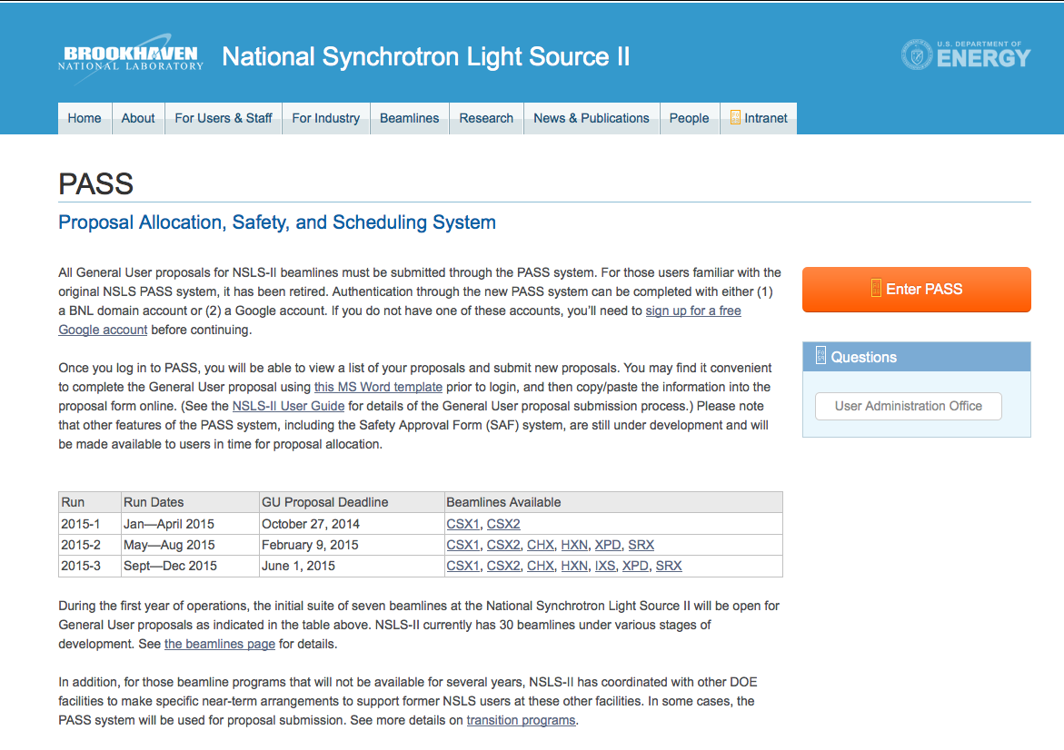
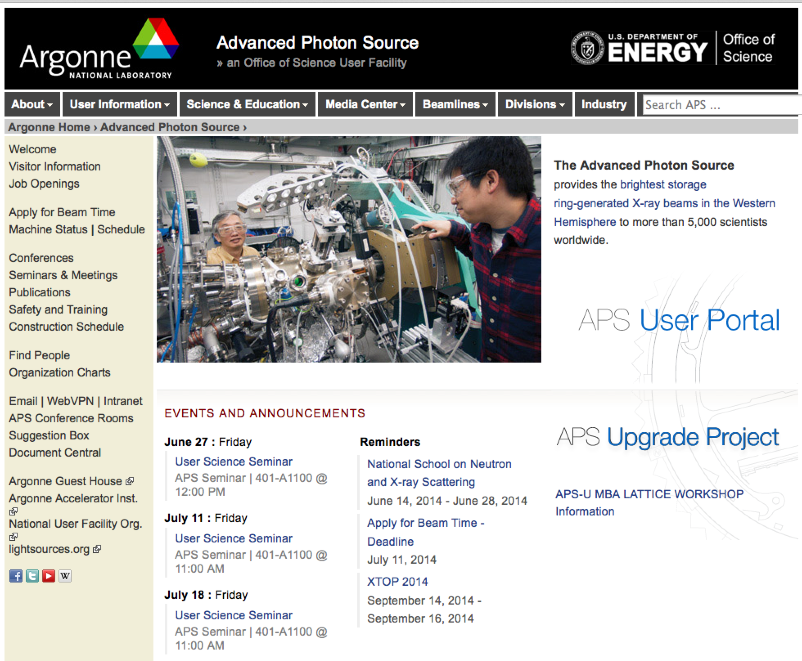
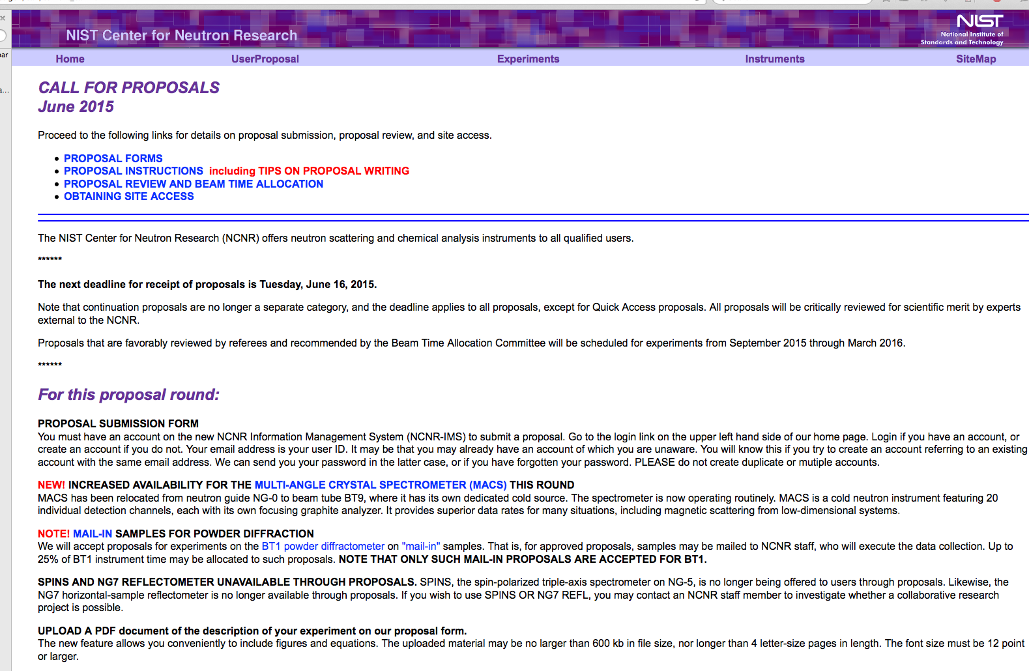
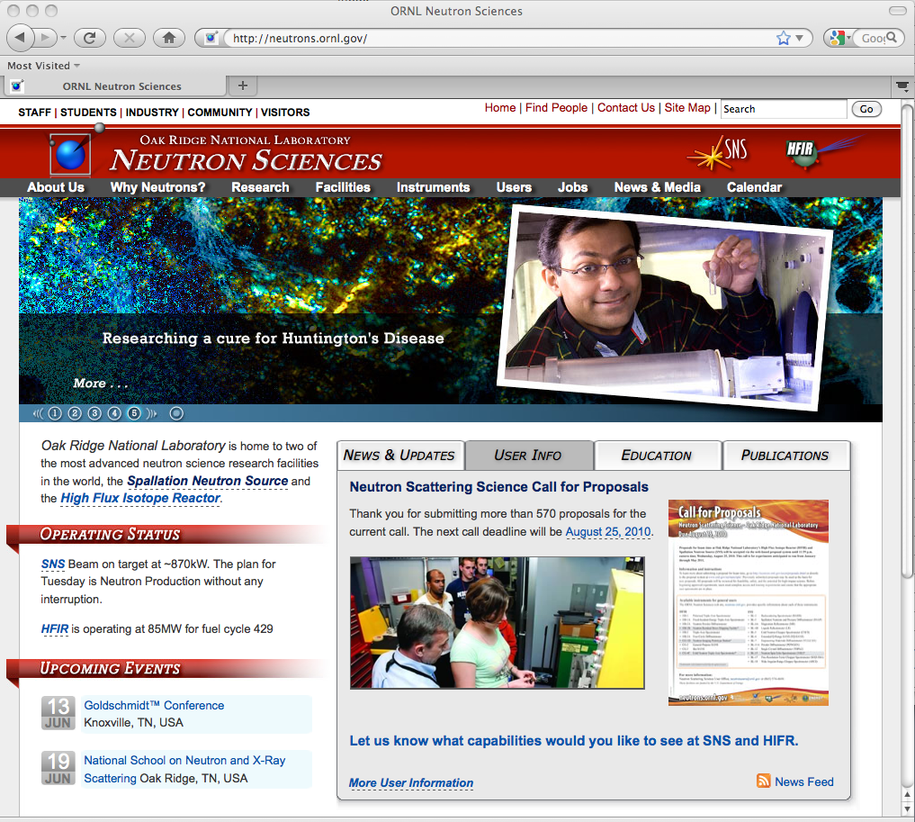
Submitting a proposal
Facilities have link on home page
NSLS-II
APS
NIST
SNS
HFIR

Slide 12
Different types of proposals allow facility flexibility
Each facility has particular systems or proposal modes:
APS
GUP - General User Proposal. A "rapid-access beamtime request" against a submitted proposal can be considered for any unallocated general user time during the current run.
PUP – Partner User Proposal - Groups whose work involves a greater degree of collaboration with the APS. (e.g. major new instrumentation or technique).
11-BM User Program – Accepts user proposals for both on-site experiments and for the rapid-access mail-in service (~60% of user beamtime reserved for mail-in samples). Very easy – they send you capillary tubes. This capability is not obvious on the GUP website.
CHESS – Cornell (received new NSF funding)
Express-Mode proposals are for a single visit of limited duration to CHESS to perform a straight-forward experiment. Express-Mode proposals undergo a rapid on-line review process to enable users to quickly gain access to beam time.
Feasibility Study proposals are to test an idea or procedure at one of the CHESS stations.
NSLS ➔ NSLS-II
7 beamlines now accepting General User Proposals
CSX1 (Coherent Soft X-ray Scattering), CSX2 (Coherent Soft X-ray Spectroscopy), CHX (Coherent Hard), HXN (Hard X-ray Nanoprobe), IXS (Inelastic X-ray Scattering), XPD (X-ray Powder Diffraction), SRX (Submicron Resolution X-ray Spectroscopy)
Commissioning on some other beamlines – opportunity to test ideas

Slide 13
Different types of proposals allow facility flexibility – cont.
NIST NCNR
MAIL-IN SAMPLES FOR POWDER DIFFRACTION Accepts proposals for experiments on the BT1 powder diffractometer on ”mail-in” samples. That is, samples may be mailed to NCNR staff, who will execute the data collection.
QUICK ACCESS PROPOSALS If a user feels that beam time is required very soon to carry out important measurements that cannot be delayed, a proposal may be submitted requesting expedited access. The proposal will be reviewed by the BTAC, and held to a substantially higher standard than regular proposals.
Macromolecular Crystallography is often a separate, self-contained community
A separate proposal system at APS.
Highly automated for mail-in measurements.
Beamtime relatively available.

Slide 14
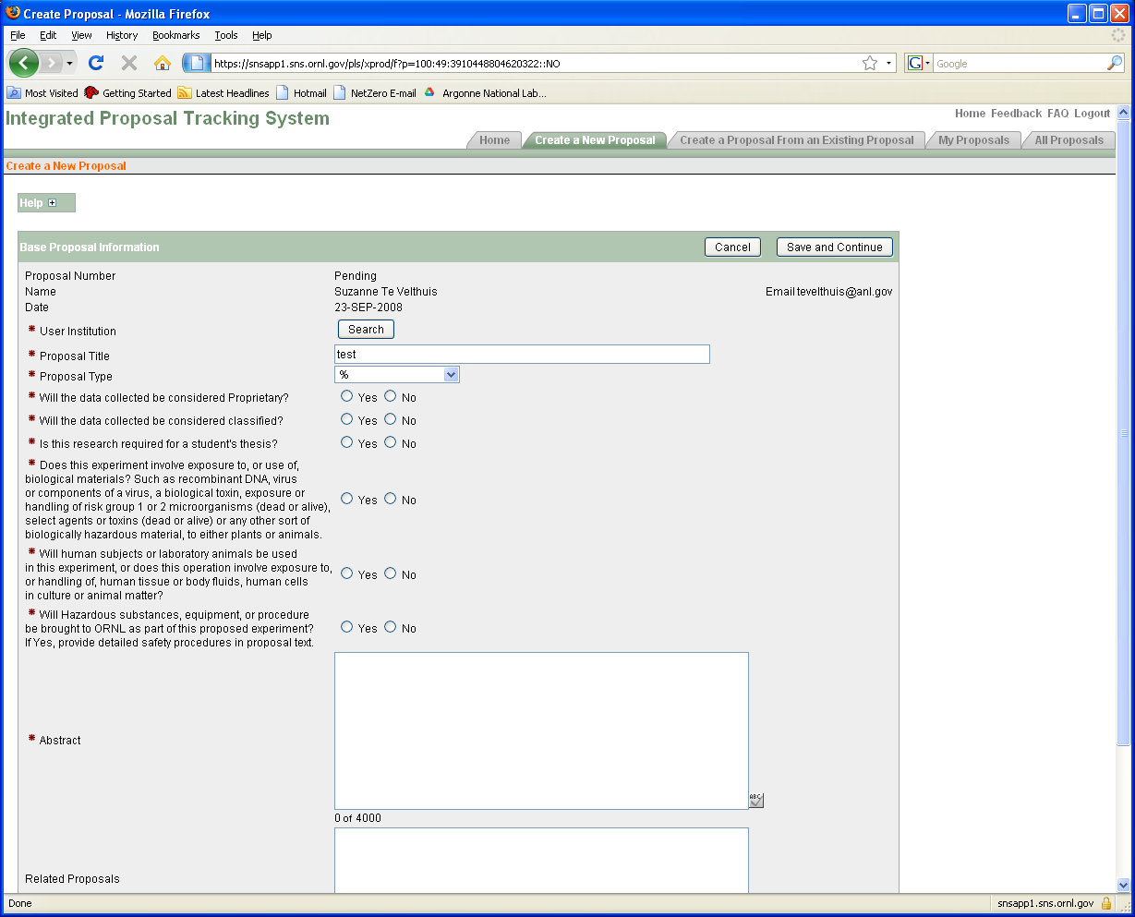
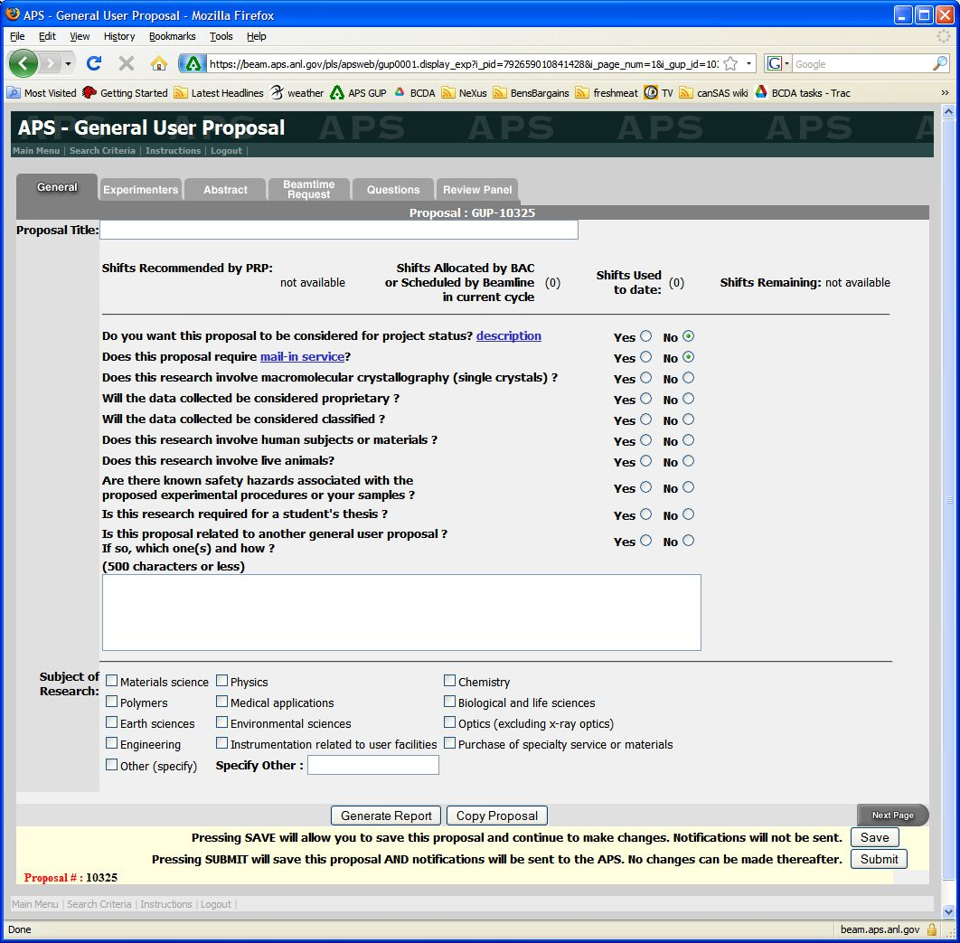
Proposal forms at SNS and APS
SNS/HFIR
APS
Each proposal system will ask very similar questions

Slide 15
Questions asked
Proposal Title
General Info (Title, Experimenters, Funding source, etc.)
Abstract - What is the scientific importance of the proposed research?
Why do you need the facility to do this research?
(Neutron vs. X-rays) or (Neutrons + X-rays)?
Why do you need an insertion device beamline instead of a bending magnet?
Spallation source vs. reactor source
Hard X-rays vs. Soft X-rays
Why do you need the beam line (and/or instrument)?
Particular technique or sample environment
What previous experience / results do you have (pubs important)?
Describe the proposed experiment(s), including samples and procedures. Show that you’re prepared.
Justification of the amount of time requested. Don’t be greedy or unrealistic about time needed. Ask beamline staff.

Slide 16
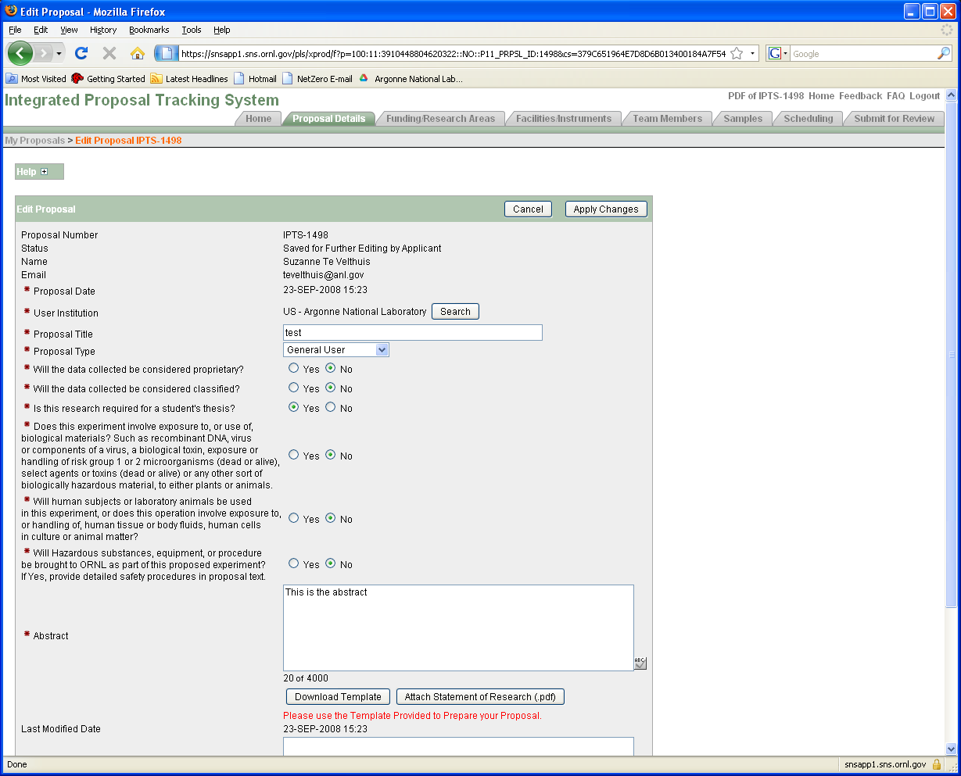
General Information

Slide 17
Proposal: General information
Pick a good title. Specific and to the point is better than spectacular and vague. Spectacular and specific is fine if credible.
Good: “XAS study of Fe valence in CaFe2As2 under pressure ”
Bad: “Understanding superconductivity in superconductors”
Is it thesis related? Is there a deadline?
Will push your proposal up if scores are close

Slide 18
Proposal: General information
Fill in the abstract - This is where reviewer develops first impression.
Do not just upload a PDF document! More work for reviewer.
Science impact in abstract is most important criteria for score.
Do upload a figure/publication from previous work.
Shows you made good use of beam time. Becoming more important.
Do not upload a 20 pages of supplemental information
(figures often help, couple of plots with text OK)

Slide 19
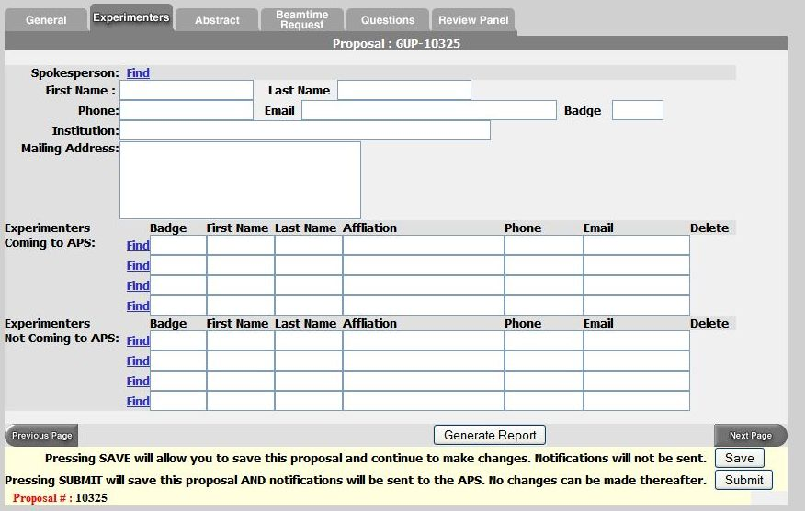
Proposal: Experimenters page
Use the “find” feature
List everyone involved in experiment
Even theorists are useful to show impact

Slide 20
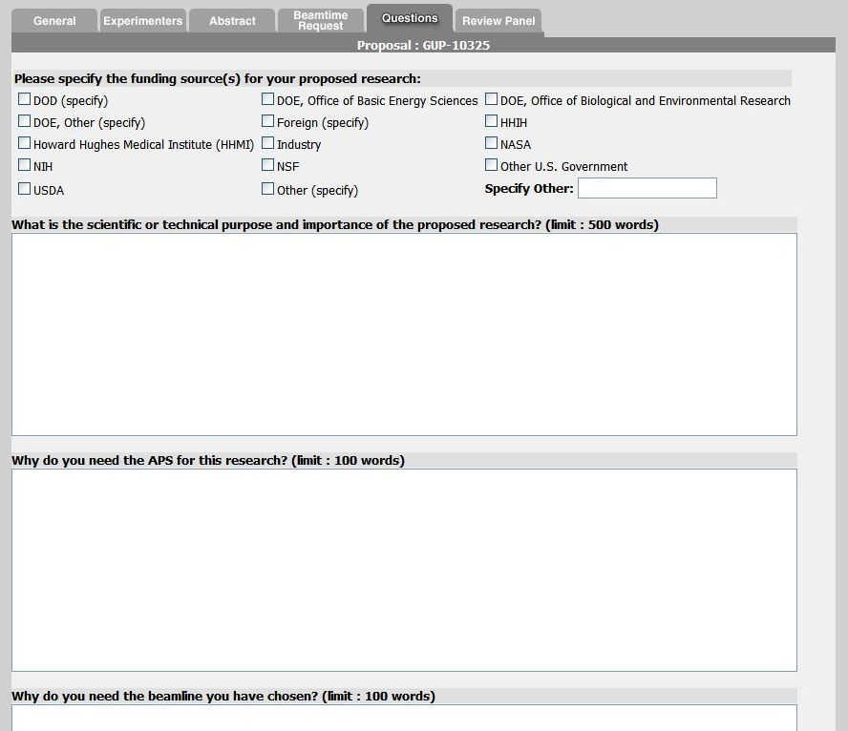
Experiment Description
Note guidance! Don’t write one sentence or 1000 words.
Do not use undefined jargon or acronyms that could frustrate reviewer!

Slide 21
Experimental Details
Give background information why it is important.
Science at facilities is very diverse. Reviewer is not necessarily an expert on your subject. Try to capture imagination of reviewer with basic idea.
@ APS each committee gets ~60 proposals each cycle (~700 total/cycle)
Clearly state what you want to measure and how
Give details. Temperature range, X-ray Energy, Sample geometry
What sample characterization has been done already? (XRD, SEM, etc.)
Can you provide a calculation to show sensitivity is there ?
Reviewer needs to judge if experiment is feasible
Does x-ray energy match laser penetration depth
% of dilute atoms OK for fluorescence measurements

Slide 22
Experimental Details
Why use x-rays or neutrons?
Neutron vs. X-rays OR Neutron + X-rays?
TEM, Mössbauer, Laser Raman, etc.
Justify the amount of beam time requested (ask instrument scientist!)
Be reasonable.

Slide 23
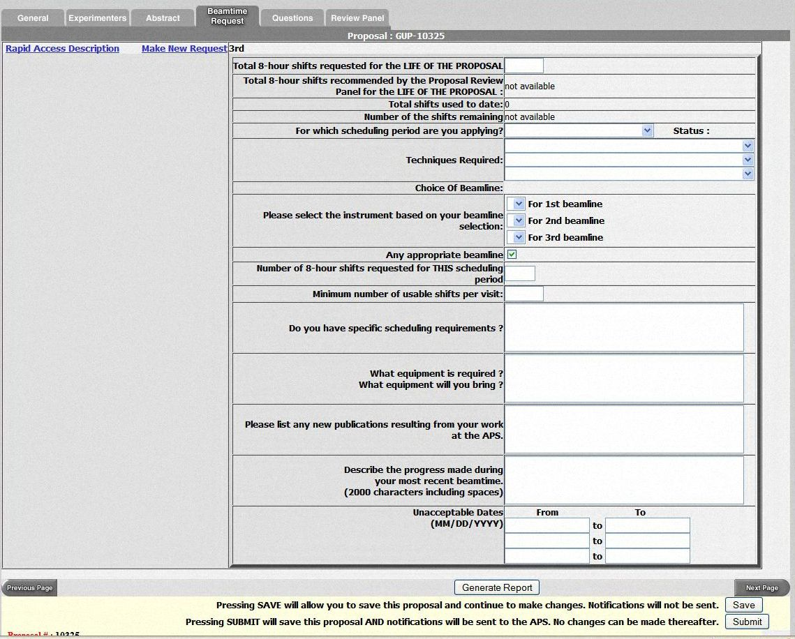
Beamtime Request
APS proposals are valid for two years, but need to put in beam time request each cycle.
Chose multiple beamlines.
SAXS (12-ID, 5-ID, 15-ID)
XAFS (20-BM, 10-ID,12-BM)
General Diffraction
Don’t list only one week that you can come. Holidays?
Special sample environment / detectors will place more constraints on schedule.
GE amorphous Si detector
Magnet
….

Slide 24
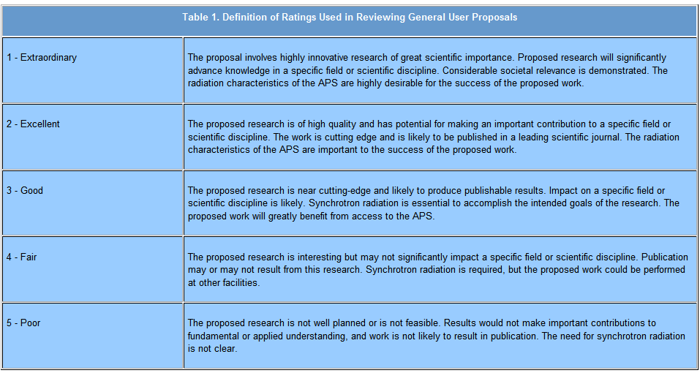
Ratings for APS Proposals
APS proposals are rated on a scale from 1 to 5
Average score is ~2.2
Cut off score for receiving beam time varies by beamline (1.5 - 2.2)
Proposal “ageing” (score improves by 0.2 each cycle it does not receive time). This is needed for getting time at some oversubscribed beamlines, so long-term planning is needed. But you have to remember to request beamtime again for every cycle.

Slide 25
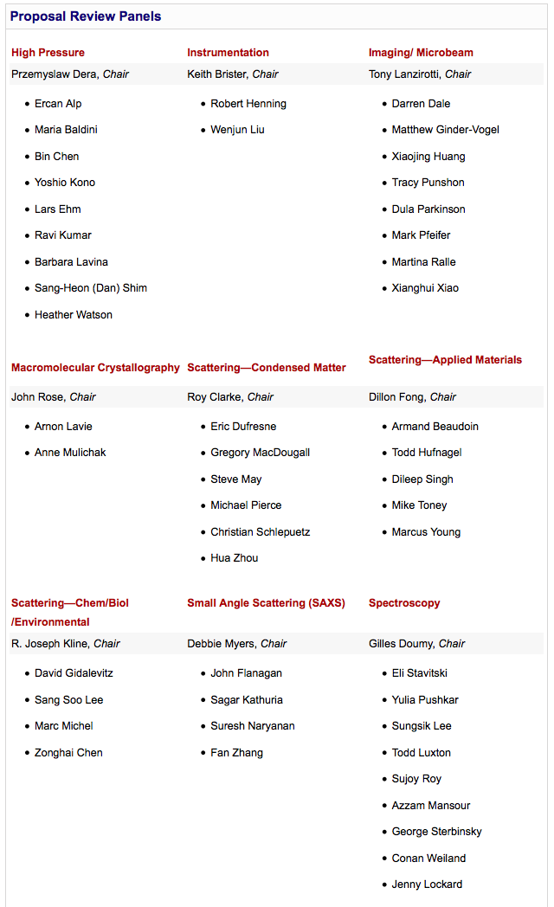
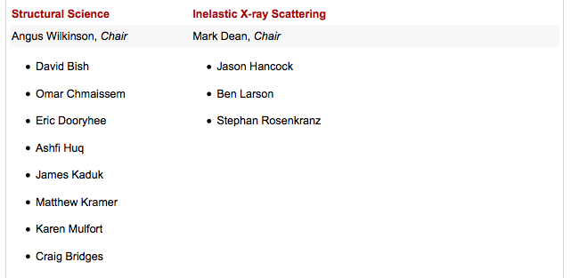
Pick appropriate panel – Important!
Old APS Panels
High Pressure
Instrumentation
Imaging/Microbeam
Macromolecular Crystallography
Scattering Applied Materials
New Panels
High Pressure
Instrumentation
Imaging/Microbeam
Macromolecular Crystallography
Scattering - Condensed Matter
Scattering - Applied Materials
Scattering – Chem / Biol / Environment
Small Angle Scattering (SAXS)
Spectroscopy
Structural Science
Inelastic X-ray scattering
If multiple possibilities - Look at members & Ask staff
https://www1.aps.anl.gov/About/Committees/Proposal-Review-Panels

Slide 26
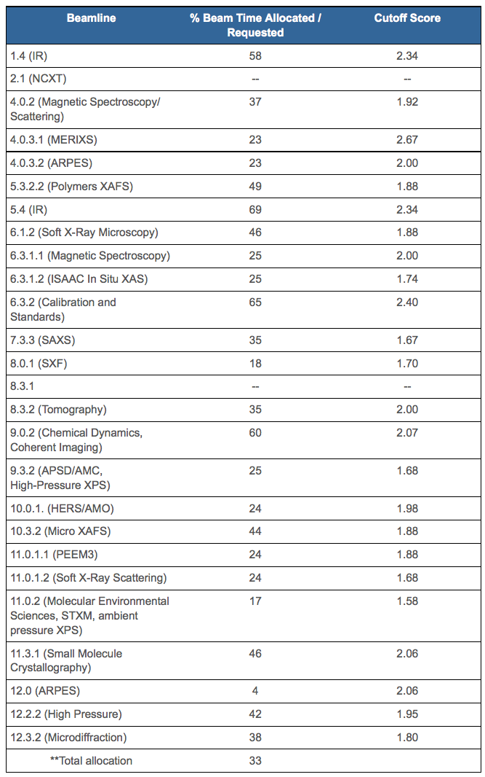
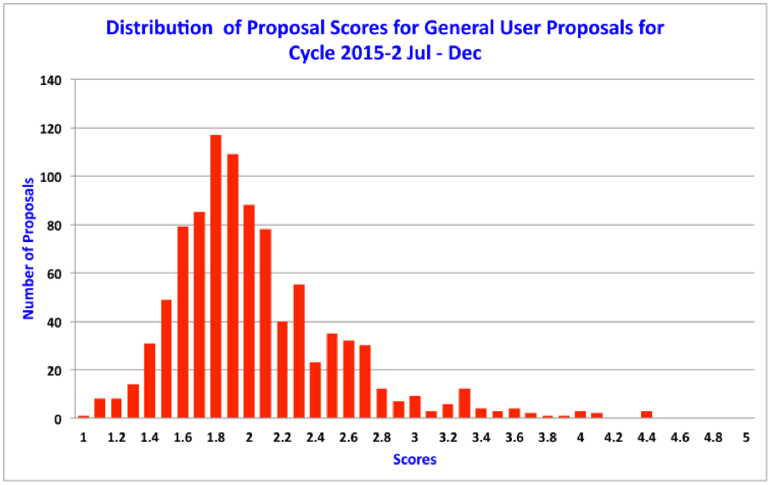
ALS provides cutoff scores – Helps you know what to expect
Beamline cutoff scores
http://www-als.lbl.gov/index.php/user-information/user-guide/354-proposal-score-statistics.html
➔
easier
➔
easier
“Medium priority”
➔
easier
➔
harder
➔
harder
➔
harder
1
2
4
5
3
➔
harder

Slide 27
Tips
Give a concise explanation of this specific proposal
Provide background on importance (i.e., “bigger picture”)
State clearly and exactly what you are going to measure and why.
Reviewer want so assess likelihood of success.
Include relevant details to experiment but do not get too verbose
Reviewer needs to judge not only scientific importance, but also if the experiment is feasible and if you are asking for the right instrument.
If you are a first time user, talk to the local contact/instrument scientist.
Find out about details of the instrument, typical measuring times…
Over-subscription rate? Can a less popular instrument do the same measurements?
Send them the proposal ahead of time and ask for advice. Collaborate?
If you have previous results from other experiments include them!
Home, other institution, previous experiment.
Sample characterization.
Take advantage of proposal ageing. Plan ahead!

Slide 28
Several common pitfalls
Proposer assumes committee is familiar with their specialty. Explain impact.
Proposer writes large general vague proposal asking for multiple weeks of time. Better to write a shorter proposal with a well defined objective. Be realistic with beam time request.
Proposer submits 2 (or more) similar proposals for related materials thinking that multiple proposals increases chances.
Proposal deadline (for next cycle) is before scheduled beam time this cycle.
Common Reviewer comments:
“Proposers could improve their score by including more experimental details, attaching previous results and expanding on the purpose and importance of the research.”
“Hasn't the proposed research been published previously?”
“We do not feel that granting 20 shifts/cycle for 2 years is consistent with the history of publication of this work.”
“Proposer should perform initial characterization with lab sources or TEM.”

Slide 29
After submission
Allow time for review and revisions
Expect feedback several weeks from the call close
Be ready to schedule experiment if approved
Identify participating team members
Respond to facility access approval information
Facilitate execution of user agreements
Complete required training
Confirm sample availability and description and laboratory needs
Consider reviewer comments if not approved and plan to resubmit this proposal or a new proposal in the next call. Opportunities (# of facilities and beamlines/facility) continue to grow.

Slide 30
Thanks to:
Jonathan Lang (APS)
John Budai

