Slide 1
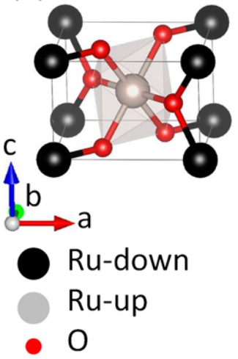
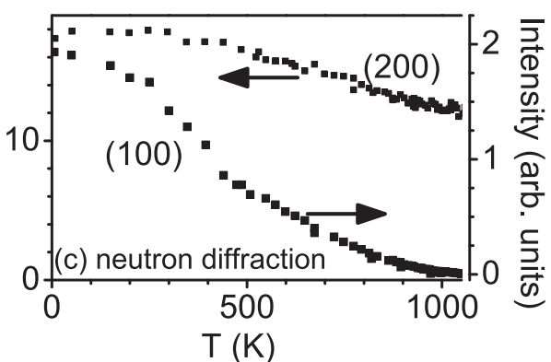
Itinerant Antiferromagnetism in RuO₂
Scientific Achievement
Rutile-type RuO₂ had been considered a Pauli paramagnet, until this report demonstrated a previously undetected lattice distortion below approximately 900 K accompanied by antiferromagnetic order. The room temperature magnetic moment of approximately 0.05 μB is small, but clearly confirmed by polarized neutron diffraction. This experiment and corresponding theory suggest that the combination of high Néel temperature and small itinerant moments in RuO₂ are unique among metallic oxides.
Atomic and magnetic structure of rutile-type RuO₂ as predicted by Density Functional Theory and confirmed by neutron diffraction.
Significance and Impact
The magnetic properties of other 4d and 5d metallic oxide systems should be reevaluated, given that many of these materials already are of technological importance, as catalysts for instance. The existence of itinerant antiferromagnetism in this class of materials offers possibilities for spintronics, if the moment size can be enhanced by alloy substitution or dimensional confinement.
Berlijn, T., P. C. Snijders, O. Delaire, H.-D. Zhou, T. A. Maier, H. B. Cao, S.-X. Chi, M. Matsuda, Y. Wang, M. R. Koehler, P. R. C. Kent, H. H. Weitering, Itinerant antiferromagnetism in RuO₂. Physical Review Letters 118, 077201 (2017).
Temperature dependence of nuclear (200) and magnetic (100) Bragg peaks measured by neutron diffraction
Work performed at ORNL’s HFIR instruments HB-1, HB-3, and HB-3A was supported by the DOE Office of Science User Facilities.
Notes:
A. Banerjee, C. A. Bridges, J.-Q. Yan, A. A. Aczel, L. Li, M. B. Stone, G. E. Granroth, M. D. Lumsden, Y. Yiu, J. Knolle, S. Bhattacharjee, D. L. Kovrizhin, R. Moessner, D. A. Tennant, D. G. Mandrus, and S. E. Nagler, “Proximate Kitaev Quantum Spin Liquid Behaviour in a Honeycomb Magnet,” Nature Materials (2016). DOI: 10.1038/nmat4604.
http://www.nature.com/nmat/journal/vaop/ncurrent/abs/nmat4604.html
ABSTRACT
Quantum spin liquids (QSLs) are topological states of matter exhibiting remarkable properties such as the capacity to protect quantum information from decoherence. Whereas their featureless ground states have precluded their straightforward experimental identification, excited states are more revealing and particularly interesting owing to the emergence of fundamentally new excitations such as Majorana fermions. Ideal probes of these excitations are inelastic neutron scattering experiments. These we report here for a ruthenium-based material, α-RuCl₃, continuing a major search (so far concentrated on iridium materials) for realizations of the celebrated Kitaev honeycomb topological QSL. Our measurements confirm the requisite strong spin–orbit coupling and low-temperature magnetic order matching predictions proximate to the QSL. We find stacking faults, inherent to the highly two-dimensional nature of the material, resolve an outstanding puzzle. Crucially, dynamical response measurements above interlayer energy scales are naturally accounted for in terms of deconfinement physics expected for QSLs. Comparing these with recent dynamical calculations involving gauge flux excitations and Majorana fermions of the pure Kitaev model, we propose the excitation spectrum of α-RuCl₃ as a prime candidate for fractionalized Kitaev physics.

