Slide 1
Reducing HB2a DATA into FullProf or GSAS File FORMAT
HB2a Instrument Team
High Flux Isotope Reactor
August 2014
Notes:
PAC edits

Slide 2
Access to HB2a DATA
The Hb2a experimental files are accessible on the instrument using the running SPICE data acquisition and data reduction system
The data may be accessed and reduced remotely by downloading the files from a secure HFIR server using the HFIR Graffiti software which may be downloaded and installed from:
http://neutron.ornl.gov/spice/ or
http://neutron.ornl.gov/spice/Executables/GraffitiInstaller%20version%202.6.0.53.exe
Notes:
Remove “the running”

Slide 3
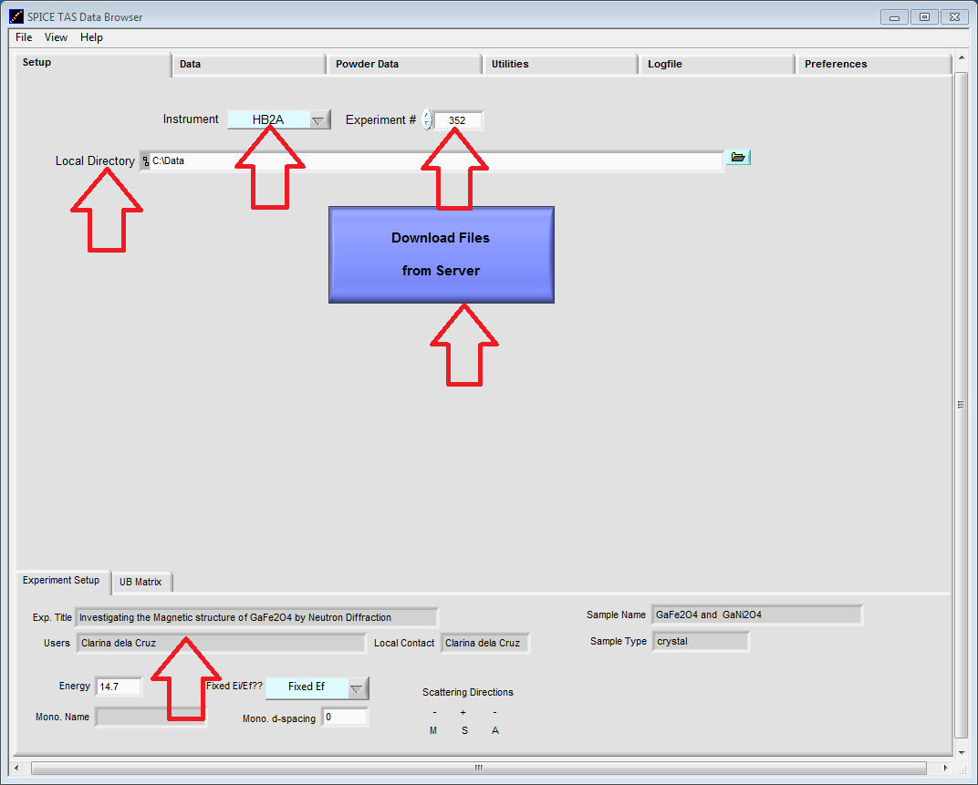
If using Graffiti, download the data from server
2
3
1
Set instrument to HB2a
Set experiment number
Set local directory to your choice (default to C:\Data)
Press “Download Files from Server”
Check experiment information in lower part to ensure you downloaded the correct experiment
4
5

Slide 4
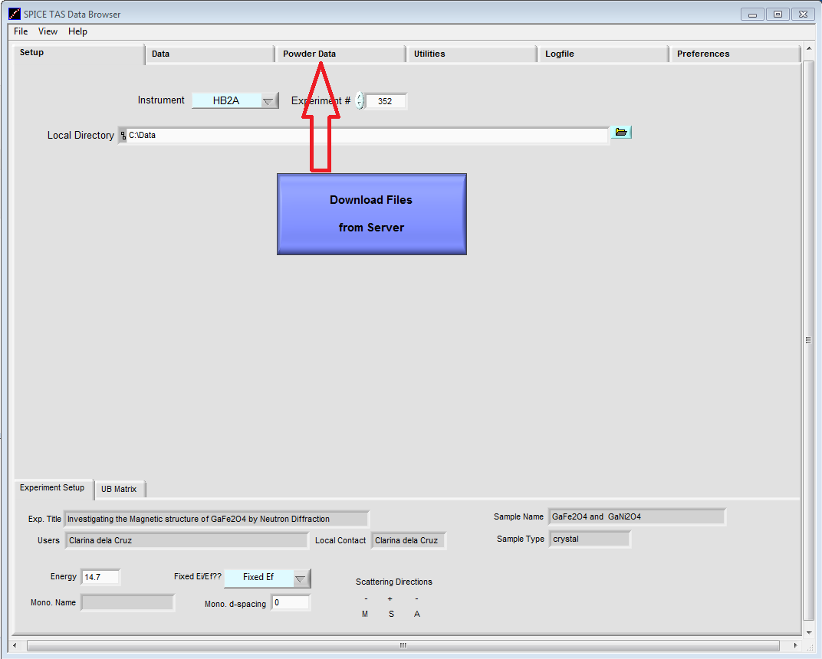
1. Enter the “Powder Data” Tab

Slide 5
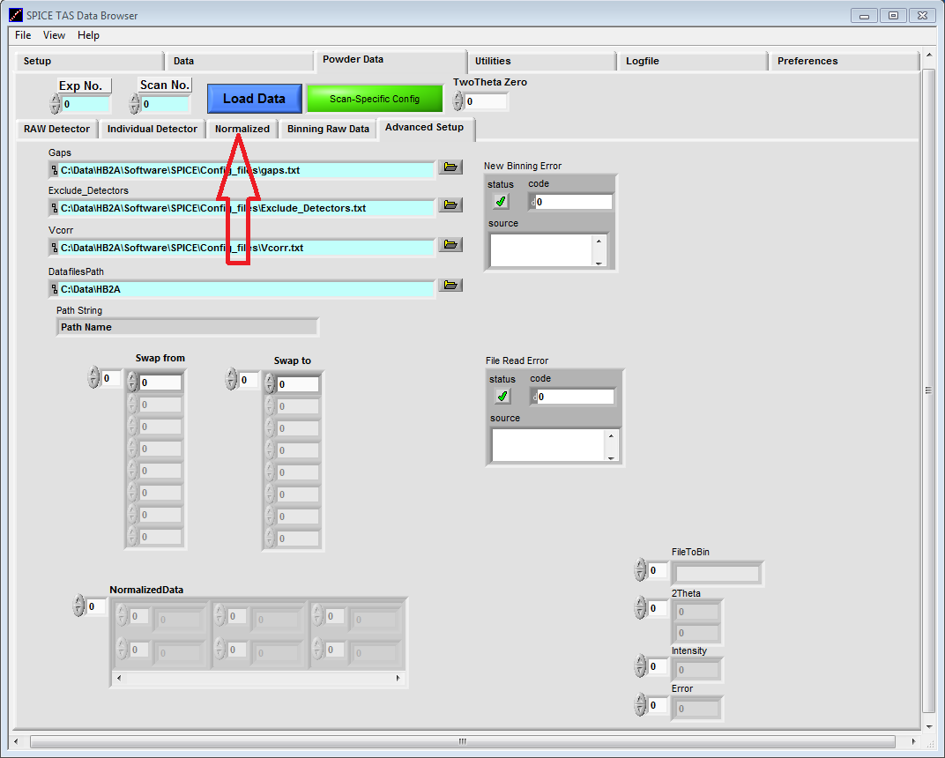
2. Enter the “Normalized” Sub-Tab

Slide 6
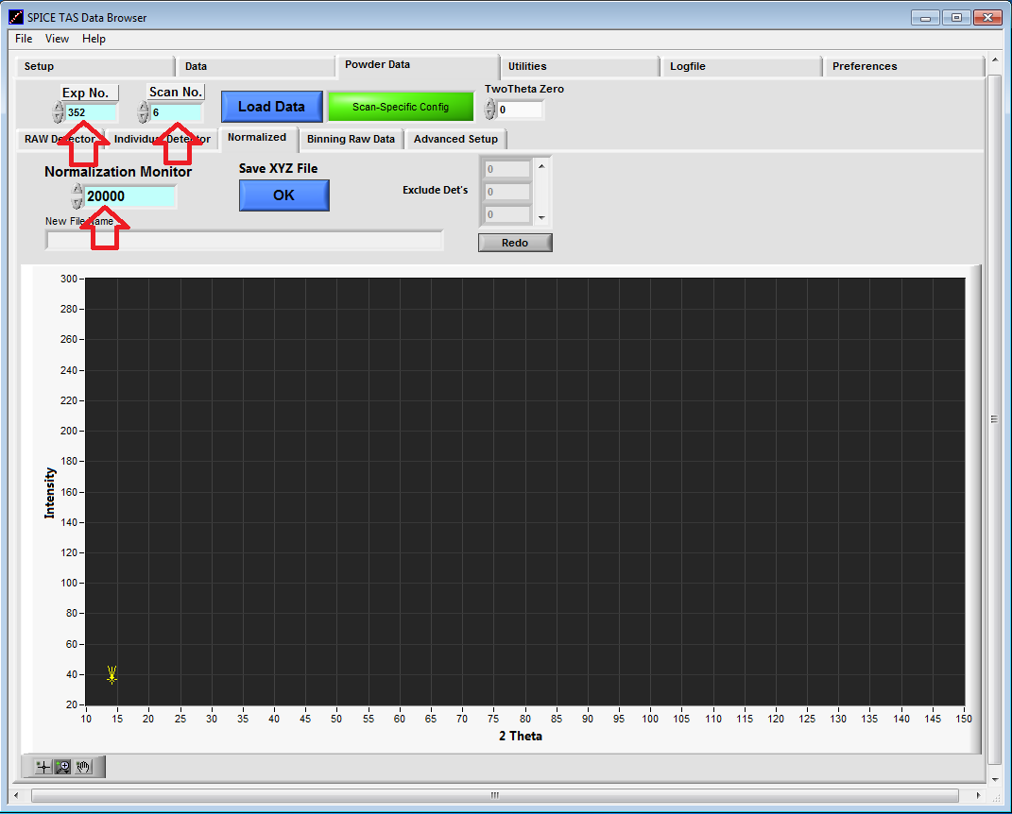
3. Enter data details
The Experiment Number, Scan Number, and the Normalization Monitor(default value at 20,000 counts/minute)
Notes:
Fixed typo

Slide 7
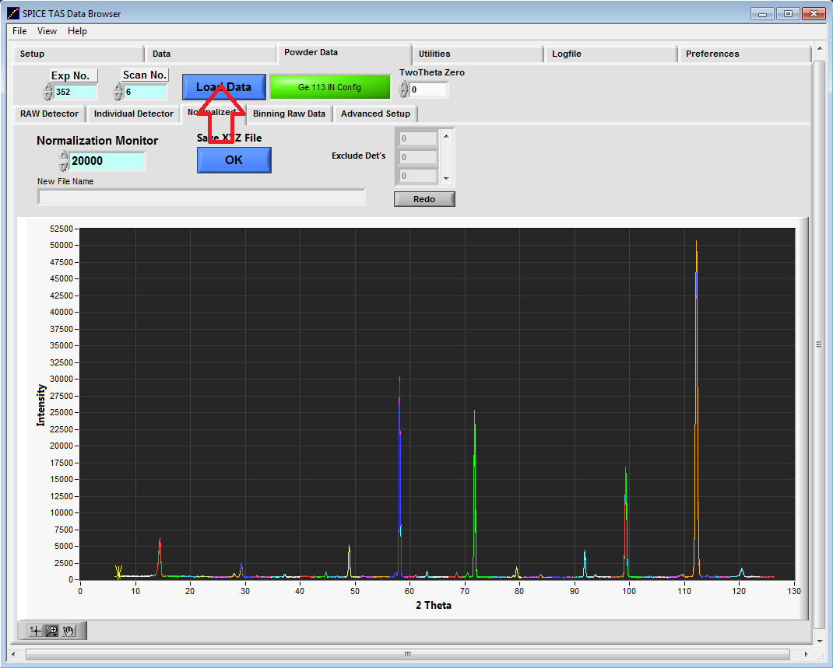
4. Viewing multidetector pattern
Press the “Load Data” Button to view noramlized data
The Green button will show the measurement configuration for the data set
(i.e. Ge113 IN Config means λ=2.41Ǻ, α₂ pre-sample collimator is IN)
3. On the instrument computer, the data is stored at C:\Data\HB2A\exp#

Slide 8
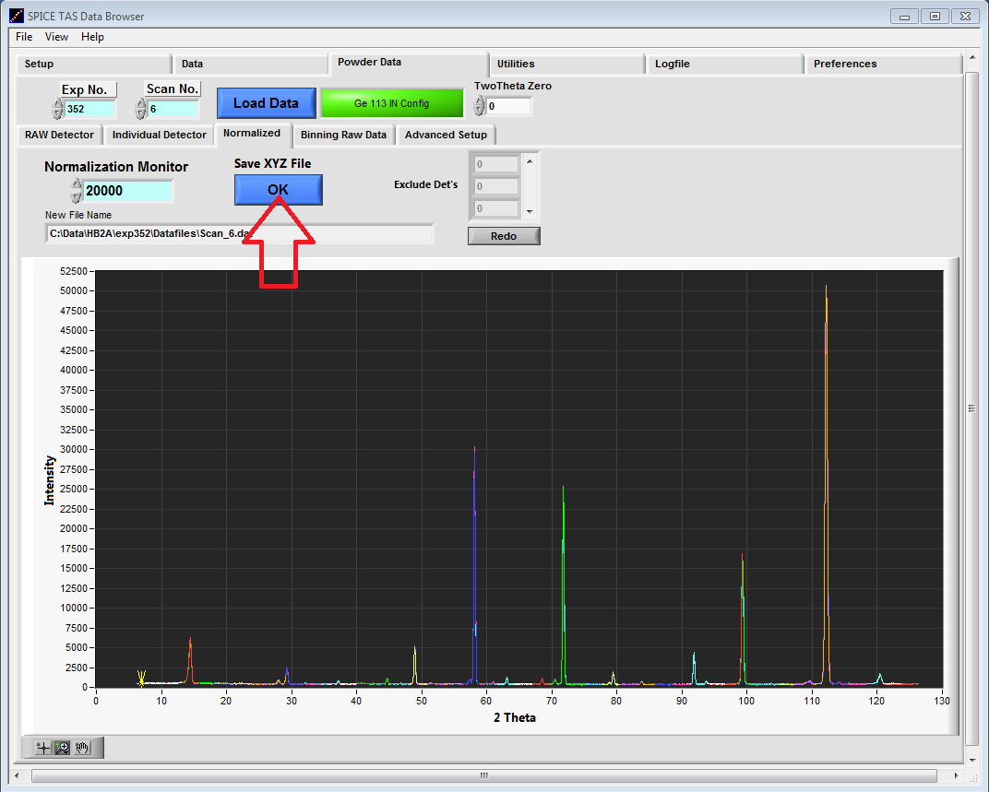
5. Save 3-column (XYZ) intermediate file
Save XYZ File, Press the “OK” Button
This is an intermediate file that stitches together the output from all 44 detectors
The raw data files “HB2a_exp0#_scan#.dat” and the XYZ files “Scan_#” are saved at the instrument computer at C:\Data\HB2A\exp#\Datafiles\Scan_#.dat

Slide 9
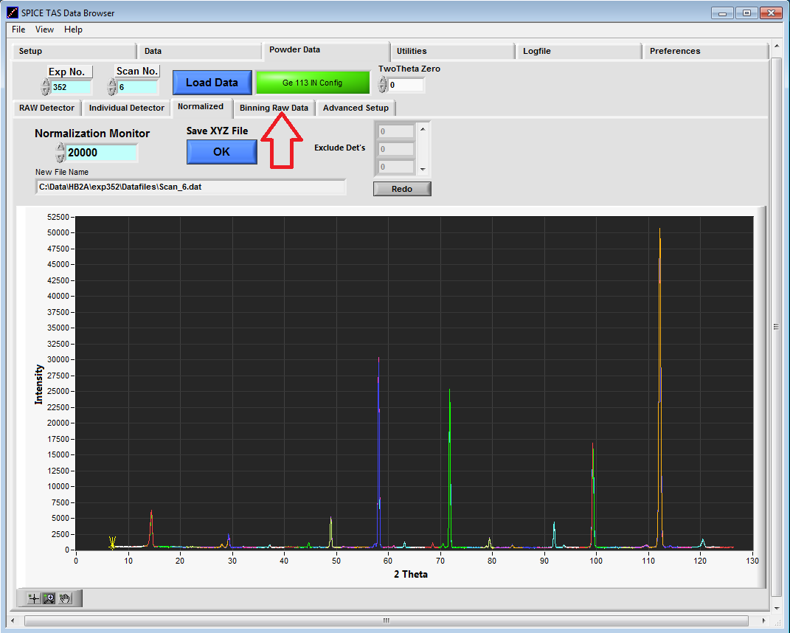
6. Binning the XYZ intermediate file
Enter the “Binning Raw Data” Sub-Tab

Slide 10
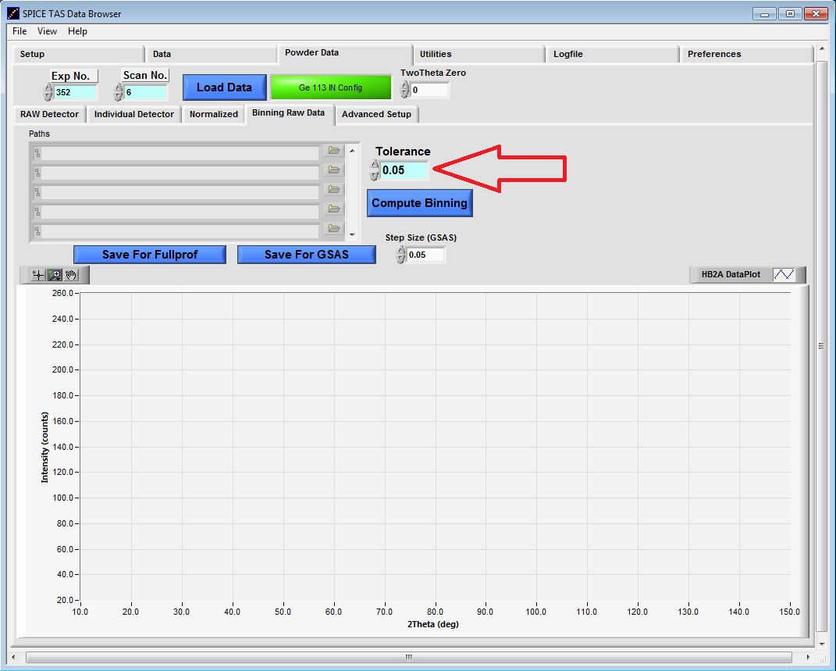
7. Binning the XYZ intermediate file
Choose the “Tolerance”.
This is the size of the bins within which the data will be averaged in 2theta and Intensity. The default value is 0.05 degrees which is the typical step-size in the data acquisition.

Slide 11
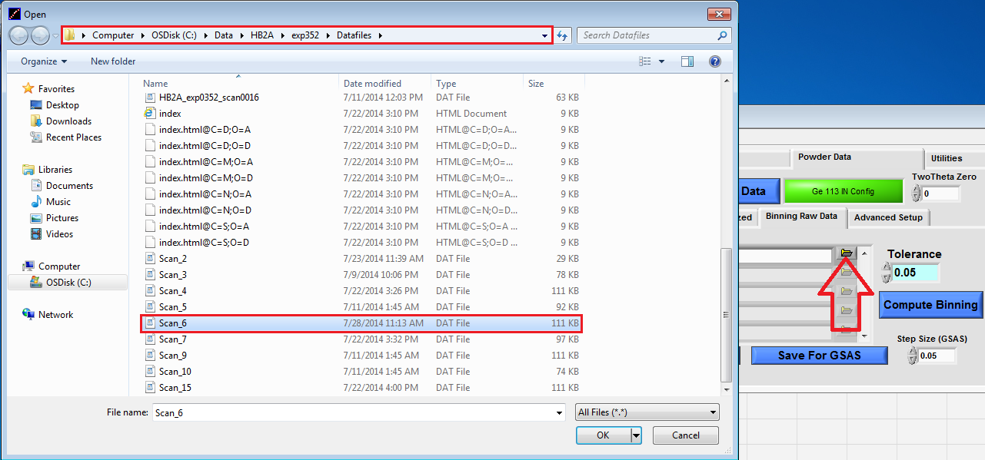
8. Binning Individual scans
Click the “Folder” Button to Open the Scan_# You Want to Bin

Slide 12
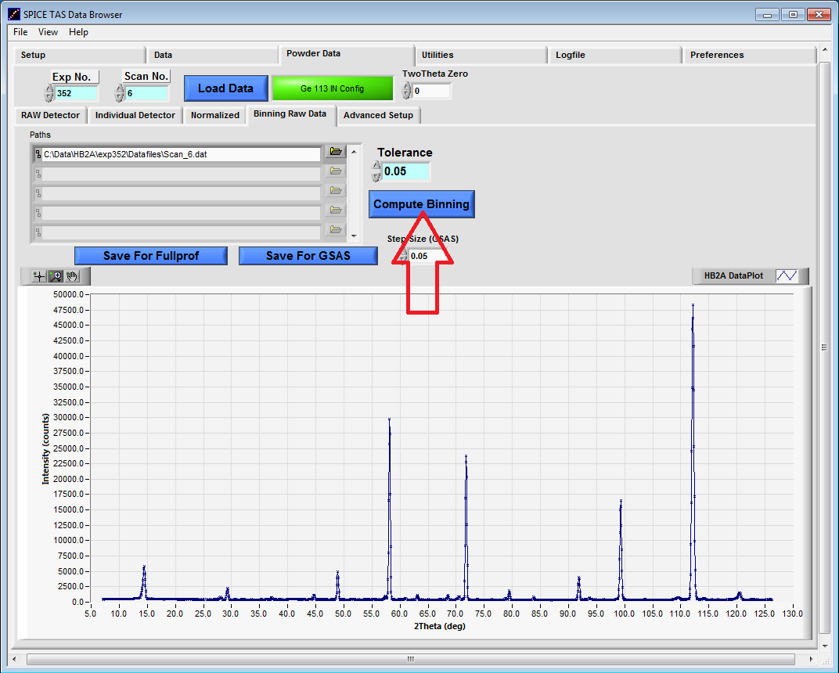
8. Binning Individual scans
Compute Binning by Pressing the “Compute Binning” Button

Slide 13
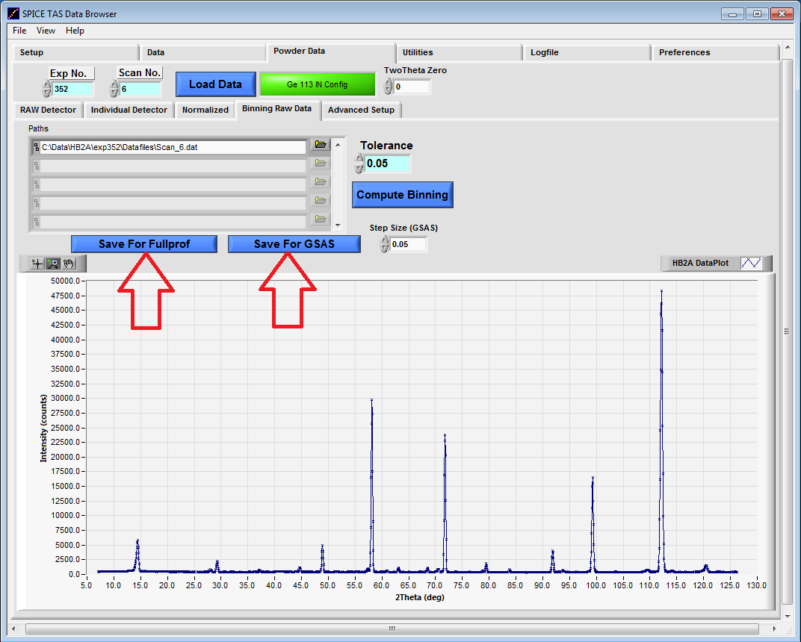
8. Binning individual scans
Save the File Either As a FullProf File or a GSAS File by Clicking the Appropriate Button
Notes:
This slide could be merged with the previous.

Slide 14
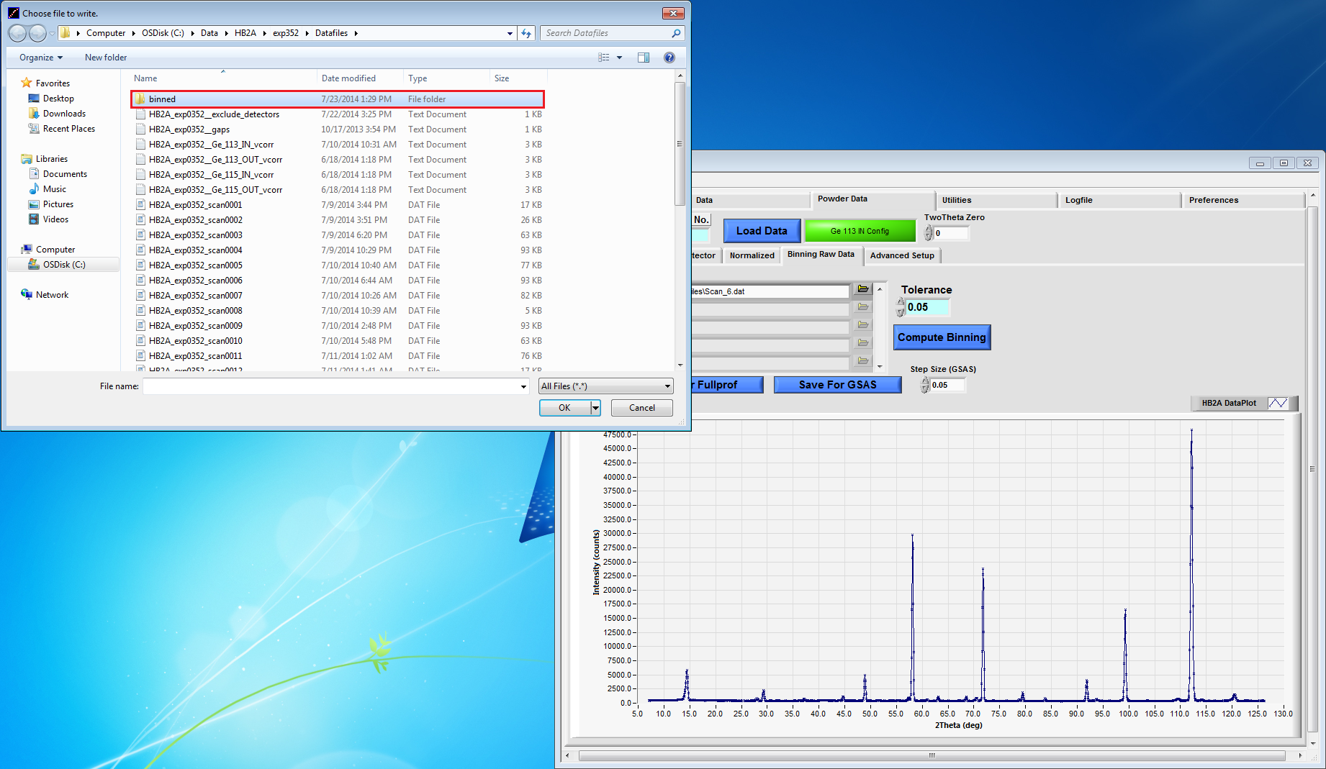
9. Saving Binned /Reduced Files
Create a “Binned” folder under “Datafiles” to Save the reduced Binned files in
Notes:
Is there more to this sentence “..binned files in..?”

Slide 15
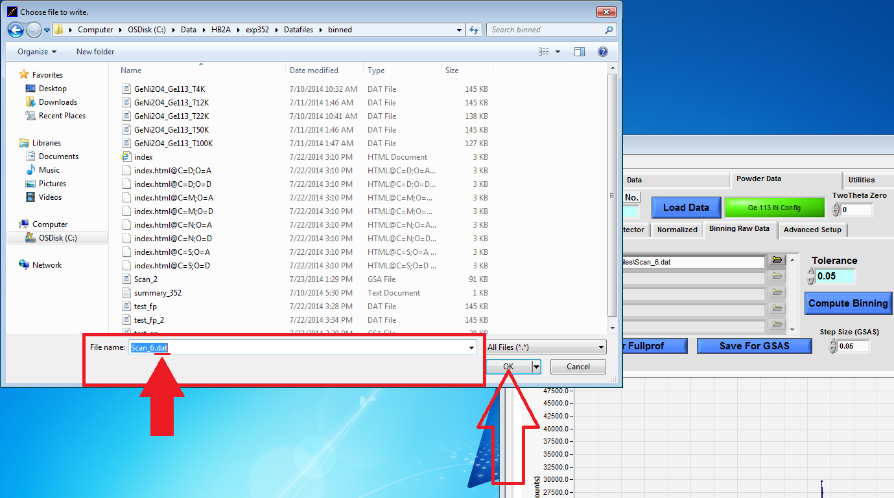
9. Saving Binned /Reduced Files
To Save as a FullProf File, use the filename extension “.dat”
The Fullprof file is a 3-column data file (2theta, Intensity, error bar)

Slide 16
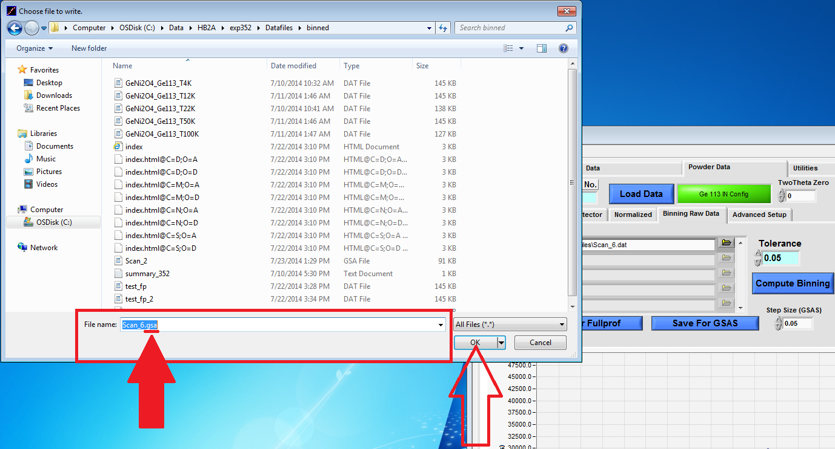
9. Saving Binned /Reduced Files
To Save as GSAS File, use the filename extension “.gsa”
The GSAS file is an 8-column data file

Slide 17
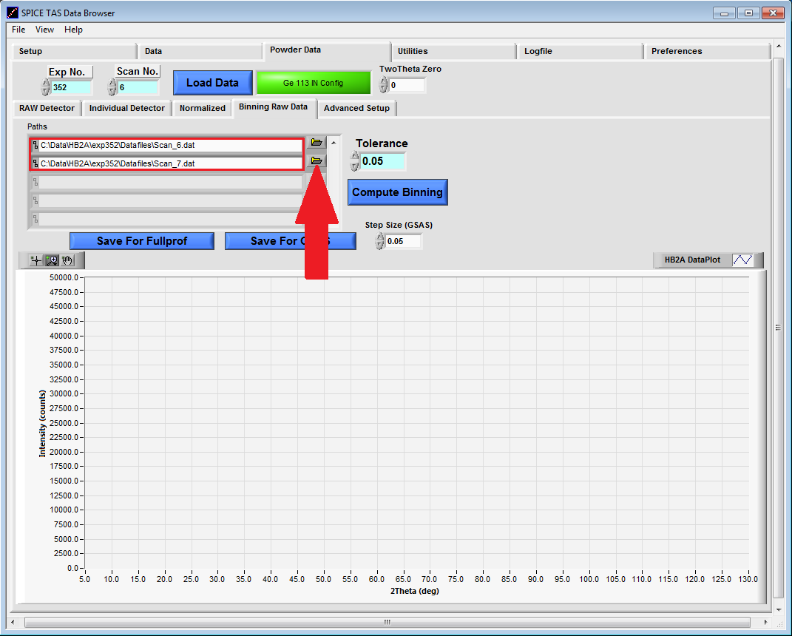
10. Binning Multiple scans
Click each of the “Folder” Button to Open the intermediate XYZ files “Scan_#” you want to Bin
Data files that are binned together should be measured in the same environmental conditions as well as counting parameters for the statistical variance to be meaningful

Slide 18
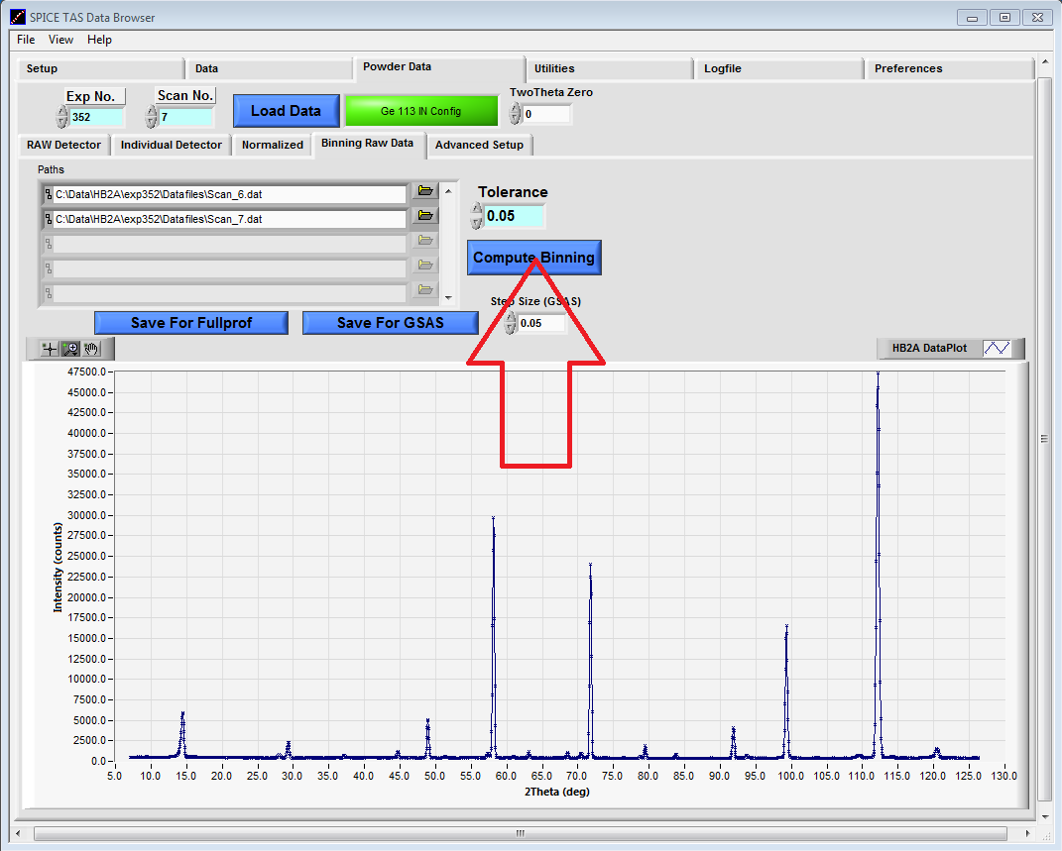
10. Binning multiple scans
Compute Binning by Pressing the “Compute Binning” Button

Slide 19
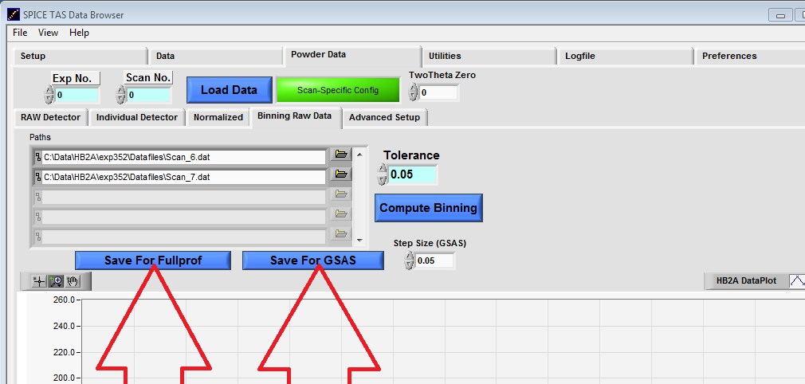
11. Saving reduced/binned files from multiple scans
Save the reduced file in the “binned” folder either as a FullProf file or a GSAS file by clicking the appropriate button with file extensions *.dat and *.gsa respectively (see step 9)

Slide 20
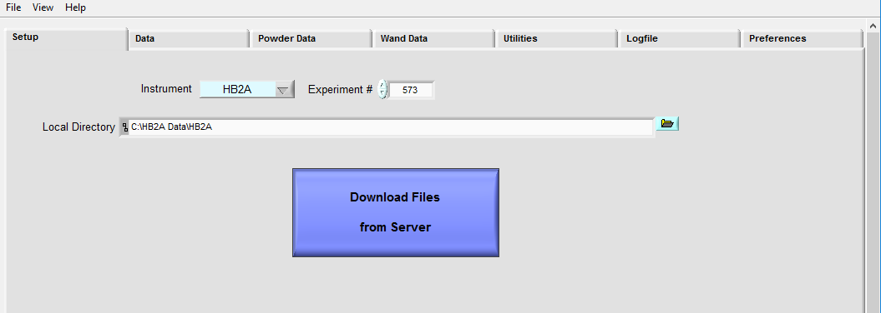
Plotting, Binning/Saving OP Scans
Select “Data”

Slide 21
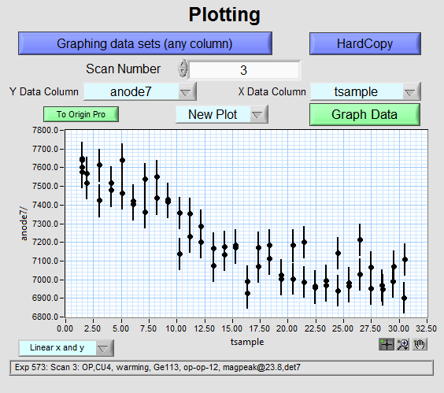
Plotting, Binning/Saving OP Scans
On this screen you can scroll to the scan you intend to bin and press “Graph Data”. This will allow you to see a quick plot of your scan with error.

Slide 22
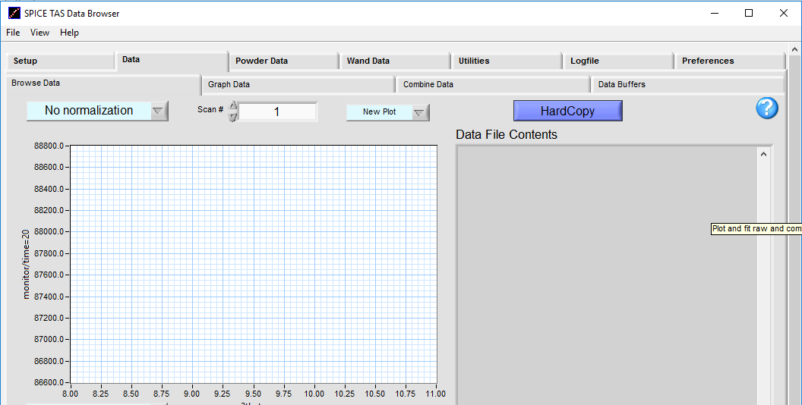
Plotting, Binning/Saving OP Scans
Select “Combine Data”

Slide 23
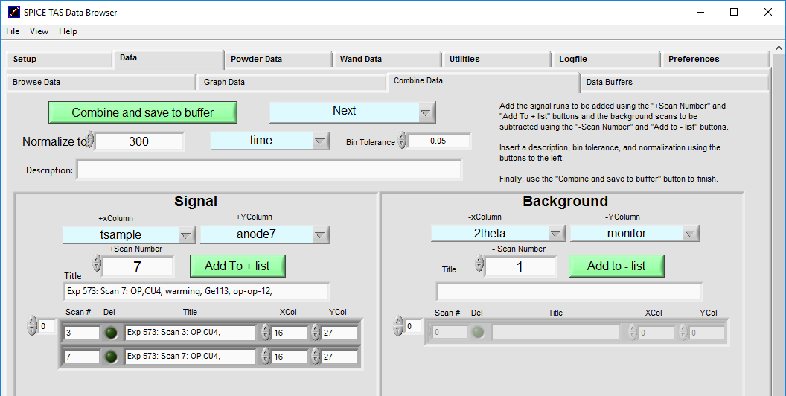
Plotting, Binning/Saving OP Scans
Scroll through the list of “+Scan Number.” Select your scan(s) and click “Add To + list”.

Slide 24
Plotting, Binning/Saving OP Scans
Check that XColumn corresponds to your independent variable, temperature (tsample) and YCol corresponds to the correct detector (anode7).
In the event defxy command in the script failed to assign the independent/dependent variables, you will have to manually select the correct columns here. Check the raw data to get the correct column numbers.

Slide 25
Plotting, Binning/Saving OP Scans
Change “Normalize to” to the time step value of your OP scan. In this example, we counted for 5 minutes so we normalize to 300 time(seconds). Change the text box to say “time”.

Slide 26
Plotting, Binning/Saving OP Scans
Change Bin Tolerance to .05. Set “Bin tolerance” to the value over which the independent variable will be averaged over. For example, if the independent variable Xcol is tsample (sample temperature), setting bin tolerance to be 0.05 means that you are averaging data within 0.05K. Making the bin tolerance larger means that you will be able to average more data points decreasing your standard deviation for the dependent variable Ycol, but at the expense of a larger standard deviation for the independent variable XCol

Slide 27
Plotting, Binning/Saving OP Scans
Enter a description for the buffer file and select “Combine and save to buffer”. Click the “Data Buffers” tab.

Slide 28
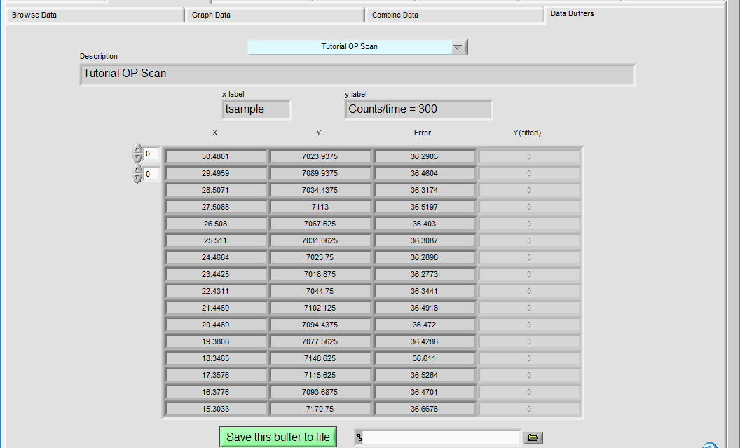
Plotting, Binning/Saving OP Scans
The buffer file gives you the correctly binned data set/s showing the Xcol (tsample), YCol normalization counts/time=300 and Error which is the standard deviation
Select your Data Buffer from the drop down menu. Press “Save this buffer to file”

Slide 29
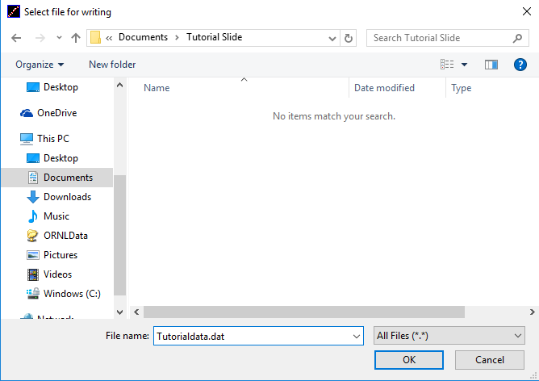
Plotting, Binning/Saving OP Scans
Save your file in the desired location. Use extension for asci file (*.dat)

Slide 30
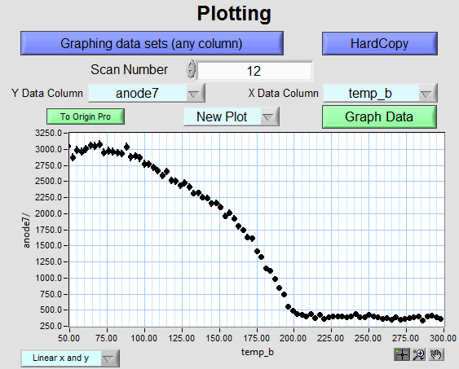
Plotting, Binning/Saving OP Scans
Example Plot of OP Scan

Slide 31
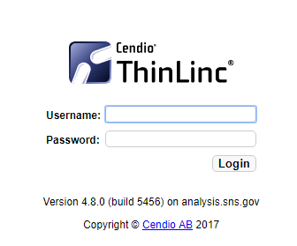
VCorr
Access ThinLinc - analysis.sns.gov Launch the session and log in using your 3 character username.

Slide 32
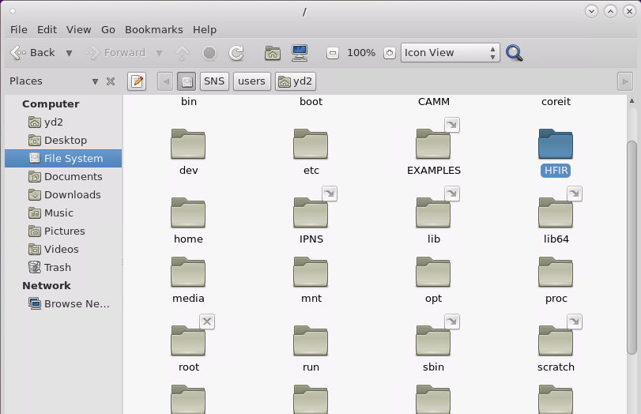
VCorr
In the “File System”, find the HFIR file

Slide 33
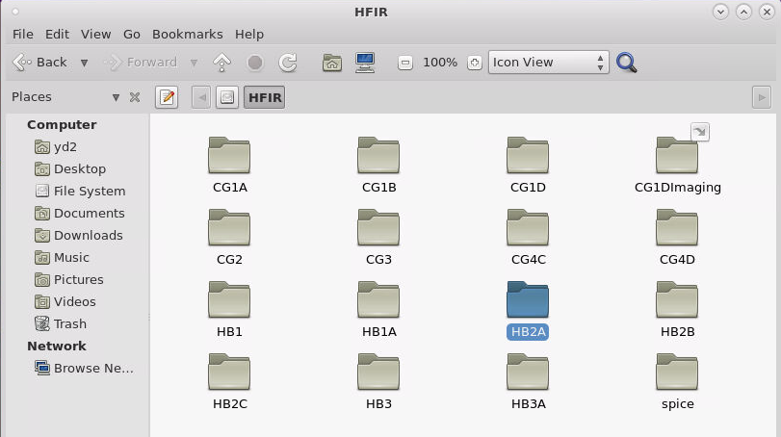
VCorr
Access “HB2A”

Slide 34
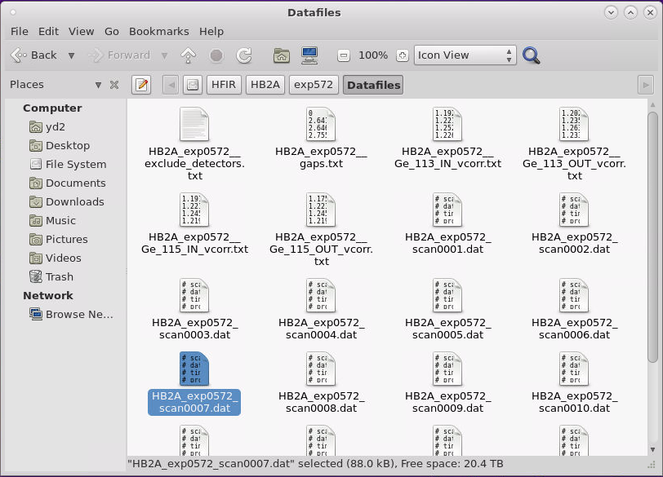
VCorr
Access “HB2A”
Select the folder for your experiment and copy the set of 4 corresponding scans for vanadium

Slide 35
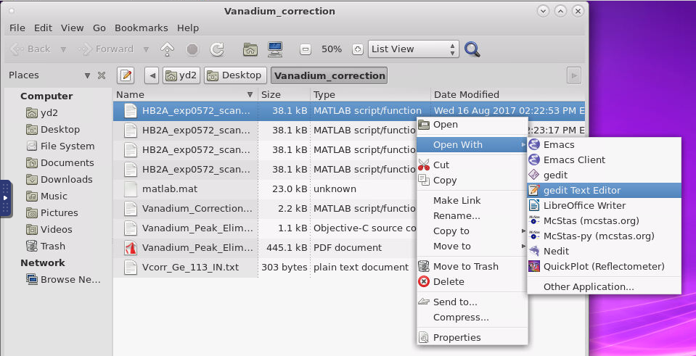
VCorr
Access the folder with your vanadium data and open with “gedit Text Editor”

Slide 36
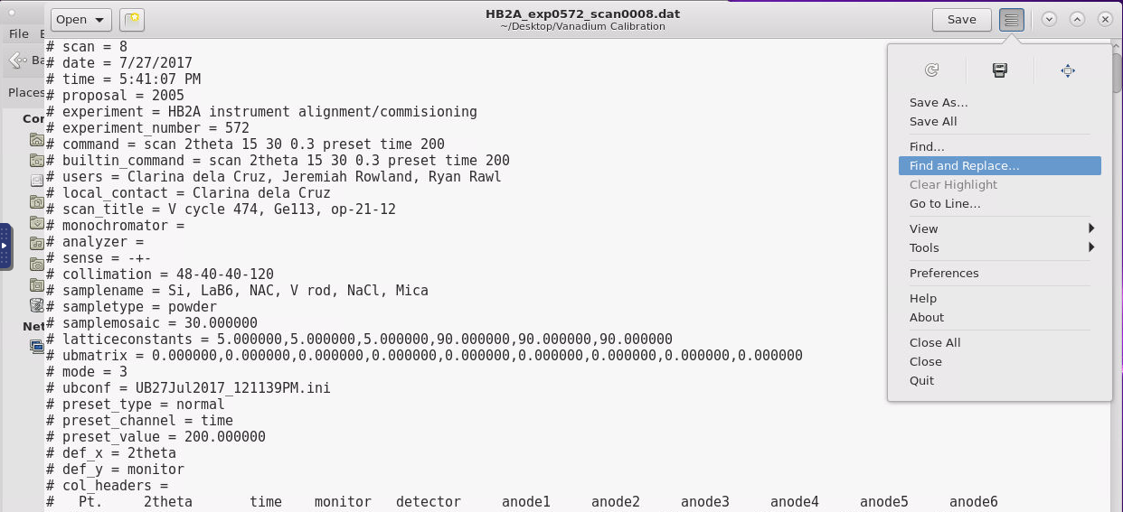
VCorr
In gedit Text Editor select “Find and Replace…”

Slide 37
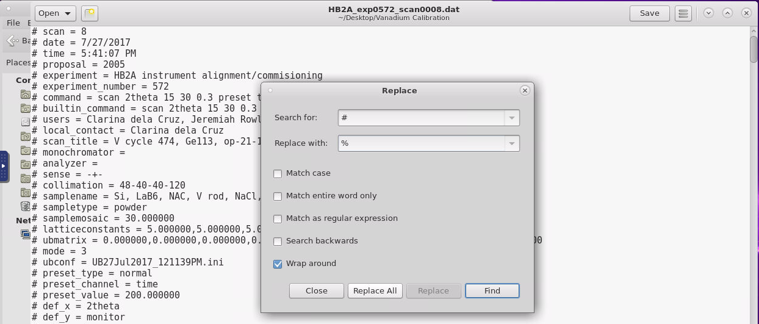
VCorr
Search for “#” and replace with “%”. Replace all. Save and close the document. Repeat this process for all four files.

Slide 38
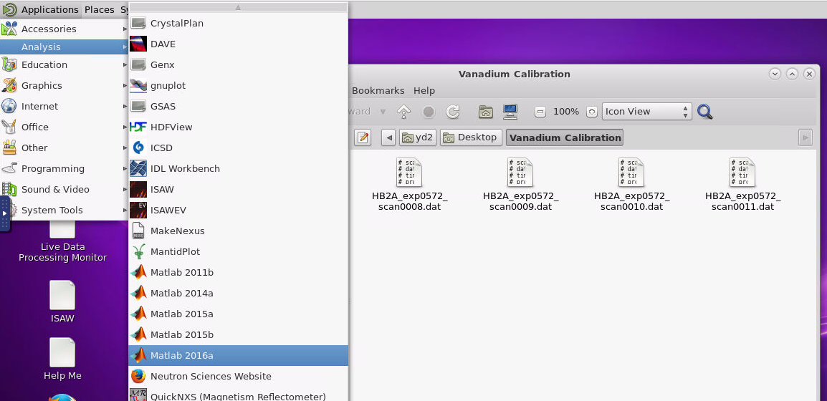
VCorr
Highlight Applications: Analysis and select “Matlab 2016a”

Slide 39
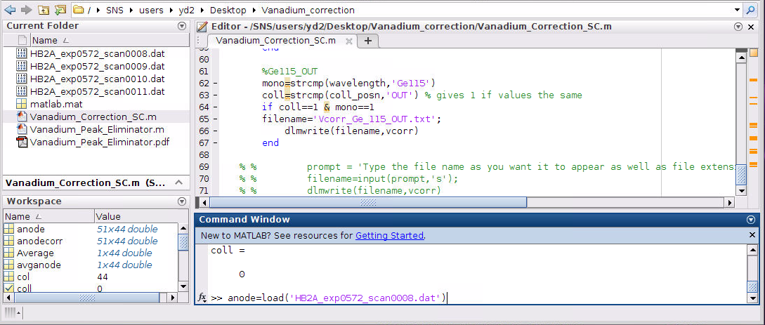
VCorr
Enter command: anode=load(‘filename’) for your vanadium scan
Be sure to double click to select your working folder for this command or it will produce an error.
Tip: When you begin typing the file name, you can press tab and it will suggest the file names. This will avoid typos that can produce errors.

Slide 40
VCorr
Enter the command “ anode=anode (:,6:49) ”

Slide 41
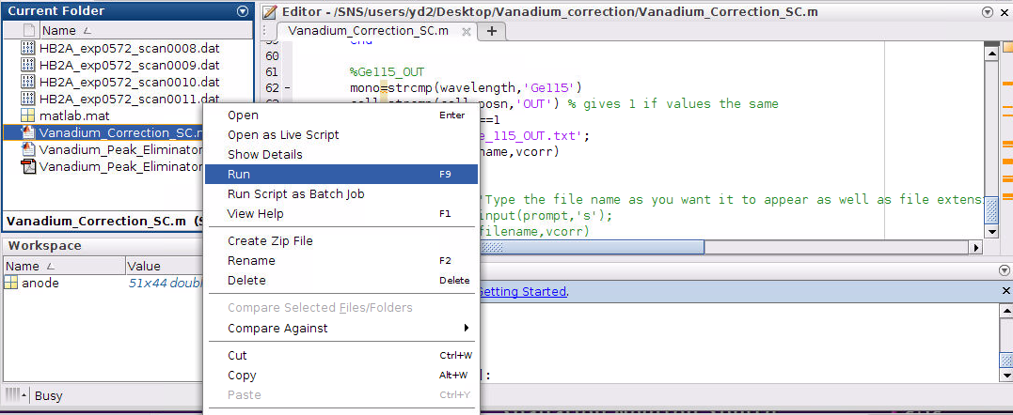
VCorr
Obtain and run the file “Vanadium_Corrections_SC.mat”

Slide 42
VCorr
Select the correct wavelength and collimation for your scan. op-21-12 is IN and op-op-12 is OUT.
Tip: Caps matter. Typing GE115 or in will not successfully produce the Vcorr file. Enter the prompts exactly as shown in the brackets.
Repeat Slides 38-41 for the other three vanadium scans.

Slide 43
VCorr
Select the correct wavelength and collimation for your scan. op-21-12 is IN and op-op-12 is OUT.
Tip: Caps matter. Typing GE115 or in will not successfully produce the Vcorr file. Enter the prompts exactly as shown in the brackets.
Repeat Slides 38-41 for the other three vanadium scans.

Slide 44
VCorr
Be sure to update the Spice config files at the instrument – Place old Vcorr files in a folder named with the cycle and replace the files with the updated ones you created.

