Slide 1
Introduction to Neutron Radiography and Computed Tomography
Neutron Imaging Team at CG-1D:
Indu Dhiman, Postdoc Research Associate
Lou Santodonato, Scientific Associate
Jean Bilheux, User Imaging Software
Data Analysis
Jiao Lin, Reconstruction
Steven Hahn, 3D visualization
Gian Song, Postdoc Research Associate
Barton Bailey, Engineer
Hassina Bilheux, Instrument Scientist
NX School
August 5, 2016

Slide 2
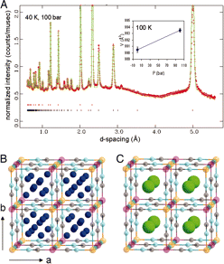
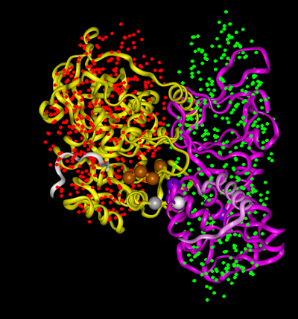
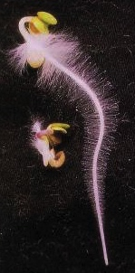
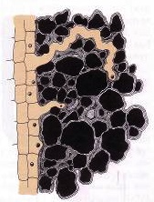
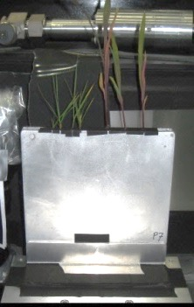
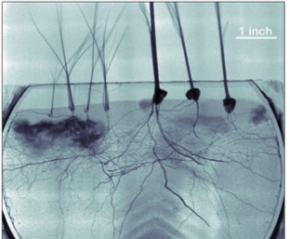
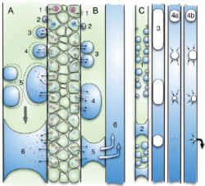
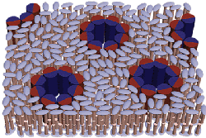
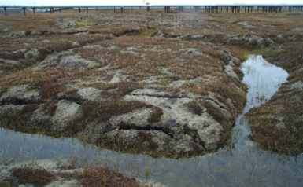

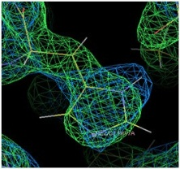
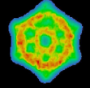
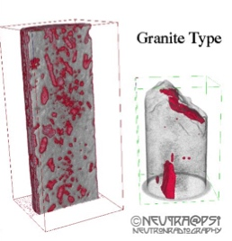
Neutrons Measure Structure
Neutron Diffraction
Neutron Scattering
Neutron Microscopy
Neutron Imaging
Fluid interactions in plant-groundwater systems
Soil-root interface (rhizosphere)
SANS used to construct protein kinase A (PKA)
Neutron diffraction of D₂ sorption in Cu3[Co(CN)₆]₂
Computed tomography
Characterization of biological membranes, colloids, porosity, etc.
In Vivo Study of Embolism Formation
Nuclear and electronic density in enzymes
Ice/water segregation in permafrost structures
Inferred structure (indirect)
Direct structure
10⁻¹¹
10⁻⁹
10⁻⁷
10⁻⁵
10⁻³
Dimension (meters)
0.1Å
1.0nm
0.1μm
10.0μm
1mm

Slide 3
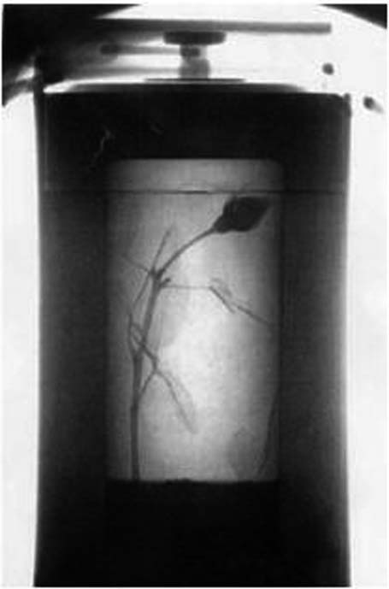
Neutron sensitivity
Neutron Radiograph of camera
X-ray Radiograph of camera
Neutron Radiograph of Rose in Lead Flask
[M. Strobl et al., J. Phys. D: Appl. Phys. 42 (2009) 243001]
Courtesy of E. Lehmann,PSI

Slide 4
Imaging throughout Nobel Prize history
1901: Roentgen, FIRST Nobel Prize in Physics,
Discovery of X-rays
1979: Cormack and Hounsfield, Nobel Prize
in Medicine, Computed Tomography (CT)
1986: Ruska, Binnig, Rohrer, Nobel Prize in Physics,
Electron Miscroscopy
2003: Lauterbur and Mansfield, Nobel Prize in Medicine, Magnetic Resonance Imaging (MRI)
2009: Boyle and Smith, Nobel Prize in Physics,
Imaging semi-conductor circuit, the CCD* sensor
(*) Charge-Coupled Device

Slide 5
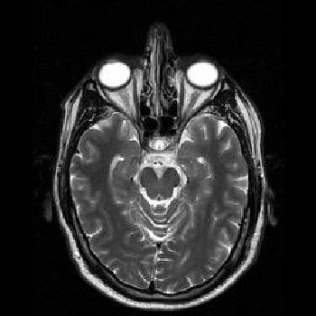
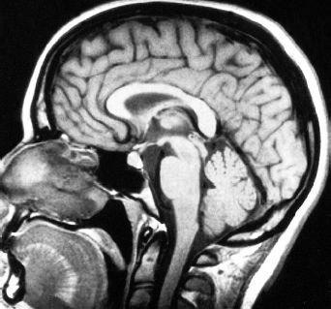
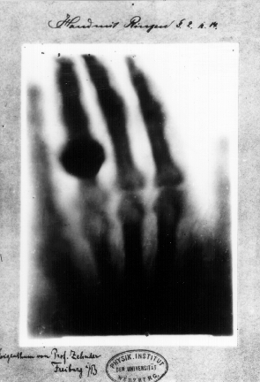
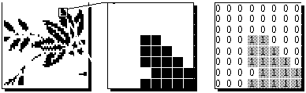
What is imaging?
Imaging is the visual representation of an object: photography, cinematography, medical imaging, X-ray imaging, thermal imaging, molecular imaging, neutron imaging, etc.
Digital Imaging is a field of computer science covering images that can be stored on a computer as bit-mapped images

Slide 6
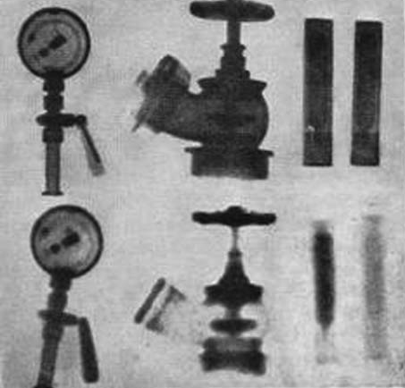
Early neutron imaging measurements
Neutron Imaging started in the mid 1930’s but only during the past 30 years has it come to the forefront of non-destructive testing
World class dedicated imaging user facilities such as NIST, PSI, HZB, FRM-II and at many worldwide universities
World conferences and workshops being held regularly
Growing worldwide user community
Discovery of neutron in 1932 by Chadwick
First neutron radiograph in 1935
Left to right: Pressure gauge with metal backplate; fire hydrant and test tubes filled with H2O
and D2O imaged with gamma-rays (top) and neutrons (bottom)
[ Kallman and Kuhn, Research 1, 254 (1947) ]

Slide 7
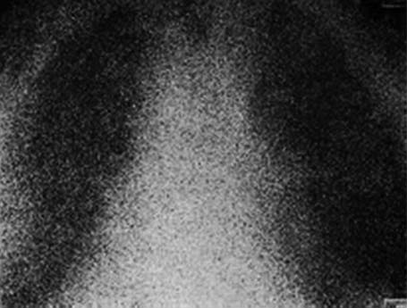
Multiple scattering and low detector spatial resolution
[ J. Anderson et al., Br. J. Radiol. 37, 957 (1964) ]

Slide 8
Today: Comparison microscopy/microCT and neutron radiography
92% of the pixel intensities agreement between histological and neutron
Watkin, K. et al., Neutron Imaging and Applications, Springer, 2009.

Slide 9
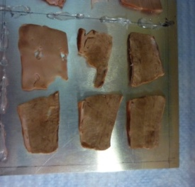
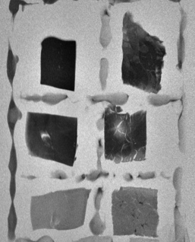
Attenuation-based neutron imaging
Neutron
Radiograph
Photograph
Beam attenuation caused by a homogeneous uniformly thick sample composed of a single isotope is given by
σ_{t}(λ) = scattering and absorption
μ is the attenuation coefficient and Δx is the thickness of the sample
σ_{t}(λ) is the material’s total cross section for neutrons, ρ is its density, N_{A} is Avogadro’s number, and M is the molar mass.

Slide 10
Detection of “imaging” neutrons
Scintillator-based techniques such as ⁶Li(n,α) ³H
  Good signal-to-noise (SNR) ratio
  Large Field Of View (FOV) and 0.01 to hundreds of seconds images
  BUT spatial resolution limited by the dissipation of particles
  Can take a lot of neutron flux!
1,1 | 1,2 | 1,3 | … | … | 1, ny
2,1 | 2,2 | 2,3 | … | … | 2, ny
3,1 | 3,2 | … | … | … | 3, ny
… | … | … | … | … | …, nx
nx, 1 | nx, 2 | nx, 3 | … | … | nx, ny
Each pixel is coded using n-bit.
16-bit = pixel value is between 0 and 65535
Notes:
n + ⁶Li → ⁴He + ³H + 4.79 MeV
Collisions with these charged particles cause the ZnS(Ag) to scintillate at a wavelength of approximately 450 nm

Slide 11
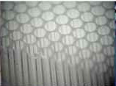
Detection of “imaging” neutrons (cont’d)
Pixelated detectors
  Micro-Channel Plate (MCP)
  In the direct path of the beam
  Limited FOV for high spatial resolution MCPs
    2.8 cm x 2.8 cm at ~ 25-30 microns (in centroiding mode)
  Encodes events at x, y position and time of arrival, at high temporal resolution ~ 1 MHz
  Detection efficiency has improved for both cold (~70%) and thermal (~50%) energy range
  Absence of readout noise
  Not as gamma sensitive (less than 1%)
  Becoming commercial
  BUT: works in relatively low-signal beam!
Notes:
n + ¹⁵⁵Gd → Gd* → γ-ray spectrum → conversion electron spectrum
n + ¹⁵⁷Gd → Gd* → γ-ray spectrum → conversion electron spectrum

Slide 12
Example: Cu, Zn and Al
Compound | Abs. Coeff. [Å⁻²] | Inc. Coeff. [Å⁻¹]
Cu (100%) | 1.78E-09 | 4.65E-10
Al (100%) | 7.75E-11 | 4.94E-12
Zn (100%) | 4.06E-10 | 5.06E-11

Slide 13
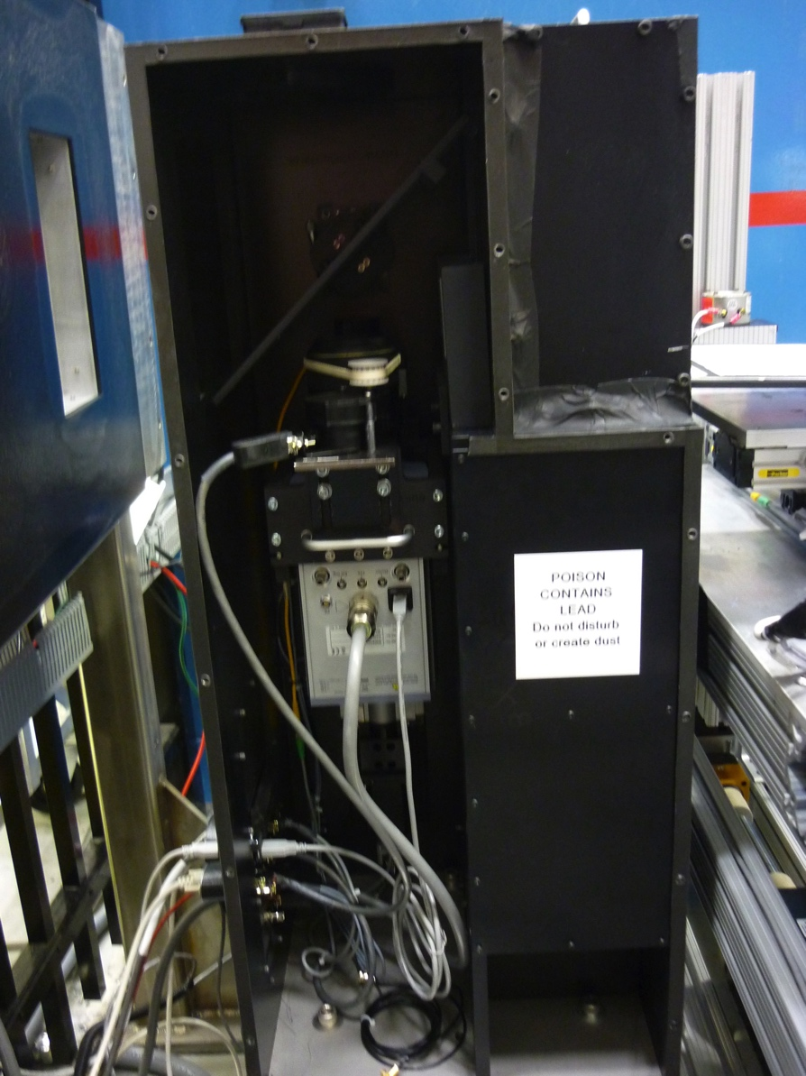


CG-1D Neutron Imaging Facility
Scintillator
Mirror
Lens
CCD
ANDOR Camera:
4Mpixels – 2048x2048
Field of view:
7x7cm²
Quantum Efficiency:
95%

Slide 14
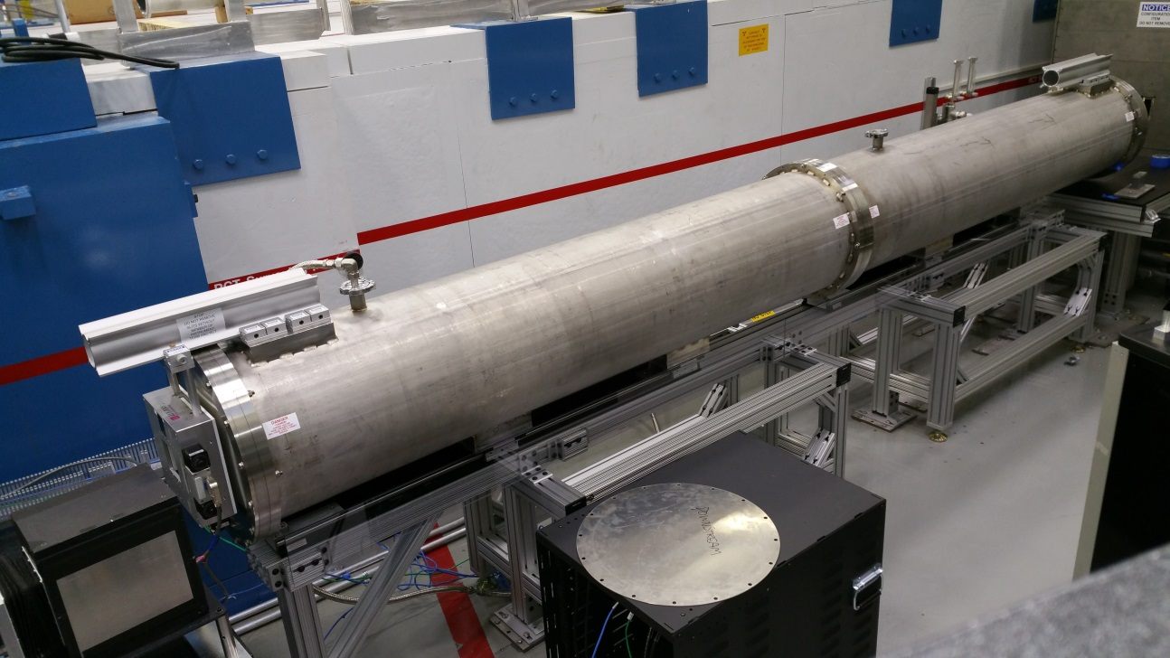
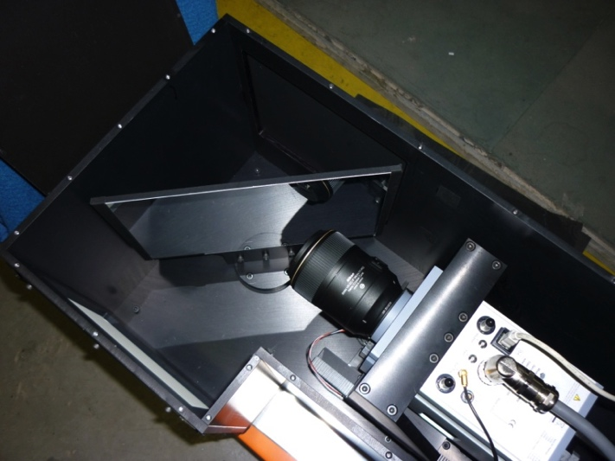
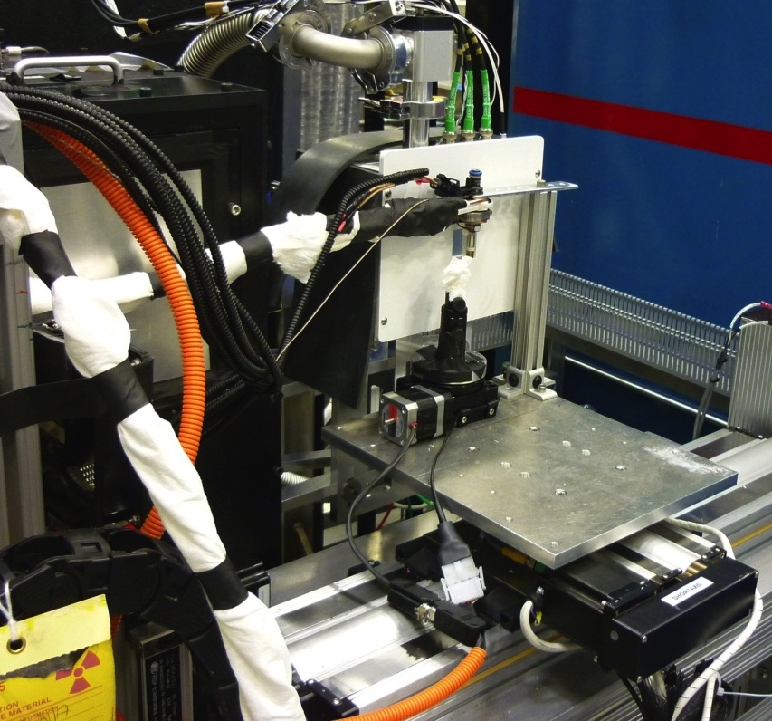
HFIR Neutron Imaging Facility (CG-1D)
Neutron Beam Path
Detector capability/spatial resolution:
ANDOR® CCD Detector ~ 100 microns
sCMOS ~ 50 microns, 100 fps
MCP(*) ~ 100 microns (and ~ 25-30 microns in centroiding mode), or microsecond time frames
(*) In Collaboration with Prof. Anton Tremsin, UC-Berkeley
Notes:
Put a scale on photo
Beam path instead of flight tube
Changed to new photos.

Slide 15
The CG-1D detector suite and respective common applications
Type of detector | Largest field-of-view (cm²) | Effective pixel size where the image is formed (microns) | Corresponding spatial resolution (microns) | Maximum Dynamic resolution (no pixel binning) | Dynamic range (bit) | Applications
CCD | 7.4 x 7.4 | 36 | ~100 | 1 image/second | 16 | Additive Manufacturing (AM), Energy, Aerospace, Transportation Research, Geosciences, Biology, Botanical, Archeology, Medical, Food Science
sCMOS | 3.3 x 2.8 | 13 | < 100 | 100 images/second for 4 sec max (**) | 16 | AM, Geosciences, Petroleum, Food Science
MCP (*) | 2.8 x 2.8 | 55 | ~100 | 1 million images/second | 14 | Transportation Research, AM, Energy, Aerospace, Biology, Geosciences, Petroleum, Botanical, Food Science
 | 2.8 x 2.8 | 12 | ~ 25-30 | 1 image/ 4 hours | 14 | Biology, Botanical, Medical
(*) The MCP detector has two modes of operation: the high time resolution and the high spatial resolution options, respectively.
(**) When binning pixels or working at lower frame rate, the limit is the 5 TB storage on the sCMOS server (each image is 10 MB). We can thus collect thousands of images.

Slide 16
CG-1D polychromatic beam
CG-1D spectrum measured with the MCP detector at a flight path distance of approximately 5.5 m, with the chopper running at a frequency 40 Hz and an 5 mm aperture. Kang M. et al., Nuclear Instruments and Methods, 708, 2013]

Slide 17
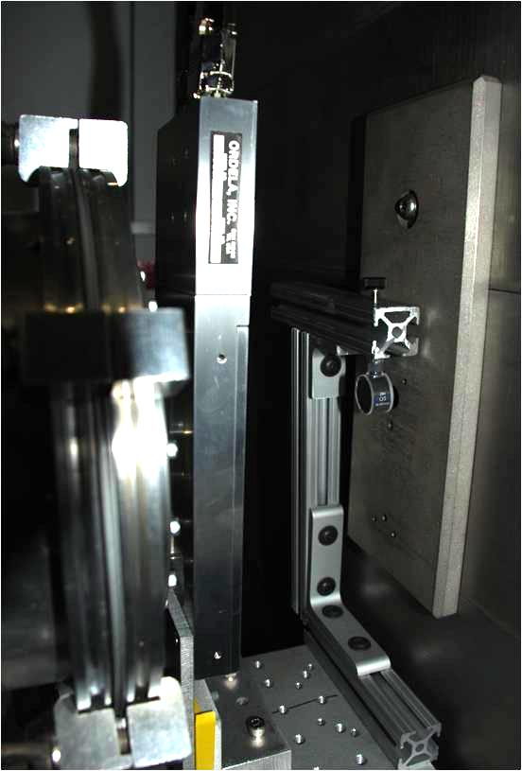
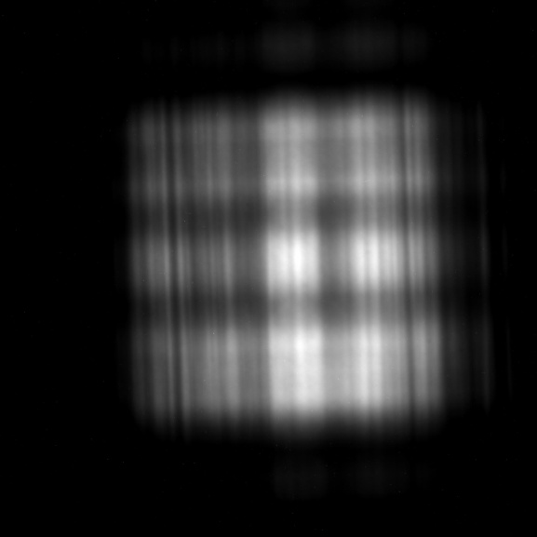
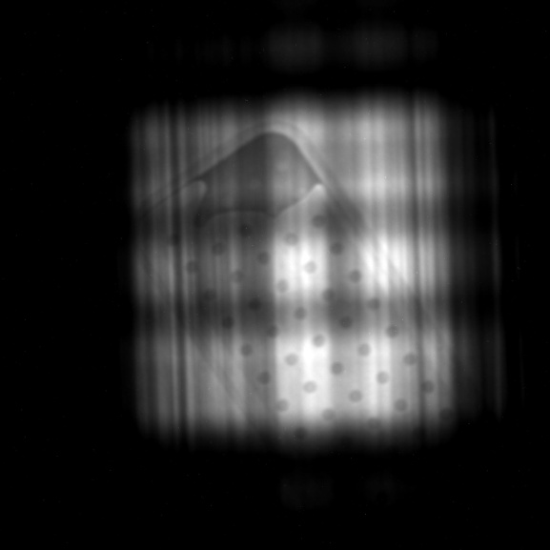
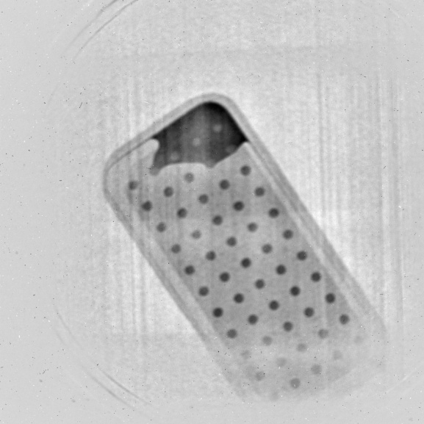
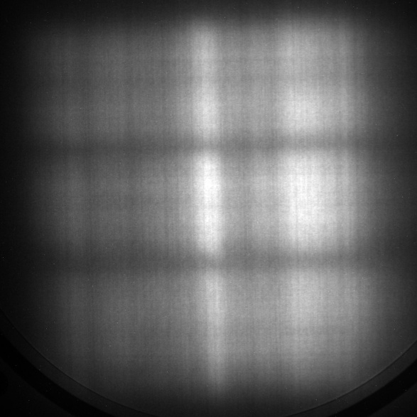
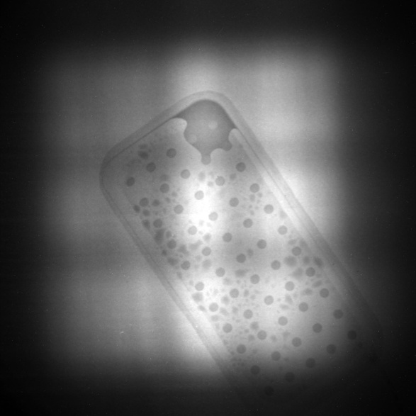
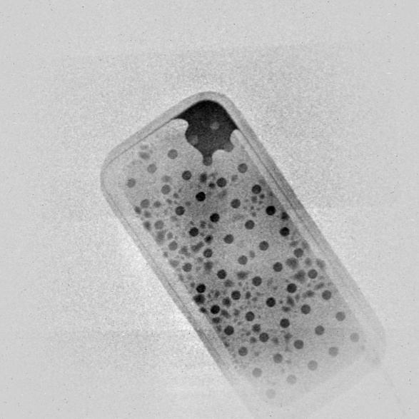
Use of Diffusers
1 cm thick Graphite Powder (4 to 10 microns)
Open Beam Heat Pipe Sample Reduced Image
Without diffuser
With diffuser
Notes:
Now, we use 10 nm Al2O3 nanoparticles enclosed in Al containers (1 mm to 4 mm). Usually, we use the 2 mm diffuser.

Slide 18
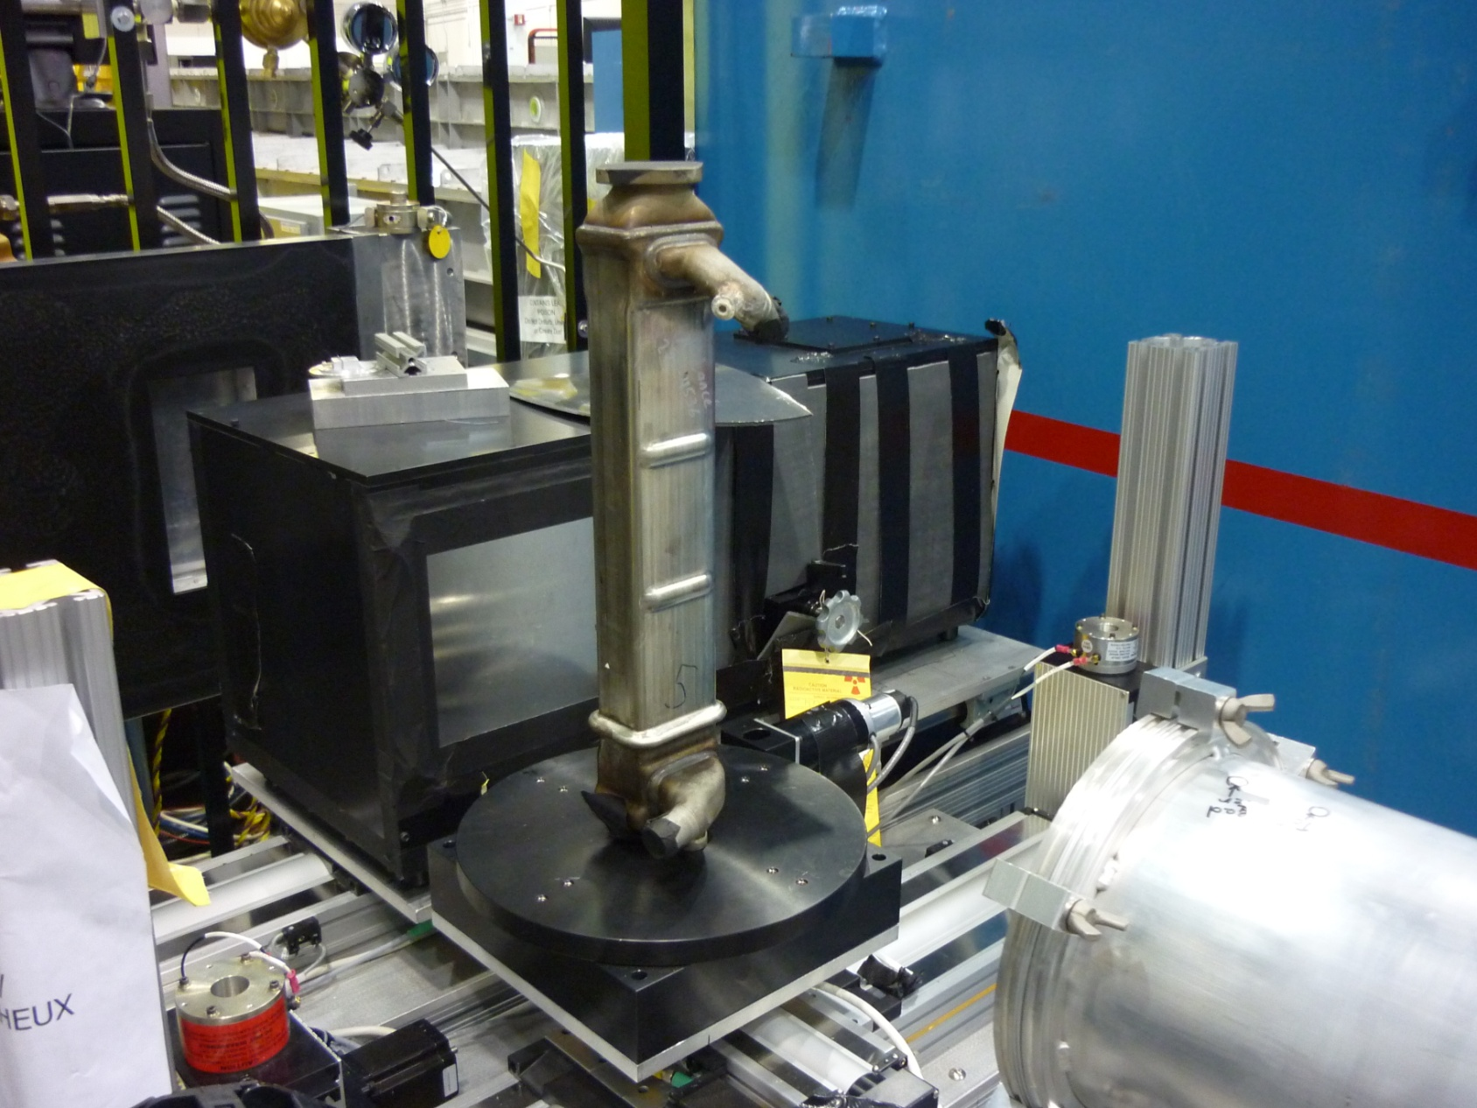
Sample stage for nCT
CCD Detector
EGR
Cooler
Rotation/
Translation
Stage
Neutrons

Slide 19
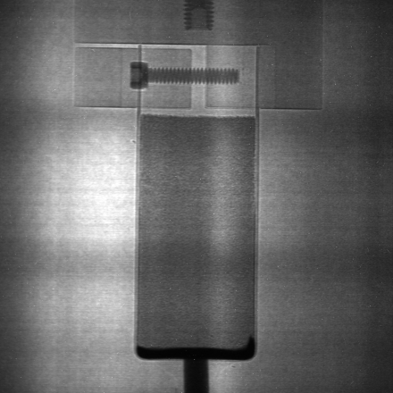

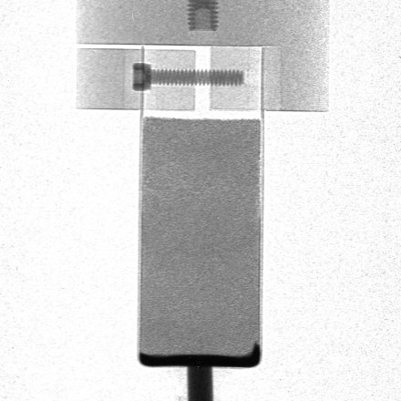
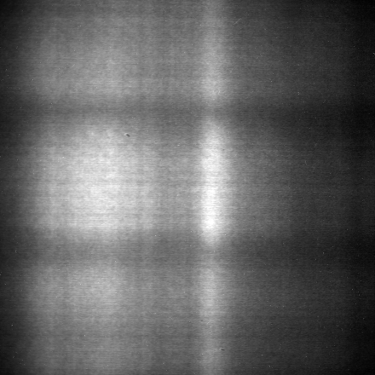
Data Normalization for Imaging
2D – Radiography
  Normalization
Normalized Image
-
1
Image
Dark Field
=
0
-
Transmission
Open Beam
Dark Field

Slide 20
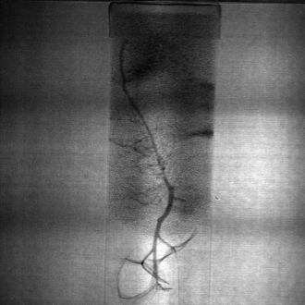
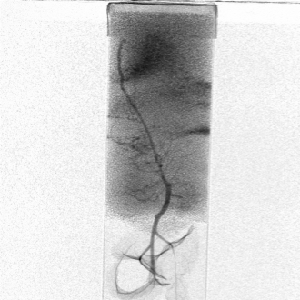
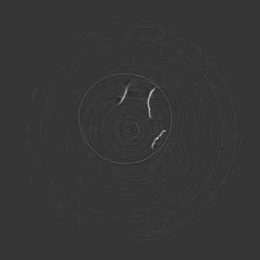

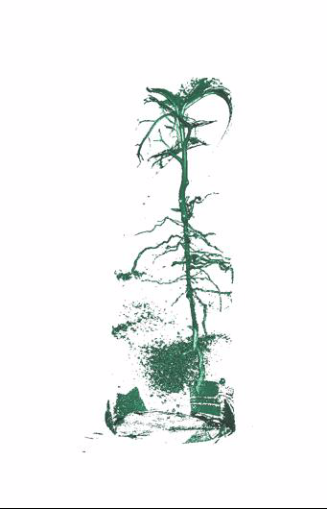
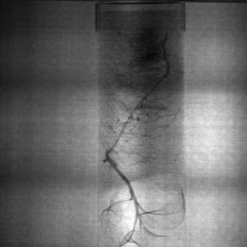
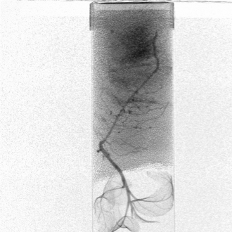
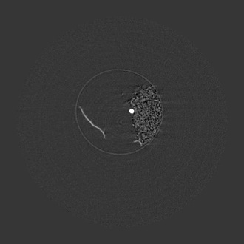

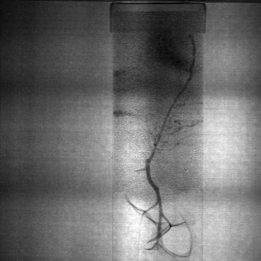
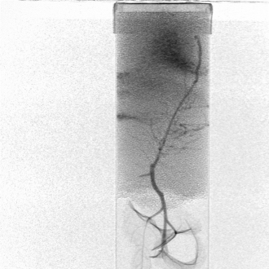
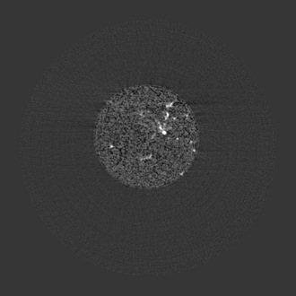

Computed/Computerized Tomography (FBP)
  Filtered back projection method
Raw Data:
2048x2048 pixels,
721 projections
Normalized Data:
2048x2048 pixels,
721 projections
Sinograms:
2048x721 pixels,
2048 files
Slices:
2048x2048 pixels,
2048 slices
3D reconstruction:
2048x2048x2048 voxels
~700
Counts
~20700
Transmission
Transmission
Attenuation
0
1
0
1
0
∞

Slide 21
Computed/Computerized Tomography (CT)
Several techniques:
  Filtered Back Projection
    Radon transform
    Works well with high signal to noise ration measurements
    Easy-to-use commercial, semi-automated software available
    Quick
  Iterative Reconstruction
    Direct approach
    Less artifacts
    Can reconstruct incomplete data
    High computation time

Slide 22
Conventional Neutron Imaging Techniques at steady-state sources
Radiography (available at CG-1D)
Tomography (available at CG-1D)
Phase Contrast Imaging
Polarized Neutron Imaging
Stroboscopic Imaging
Imaging of processes that happen fast
Energy selective techniques possible with double-monochromator configuration

Slide 23
Neutron Imaging Techniques at pulsed sources
Energy-selective (or Time-of-Flight) imaging
  Contrast enhancement
  Bragg edge
Energy resonance imaging
Stroboscopic imaging
  SNS has a natural clock
Neutron Imaging at energies not accessible at reactor facilities
  Mainly bio-medical applications

Slide 24
Neutron imaging techniques
Radiography
Computed tomography
Bragg edge imaging
Neutron phase imaging
Stroboscopic imaging
Neutron Stimulated Computed Emission Tomography or NSECT
Polarized imaging
Dark field imaging
Energy resonance imaging

Slide 25
Bragg Edge Imaging
Crystalline structure mapping
Bragg reflected neutrons result in narrow dips in the actual transmission at precise wavelengths specified by Bragg’s law:
λ_{hkl} = 2d_{hkl} sinθ_{hkl}
where d_{hkl} is the interplanar distance for the (hkl) planes and θ_{hkl} are the Bragg angles θ_{hkl} depends on the relative orientation of the crystal lattice to the neutron beam.
At λ_{hkl}, creation of map of the number of crystals having any of their (hkl) directions making an angle, β_{hkl}, with the incident beam given by:
β_{hkl} = (π/2) – arcsin (λ_{hkl} / 2d_{hkl})
Kockelmann et al., NIM A, Vol. 578 (2007) 421.

Slide 26
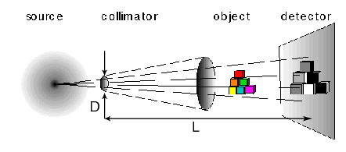
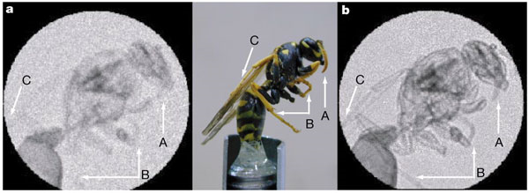
Propagation-based Neutron Phase Imaging
  Source needs to be spatially coherent (i.e. small pinhole and long pinhole-detector distances)
  Flux is low (up to 98% of flux is sacrificed, several hours to days for one radiograph)
D < 1 mm
L > 15 m
SOURCE
L>>D
(a) Neutron attenuation radiograph (e) and phase contrast radiograph of a lead sinker mounted on an Al screw. [B. Schillinger et al., Mat. Trans. Proc. (2006) 61]
Neutron attenuation radiograph (b) photograph and (c) phase contrast radiograph of a yellow jacket wasp.
[B. E. Allman et al., Nature 408 (2000) 158]
Notes:
Mention values D, L

Slide 27
Phase Radiography using Grating Interferometry
G0 creates array of coherent sources from source w
G1 creates diffraction patterns for each source which overlap if
Diffraction pattern has maximum contrast when d is a integer multiple of the Talbot length, L_{T}
Phase object cause distortion of diffraction pattern (or phase shift of incident wave Φ)
Measure diffraction pattern by translating G2
Φ
G0: (source) absorption grating, period p₀
G1: phase grating, period p₁
G2: (analyzer) absorption grating, period p₂
[Pfeiffer et al., PRL. 96 (2006) 215505]
p₀ ~ 1 mm, p₁ ~ 10 μm, p₂ ~ 5 μ m, ~ 5 m, d ~ 20 mm
Notes:
----- Meeting Notes (6/17/11 11:26) -----
This detector has rather poor pixels
G2 allows you to measure this diffraction pattern which has micron sinus waves with a poor resolution detector.
G2 is just a trick for being able to measure intensity with lower resolution detector.

Slide 28
Stroboscopic imaging
Makes a cyclically moving object appear to be slow moving
Pulsed sources are by definition stroboscopic neutron sources
Oil spreading into bottom of piston
Oil jet ejected into bottom of piston
Stroboscopic imaging: 150 exposures, 200 ms each, 24 cm x 24 cm field of view
BMW engine, NEUTROGRAPH, ILL, France
Schillinger et al., NIM A 542 (2005) 142.

Slide 29
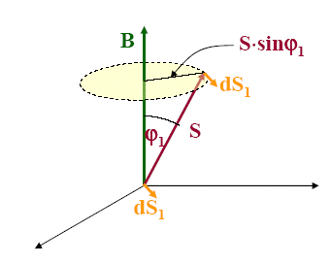

Polarized neutron imaging
Spin rotation in magnetic field B, length s, v = velocity of neutrons
Setup:
Magnetically aligned polarized neutron beam is a great probe for the investigation of magnetic materials
http://iopscience.iop.org/1367-2630/11/4/043013/fulltext/

Slide 30
Polarized neutron imaging
Produce a polarized neutron beam.
Preserve the polarization of the beam.
Manipulate the polarization of the neutron beam: if needed.
Deliver it to the sample.
Preserve the change in polarization (if at all), as the beam is transmitted through the sample.
Detect this change using CCD cameras.

Slide 31




Polarized Neutron imaging set – up on CG-1D

Slide 32


Applications at a glance
Visualization of water transport in artificial soil sedimentation (20 s frame, 25 x 25 cm²)
Advanced Manufacturing
Archeology
Bio-medical
Botany
Contraband
Cultural Heritage
Energy
Engineering/Materials Science
Forensic Science
Geology/Earth Sciences
Homeland Security
Paleontology
Quality Assurance
http://neutra.web.psi.ch/gallery/animations.html
Radiography of a dry monkey skull
http://neutra.web.psi.ch/gallery/biological.html

Slide 33
Materials Research, Energy and Engineering Applications

Slide 34






Neutron Computed Tomography (CT) maps distortion and defects in AM parts
Variance measurements based on comparison between the file used to print and neutron CT
Distortion and defects clearly apparent in the final product
These details can be fed back to modeling tools at Honeywell to optimize printing parameters
=
Notes:
Visualization and analysis shown here have been produced with VGStudio Max (Commercial Software).

Slide 35


Slide 36
Neutron Computed Tomography Characterizes Particulate Properties During Regeneration
  Diesel particulate filters (DPF)
  clean exhaust
  and reduce
  pollution
Scientific Achievement
  Employed neutron tomography to measure the properties of soot cake layer thickness and subsequently density during a sequential regeneration. Identified key parameters that will aid understanding of the fuel-consuming regeneration process.
Significance and Impact
  Understanding the regeneration progression of DPFs is important in improving the efficiency of the process and to understand the correlation between pressure drop and soot level. The results from this work can directly provide model parameters to industry so they can better predict the level soot/particulate in the DPFs.
Research Details
  DPFs were filled to different levels (3, 5 and 7 g/L) using diesel engine
  Full DPFs analyzed with neutron tomography to determine the soot cake thickness and packing density
  Soot cake density, thickness and axial profile measured during sequential regeneration
  Highest soot cake density observed during initial 20% regeneration; layer then loses density, porosity increases and channels open up
  Different soot loading displayed same behavior during regeneration
DPFs collect soot during engine operation, leading to soot cake. During regeneration soot cake properties change significantly as identified in neutron imaging campaign.
  Work performed at the High Flux Isotope Reactor Imaging (CG1D) beamline was supported by Scientific User Facilities Division, Office of Basic Energy Sciences, US Department of Energy.
T. J. Toops, H. Bilheux, S. Voisin, J. Gregor, L. Walker, A. Strzelec, C. E. A. Finney, J. A. Pihl, Nuclear Instruments and Methods in Physics Research Section A 729 (2013) 581-588.
T. J. Toops, J. A. Pihl, C. E. A. Finney, J. Gregor, H. Bilheux, Emission Control Science and Technology 1:1 (2015) 24-31.

Slide 37






Non-destructive neutron imaging being employed to investigate automotive devices and functionality
Unique and powerful neutron capabilities available at ORNL
Neutron imaging is a non-destructive technique and analytical tool
  Particulate distributions
  Quantification possible
  Average distribution and depth for 3 particulate loadings (3, 5, 7 g/L)
Intra-fuel injector flow patterns
  More sensitive to fuel the metal
Sophisticated image processing allows device tomography
Cross-sectional photograph (left) and equivalent neutron radiograph (right)
1 inch
T. Toops (PI), S. Voisin, C. Finney, J. Gregor, H. Bilheux

Slide 38





Comparison of Li Distribution as a function of depth of battery
Li-Air (no catalyst)
Control
Nanda et al., Journal of Physical Chemistry C, 2012.
Li-Air (with catalyst)
Notes:
All authors listed and title of the publications, anytime paper cited

Slide 39

Neutron Imaging Provides the Basis for Developing Models
Non-uniform lithium distribution may limit rechargeability
Neutron image
Li- air cathode
Reaction phase 3 dimensional modeling was used to predict results and compare with measurements
Spatiotemporal reaction phase three-dimensional modeling of the electrodes also predicted a non-uniform lithium product distribution, confirming the neutron imaging result.
Need to match resolution of neutron imaging capabilities to further improve feedback to modeling tools
3D model
Li-air cathode

Slide 40

Rapid Imbibition of Water in Fractures within Unsaturated Sedimentary Rock
Scientific Achievement
  Spontaneous imbibition of liquids into gas-filled fractures in variably-saturated porous media is important in a variety of engineering and geological contexts. Dynamic neutron radiography was applied to directly quantify this phenomenon in terms of sorptivity and dispersion coefficients.
Significance and Impact
  The theory derived describes rapid early-time water movement into air-filled fractures in sedimentary rock. Both theory and observations indicate that fractures significantly increase spontaneous imbibition and dispersion of the wetting front in unsaturated sedimentary rocks. Capillary action appears to be supplemented by surface spreading on rough fracture faces. The findings can be applied in modeling hydraulic fracturing.
Research Details
  Imbibition into unsaturated Berea sandstone cores was controlled with a Mariotte bottle setup. Images were collected using dynamic neutron radiography and analyzed using ImageJ.
Time sequence of neutron radiographs showing the rapid uptake of water into a longitudinal, air-filled fracture zone in Berea sandstone (~50 mD). FOV is ~28 x 28 mm².
  Work performed at the High Flux Isotope Reactor Imaging beam line (CG1D) was supported by the Scientific User Facilities Division, Office of Basic Energy Sciences, U.S. Department of Energy.
Cheng C. -L., Perfect E., Donnelly B., Bilheux H. Z., Tremsin A. S., McKay L. D., DiStefano V. H., Cai J. C., Santodonato L. J., Rapid imbibition of water in fractures within unsaturated sedimentary rock. 2015. Advances in Water Resources, Volume 77, Pages 82–89 <http://dx.doi.org/10.1016/j.advwatres.2015.01.010>

Slide 41


Significance
Water in porous media
  agricultural crop production
  infiltration & aquifer recharge
  remediation of contaminated soils
  subsurface carbon sequestration
  enhanced oil recovery
Plant-soil-water system
Contaminant transport
CO₂ sequestration

Slide 42


Neutron Radiography of Roots at CG1-D
Plants in Al chamber
Switchgrass and Maize
Water injected into root zone at base
Unidentified endophyte (symbiotic) or decomposer fungi visible near roots of switchgrass (left), revealing substantial hydration of the rhizosphere
Both fine and coarse roots are readily visible
Notes:
Fairly dry condition
Endophytics means roots of fungus spread and attached to roots, increase surface area of roots, able to maintain hydration of roots in the rhizosphere
Bulk water content measured, no idea what happens in the roots and around the rhizosphere

Slide 43
Changes in Soil and Root Water Content using Neutron Radiography
Notes:
Corn, dynamics measurements over 12 hours
Larger root is more hydrated (white color), dark areas means water extracted from system (less hydrated roots)
Loosing conductivity around the smaller roots
Water content increases in the top of circle over time: root growth and water release

Slide 44
Water Uptake by Roots and Stem
10-d old maize seedling (A) aluminum sample chamber; (B) neutron radiograph at ~70 µm pixel resolution illustrating roots distribution (0.2-1.6 mm); C) 3D tomographic reconstruction; (D) Timing of water uptake by plant components highlighted in (B) illustrating impact of solar radiation on rate of water flux in stem and ~0.5 mm first and second order roots.
This study provides direct evidence for root-mediated hydraulic redistribution of soil water to rehydrate drier roots
Notes:
In soil plant systems, water variations were recorded in 10-day old Zea. mays (corn) seedlings following irrigation with D₂O. D₂O displacement of existing H₂O within the plant vascular system, or influx of D₂O into previously dry tissue or soil resulted in changes in image intensity through time. The dynamic internal demand for water between soil, individual roots, stems and leaves was thus readily visualized and quantified illustrating the value of this technique to assess root-shoot responses to changing environmental conditions.

Slide 45



Ancient Craft Skills meet Modern Characterization
K. Ryzewski (PI), S. Herringer, H. Z. Bilheux, J.-C. Bilheux, B. Sheldon

Slide 46




Thank you
Courtesy of
Krysta Ryzewski, Wayne University
Susan Herringer, Brian Sheldon, Brown University

