Slide 1
Time-resolved scattering
Paul G. Evans
pgevans@wisc.edu
August 11, 2016

Slide 2
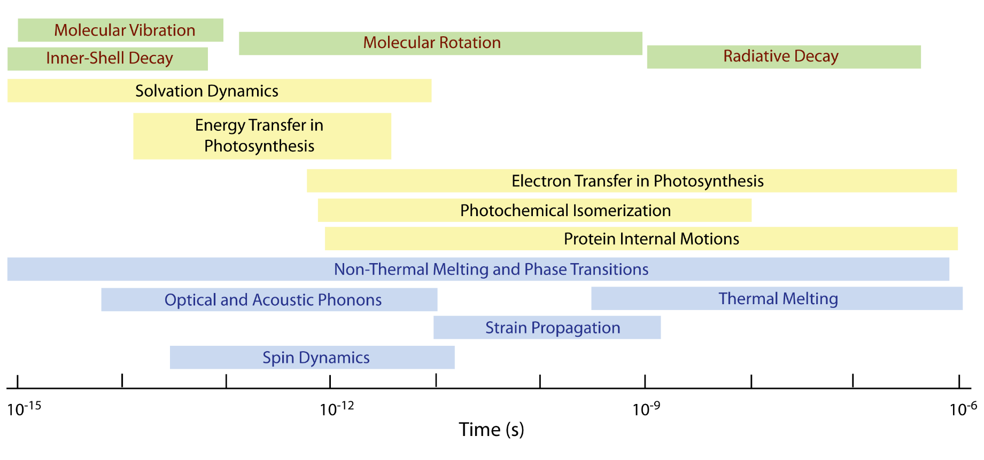
Motivations: Timescales of Dynamical Processes
Atomic, molecular physics
Chemistry, chemical physics
Condensed matter, materials
10⁻¹⁵
10⁻¹²
10⁻⁹
10⁻⁶
Time (s)

Slide 3
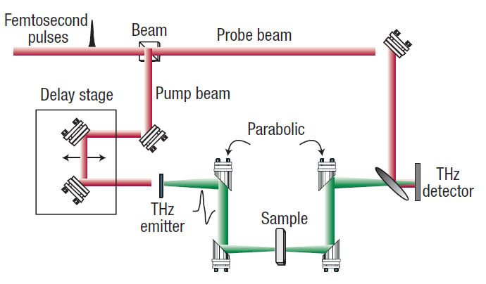
Examples of Dynamical Phenomena in Condensed Matter 1
Fundamental Excitations
- Structure and Dynamics of Excitons in Organic Semiconductors
- Phonon Generation and Dynamics
Marciniak et al., Phys. Rev. Lett. 99, 176402 (2007).
Rinaldi et al., IEEE Trans. on Ultrasonics, Ferroelectrics, and Freq. Control 57, 38 (2010).
GHz Mechanical Materials and Devices
THz Electronics and THz Properties of Materials
B. Ferguson and X.-C. Zhang, Nature Mater. 1, 26 (2002).

Slide 4
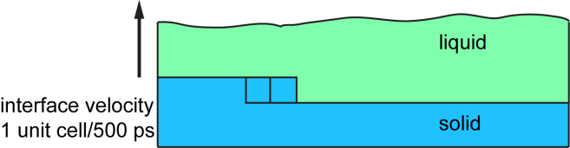
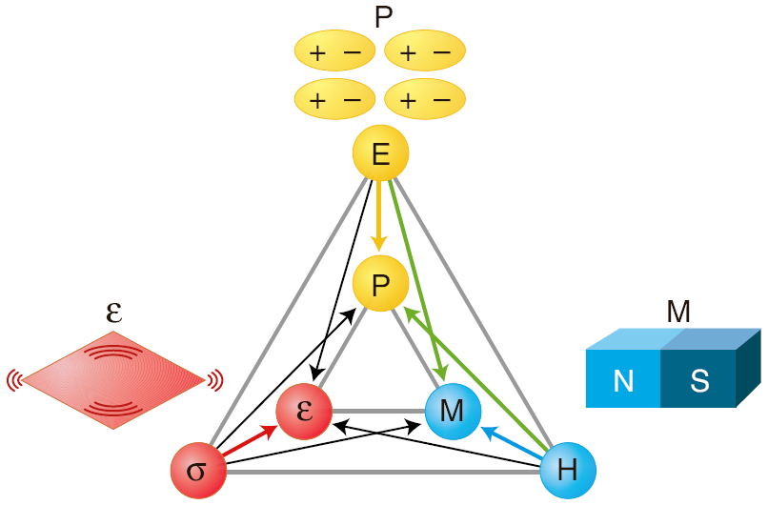
Examples of Dynamical Phenomena in Condensed Matter 2
Magnetic Dynamics: Spin-transfer Torque
Pribiag, et al., Nature Phys. 3, 498 (2007).
Atomic and Thermal Transport
- Pulsed Laser Materials Processing
- Nanomaterials Thermal Transport
M. A. Scarpula, et al., Appl. Phys. Lett. 82, 1251 (2003).
N. A. Spaldin and M. Fiebig, Science 309, 391 (2005).
Dynamics in Complex Oxides

Slide 5
Small and Fast Go Together
Small and fast
  If you want to look at dynamical processes in small areas you need to be fast
  If you want to look at small areas the dynamics can be fast.
  1 km/sec = 1 nm/ps (~sound)
  (10⁸ m/sec=100 nm/fs)
Timescales/wavelengths of probes must be chosen to match the problem.
X-rays (wavelength ~ 1 Å) match the size-scale of atomic-to-nanoscale processes.
Many ways to use x-rays to study dynamics.

Slide 6
What about Bandwidth?
Question: Can we just find a way to chop up x-rays and do the same experiments we’d do with longer pulses? At synchrotrons: yes.
The energy bandwidth and duration of optical pulses are related by an uncertainty relation called the time-bandwidth product: ΔE Δt > h
A 2 fs visible pulse with λ=600 nm has a bandwidth of nearly 300 nm, spanning nearly the whole visible spectrum.
X-rays have far higher frequency, and the same frequency width is not a concern, even for fs pulses.

Slide 7
X-ray Sources are Not Yet Transform Limited
Synchrotron Radiation Light Sources
  Example:
    APS 100 ps duration pulse, 100 eV bandwidth from undulator, typical 1 eV bandwidth selected for diffraction.
    ΔE Δt =30000 h (!!!)
Free Electron Lasers
  LCLS and other FELs based on spontaneous emission are closer, but not there yet.
So far, just use the pulsed x-ray sources as short duration lamps.

Slide 8
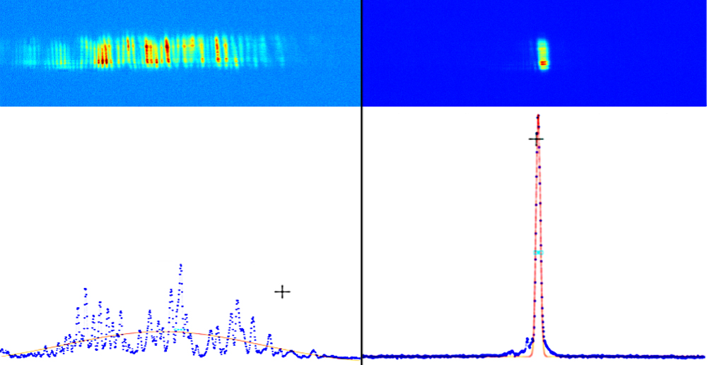
How Close are FELs? Really Close!
LCLS normal operation: SASI, several modes
LCLS self seeding test 0.5 eV bandwidth at 8 keV
J. Amman et al., Nature Photonics 6, 693 (2012).

Slide 9
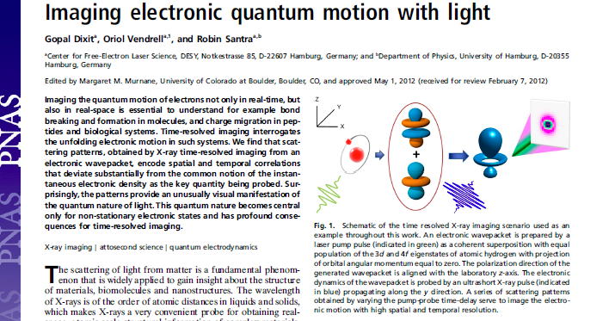
What if we were at the transform limit?
Theory of scattering with transform-limited pulses from electron orbital wavepackets.
Dixit et al., Proc. Nat. Acad. Sci. 109, 11636 (2012)
We don’t have to worry about this in experiments yet!

Slide 10
Key Parameters and Sources of Short-Duration X-ray Pulses
Experimental design parameters: pulse duration, x-ray photon energy, repetition rate, photons per pulse
Synchrotron light sources
  40-100 ps duration, 100 eV-50 keV, MHz-GHz repetition rates, 10³-10⁷ photons/pulse
  (*) Also laser slicing sources, etc. for niche applications with short durations but very low flux.
Free electron lasers
  LCLS ~100 Hz repetition rate, 800 eV-8 keV, 2 fs, >10¹⁰ photons/pulse
  European XFEL: similar, but with ~30 kHz repetition rate

Slide 11
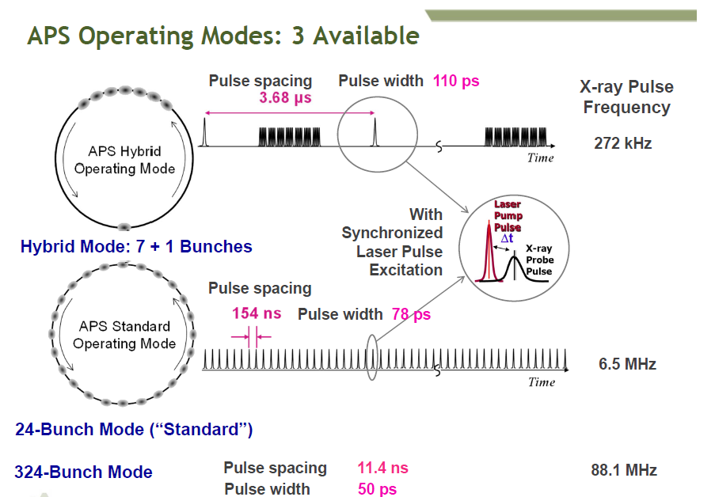
D. Tiede (ANL)

Slide 12
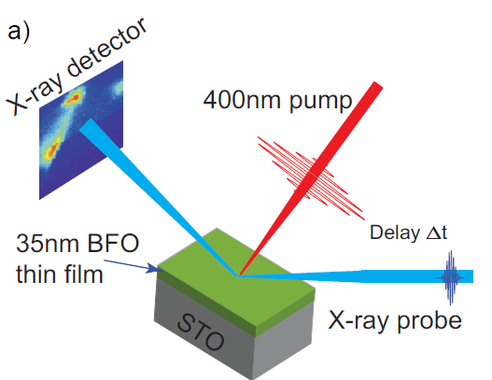
Experimental Strategies 1: Diffraction from Thin Films
Excite sample with a short transient, e.g. a laser pulse
Repeat diffraction experiment at a series of times.
H. Wen et al., Laser-driven strain in BiFeO₃ thin flims, Phys. Rev. Lett. 110, 037601 (2013) and Phys. Rev. Lett. 112, 097602 (2014).

Slide 13
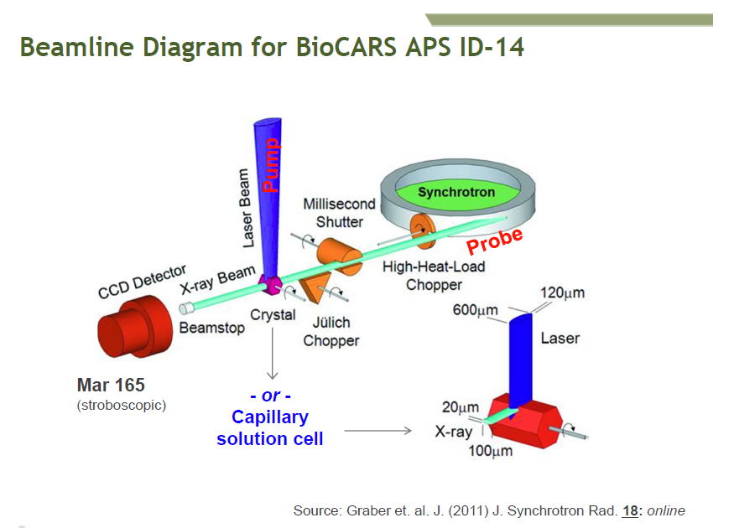
Experimental Strategies 2: Solution Scattering
D. Tiede (ANL)

Slide 14
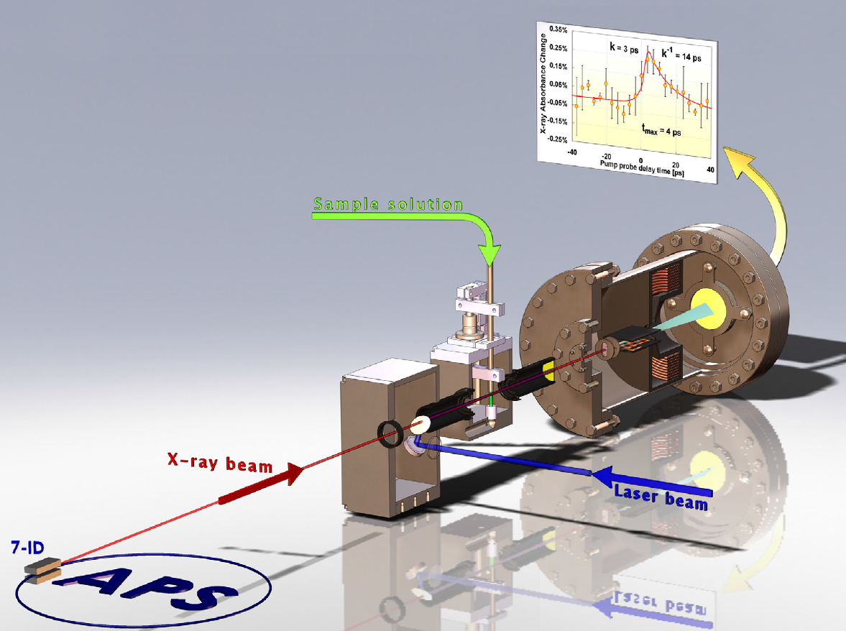
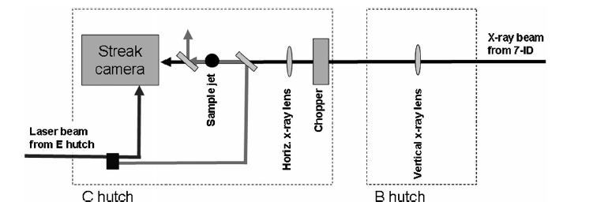
Ultrafast Spectroscopy
X-ray absortion spectroscopy in solution.
Picosecond resolution using streak camera detector.
B. Ahr et al., Phys. Chem. Chem. Phys. 13, 5590 (2011).

Slide 15
Examples of Experiments
Condensed Matter and Materials Science
Chemical Transformations
Biological Molecules

Slide 16
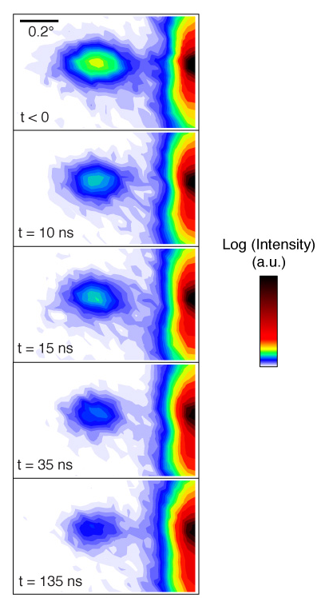
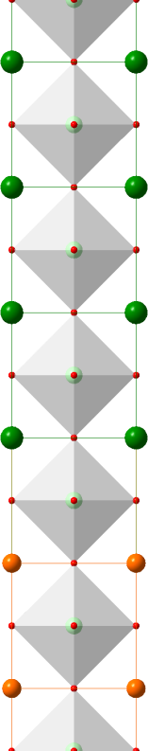
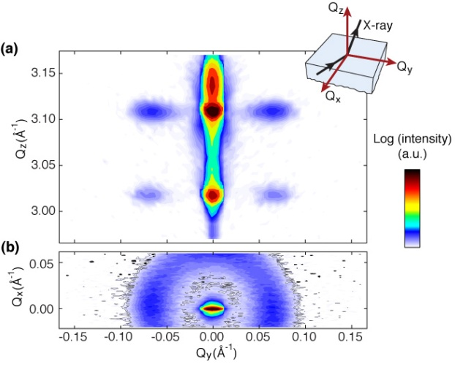
Example 1: Dynamics in artificial ferroelectrics: ferroelectric/dielectric superlattices
TiO₂
Self-organized nm-scale domains
PbO
TiO₂
PbTiO₃
12 unit cells
…
TiO₂
TiO₂
PbO
TiO₂
SrO
SrTiO₃
3 unit cells
…
TiO₂
Electronic properties arise from the E-field driven reconfiguration of domains.
SrO
TiO₂
J. Y. Jo, et al., Phys. Rev. Lett. 107, 055501 (2011).
Probing ultrafast structural dynamics is crucial. Future sources will provide insight into the mechanism of switching and the field-distorted structure of the superlattice.

Slide 17
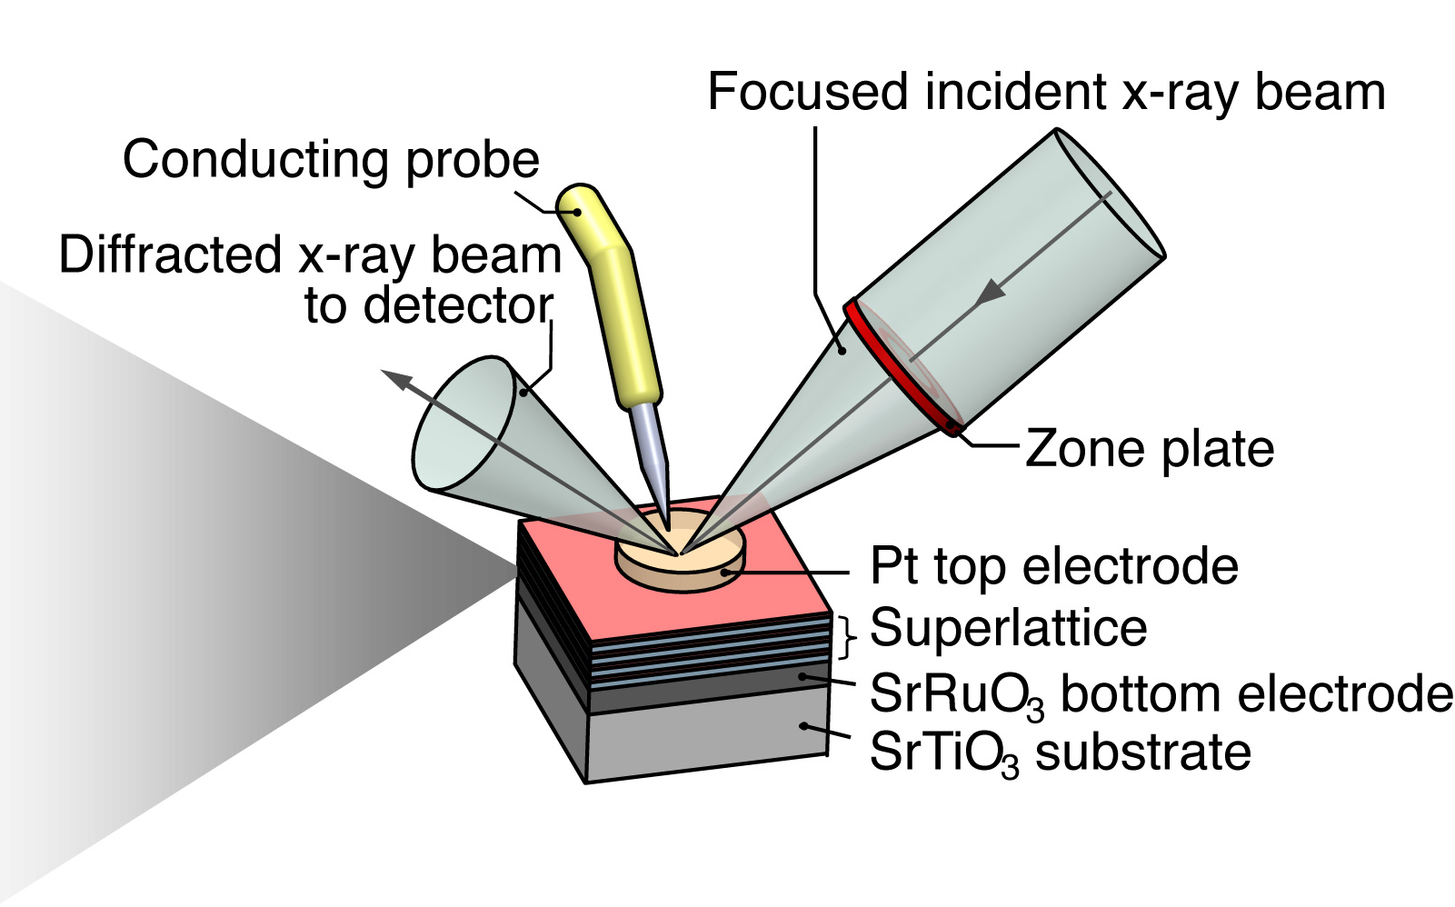
Time-Resolved Diffraction:
SrTiO₃/PbTiO₃

Slide 18
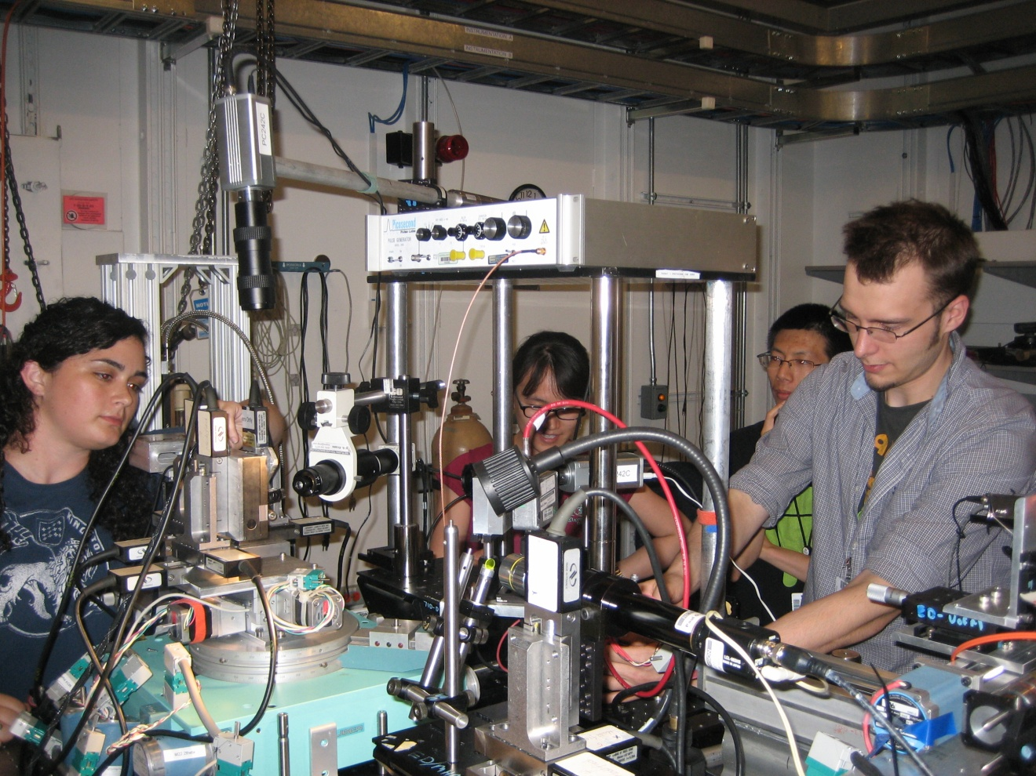
Nanodiffraction at APS sector 7: 100 nm spot size, ~100 ps time resolution

Slide 19
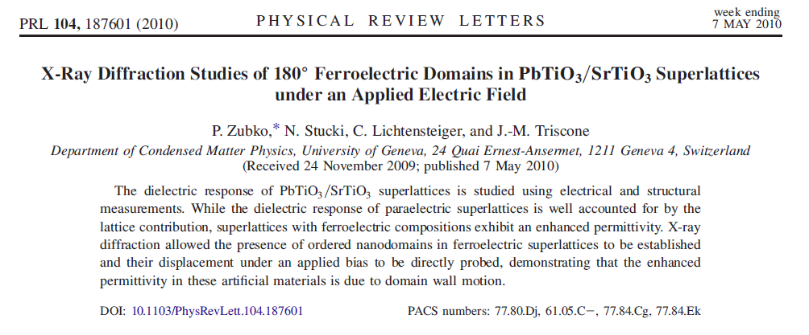
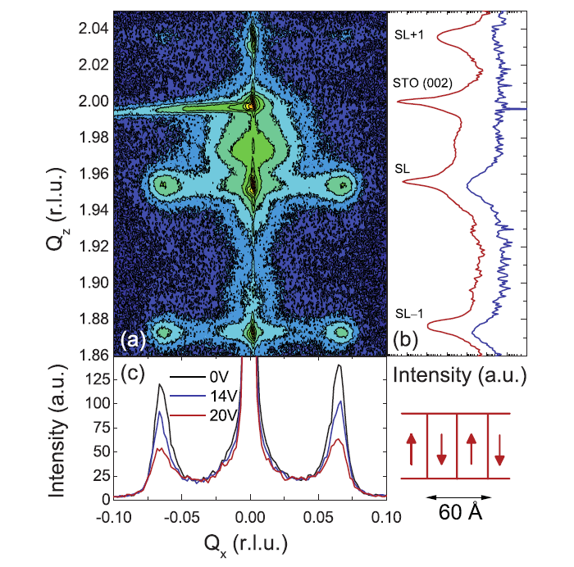
Domains
Zubko, et al., Phys. Rev. Lett. 104, 187601 (2010)

Slide 20
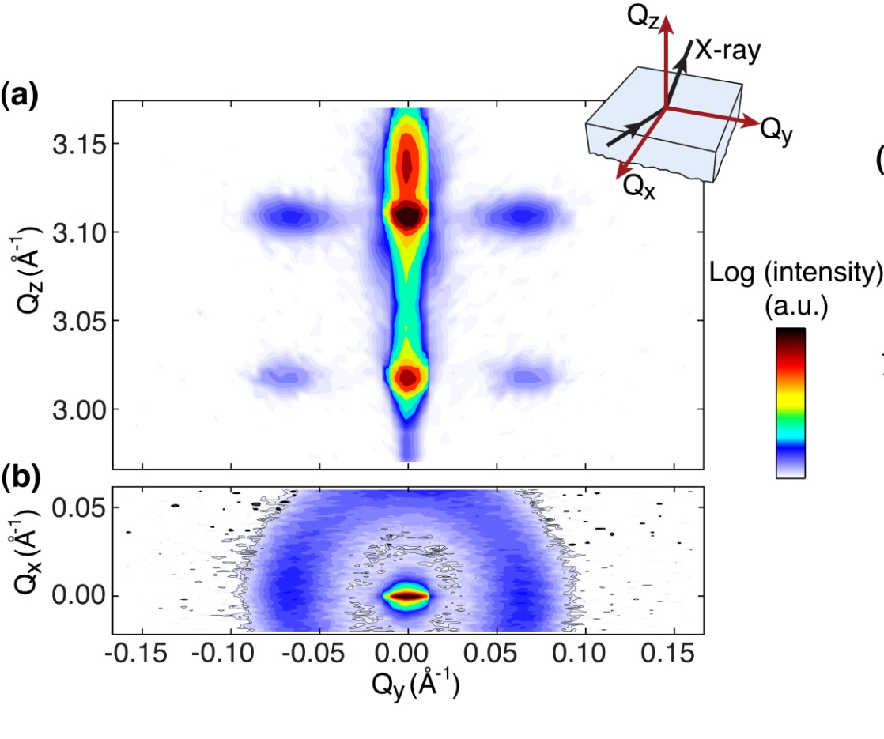
Domain Diffuse Scattering in 12(PbTiO₃)/3(SrTiO₃)
Domain period 9.5 nm
Coherence length only 20 nm

Slide 21
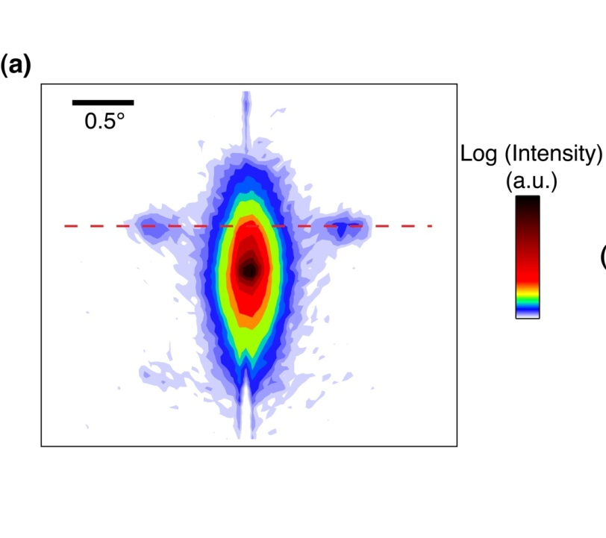
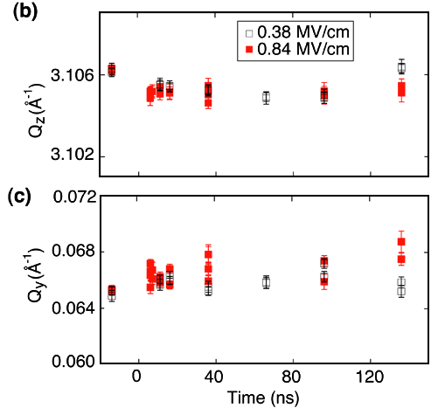
No Piezoelectric Expansion within Domains
Domain wavevectors
Out-of-plane
In-plane

Slide 22
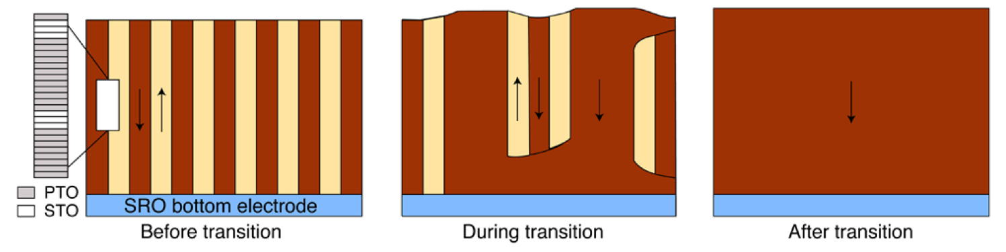
Proposed Switching Mechanism
Challenges: 2D (or 3D) imaging of domains? During switching?

Slide 23
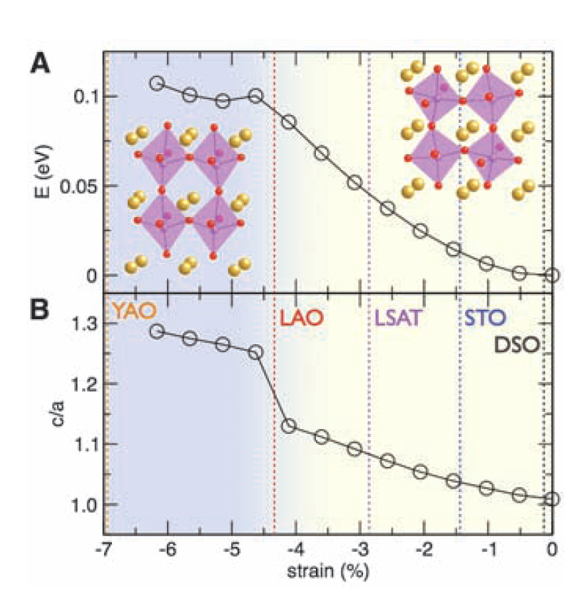
Timescales for Structural Phase Transitions
Strain drives a transition between rhombohedral-like and tetragonal-like phases – and causes huge distortion.
What are the dynamics of these structural transitions? Expect that it proceeds at the sound velocity, ~1 nm/ps.
Pump with THz radiation, probe with X-ray pulses.
R. J. Zeches, et al., Science 326, 977 (2009).
“Morphotropic” phase boundary in BiFeO₃

Slide 24
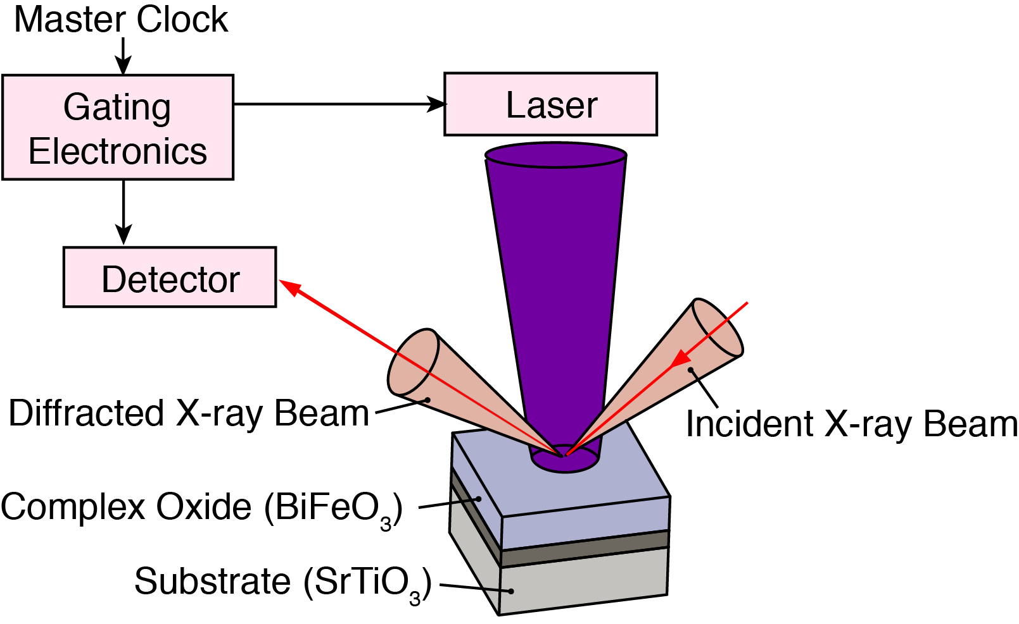
Ultrafast Optical Excitation
Laser specs:
400 nm (above bandgap)
50 fs duration
5 kHz repetition
2.5 W max power
Synchronize femtosecond laser with x-ray pulses

Slide 25
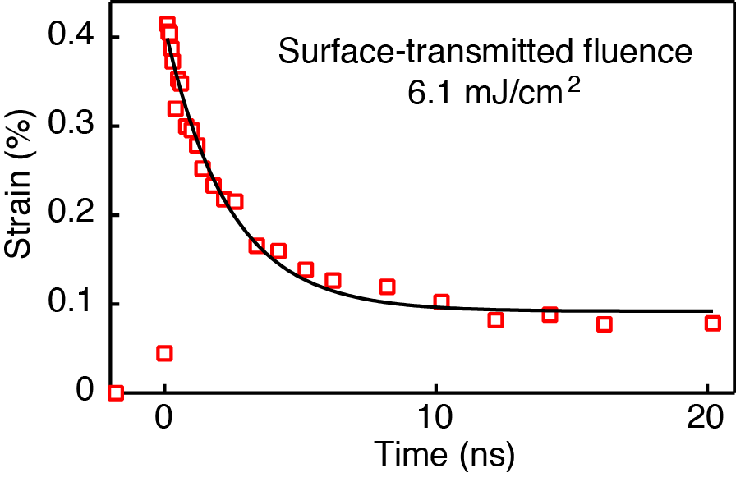
Ultrafast Strain Generation in BiFeO₃
H. Wen et al., Phys. Rev. Lett. 110, 037601 (2013).
½% strain develops within 100 ps, relaxes in several ns
Minor thermal contribution to the peak strain, important at long times
Electronic contribution at short times, relaxation agrees with carrier recombination

Slide 27
(Nearly) Instantantaneous Stress Generation
Strain consistent with elastic response to instantaneous stress.
D. Schick et al., Phys. Rev. Lett. 112, 097602 (2014).

Slide 28
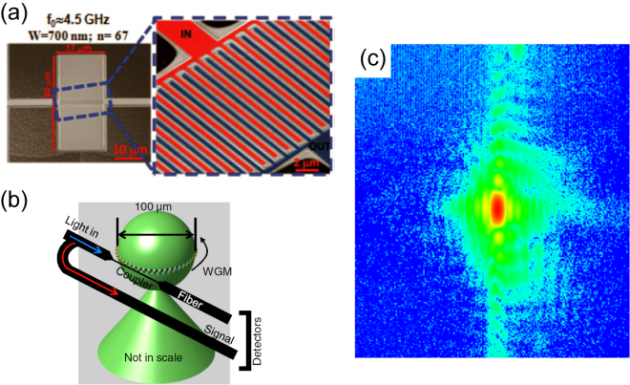
Example 2: Ultrafast Mechanics
4.5 GHz NEMS resonator
Rinaldi et al., IEEE Trans. on Ultrasonics, Ferroelectrics, and Freq. Control 57, 38 (2010).
11 GHz whispering gallery mode resonator
M. Tomes and T. Carmon, Phys. Rev. Lett. 102, 113601 (2009).
High Q and high frequency are desirable but highly challenging in materials and device design.
What are the mechanical modes?
Where does nonlinearity come from?
100 ps is not fast enough to capture the relevant effects.

Slide 29
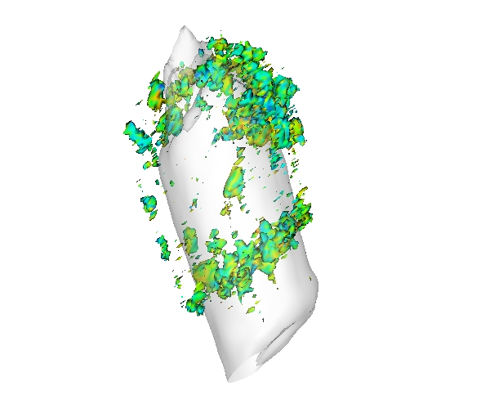
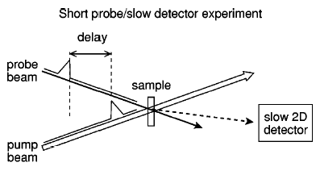
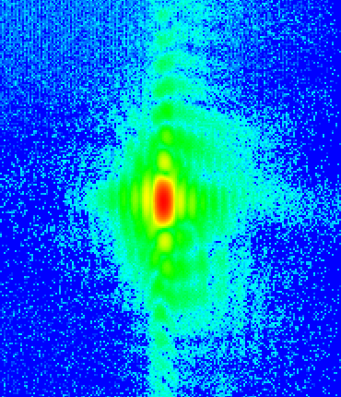
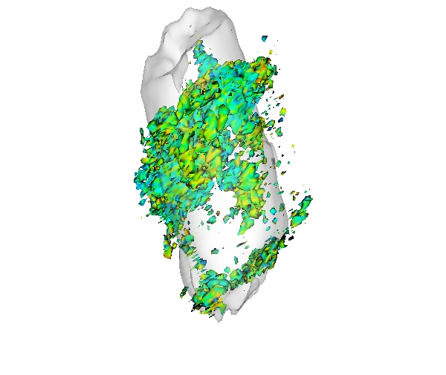
Ultrafast Coherent Diffraction Imaging of Strained Nanostructures
Time zero
Ni-capped ZnO nanorod coherent diffraction
Time +50ps
R. Harder (ANL)
(002) peak

Slide 30
Acoustic Modes of Nanocrystals
J. N. Clark et al., Science 341, 56 (2013).

Slide 31
Imaging Phase Transformations
VO₂ low-temperature insulating monoclininc phase, high temperature metallic rutile phase
Y. Zhu et al., Scientific Rep. 6, 21999 (2016).

Slide 32
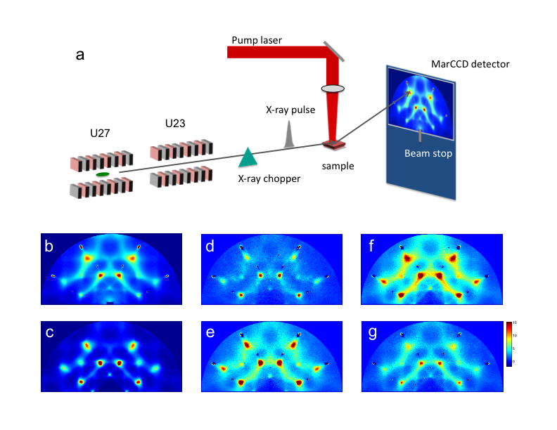
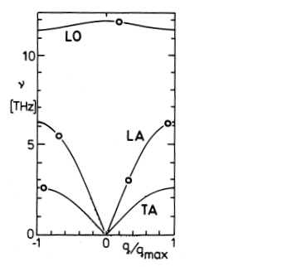
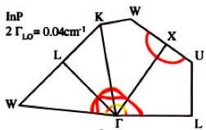

Example 3: Tracking phonons in time and momentum
A. Debernardi, et al., Phys. Rev. B., 57, 12847 (1998).
M. Trigo, et al., Phys. Rev. B, 82 235205 (2010).
Nonthermal distributions, anharmonic decay
Ultrafast thermal diffuse scattering
Phonon-phonon, electron-phonon interactions
Time-domain often necessary to access these non-equilibrium states
Future sources will match x-ray scattering to the natural timescale of these interactions.

Slide 33
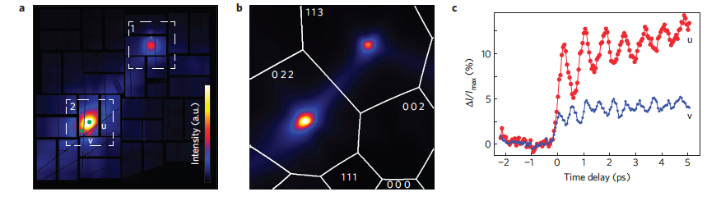
Fourier Transform Methods for Phonon Dispersions
Femtosecond laser impulsive excitation.
Diffuse scattering oscillates, Fourier transform to determine phonon frequency.
M. Trigo et al., Nature Phys. 9, 790 (2013).

Slide 34
Time Dependence of Diffuse Scattering
Depends on Phonon Dispersion
Determine two parameters:
1) q from location in reciprocal space
2) Ω from time dependence
M. Trigo et al., Nature Phys. 9, 790 (2013).

Slide 35
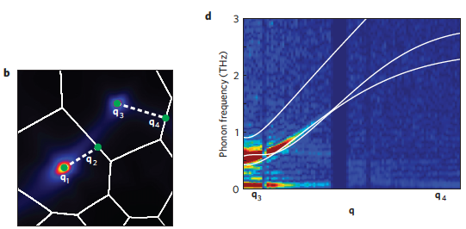
Experimental Phonon Dispersions
Ge
M. Trigo et al., Nature Phys. 9, 790 (2013).

Slide 36
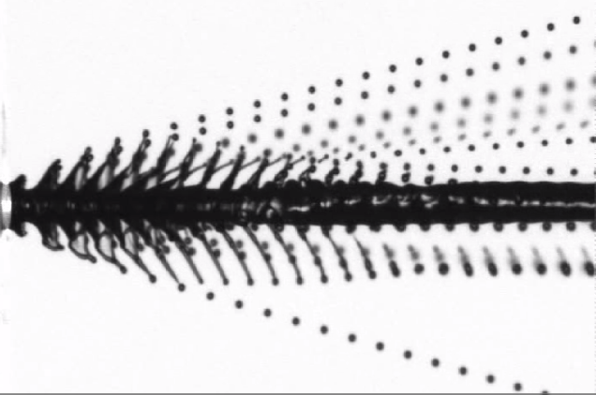
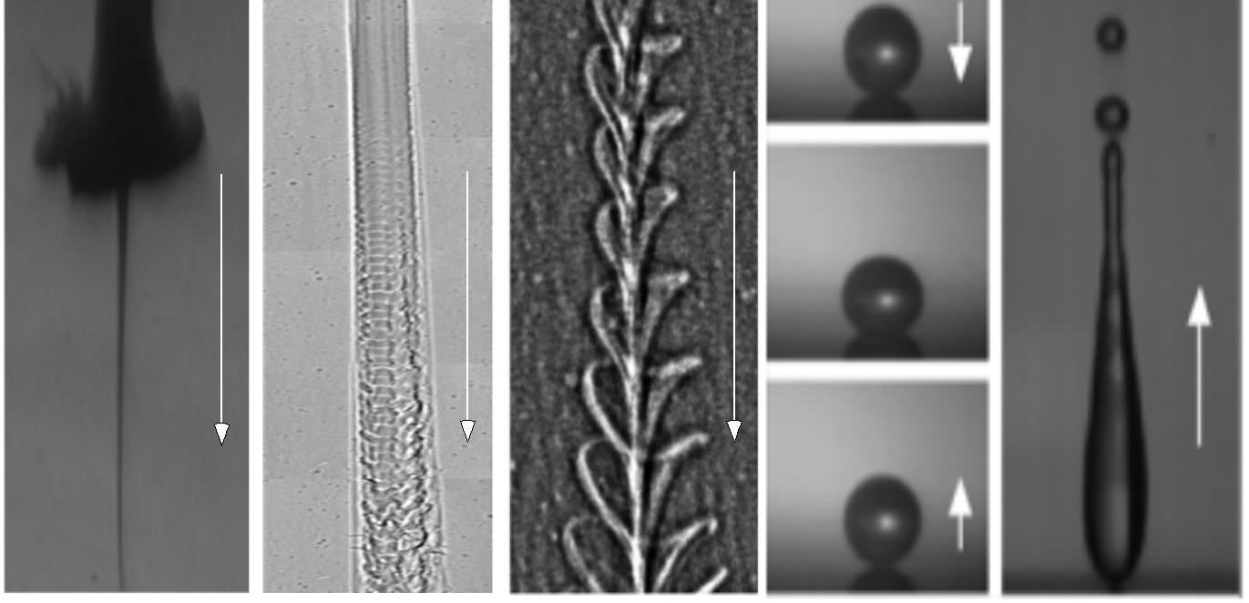
Example 4: Imaging Microscopic Multiphase Liquid Flows
Can high-speed flows (often turbulent) be a well-controlled process?
Engine sprays, high-pressure industrial sprays. Immediate implication for next-generation fuel and combustion.
Humberto Chaves (Freiberg U)
High-pressure injector
High-pressure diesel spray
Jet with in-nozzle vorticity
Liquid drop bouncing on a solid surface
Challenges:
Optically dense due to many interfaces
Highly dynamic – high temporal resolution
Even more difficult on micrometer length scale-high spatial resolution
X-rays provide easily interpreted image of mass density.
Spray direction
J. Wang (ANL)

Slide 37
Examples of Experiments
Condensed Matter and Materials Science
Chemical Transformations
Biological Molecules

Slide 38
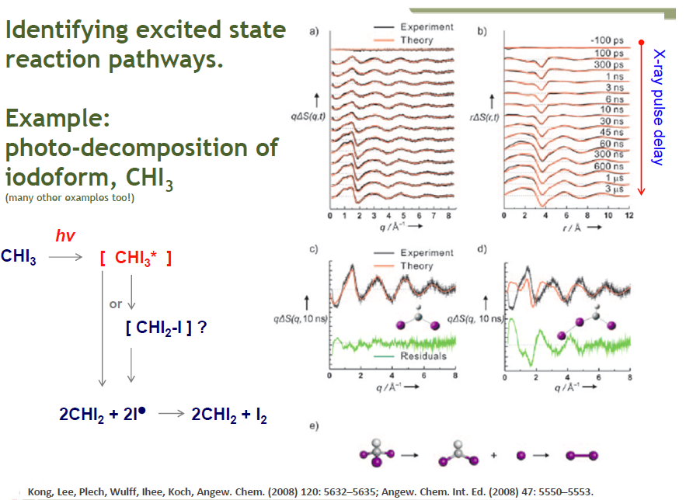
Example 1: Photo-decomposition of Iodomethane
D. Tiede (ANL)

Slide 39
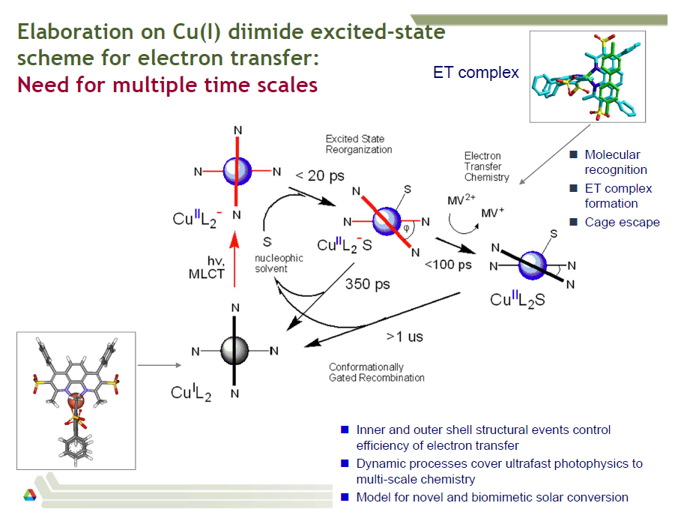
Example 2: Molecular Excited States
D. Tiede, L. Chen (ANL)

Slide 40
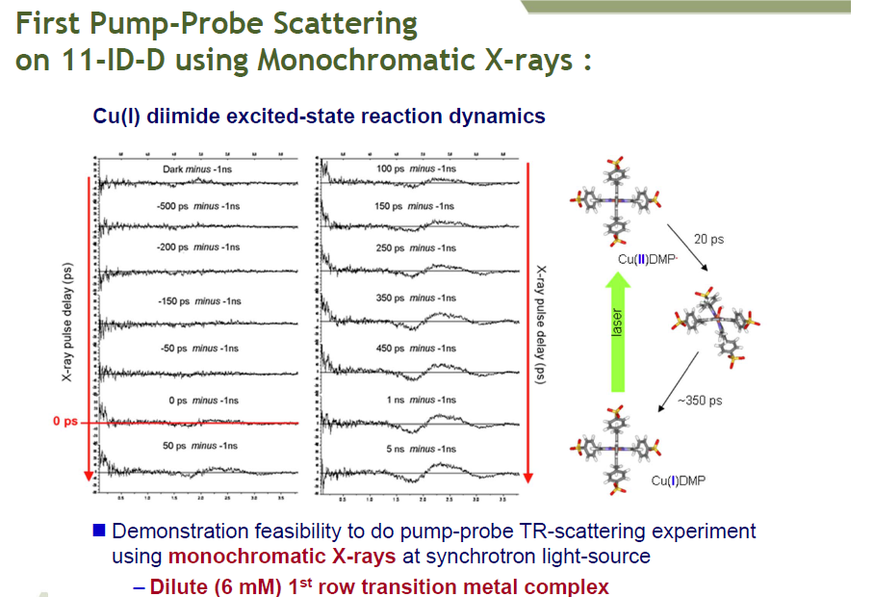
Example 2 (continued): Molecular Excited States
D. Tiede, L. Chen (ANL)

Slide 41
Examples of Experiments
Condensed Matter and Materials Science
Chemical Transformations
Biological Molecules

Slide 42
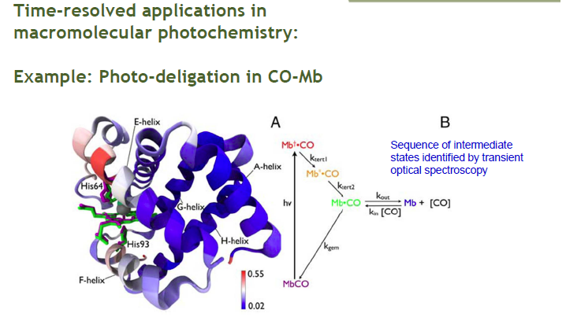
Example: Photo-deligation in Myoglobin
Start in carbon monoxy form (MbCO), optically induced transition to deoxy form (Mb).
Cho et al., Proc. Nat. Acad. Sci. 107, 7281 (2010).
D. Tiede (ANL)

Slide 43
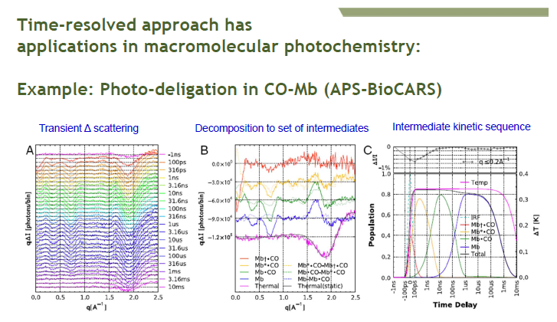
Example: Photo-deligation (continued)
Cho et al., Proc. Nat. Acad. Sci. 107, 7281 (2010).
D. Tiede (ANL)

Slide 44
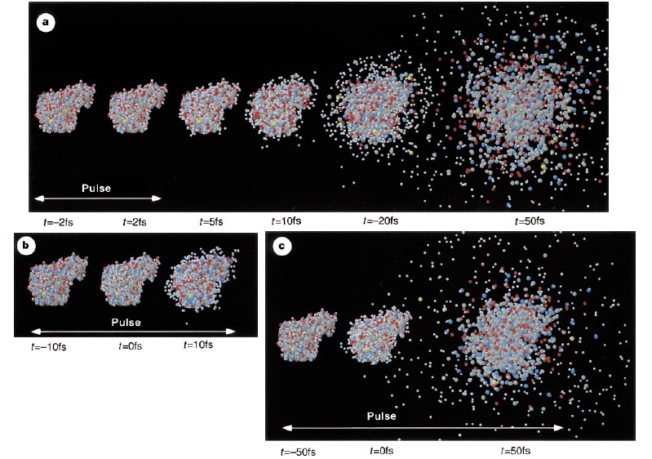
New Strategies: Single-Shot Experiments at FELS
FELs have sufficient intensity that the sample can be damaged or destroyed by the first pulse! (Each LCLS pulse has the photons of 10³⁻10⁵ synchrotron bunches, but in 2 fs.)
Can you get the information you need in one pulse?
Can the pulses be short enough to get the information before the structure explodes?
Prediction (2000): Neutze et al. Nature 406, 752 (2000).

Slide 45
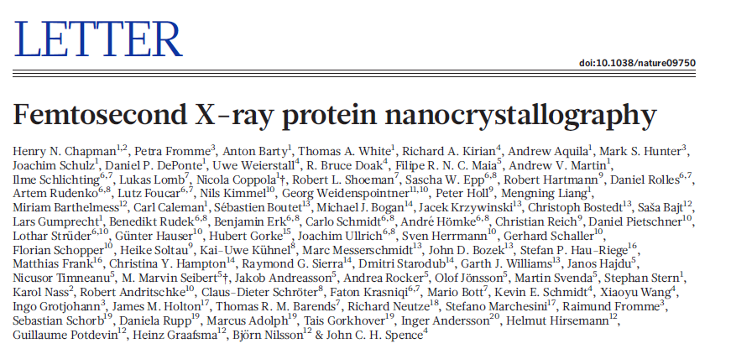
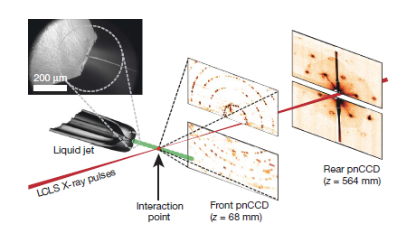
Femtosecond Nanocrystallography
Experiment (2011)

Slide 46
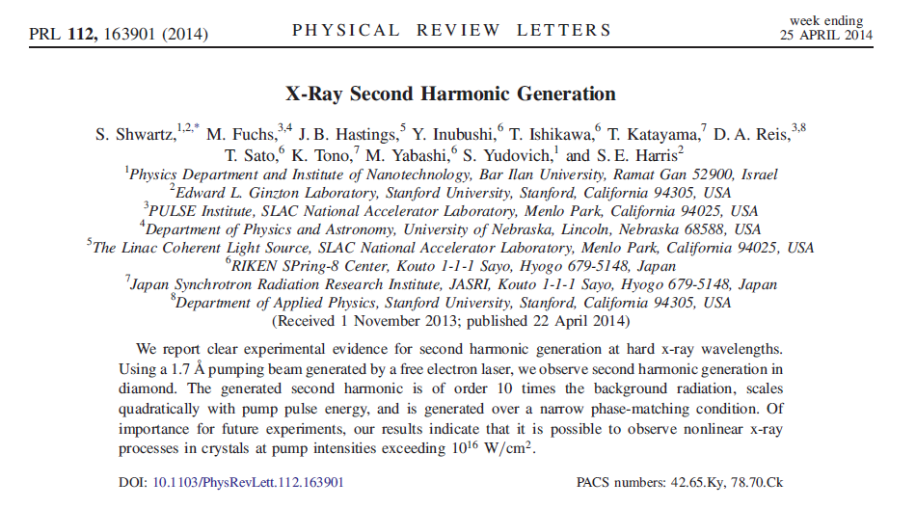
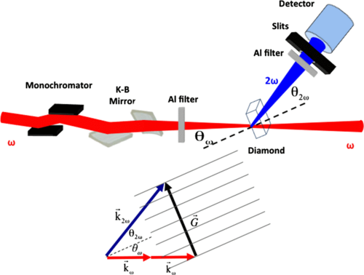
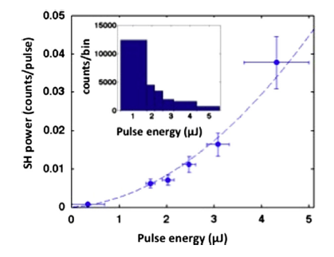
X-ray Nonlinear Optics

Slide 47
New Sources are Coming Soon
Improvements in synchrotron sources
New FELs
  Building/Built: SACLA (Japan), European XFEL, Pohang (Korea), Swiss FEL
  LCLS-II (high-repetition rate)
Proposed FELs
  Hard x-ray LCLS upgrade

Slide 49
Current and Future FELs

Slide 50
Storage Ring Sources

Slide 51
Conclusions
Dynamics in condensed matter, materials science, chemistry, and macromolecules have wide relevance to important questions.
X-ray techniques can address these questions using dynamical versions of techniques we’re familiar with.
Near Future: Many new sources, new techniques.
Further Future: Transform-limited x-ray pulses.

