Slide 1
SAMPLE HOLDERS for POwders
HB2a Instrument Team
High Flux Isotope Reactor
August 2016

Slide 2
TYPES of POWDER CANS
Vanadium Cans with Aluminum Flange and Lids, SS or Al screws [Measurements at T<300K]
(V-can is glued to Al flange using low temperature Stycast epoxy)
SMALL
MEDIUM
LARGE
Vanadium Cans with Titanium Flange and Copper (SS screws) or Boron-Nitride Lids (Molybdenum screws)
[Cu Lid: Measurements at T<800K]
[BN Lid: Measurements at T<1200C]
M8x1.25 Female
M8x1.25 Female
M8x1.25 Female
SMALL V-CAN & Ti Flange
Copper Lid or Boron Nitride Lid
MEDIUM V-CAN & Ti Flange
Copper Lid or Boron Nitride Lid
LARGE V-CAN & Ti Flange
Copper Lid or Boron Nitride Lid
SMALL
MEDIUM
LARGE

Slide 3
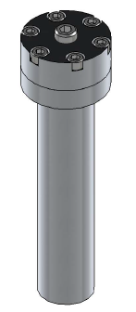
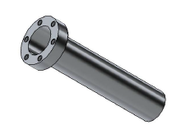
TYPES of POWDER CANS
Aluminum Cans with Aluminum Flange and Lids, SS or Al screws
[Measurements at T<300K]
D
ID
Size | Length (L) | Inner Diameter (ID) | Lid Diameter (D) | Screws | Lid thread size
Xsmall | 2” | 0.188” | 0.75” | 4-40 UNC | ¼-28
Small | 2” | 0.250” | 0.75” | 4-40 UNC | ¼-28
Medium | 2.5” | 0.345” | 0.75” | 4-40 UNC | ¼-28
Large | 3” | 0.600” | 1.0” | 4-40 UNC | ¼-28
L

Slide 4
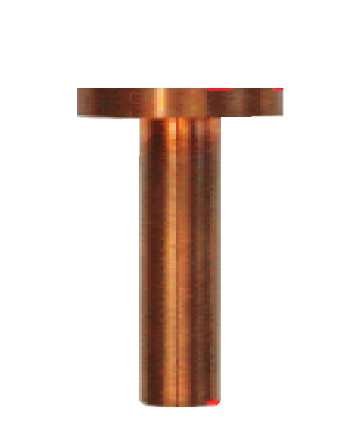
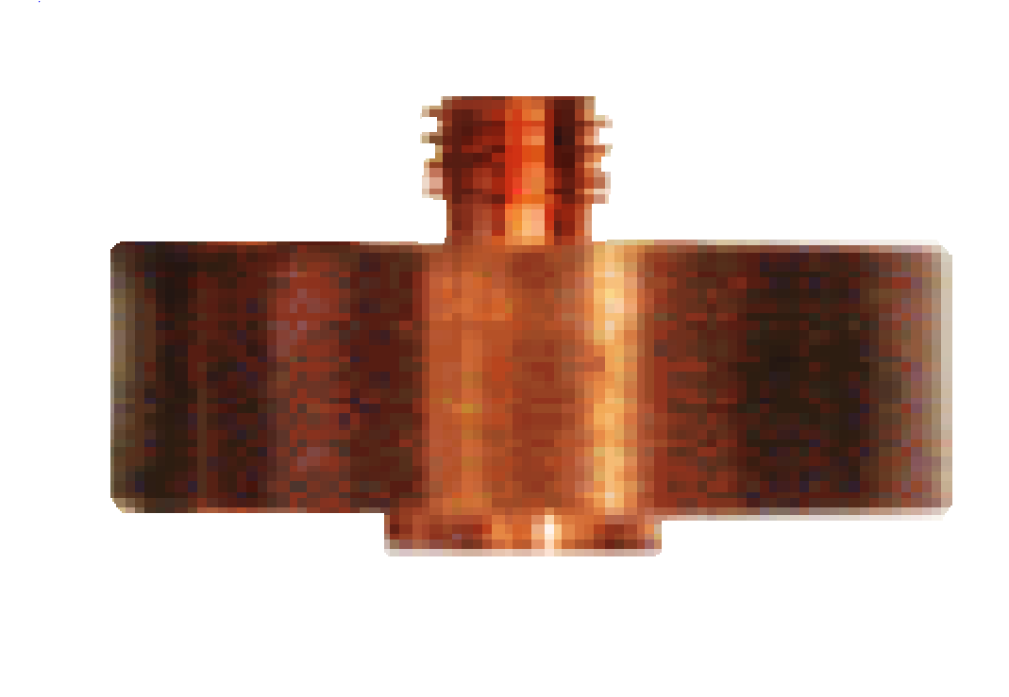
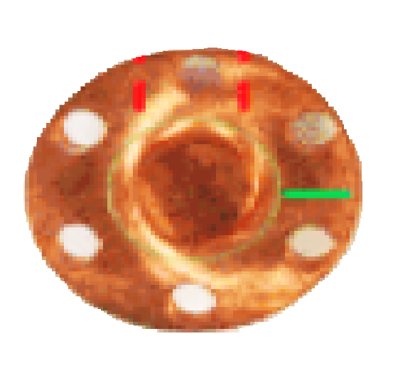
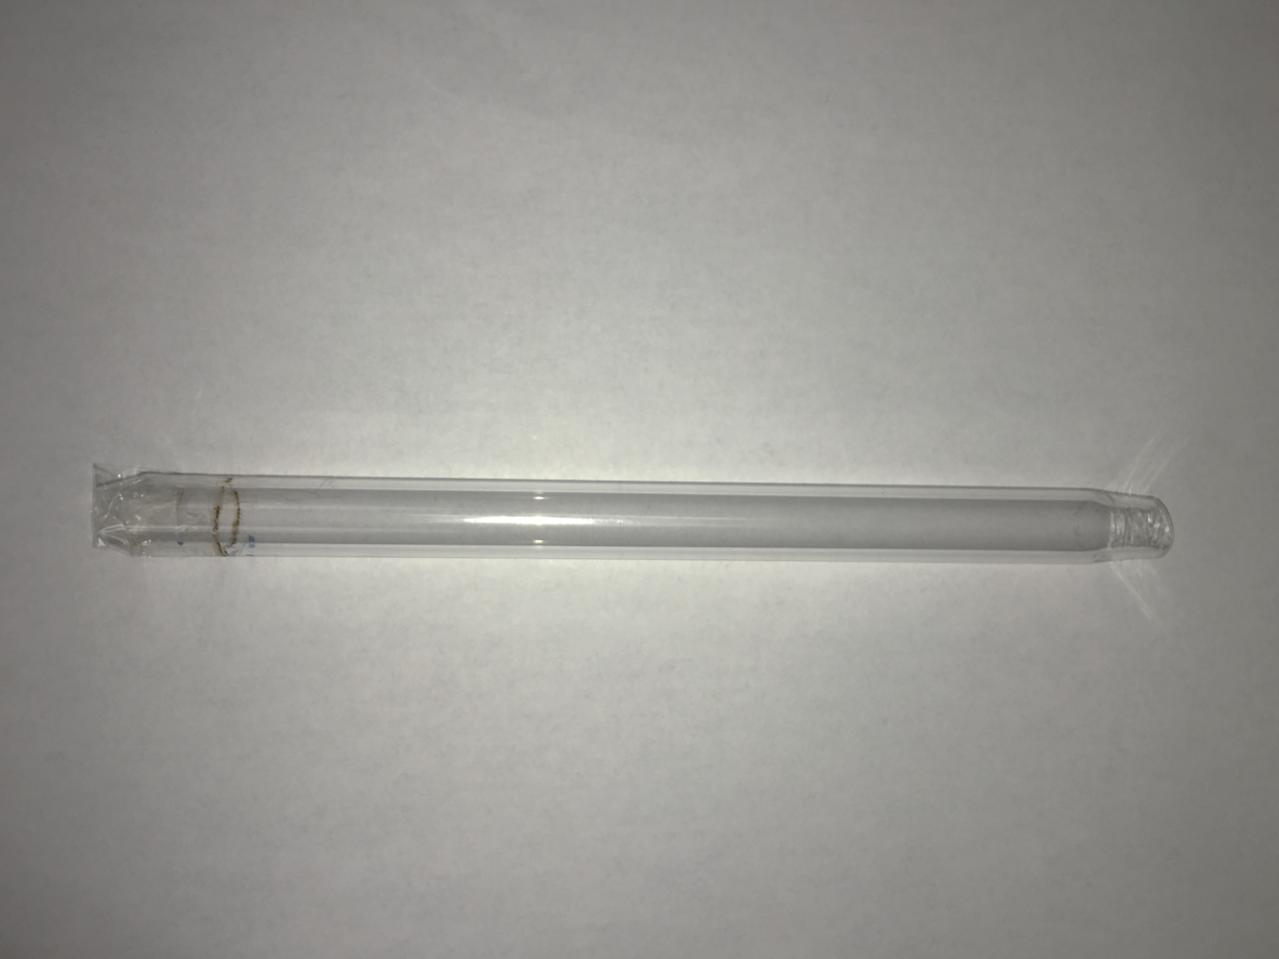
SPECIALTY SAMPLE HOLDERS
Aluminum Annular Cans
[Measurements at T<300K]
Copper Cans with Copper Lid
[Measurements in ³He and Dilution Insert T<300K]
2.493”
M6x1.0 Male
0.343” ID
0.376” OD
0.300”
0.375”
0.063”
0.343”
1”
1”
Groove for
Indium gasket
Aluminum Can for Gas pressure Cell
Quartz glass for ILL Air Furnace
[Measurements at T<300K]
[Measurements at T<1200C]
0.5” OD
0.375” ID
27.5”

