Slide 1
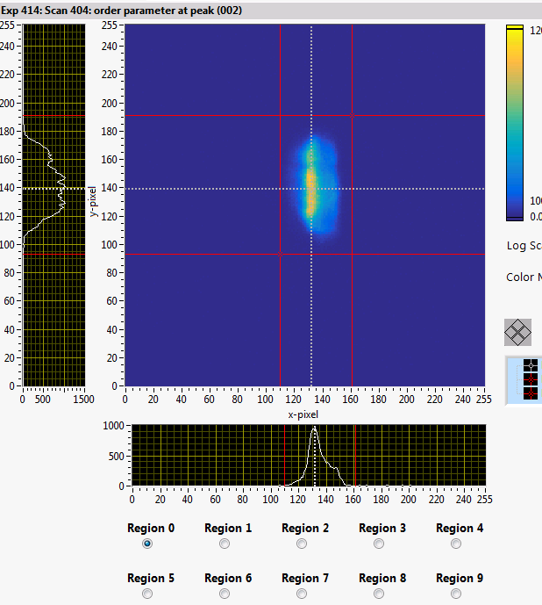
Impact:
Users are able to independently plan and setup experiments.
Quick setup for the efficient data collection (specify the counting time for each reflection).
Optimized signal/noise ratio by customizing the Region of Interest.
Rapid crystal alignment and orientation matrix determination.
Quick tracking of the experiment progress.
Time saving in measurement:
1+ hours saved in crystal alignment and optimizing UBmatrix 3+ hours saved per day in the data collection.
SPICE upgrade for HB-3A 2D detector:
Added cursors to identify each pixel ID, corresponding hkl, and received neutron counts..
New function to let users define Region of Interests.
Instrument configuration is written in each measured data.
Improved capability for optimizing the data collections.
Monitor was better synchronized through HFIRLITE

