Slide 1
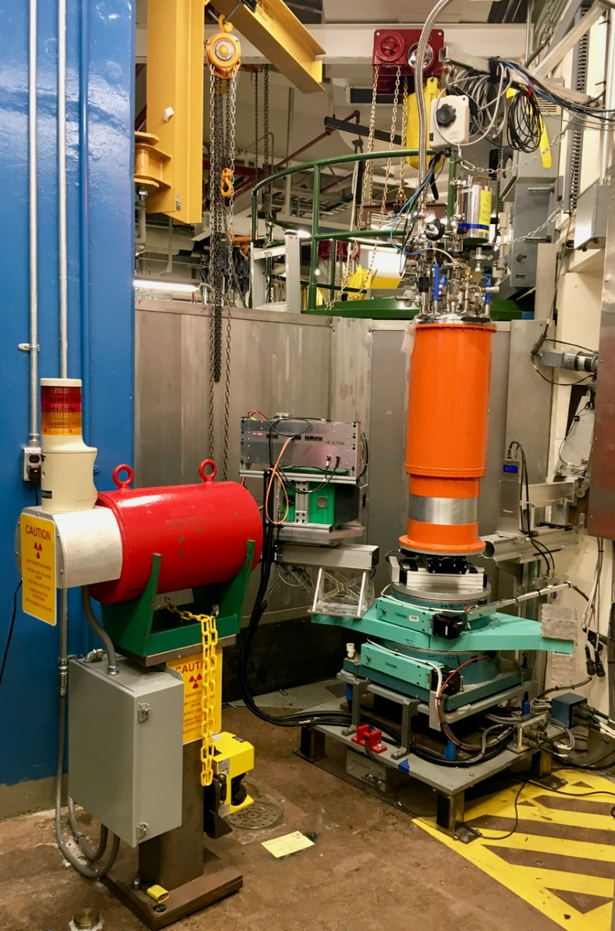
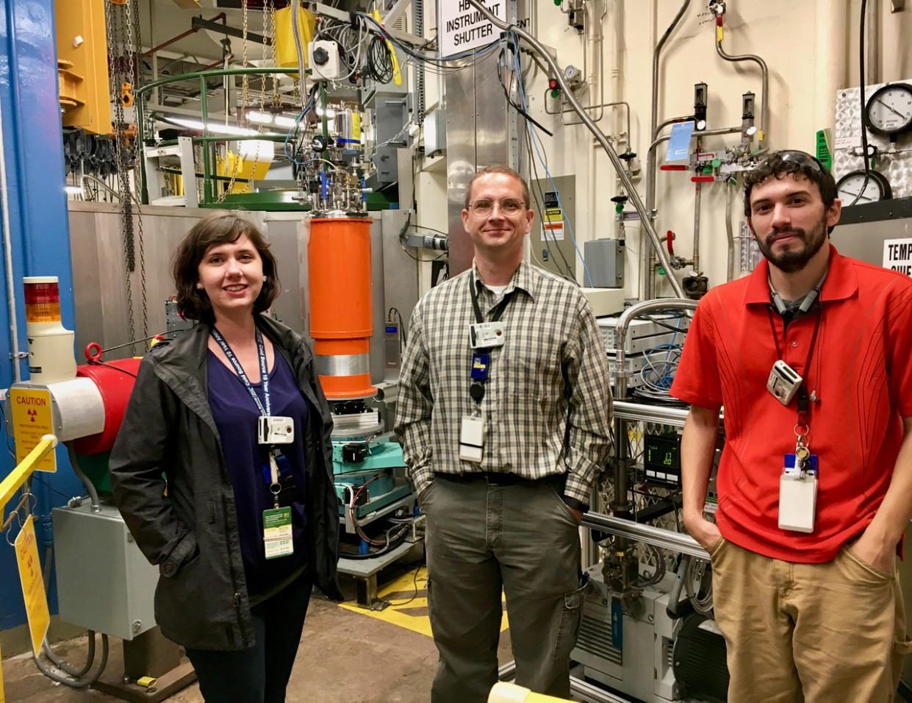
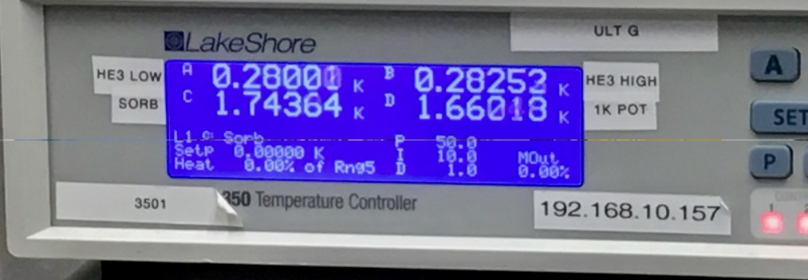
Ultralow Sample Temperatures available at HFIR HB-3A Single-Crystal Diffractometer
Temporary removal of the chi/phi axes allows room for an orange cryostat with He-3 insert, making use of the new overhead jib crane. Different versions of SPICE instrument control software are configured for this and other setups, e.g., virtual motors for phi and chi axes. This capability has been made possible by Cory Fletcher, Tyler White, Eric Stringfellow, Mike Hittman, Jon Smith, Gary Taufer, and Katie Andrews.
Corey
Fletcher
Katie
Andrews
Tyler
White
0.28K
Notes:
Notes: Include 200 word highlight summary….

