Slide 1
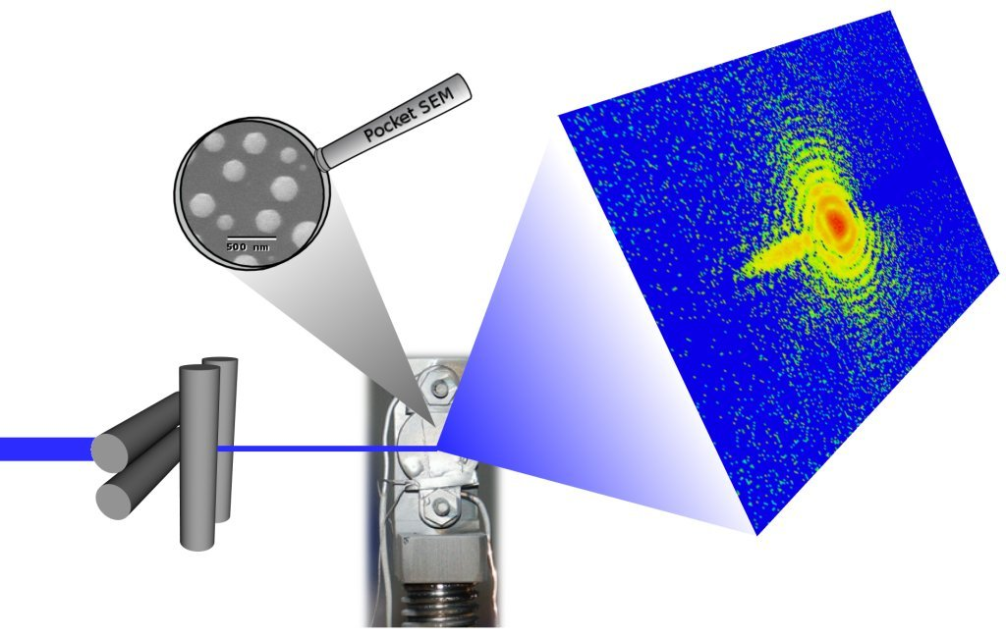
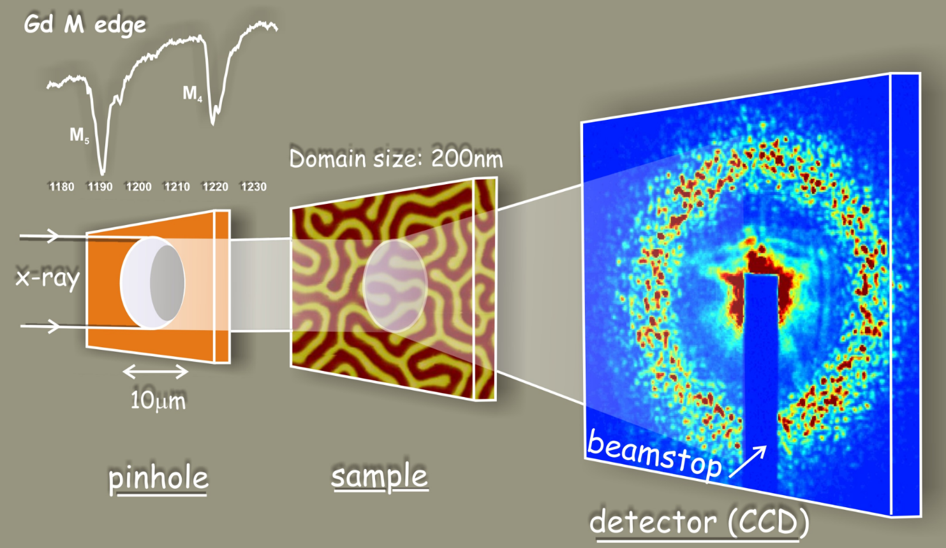
Coherent Diffraction Imaging
Ross Harder
Acknowledgments:
Prof. Ian Robinson (BNL)
Dr. Xiaojing Huang (BNL)
Dr. Jesse Clark (PULSE institute, SLAC)
Prof. Oleg Shpyrko (UCSD)
Dr. Andrew Ulvestad (ANL - MSD)
Dr. Ian McNulty (ANL – CNM)
Compact Objects (CDI)
Non-compact samples (Ptychography)

Slide 2
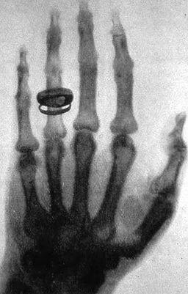
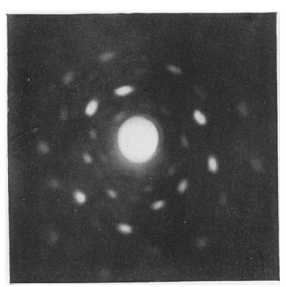
X-rays, two extremes for structural study:
Courtesy Prof. Oleg Shpyrko (UCSD)
X-ray Imaging
(Shadowgraphs)
Inhomogeneous,
non-periodic materials
Limited spatial resolution
(~0.001 mm)
X-ray Diffraction
(Scattering)
Is particularly sensitive to periodicity in the sample (Crystals)
Atomic resolution (unit cell)
Coherent Imaging
is scattering
Von Laue, Nobel 1914
Bragg & Bragg, Nobel 1915
Roentgen, Nobel 1900

Slide 3
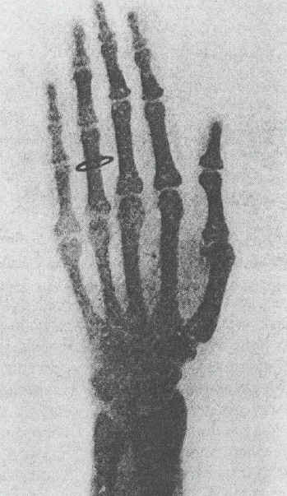
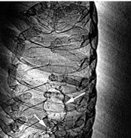
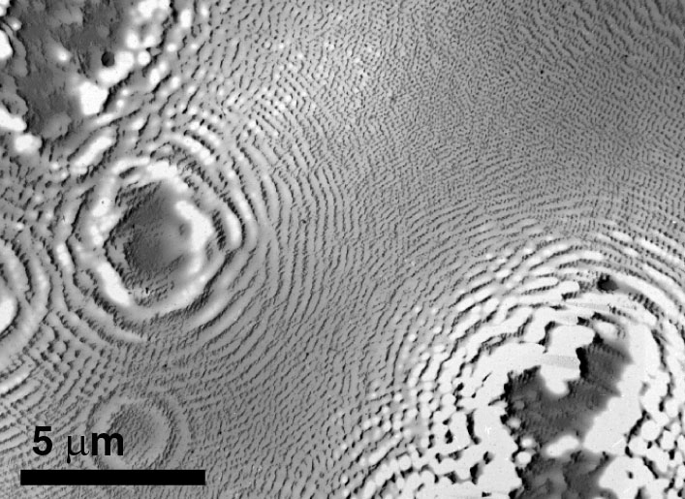
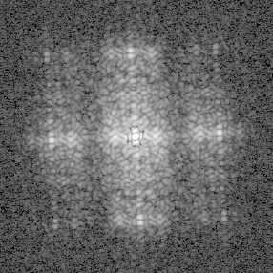
Imaging regimes with coherent x-rays
Courtesy Prof. Oleg Shpyrko (UCSD)
near-field
Fresnel
far-field Fraunhofer
2a
X-ray beam
z ~ a²/λ
z >> a²/λ
absorption
radiograph
phase
contrast
in-line holography
coherent diffraction
Kagoshima (1999)
Jacobsen (1990)
Miao (1999)

Slide 4
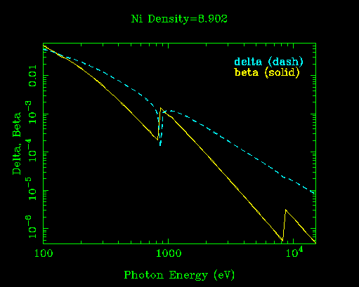
Refractive index and contrast in the x-ray region
Absorption contrast:
sensitive to Im(n)
Phase contrast:
sensitive to Re(n)
Diaz, Ana, et al, 2012. “Quantitative X-Ray Phase
Nanotomography.” Physical Review B 85.

Slide 5
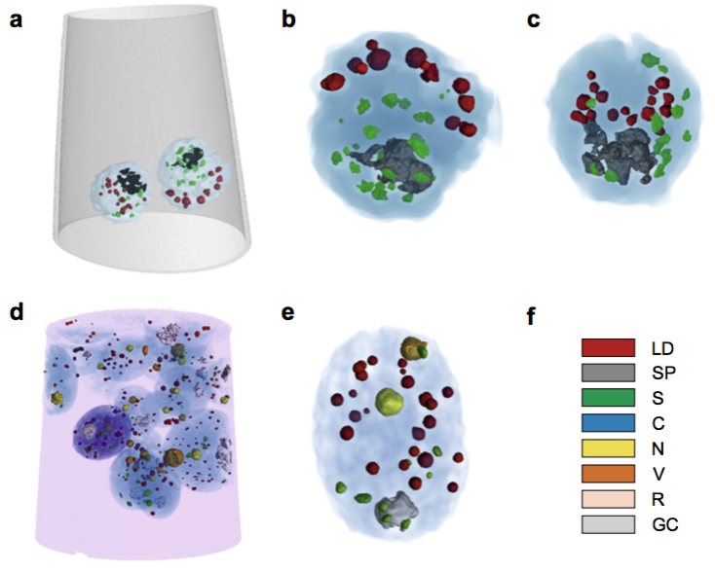
Refractive index and contrast in the x-ray region
A. Diaz,et al., Journal of Structural Biology, vol. 192, no. 3, pp. 461–469, Oct. 2015.
Absorption contrast:
sensitive to Im(n)
Phase contrast:
sensitive to Re(n)

Slide 6
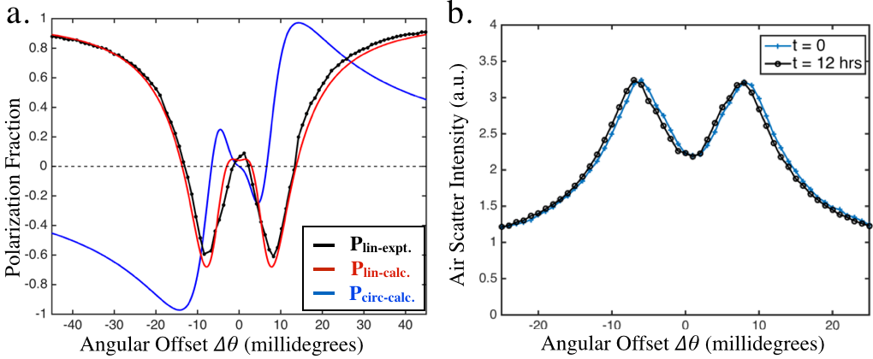
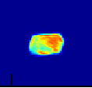
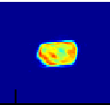
Polarized x-rays give sensitivity to electron spin
in PtCo
LCP @ 11.565keV
RCP @ 11.565keV
Figueroa, A. I., et al. (2014). Physical Review B, 90(17), 174421
Notes:
Dichroism: difference in absorption depending on polarization of incident light due to
fine-structure splitting of electronic states (spin-orbit coupling).
Circular dichroism: differential absorption using left and right-circularly polarized light.

Slide 7
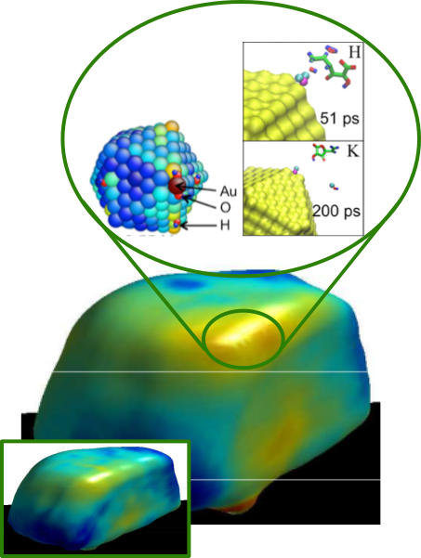
CDI in Bragg geometry:
Imaging displacement field
(strain)
Displacement field u(r):
Coherent X-ray Diffraction measures:
Strain is a gradient of u(r), the phase component of the complex-valued density

Slide 8
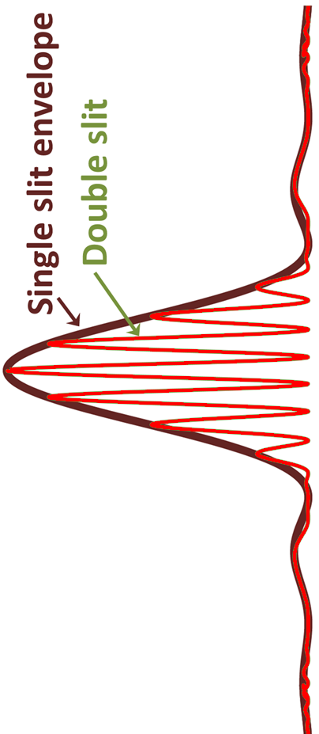
Coherence
Visibility of fringes is a direct measure of the coherence of a beam.
If beam is coherent across the spacing of the slits a Fourier Transform
of the slit structure is created downstream.

Slide 9
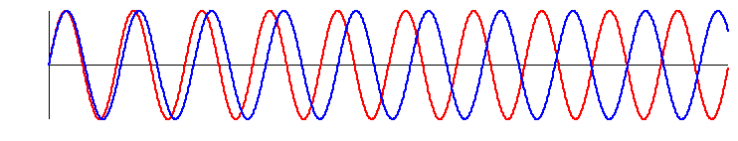
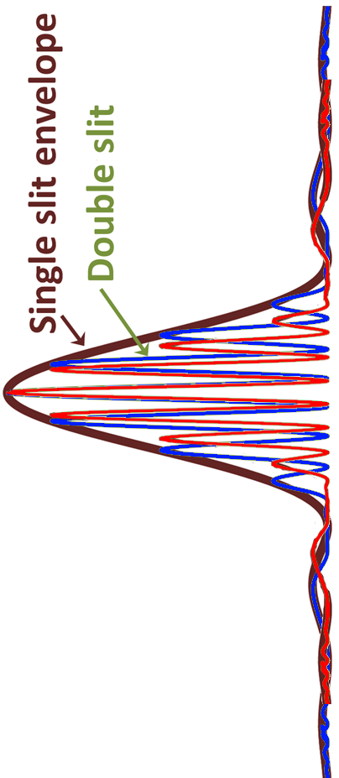
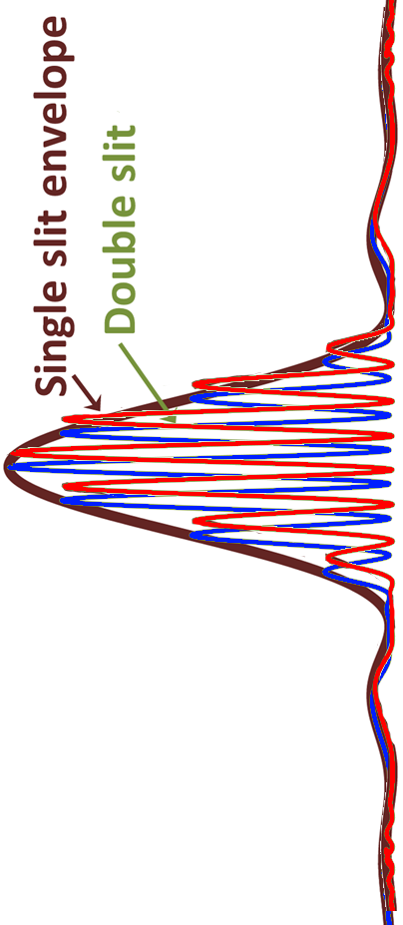
Coherence
longitudinal coherence
Δλ
λ
transverse coherence
d
w_{c}
z

Slide 10
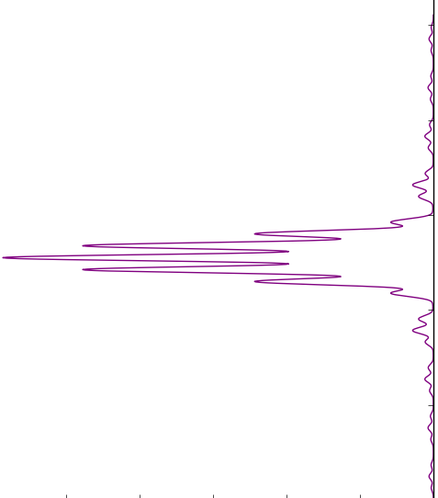
Coherence
longitudinal coherence
Δλ
λ
transverse coherence
d
w_{c}
z

Slide 11
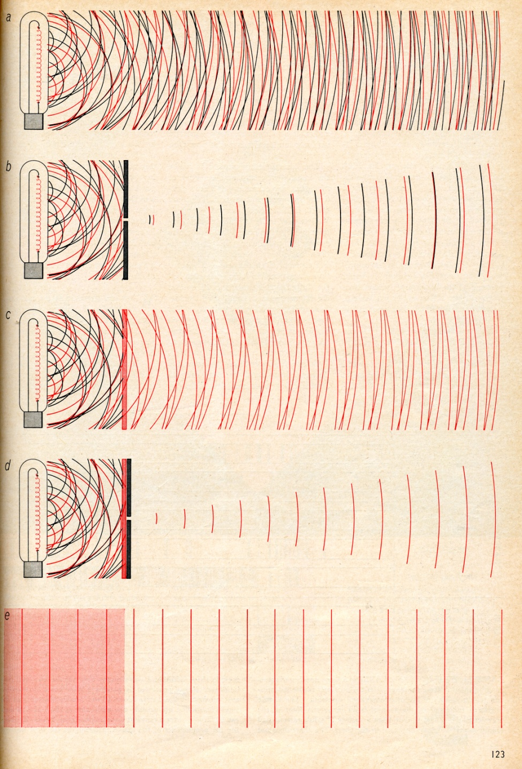
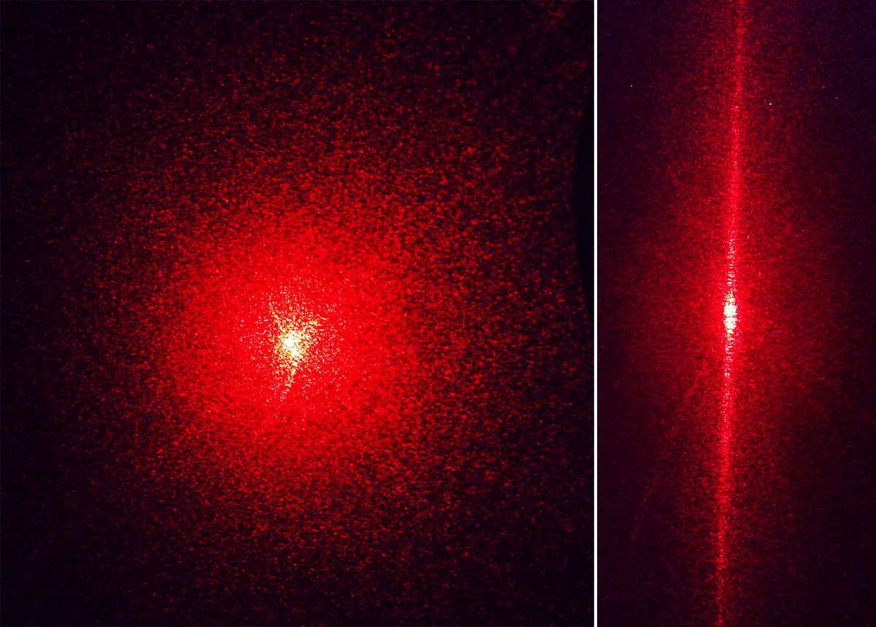

Coherence: Laser Speckle
Courtesy Prof. Oleg Shpyrko (UCSD)
A. L. Schawlow “Laser Light"
Scientific American, 219 (3), p. 120, (1968)
Laser Speckle: Interference pattern arising from randomly distributed scatterers

Slide 12
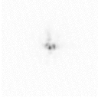
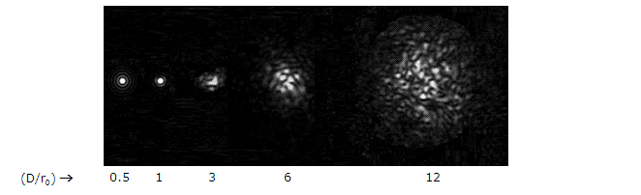
Simplest Speckle Experiment:
Twinkle, Twinkle Little Star
Courtesy Prof. Oleg Shpyrko (UCSD)
Stars are big, but very far away. As a result, their light has a high transverse coherence.
As the light propagates through the atmosphere our eye detects a portion of
the coherent diffraction

Slide 13
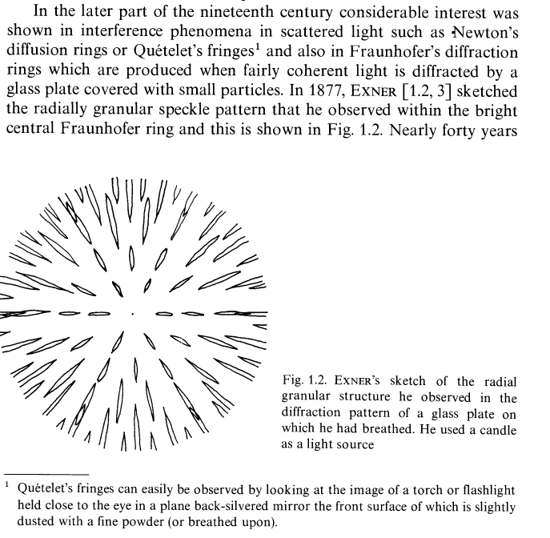
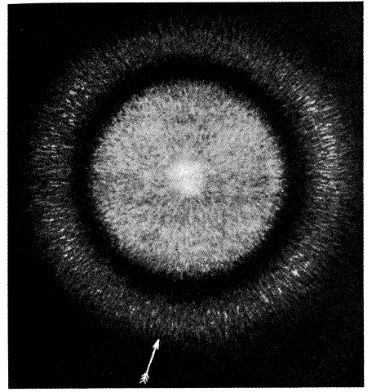
Courtesy Prof. Oleg Shpyrko (UCSD)
First Speckle: Exner, 1877
(using candle light)
First Speckle Photo:
von Laue, 1914
(using arc discharge lamp)
K. Exner: Sitzungsber. Kaiserl.
Akad. Wiss. (Wien) 76, 522 (1877)
M. von Laue: Sitzungsber. Akad. Wiss. (Berlin) 44, 1144 (1914)

Slide 14
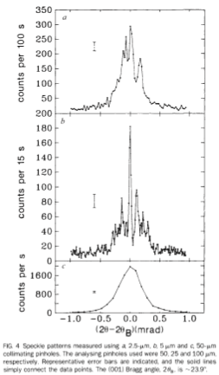
Courtesy Prof. Oleg Shpyrko (UCSD)
First X-ray Speckle:
M. Sutton et al., Nature 352, 608-610 (1991)

Slide 15
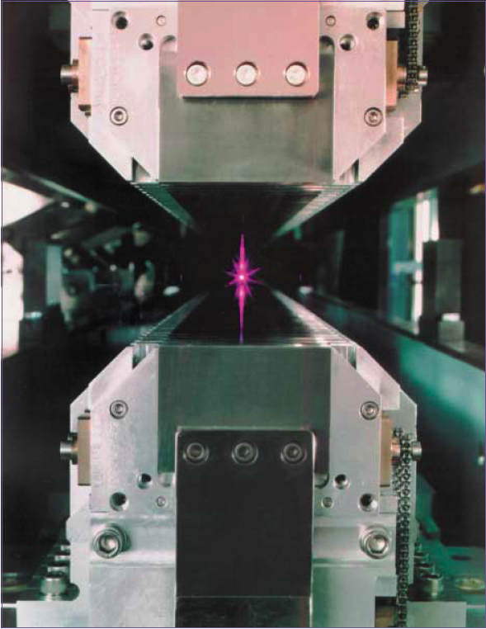
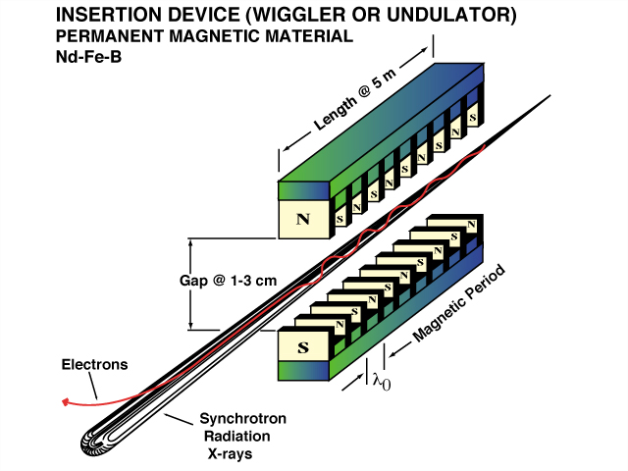
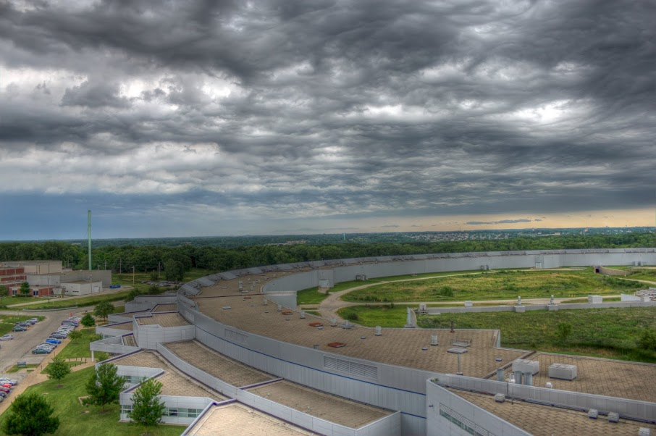
Why use synchrotron radiation?
Courtesy Prof. Oleg Shpyrko (UCSD)
Synchrotron sources offer:
Brightnesss (small source, collimated)
Tunability (IR to hard x-rays)
Polarization (linear, circular)
Time structure (short pulses)
Source brightness is the key figure of merit for coherent imaging
B = photons/source area, divergence, bandwidth
F_{c} ~ λ² B

Slide 16
Coherent X-ray References
Vartanyants, I A, and A Singer. 2010 “Coherence Properties of Hard X-Ray Synchrotron Sources and X-Ray Free-Electron Lasers.” New Journal of Physics 12 (3): 035004.
Singer, Andrej, and Ivan A Vartanyants. 2014. “Coherence Properties of Focused X-Ray Beams at High-Brilliance Synchrotron Sources.” Journal of Synchrotron Radiation 21 (1). International Union of Crystallography: 5–15. doi:10.1038/nnano.2008.246.
Nugent, Keith. 2009. “Coherent Methods in the X-Ray Sciences.” Advances in Physics 59 (1): 1–99. doi:doi: 10.1080/00018730903270926.

Slide 17
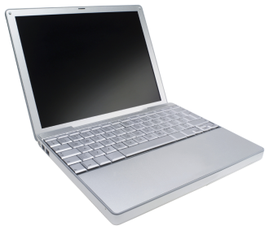
Traditional Microscopy:
Courtesy Prof. Oleg Shpyrko (UCSD)
Object Plane
Detector Plane
Lens-less Imaging:

Slide 18
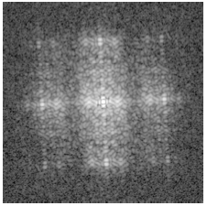
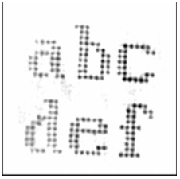
First demonstration of CDI with x-rays
Courtesy Prof. Oleg Shpyrko (UCSD)
diffraction pattern
reconstruction
J. Miao, Nature 400, 342 (1999)

Slide 19
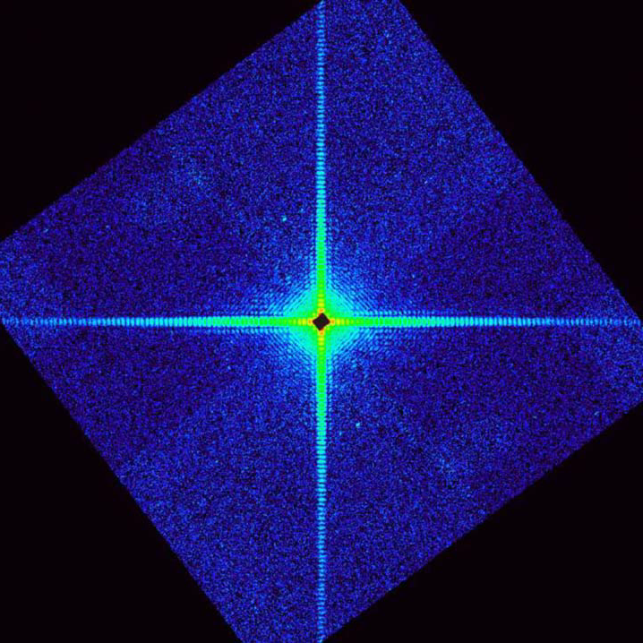
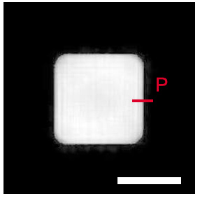
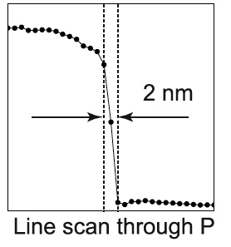
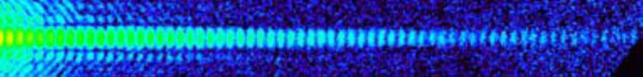
Coherent Diffractive Imaging:
Y. Takahashi et al.,
Phys. Rev. B 82, 214102 (2010)

Slide 20
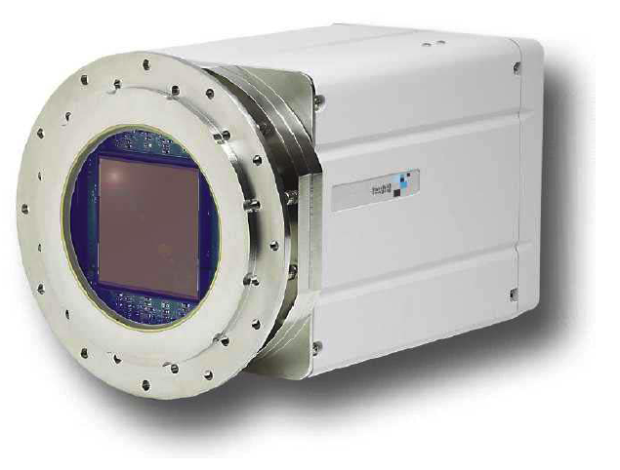
Large-format, single-photon sensitive x-ray CCD cameras opened the door to coherent x-ray imaging
Fairchild Peregrine 486 CCD Camera
• 4K x 4K pixel array (61.4 mm square area)
• 15 μm pixels, 100% fill factor
• Back-illuminated for up to 80% QE
• Readout noise < 5 e- at 50 Kpixels/s
• Dynamic range > 86 dB in MPP
• 6 s readout with four on-chip amplifiers
• Pixel binning for more rapid readout
• Peltier-cooled to -50 C for low dark current
Notes:
20

Slide 21
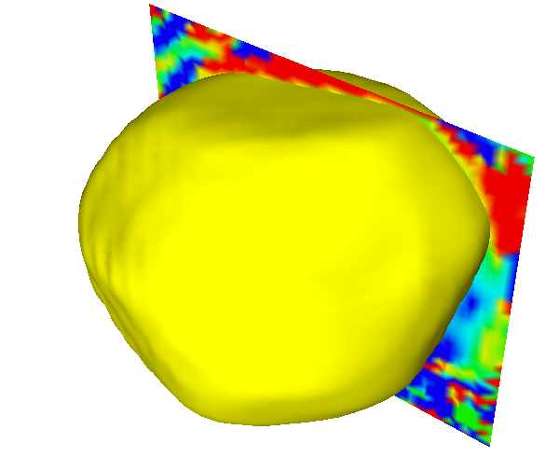
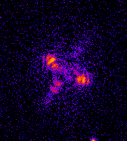
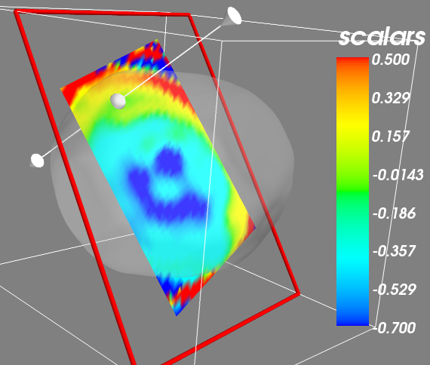
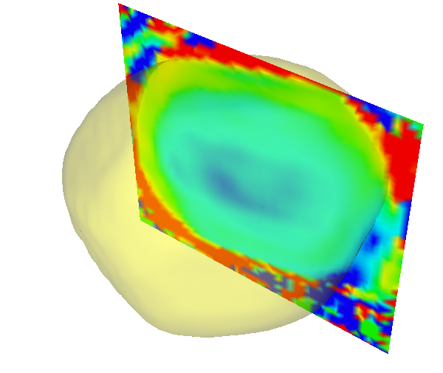
Hi Resolution Imaging (CCD)?
210nm
At APS 34-ID-C:
9.25 hours of scanning
38 minutes of x-ray exposure
~7nm data
Rainbow color map (still) considered harmful
http://ieeexplore.ieee.org/document/4118486/

Slide 22
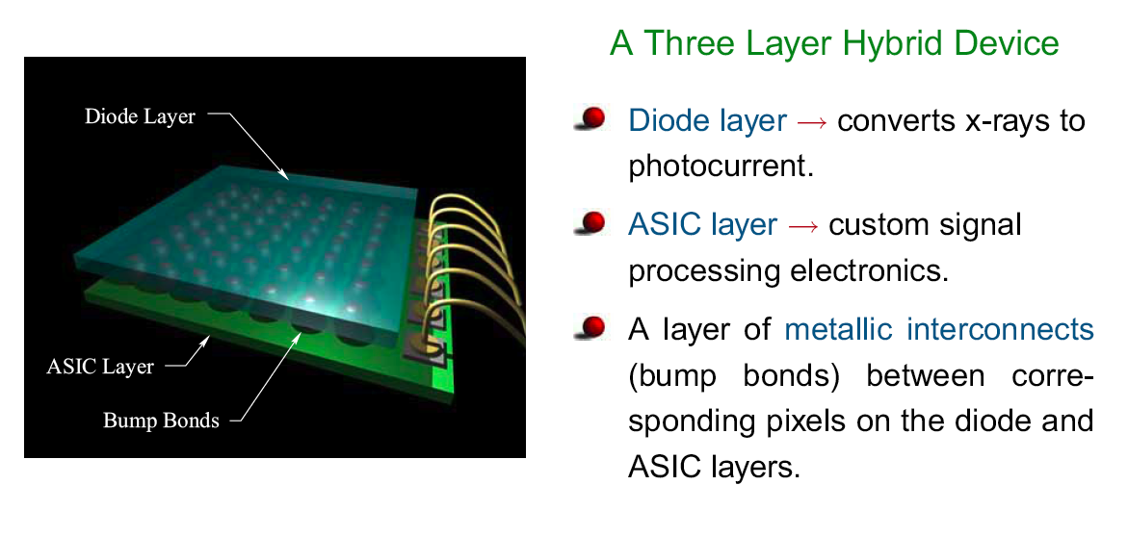
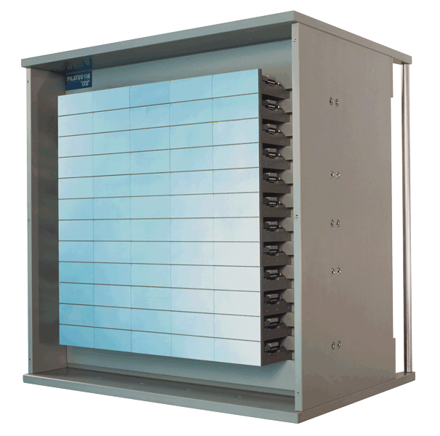
Pixel array detectors: revolutionizing coherent imaging
D. Schuette, S. Gruner (Cornell)
PADs can be read out in ~1 ms
(CCDs take seconds!)
PAD pixels are 55-150 µm.
(CCDs are 12-24 µm)
Pilatus 6M detector
(PSI/Dectris)
Notes:
22

Slide 23
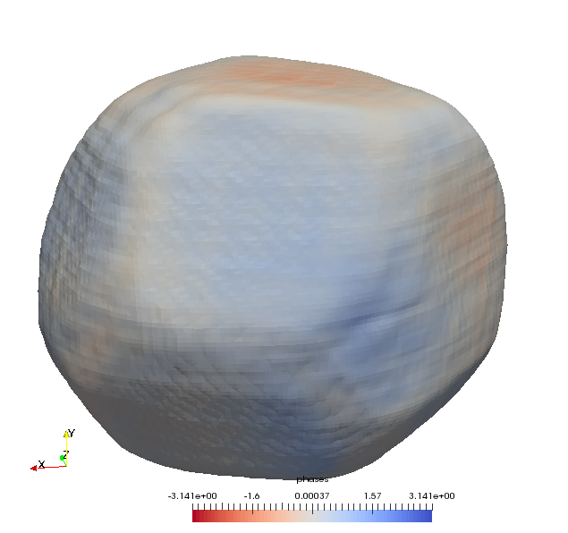
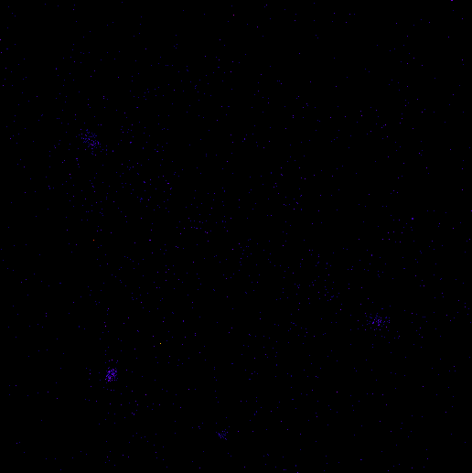
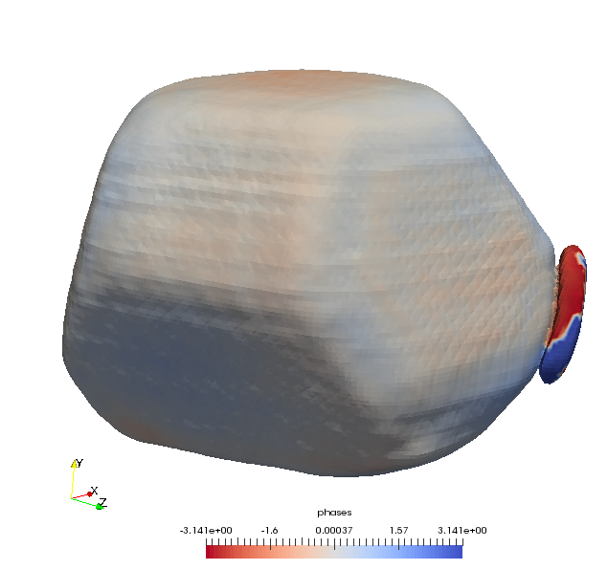
Hi Resolution Imaging (PAD)?
Quad Timepix GaAs sensor
700nm gold crystal
3 degree rocking curve
25 minute measurement
45 sec movie (3X APS-U measurement)

Slide 24
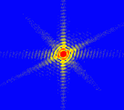
Coherent Diffraction from Crystals
|Fourier Transform|²

Slide 25
Coherent Diffraction from Crystals
K
|Fourier Transform|²
H

Slide 26
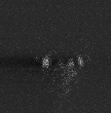
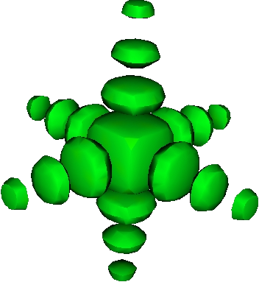
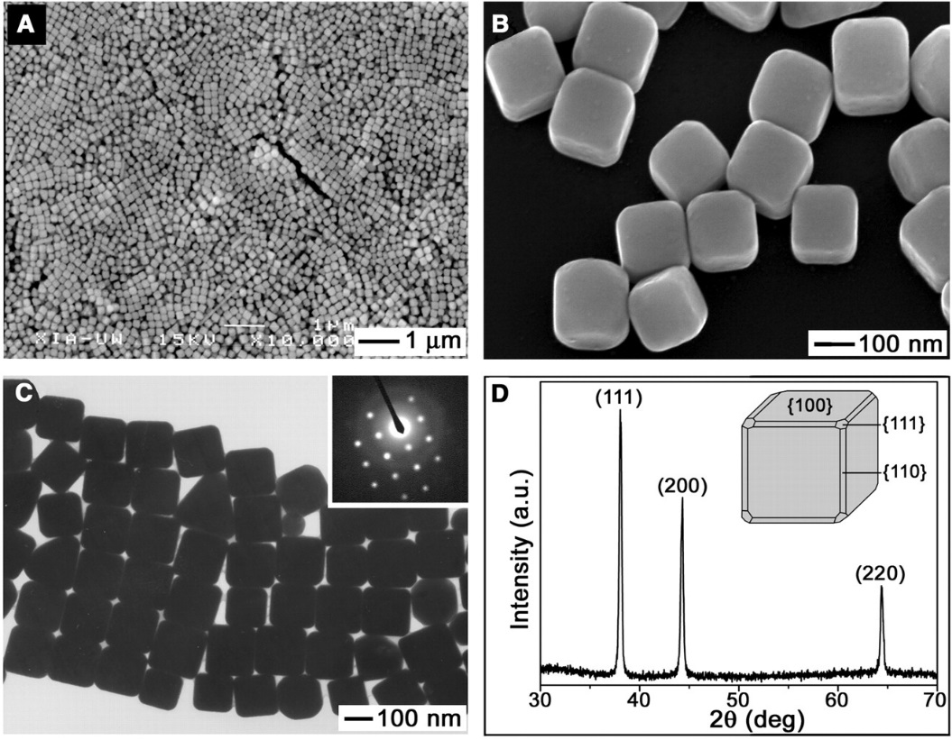


Measuring 3D CXD
Silver Nano Cube (111)
CCD
k_{f}
k_{i}
Q=k_{f}-k_{i}
Yugang Sun and Younan Xia, Science 298 2177 (2003)

Slide 27




3D Ag Nano Cube
Yugang Sun and Younan Xia, Science 298 2177 (2003)
Q
200nm

Slide 28



APS 34-ID-C
Precision scanning stage

Slide 29

Original Phase Retrieval Paper (by D. Sayre):
NOT ρ=ρ² Acta Cryst. (1952). 5, 60

Slide 30

Critical sampling
N unknown densities
N/2 equations
$$\left|A_{q}\right|={\left|\sum_{0}^{N}{ρ_{n}e^{−iqr_{n}}}\right|}^{}$$
Nyquist Freq = 1/(2*bandwidth)
Intensity is under sampled

Slide 31

Oversampling 2x
N/2 equations
N/2 Unknown densities
N/2 Known Densities(zero)
$$\left|A_{q}\right|={\left|\sum_{0}^{N}{ρ_{n}e^{−iqr_{n}}}\right|}^{}$$

Slide 32
Input Output Algorithms
FFT
Reciprocal Space Constraints
Experimental Amplitudes
Oversampled
Thresholded
&
ZeroPadded
Direct Space Constraints
Support
Total Energy
Mixing previous iterates.
Positivity
FFT ⁻¹
J. R. Fienup Appl. Opt. 21 2758 (1982)
Collins Nature 298, 49 (1982)
R. W. Gerchberg and W. O. Saxton Optik 35 237 (1972)
Fienup, James R. 2013. “Phase Retrieval Algorithms: a Personal Tour.” Applied Optics 52 (1): 45–56.

Slide 33
Input Output Algorithms
τ^{(n)}
Reciprocal Space Constraints
Experimental Amplitudes
Oversampled
Thresholded
&
ZeroPadded
Direct Space Constraints
Support
Total Energy
Mixing old and new iterates.
Positivity
u^{(n)}
J. R. Fienup Appl. Opt. 21 2758 (1982)
Collins Nature 298, 49 (1982)
R. W. Gerchberg and W. O. Saxton Optik 35 237 (1972)
Fienup, James R. 2013. “Phase Retrieval Algorithms: a Personal Tour.” Applied Optics 52 (1): 45–56.

Slide 34
Input Output Algorithms
τ^{(n)}
Reciprocal Space Constraints
Experimental Amplitudes
Oversampled
Thresholded
&
ZeroPadded
Direct Space Constraints
Support
Total Energy
Mixing old and new iterates.
Positivity
Error Reduction
Hybrid Input-Output
u^{(n)}
J. R. Fienup Appl. Opt. 21 2758 (1982)
Collins Nature 298, 49 (1982)
R. W. Gerchberg and W. O. Saxton Optik 35 237 (1972)
Fienup, James R. 2013. “Phase Retrieval Algorithms: a Personal Tour.” Applied Optics 52 (1): 45–56.

Slide 35
Input Output Algorithms
τ^{(n)}
Reciprocal Space Constraints
Experimental Amplitudes
Oversampled
Thresholded
&
ZeroPadded
Direct Space Constraints
Support
Total Energy
Mixing old and new iterates.
Positivity
Hybrid Input-Output
u^{(n)}
Harder, R., Liang, M., Sun, Y., Xia, Y., & Robinson, I. K. (2010). Imaging of complex density in silver nanocubes by coherent x-ray diffraction. New Journal of Physics, 12(3), 035019.
Huang, X., Harder, R., Xiong, G., Shi, X., & Robinson, I. (2011). Propagation uniqueness in three-dimensional coherent diffractive imaging. Physical Review B, 83(22), 224109.

Slide 36


Input Output Algorithms
τ^{(n)}
Reciprocal Space Constraints
Experimental Amplitudes
Oversampled
Thresholded
&
Zero Padded
Direct Space Constraints
Support
Total Energy
Mixing previous iterates.
Positivity
u^{(n)}
Harder, R., Liang, M., Sun, Y., Xia, Y., & Robinson, I. K. (2010). Imaging of complex density in silver nanocubes by coherent x-ray diffraction. New Journal of Physics, 12(3), 035019.
Huang, X., Harder, R., Xiong, G., Shi, X., & Robinson, I. (2011). Propagation uniqueness in three-dimensional coherent diffractive imaging. Physical Review B, 83(22), 224109.

Slide 37
3D Ag Nano Cube
Yugang Sun and Younan Xia, Science 298 2177 (2003)
Q
200nm

Slide 38

3D Strain Map in ZnO
2μm
Nature Materials 9, 120 - 124 (2010)

Slide 39





3D Strain Map in ZnO
Nature Materials 9, 120 - 124 (2010)

Slide 40


3D Strain Map in ZnO
Nature Materials 9, 120 - 124 (2010)

Slide 41





Patterned Gold Nanocystal Samples

Slide 42


Multiple reflection reconstructions
(11-1)
1-11
-111
11-1
Notes:
-*here is a movie of a 3D diffraction pattern along with a Scanning electron micrograph of the 200nm crystal being measured*
-this is the 11-1 Bragg peak from this crystal
-*you can see a defect of some kind which visible in this SEM image*
-possibly as a result of a slip band which has produced a ridge on the surface
-*Again you can see the characteristic fringes corresponding the facets of the crystal

Slide 43



Multiple reflection reconstructions
(11-1)
-π/2 π/2
1-11
11-1
-111
11-1
Notes:
-*here I’ve replaced the movie with a cut through the centre of the diffraction pattern with a logarithmic scale to allow for the high dynamic range of the image*
-*this image shows the reconstructed complex amplitude from this Bragg reflection.*
-twinning in reconstructions in an inherent problem – 50% of the time the complex conjugate of the solution will be found, but in this case easy to determine which orientation is up due to very obvious top and bottom facet
-The agreement with the SEM is uncanny, except interestingly there is no evidence of the defect in the reconstruction. This will be explained on the next slide
-*the next image shows the inverse Fourier transform of recovered phase information from this reflection with the arrows pointing in direction of q vector*
-this image reveals any displacement from the equilibrium lattice
-method is mostly sensitive to displacements in the direction of the Q vector
-as we can see there some displacement at the left corner of the crystal likely due to interactions between it and the substrate

Slide 44

Multiple reflection reconstructions
(11-1)
(-111)
1-11
-111
11-1
Notes:
-*here is another diffraction pattern of different reflection from the same crystal this time from -111*
-you can see that this diffraction pattern is not as perfect in its appearance – there are twin fringes which correspond to a defected region of crystal or a twin
-when we take a look at the reconstructed complex amplitude and recovered phase information the result of these twin fringes on reconstruction can be seen

Slide 45


Multiple reflection reconstructions
(-111)
-π/2 π/2
-111
1-11
-111
11-1
Notes:
-the defected region visible in the SEM image is clearly apparent in the reconstructed amplitude and phase
-there is a displacement either side of the defect which is likely associated with the crystal being stretched as a result of the different thermal expansion rates between Au and silicon substrate
-we now believe the defect is as a result of a section of reverse stacking with a slip line on either side of it. It is likely that there are also edge dislocations within the missing piece
-the reason that the first reflection does not show any evidence of the defect is that the Q vector of the 11-1 is perpendicular to direction of slip

Slide 46


Multiple reflection reconstructions
(1/3 1/3 5/3)
(1/3 1/3 5/3)
1-11
-111
11-1
Notes:
-it is possible to measure reflection from missing chunk and these are reconstructed amplitudes from the 1/3 1/3 5/3 reflection which corresponds to the missing section of crystal

Slide 47
Multiple reflection reconstructions
(1/3 1/3 5/3)
(1/3 1/3 5/3)
(-111)
1-11
-111
11-1
Notes:
-it is possible to measure reflection from missing chunk and these are reconstructed amplitudes from the 1/3 1/3 5/3 reflection which corresponds to the missing section of crystal

Slide 48


Multiple reflection reconstructions
(020) (-111) (11-1)
Notes:
-here are three images of the recovered phase which show distortion given by phi=q.u(r)
-Ions displaced from the ideal lattice result in a phase shift of phi in reflected wave from distorted region
-when phase is reconstructed a component of the phase is obtained in the direction of the q vector
-multiple Bragg reflections therefore give multiple components of the displacement vector from which we can construct a displacement field
-Three non-coplanar reflections are required to do this

Slide 49






Vector Displacement Field of Gold lattice
Produced by combining reconstructions from (11-1) (020) (-111)

Slide 50




BCDI Today
Liquid Catalysis
Operando Nanoscale Imaging
Dislocation dynamics in Li-Ion battery
Ulvestad, A., et al. (2015).
Science, 348(6241), 1344–1347
A. Ulvestad, et al.
J. Phys. Chem. Lett., vol. 7, no. 15, pp. 3008, Aug. 2016.
Strain Tensor Imaging
Dislocation dynamics in the hydriding phase transformations of Pd
F. Hofmann, et al.
Sci Rep, vol. 7, p. 45993, Apr. 2017.
Ulvestad, et al.
Nature Materials, vol. 16, no. 5, pp. 565–571, Jan. 2017.

Slide 51




Imaging Lattice Dynamics
Laser Pump – CXD Probe
Diffraction pattern
as a function of laser
delay.
fast period = 400ps
slow period = 5.56ns
ZnO CXD
(002) peak
Dufresne, E. M., Chollet, M., Harder, R., Leake, S., et al.
(2011). Nucl Instrum Meth A, 649(1), 191–193.

Slide 52


Imaging Lattice Dynamics
Laser Pump – CXD Probe@LCLS
600 pm “breathing modes”
Crystal A
101 ps and 241 ps
Crystal B
90 ps and 256 ps
Ultrafast three dimensional imaging of lattice dynamics in individual gold nanocrystals
J. N. Clark, L. Beitra, G. Xiong, A. Higginbotham, D. M. Fritz, H. T. Lemke, D. Zhu,
M. Chollet, G. J. Williams, M. Messerschmidt, B. Abbey, R. J. Harder,
A. M. Korsunsky, J. S. Wark & I. K. Robinson. (2013). Science, 341(6141), 56–59

Slide 53


Imaging Lattice Dynamics
Laser Pump – CXD Probe@LCLS
Ultrafast three dimensional imaging of lattice dynamics in individual gold nanocrystals
J. N. Clark, L. Beitra, G. Xiong, A. Higginbotham, D. M. Fritz, H. T. Lemke, D. Zhu,
M. Chollet, G. J. Williams, M. Messerschmidt, B. Abbey, R. J. Harder,
A. M. Korsunsky, J. S. Wark & I. K. Robinson. (2013). Science, 341(6141), 56–59

Slide 54

Imaging Lattice Dynamics
Laser Pump – CXD Probe@LCLS
Orthogonal slices
Through crystal density
MD simulation
at +110ps
Ultrafast three dimensional imaging of lattice dynamics in individual gold nanocrystals
J. N. Clark, L. Beitra, G. Xiong, A. Higginbotham, D. M. Fritz, H. T. Lemke, D. Zhu,
M. Chollet, G. J. Williams, M. Messerschmidt, B. Abbey, R. J. Harder,
A. M. Korsunsky, J. S. Wark & I. K. Robinson. (2013). Science, 341(6141), 56–59

Slide 55



Coherent Imaging of Extended Samples
29nm pixels
Ptychography
“Arbitrary” field of view
Quantitative phase information
Simultaneous image of sample illumination
Rodenburg, J., et al. (2007). Physical review letters, 98(3), 034801.
Thibault, et al. (2008). Science, 321(5887), 379–382.

Slide 56
Ptychography
Microprobes -> Coherent Imaging Instrument
Vine, et al. (2012). Opt. Express, 20(16), 18287–18296.

Slide 57


GdFe layered magnetic films
Ta (20 Å)
↓ Gd (4.5 Å)
↑ Fe (4.1 Å)
↓ Gd (4.5 Å)
↑ Fe (4.1 Å)
↓ Gd (4.5 Å)
↑ Fe (4.1 Å)
× 101
Ta (20 Å)
Si₃N₄
A. Tripathi, O.S. et al., Proc Natl Acad Sci USA 108, 13393 (2011)

Slide 58


Magnetic Contrast Mechanism
Gd M₅ edge
On-resonance:
Off-resonance:
10⁻² nm⁻¹
A. Tripathi, O.S. et al., Proc Natl Acad Sci USA 108, 13393 (2011)
Notes:
Fig. 2

Slide 59




Real Space Reconstruction
Magnetic structure
(exit wave)
Illumination Function
A. Tripathi, O.S. et al., Proc Natl Acad Sci USA 108, 13393 (2011)

Slide 60

Real Space Reconstruction
Magnetic structure
(exit wave)
Illumination Function
A. Tripathi, O.S. et al., Proc Natl Acad Sci USA 108, 13393 (2011)

Slide 61


A. Tripathi, O.S. et al., Proc Natl Acad Sci USA 108, 13393 (2011)

Slide 62






Increasing Field
7.5 mT
42.5 mT
M_{s}
a
c
d
c
b
-M_{s}
c
d
e
a
58.5 mT
76.5 mT
96.5 mT
A. Tripathi, O.S. et al., Proc Natl Acad Sci USA 108, 13393 (2011)

Slide 63



Nanoscale Strain in SiGe
film devices
Hruszkewycz, S. O., Holt, M. V., et al. (2012). Nano Letters, 12(10), 5148–5154.

Slide 64


Surface diffraction Coherent Imaging
Image local surface structure
Steps and step dynamics during film growth or interfacial reactivity
Nanoparticle nucleation
Defect distributions, particularly at interfaces
Combined with x-ray micro fluorescence…..
C. Zhu, et al. Applied Physics Letters, vol. 106, no. 10, p. 101604, Mar. 2015.

Slide 65





Thank You
Calcium Oxalate in
maize stover
Scientific reports, 3, 2843. (2013)
Strain in ZSM-5 Zeolite
Use of the Advanced Photon Source was supported by the U. S. Department of Energy, Office of Science, Office of Basic Energy Sciences, under Contract No. DE-AC02-06CH11357.

