Slide 1
Setting up measurements at the HB2a high resolution powder diffractometer using
HB2a Instrument Team
High Flux Isotope Reactor
October 2015

Slide 2
OUTLINE
Introduction to data acquisition system SPICE with links to live view of instrument status and remote access to HB2a data
Aligning the sample with remote neutron camera
Running test scans
Common scan commands for various sample environment set-ups available for HB2a
Order parameter scan or “sit-on-a-peak” scan

Slide 3
DATA ACQUISITION SYSTEM :
The Spectrometer Instrument Control Environment (SPICE) is a LabVIEW based program written at ORNL for control of neutron scattering instruments at the HFIR. The core components of the program are written to be independent of the type of instrument allowing the software to be expanded to different instrument types. More information about the programming details may be found at http://neutron.ornl.gov/spice/
The Local Contact/Scientific Associate will set up the SPICE on the instrument HB2a USER computer to communicate with the designated sample environment for your experiment.

Slide 4
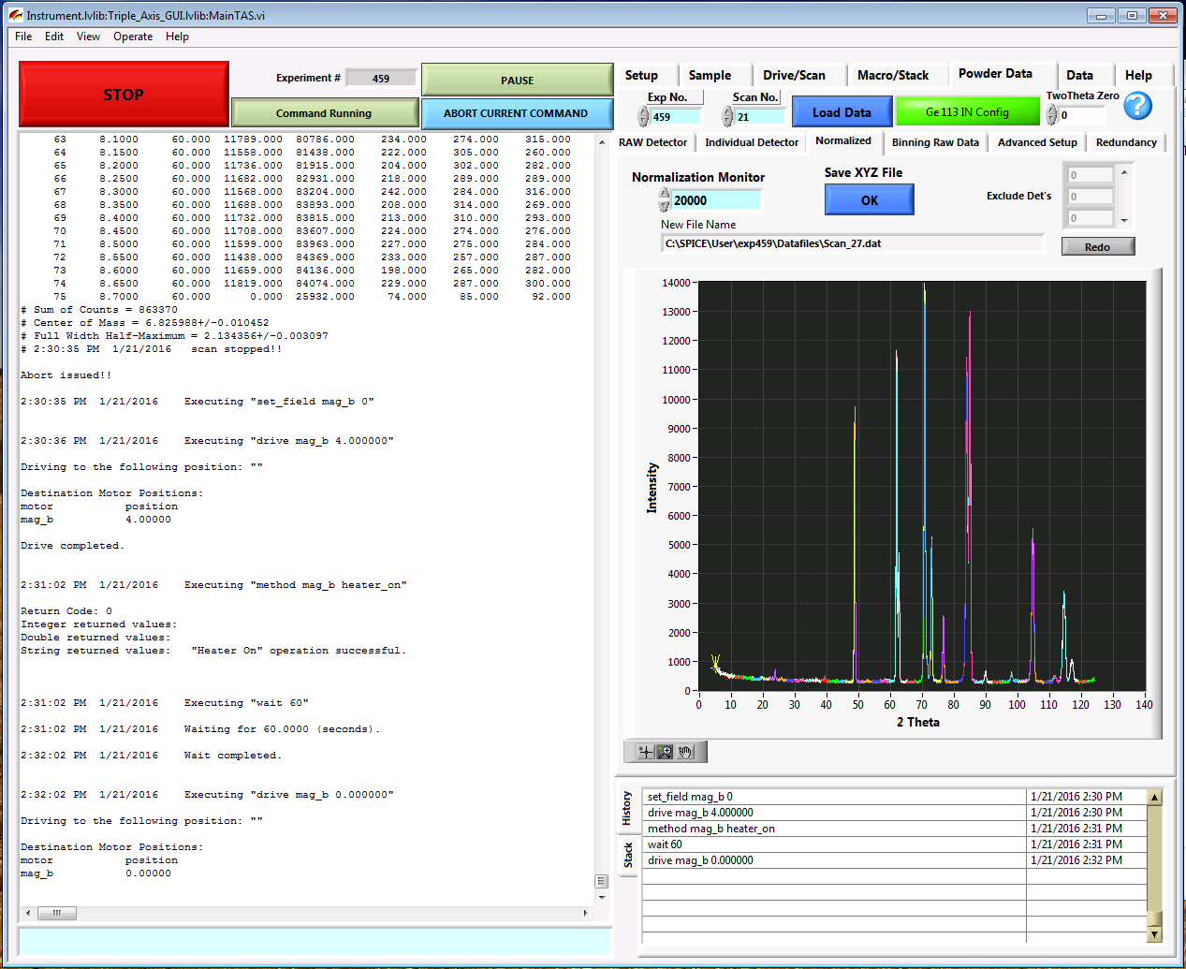
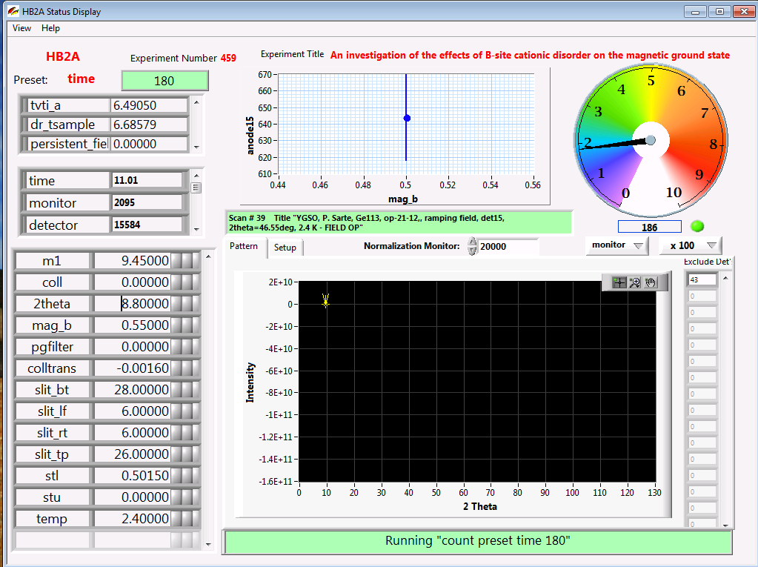
There will be two windows: a command console to enter the commands and a status monitor window that displays the status which includes motor and variable values and ongoing scan
Command console window
Status monitor window

Slide 5
The Status monitor window
Independent Variables
Experiment Number
This is an example for an experiment with the sample in a dilution refrigerator to be measured in the magnet (Mag_B)
VTI temperature (K)
This window will be the same that you will see in the live status monitor accessible online:
http://neutron.ornl.gov/hb2a/Statusmonitor20.html
Experiment Title
Sample temperature in Dilution refrigerator(K)
Persistent vertical field (Tesla)
Measurement information
Monitor neutron counts
Time to measure each point (secs)
Beam Monitor neutron counts
Total neutron counts on 44 detectors
[Individual detector counts (anode#) can be found as you scroll down]
Instrument Configuration
Monochromator position
m1=0, Ge115, λ=1.54Å
m1=9.45, Ge113, λ=2.41Å
Pre-sample collimator (α2) alignment
2theta position of detector 1
Magnetic field value while driving to target field. The value is zero when the magnet is in persistent mode
PG filter position: if m1=0, pgfilter=80 (OUT)
if m=9.45, pgfilter=0 (IN)
Collimator(α2) position: colltrans=0, collimator IN
colltrans=80, collimator OUT
(temp) Target temperature
Current command/scan running
(stl)Sample alignment position perpendicular to the beam
Motorized slits: bottom(slit_bt), top (slit_tp), right(slit_rt), left(slit_lf), adjustable from 0(CLOSED)-31(WIDE OPEN)
(stu)Sample alignment position parallel to the beam
Notes:
Perhaps there is too much information on this page?
Fixed typos

Slide 6
The Command Console window
SEQUENCE CONTROL
POWDER DATA
DATA REDUCTION TAB
STOP current scan and abort sequence, empties macro stack
PAUSE
current scan
Please follow the HB2a data access and reduction quick guide at:
http://neutrons.ornl.gov/sites/default/files/data-reduction-guide.pdf
ABORT CURRENT COMMAND,stop current scan/command and proceeds to next scan/command in sequence (stack)
Read-only
LOG FILE
COMMAND LINE
Enter commands manually HERE
Chronological list of commands entered with time stamp
Notes:
Fixed typo

Slide 7
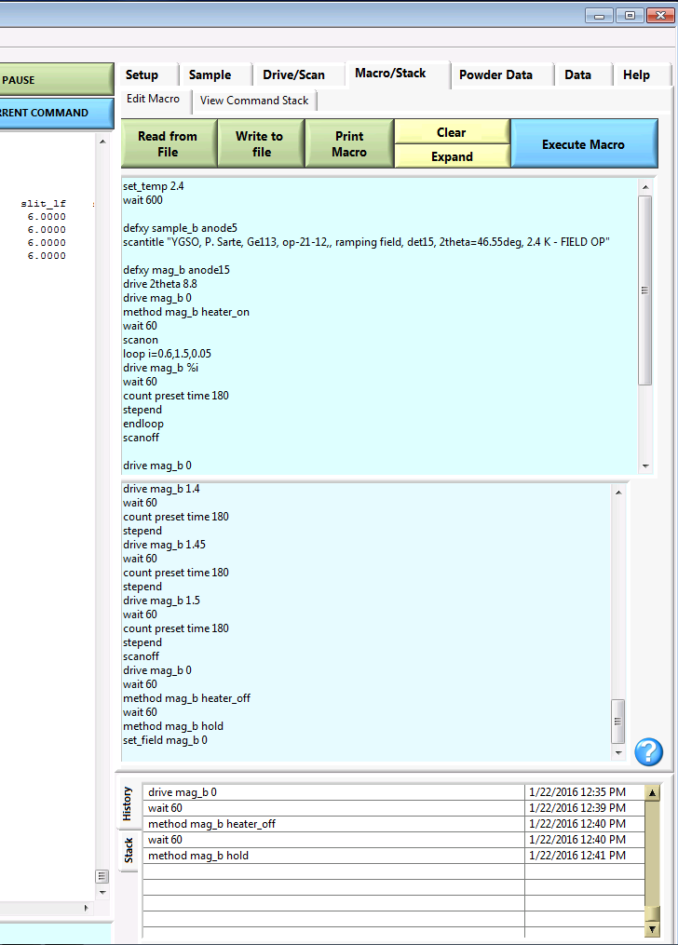
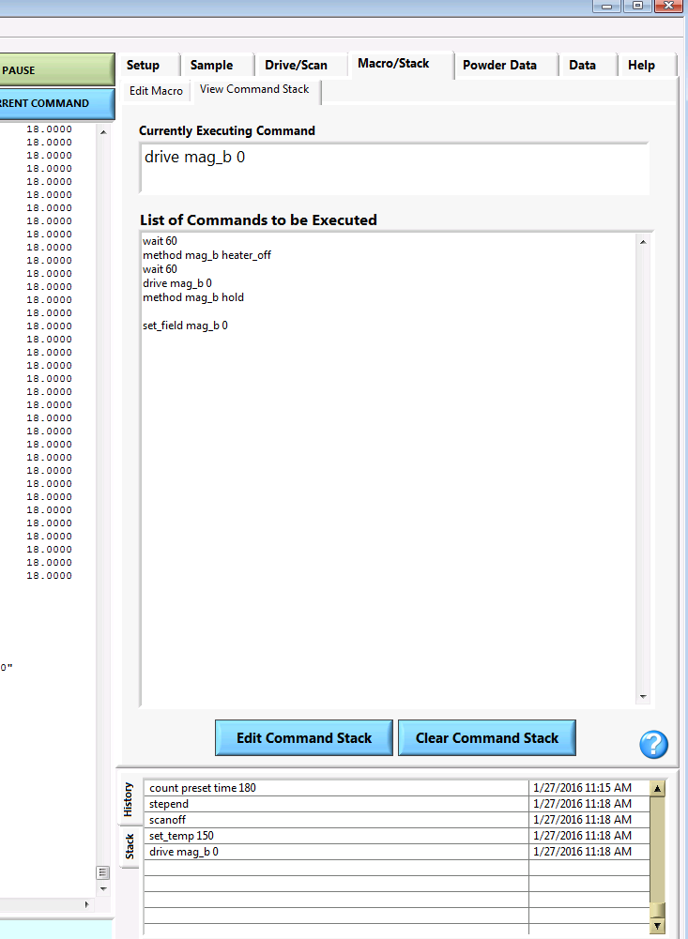
The Command Console window
MACRO/STACK TAB
EDIT MACRO SUB-TAB
Write/read/print/execute SEQUENCE
MACRO/STACK TAB
VIEW COMMAND STACK SUB-TAB
Shows the list of commands/scans to be executed in order
EXPAND sequence when using “loop” commands
EXECUTE MACRO
Transfers sequence of commands/scans to the
COMMAND STACK to be executed
CLEAR work space to write/edit macro
Write /edit macro (sequence of commands/scans) here
PRINT MACRO on user desktop printer
Displays sequence of commands/scans in order of execution
Save macro as text file in folder:
C:\SPICE\User\exp#\Macros
EXPANDED version of macro
Read saved macro from folder:
C:\SPICE\User\exp#\Macros
Notes:
Red text effect hard to read

Slide 8
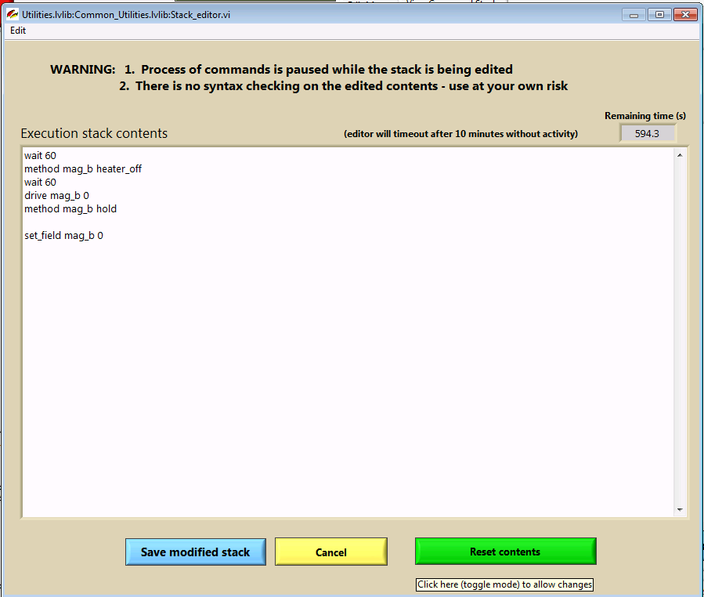
The Command Console window
MACRO/STACK TAB
VIEW COMMAND STACK SUB-TAB
Shows the list of commands/scans to be executed in order
Edit sequence of commands/scans here
NOTE THE WARNING 1 and 2 above.
EDIT COMMAND STACK
Opens a window where you can edit the sequence in the stack of commands/scans to be executed
SAVES the changes made to the command stack, but NOT saved on MACRO on file
CLEARS the entire command stack. A window will pop asking if you want to clear the contents of the command stack. You have to confirm your decision by pressing YES or NO.
CANCELS changes made and reverts to the original stack
Notes:
Red text effect in window is hard to read.

Slide 9
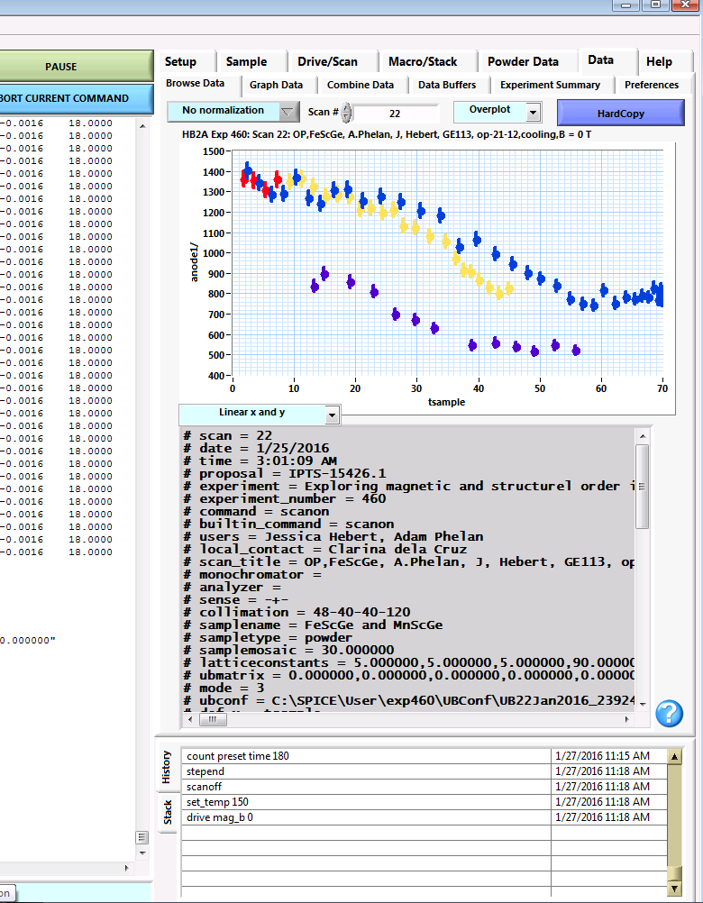
The Command Console window
DATA TAB
BROWSE DATA SUB-TAB
Allows one to take a look at the raw data
Allows overplotting of scans entered
Enter SCAN number here
Plots the data for the scan entered. These are helpful for order parameter scans, not for looking at diffraction pattern scans
PRINTS a copy of the graph on the user desktop printer
Displays the raw data for the scan entered

Slide 10
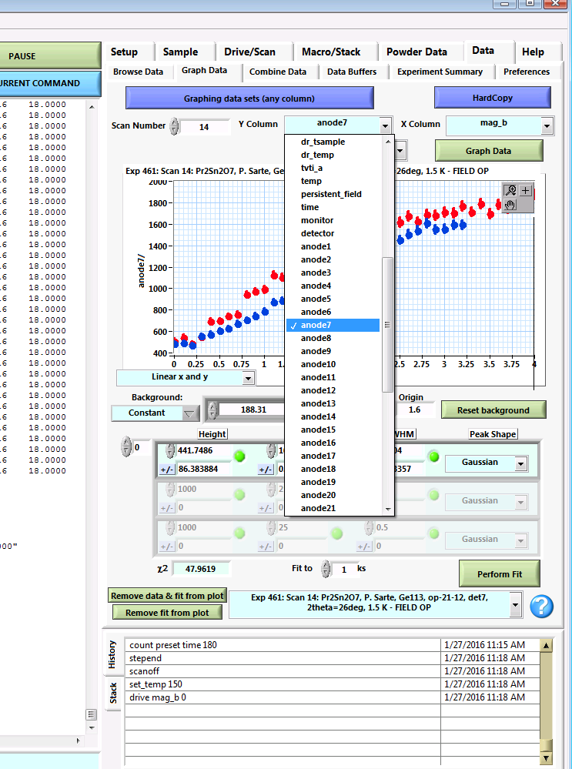
The Command Console window
Enter SCAN number here
DATA TAB
GRAPH DATA SUB-TAB
Allows one to take a look at the raw data, plotting any parameter vs other parameters in the data set and make simple single or multi-peak fits
This mode allows plotting of raw data set parameters
Select the parameter to be plotted on the Y-axis
PRINTS a copy of the graph on the user desktop printer
Plots the data for the scan entered.
Displays Experiment #, Scan # and scan title
Select the parameter to be plotted on the X-axis
Display plot as:
Linear x and y (default)
Log y; linear x
Log x – Log y
Notes:
Fixed typo

Slide 11
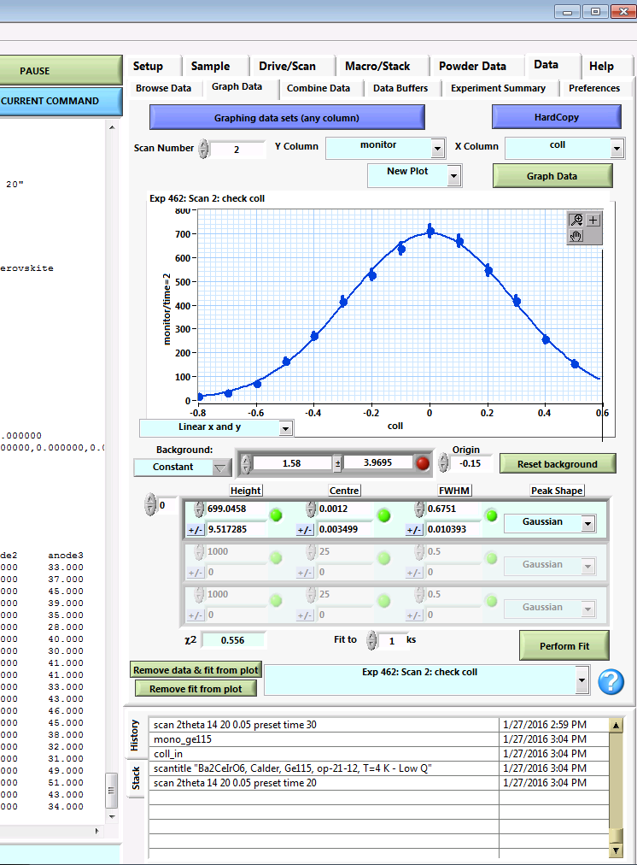
The Command Console window
DATA TAB
GRAPH DATA SUB-TAB
Allows one to take a look at the raw data, plotting any parameter vs other parameters in the data set and make simple single or multi-peak fits
DATA TAB
GRAPH DATA SUB-TAB
single or multi-peak fitting capabilities
Peak fitting Parameters
Given as [Value] ± [error bar]
BACKGROUND
Choose from constant, linear, quadratic, 3rd order, 4th order. Reset puts it back to constant. Origin refers to the origin of the polynomial used.
PEAK SHAPE
Choose from Gaussian, Lorentzian and Lorentzian^2
PEAK CENTER
FWHM (Full Width Half Max)
PEAK HEIGHT
NUMBER OF PEAKS TO FIT
0 ➔ 1 peak, 1 ➔ 2 peaks ..etc
DISPLAY CONTROL
Allows removal of selected plots and fit to plots from the graph on display
NEW PLOT
Shows each scan entered as a new plot
OVERPLOT
Overplots selected scans on top of each other
Plots the data and fit to data for the scan entered.
Press the parameter fitting button:
fixes the parameter to a constant
changes the parameter for fitting
Press to calculate the fit

Slide 12
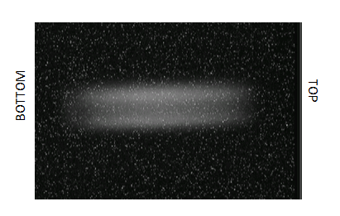
ALIGNING the SAMPLE in the BEAM
The sample must be aligned parallel and perpendicular to the beam. This is done by visualizing the sample with respect to the beam using a neutron camera that can be remotely controlled from the user desktop computer.

Slide 13
ALIGNING THE SAMPLE
1) start-up visualization software
Enter in command line: slit_h 8
Enter in command line: slit_v 30 ➔ opens the motorized sits to have a large beam size
c. Open Corel Video Studio Pro
➔click 1 Capture
➔click Capture video
2) Move neutron camera into ACTIVE position
Enter in command line: CAMIN CAMIN drives: 2theta=25°,camtrans=0.5, camrot=270°
Enter in command line: drive camtrans [ ] [ ]=45 for JANIS, 25 for Orange
3) Center sample perpendicular to beam
Enter in command line: drive stl [ ] [ ] is typically between -7 to 7 to center
Check Camera Image to visually center the
sample with respect to the beam both
horizontally and vertically. In most cases, if the
sample height is wrong, it can be manually
adjusted on the sample stick.
Bright portion represents the Neutron beam
SAMPLE
The more neutron absorbent the sample, the darker it will appear on the image

Slide 14
ALIGNING THE SAMPLE
4) Center sample parallel to beam
Enter in command line: drive s1 -60
➔ rotating the sample and cryostat by 60 degrees to center close to parallel to the beam
➔ watch the attached hoses to the cryostat, make sure there is no strain on them
b. Enter in command line: drive stu [ ]
➔ [ ] is typically between -7 to 7 to center sample with respect to the beam
c. Adjust motorized slits
Enter in command line: slit_h [ ]
➔ [ ] is typically 5.5 for small cans, 6 for medium cans , 8 for large cans
➔ closes the slits horizontally (left and right)
Enter in command line: drive slit_tp [ ]
Enter in command line: drive slit_bt [ ]
➔ adjust [ ] to close the top and bottom slits, ensure that the slits are not cutting into the sample
Enter in command line: drive s1 0
➔ Rotates sample/cryostat back to original position
5) Move neutron camera into IDLE position
Enter in command line: CAMOUT CAMIN drives: 2theta=25°,camtrans=0.5, camrot=180°
6) close visualization software (Corel Video Studio Pro)

Slide 15
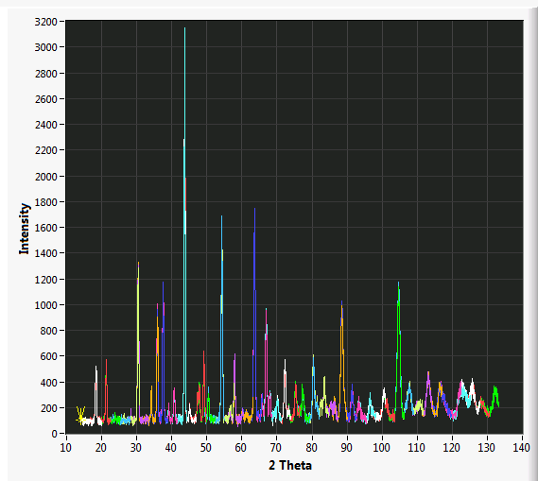
RUNNING QUICK TEST SCANS
A quick test scan is done to ensure that the sample is properly aligned with respect to the beam.

Slide 16
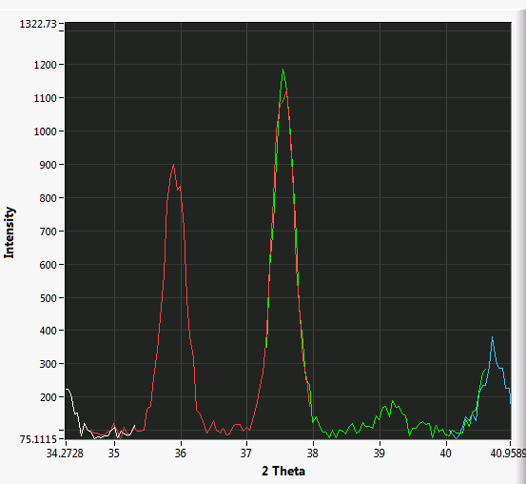
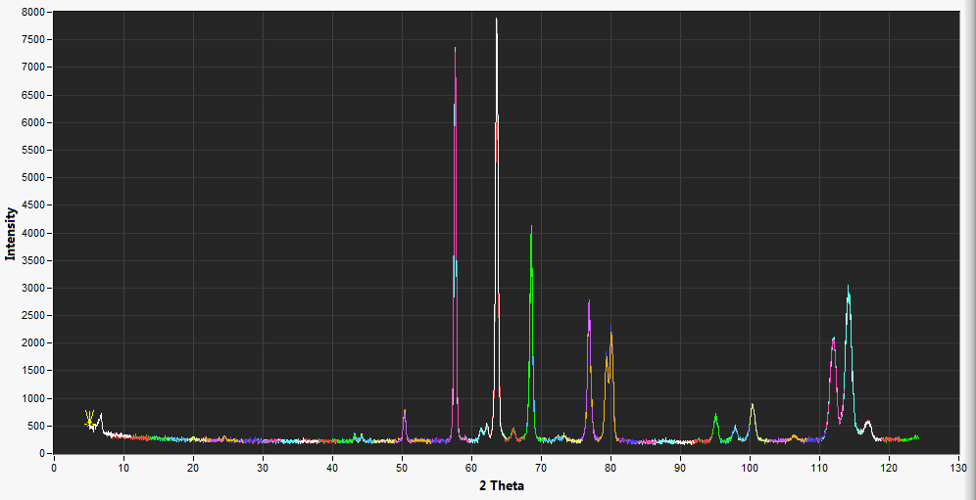
SCAN COMMANDS to get a DIFFRACTION PATTERN
The quick scan command to get a diffraction pattern is:
The above command scans detector 1 from 5° to 11 ° moving with step size of 0.1, counting 20 seconds for each point.
The 6 degree 2theta scan allows neighboring detectors to overlap.
Since the rest of the detectors (2-44) are of known positions with respect to detector 1, you will see the multidetector data shown in different colors where neighboring detectors have substantial overlap
scan 2theta 5 11 0.1 preset time 20
Ensure that neighboring detectors measure similar intensities. Highly disparate counts where there is overlap, suggests misalignment of the sample
A typical scan command to get a diffraction pattern is:
scan 2theta 5 11 0.05 preset time 60
The above command scans detector 1 from 5° to 11 ° moving with the HB2a resolution limited stepsize of 0.05°, counting 60 seconds for each point. This is approximately a 2hr 10 min long scan. The resulting diffraction pattern is from 5° to 127°

Slide 17
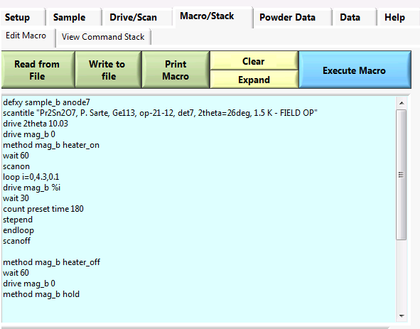
COMMANDS FOR AN HB2a EXPERIMENT
A sequence is best prepared using the “Edit MACRO” sub-tab and using the commands to control parameters in the instrument and sample environment equipment

Slide 18
Instrument Configuration COMMANDS
Moving detector bank
drives the detector bank to put detector one at [ ] degrees
The detector bank may be moved from 1.20° to 38°
drive 2theta [ ]
Changing wavelength
changes wavelength to 1.54Å
changes wavelength to 2.41Å
This moves both the monochromator angle (m1=0 for 1.54 Å, m1=9.45 for 2.41 Å) and PG filter into the beam for 2.41 Å (pgfilter=0) and out of the beam for 1.54 Å (pgfilter=80). The PG filter cleans out λ/2 contamination from the longer wavelength.
Note: the m1 and pgfilter motors can be driven separately if necessary with standard commands.
EX: drive pgfilter 80 ➔ This drives the pgfilter out of the beam
mono_ge115
mono_ge113

Slide 19
Instrument Configuration COMMANDS
Changing collimation for α₂
drives colltrans =0, puts α₂ collimator in beam path
drives colltrans =80,puts α₂ collimator out of beam path
We typically use the 21’ collimator, others available are 6’ and 16’
coll_in
coll_out
Aligning α₂ collimator
assures that no intensity is lost
due to misalignment of
pre-sample collimator
scanrel coll -1 1 0.1

Slide 20
Instrument Configuration COMMANDS
Moving PG filter
puts PG filter in beam path
puts PG filter out of beam path
drive pgfilter 0
drive pgfilter -80
Rotating sample on about the vertical axis
rotates the sample by [ ]°. Sample stage/goniometer may rotate a full 360° but always watch out for the vacuum hoses and electrical cables attached to the sample environment equipment when rotating.
drive s1 [ ]

Slide 21
SAMPLE ENVIRONMENT COMMANDS
JANIS top loader with double-heater stick
sets the VTI temperature to [ ] K
sets the sample temperature to [ ] K
VTI (vti_a) and Sample (sample_b) temperature range is 3.4K to 300K
set_temp_a [ ]
set_temp_b [ ]
JANIS top loader with HOT stick
sets the VTI temperature to [ ] K
sets the stick heater block temperature to [ ] K
VTI (vti_a) temperature range is 3.4K to 300K
Sample (sample_b) temperature range is 30K to 800K
set_temp_a [ ]
set_temp_b [ ]

Slide 22
SAMPLE ENVIRONMENT COMMANDS
ORANGE regular stick with needle valve control
sets the VTI(vti_a) temperature to [ ] K
sets the needle valve flow to [ ] mBar
➔ set to 20 mbar during cooling, 7.5 when at stable temperature
set_temp [ ]
set_press [ ]

Slide 23
SAMPLE ENVIRONMENT COMMANDS
Dilution Refrigerator (DR)
sets the DR temperature to [ ]
Sample temperature range is 30 mK to 300K.
Note: to go above or below ~1.5 K requires support staff and planning.
set_tempdr [ ]
He3 Insert
Temperature range 0.3 K (base) to ~1.5 K
Tsorb Sample Temperature
0 base
5 0.28 K
10 0.34 K
12 0.43 K
15 0.67 K
17 0.88 K
20 1.2 K
25 1.6 K
Temperature range 1.5 K to 300 K. set_sorb to 17
Sets sample temperature to [ ].
set_sorb [ ]
set_ht [ ]
Notes:
Changed text color for “note”

Slide 24
SAMPLE ENVIRONMENT COMMANDS
MAGNET
Several magnets are used on HB-2A. These are labeled mag_a, mag_b, mag_e in commands.
sets the magnetic field for mag_b to [ ] Tesla.
If using mag_a /mag_e change command accordingly.
mag_b can apply a vertical field up to 4.0T
mag_a can apply a vertical field up to 6.0T
set_field mag_b [ ]

Slide 25
SAMPLE ENVIRONMENT COMMANDS
Temperature stabilization commands
Wait until [temperature variable] is within [tolerance] of [target temperature], then stabilize for [stabilization time] seconds. Whether the target is reached or not, the wait ends once the [maximum hold time] is exhausted.
EX.
➔wait for tsample to be between 9K and 11K, then start stabilizing for 10 minutes=600secs. Whatever the value of tsample after 1hr=3600secs, the wait commences.
waitpost [temperature variable] [target] [tolerance] [ stabilization time] [maximum hold time]
waitpost tsample 10 1 600 3600
Notes:
Should waitpost be “waitpos?”
Fixed typo and moved text box that was covering other text.

Slide 26
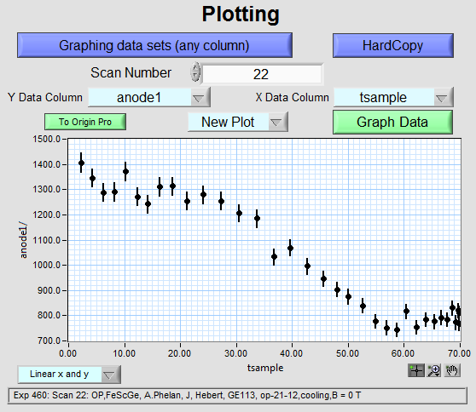
Order parameter (OP) or “sit-on-a-peak” scan
This type of scan is used to measure the temperature or magnetic field dependence of a known signal or peak

Slide 27
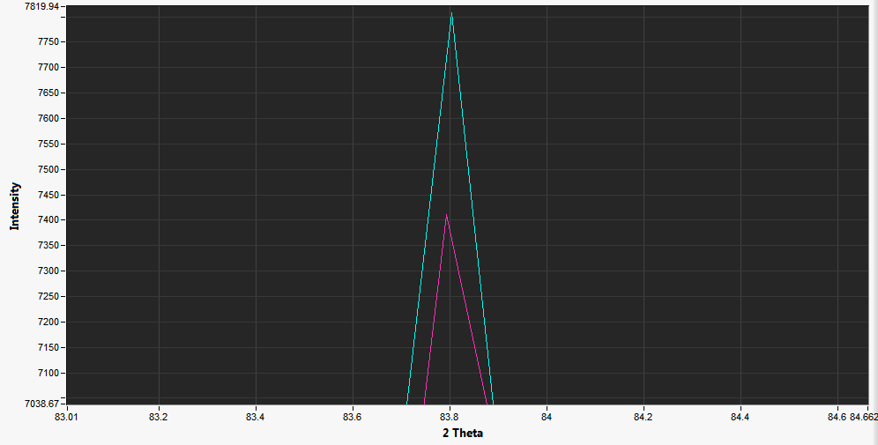
Find the detector to use for the OP scan
Use the Excel spreadsheet called “Detector finder.xlxs” on the user computer desktop
For example, you would like to monitor the peak height of the peak at 83.8° on the zoomed in pattern below
Insert that number of 83.8° into cell G3 of the excel spreadsheet.
In cell B3, insert the value of 2theta which the scan started on. In this example its starts at 4°. In cell F3, insert the degrees that 2theta scanned. In this example 2theta was scanned for 6°.

Slide 28
Find the detector to use for the OP scan
3. The Matching detectors column will put a "YES" in each row that has a detector hitting the angle you are concerned about.
The Drive column tells you what value 2theta (detector 1 position) should have to match the corresponding detector to the position of the peak you are interested in.
In this example we can see that for the peak at 83.8°, 2 detectors, 29 & 30 are being hit. We can either drive 2theta to 10.241° or 7.529 ° to align one of those detectors to the peak that we want to observe.

Slide 29
Temperature Dependent OP
Below is a typical scan sequence to measure the temperature dependence of the order parameter, which is taken to be the peak height.
Given the example, let’s choose to
use detector 29
Assigns the dependent(Y) and independent (X)variables
The “loop” command expands in the command stack as:
scantitle “OP temperature dependence, det29@83.8deg, warming”
defxy tsample anode29
drive 2theta 10.241
scanon
loop i=1,70,5
set_temp %i
wait 120
count preset time 120
stepend
endloop
scanoff
Drives detector 29 to the peak position at 83.8°
scanon
set_temp 1
wait 120
count preset time 120
stepend
set_temp 6
wait 120
count preset time 120
stepend
.
.
.
set_temp 66
wait 120
count preset time 120
Stepend
scanoff
Sets the start temperature, end temperature and step size in Kelvin
Time in seconds to stabilize the sample temperature
Measure the intensity for 120 seconds

Slide 30
Magnetic field Dependent OP
Below is a typical scan sequence to measure the field dependence of the order parameter. In this example, we are using mag_b, measuring during increasing field
To drive the field to zero after the OP scan,execute:
Assigns the dependent(Y) and independent (X)variables
scantitle “OP, field dependence, det29@83.8deg”
defxy mag_b anode29
drive 2theta 10.241
drive mag_b 0
method mag_b heater_on
wait 60
scanon
loop i=0,4.3,0.1
drive mag_b %i
wait 30
count preset time 180
stepend
endloop
scanoff
method mag_b heater_off
wait 60
drive mag_b 0
method mag_b hold
The “loop” command expands in the command stack as:
Drives detector 29 to the peak position at 83.8°
scanon
drive mag_b 0
wait 30
count preset time 180
stepend
drive mag_b 0.1
wait 30
count preset time 180
stepend
.
.
.
drive mag_b 4.3
wait 30
count preset time 180
stepend
scanoff
Engages the superconducting magnet to the power supply
Sets the start field, end field and step size in Tesla
Time in seconds to stabilize the field
Measure the intensity for 180 seconds
Disengages the superconducting magnet to the power supply leaving the magnet in
PERSISTENT MODE AT 4.3T
set_field mag_b 0

