Slide 1
Introduction to Quasi-elastic Neutron Scattering
Ken Herwig
Instrument and Source Division
Neutron Sciences Directorate
Oak Ridge National Laboratory
August 2, 2016

Slide 2
OUTLINE
Background – the incoherent scattering cross section of H
Neutrons and QENS
Experiment Design
Connection to Molecular Dynamics Simulations
The Elastic Incoherent Structure Factor (EISF)
The Role of Instrumentation
Restricted Diffusion Example – Tethered Molecules
References and Summary

Slide 3
Incoherent and Coherent Scattering
Origin – incoherent scattering arises when there is a random variability in the scattering lengths of atoms in your sample – can arise from the presence of different isotopes or from isotopes with non-zero nuclear spin combined with variation in the relative orientation of the neutron spin with the nuclear spin of the scattering center
Coherent scattering – gives information on spatial correlations and collective motion.
  Elastic: Where are the atoms? What are the shape of objects?
  Inelastic: What is the excitation spectrum in crystalline materials – e.g. phonons?
Incoherent scattering – gives information on single-particles.
  Elastic: Debye-Waller factor, # H-atoms in sample, Elastic Incoherent Structure Factor – geometry of diffusive motion (continuous, jump, rotations)
  Inelastic: diffusive dynamics, diffusion coefficients.
Good basic discussion:
  “Methods of x-ray and neutron scattering in polymer science”, R.-J. Roe, Oxford University Press. (available)
  “Theory of Thermal Neutron Scattering”, W. Marshall and S. W. Lovesey, Oxford University Press (1971). (out of print)

Slide 4
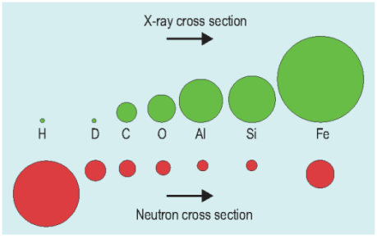
Neutron Properties – H is our friend!
  Isotopic sensitivity of H
  H has a large incoherent neutron scattering cross-section
  H and D have opposite signed scattering lengths
  D has a much smaller cross section
The signal from samples with H are often dominated by the incoherent scattering from H
The Q and ω ranges probed in QENS experiments is well-suited to the “self” part of the dynamic structure factor

Slide 5
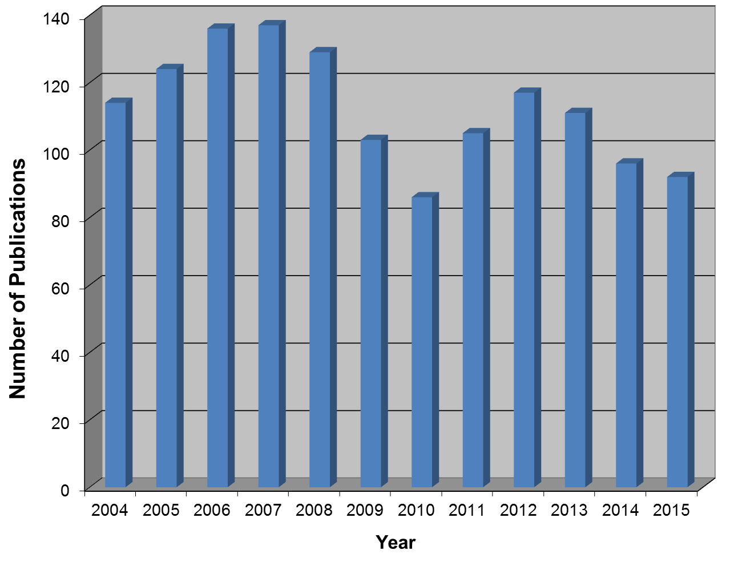
Quasi-elastic Neutron Scattering
Why Should I Care?
Applicable to wide range of science areas
  Biology – water-solvent mediated dynamics
  Chemistry – complex fluids, ionic liquids, porous media, surface interactions, water at interfaces, clays
  Materials science – hydrogen storage, fuel cells, polymers, proton conductors
Probes true “diffusive” motions
Analytic models
  Useful for systematic comparisons
Close ties to theory – particularly
Molecular Dynamics simulations
Complementary
  Light spectroscopy, NMR,
  dielectric relaxation
Unique – Answers questions you
cannot address with other methods

Slide 6
A Neutron Experiment
scattered neutron
detector
incident neutron
sample
Measure scattered neutrons as a function of Q and ω −> S(Q,ω).
ω = 0 −> elastic
ω ≠ 0 −> inelastic
ω near 0 −> quasielastic

Slide 7
Quasi-Elastic Neutron Scattering
Neutron exchanges small amount of energy with atoms in the sample
Harmonic motions look like flat background
Vibrations are often treated as Inelastic Debye-Waller Factor
Maximum of intensity is always at ω = 0
Samples the component of motion along Q
Low-Q – typically less than 5 Å⁻¹

Slide 8
Experiment Design
σ is the microscopic cross section (bn/atom) 10⁻²⁴ cm²/atom
n is the number density (atom/cm³)
Σ is the macroscopic cross-section (cm⁻¹)
The transmission, T, depends on sample thickness, t, as:
Good rule of thumb is T = 0.9
  5 – 15 mmole H-atoms for ≈10 cm² beam
  (BaSiS, HFBS, CNCS, DCS)

Slide 9
An Example – Water
Ignore the oxygen contribution
Samples with a lot of hydrogen must be thin

Slide 10
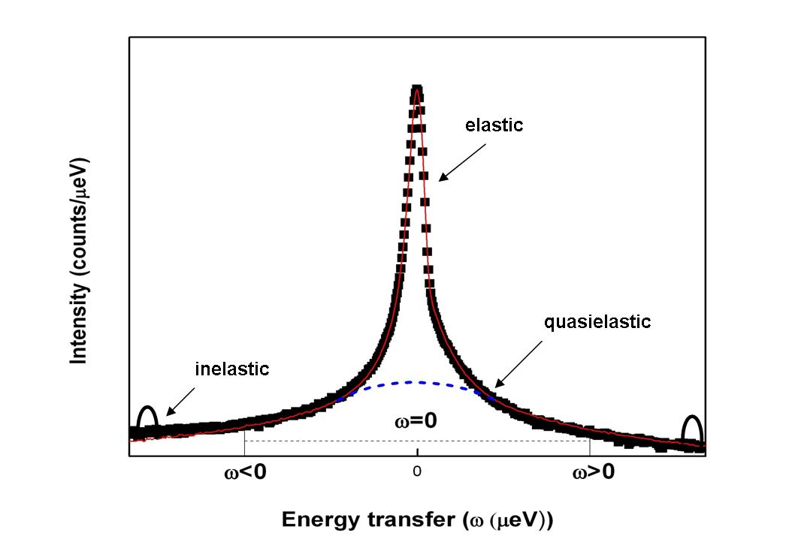
QENS Spectra
(broadened by instrument resolution)
Slowest Time is set by the width of the instrument resolution
Fastest Time is set by the dynamic range of the instrument (ω_{max})

Slide 11
Incoherent Intermediate Scattering Function, S(Q,ω), and Molecular Dynamics Simulations
TOOLS
nMOLDYN:
http://dirac.cnrs-orleans.fr/plone
SASSENA:
http://www.sassena.org
Intermediate Scattering Function
  time dependent correlation function
  incoherent scattering –> no pair correlations, self-correlation function
  calculable from atomic coordinates in a Molecular Dynamics Simulation
  S_{inc}(Q,ω) – the Fourier transform of I_{inc}(Q,t)

Slide 12
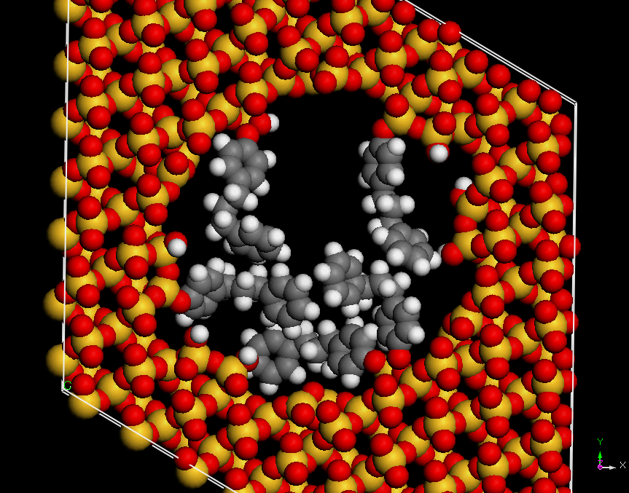
QENS and Molecular Dynamics Simulations
Same atomic coordinates used in classical MD are all that is needed to calculate I_{inc}(Q,t)
1,3 diphenylpropane tethered to the pore surface of MCM-41

Slide 13
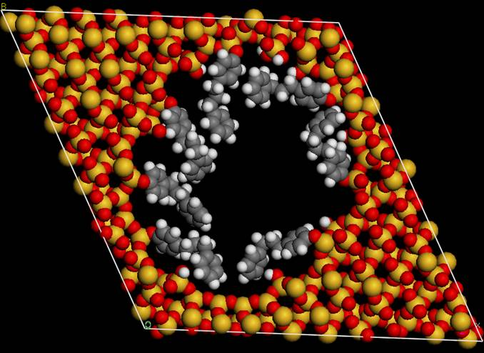
The Elastic Incoherent Structure Factor (EISF)
A particle (H-atom) moves out of volume defined by 2π/Q in a time shorter than set by the reciprocal of the instrument sensitivity, dω (meV) – gives rise to quasielastic broadening.
The EISF is essentially the probability that a particle can be found in the same volume of space at some
subsequent time and so
depends on the size
of the box (2π/Q).
A_{E}
2π/Q
A_{Q}
EISF = A_{E} /(A_{E}+A_{Q} )

Slide 14
QENS and Neutron Scattering Instruments
Probe Diffusive Motions
  Length scales set by Q, 0.1 Å⁻¹ < Q < 3.7 Å⁻¹, 60 Å > d > 1.7 Å – depends on λ.
  Time scales set by the width of instrument energy resolution, typically at least 0.1 meV (fwhm) but higher resolution -> longer times/slower motion
Energy transfers ~ ± 2 meV (or less)
  High resolution requirements emphasizes use of cold neutrons (but long λ limits Q)
  Incident neutron wavelengths typically 4 Å to 12 Å (5.1 meV to 0.6 meV)
Why a variety of instruments? (Resolutions vary from 1 μeV to 100 μeV)
  Energy resolution depends on knowing both the incident and scattered neutron energies
  Terms in the resolution add in quadrature – typically primary spectrometer (before sample), secondary spectrometer (after the sample)
  Improvement in each resolution term cost linearly in neutron flux (ideally)
  Optimized instrument has primary and secondary spectrometer contributions approximately equal
  Factor of 2 gain in resolution costs at a minimum a factor of 4 in flux

Slide 15
Role of Instrumentation
Currently about 25 neutron scattering instruments in the world useful for QNS (6 in the U.S., including NSE)
U.S. instruments – Opportunity is Good- Competition is High
  NIST Center for Neutron Research
    High Flux Backscattering Spectrometer
    Disc Chopper Spectrometer
    Neutron Spin Echo
  Spallation Neutron Source
    BaSiS – near backscattering spectrometer (3.5 μeV)
    Cold Neutron Chopper Spectrometer (CNCS) (10 – 100 μeV)
    Neutron Spin Echo (t to 400 nsec)
Trade-offs
  Resolution/count rate
  Flexibility
  Dynamic range
  Neutron λ vs Q
    large λ −> high resolution -> long times/slow motions
    large λ −> limited Q-range, limited length scales

Slide 16
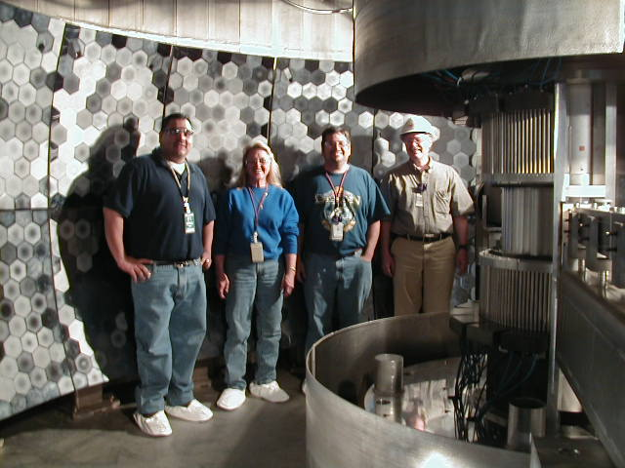
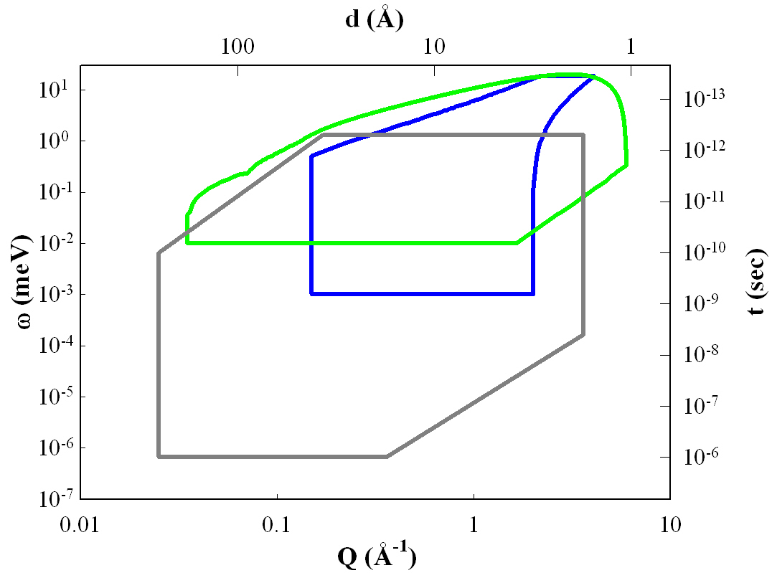
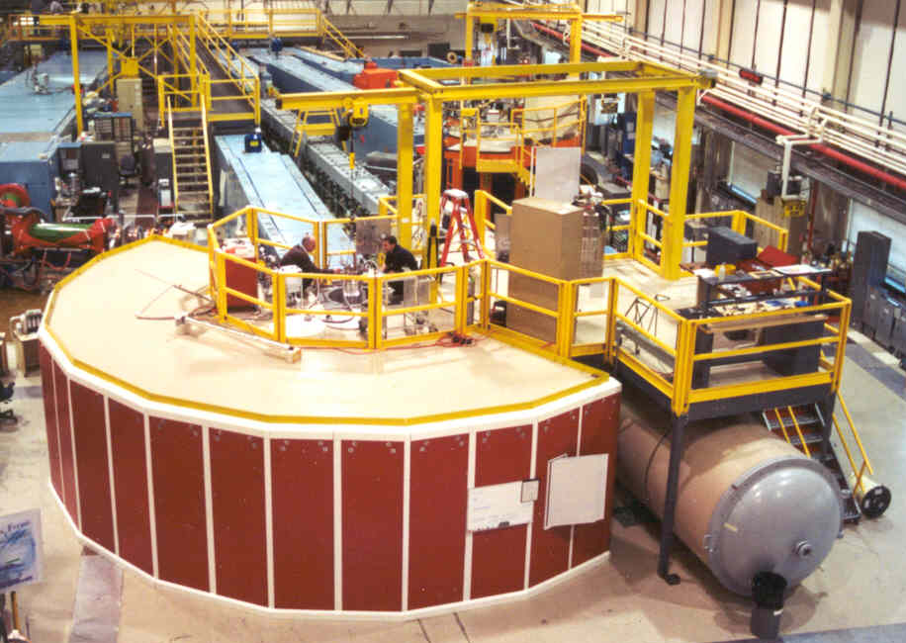
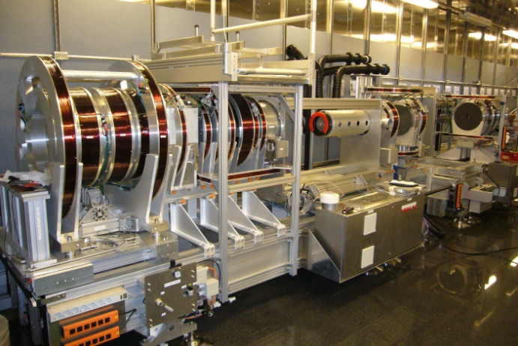
The High-Resolution Neutron Spectrometer Landscape
Backscattering
Molecules in Confinement
Small Molecule Diffusion
Colloids/Complex Fluids
Polymers and Proteins
Cold Neutron Chopper
Neutron Spin Echo

Slide 17
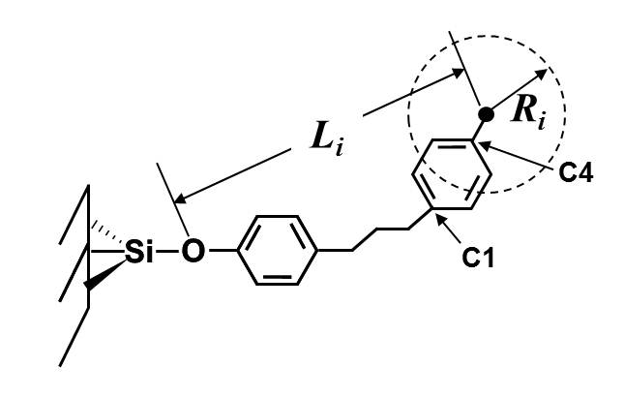
Restricted Diffusion – Tethered Molecules
Samples – typical 0.7 g
240 K < T < 340 K
Simple Fit – Lorentzian + δ
Pore Diameter (nm) | Coverage (molecules/nm²)
1.6 | 0.85 (saturation)
2.1 | 1.04 (saturation)
3.0 | 0.60 0.75 1.61 (saturation)
MCM-41 (2.9 nm pore diameter) high DPP coverage
DPP
MCM-41

Slide 18
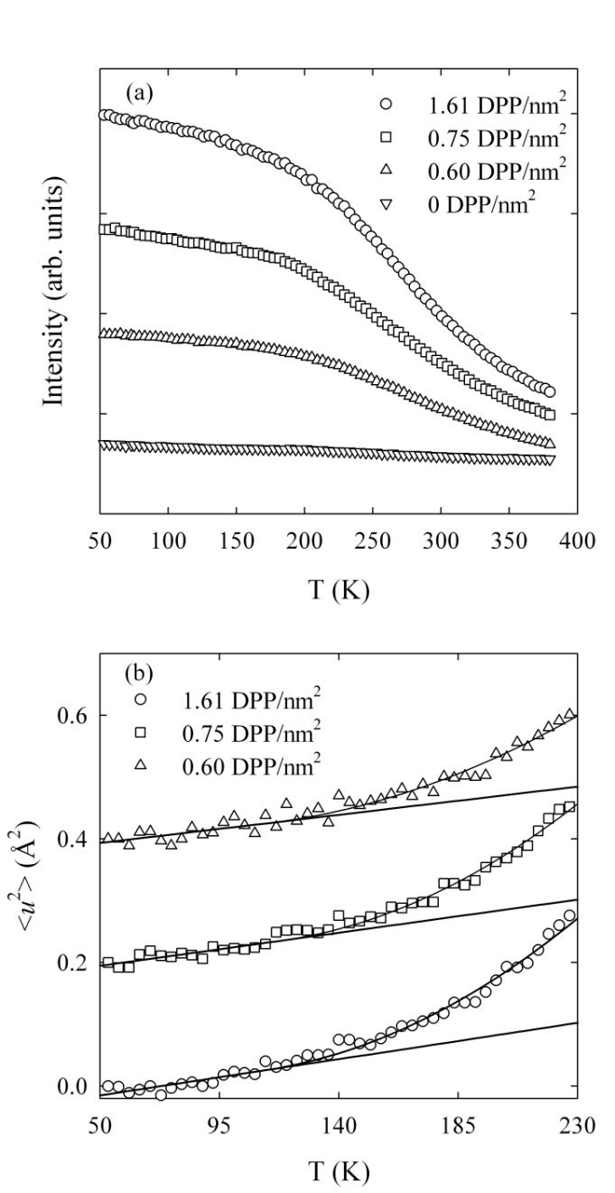
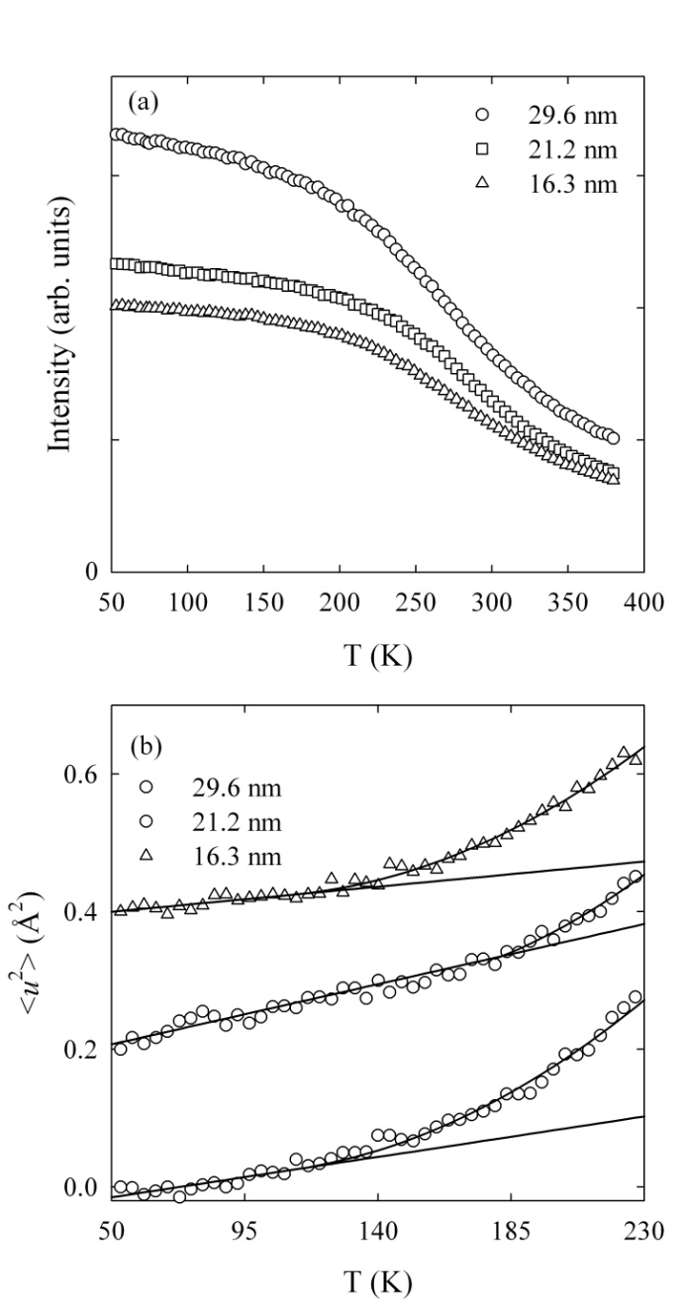
Elastic Scans – Fixed Window Scans
Coverage Dependence
Pore Size Dependence
Onset of diffusive motion giving rise to QENS signal (typically)
Onset of diffusive and anharmonic motion (T_{T})

Slide 19
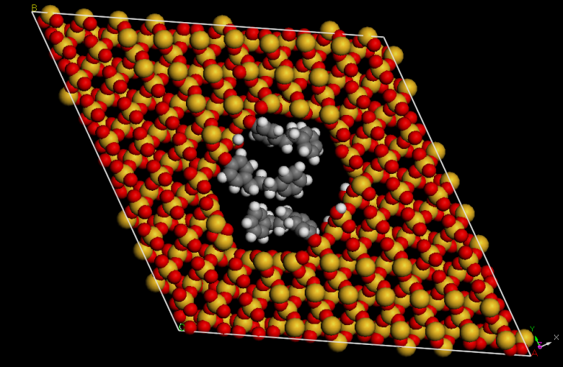
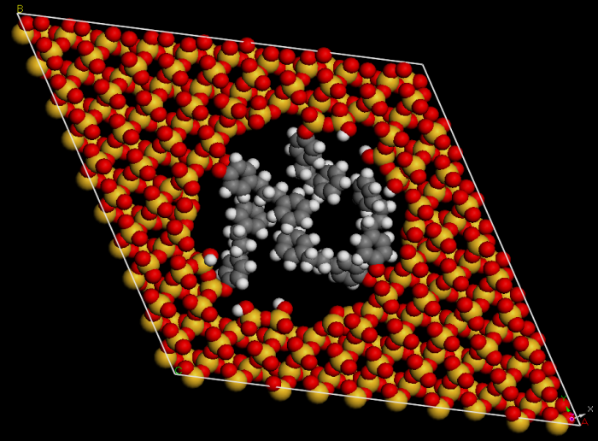

Elastic Scans
(Fixed Window Scans)
T_{T}
  No dependence on DPP surface coverage at 3.0 nm pore diameter (≈ 130 K)
  196 K for 2.1 nm pore (maximum DPP surface coverage) – Deeper potential
Simulations indicate that at 2.1 nm (2.2 nm) DPP molecules adopt a conformation that has a more uniform density throughout the pore volume
Large pores have enough surface area for DPP to orient near the MCM-41 surface
1.7 nm
2.2 nm
2.9 nm

Slide 20
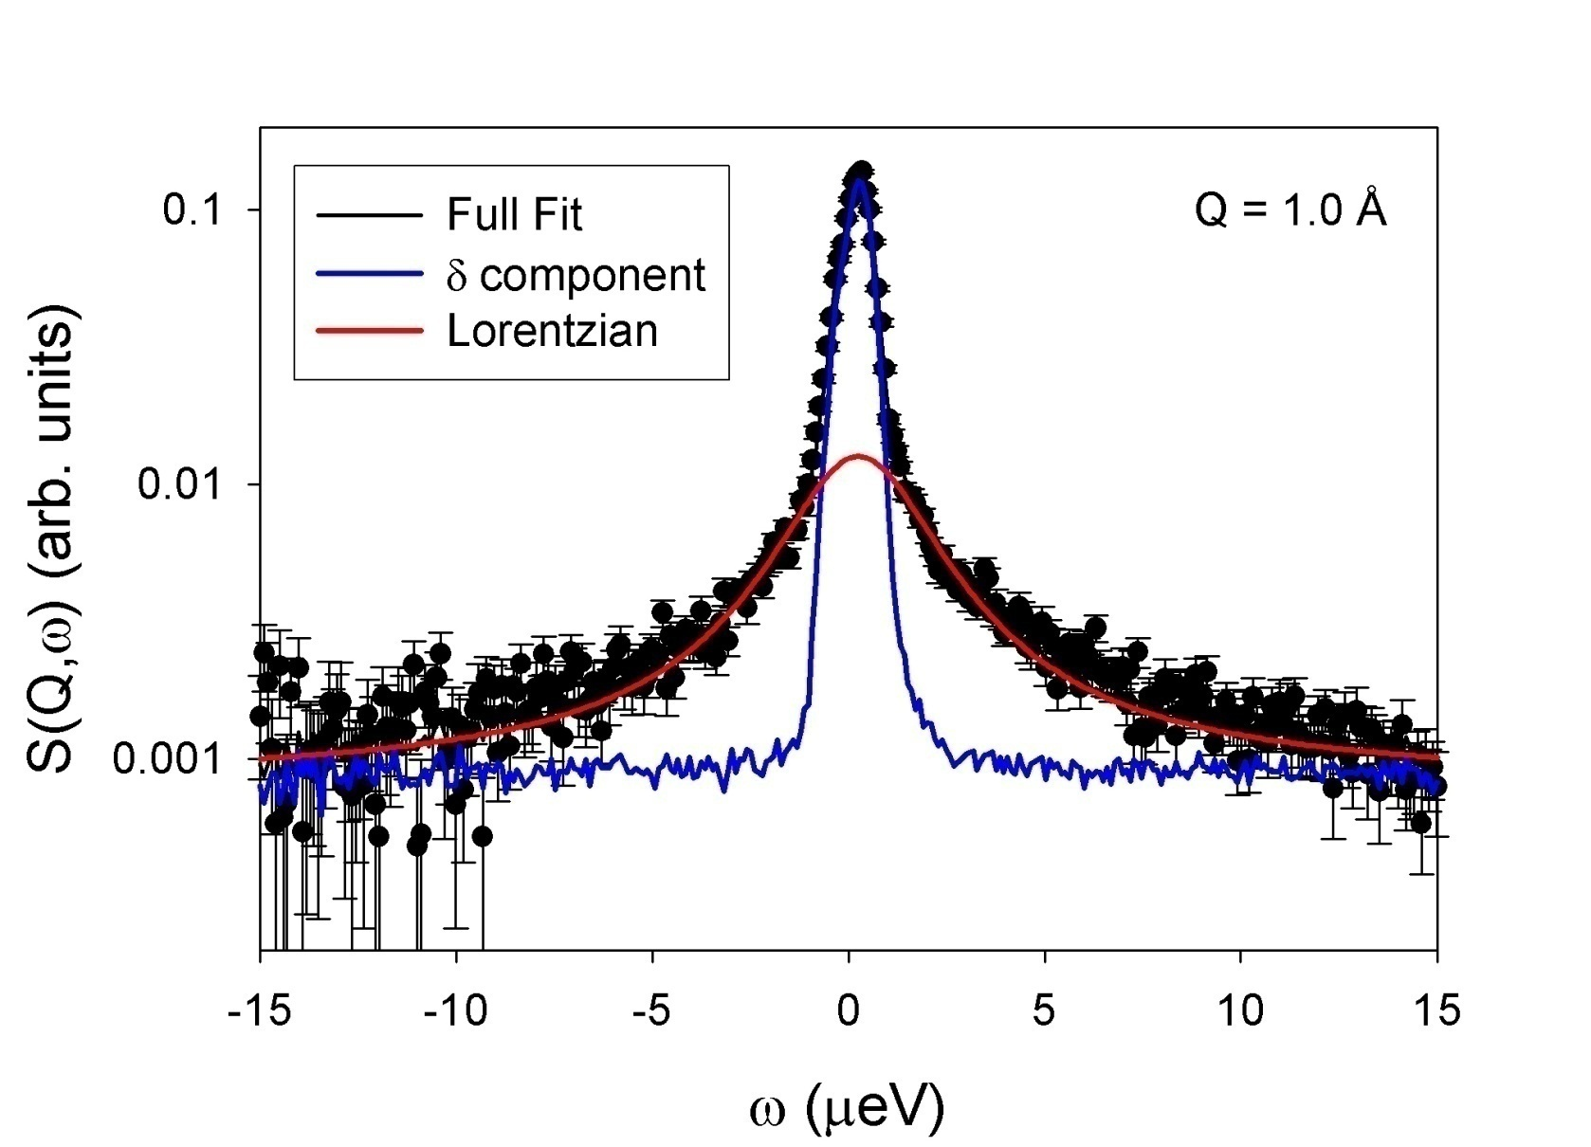
Simple Fit to data (HFBS – NCNR) 30 Å diameter pore, 320 K, Q = 1 Å⁻¹
-1
A_{E}
EISF = A_{E} /(A_{E}+A_{Q} )
A_{Q}

Slide 21
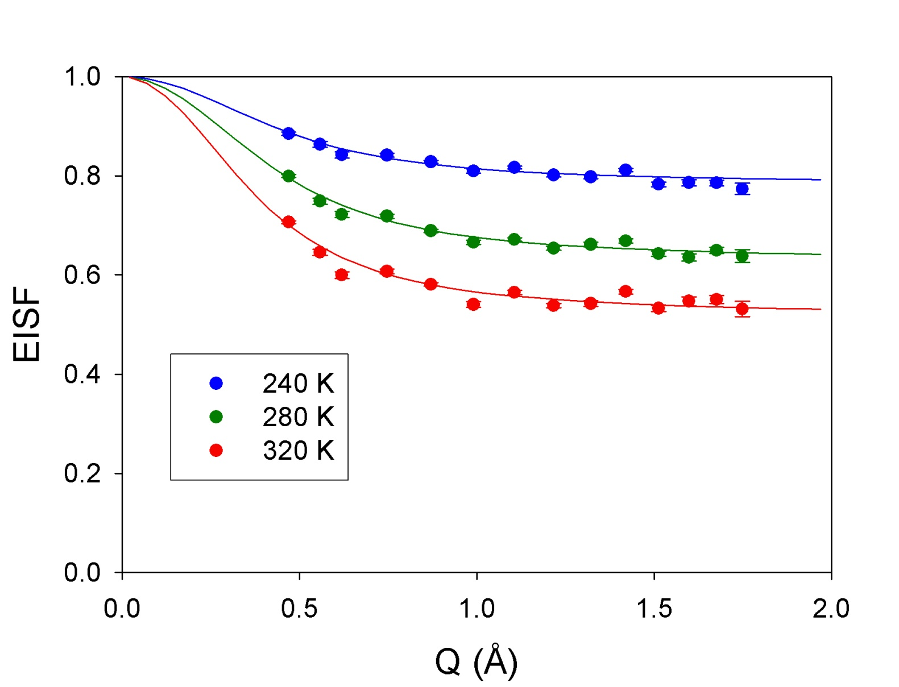
EISF – 30 Å DPP sample, saturation
Curvature determines R_{max}
f_{m}
Non-zero asymptote implies immobile H-atoms (on the time scale of this instrument)
1-f_{m}

Slide 22
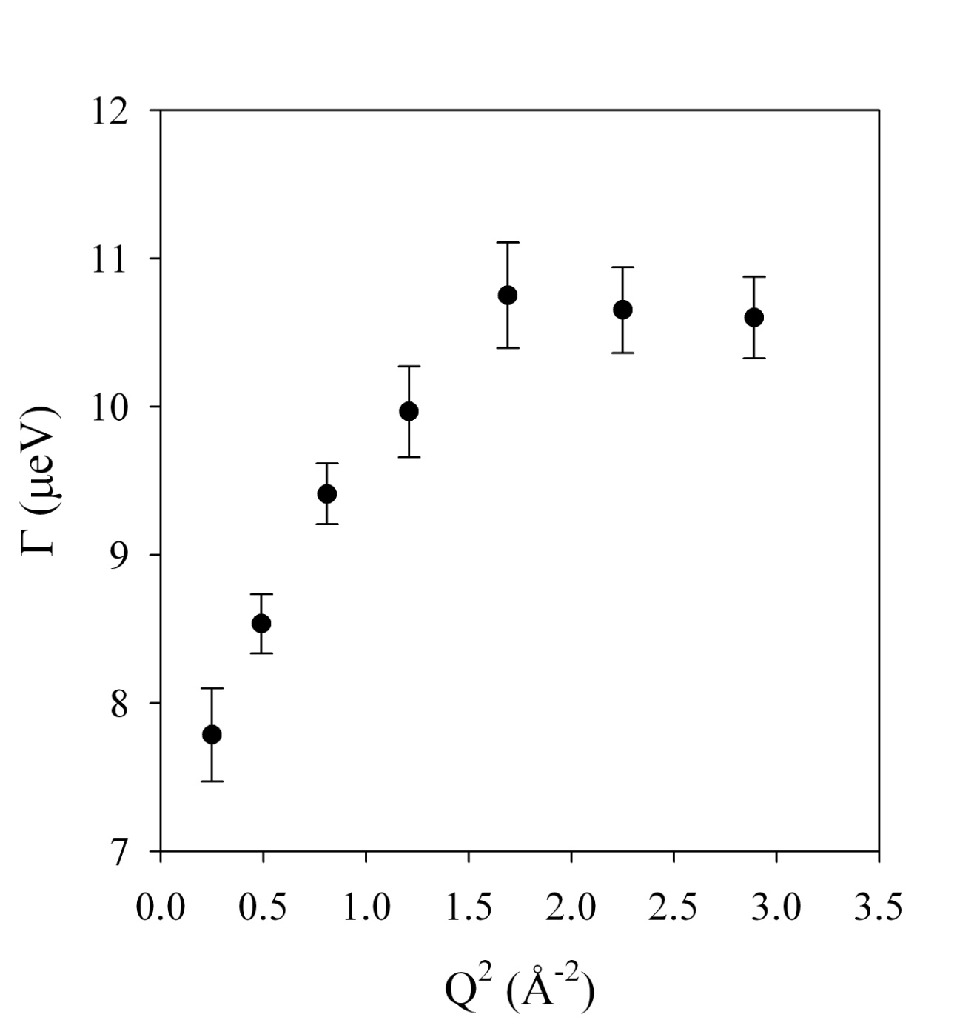
Lorentzian Γ(Q)
Non-zero intercept
Implies restricted/confined diffusion

Slide 23
Simple Analytical Model – e.g. Diffusion in a Sphere
2r
EISF:
Volino and Dianoux, Mol. Phys. 41, 271-279 (1980).

Slide 24

Extend to a Sum over Spheres of Varying Size (15 H-atoms)
Fits to Data
MCM-41
Fraction of DPP H-atoms moving on time scale of instrument

Slide 25
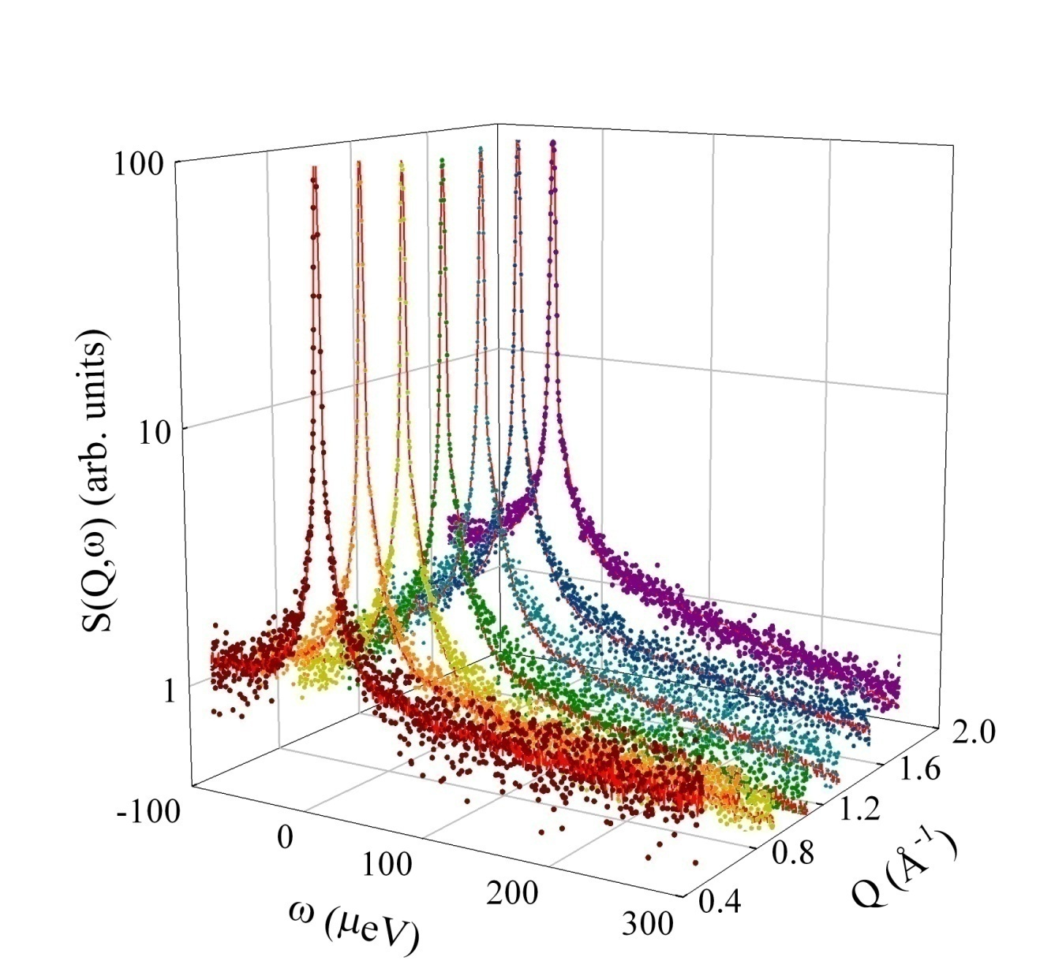
DPP – 29 Å diameter pores – 370 K (BaSiS - SNS) – Beyond the EISF – Fitting the Model to the Full Data Set

Slide 26
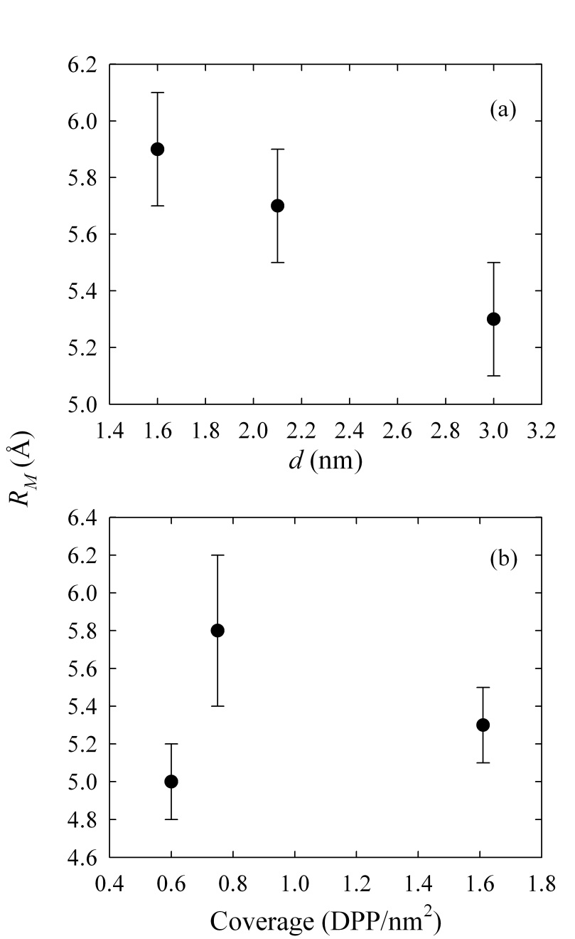
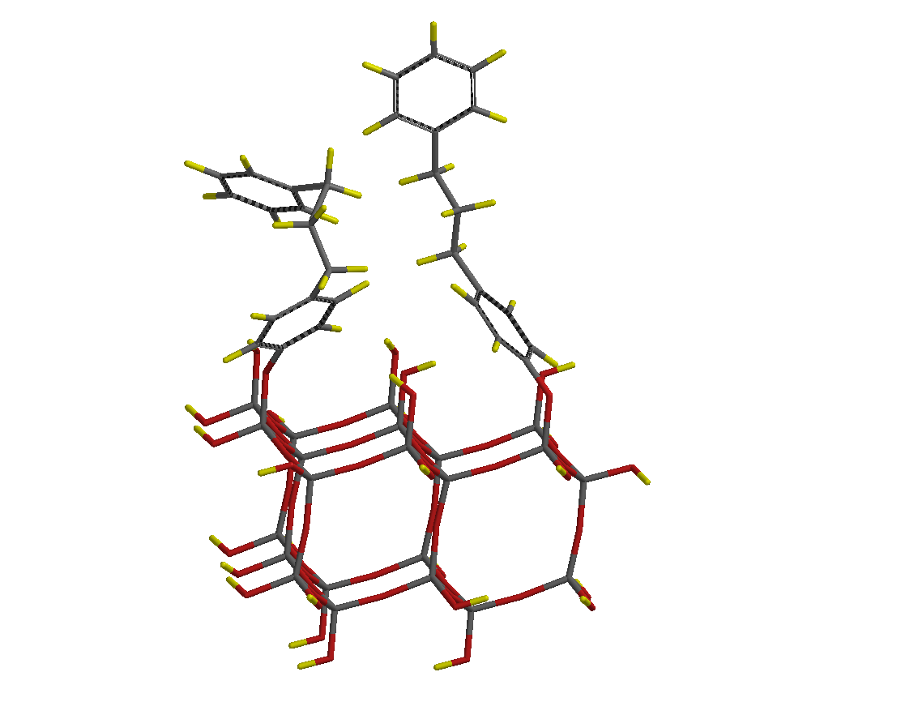
R_{M} – How extended is the motion?
Partially folded DPP
O – terminal H distance 5.9 Å
Extended DPP
O – terminal H distance 12 Å
Maximal DPP coverage
β-cristobailite
R_{M} decreases with increasing pore diameter! (Molecules can interact with surface)
R_{M} generally is larger at higher DPP surface coverage (Molecules are excluded from surface)
Small pores and high coverage tend to drive DPP into the pore center where there is more volume available for motion
3.0 nm

Slide 27
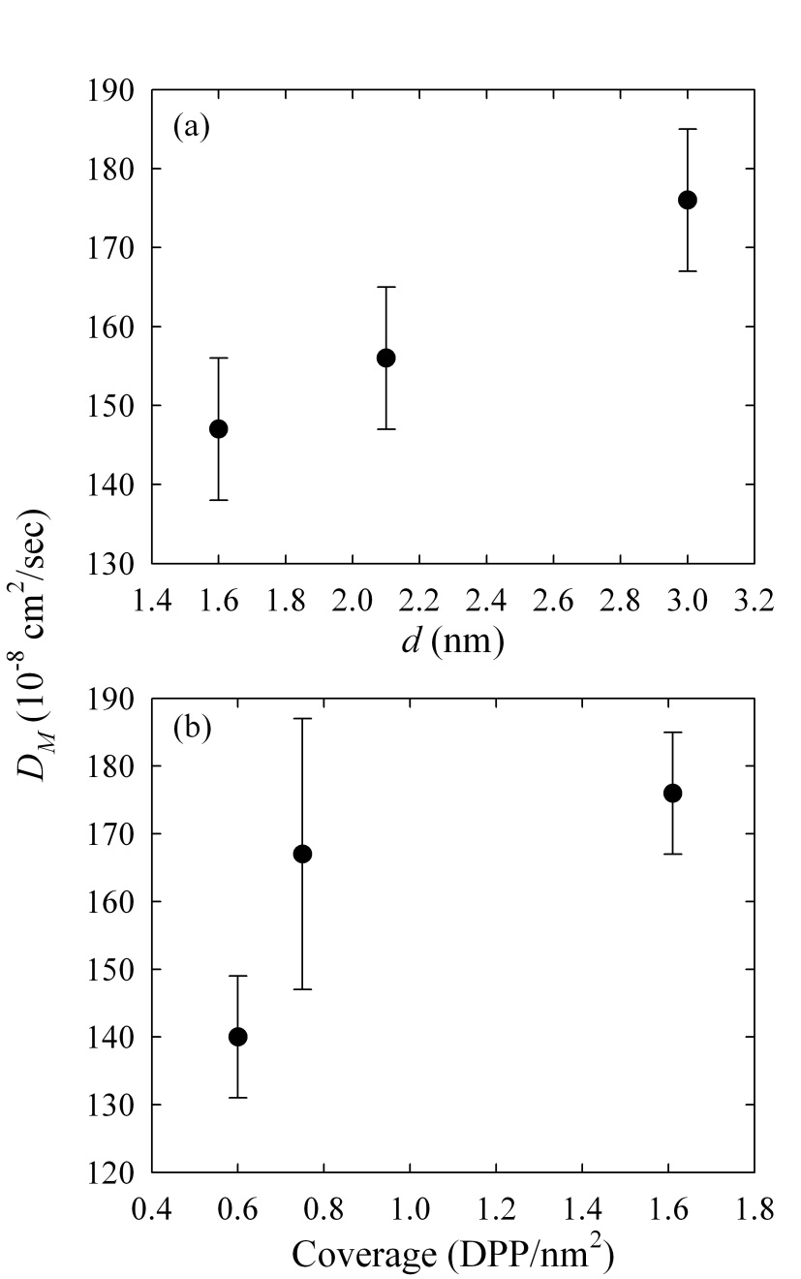
D_{M} – How fast is the motion?
Maximal DPP coverage
D_{M} increases with pore diameter while R_{M} decreases
  Diffusion in the pore volume depends on how crowded it is
D_{M} increases with surface coverage in large pores
  More molecules are forced into the more open volume of the pore and away from the pore surface
3.0 nm

Slide 28
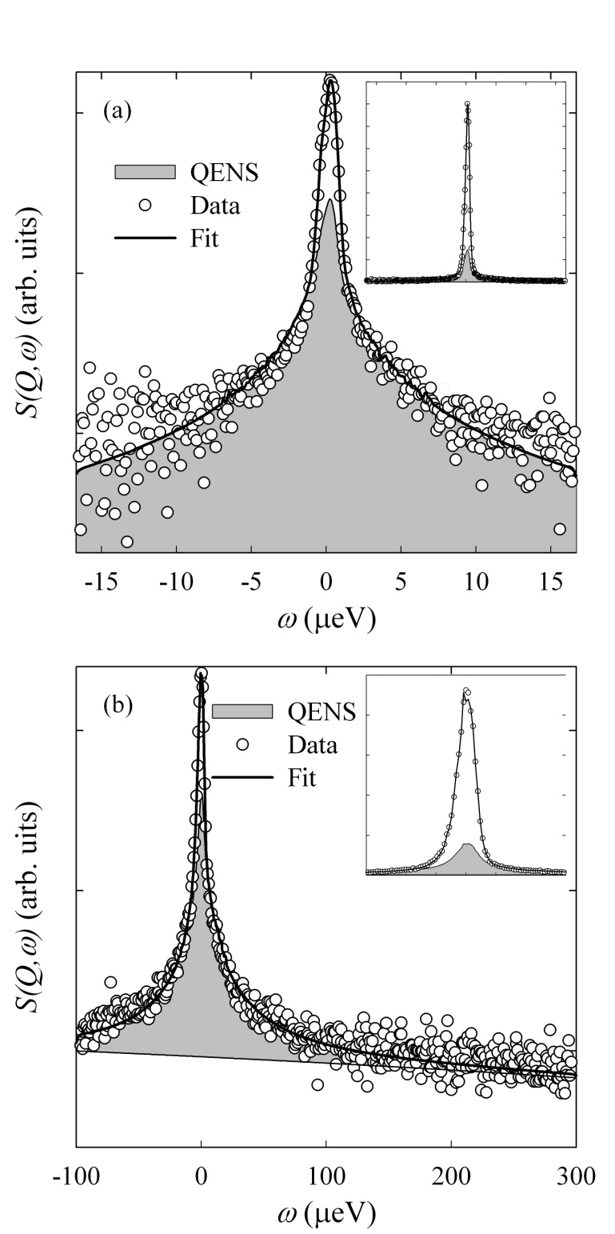
Two Instruments – Two Resolutions – Two Dynamic Ranges – 3.0 nm 320 K
HFBS (1 μeV, ±17.5 μeV)
BaSiS (3 μeV, -100 to 300 μeV)
QENS
E.J. Kintzel, et al., J. Phys. Chem. C 116, 923-932 (2012).

Slide 29
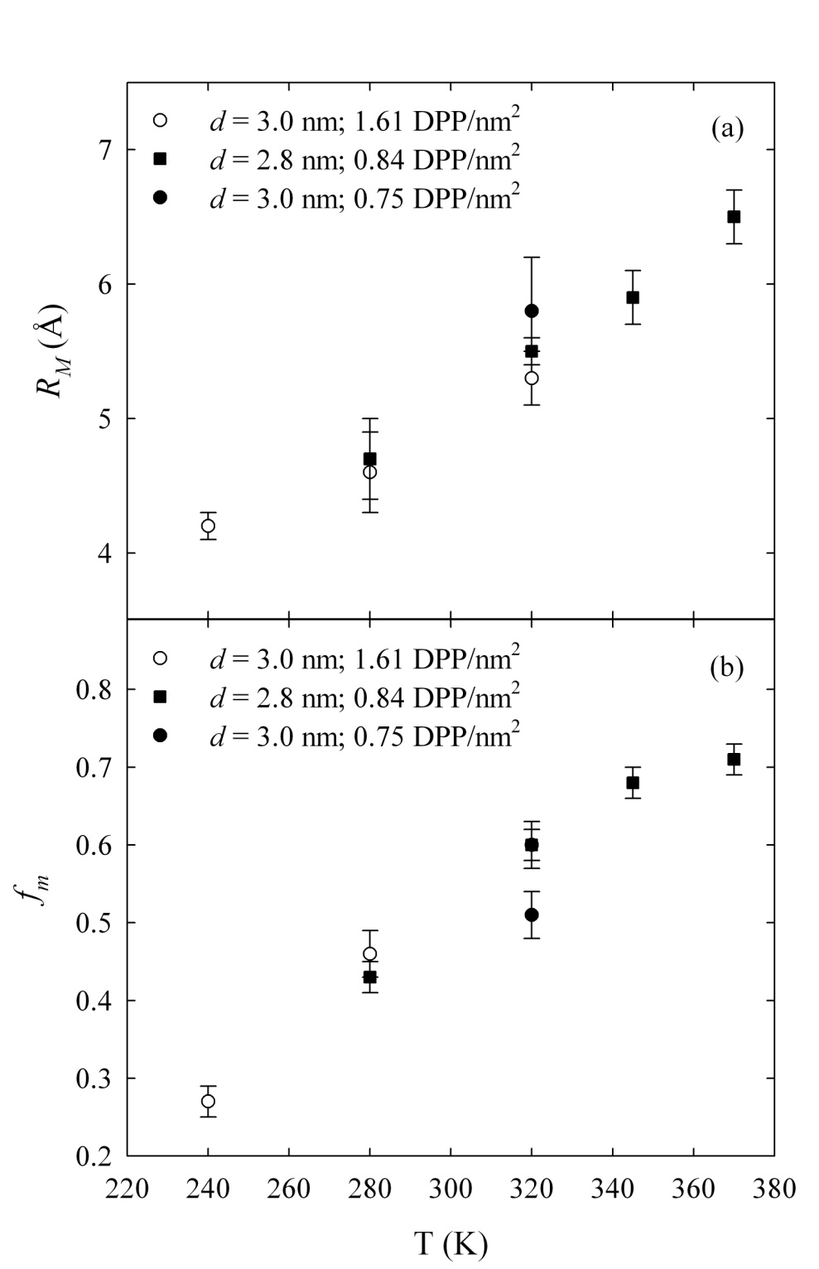
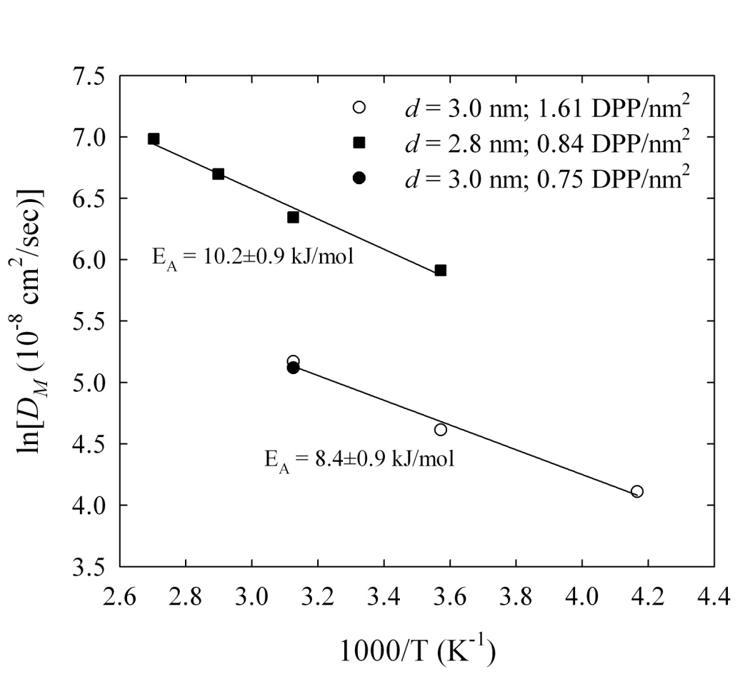
Two Instruments
Geometry – nearly identical – determined by intensity measurements
Dynamics
Similar activation energies
Different magnitudes

Slide 30

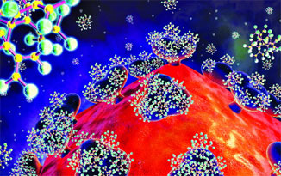
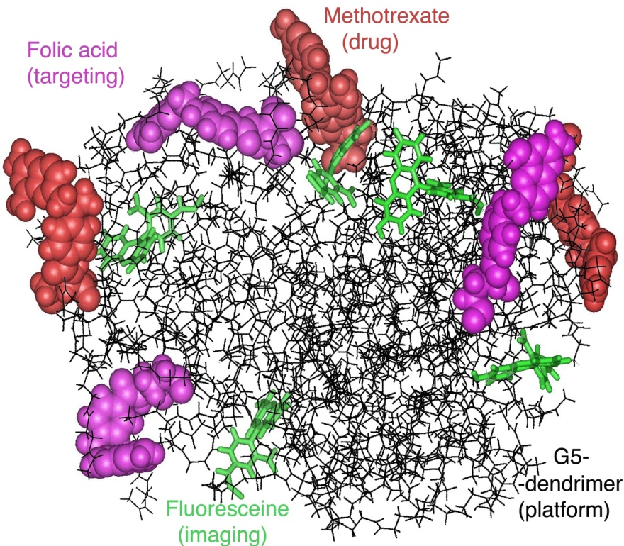
Example 2: Dendrimers – Colloidal Polymer – pH responsive
Dendrimers bind to receptors on HIV virus preventing infection of T cells. Sharpharpm
C & E News 83, 30 (2005)
“Trojan horse” – folic acid adsorbed by cancer cell delivering the anti-cancer drug as well
James R. Baker Jr., Univ. of Michigan Health Sciences Press Release

Slide 31
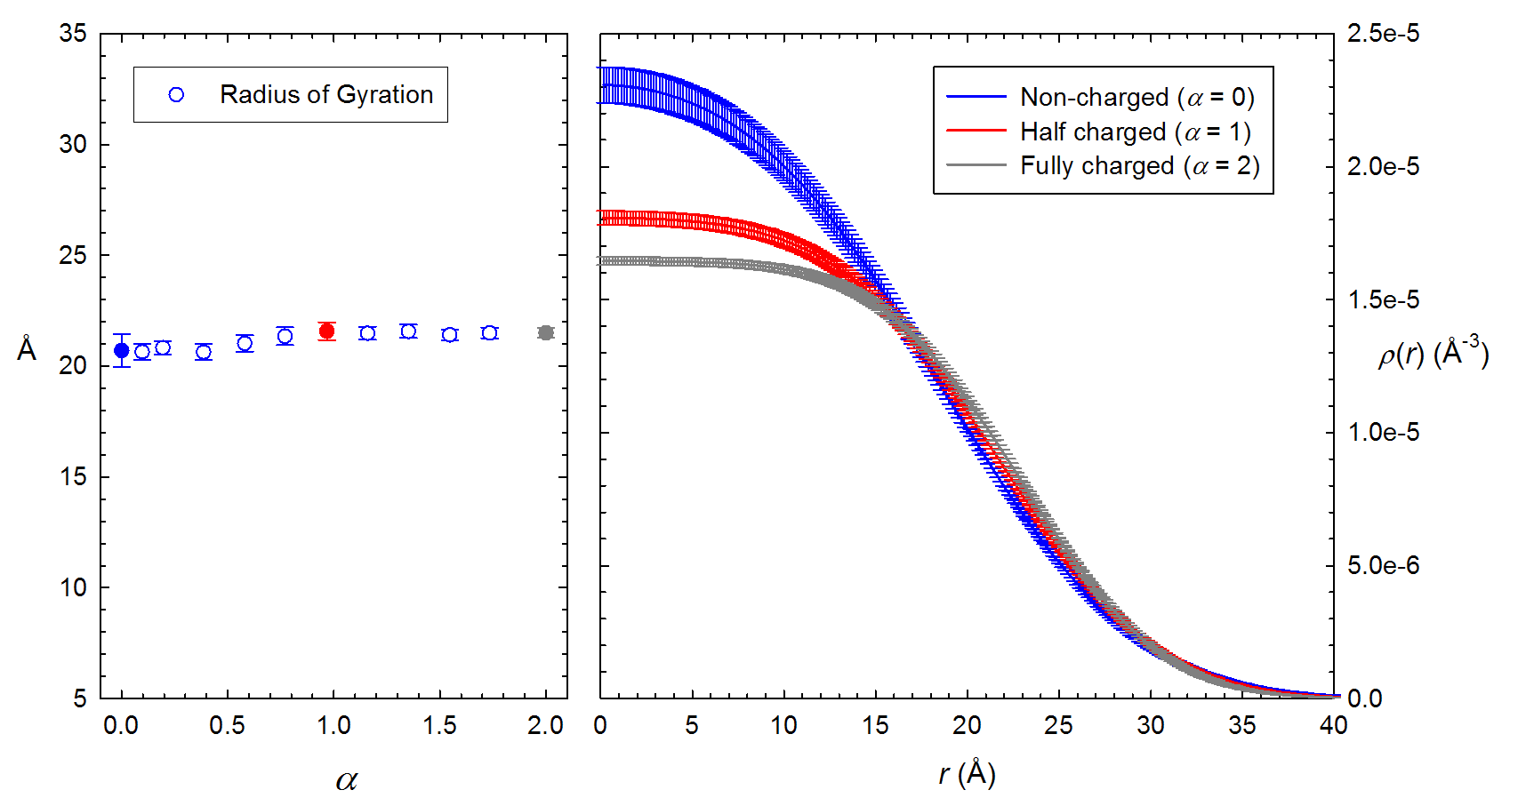
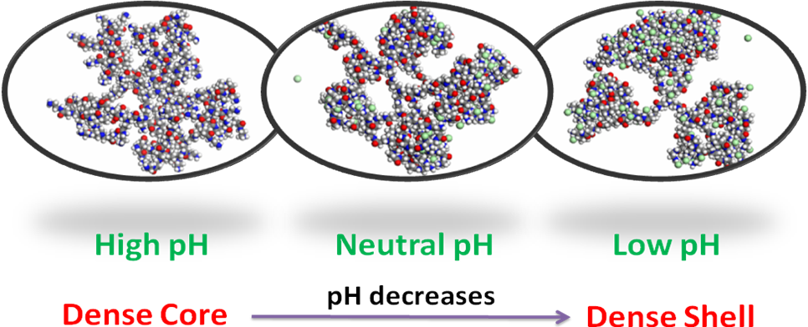
SANS Results – Global Size Constant, Redistribution of Mass
Samples: 0.05 gm protonated dendrimer in 1 ml deuterated solvent
Molecular Dynamics Simulations
Basic
Acidic

Slide 32
Methodology
Determine center-of-mass translational motion with pulsed field-gradient spin echo NMR
  Could have been determined directly from QENS measurement but this tied down parameter set
Measure (dendrimer + deuterated solvent) – (deuterated solvent) -> dendrimer signal
Vary pH to charge dendrimer amines (α = 0 (uncharged), α = 1 (primary amines charged), α = 2 (fully charged))

Slide 33
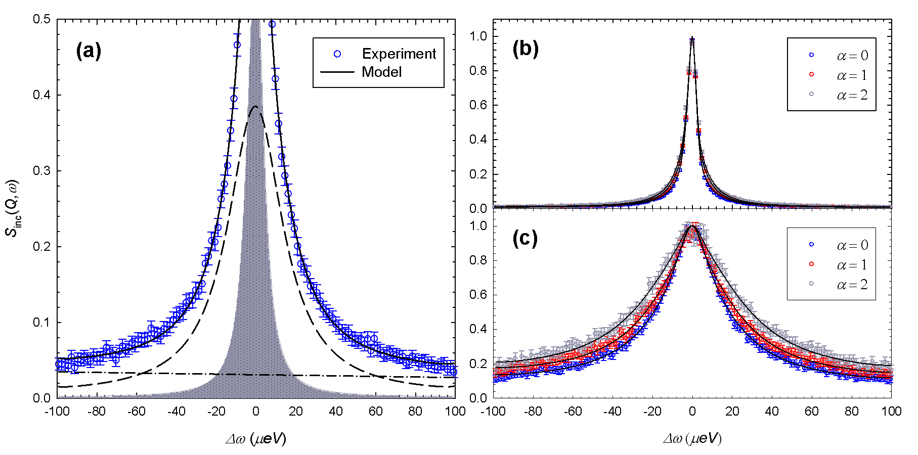
Localized Motion of Dendrimer Arms
Q = 0.5 Å⁻¹
Q = 1.3 Å⁻¹
Localized motion modeled as Diffusion in a Sphere
R ~ 2.8 Å, α independent
1.60 ± 0.03 10⁻¹⁰ m²/s α = 0
D 2.58 ± 0.03 10⁻¹⁰ m²/s α = 1
3.11 ± 0.03 10⁻¹⁰ m²/s α = 2
Localized motion increases as amines are charged!
X. Li, et al, Soft Matter 7, 618-622 (2011)

Slide 34
Reference Materials - 1
Reference Books
  Quasielastic Neutron Scattering, M. Bee (Bristol, Adam Hilger, 1988).
  Methods of X-Ray and Neutron Scattering in Polymer Science, R. –J. Roe (New York, Oxford University Press, 2000).
  Quasielastic Neutron Scattering and Solid State Diffusion, R. Hempelmann (2000).
  Quasielastic Neutron Scattering for the Investigation of Diffusive Motions in Solids and Liquids, Springer Tracts in Modern Physics, T. Springer (Berlin, Springer 1972).

Slide 35
Reference Materials - 2
Classic Papers
  L. Van Hove
    Phys. Rev. 95, 249 (1954)
    Phys. Rev. 95, 1374 (1954)
  V. F. Sears
    Canadian J. Phys. 44, 867 (1966)
    Canadian J. Phys. 44, 1279 (1966)
    Canadian J. Phys. 44, 1299 (1966)
  G. H. Vineyard
    Phys. Rev. 110, 999 (1958)
  S. Chandrasekhar
    “Stochastic Problems in Physics and Astronomy”, Rev. Mod. Phys. 15, 1 (1943) (not really QNS but great reference on diffusion models)
Data Analysis – DAVE – NIST Center for Neutron Research http://www.ncnr.nist.gov/dave/

Slide 36
SUMMARY
QENS is an excellent technique to measure diffusive dynamics
  Length scales/geometry accessible through Q-dependence
  Many analytic models form a framework for comparison and parametric studies
  Large range of time scales ( sub-picosecond < t < nanosecond (100’s nsec for NSE)
  H-atom sensitivity
Instrument selection is a critical decision – the resolution must match the time scale of the expected motion
World-class instrumentation is currently available in the U.S.
Natural connection to theory (Molecular Dynamics Simulations)
Analysis Software
  DAVE at the NCNR at NIST – available from the NCNR Web site

