Slide 1


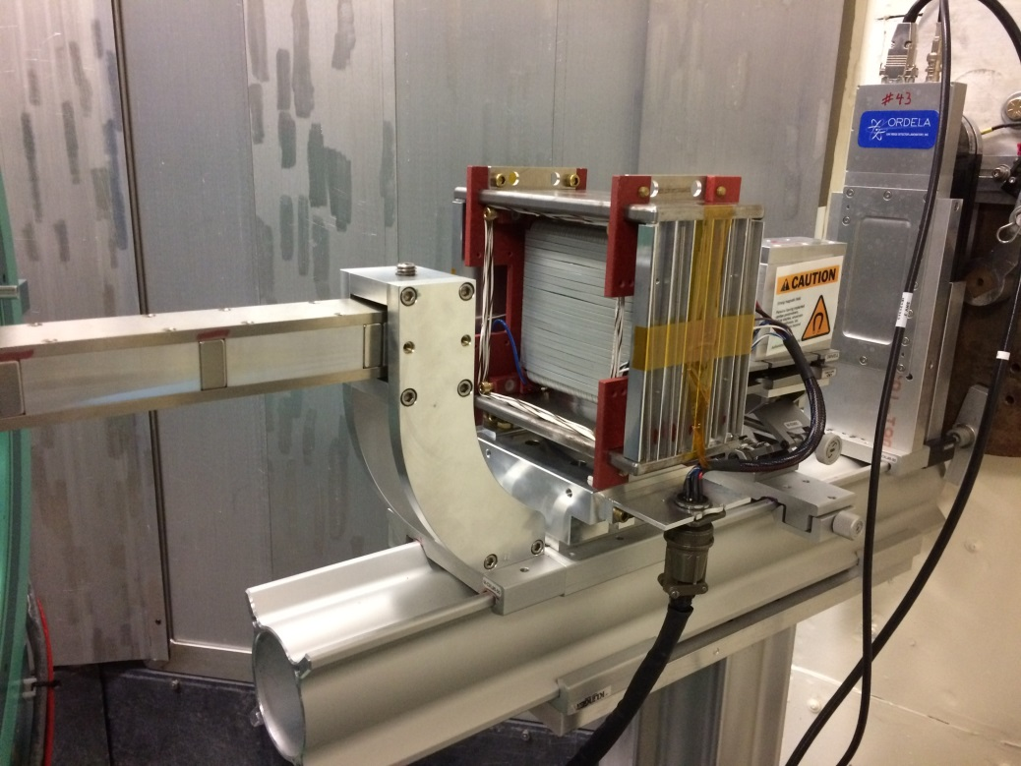
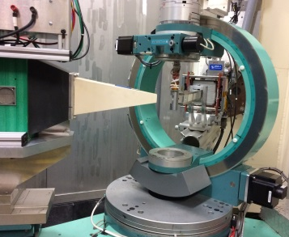
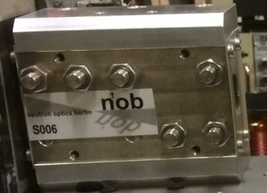
Polarized Neutron Diffraction at HFIR HB-3A
HB-3A
λ = 1.537 Å
Collimator with guide field
flipper
λ = 1.537 Å
S-bender supermirror polarizer
λ = 1.537 Å
Achievement
High neutron polarization ratio (>94%) and a good transmission (16% based on the diffraction on a 2 mm size hexaferrite crystal) enable effective polarized neutron diffraction at HB-3A. Tolerance to the horizontal focus yields double the neutron flux. 24% transmission can be achieved by moving the polarizer closer to the sample position, which requires redesigning a more compact flipper and collimator mount.
Huibo Cao, Bryan Chakoumakos, Katie Andrews
William Hamilton, Lowell Crow, Tony Tong, Lee Robertson
Brent Taylor, Gary Taufer, Daniel Brown
Ron Maples, John Stout, Charles Fraker, John Rockwell

