Slide 1
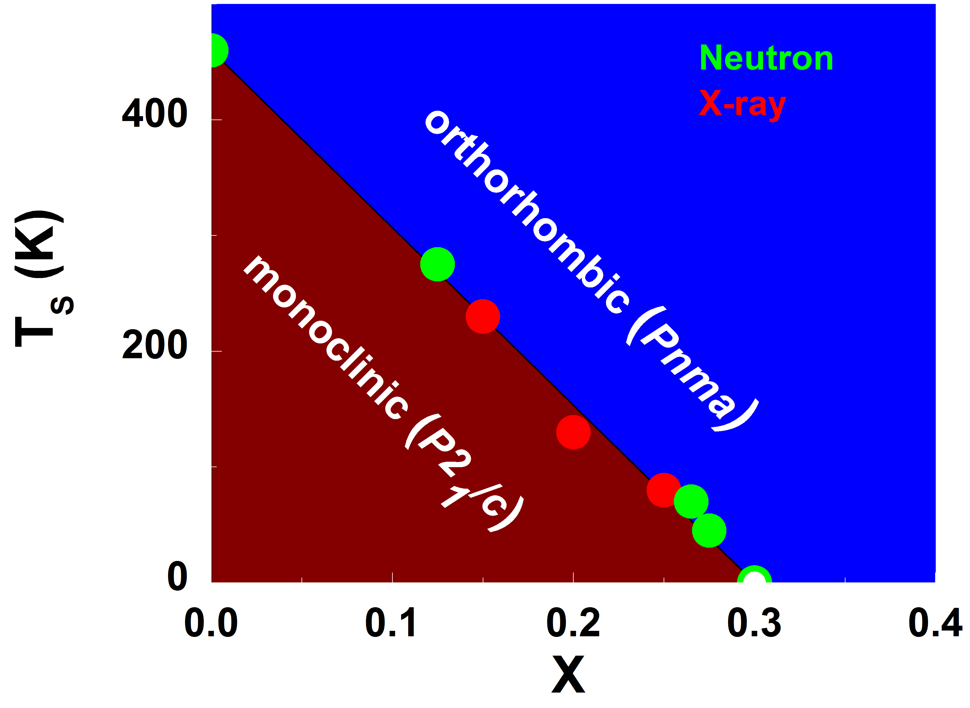
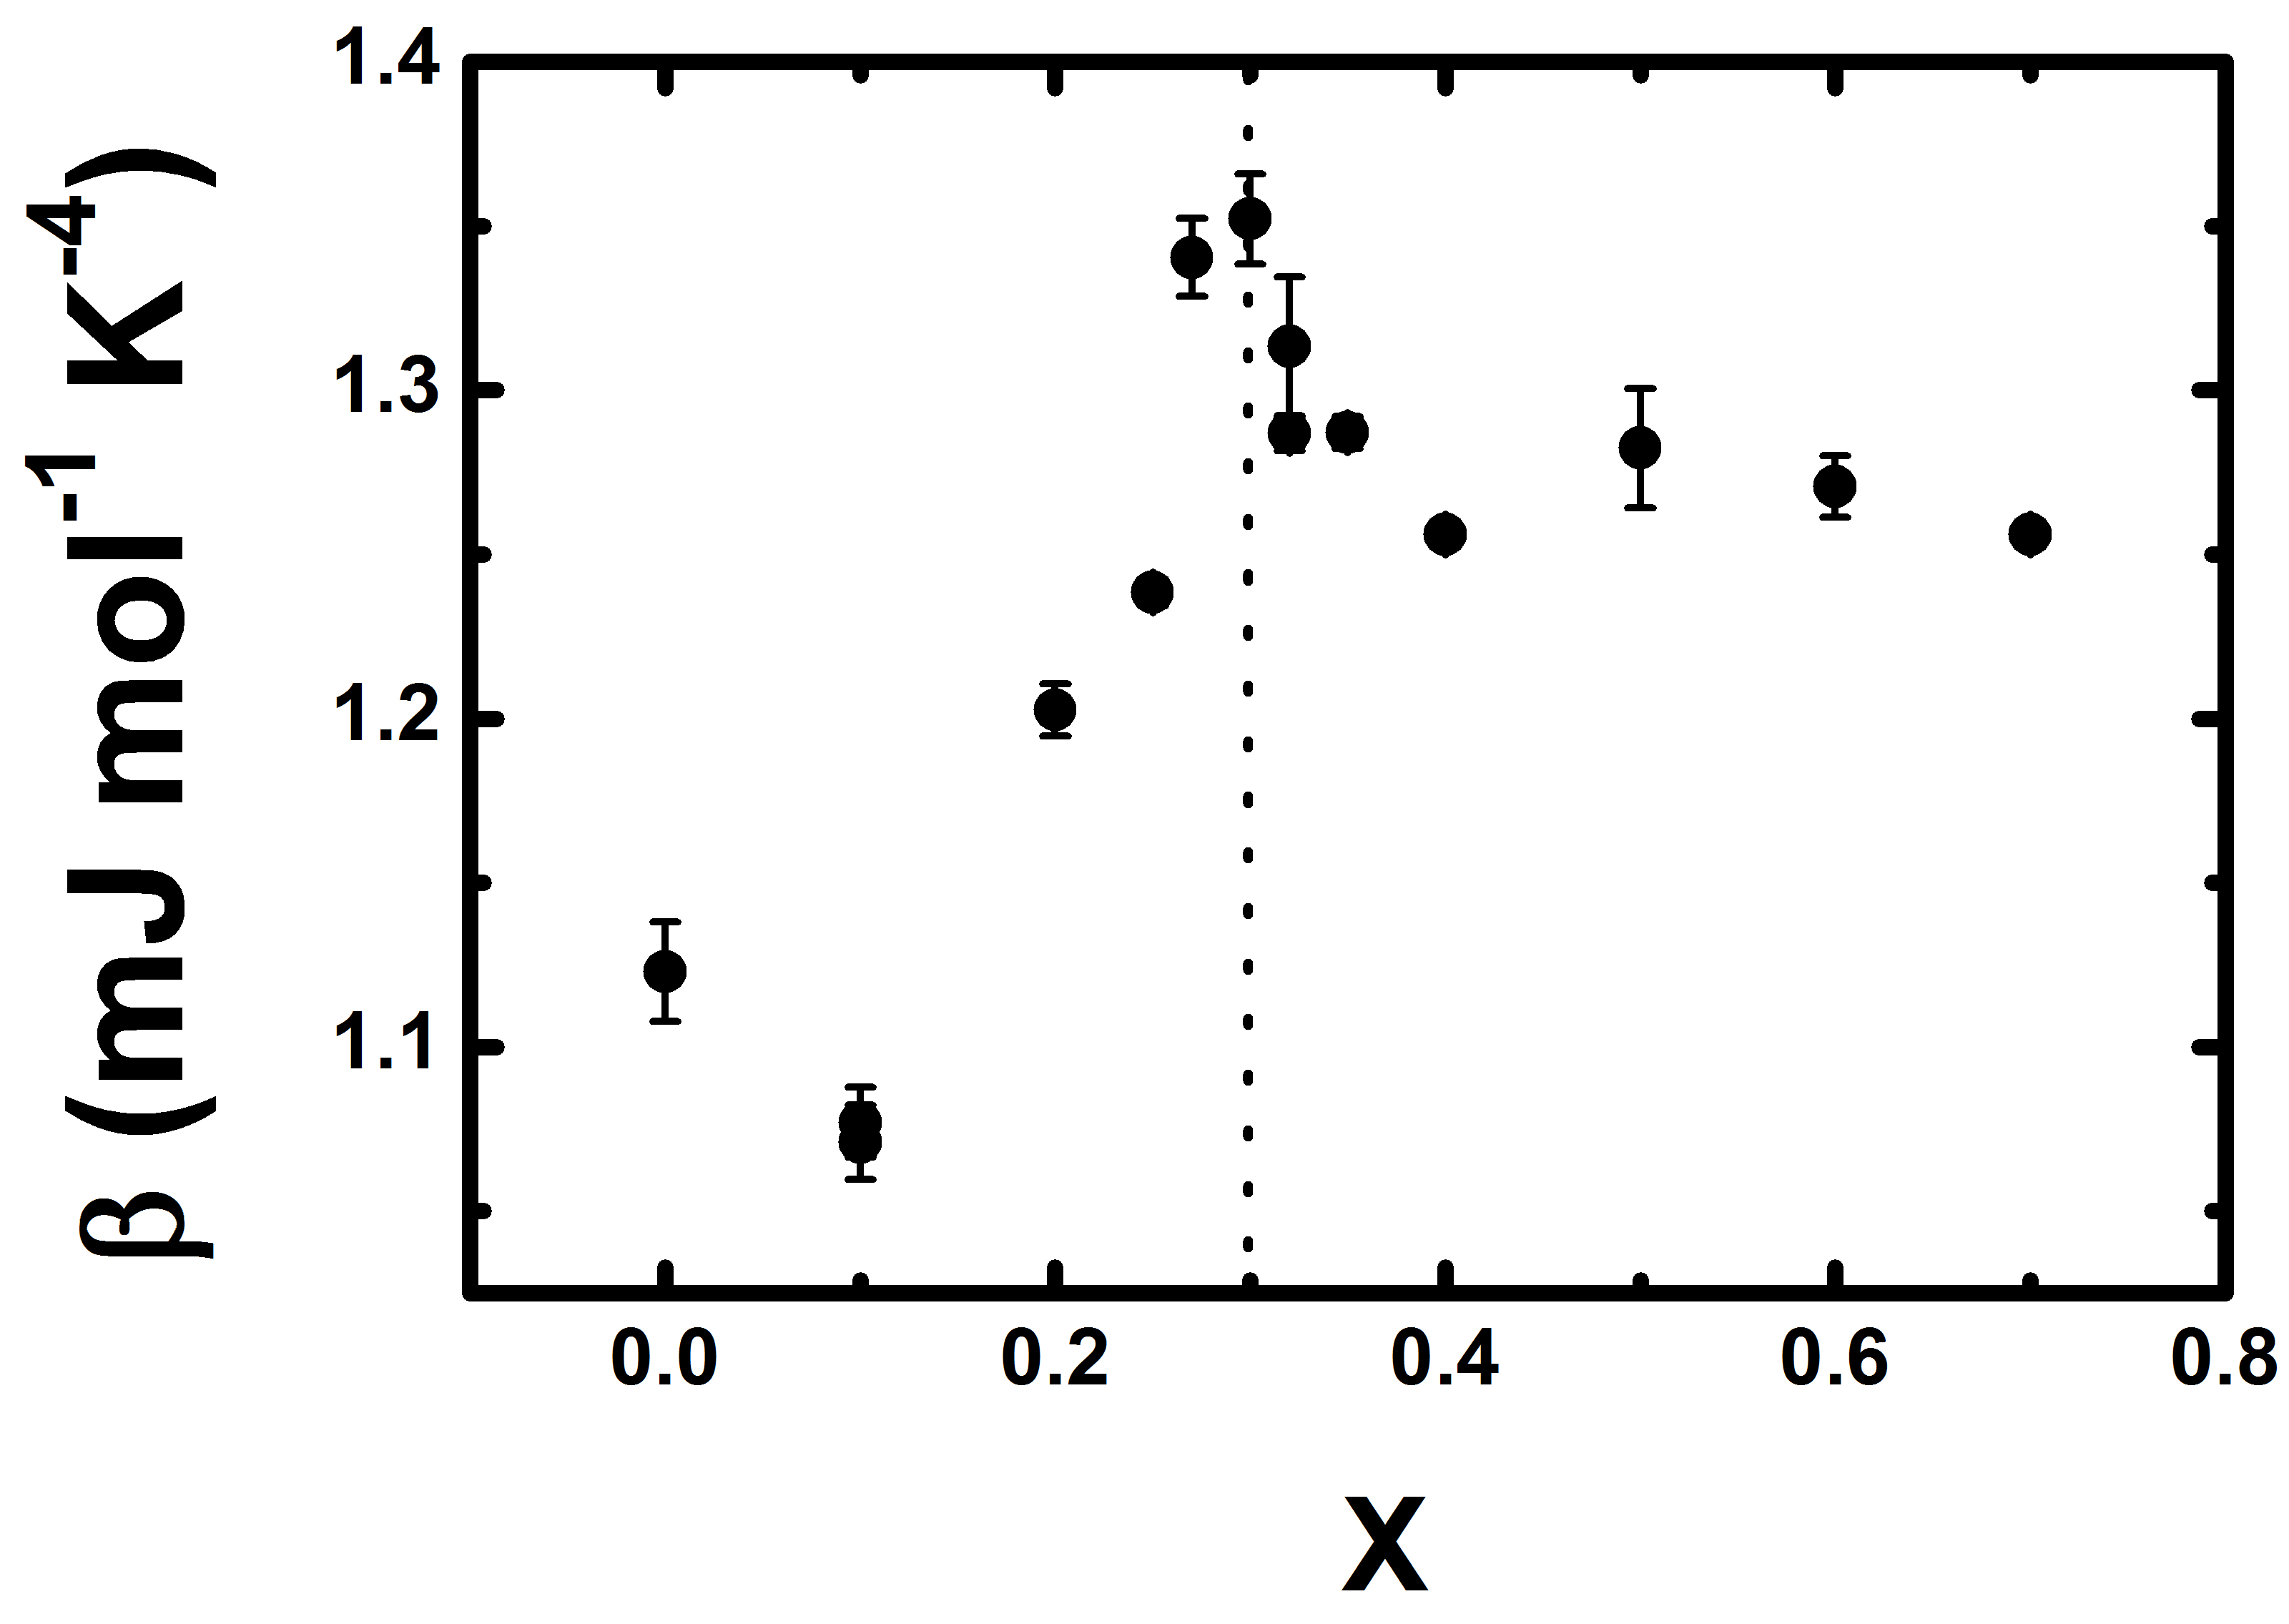




Candidate Elastic Quantum Critical Point in LaCu_{6-x}Au_{x}
Scientific Achievement:
A combination of neutron diffraction, x-ray diffraction, and heat capacity measurements in conjunction with first principles calculations were used to show that the LaCu_{6-x}Au_{x} system hosts the first known example of an elastic quantum critical point. Neutron and x-ray diffraction measurements were performed to study the structural properties as a function of temperature and Au-composition. First principle calculations confirm that the phase transition is driven by an elastic instability and is independent of electronic properties. Heat capacity measurements indicate the presence of quantum fluctuations at the critical composition.
Significance and Impact:
Quantum phase transitions occur at absolute zero, but have dramatic consequences at finite temperatures. In particular, quantum phase transitions are widely recognized as generators of novel phases of matter ranging from high temperature superconductivity to quantum spin liquids. Beyond being the first example of an elastic quantum critical point, the quantum critical point identified in this work is noteworthy in that it appears to be uncommonly free from nearby competing phases and therefore provide a unique opportunity to investigate the physics of quantum phase transitions.
Research Details:
The structural properties were probed with neutron and x-ray diffraction.
Density functional theory (DFT) calculations provides insight into the characteristics of structural phase transition.
Heat capacity measurements were performed to measure the thermodynamic properties near the elastic QCP.
Phase diagram of LaCu_{6-x}Au_{x.} T_{s} decreases linearly with Au-composition until a complete termination of the monoclinic phase occurs at the critical composition x = 0.3.
The neutron scattering experiments were performed at HB-2A of High Flux Isotope Reactor (HFIR) at Oak Ridge National Laboratory (ORNL). Synchrotron x-ray diffraction measurements were performed at 11-BM of Advanced Photon Source (APS) of Argonne National Laboratory (ANL)
L. Poudel, A. F. May, M. R. Koehler, M. A. McGuire, S. Mukhopadhyay, S. Calder, R. E. Baumbach, R. Mukherjee, D. Sapkota, C. de la Cruz, D. J. Singh, D. Mandrus, and A. D. Christianson, Phys. Rev. Lett. 117 235701 (2016)
The phonon heat capacity (β) is maximum at the critical composition x = 0.3 , as expected for an elastic QCP.
Notes:
http://journals.aps.org/prl/accepted/56071YefI7b1094816b28c57360b4549522b566fa

