Slide 1
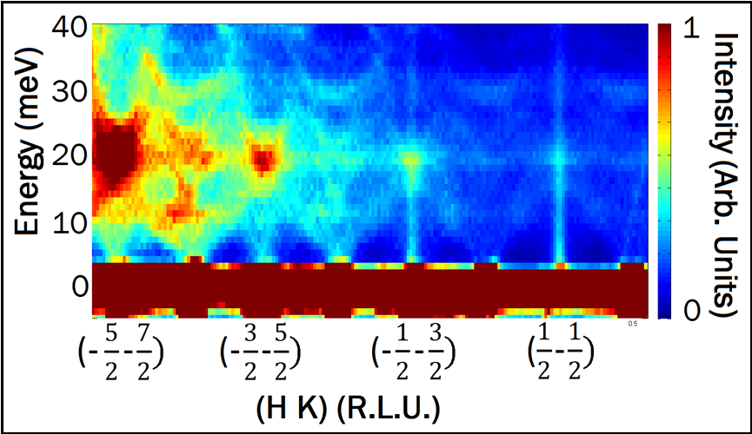
Magnetic Neutron Scattering
Bruce D Gaulin
McMaster University
Magnetism and Neutron Scattering:
A Killer Application
Magnetism in solids
Bottom Lines on
Magnetic Neutron Scattering
Examples

Slide 2
A brief history of magnetism
~ 500 BC:
Ferromagnetism documented in Greece, India, used in China
time
Antiferromagnetism proven experimentally
sinan, ~200BC
1949 AD:

Slide 3
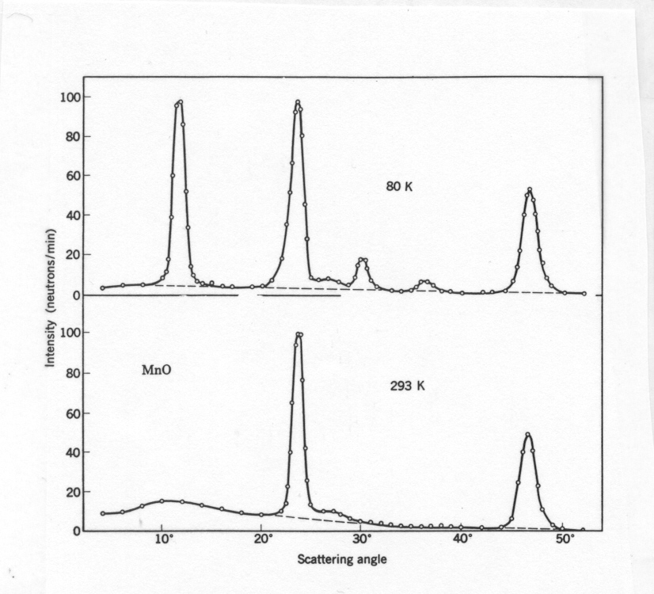
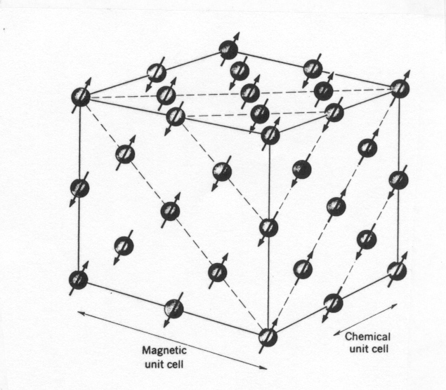
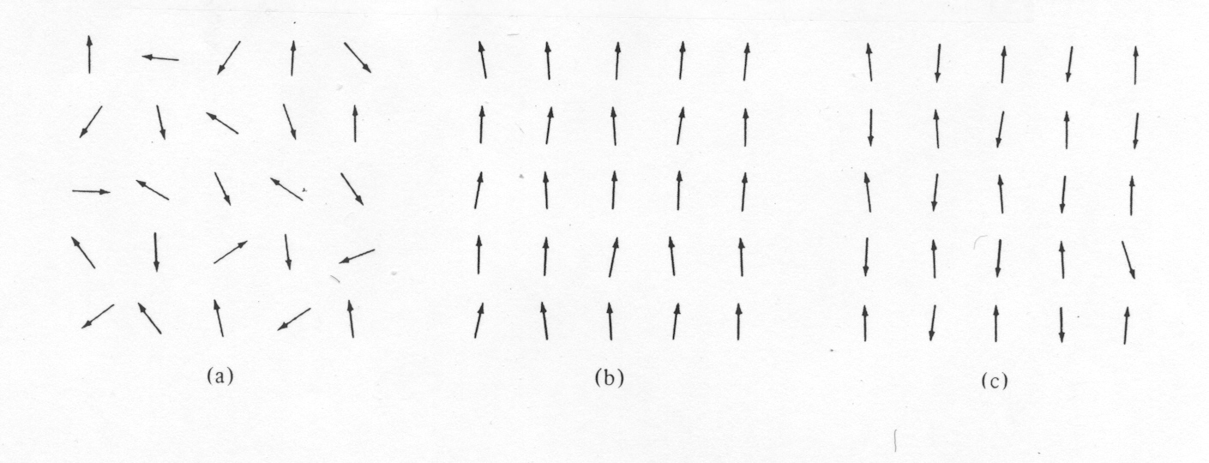
C. G. Shull et al, 1951 Magnetic Structure of MnO
Paramagnet Ferromagnet Antiferromagnet
T>T_{C} T<T_{C} T<T_{N}

Slide 4
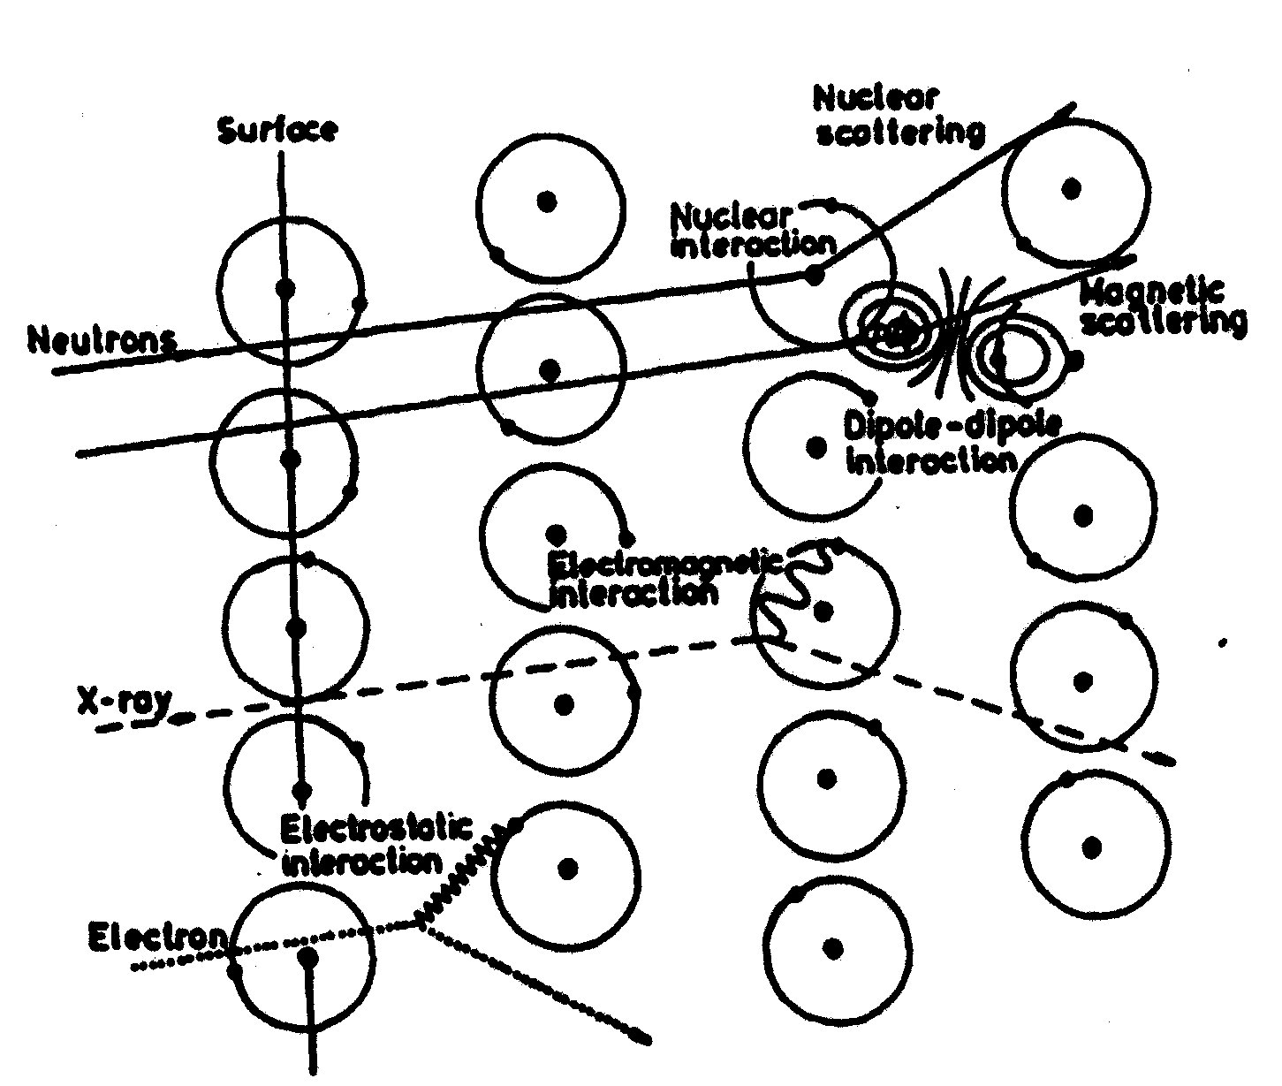
Magnetic Neutron Scattering directly probes the electrons in solids
Killer Application: Most powerful probe of magnetism in solids!

Slide 5
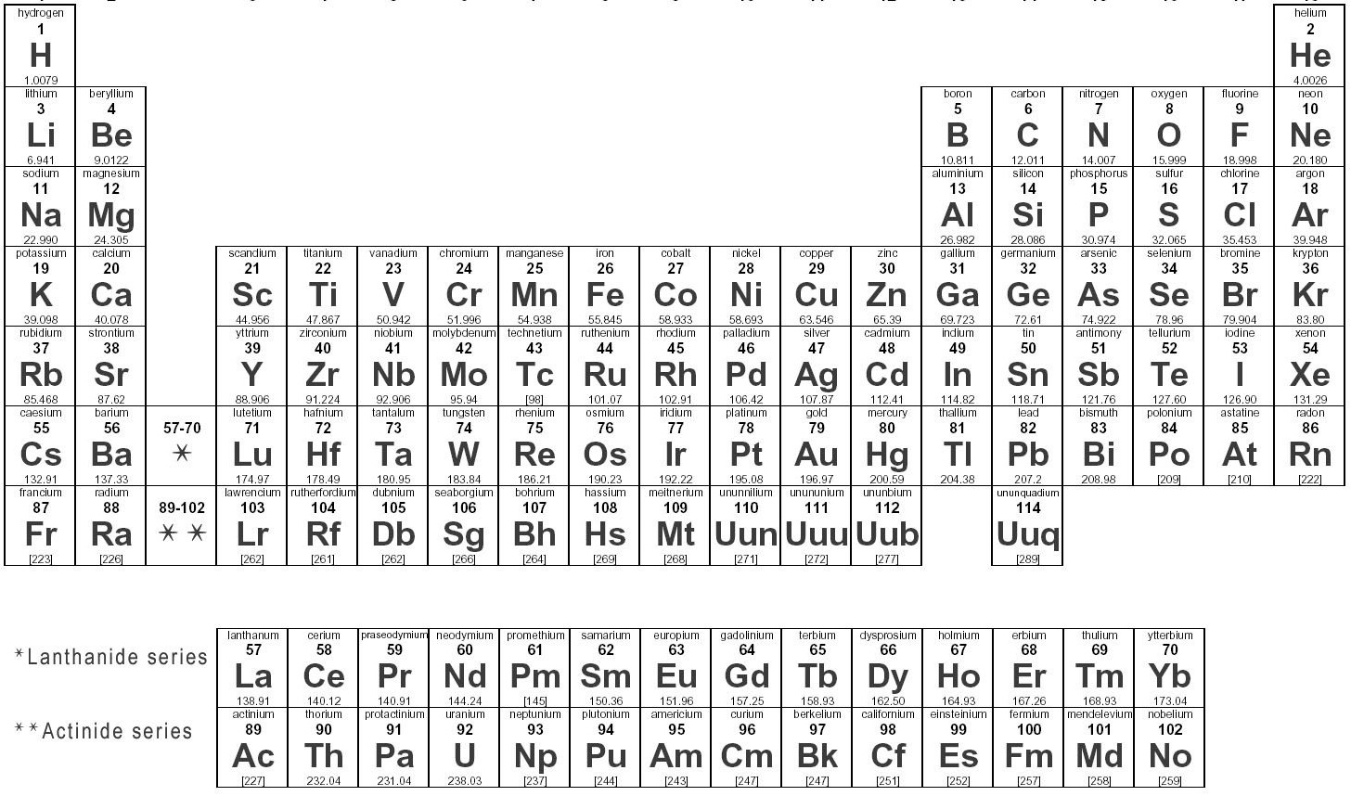
Magnetism = Net Angular Momentum
d-electrons: 10 levels to fill
4f
14 levels
5f

Slide 6
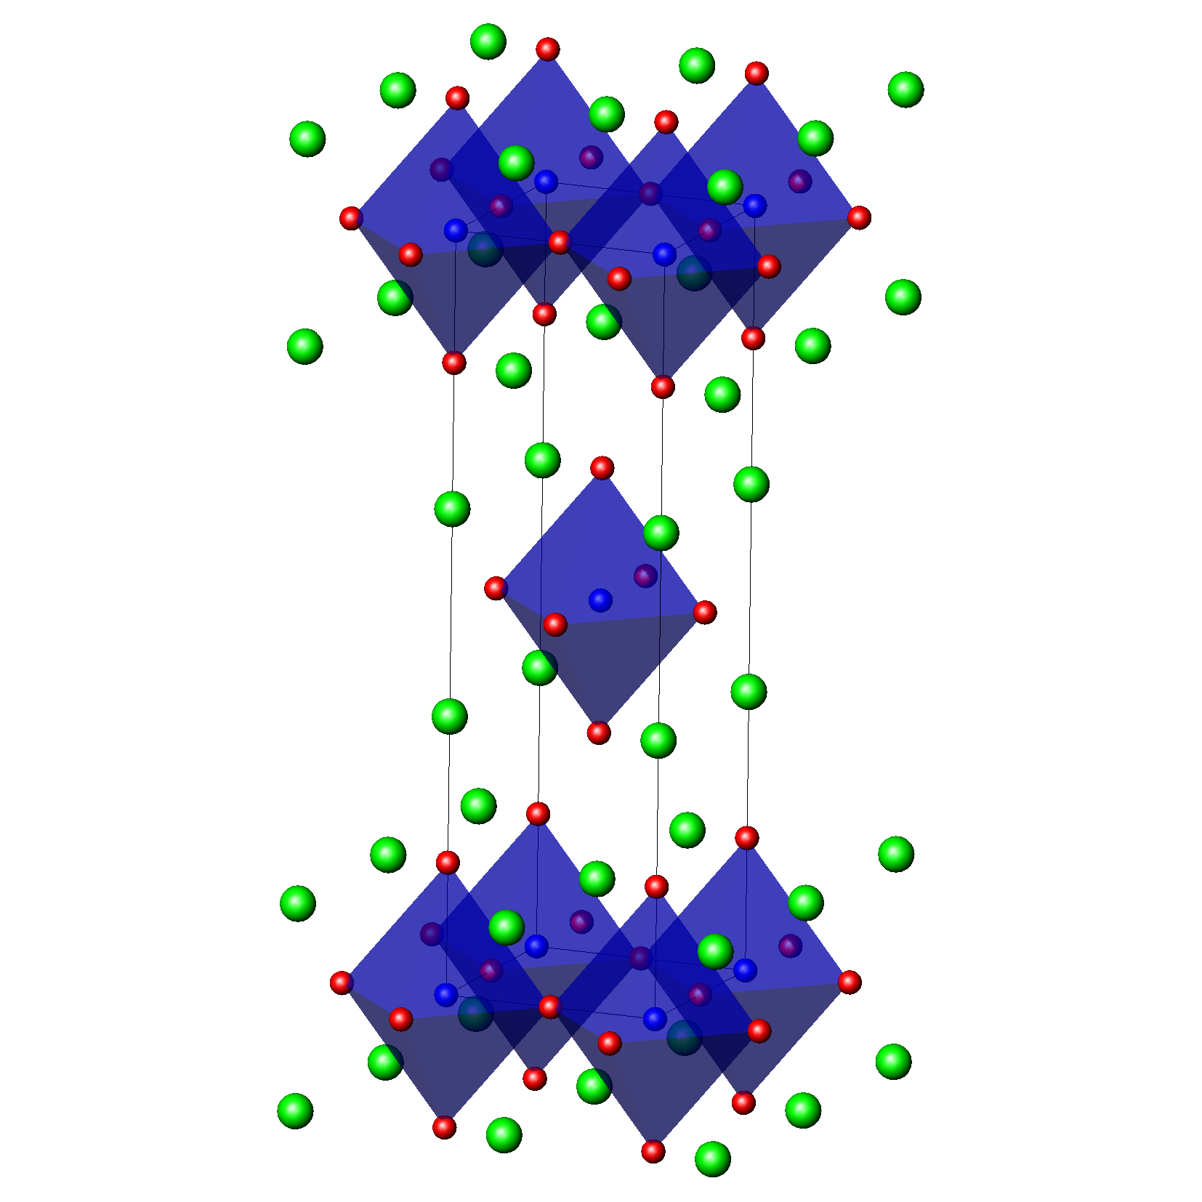
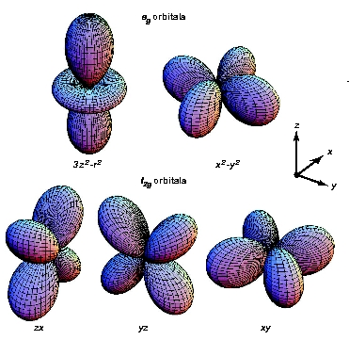
e_{g} orbitals
t_{2g} orbitals

Slide 7
3d⁵ : Mn²⁺
e_{g} orbitals
t_{2g} orbitals

Slide 8
3d⁹ : Cu²⁺
e_{g} orbitals
t_{2g} orbitals

Slide 9
Superexchange Interactions in Magnetic Insulators
H = J Σ_{i,j} S_{i}∙S_{j}
RKKY exchange in Itinerant Magnets (eg. Rare Earth Metals)

Slide 10
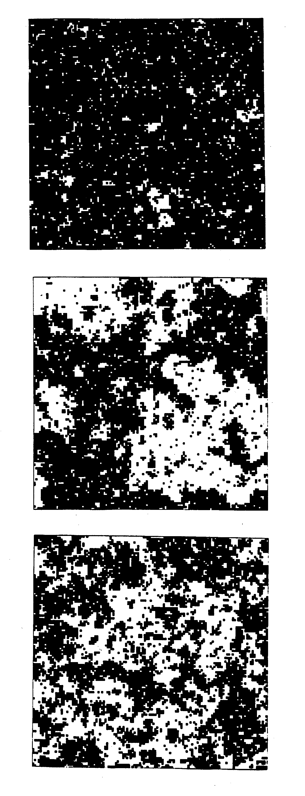
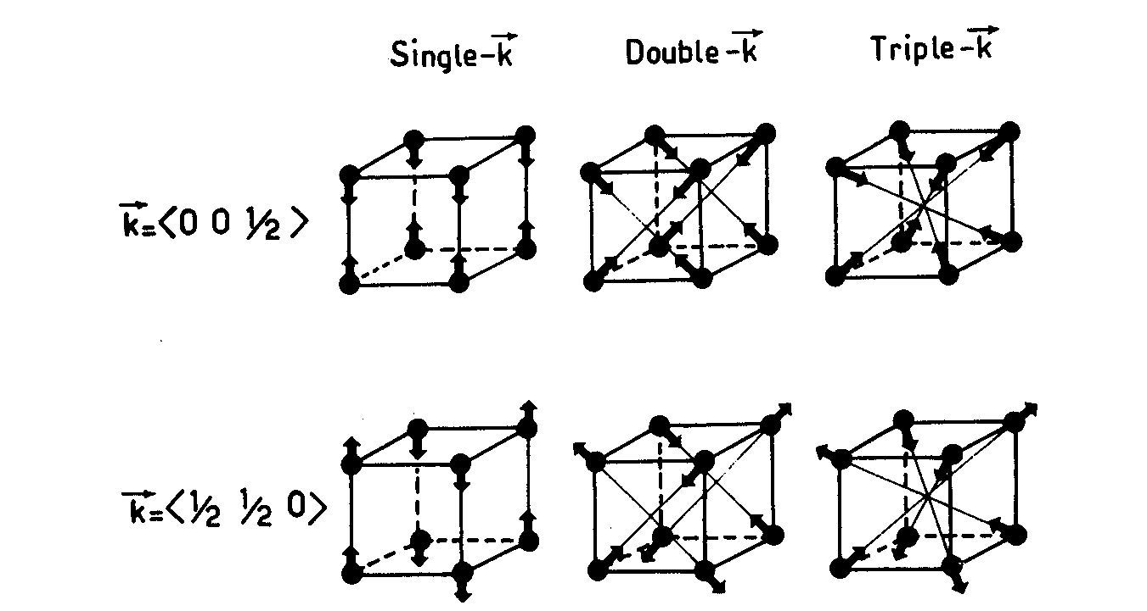
T = 0.9 T_{C}
T = T_{C}
T = 1.1 T_{C}

Slide 11
Magnetic Neutron Scattering
Neutrons carry no charge; carry s=1/2 magnetic moment
Only couple to electrons in solids via magnetic interactions
μ_{n} = - γ μ _{N} σ
γ = 1.913 nuclear magneton=e ħ/2m_{n} Pauli spin operator
How do we understand what occurs when a beam of
mono-energetic neutrons falls incident on a magnetic material?

Slide 12
Calculate a “cross section”:
What fraction of the neutrons scatter off the sample with a particular:
Change in momentum: κ = k – k´
b) Change in energy: ħω = ħ²k²/2m - ħ²k^{´2}/2m
Fermi’s Golden Rule
1st Order Perturbation Theory
d²σ/dΩ dE´ : k , σ , λ → k´, σ´ , λ´
= k´/k (m/2π ħ²)² |< k´σ ´λ´ | V_{M} | k σ λ >|² δ (E_{λ} – E_{λ}´+ ħω)
kinematic interaction matrix element energy conservation

Slide 13
Understanding this means understanding:
V_{M}: The potential between the
neutron and all the unpaired
electrons in the material
V_{M} = -μ_{n}B
e⁻
n
Magnetic Field
from spin ½ of Electron: B_{S}
e⁻
Magnetic Field
from Orbital Motion of Electrons: B_{L}

Slide 14
The evaluation of | <k´σ´ λ´ | V_{M} | k σ λ> | ² is somewhat complicated, and I will simply jump to the result:
d²σ/dΩ dE´ = (γ r₀)² k´/k Σ_{α β} (δ_{α β} – κ_{α} κ_{β} )
× Σ Σ_{All magnetic atoms at d and d´} F_{d´}*(κ)F_{d}(κ)
× Σ _{λ λ}´ p_{λ} < λ | exp(-iκ R_{d´})S^{α}_{d´}| λ´ >< λ´ | exp(iκ R_{d})S^{β}_{d} | λ >
× δ (E_{λ} – E_{λ}´ + ħω)
With κ = k – k´
This expression can be useful in itself, and
explicitly shows the salient features of magnetic neutron scattering

Slide 15
We often use the properties of δ (E_{λ} – E_{λ}´ + ħω) to obtain
d²σ/dΩ dE´ in terms of spin correlation functions:
d²σ/dΩ dE´ = (γ r₀)²/(2πħ) k´/k N{1/2 g F_{d}(κ)}²
× Σ_{α β} (δ_{α β} – κ_{α} κ_{β} ) Σ_{l} exp(iκ∙l)
× ∫ <exp(-iκ∙u₀))exp(iκ∙u_{l}(t))>
× <S₀^{α}(0) S_{l}^{β}(t)> exp(-iω t) dt
Dynamic Spin Pair Correlation Function
Fourier tranform: S(κ, ω)

Slide 16
Bottom Lines:
Comparable in strength to nuclear scattering
{1/2 g F(κ)}² : goes like the magnetic form factor squared
Σ_{α β} (δ_{α β} – κ_{α} κ_{β} ) : sensitive only to those components
of spin ⊥ κ
Dipole selection rules, goes like: < λ´ | S^{β}_{d} | λ > ;
where S^{β} =S^{x}, S^{y} (S⁺, S⁻) or S^{z}
Diffraction type experiments:
Add up spin correlations with phase set by κ = k – k´
Σ_{l} exp(iκ∙l) <S₀^{α}(0) S_{l}^{β}(t)> with t=0

Slide 17
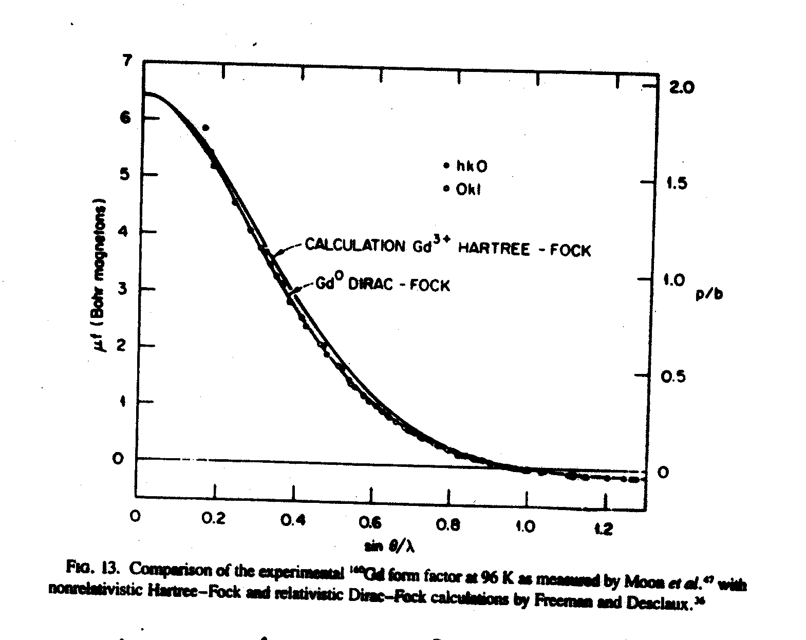
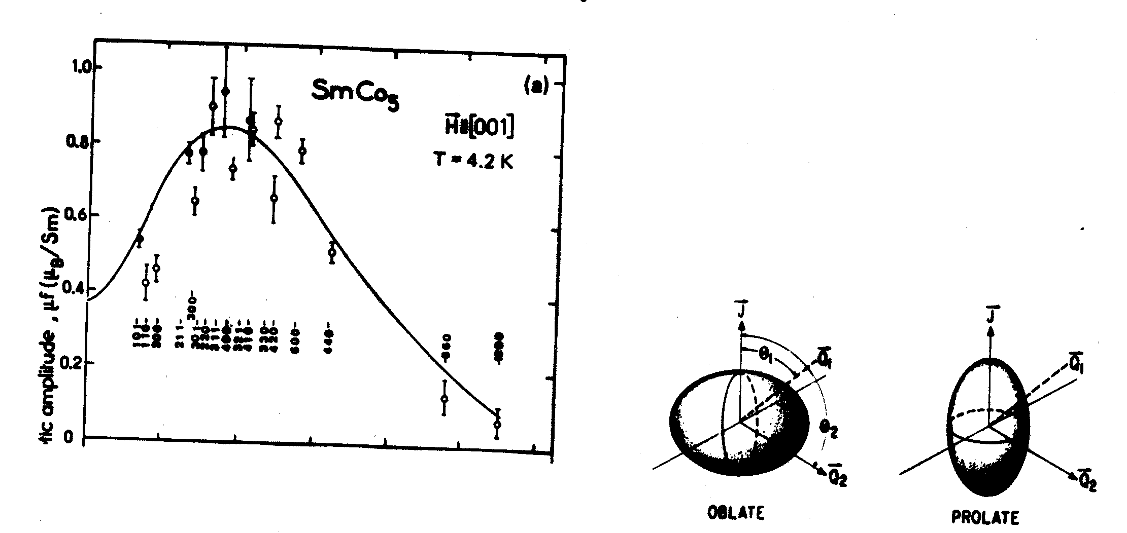
Magnetic form factor, F(κ),
is the Fourier transform of the
spatial distribution of magnetic
electrons –
usually falls off monotonically
with κ as π/(1 A) ~ 3 A⁻¹

Slide 18
Three types of scattering experiments are typically performed:
Elastic scattering
Energy-integrated scattering
Inelastic scattering
Elastic Scattering
ħω = (ħk)²/2m – (ħk´)²/2m =0
measures time-independent magnetic structure
dσ/dΩ = (γ r₀)²{1/2 g F(κ)}² exp(-2W)
× Σ_{α β} (δ_{α β} – κ_{α} κ_{β} ) Σ_{l} exp(iκ∙l) <S₀^{α}> <S_{l}^{β}>
S ⊥κ only Add up spins with
exp(iκ∙l) phase factor

Slide 19
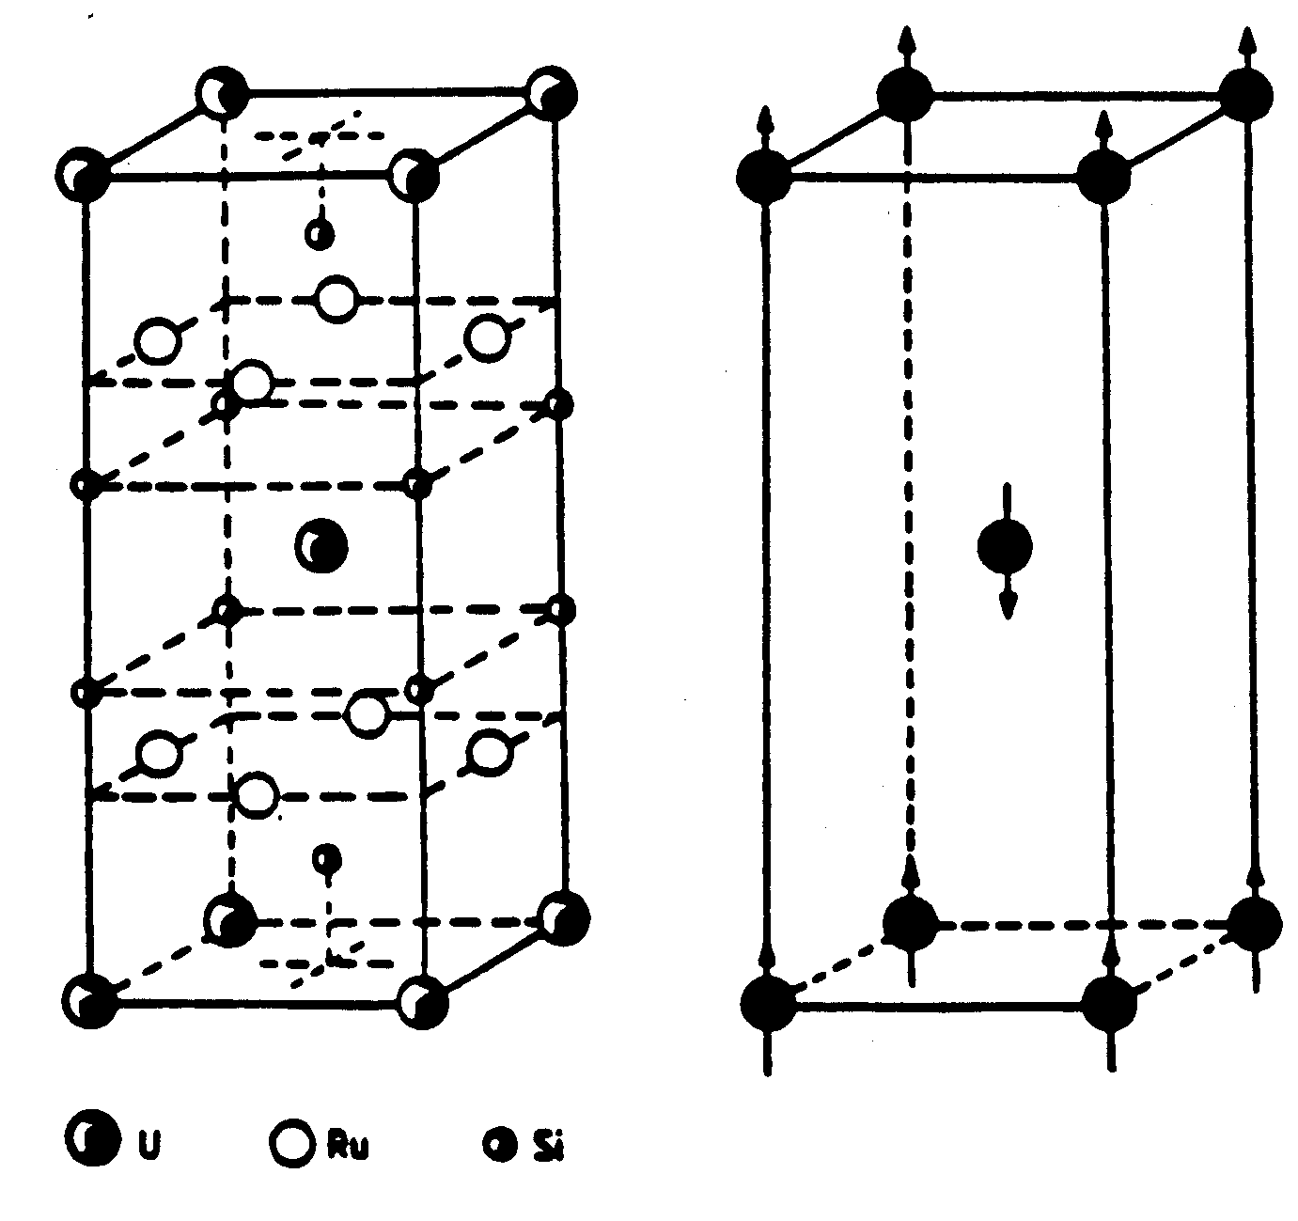
URu₂Si₂
κ = 0,0,1
a*=b*=0:
everything within a basal
plane (a-b) adds up in phase
c*=1:
2π phase shift from top to
bottom of unit cell
π phase shift from corners
to body-centre –good …..
but μ // κ kills off intensity!
+
+
Try κ = 1,0,0:
μ ⊥ κ good!
_
+
+

Slide 20
Mn²⁺ as an example: ½ filled 3d shell S=5/2
(2S+1) = 6 states : |S(S+1), m_{z} >
m_{z} = +5/2 ħ, +3/2 ħ, +1/2 ħ, -1/2 ħ, -3/2 ħ ,–5/2 ħ
-5/2 ħ
-3/2 ħ
-1/2 ħ
½ ħ
3/2 ħ
5/2 ħ
H=0; 6 degenerate states
H ≠ 0; 6 non-degenerate states
< 3/2 | S⁻ | 5/2 > ≠ 0 → inelastic scattering

Slide 21
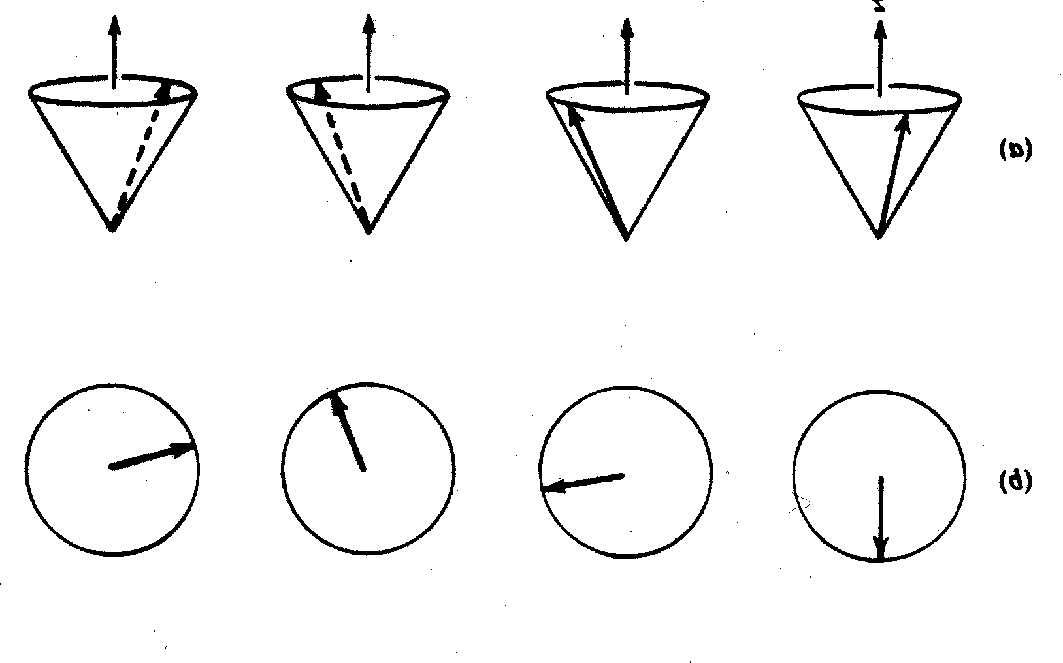
Magnetic sites are coupled by exchange interactions:
|5/2> |5/2> |5/2> |3/2> |5/2> |5/2> |5/2>
k
k´
H = J Σ_{i,j} S_{i}∙S_{j}
Spin Wave Eigenstate:
“Defect” is distributed over
all possible sites

Slide 22
Inelastic Magnetic Scattering : |k| ≠ |k⁰|
Study magnetic excitations (eg. spin waves)
Dynamic magnetic moments on time scale 10⁻⁹ to 10⁻¹² sec
S(κ, ω) = n(ω) χ˝(κ, ω)
Bose (temperature) factor Imaginary part of the
dynamic susceptibility

Slide 23
Sum Rules:
One can understand very general features of the magnetic neutron
Scattering experiment on the basis of “sum rules”.
1. χ_{DC} = ∫ (χ˝(κ=0, ω)/ω) dω ;
where χ_{DC} is the χ measured with a SQUID
2. ∫dω ∫_{BZ} dκ S(κ, ω) = S(S+1)

Slide 24
T = 0.9 T_{C}
Symmetry broken
T = T_{C}
∼ very large
Origin of universality
T = 1.1 T_{C}

Slide 25
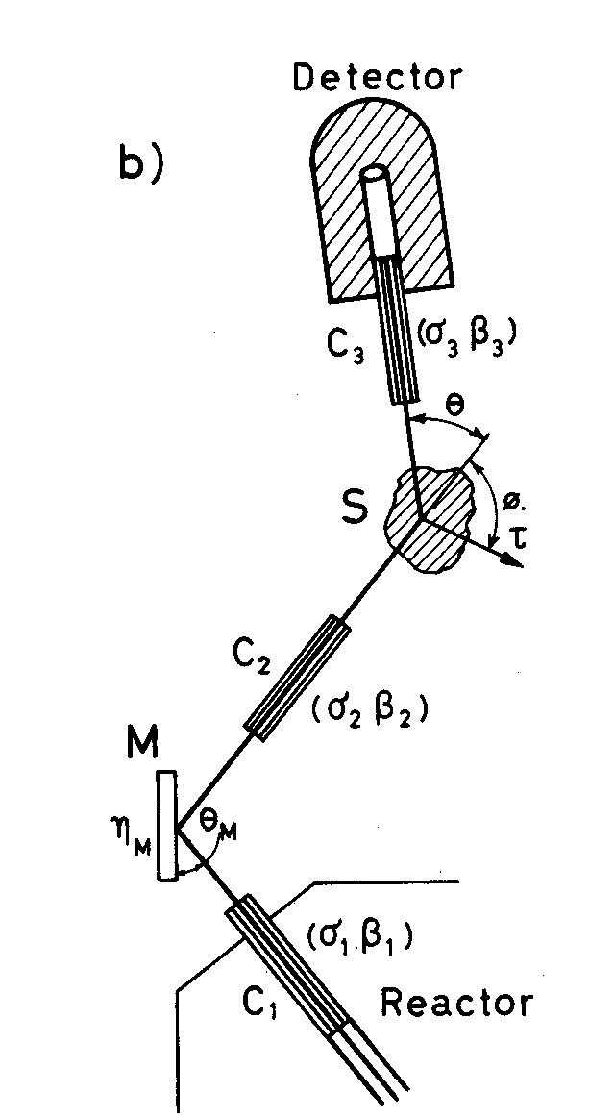
Bragg scattering gives square of
order parameter; symmetry breaking
Diffuse scattering gives
fluctuations in the order
parameter
T<T_{C}
Intensity
M(Q)²
χ(Q_{ord})
κ
Q=2π/d

Slide 26
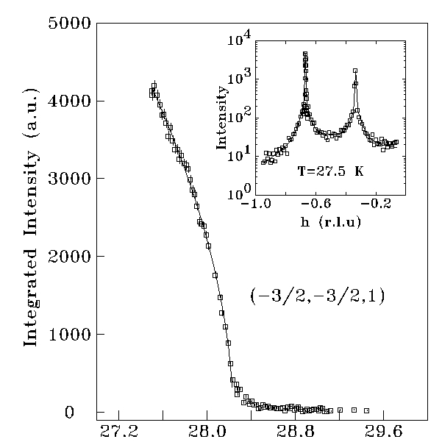
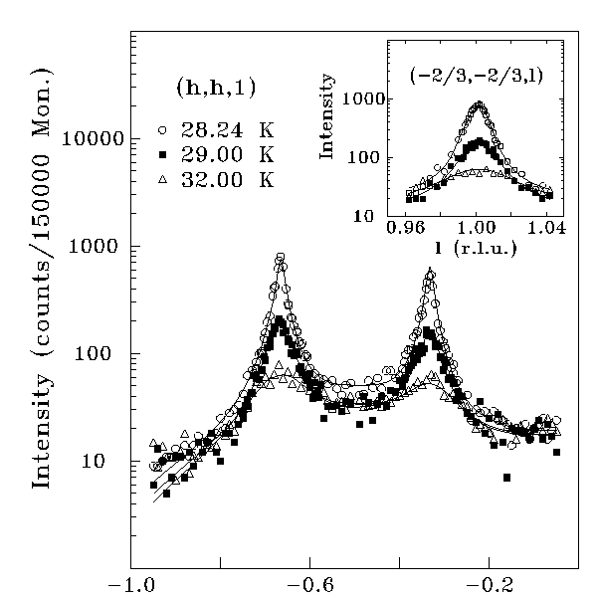
CsCoBr₃
Bragg scattering
Q=(2/3, 2/3, 1)
Energy-integrated
critical scattering
I=M²=M₀²(1-T/T_{C})^{2β}

Slide 27
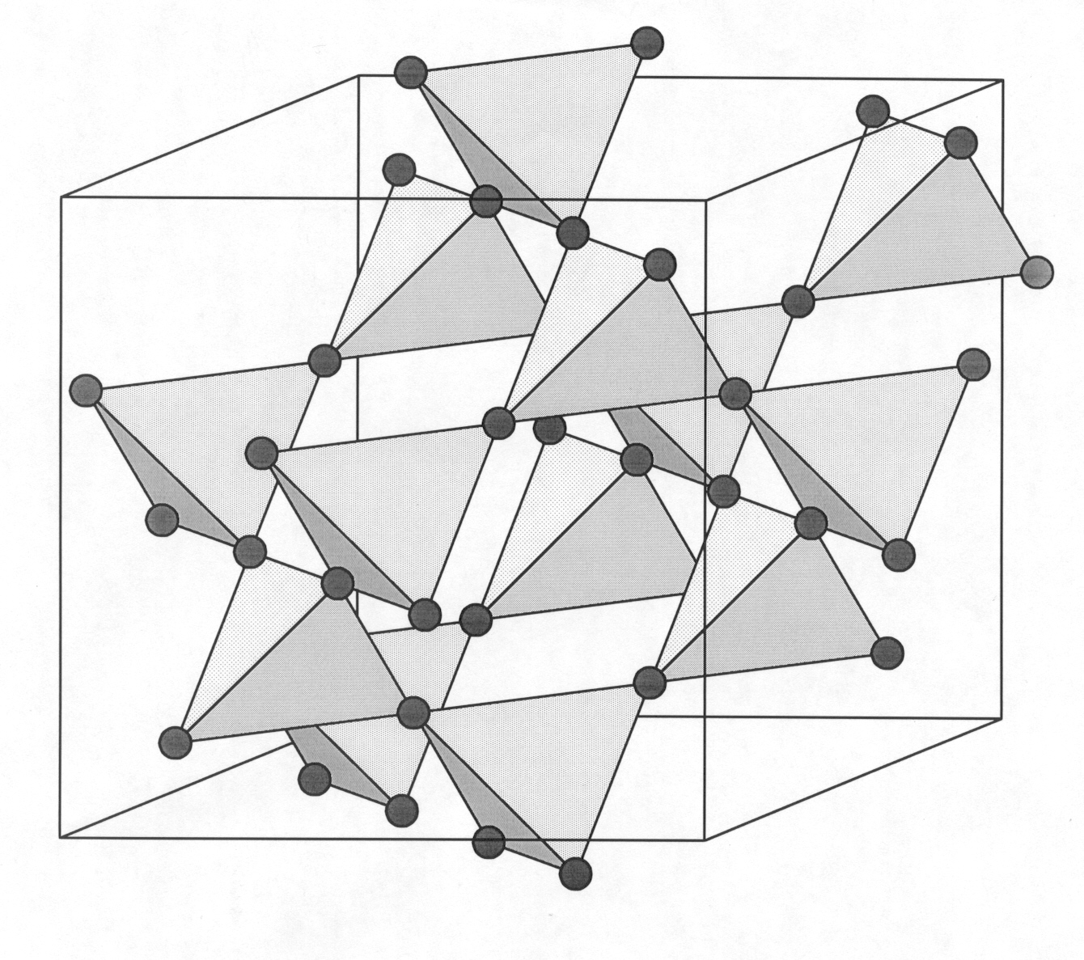
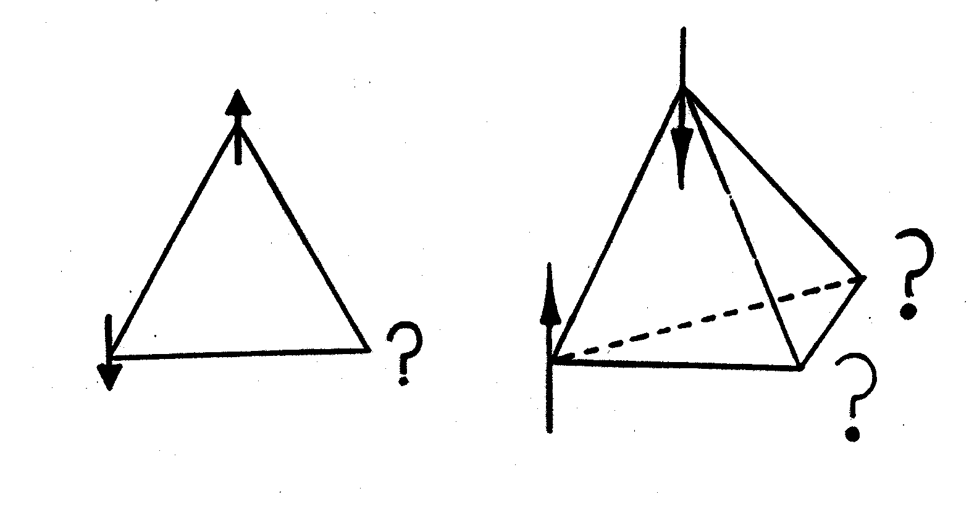
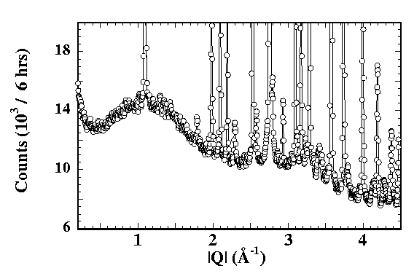
Geometrical Frustration:
The cubic pyrochlore structure;
A network of corner-sharing tetrahedra
Low temperature powder
neutron diffraction from
Tb₂Ti₂O₇

Slide 28
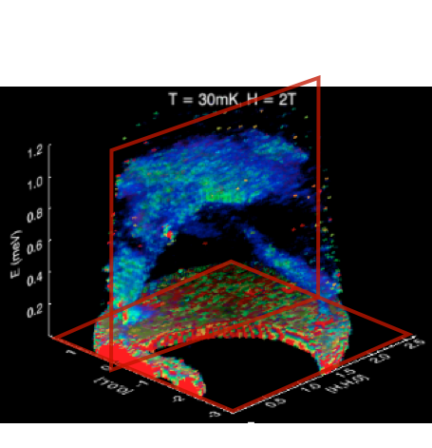
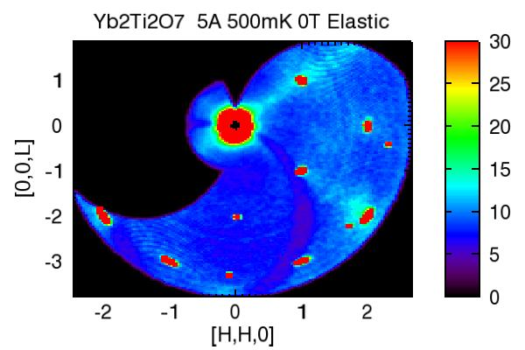
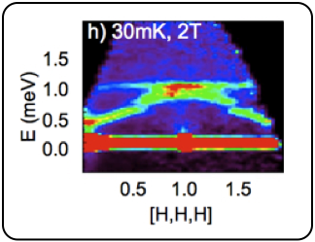
Yb₂Ti₂O₇ field polarized state

Slide 29
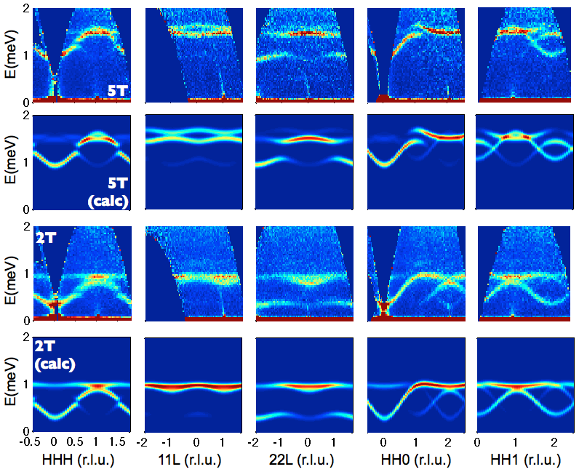
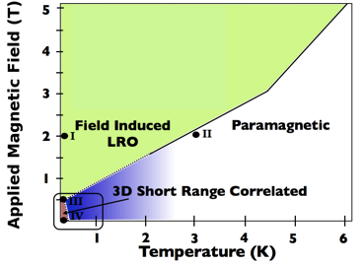
Yb₂Ti₂O₇ field polarized state
“Quantum Spin Ice”
K.A. Ross, L. Savary, B. D. Gaulin, and L. Balents, Quantum Excitations in Quantum Spin Ice, Phys. Rev. X 1, 021002 (2011).
(meV)

Slide 30
Conclusions:
Neutrons probe magnetism on length scales from
1 – 100 A, and on time scales from 10⁻⁹ to 10⁻¹² seconds
Magnetic neutron scattering goes like the form factor
squared (small κ), follows dipole selection rules
< λ´ | S^{+,−,z} | λ > , and is sensitive only to
components of moments ┴ to κ.
Neutron scattering is the most powerful probe of
magnetism in materials; magnetism is a killer
application of neutron scattering (1 of 3).

