Slide 1
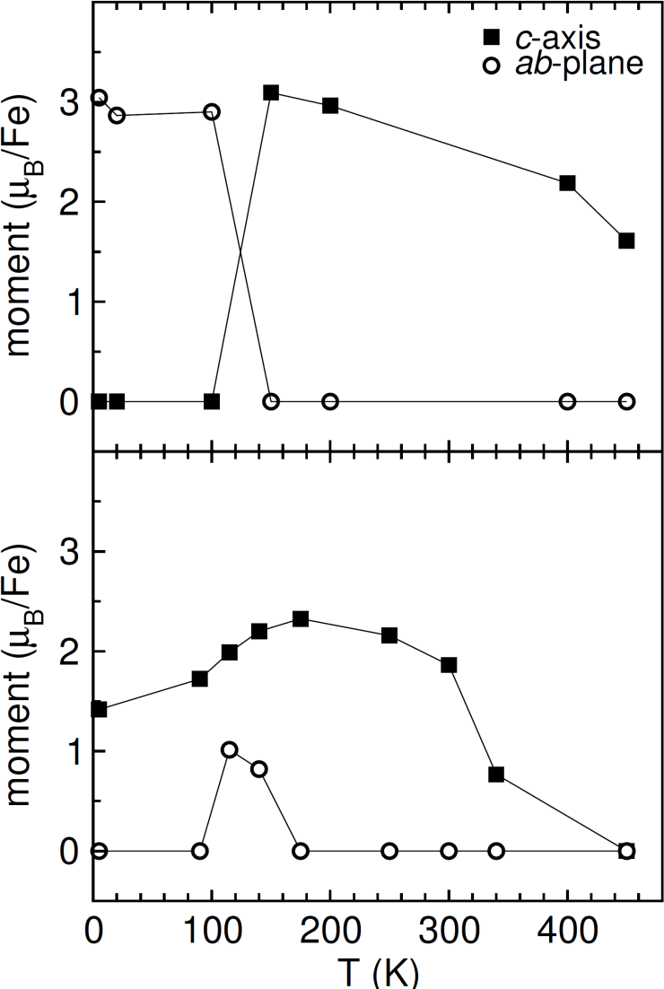
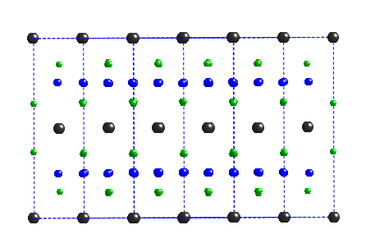
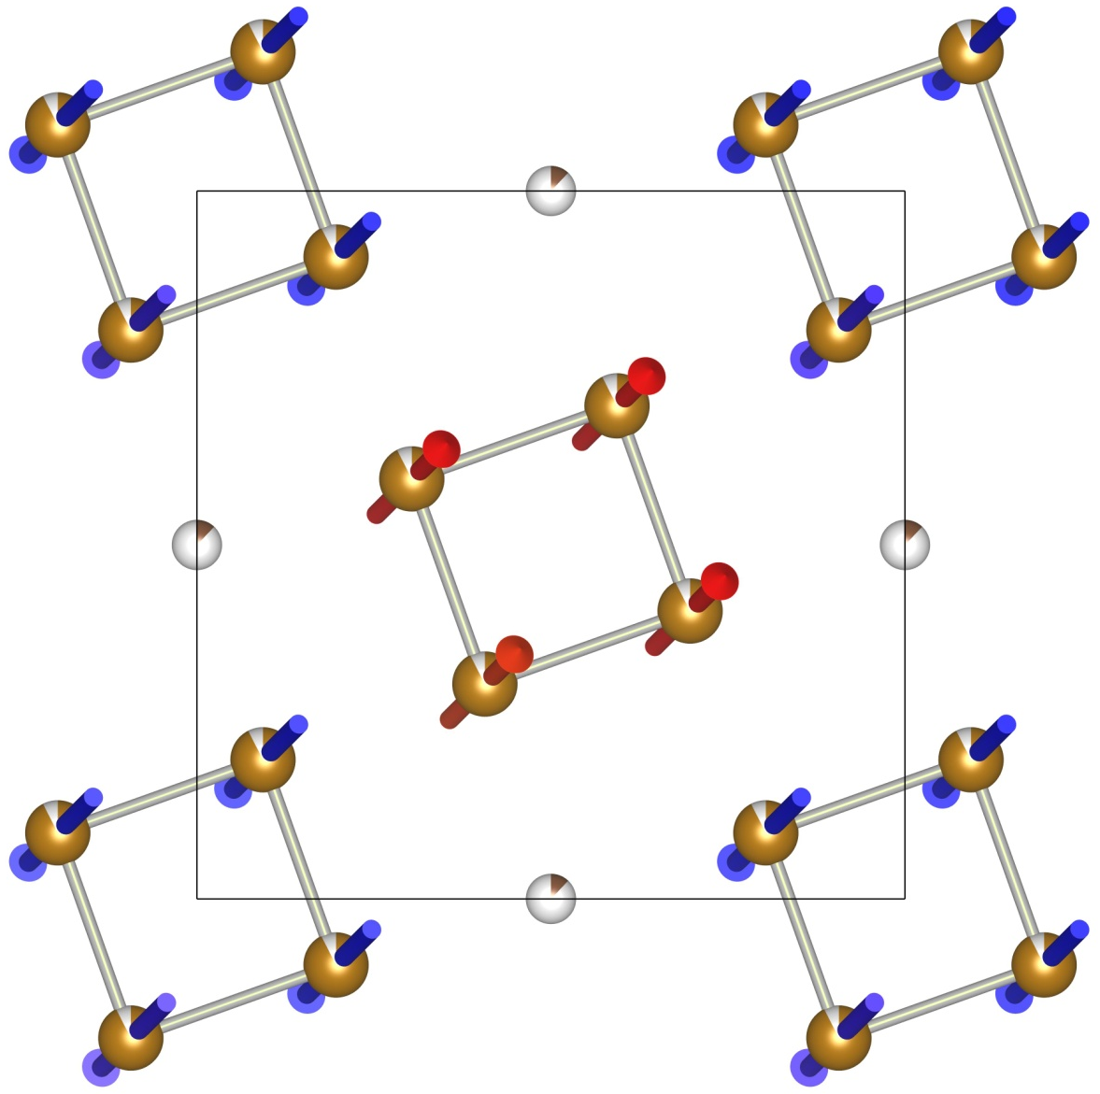
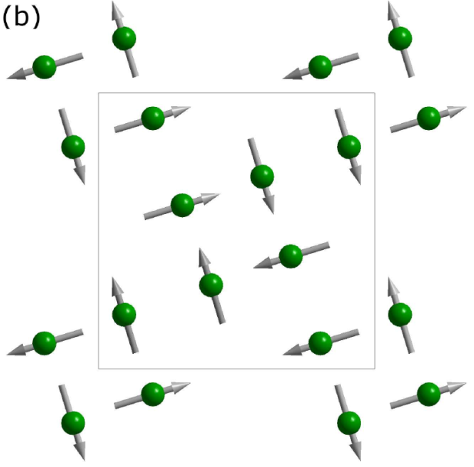
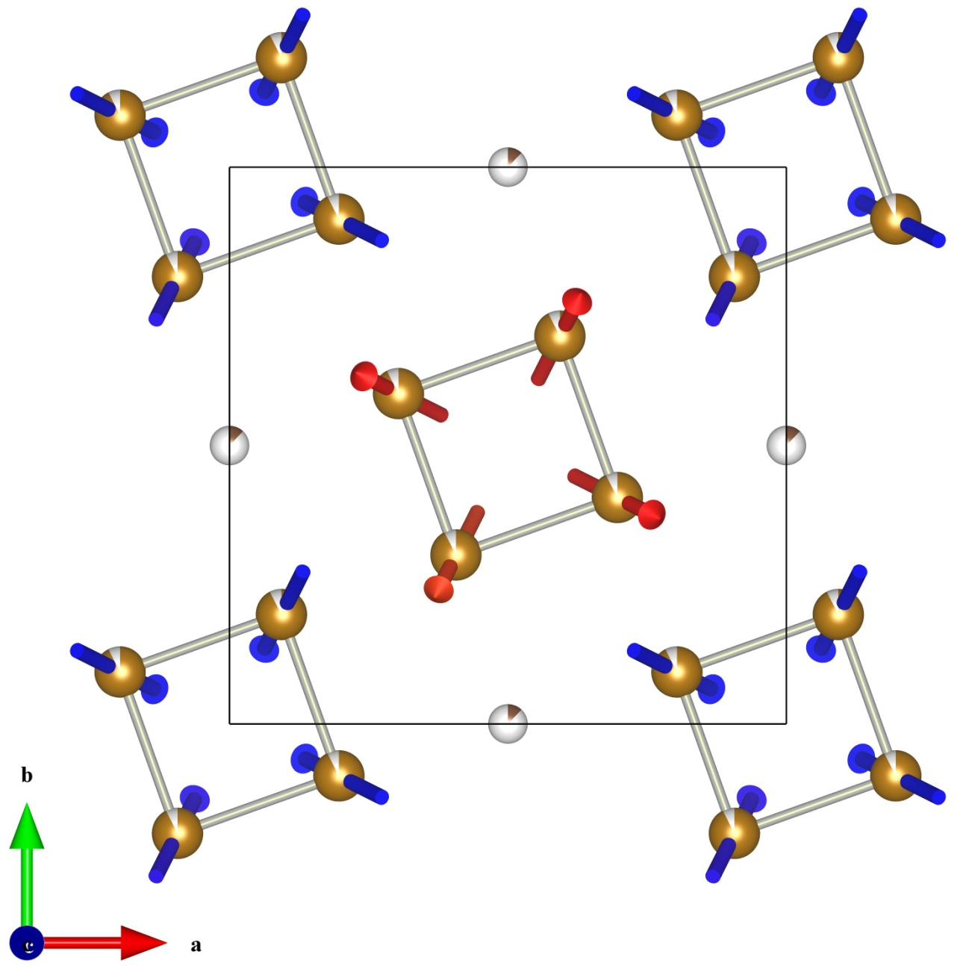
Spin Reorientation in TlFe_{1.6}Se₂ with Complete Vacancy Ordering
Ordered vacancies tune the magnetic order.
Ordered region
Detailed characterization of single crystal TlFe_{1.6}Se₂ with complete chemical and vacancy order reveals a previously unobserved spin reorientation with spins lying in the ab-plane for T < 100 K.
A strong interaction between the ordered and disordered regions must prevent this ground state from occurring in the partially ordered crystals at low temperatures.
Single-crystal neutron diffraction was used at the HB-3A four-circle diffractometer, High Flux Isotope Reactor, ORNL, to determine these magnetic structures as a function of temperature.
Complete vacancy ordering
Partially vacancy ordering
2 nm
Disordered region
NC: non-collinear AFM structure with spins lying in ab-plane
Canted: spins in BC develop an ab-plane component of the moment
BC: block-checkerboard structure with spins aligned with c-axis
May et al., Physical Review Letters, 109, 077003 (2012)

