Slide 1
Welcome to the 2018 Neutron and X-ray Scattering School
22 July, 2018
Argonne National Laboratory
&
Oak Ridge National Laboratory

Slide 2
Introduction to the 2018
X-ray and Neutron School
John M. Carpenter
Advanced Photon Source Engineering Support Division
Senior Physicist, retired
Emeritus Scientist
Argonne Distinguished Fellow

Slide 3
History of Neutron and X-ray Scattering
X-ray diffraction became well integrated into science programs since the discovery of diffraction in 1915.
The discovery of the neutron in 1932 and the later proof of neutron diffraction led pioneering scientists working at the first reactors in the 1940s to demonstrate the capabilities of reactor-generated thermal neutrons for materials science research, in addition to the uses of reactors for “other” purposes.
From these beginnings came the construction of progressively larger reactor facilities and of neutron scattering instruments specifically devoted to materials research. And in the 1950s and 1960s, to installation of medium-power reactors in laboratories and universities around the world.
The first school seems to have been organized in the 1960s around the UK research reactors and the electron linac neutron source at the Atomic Energy Research Establishment, Harwell, UK. Around that time, numerous medium-flux research reactors were built that could support a community of users. As the world’s complement of installations evolved,

Slide 4
Evolution of neutron sources
Reactor-based neutron facilities developed up to engineering heat transfer the limits. Accelerator-based pulsed spallation neutron sources, which leap beyond these constraints, with scattering instruments to match, evolved in the 1970s.

Slide 5
X-ray sources
For a long time, energetic electron beams striking solid targets produced x-rays for diffraction applications. Electron synchrotrons and storage rings, earliest with bending magnets and now with undulators producing synchrotron radiation (bremsstrahlung) photons, have replaced that technology in the large research establishments for x-ray scattering applications. These have evolved far beyond the capabilities of solid-target x-ray sources. And they have proliferated into scores of installations, each of which support tens of x-ray scattering instruments.

Slide 6
Schools
Neutron and x-ray scattering schools have arisen around major facilities that support materials science research. The first of the neutron scattering schools seems to have been the one at the Atomic Energy Research Establishment at Harwell, UK, established in the 1960s and related to the early research reactors and the Harwell electron-linac based bremsstrahlung photoneutron source there. The school supported and was peopled largely by a community of users mostly in UK universities and the AERE research staff. That school and the UK Neutron Beam Research Unit of the UK Ministry of Science (I think it was called) provided a model system that served the large user community, which is the same as is widely in use today.

Slide 7
Neutron and X-ray schools around the world
CETS, Central European Neutron School, Budapest
HERCULES, Higher European Research Course for Users of Large Experimental Science, Grenoble, Paris, Villigen
Oxford School of Neutron Scattering, Oxford
Berlin Neutron School, HZB Berlin
SONS , School of Neutron Scattering, Scuola Neutroni, Erice
LANSCE School on Neutron Scattering, Los Alamos
JCNS Laboratory Course on Neutron Scattering, Jülich

Slide 8
Neutron and X-ray schools around the world
AONSA Muon and Neutron School, Asia-Oceania-Pacific member-laboratory venues
The All-Russian School for Young Scientists and Students and International Student Practice Summer School, Всероссийская Школя Молодых Учёных, Dubna
SwedNESS Swedish Neutron School NNSP, : Swedish Foundation for Strategic Research (SSF), first meeting Tartu, Estonia
Nordic Neutron School, : NordForsk (Denmark, Norway, Sweden collaboration), to be established soon (2018?)
PSI Summer School on Condensed Matter Research, Zuoz
NIST Summer School on Fundamentals of Neutron Scattering, Gaithersburg

Slide 9
Schools, continued
ANL/ORNL National School on Neutron and X-Ray Scattering,
Argonne and Oak Ridge
THAT’S US!
LAST YEAR’S (2017) GROUP

Slide 10
You are all members of a select group:
• Because of your scientific qualifications
• Because of your scientific interests
• You will meet others who share your
experience in the neutron and x-ray schools. And you will be seeing them
again, cooperating and collborating
• You will meet experienced scientists who
will share their knowledge and experience and answer your questions

Slide 11
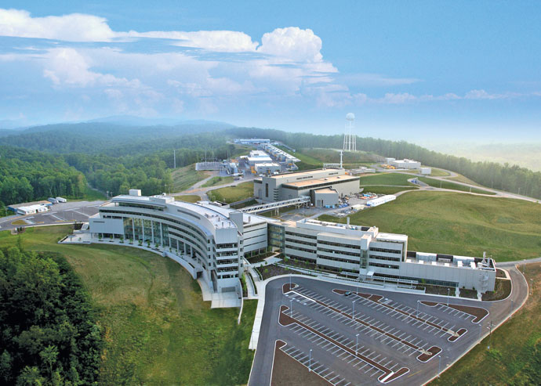
The Spallation Neutron Source at ORNL

Slide 12
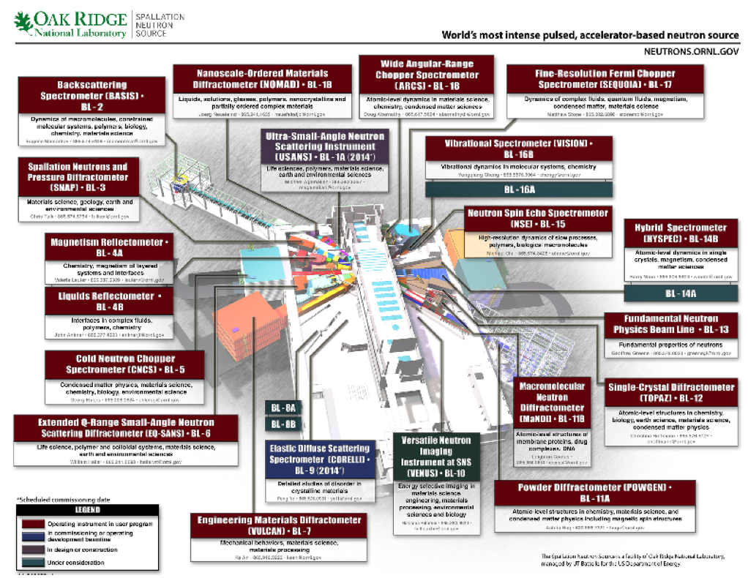
SNS Neutron-Scattering Instruments

Slide 13
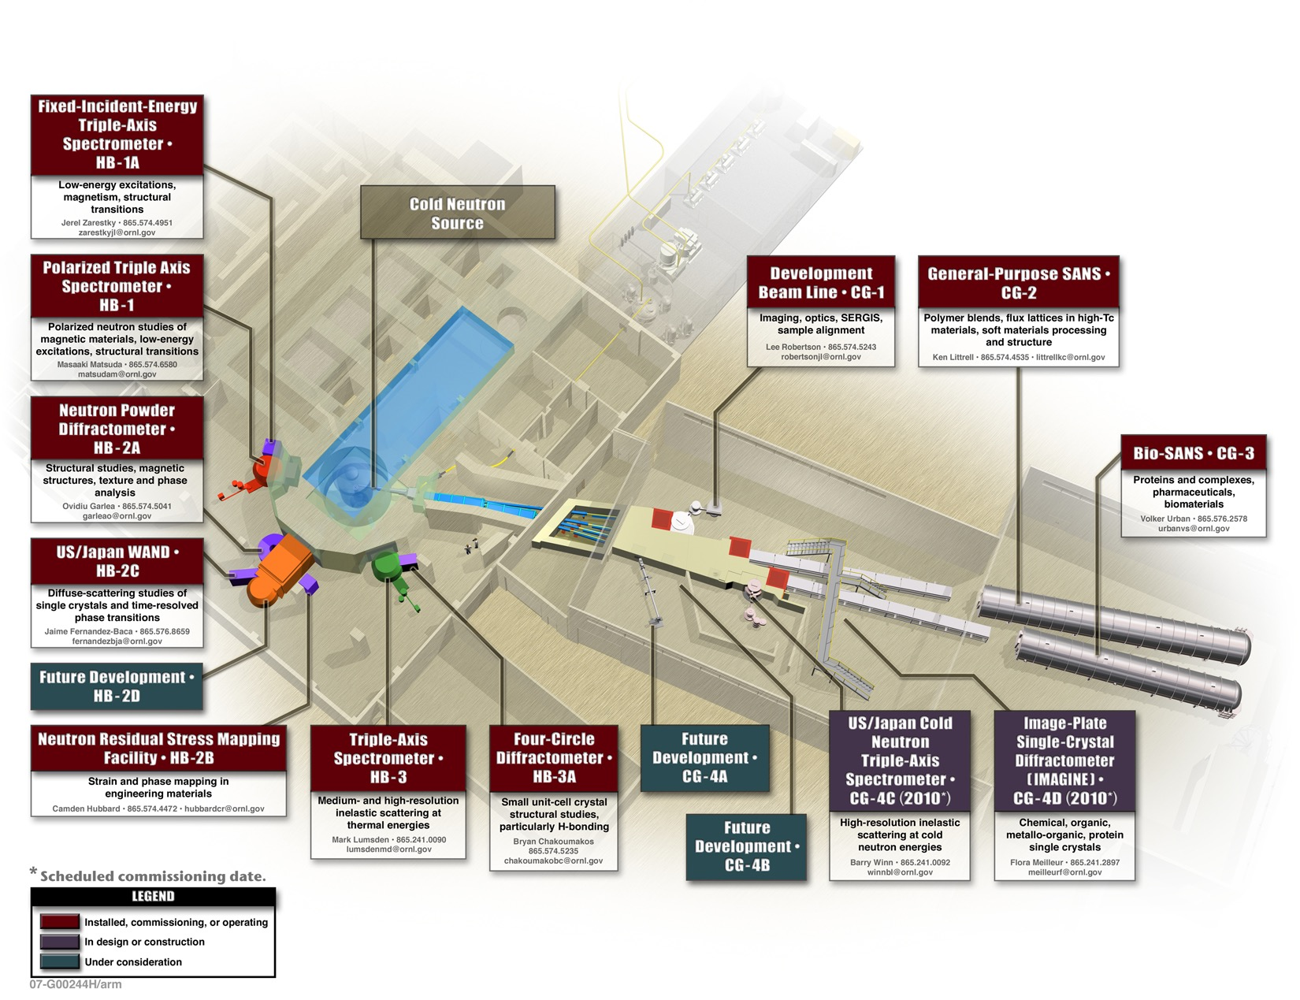
HFIR Neutron-Scattering Instruments

Slide 14
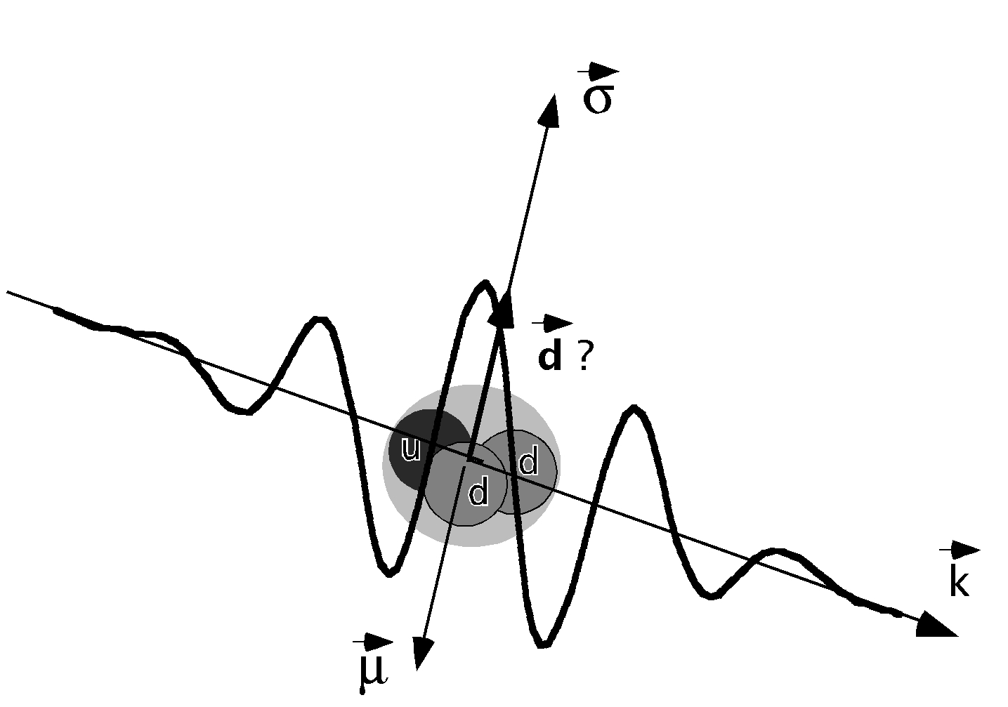
Some Things You Probably Already Know
THE NEUTRON AND ITS QUARK STRUTURE

Slide 15
THE QUARKS (each has an “anti”)
Generation | Flavor | Symbol | Charge, e units | Rest Mass, MeV
First | down | D | -1/3 | 5
First | up | U | 2/3 | 10
Second | strange | S | -1/3 | 200
Second | charm | C | 2/3 | 1500
Third | bottom | B | -1/3 | 5000
Third | top | T | 2/3 | 173 000

Slide 16
Relative Scattering Lengths
(apparent sizes) of Representative Elements

Slide 17
Energy-Wavelength Relationships

Slide 18
Nomenclature Of Neutron Energies

