Slide 1
Extreme Conditions Environments
Bianca Haberl
Neutron Scattering Division,
Neutron Sciences Directorate,
Oak Ridge National Laboratory,
Oak Ridge, TN 37831, USA

Slide 2
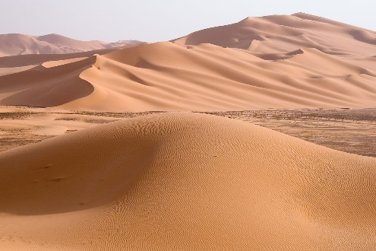
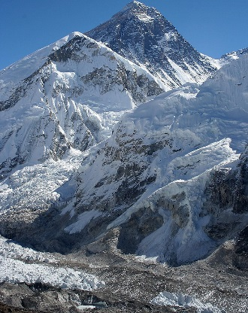
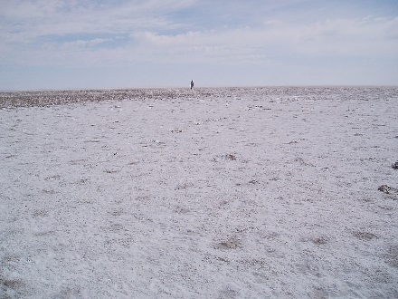
Extreme conditions environments
Wikipedia:
“An 'extreme environment' contains conditions that are hard to survive for most known life forms.”
Alkaline/acidic: below pH 5 or above pH 9
Extremely cold/hot: below -17ºC or above 40ºC
Under pressure: e.g. habitats deeper than 2000 m
Under radiation
Hypersaline
Without water or oxygen
Sandy desert
Mount Everest
Source: Wikipedia
Salt lake

Slide 3
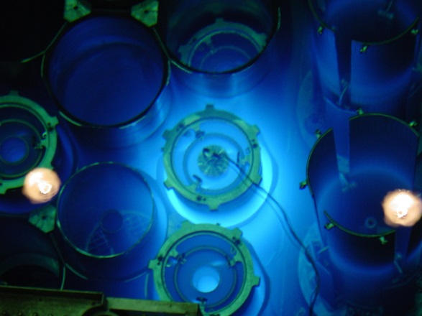
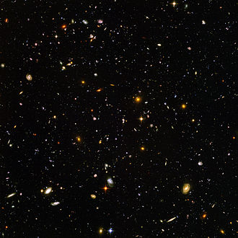
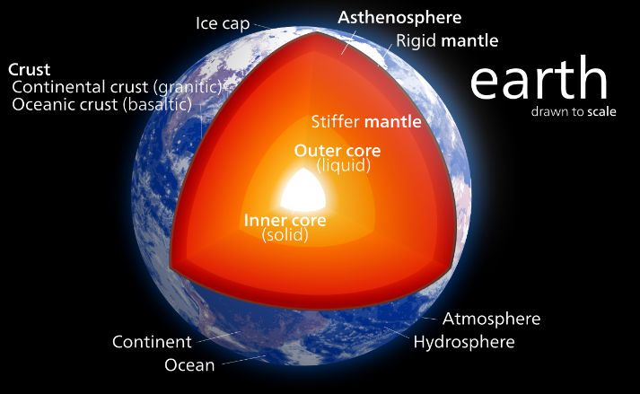
Common extreme conditions environments here
Extremely cold: ~80 K down to a few 100 mK
High magnetic fields: several Tesla
Intense radiation: e.g. in HFIR
Extremely hot: ~1000-3000 K
Pressure: up to 100 GPa (or 1 Mbar)
Spent elements in HFIR
Temperature in deep space due to background radiation ~3 K
Pressure and temperature in the earth core ~360 GPa and ~5700 K
Photo source: Wikipedia

Slide 4
Outline
Overview over extreme environments used at ORNL:
1. Irradiation environment
2. Cryostats and magnets
3. Extreme high temperature
4. More detailed introduction to pressure techniques
Gas pressure cells
SANS cells
Clamp cells
Paris-Edinburgh presses
Diamond anvil cell program at ORNL

Slide 5
1. Irradiated samples
Radioactive samples from HFIR for example can be contained within large lead shielding and measured with neutrons.
Pb shielding
radioactive sample
neutron beam
Example courtesy of Ken Littrell, GP-SANS
Samples that require thick shielding can still be studied with neutrons and even placed into further sample environments themselves.

Slide 6
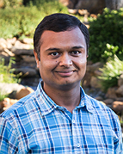
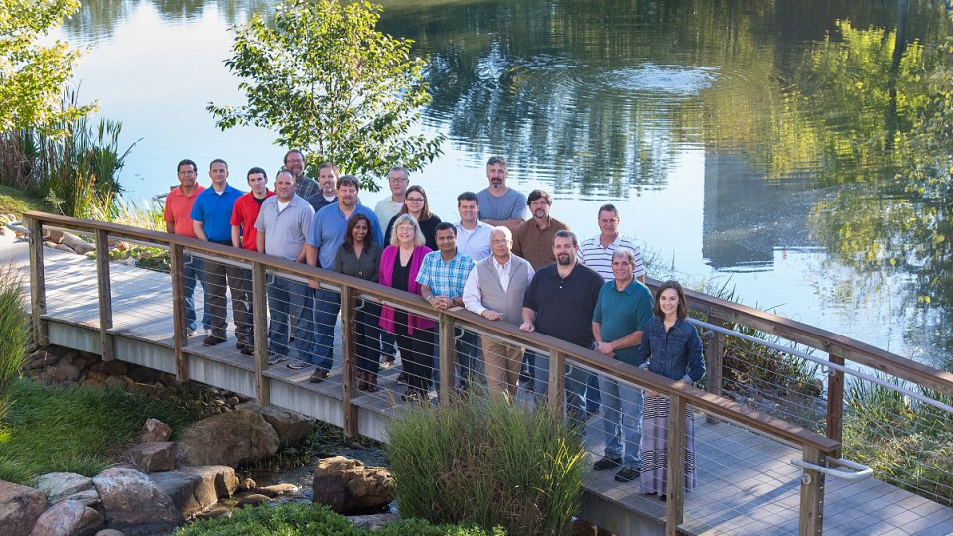
Outline
Overview over extreme environments used at ORNL:
1. Irradiation environment
2. Cryostats and magnets
3. Extreme high temperature
4. More detailed introduction to pressure techniques
Gas pressure cells
SANS cells
Clamp cells
Paris-Edinburgh presses
Diamond anvil cell program at ORNL
Harish Agrawal
SNS & HFIR Sample Environment Group

Slide 7
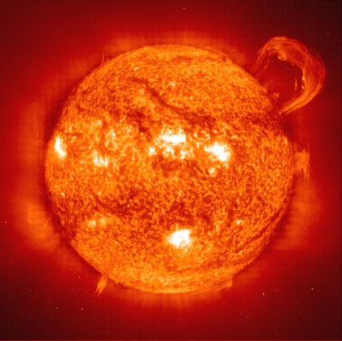
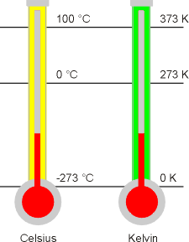
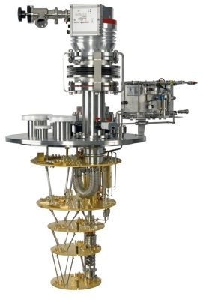
2. What are Ultra Low Temperatures?
Sun~ 6,000 K
X 20
Room temp ~ 300K
X 30,000
<1 K is called ULT
D/R system~10mk
Source: Harish Agrawal (ORNL)

Slide 8
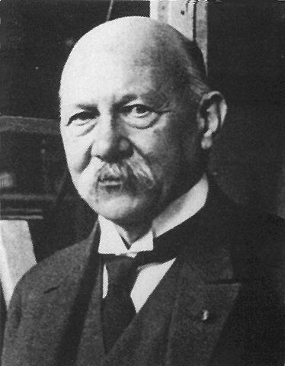
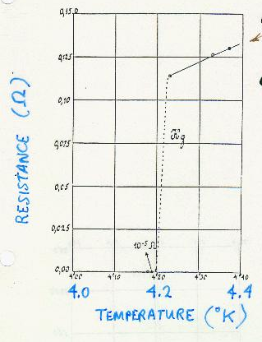
2. Eventful times in Leiden: ~110 years ago
Heike Kamerlingh Onnes
appointed to a chair of physics in Leiden aged 29: experimentalist, engineer and
organisational genius
1884 Constructed a cascade liquefaction plant for oxygen, nitrogen and air
1906 Liquefied hydrogen
1908 First liquefaction of helium
Discovered superconductivity (in mercury)
Received the Nobel Prize in 1913 for his studies of the properties of matter at low temperatures which led to liquid helium.
He was the winner in the race to make liquid helium
Source: Harish Agrawal (ORNL)

Slide 9
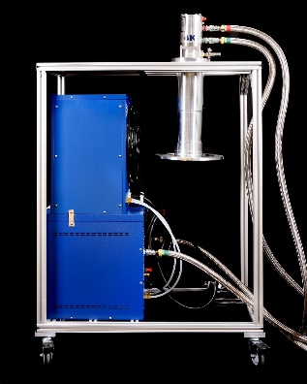
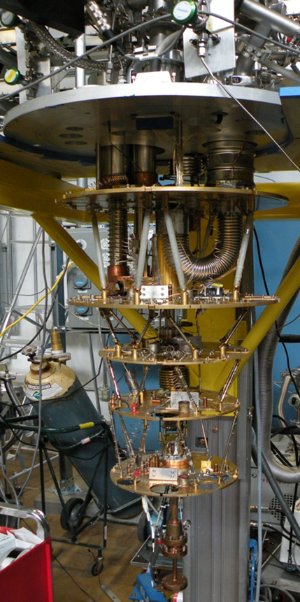
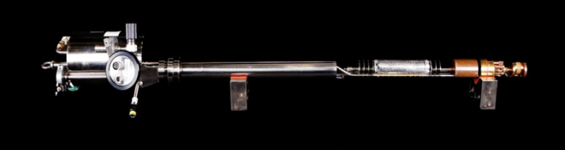
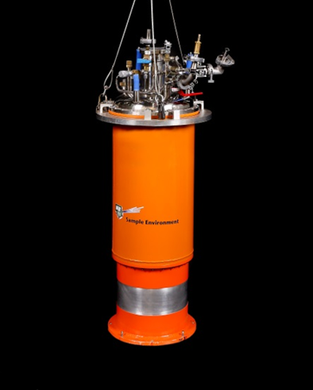
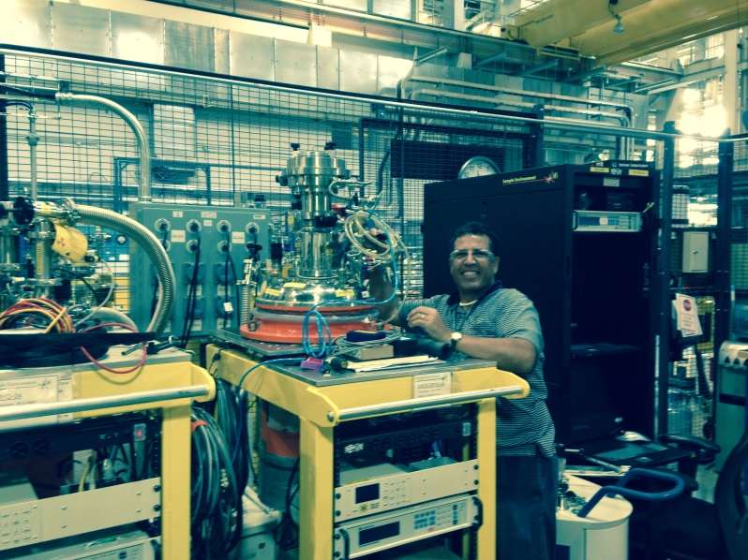
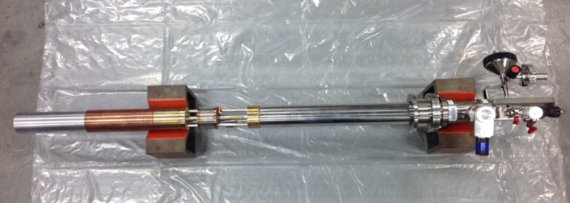
2. Low Temperature Equipment
Closed cycle refrigerators 4 K - 300 K
Liquid Helium Cryostats 1.5 K - 300 K
3He inserts 0.3 K - 300 K
Dilution refrigeration inserts 0.03 K - 300 K
Source: Harish Agrawal (ORNL)

Slide 10
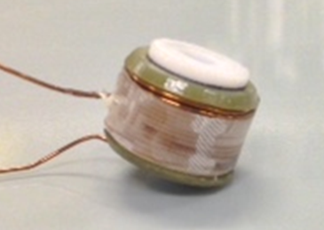
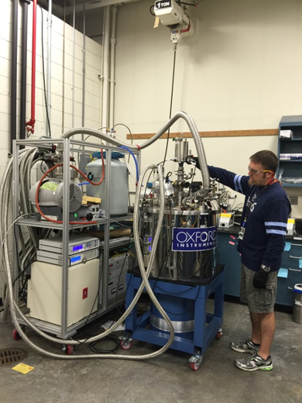
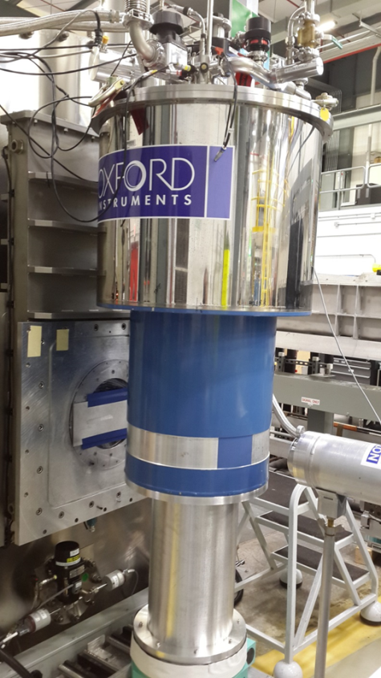
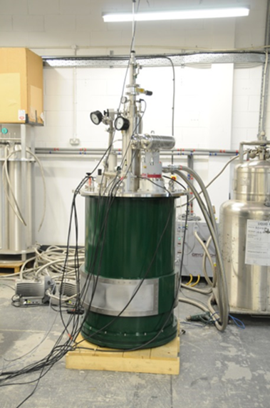
2. Magnetic field equipment
HFIR and SNS: 0.5-3 T electromagnet: specialized for Reflectometry or SANS
HFIR: 11 T (horizontal field), 11 T, 8 T, 6 T, 5 T (vertical field)
SNS: 30 T pulsed, 8 T, 5 T, 7T (IPNS), 11T (LANL), 7T (Cryogen Free) (vertical field)
Source: Harish Agrawal (ORNL)

Slide 11
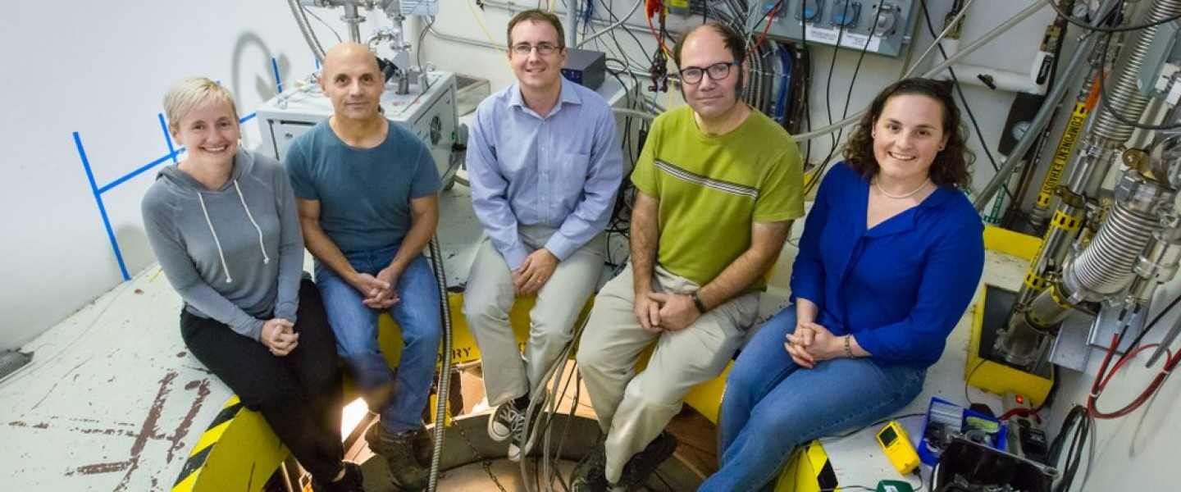
Outline
Overview over extreme environments used at ORNL:
1. Irradiation environment
2. Cryostats and magnets
3. Extreme high temperature
4. More detailed introduction to pressure techniques
Gas pressure cells
SANS cells
Clamp cells
Paris-Edinburgh presses
Diamond anvil cell program at ORNL
NOMAD Team

Slide 12
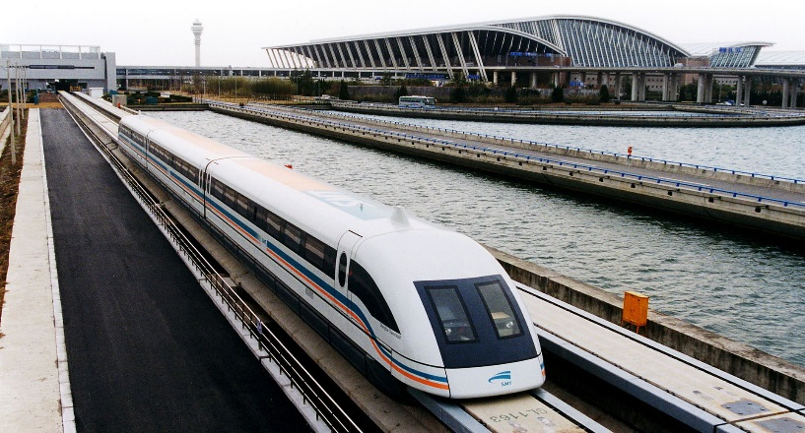
3. Extreme high temperature: Levitation
Levitation holds an object aloft in a stable position:
Magnetic levitation – magnetic field
Electrostatic levitation – electric field on charged particle
Aerodynamic levitation - stream of gas
Acoustic levitation – intense sound waves
Optical levitation – photon momentum transfer
Magnetic levitation used for Maglev train in Shanghai
Photo Source: Wikipedia

Slide 13
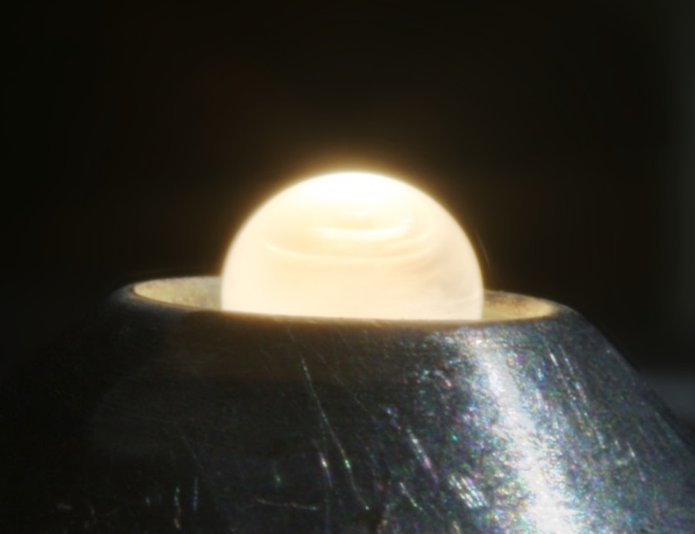
3. Levitation and melting
Levitation is extremely useful for the study of melt properties since no reaction with sample chambers can occur.
The levitation sample is typically heated with a CO₂ laser. This is a continuous wave gas lasers with wavelength ~10 µm.
Maximum temperature limited by sample evaporation, pyrometer reading ~800-3500ºC.
Laser-heated sample in the online aerodynamic levitator on NOMAD
Source: Joerg Neuefeind, NOMAD (ORNL)

Slide 14
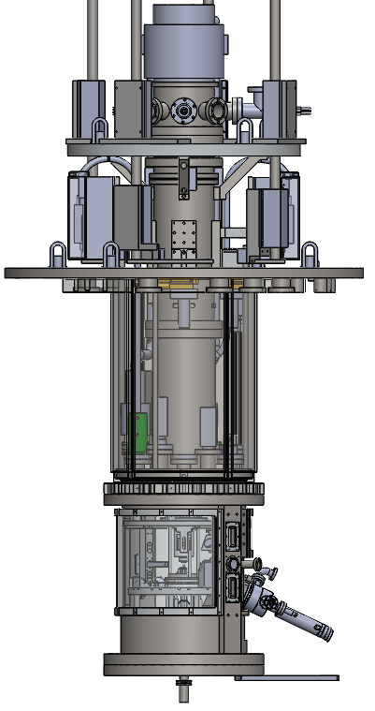
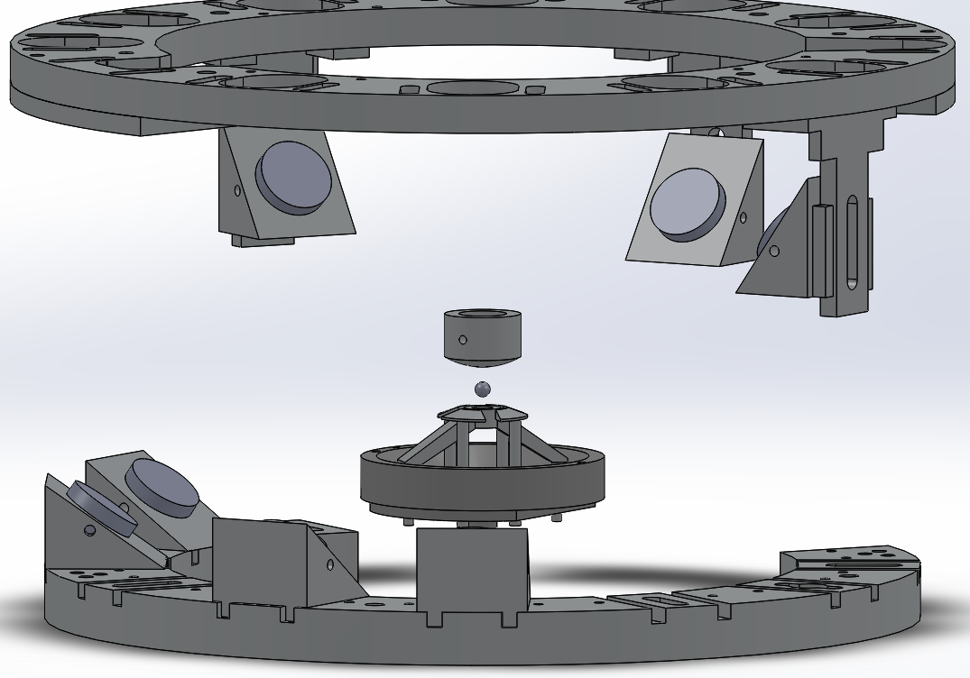
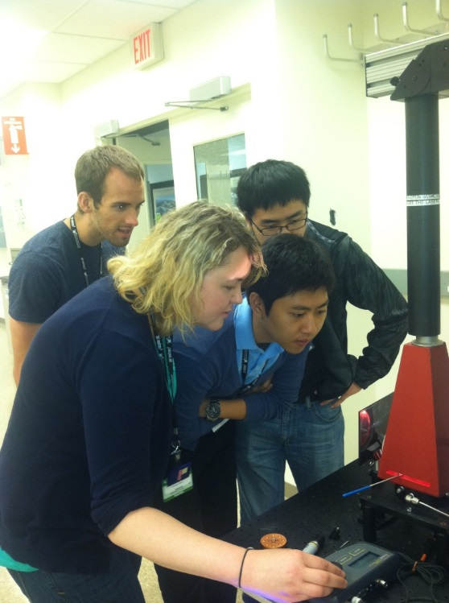
3. NOMAD offline levitator: Neutron ElectroStatic Levitator (NESL)
Turbo Pump
To PSD
Positioning
Heating
Mounting flange
Instrumentation
Neutrons
Sample
UV Lamp
Scattering Window
Sample collector
Sample synthesis in
the offline levitator
Source: Joerg Neuefeind, NOMAD (ORNL)
See: N. A. Mauro, A. J. Vogt et al., Rev. Sci. Instrum. 87 (2016) 013904.

Slide 15
Outline
Overview over extreme environments used at ORNL:
1. Irradiation environment
2. Cryostats and magnets
3. Extreme high temperature
4. More detailed introduction to pressure techniques
Gas pressure cells
SANS cells
Clamp cells
Paris-Edinburgh presses
Diamond anvil cell program at ORNL

Slide 16
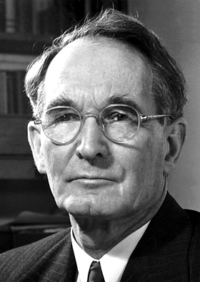
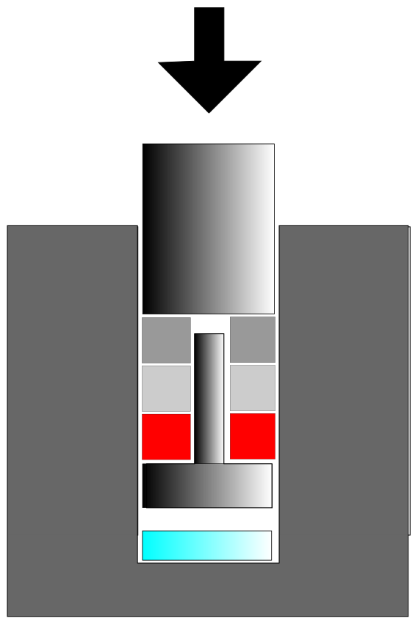
4. Eventful times also at Harvard
Percy Williams Bridgman
father of high pressure studies
1919: appointed full professor in Harvard aged ~37
New pressure apparatus (1905), Bridgman anvils
Invented the Bridgman seal
Studied over 100 materials under pressure
Received the Nobel Prize in 1946 for his studies of the properties of matter at high pressure and the invention of his high pressure apparatus.
WC
Bridgman
anvils
WC
Photo Source: Wikipedia
Bridgman seal

Slide 17
4. Application of pressure
force
area
pressure =
For a radius of 2 μm,
an applied force of ~0.120 N already achieves 10 GPa!
Indentation:
‘flat punch
tip’
spherical tip
Berkovich tip
17

Slide 18
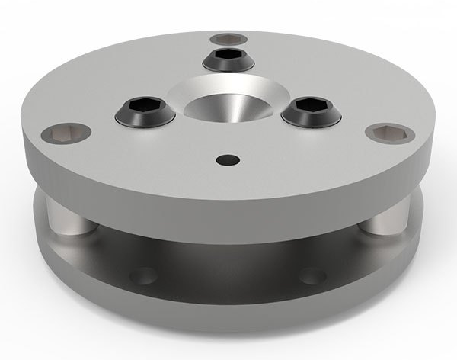
4. Application of pressure
For a radius of 200 μm,
we now need to apply a force of ~1200 N (equivalent to ~130 kg) to achieve 10 GPa.
force
area
pressure =
Diamond anvil cell:
Such a radius enables sufficient sample size for optical experiments while loads/forces can be locked in with screws.
Boehler-Almax Plate DAC
18

Slide 19
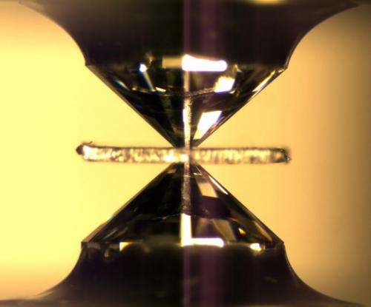
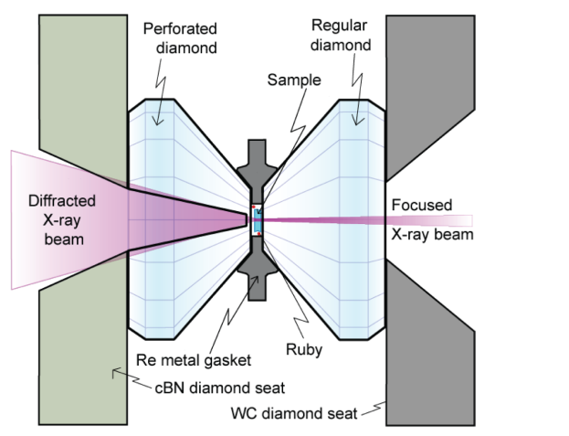
4. High pressure synchrotron scattering – almost exclusively diamond anvil cells
Material is confined between gasket and two diamond
anvils and then compressed.
from Phys.org by Stas Sinogeikin (HCPAT)
Large pressure range from very low pressures to ~300 GPa is
accessible in a DAC.
Large temperature range from ~0.1 mK to ~4000 K is possible.
Modifications allow easy adaption to more specific questions (e.g. membranes for rate control on de/compression, perforation for low signal samples, designer anvils for transport measurements etc.).

Slide 20
4. High pressure neutron scattering
The diamond anvil cell for synchrotron scattering or optical techniques is sufficiently versatile for most in situ studies.
BUT:
For a diamond with 200 µm culet radius,
the volume of the sample chamber is 0.006 mm³.
The minimum-size on high flux instruments such as NOMAD or VISION is 1 mm³ on very well scattering samples.
This sample volume is not sufficient for neutron scattering.

Slide 21
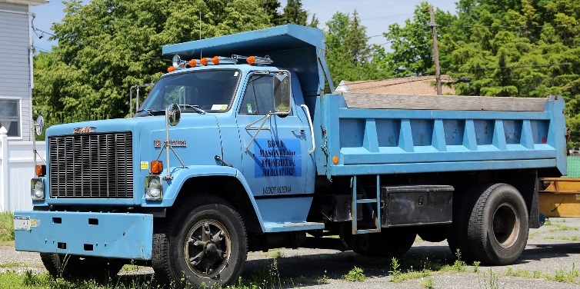
4. High pressure neutron scattering
For a radius of 2 mm,
we need to apply a force of ~120 kN to achieve 10 GPa. This is equivalent to 13 metric tons.
force
area
pressure =
Photo source: Wikipedia
21

Slide 22
4. High pressure neutron scattering
To accommodate the necessary large sample volumes, a variety pressure cells exist for neutron scattering.
These are often optimized for specific application.
Many developmental efforts aim to increase pressure capabilities for in situ neutron scattering.

Slide 23
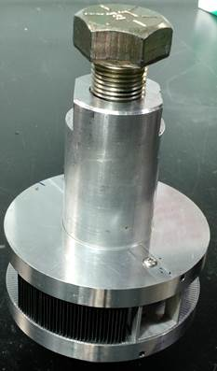
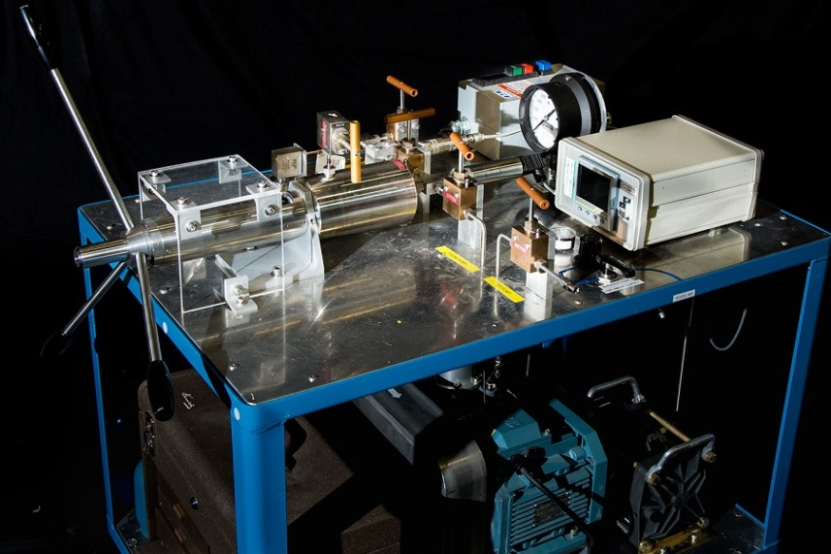
4. Experiments with gas pressure cells
Up to 0.7 GPa gas pressure,
Inert gases as well as H₂/D₂ available,
Cooling down to 5 K possible,
Routinely used at many beamlines for diffraction and inelastic scattering,
Supported by Sample Environment.
Gas pressure cell with radial SNAP collimator [1]
SITEC Gas Intensifier rated to 7 kbar
[1] A. dos Santos et al. accepted with Review of Scientific Instruments.

Slide 24
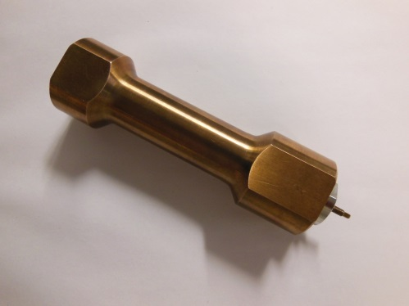
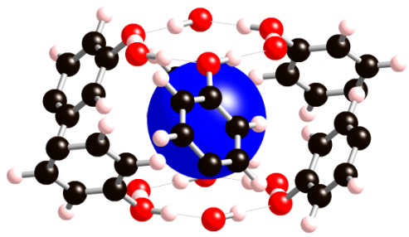
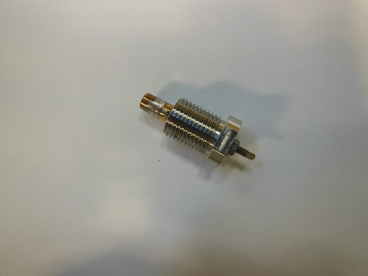
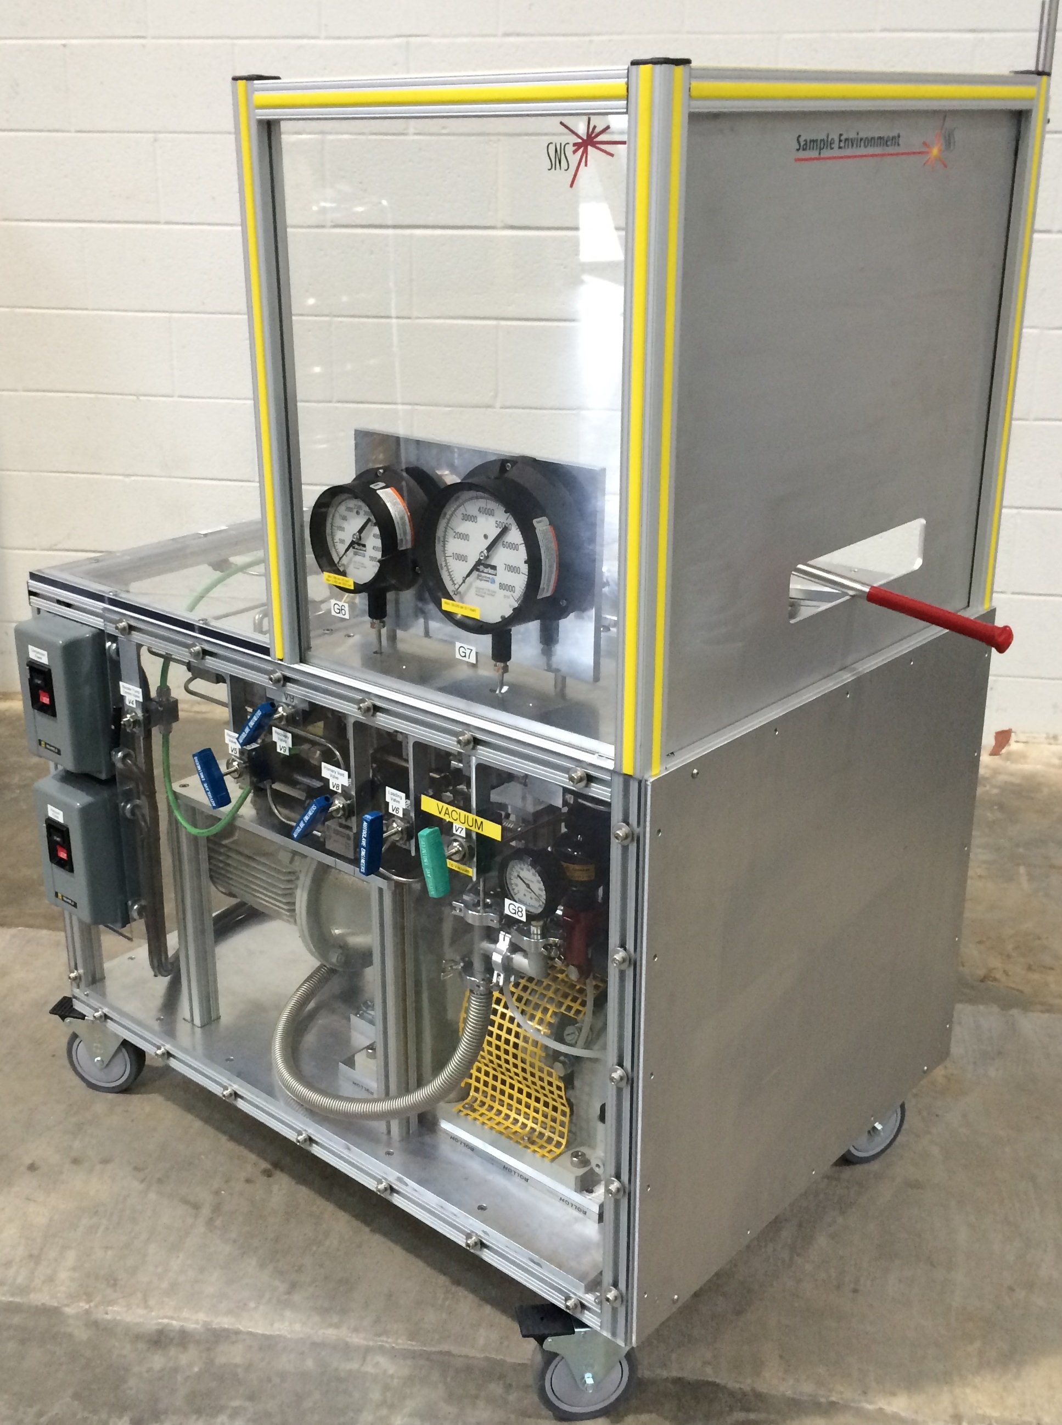
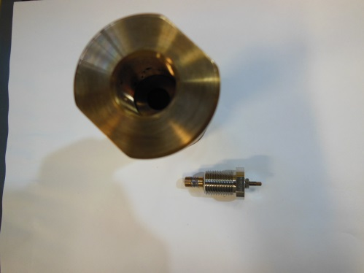
4. Gas pressure experiments at VISION
H₂ as 2D hindered rotor in organic clathrate cages
J=1 → J=1
Center of mass “rattling” fundamental
Diamond anvil cell gas loader can be used as portable H₂ intensifier
J=0 → J=1
Pure rotational transition
(single peak at 14.7 meV for solid H₂)
Ortho
Para
Gas pressure cell used on VISION
Source: Daemen (ORNL), see T.A. Strobel et al, PRL 120, 120402 (2018).

Slide 25
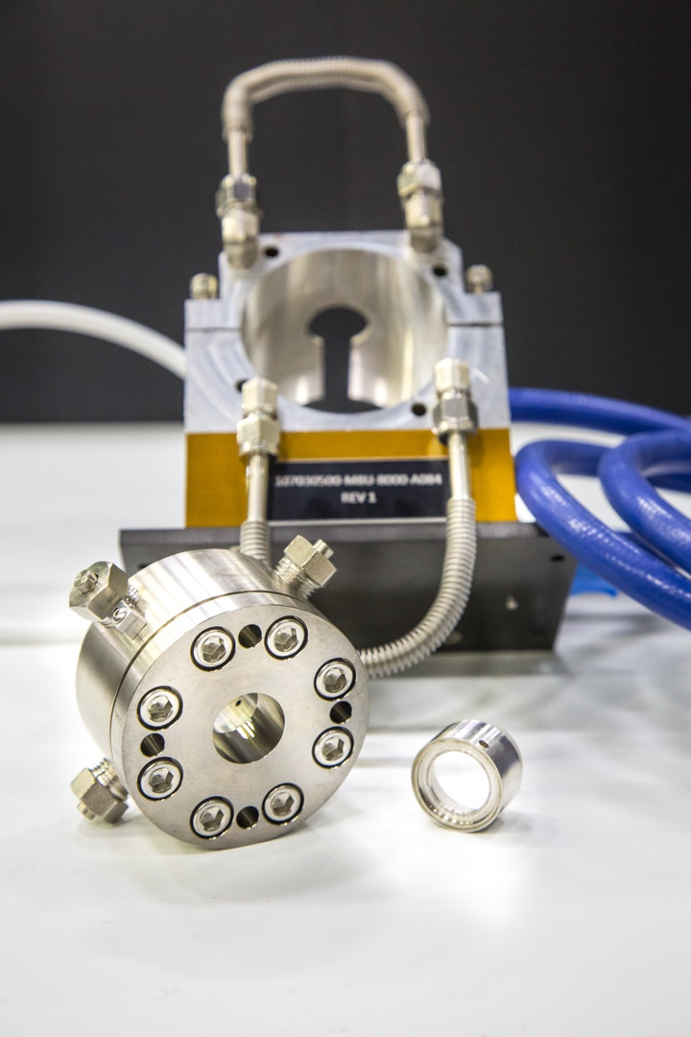
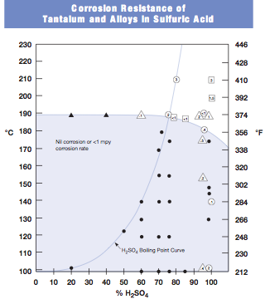
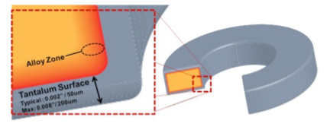
4. Pressure cells for small angle neutron scattering
Extended McHugh cells – Reaction cell for in situ pretreatment:
For acid pretreatments, stainless steel is not good but tantalum < 1 mpy corrosion rate
Reaction cell - Stainless steel with surface alloyed tantalum
0.5-1.5%
Source: S.V. Pingali, Bio-SANS instrument team (ORNL)

Slide 26
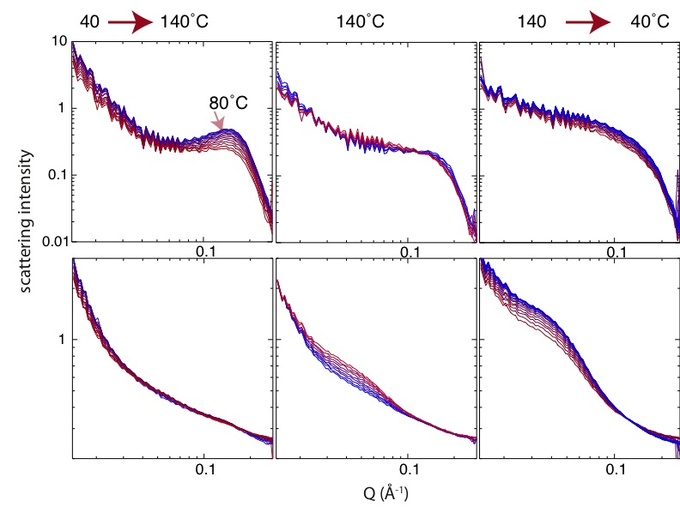
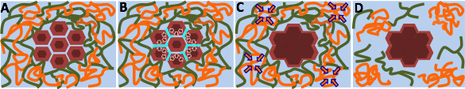
4. High pressure SANS at HFIR
Morphological changes in cellulose and lignin components of biomass occur at different stages during steam pretreatment
I
In-situ time-resolved neutron small-angle scattering data. Top row (horizontal sector) highlights cellulose morphological changes and bottom row (vertical sector) lignin.
A schematic summarizing the fundamental processes responsible for the morphological changes of cellulose and lignin components during steam explosion pretreatment.
II
Pingali et al. Cellulose 21, 873 (2014); Nishiyama et al. Cellulose 21, 1015 (2014) ; Langan et al. Green Chemistry 16, 63 (2014)
Contact: pingalis@ornl.gov.

Slide 27
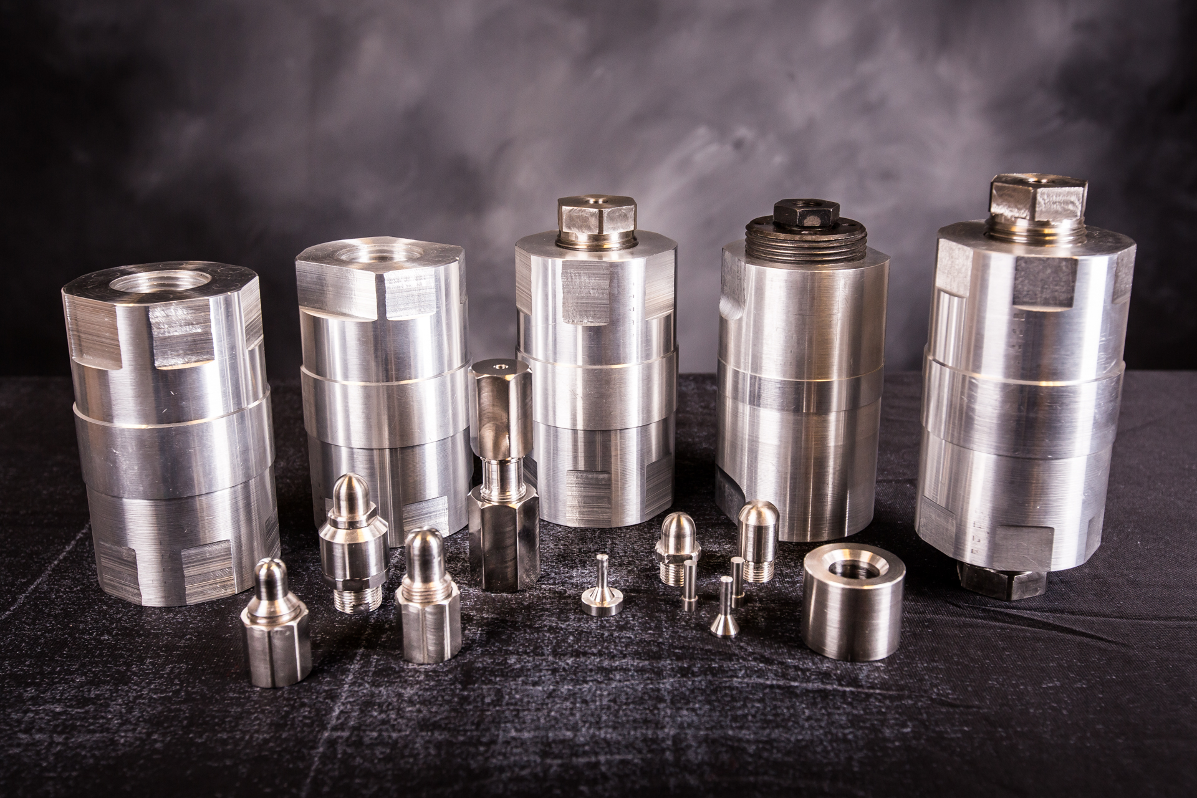
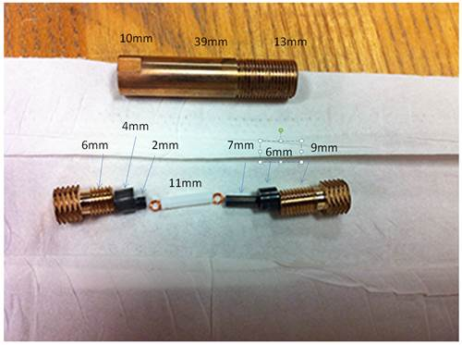
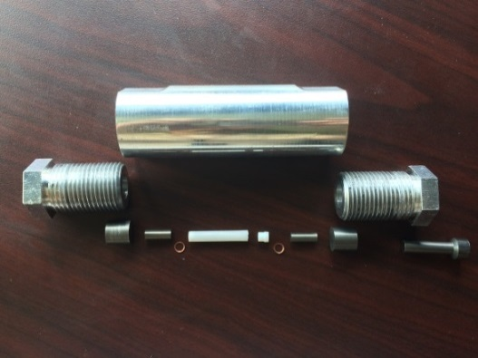
4. Clamp cell experiments
Very useful for inelastic neutron scattering due to the large sample volumes possible, the relative ease of cooling and the possibility to insert cell into a magnet.
CuBe cell available through US-Japanese collaboration
with a maximum pressure of 1.8 GPa.
NiCrAl cell that can be cooled to 300 mK and allows maximum pressures of 2.2 – 3 GPa.
CuBe cell for maximum pressure of 2 GPa supported by Sample Environment. Sample size is 15 mm height and 4.5 mm diameter.
Source: Podlesnyak, Lumsden, Loguillo, Rucker, Tian, Matsuda (ORNL),
Uwatoko (University of Tokyo)

Slide 28

4. Clamp cell INS experiments at SNS
“Pressure effect on hydrogen tunneling and vibrational spectrum in α-Mn”
Clamp cells and INS (CNCS and SEQUOIA) were used to measure the pressure effect of the tunneling mode and vibrational spectra of hydrogen in α-MnH_{0.07} for pressures up to 3 GPa [2].
First publication using clamp cells on CNCS:
“Spin dynamics in pressure-induced magnetically ordered phases in (C₄H₁₂N₂)Cu₂Cl₆” [1].
[1] G. Perren, et al. PRB 92, 54413 (2015), Editor’s suggestion
[2] A.I. Kolesnikov et al., PRB 94, 1343012 (2016).

Slide 29


4. Diffraction in a camp cell at HFIR
Single crystal diffraction: Magnetic precursor of the pressure-induced superconductivity in Fe-ladder compound
Pressure-temperature phase diagram. The inset shows the size of the ordered moment as a function of pressure
Pressure-temperature phase diagram. The inset shows the size of the ordered moment as a function of pressure
Source: Cao, HB-3A and HB-2C teams (ORNL), see S. Chi et al, PRL 117, 47003 (2016).

Slide 30


4. Paris-Edinburgh cell on SNAP
Key elements are a 200 ton press and toroidal anvils,
10 GPa with cubic boron nitride anvils,
20 GPa with polycrystalline diamond anvils,
Cooling down to 85 K,
gasket made from TiZr (no diffraction peaks).

Slide 31



4. Diffraction in the Paris-Edinburgh cell
Understanding the phase diagram of lithium [1].
Pressure variation of the Néel temperature of MnTe₂ measured on SNAP in the PE cell [2].
[1] A. M. Schaeffer et al. Nature Communications 6, 8030 (2015).
[2] Tapan Chatterji, et al, Phys Rev. B 91, 104412 (2015).
31

Slide 32

4. Large volume DACs on SNAP
First generation diamond anvil cell on SNAP:
Maximum pressures of 100 GPa were achieved.
Single crystal diamond anvils allow removal of diamond peaks.
Membrane press enabled online pressure increase.
Gasket made from stainless steel.
Panoramic diamond anvil cell inside a membrane press. The sample
volume is ~0.05 mm³ [1].
[1] R. Boehler, M. Guthrie et al. High Pres. Res. (2013).

Slide 33
4. Large volume DACs on SNAP
Seat and natural diamonds
used.
one anvil + seat:
$ 4500
WC
Neutron diffraction
up to 94 GPa on ice. Sample volume at highest pressure was ~0.015 mm³.
[1] R. Boehler, M. Guthrie et al. High Pres. Res. (2013).

Slide 34
4. Development of new DACs
Although the previous development and pressure record on SNAP was highly encouraging, we need:
Larger sample volumes for diffraction in order to detect more complex structures.
Less expensive and more reliable diamond anvil/seat configurations.
Extend DAC program to other instruments at ORNL.
New DACs with synthetic single crystal diamond anvils for pressures to 100 GPa.
New DACs with polycrystalline diamonds for pressures to 10 GPa.

Slide 35

4. Ultra-large volume DAC with CVD anvils
New diamond anvil cell designed for SNAP [1].
Opening aperture allows
Q = 1.3 – 22 Å⁻¹ on SNAP.
Pressure can be increased online.
Cell can be cooled to ~5 K.
Maximum pressure of 45 GPa on ~0.15 mm³.
DAC with membrane controller for online pressure change used on SNAP.
[1] R. Boehler, J.J. Molaison, B. Haberl, Rev. Sci. Instr. 88, 83905 (2017).

Slide 36


4. Ultra-large volume DAC with CVD anvils
New design relies on two key components, large CVD anvils and machined gaskets for added support [1].
Conical anvil design.
6 mm conical CVD anvils inside steel seats.
Machined stainless steel gasket
[1] R. Boehler, J.J. Molaison, B. Haberl, Rev. Sci. Instr. 88, 83905 (2017).

Slide 37

4. DACs with CVD anvils
1h exposures of Ni at different pressures. A 5 minute spectrum is shown as inset.
Pressure-load curve.
[1] R. Boehler, J.J. Molaison, B. Haberl, submitted to Rev. Sci. Instr. (2017).

Slide 38



4. DACs with CVD anvils
0.06 mm³ of ice VII at ~62 GPa [1].
0.06 mm³ of octadecane
Source: Basu (GL)
Source: Guthrie (ESS)
0.15 mm³ of glassy carbon at ambient pressure
[1] M. Guthrie et al, submitted to PRB (2018).

Slide 39


4. Clamped wide-angle DACs
Clamped diamond anvil cell with Versimax® anvils:
Opening aperture of 120º.
Pressure is applied in press and clamped in via a simple spring mechanism.
Cell can be cooled to ~5 K.
Sample volume is up to 2 mm³.
PCD anvil
and gasket
Original Vascomax design [1]
Optimized CuBe design [2]
[1] B. Haberl et al, High Pressure Research 37, 495 (2017).
[2] B. Haberl et al, accepted Re. Sci. Instr. (2018).

Slide 40

4. Versimax anvils
Properties of Versimax® (polycrystalline diamond sintered in SiC matrix from Sandvick):
Diffraction pattern shows diamond-cubic SiC (3C) peaks.
Held up to load of ~13 GPa without any support.
Transmission on VISION is equivalent to single crystal diamond.
Powder diffraction data from SNAP.
Transmission data from VISION.
[1] B. Haberl et al, High Pressure Research 37, 495 (2017).

Slide 41

4. Clamped large volume DACs
A pressure load curve for the 3 mm anvils was measured on SNAP using NaCl as pressure calibrant.
yield strength of gasket material
extrapolated
Pressure [GPa]
Load [tons]

Slide 42



4. High pressure INS on VISION
Inelastic neutron spectrum from ~1.6 mm³ of hexamethylbenze loaded into the DAC.
Preliminary INS data of pressurized HMB in DAC measured on VISION.
9
12
Source: Daemen, Haberl, Molaison, Boehler

Slide 43

4. Single crystal diffraction in the DAC
CORELLI
HB-3A
IMAGINE
Hexaferrite ~0.1 mm³ crystal with Pb as pressure medium inside the DAC within CCR. Neutron wavelength λ=1.546 Å with half-lambda filter [2].
T = 5 K
Hexaferrite ~0.1 mm³ crystal with deuterated glycerin as pressure medium inside the DAC [2].
Single crystal diffraction from a ~240 µm thick single crystal of MnP loaded with KBr into the DAC measured at 6 K [1].
[1] B. Haberl et al, High Pressure Research 37, 495 (2017).
[2] B. Haberl et al, accepted to Re. Sci. Instr. (2018).

Slide 44





















Co-workers on pressure examples shown
Reini Boehler
(EFree, GL and
ORNL)
Yaohua Liu, Feng Ye, Masa Matsuda, Sachith Dissanayake (Corelli and PTAX)
Antonio Moreira dos Santos, Jamie Molaison, Chris Tulk (SNAP)
Venky Pingali, Shuo Qian, Volker Urban (BioSANS)
Dean Myles, Flora Meilleur, Malcolm Cochran (IMAGINE)
Huibo Cao, Bryan Chakoumakos, Yan Wu, Katie Andrews (HB-3A)
Gary Lynn, Mark Loguillo, Matt Rucker
Neelam Pradhan, Doug Armitage
(Sample Environment)
Luke Daemen, Timmy Ramirez-
Cuesta,YQ Cheng (VISION)

Slide 45
Conclusion
The use of sophisticated sample environments for extreme conditions is critical for many scientific questions and studies.
Development of new environments is continuously ongoing to push the boundaries and answer new science questions beyond current capabilties.
Reference material: “Techniques in High Pressure Neutron Scattering” by Stefan Klotz, CRC Press (2016).
Thank you!
Acknowledgment: Oak Ridge National Laboratory funded under DOE-BES contract number, DE-AC05-00OR22725, the SNS and HFIR are supported by the DOE-BES, Scientific User Facilities Division. DAC development was funded through ORNL LDRD scheme.

