Slide 1
X-ray Detection
Antonino Miceli (amiceli@aps.anl.gov)
August 7, 2016
NX School

Slide 2
Outline
Counting versus Integrating
Indirect versus Direct detection
  Area detectors using scintillators
    Large area for diffraction (low spatial resolution, 50-100 μm)
    Small area for imaging (high spatial resolution, ~ 1 μm)
  Pixel array detectors (e.g., Pilatus, Pixirad)
Energy resolving detectors (i.e., spectroscopic detectors)
  Counting and direct detection
  Measuring the energy of photons
  Silicon diodes

Slide 3
How do you detect x-rays?
Need to convert to something that you can measure
  Electrons… Q = CV
    Directly (x-rays → electrons)
      Ion chambers, pixel array detectors (e.g., Pilatus)
    Indirectly (x-rays → optical photons → electrons)
      Scintillators + Optics + photomultiplier/CCDs
  Temperature
    ΔT = E_{γ} / (Heat Capacity)
      Superconducting calorimeters

Slide 4
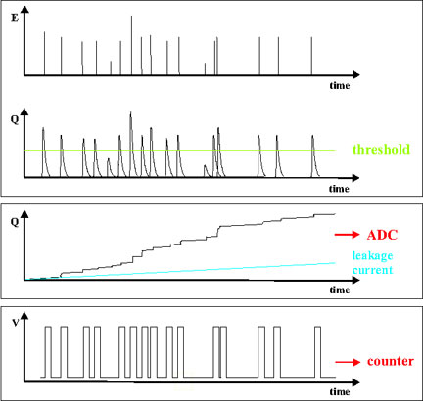
Counting versus Integrating
Goal: Measure total flux of photons.
?
?
Analog signal from detector
Pulse Height ~ Energy
threshold
Counting
Digitizer
Integrating
Dark Current

Slide 5
Counting versus Integrating
Counting
  Single photon counting
    Scintillator counting detectors (e.g., Cyberstar), avalanche photodiodes (APDs)
    Pilatus (counting pixel array detectors)
    Energy-resolving Detectors (Silicon or Germanium diode detectors)
  Deadtime limitations!!!
  Dark current rejected with a sufficiently high threshold.
  Easier to realize detectors
Integrating
  Signal accumulates
  CCDs, a-Si flat panel detectors
  No deadtime limitations
  Read noise and dark current are issues to consider
  Harder to realize detectors

Slide 6
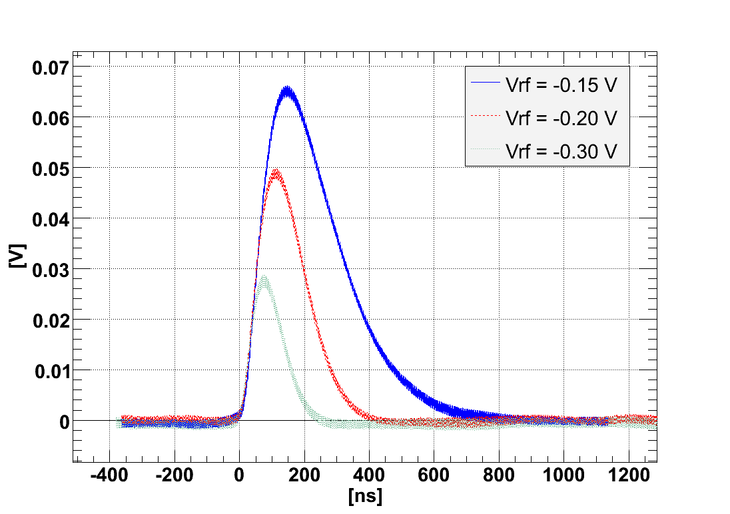
Counting detectors - Shaping time
Response time of detector
  In most detectors, the user can change this via software.
Gain is usually associated with longer shaping time.
Longer shaping time improves the energy resolution (to a point)
  But reduced the total count rate throughput.
  Energy resolution is important for certain techniques (e.g., XRF, XANES, XAS)
Analog response of a counting detector to the same x-ray photon energy

Slide 7
Deadtime limitations for counting detectors
Analog pulses
Lower Threshold
Discriminator output (Digital)

Slide 8
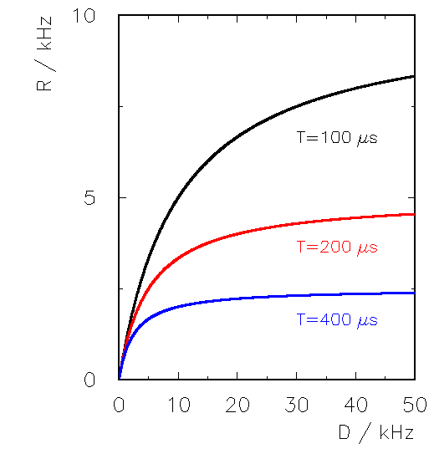
Deadtime
As you increase the input count rate (ICR), does the output count rate (OCR) follow linearly?
  The longer the shaping time, the lower the ICR before deviating from linearity.
When to worry (rule of thumb)?
  Rate > 1 / (2 x τ)
  e.g., τ ~ 1 μs ➔ 500 kHz
  Should probably calibrate to get an accurate flux measurement!
    Very important when you are looking for small changes (e.g., XAFS wiggles or XMCD)
Output count rate (OCR)
Input count rate (ICR)

Slide 9
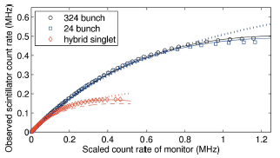
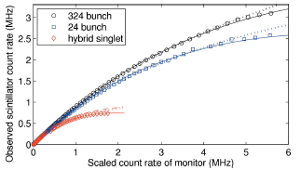
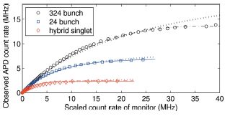
Deadtime for synchrotron (pulsed source)
Depends on the fill pattern and speed of the detector
Counting detectors can detect at most one photon per bunch
Fast detector (shorter shaping time)
NaI
YAP
APD
D.A. Walko, D.A. Arms, E.C. Landahl, J. Synchro. Rad. 15 (2008) 612; http://dx.doi.org/10.1107/S0909049508022358

Slide 10
What fill pattern pattern will you be using?
Hybrid singlet and 324 bunch mode each 2 weeks a run.
Hybrid singlet useful for certain timing experiments.
  Not great for high count rate experiments (e.g., XANES, XAFS, XRF)

Slide 11
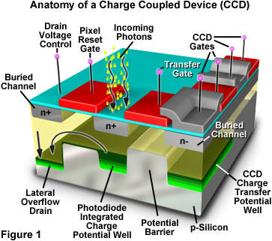
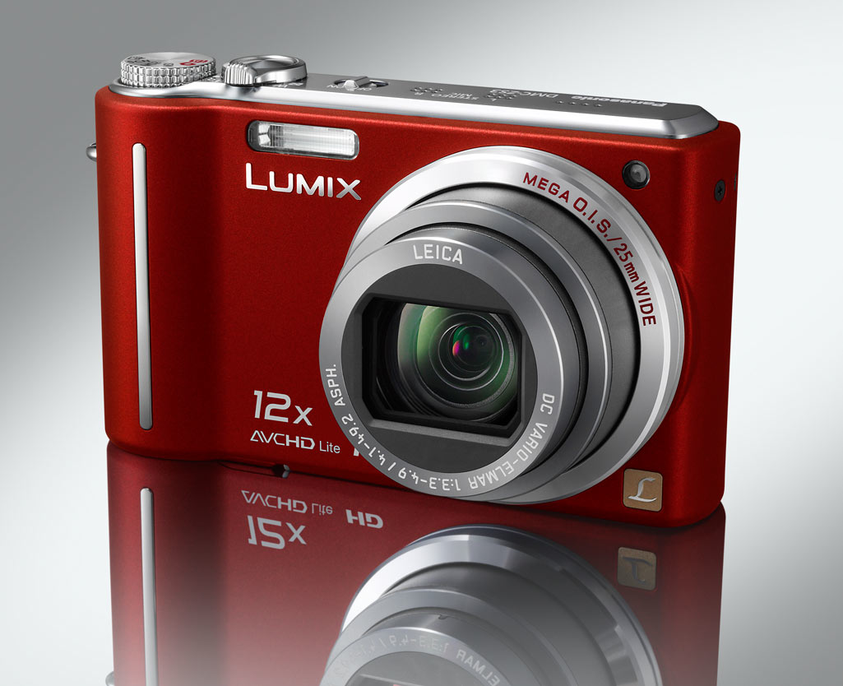
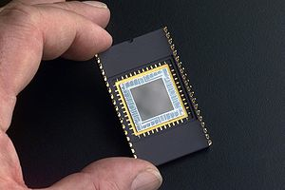
Indirectly (x-rays → optical photons → electrons)
Charge Coupled Devices (CCDs)
Optical detectors are everywhere in our lives… camera phones, etc.
CCDs are integrating detectors. No dead-time issues, but read noise and dark current

Slide 12
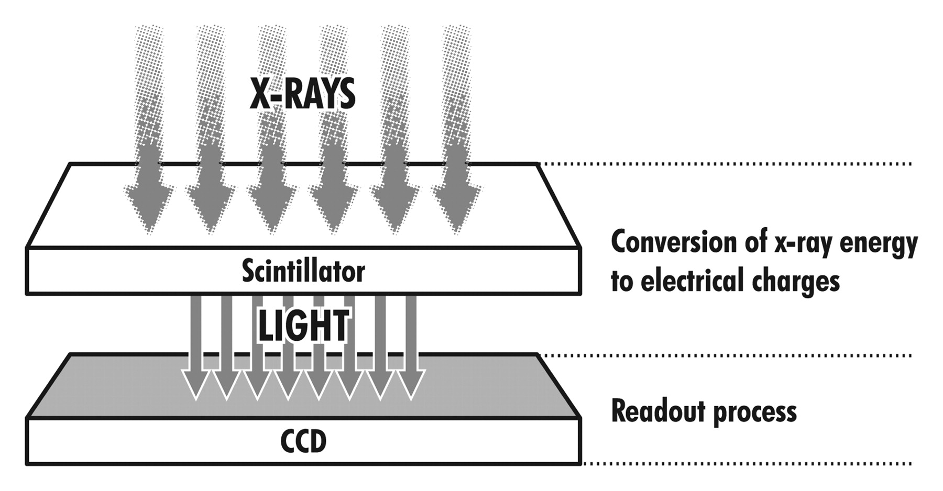
Indirectly (x-rays → optical photons → electrons)
Charge Coupled Devices (CCDs) + x-ray scintillators
Thickness of scintillator dictates the usable energy range

Slide 13
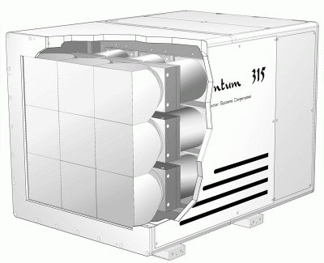
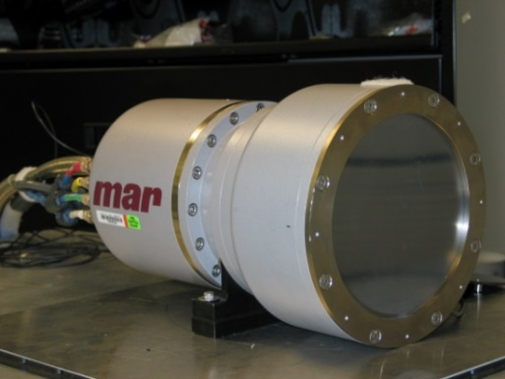
Indirectly (x-rays → optical photons → electrons)
Charge Coupled Devices (CCDs) + x-ray scintillators
With demagnification for large area detectors
  Diffraction ( < 30 keV)
CCD
sample
x-rays
Fiber Optic Taper (Optical photons)
(1 – 3 De-Magnification)
Scintillator (e.g., Gd₂O₂S)
Spatial resolution ~ 100 μm
No deadtime correction
  Integrating
Calibrations
  Dark Subtraction
  Spatial Distortion
  Spatial gain variations

Slide 14
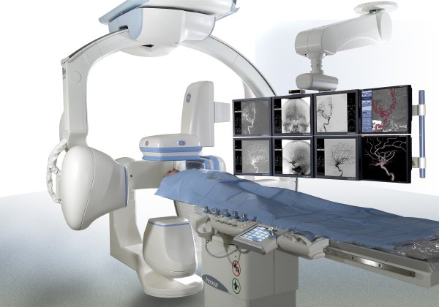
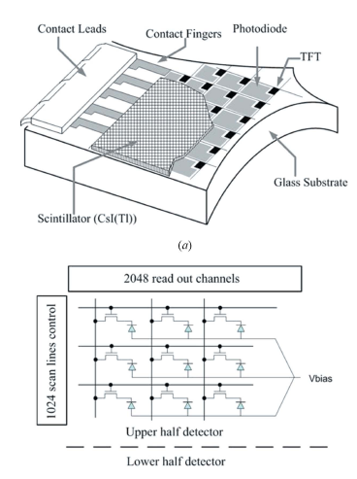
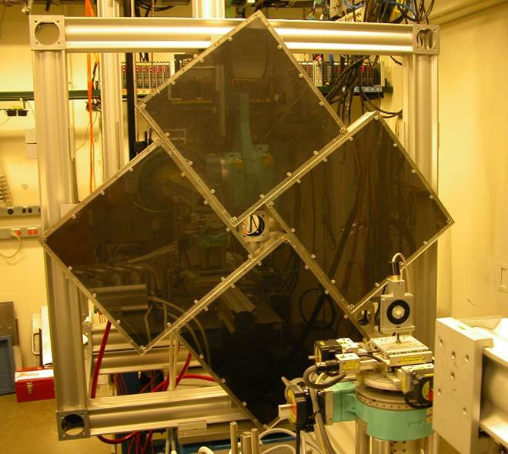
Indirectly (x-rays → optical photons → electrons)
Amorphous Silicon Flat Panel + x-ray scintillators
Used at higher energies ( > 50 keV); integrating detectors.
Thin film transistor (TFT) technology (a-Si photo-sensors) allows large area detectors
  Cheaper than CCDs, but higher noise and less dynamic range!
  Typically faster than CCDs.
Sector 1
~ 120 cm

Slide 15



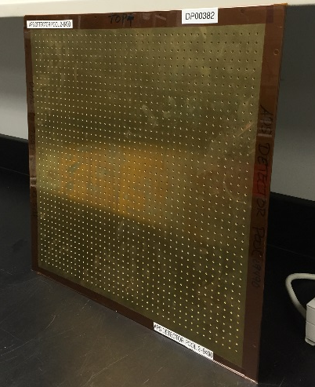
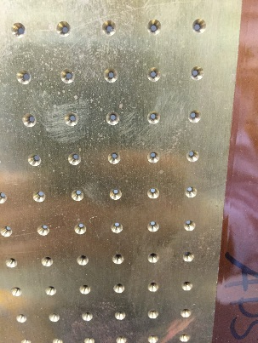
Spatial/Geometric Distortions
Input
Output
Calibration can be done with a mechanical mask (“holey plate”) or a known x-ray sample

Slide 16
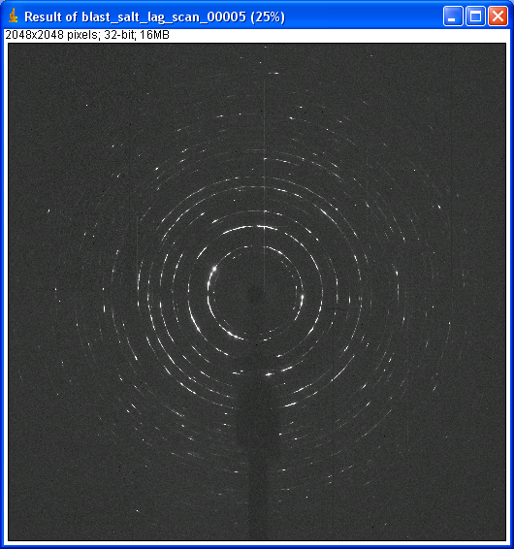
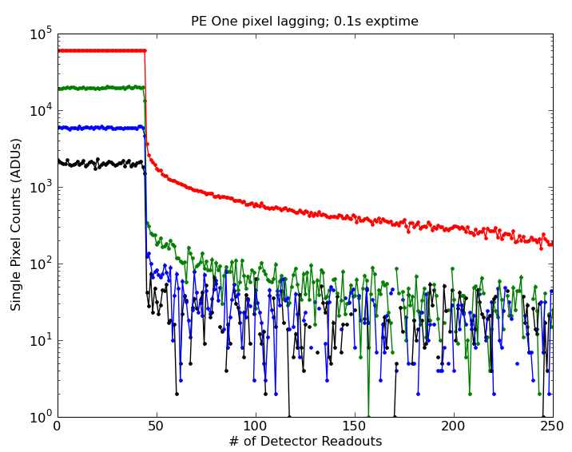
Lagging/Ghosting/Memory effects
Can effect main types of detectors (e.g., GE & PerkinElmer flat panels, CdTe-pixel array detectors

Slide 17
Direct Detection
(x-rays → electrons)

Slide 18
Directly (x-rays → electrons)
Pixel Array Detectors (e.g., Pilatus)
Dectris Ltd

Slide 19
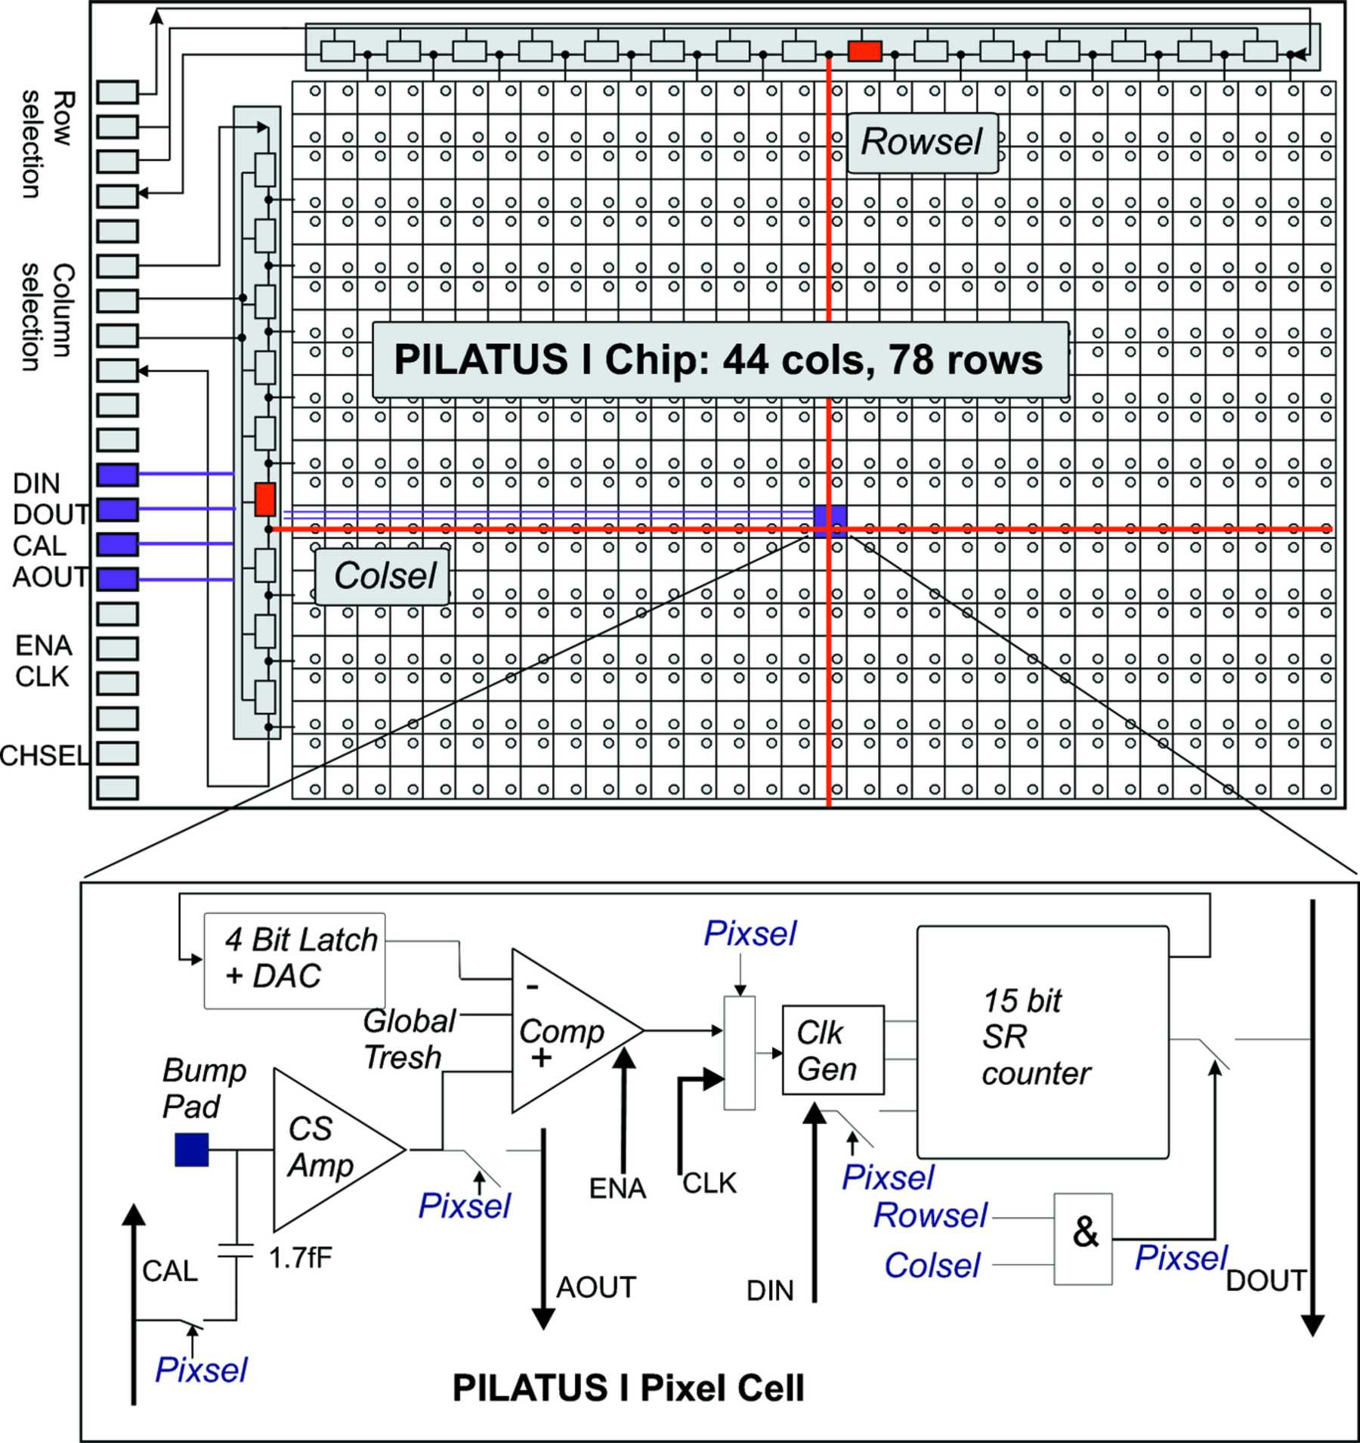
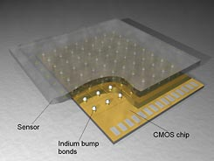
Directly (x-rays → electrons)
Pixel Array Detectors (e.g., Pilatus)
CMOS readout chip (i.e., Application Specific Integrated circuit, ASIC)
Pilatus is a digital PAD (photon counting)
AGIPD pixel
PSI/SLS Detector Group

Slide 20
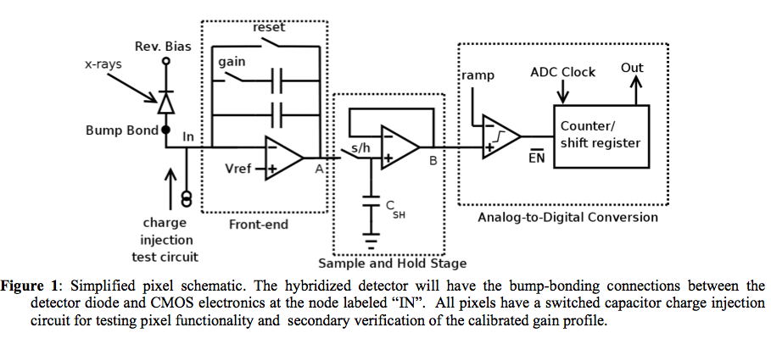
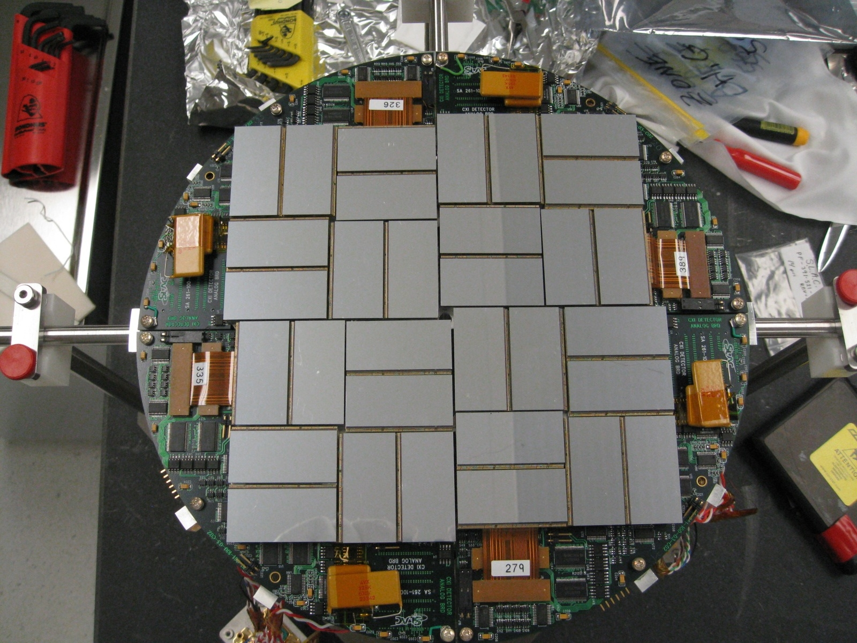
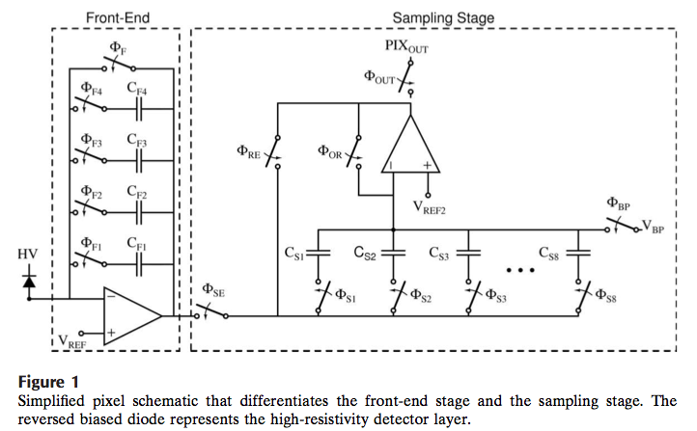
Directly (x-rays → electrons)
Integrating Pixel Array Detectors
You can design the CMOS readout in anyway you like.
  e.g., with an integrating front end.
CSPAD at LCLS
Gruner et al.,

Slide 21
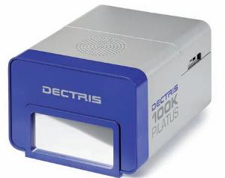
    Directly (x-rays → electrons)
    Pixel Array Detectors (e.g., Pilatus)
Each pixel is a single photon counting detectors!
Thus has count rate limitations
487 x 195 pixels (172 μm)
8.3 cm x 3.3 cm Area
Count Rate ~ 1 MHz/pixel
20-bit counter/pixel
5ms readout (Frame Rate = 200 Hz)
320 micron thick Silicon sensor
Gateable & electronic shutter
Lower Level Discriminator only
Brönnimann et al. @ PSI in Switzerland (Dectris)

Slide 22

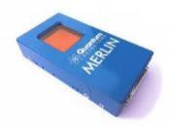
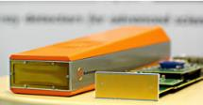
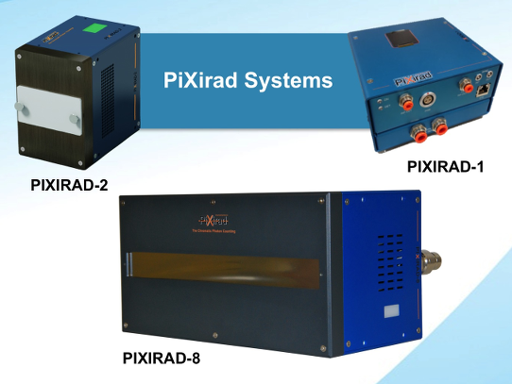
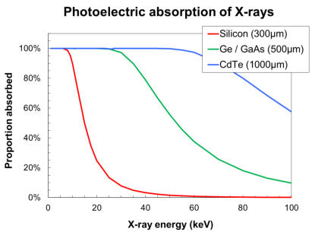
Commercial Photon Counting Detectors
Many photon counting detectors available today
  Dectris
  Medipix 3 detectors (X-Spectrum, Quantum Detectors, ASI)
  ImXPAD
  Pixirad
  Pixel sizes: 55-75 microns
  Frame rates up to 2-3 kHz.
Most vendors offer high-Z sensors (i.e., CdTe or GaAs).
  Pixirad seems to be the most reliable CdTe detector for a reasonable price.
  CdTe has “memory” problems
    Helped with cooling and HV switching
https://www.dectris.com/
http://quantumdetectors.com/merlin/
http://www.x-spectrum.de/
http://www.pixirad.com

Slide 23
Photon counting, speed and dynamic range
Pilatus specs
  487 x 195 pixels (172 microns)
  Count Rate ~ 1 MHz/pixel
  20-bit counter/pixel
  Frame Rate = 200 Hz
  Gateable & electronic shutter
  Lower Level Discriminator only
You do not have 20-bit dynamic range @ 200 Hz!!!
Frame Rate (Hz) | Dynamic Range
1 Hz | 10⁶ (20-bits)
10 Hz | 10⁵
100 Hz | 10⁴
1000 Hz | 10³
DR decreases with speed!

Slide 24
Directly (x-rays → electrons)
Pixel Array Detectors – Photon Counting Threshold
Threshold
Where to set the threshold?
Is there an “optimal” threshold?

Slide 25
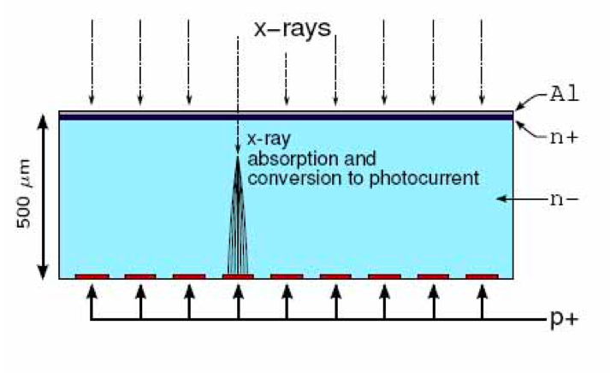
Photon Counting - Threshold –charge sharing
Pixels

Slide 26
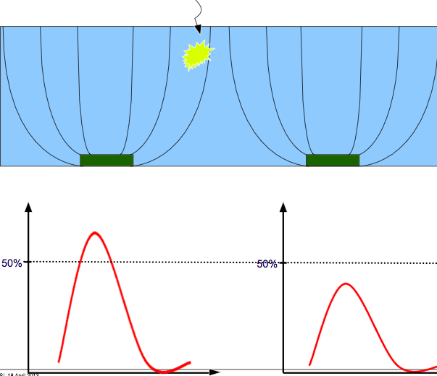
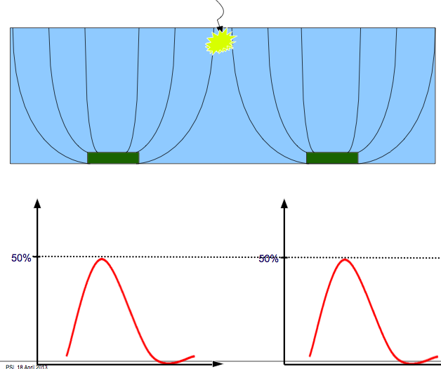
Photon Counting - Threshold –charge sharing
B. Schmitt et al
If threshold is too high, then you under count events (effectively a small pixel)
If threshold is too low, then you double count events
“Optimal” threshold is 50% of beam energy
  Unless you need to reject fluorescent background.

Slide 27
Energy resolving detectors (i.e., spectroscopic detectors)

Slide 28
Energy Resolving Detectors – Counting
(aka Energy Dispersive Detectors)
(aka Spectroscopic Detectors)
(aka XRF detector)
Copper
x-ray beam
Spectrum
XRF detector
Cu Kβ
Cu Kα

Slide 29
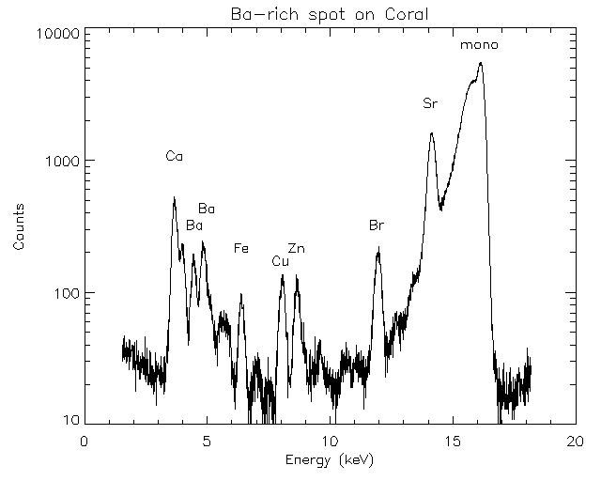
Fluorescence (XRF) Measures…
Abundance (ppm level) and spatial correlations of heavy elements
Also used for XAFS/XANES and XMCD
XRF Image of a cell
Sea Coral
Matt Newville, 13-id
Barry Lai, 2-id
Elemental Compositions of Comet 81P/Wild 2 Samples Collected by
Stardust (Flynn et al 2006)
Solid-phases and desorption processes of arsenic within Bangladesh
sediments (Polizzotto et al 2006)
A link between copper and dental caries in human teeth identified by
X-ray fluorescence elemental mapping (Harris et al 2008)
Levels of Zinc, Selenium, Calcium, and Iron in Benign Breast Tissue
and Risk of Subsequent Breast Cancer (Cui et al 2007)

Slide 30
Spectroscopic Detectors
( Silicon or Germanium )
x-ray
X-Ray Energy ~ # of e-h pair
( 3.67 eV are need to produce 1 e-h pair for Silicon!!)

Slide 31
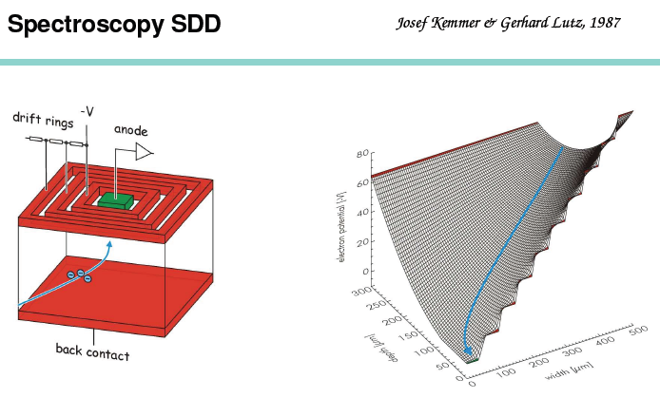
In reality, we use Silicon Drift Diodes …
Noise scale like the area of the anode!
  Thus make the anode small

Slide 32
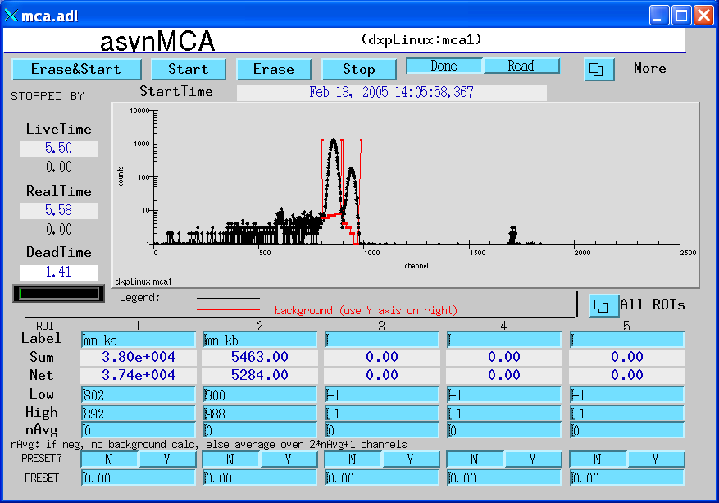
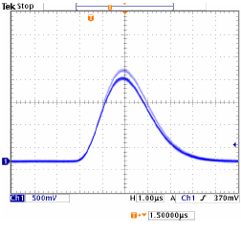
Spectroscopic Detectors – Pulses to Histograms
Fe-55 Source on a scope.
6.5 keV
(Mn Kβ)
5.9 keV
(Mn Kα)
Mn Kα
Mn Kβ
Pulse Height
1 V
MCA = histogram (e.g., 2048 channels)
3 μs

Slide 33
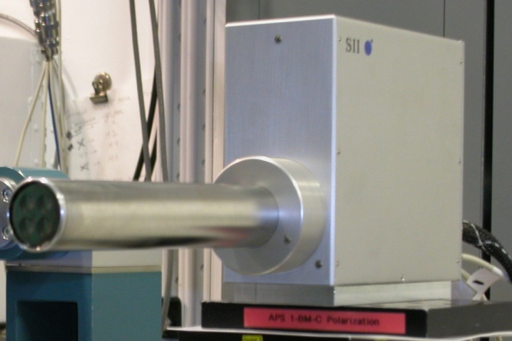
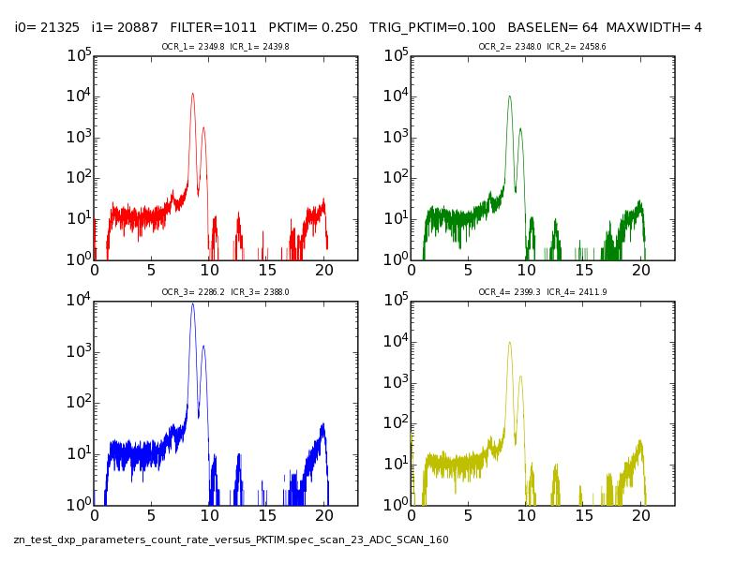
4-element Silicon Drift Diode
4-element SDD (SII Nano Inc)
Need to cool for -30C (via ThermoElectric Cooler)
Peak-to-Background Important!!!
  Usually signal is buried here!
  Recombination, incomplete charge capture, etc.
Energy resolution ~ 150eV
Optimizing detector geometry for trace element mapping by X-ray fluorescence, Sun, Y et al Ultramicroscopy 152 (2015) 44–56

Slide 34
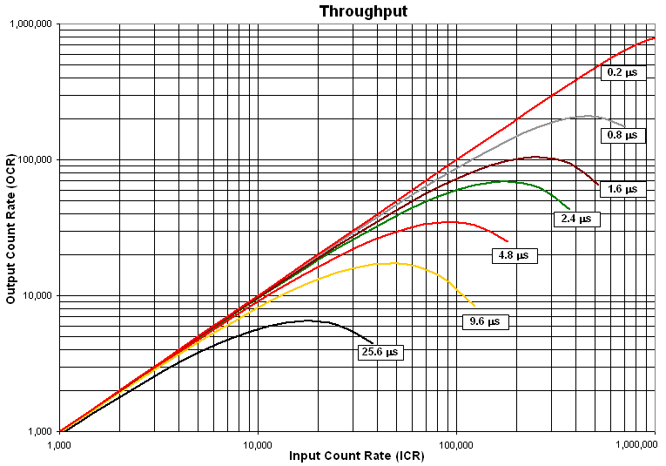
Trade-off between count rate and energy resolution!!!
Shorter shaping time (length of pulse) means more count rate, but less energy resolution.
  Depends on your experiment.
Remember that the fill pattern will effect your deadtime correction, especially if you want to anything quantitative!

Slide 35
Closing thoughts
Take a moment to think about the detector you are using.
Do you understand the detection mechanisms?
What are the limitations of the detectors?
  How does this effect the design of your experiment?
  Have the detector settings been optimized for your experiment?
What are the nonidealities of the detectors?
  Deadtime, spatial distortion, gain variations
  Can they be corrected?
You want to understand these things early in your experiment before you go home with “bad” data!

Slide 36
Extra slides

Slide 37
Dynamic Range
We typically have weak signals next to strong signals in the same image.
For counting detectors, dynamic range is set by how big your counter is (e.g., Pilatus has a 20-bit counter in each pixel)
For integrating detectors (e.g., CCD, a-Si flat panels), the dynamic range is set by how much charge each pixel can storage and the noise level.
Gruner et al.,
Detector Signal
Level
S
DR = S
1
Input Flux
Detector Signal
Level
S
DR = S/σ
σ
Input Flux

Slide 38
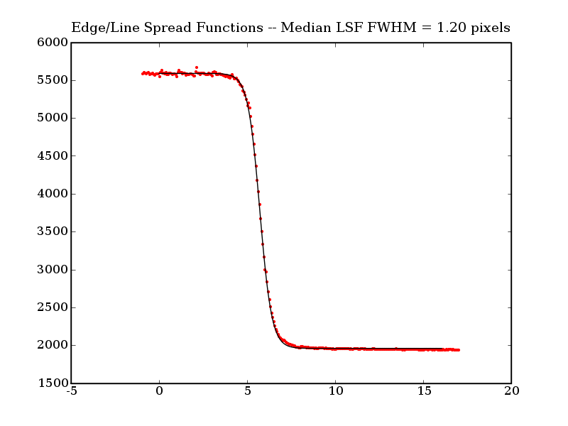
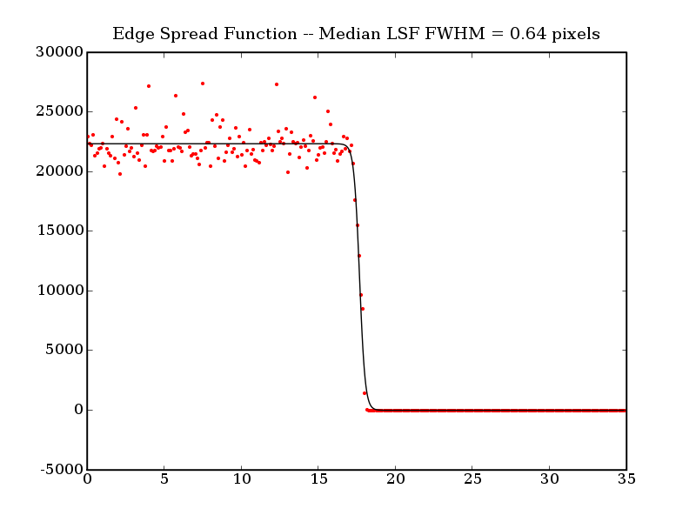
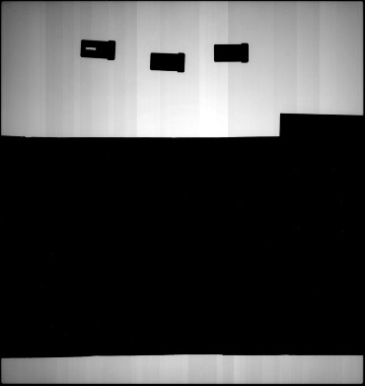

Spatial Resolution: Indirect vs. Direct
Indirect detection area detectors resolution is limited by the thickness of the scintillator because of optical blurring
Direct detection detectors have single-pixel resolution
GE a-Si Flat Panel (CsI)
Pilatus Silicon
X-ray
Scintillator
Tungsten Knife Edge
Optical Photons

Slide 39
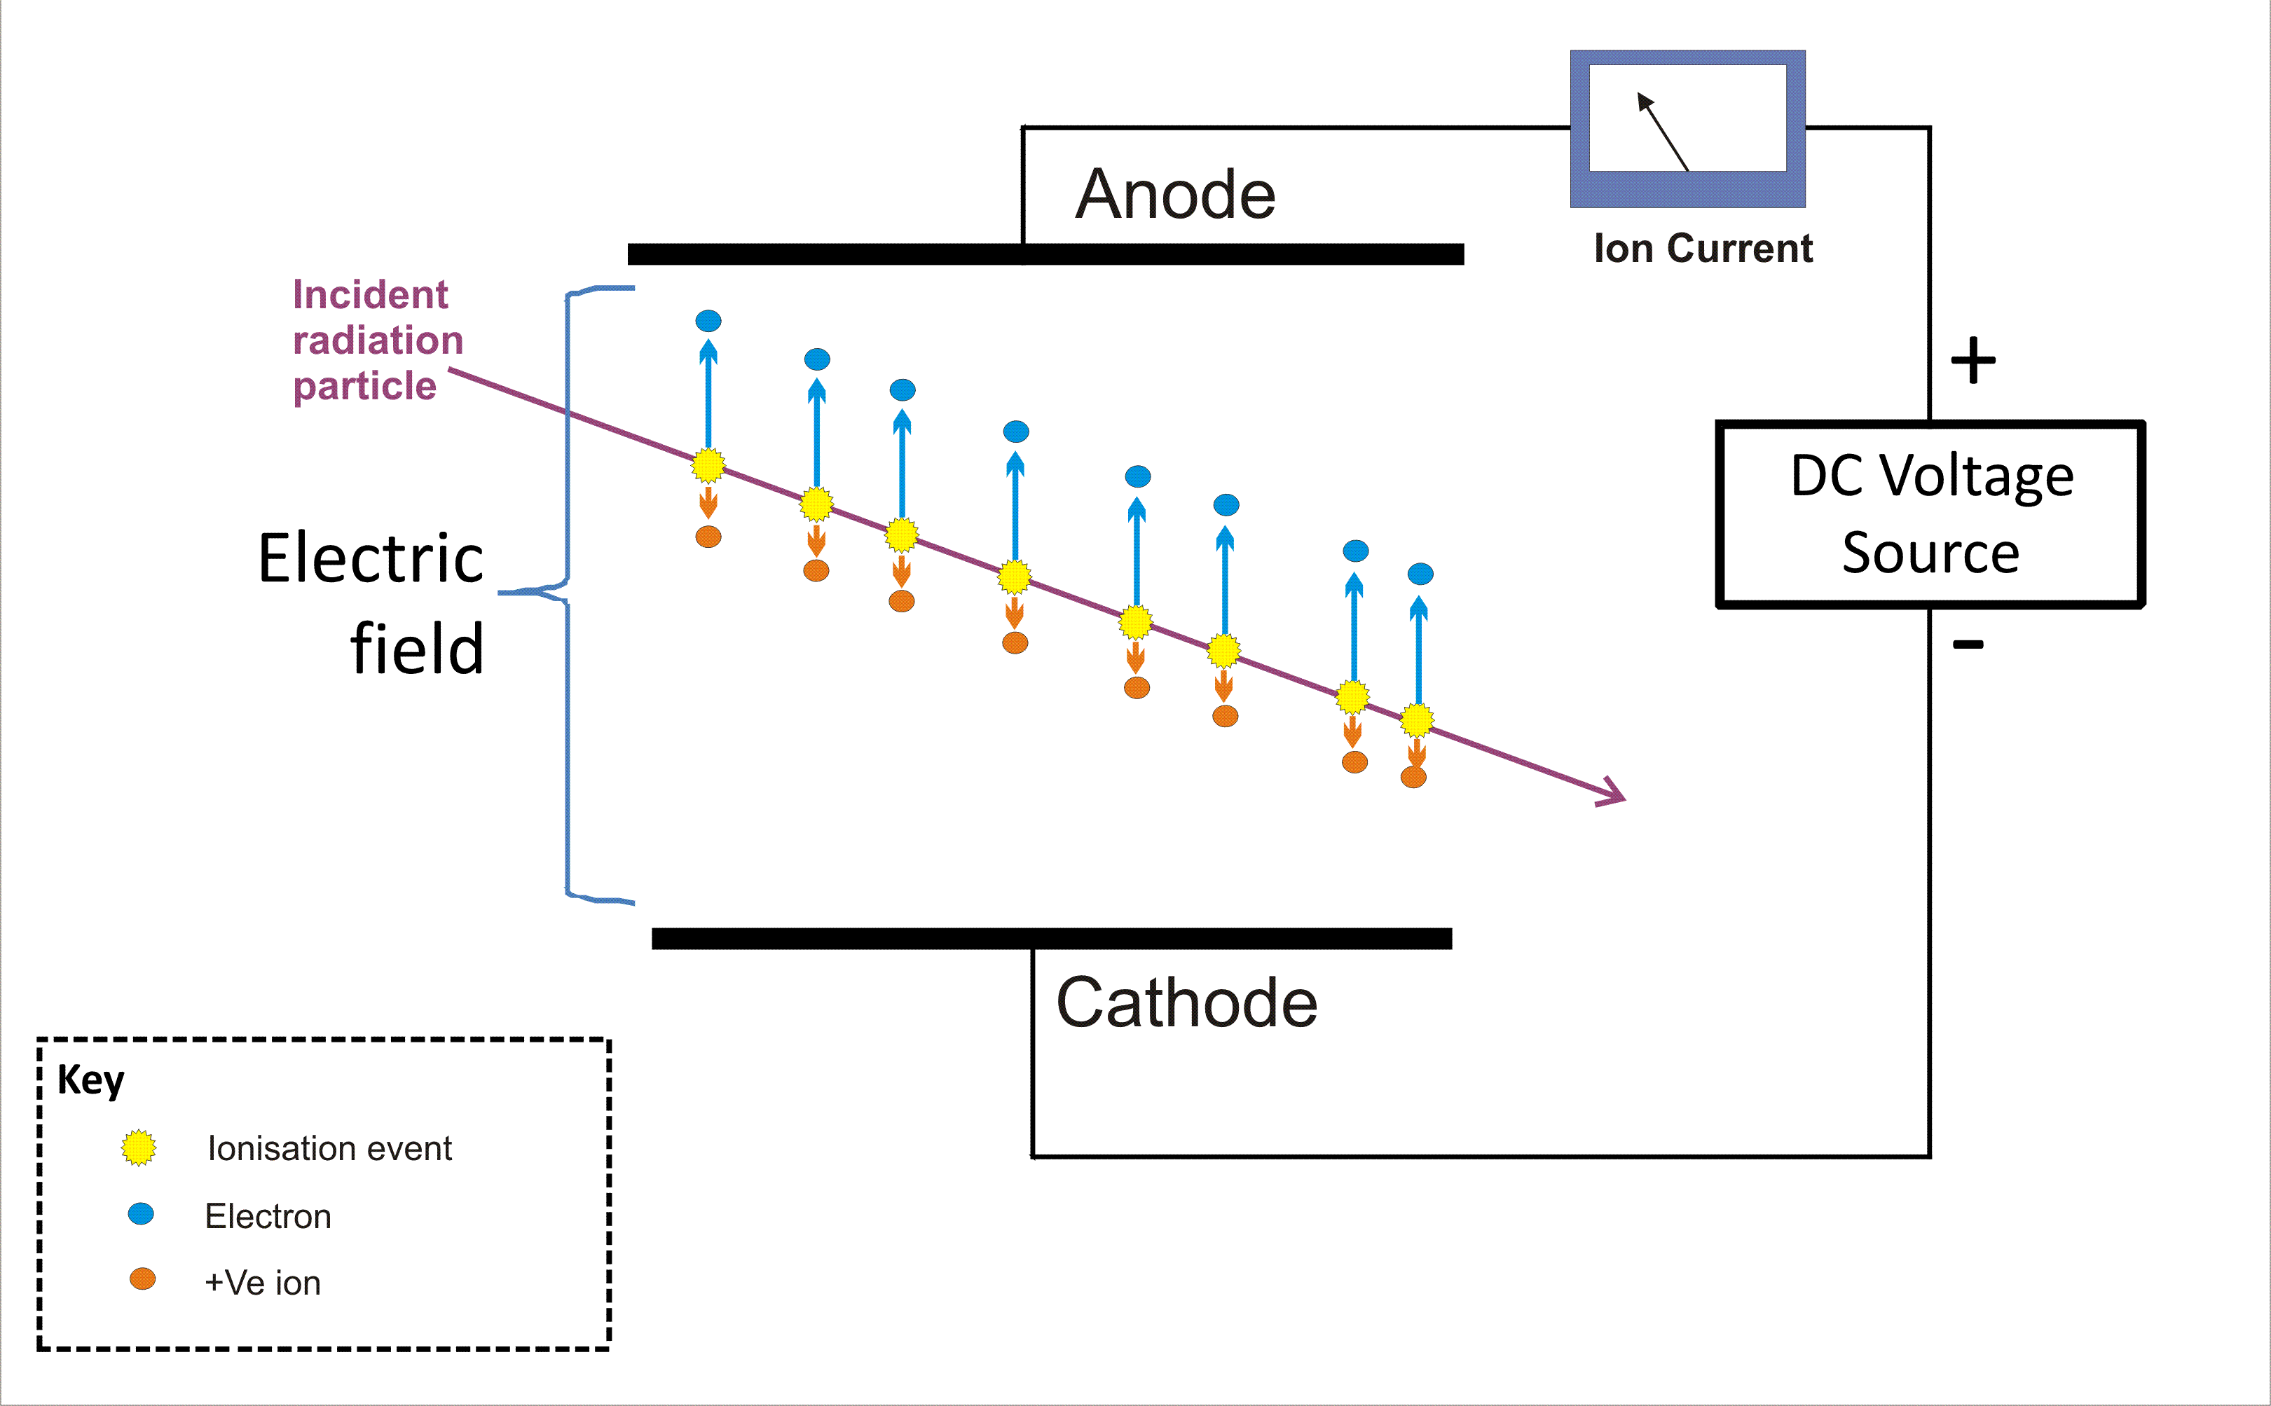
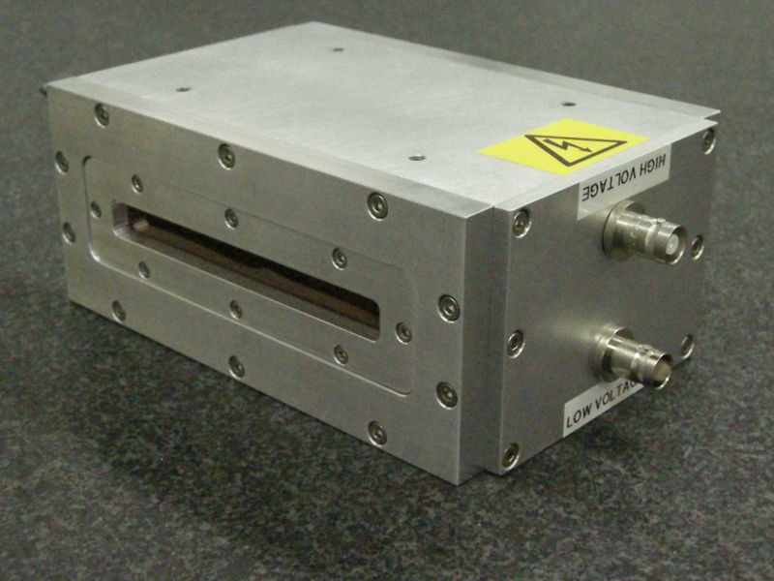
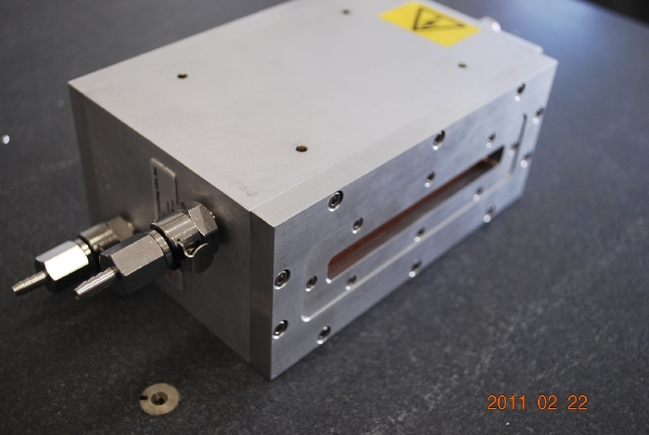
    Directly (x-rays → electrons)
    Ion Chambers
Integrating detectors… ion current ~ x-ray flux
Used to monitor beam intensity
Used to normalize data to the beam intensity (“I0”)
Also used for transmission XAS measurements.

Slide 40
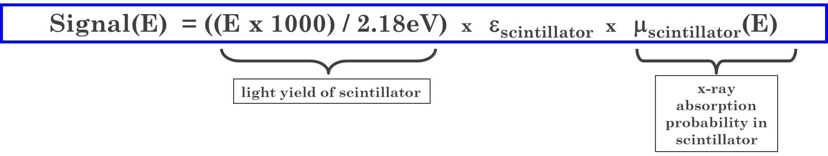
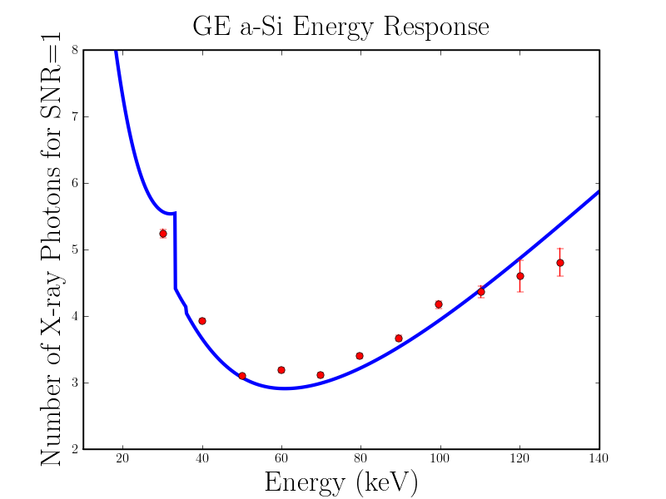
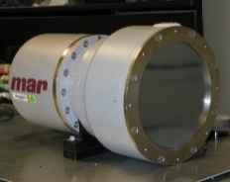
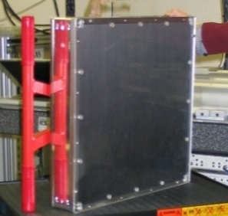
Scintillator Thickness and Optimal Energy Range
Simple Energy-Dependence Model for Indirect Detection Area Detectors
Signal Size
GE a-Si Flat Panel
8
marCCD/165
500 μm CsI
7
10
40 μm Gd₂O₂S
6
5
Number of X-ray Photons for S/N ratio = 1
4
3
2
2
10 30 50 70 90
Energy (keV)
40 60 80 100 120 140
Energy (keV)

Slide 41
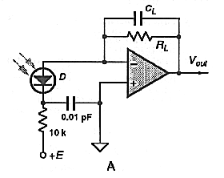
Spectroscopic Detectors – Signal Chain
Preamp
x-ray
Digitizer
diode
Shaping Amp
Pulse Height Analyzer
Multi-Channel Analyzer
Histogram
Pulse Height
1 V
3 μs
Energy ~ P.H. ~ channel #

