Slide 1
Neutron Diffraction Application
Ashfia Huq
Oak Ridge National Laboratory
Research carried out at the Spallation Neutron Source at Oak Ridge National Laboratory is supported by the Division of Scientific User Facilities, Office of Basic Energy Sciences, U.S. Department of Energy.

Slide 2


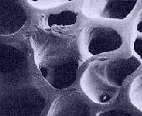
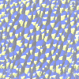
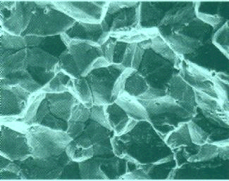
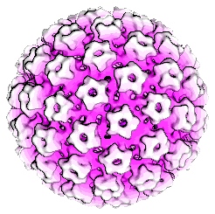
Where are the atoms?
We need wavelength (λ) ~ Object size (for condensed matter that is Å)
Amorphous
Materials
Crystal
Structure
Porous
Media
Precipitates
Grain
Structure
Virus
Neutron WAVELENGTHS are similar to atomic scale dimensions
Neutron Wavelength (Å)
X-ray
λ : 0.1 Å - 10 Å
λ[Å] = 12.398/E_{ph}[keV]
Source:
Lab diffractometers
Synchrotron Sources
Neutron
thermal λ : 1 - 4 Å
E_{n}[meV] =81.89/ l²[Å]
Source:
Reactors (fission)
Spallation Source

Slide 3
Outline
Phase ID and Quantitative analysis
Structure and transport
Neutron Powder Diffraction
Combine X-rays and Neutrons
Time resolved in-situ studies
Ab-initio structure solution
Proteins and Powder Diffraction

Slide 4
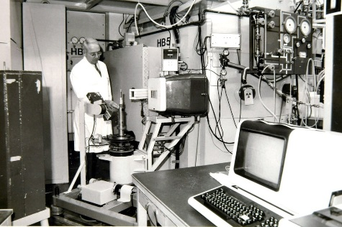
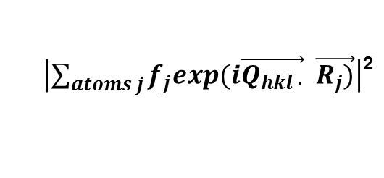

Rietveld Refinement
Structure Solution
Least square refinement method for structural analysis from powder diffraction when very good starting model is available.
Minimize goodness parameters such as χ² or R_{wp} where
Model that describes the structure
Profile parameters(lattice, line-shape, background etc.)
Atomic information (fractional co-ordinates, thermal parameters fractional occupancy etc.)
Given atom positions, it is straightforward to compute the diffraction pattern
$$I_{hkl}=$$
$\left|\sum_{atoms j}{f_{j}exp(i\vec{Q_{hkl ∙}}} \vec{R_{j})}\right|$²
Solve a new structure from powder data
1. Get data (High Quality)
2. Find the lattice (Indexing)
3. Space group (internal symmetries) systematic absences, density, guess, luck
4. Extract intensities of each individual (hkl) peak
5. Solve structure
a. Momentum space - Direct methods
b. Real space
6. Refine
J. Appl. Cryst. 2, 65, 1969

Slide 5
Finger Printing and Quantitative Phase Analysis (First two Slides from Dr. Jim Kaduk)

Slide 6
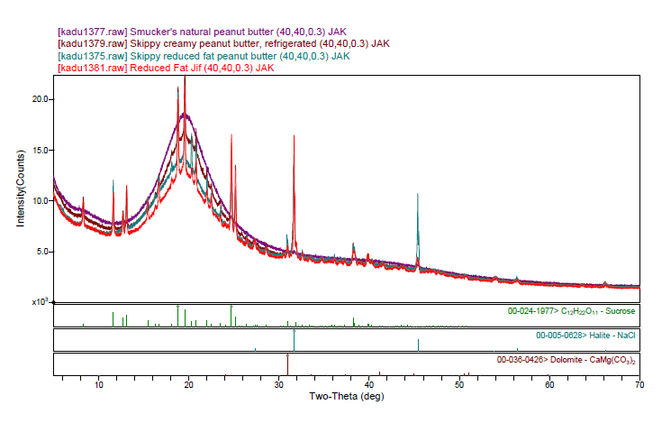


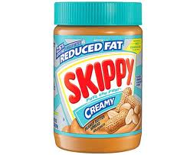
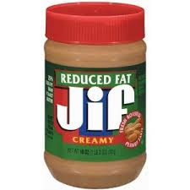
Peanut Butter

Slide 7
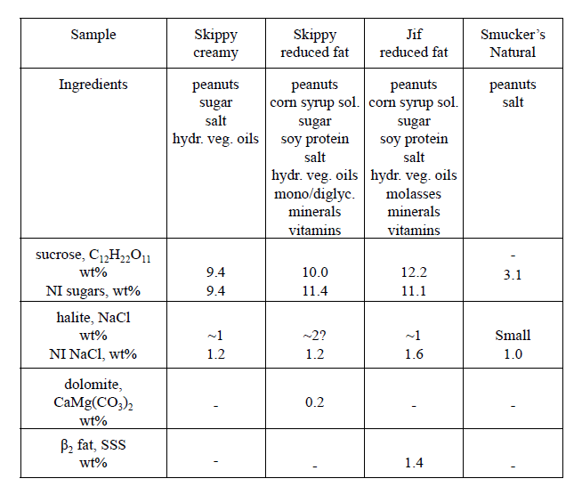

Slide 8
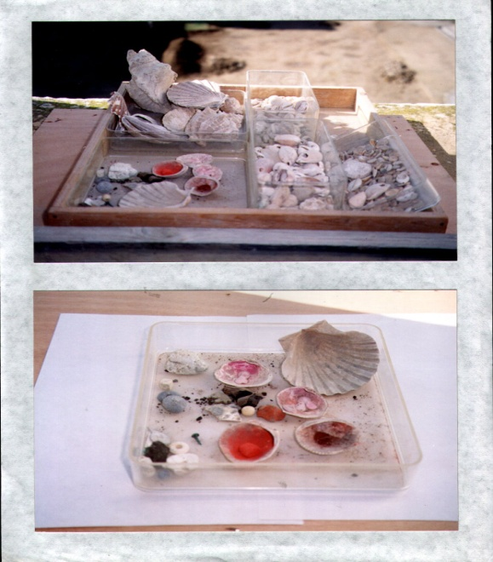
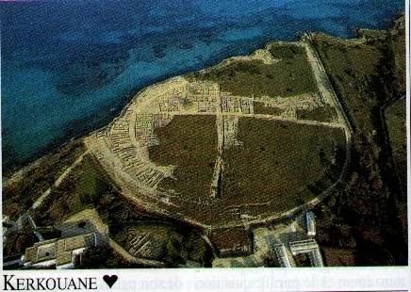
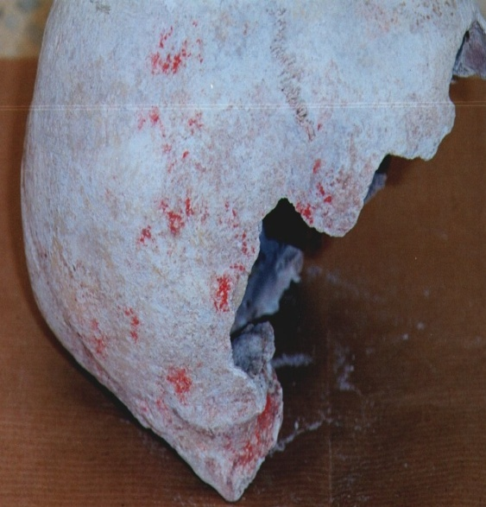
Powder Diffraction in Archeology Huq et.al. Appl. Phys. A 83, 253 (2006)
Natural antique colorants include red pigments such as cinnabar and ochre and pink pigments such as madder. These archaeological pigments have been used as ritual and cosmetic make-up and they are a material proof of handcraft activities and trade in the Mediterranean.
The pigments were discovered during different excavations in archaeological sites of Tunisia (Carthage, Kerkouane, Bekalta, Bouaarada and elsewhere).

Slide 9
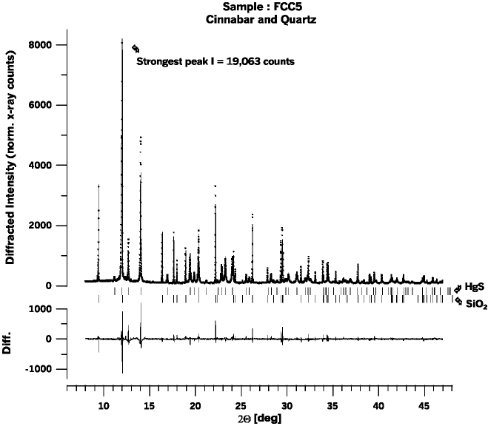
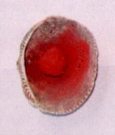
fit peak: search
database for matches.
Look up structure.
Rietveld refinement.
For mixture quantitative phase analysis.

Slide 10
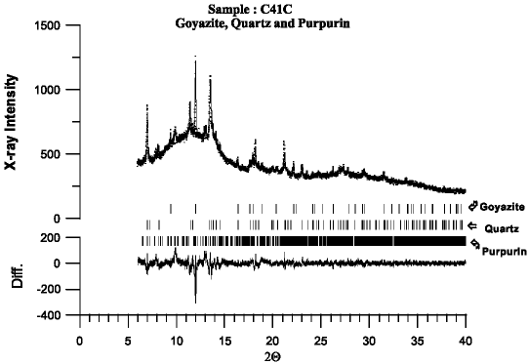
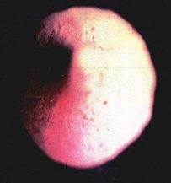
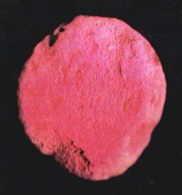
Conclusions
Ten punic make-up samples were studied with SR-XRD using a 2D CCD detector and high angular resolution powder diffraction. Four samples (B1, B2, B3 and FCC5) contain quartz and cinnabar while four other samples (B10, FCC4, FCC6 and OCRB) contain quartz and hematite. The presence of quartz is probably due to sand/clay from the excavation area.
These results are similar to what would be obtained from raw materials indicating that these eight samples were not subject to any preparation by the Carthaginians. These eight samples were used as ritual make-up. However, the last two samples (FCC2 and C41C) showed an amorphous background, their preparation required sophisticated techniques corresponding to cosmetic make-up; they contain purpurin as major pigment which is formulated in a similar fashion as a lacquer.

Slide 11
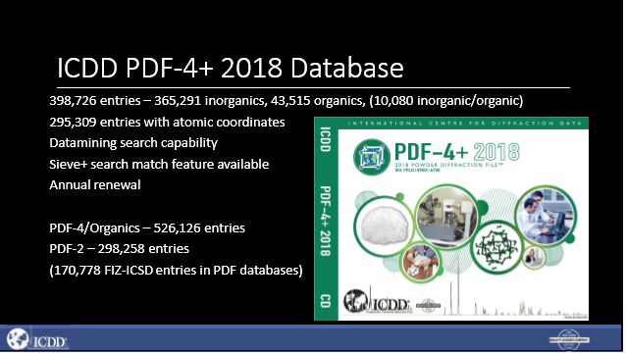
Resources (databases)
ICDD (International Center for Diffraction Data): Minerals, Organics and Inorganics http://www.icdd.com/
CCDC (Chembridge Crystallographic database): Organic structures https://www.ccdc.cam.ac.uk/
ICSD (Inorganic crystal structure database):
https://www.fiz-karlsruhe.de/de/leistungen/kristallographie/icsd.html
NIST & MPDS

Slide 12
Superconductivity in Fullerenes and Scientific Ethics! (Publishing in high profile journal)

Slide 13
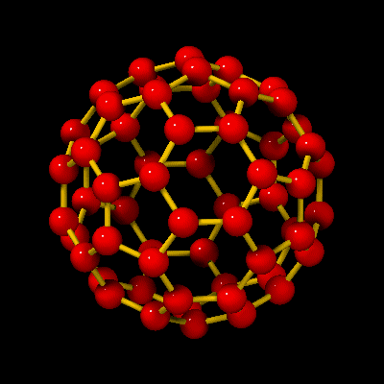
Buckminsterfullerene
1985 : R.F Curt, H.W. Croto &
R.E. Smalley discover C₆₀. They are
awarded the Nobel prize in Chemistry
in 1996.
1990 : W. Kratchmer and D.R. Huffman produces isolable quantities of C₆₀.
1991 : A group at AT&T Bell labs,
finds superconductivity in alkali doped C₆₀ with Tc=18K for K₃C₆₀. Later Tc=28K is observed for Rb₃C₆₀
Diameter of molecule 10Å. The atoms are positioned at the 60 vertices of a truncated icosahedron. 90 edges, 12 pentagons, 20 hexagons.

Slide 14
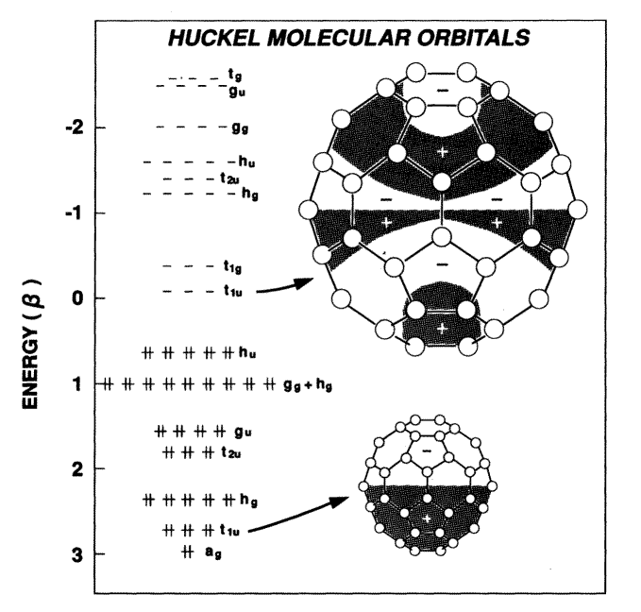
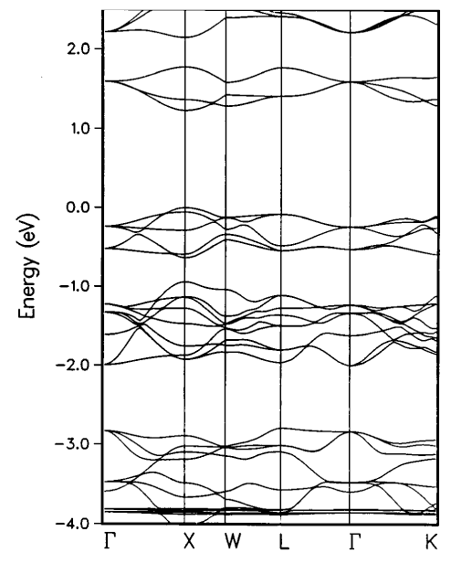
C
C
σ
σ
σ
C
π
C
LUMO+1
HOMO
LUMO
60 electrons that take part in
conduction
l = 4
l = 3
l = 2
l = 1
sub bands around E_{F} of solid C₆₀. (Erwin 1993)
l = 0
n=2(2l+1) works
up to l=4
Single bond ∼1.45Å
Double bond ∼1.39Å
HOMO – LUMO
∼2ev

Slide 15
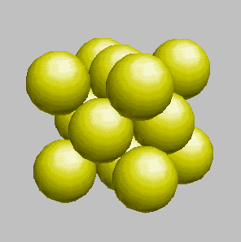
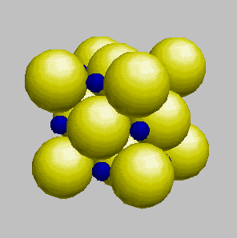
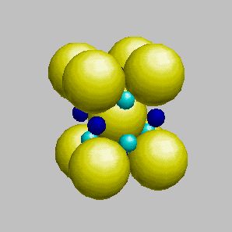
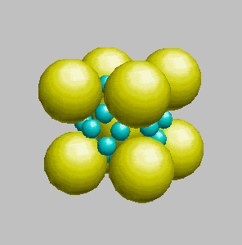
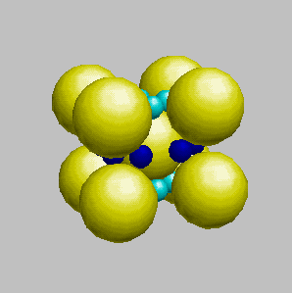
Alkali(K,Rb,Cs) doped C₆₀
fcc C₆₀(a=14.17Å)
AC₆₀(a=14.06-14.13Å)
A in octahedral site
A₃C₆₀(a=14.24-14.44)
A in both tetrahedral
And octahedral site
2/3 filling
but a band
insulator !
A₄C₆₀ bct (Cs₄C₆₀ orthorhombic & orientationally ordered.)
A₆C₆₀ bcc(a=11.39-11.84Å)

Slide 16
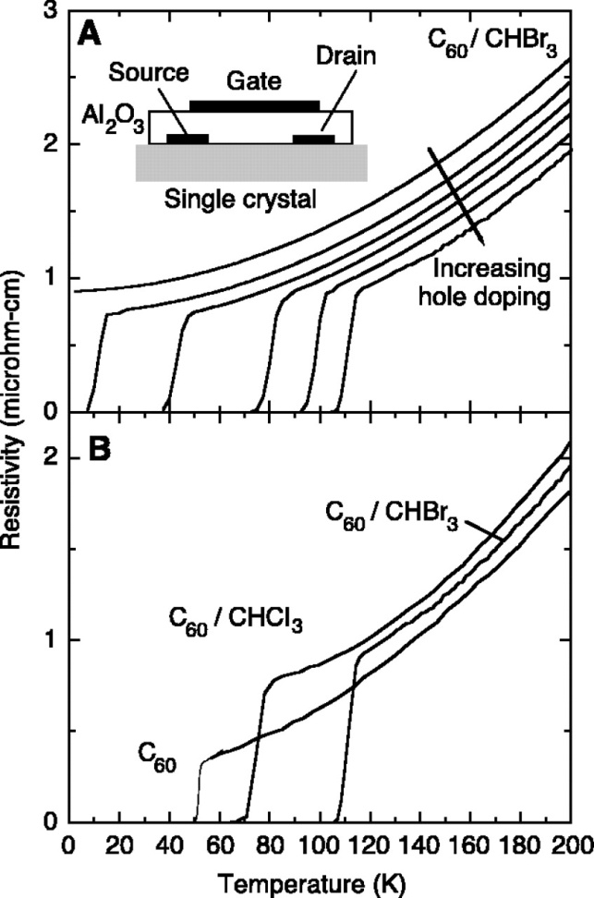
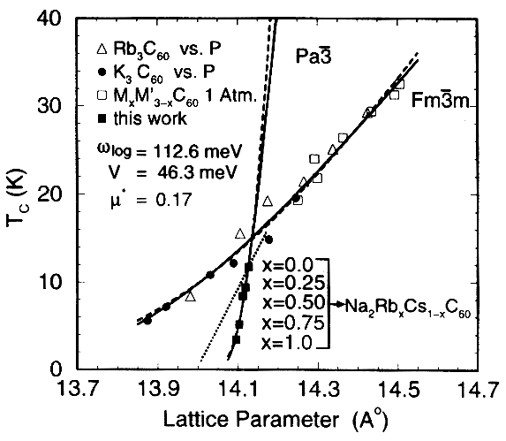
C₆₀ base Superconductors:
Changing the lattice parameter in Alkali doped fullerides, (either decreasing it with pressure or increasing it by substitution of a larger cation) increases the DOS N(E_{F}).
According to BCS theory
Increase in N(E_{F}) => Increase in T_{c}
Interesting new superconductors,
FET of organic materials (anthracine, pentacene, tetracene C₆₀. Record T_{c}=117K for C₆₀ / CHBr₃. (Tc=80K for C60 / CHCl3)
J.H. Schön, Ch. Kloc, B. Battlogg, Science 293, 2432-4 (2001).
*Yildrim T et. al., 1995, Solid State Commun. 93 269-74

Slide 17
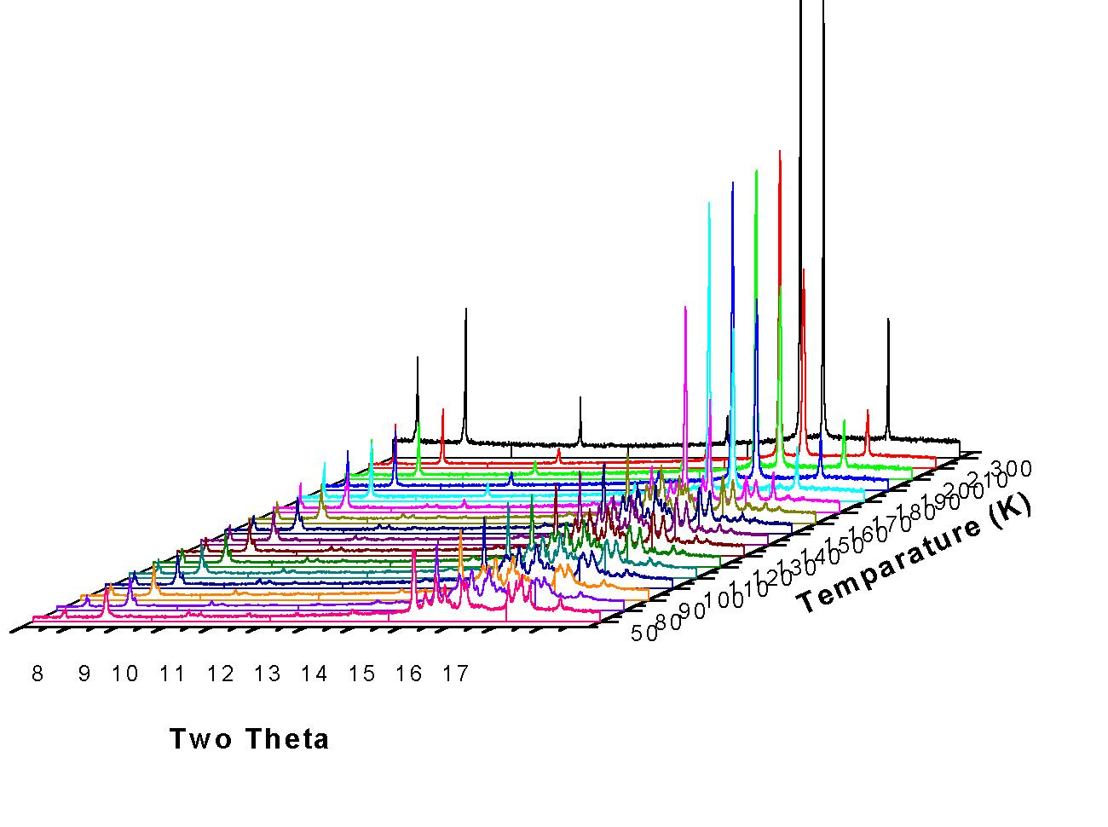
What happens to the crystal structure as we decrease T ?
Hexagonal
Monoclinic
Triclinic
Heating-cooling cycles showed pronounced hysteresis and co-existence of the different phases over a large temperature range.

Slide 18
C₆₀ · 2CHCl₃ at room temp.
Hexagonal, a = 10.096, c = 10.101Å

Slide 19
C₆₀ · 2CHCl₃ at 170K
monoclinic(16.821Å, 10.330Å, 10.159Å, 102.051°)

Slide 20
C₆₀ · 2CHCl₃ at 50K
(9.836Å, 10.091Å, 9.818Å, 101.36°, 116.46°, 79.78°)

Slide 21
The crystal structure of C₆₀ intercalated with CHCl₃/CHBr₃ is not fcc but hcp. More over when it is cooled it undergoes a phase transition and at ~150K they are converted into a fully order triclinic phase.
 | Sp Group | Lattice | T_{c} | d_{nn}
K₃C₆₀ | Fm3m | 14.24 | 18 (e-) | 10.069
Rb₃C₆₀ | Fm3m | 14.44 | 28 (e-) | 10.211
C₆₀ | Fm3m, (Pa-3) | 14.16, (14.04) | 52 | 10.013
C₆₀.2CHCl₃ | P 6/mmm | 10.09, 10.095 | 80 | 10.09
C₆₀.2CHBr₃ | P 6/mmm | 10.211, 10.216 | 117 | 10.211
along | d_{nn} (Å)
001 | 9.8179
100 | 9.8361
010 | 10.091
101 | 10.348
011 | 12.6165
-110 | 12.781
C60.2CHCl3 (P –1)

Slide 22
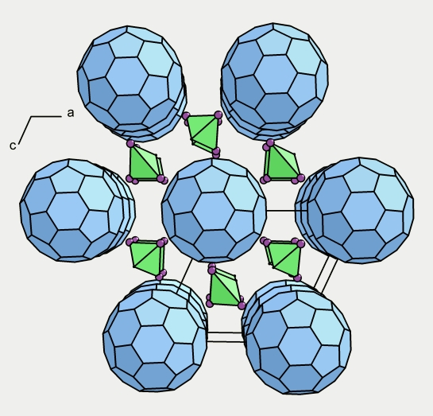
Interfullerene distances
C₆₀ · 2CHCl₃
In plane:
9.82, 9.84, 10.35
Between plane: 10.09
C₆₀ · 2CHBr₃
In plane:
9.90, 9.90, 10.50
Between plane: 10.34
cf. C₆₀: 9.93 (5K)
K₃C₆₀: 10.07
Conclude: Strong increase of T_{c} from intercalations is not just an effect of simple lattice expansion.

Slide 23


In 2001 he was listed as an author on an average of one research paper every eight days!
On October 31, 2002, Science withdrew eight papers written by Schön. On December 20, 2002, the Physical Review journals withdrew six papers written by Schön. On March 5, 2003, Nature withdrew seven papers written by Schön.

Slide 24
Neutron Powder Diffraction

Slide 25
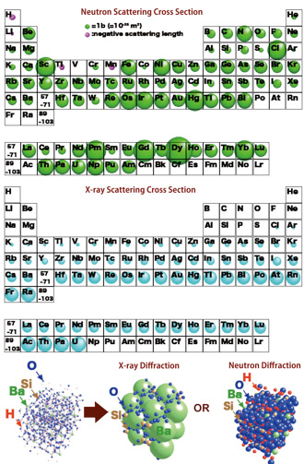
Why Neutrons ?
Detects light atoms even in the presence of heavy atoms (organic crystallography) – H is special!
Distinguishes atoms adjacent in Periodic table and even isotopes of the same element (changing scattering picture without changing chemistry)
Electrically neutral; penetrates centimeters of bulk material (allows non-destructive bulk analysis). Ease of in-situ experiments, e.g. variable temperature, pressure, magnetic field, chemical reaction etc.
Magnetic moment (magnetic structure)

Slide 26
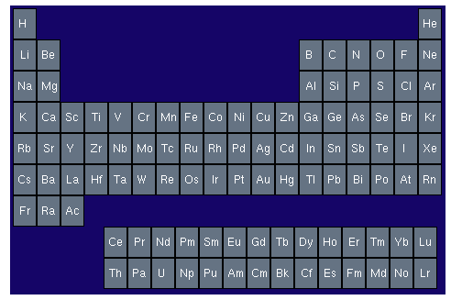
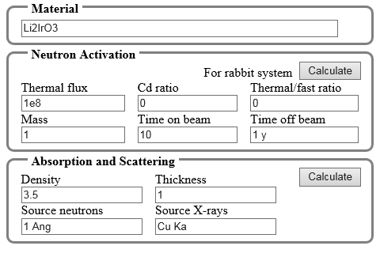
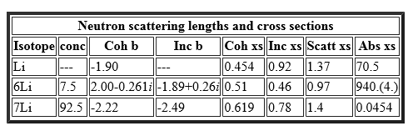
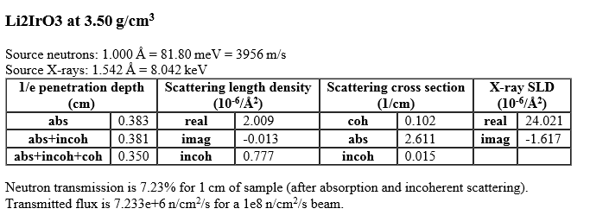
Before You Start
https://www.ncnr.nist.gov/resources/n-lengths/
https://www.ncnr.nist.gov/resources/activation/

Slide 27
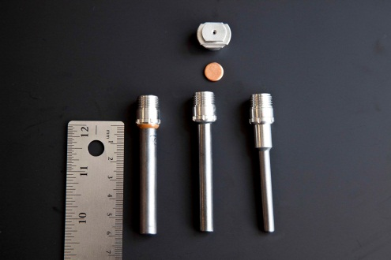
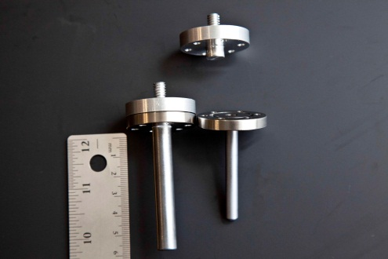
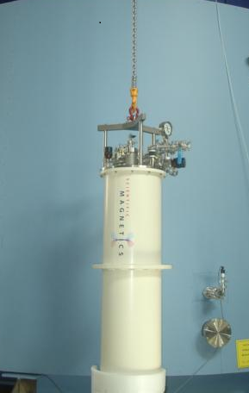
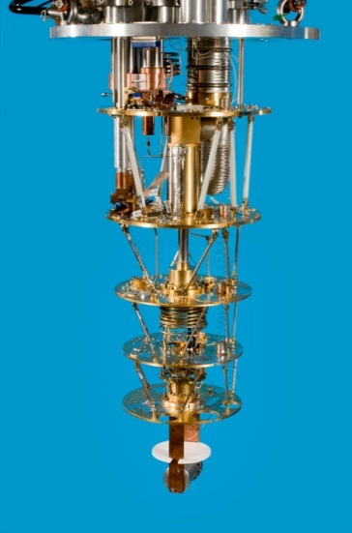
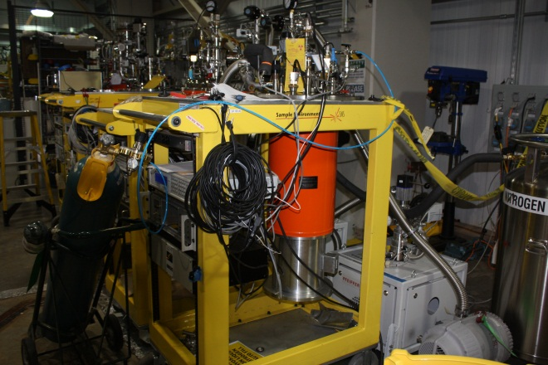
Sample Environment
Sample Containers
Usually V can
Capillaries for small sample
Low Temperature
CCR (4K-300K)
CCR with sample changer
Orange Cryostat (2K-300K)
OC with Dilution insert(mK-300K)
Cryofurnace (4K-650K)
Magnets
14T on WISH
11T on NPDF
5T on Powgen (commission)

Slide 28
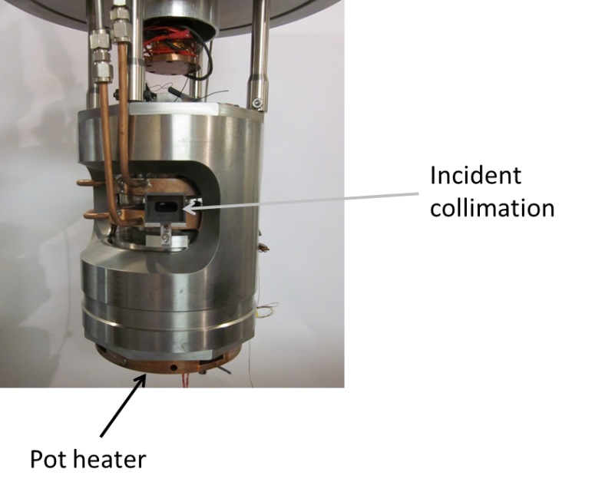
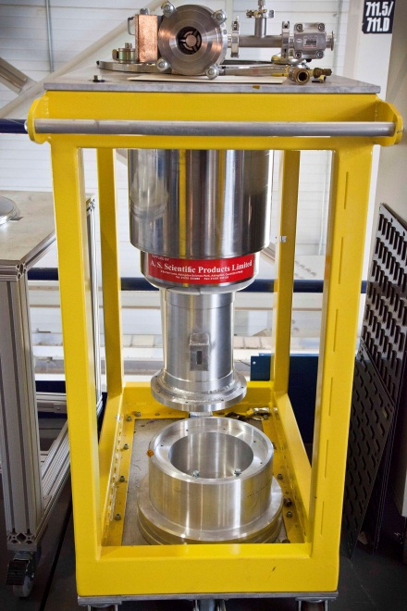
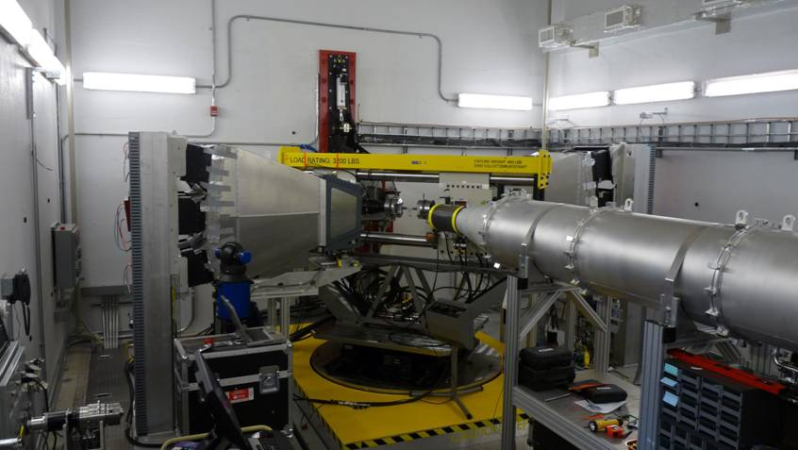
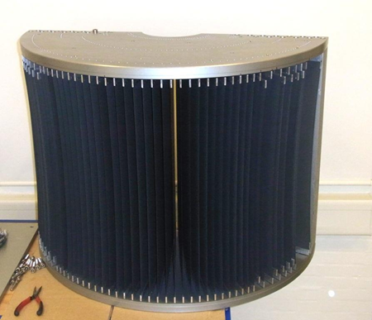
High Temperature
V (ILL) Vacuum furnace (RT-1100C)
Nb (ILL) Vacuum furnace (RT-1600C)
Gas Handling
AGES (combined with pO₂ sensor and RGA)
Sievert Absorption Setup
Engineering (dedicated instruments)
Load Frames
Euler crates
Pressure
Gas Pressure Cells
Paris Edinburgh (25GPa)
Diamond Anvil Cell ( 50-90 GPa)
This is by no means an exhaustive list.

Slide 29
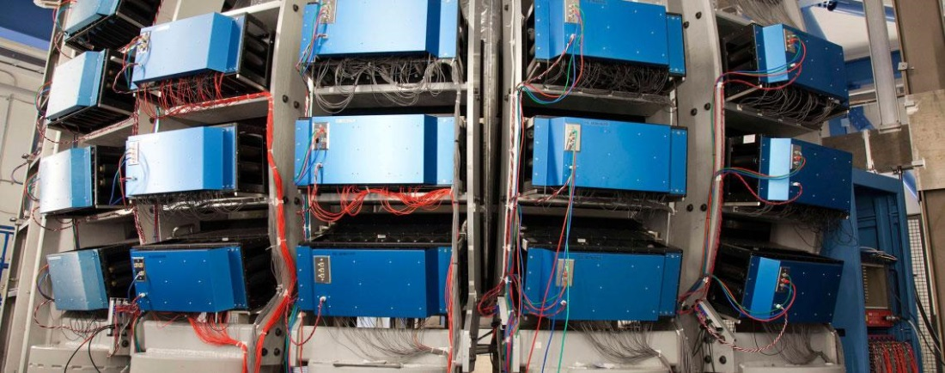

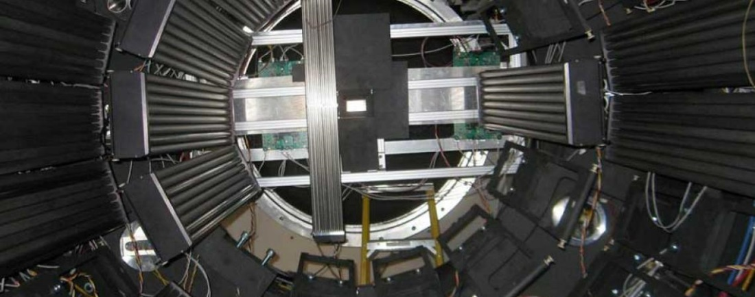
Detectors

Slide 30
Light Elements that are hard to see with other techniques

Slide 31

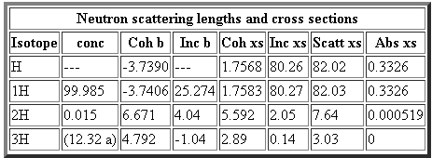

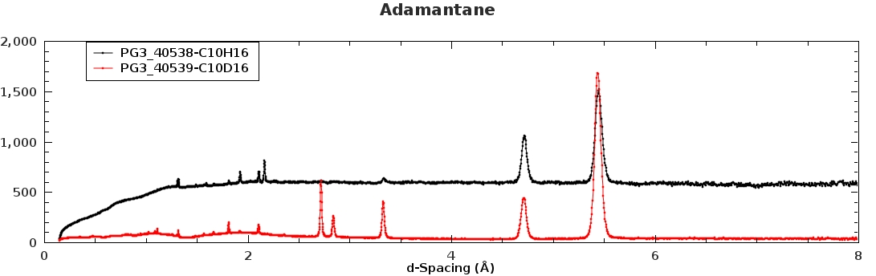
Hydrogen is special

Slide 32
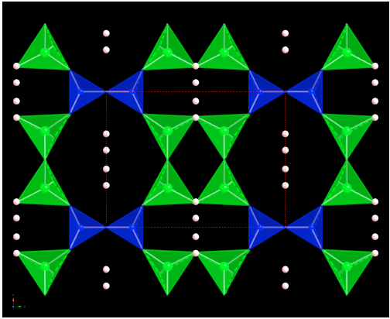


Crystal Structure of Hemimorphite (Zn₄SiO₈.H₂O)
Structure of Hemimorphtite (Zn₄Si₂O₈•H2O), showing two large open channels. Green (Zn), blue (Si), white (H). Unit cell dimension shown (a = 8.181 Å, b =10.841 Å).

Slide 33


Difference Map from Powder Data
10K Fobs
110K DELF

Slide 34
Elements that have similar Z.

Slide 35


LiNi_{0.5}Mn_{1.5}O₄ : Order Disorder
Shin D.W., Bridges C.A., Huq A., Paranthaman M.P., Manthiram A., "Role of cation ordering and surface-segregation in high-voltage spinel LiMn_{1.5}Ni_{0.5-x}M_{x}O₄ (M = Cr, Fe, and Ga) cathodes for lithium-ion batteries", Chemistry of Materials, 24, 19, 3720-3731 (2012)
Kim J.H., Huq A., Chi M., Pieczonka N.P., Lee E., Bridges C.A., Tessema M.M., Manthiram A., Persson K.A., Powell B.R., "Integrated Nano-Domains of Disordered and Ordered Spinel Phases in LiNi_{0.5}Mn_{1.5}O₄ for Li-Ion Batteries", Chemistry of Materials, 26, 15, 4377-4386 (2014).
Liu J., Huq A., Moorhead-Rosenberg Z., Manthiram A., Page K., “Nanoscale Ni/Mn Ordering in the High Voltage Spinel Cathode LiNi_{0.5}Mn_{1.5}O₄”, Chemistry of Materials, 28, 6817-6821 (2016).
GM R&D, Optimal CAE Inc., LBNL, University of Texas @ Austin, ORNL
Motivation: ~4.7V with capacity ~135mA h/g
How does synthesis and doping effect the order disorder? What is the nature of this and how does it effect performance?

Slide 36



Spinel Cathode (LiNi_{0.5}Mn_{1.5}O₄)
In disordered F d -3 m Ni and Mn are disordered in the octahedral interstitials (16d site). The order between Ni and Mn (1:3 ratio) lowers the symmetry. Ordered Phase Space Group: P4₃32.
The crystal structure can accommodate both ordered or disordered Ni and Mn distribution based on thermal history in synthesis process.
Formation of rock salt secondary phase causes reduced energy density.
Xray
Anneal vs Slow Cool
Neutron

Slide 37


Controlling the level of cation ordering by doping LiNi_{0.5-x}M_{x}Mn_{1.5}O₄ (M=Fe, Cr and Ga)
Annealing temperature and doping can be used to tune the level of cation ordering which effect the electrochemical performance of the cathode.
Notes:
Fig. 2 Neutron diffraction patterns of (a-d) LiMn_{1.5}Ni_{0.42}Cr_{0.08}O₄ before post-annealing and (e-f) LiMn_{1.5}Ni_{0.5}O₄ after post-annealing at 700 °C. In (a-c), the data are fitted with a cation-disordered model. In (c), the multipoint background is offset for clarity. Additional phases include the vanadium can and small (Li,Mn)O_{x} impurity. In (d), the patterns for the 900 °C LiMn_{1.5}Ni_{0.42}M_{0.08}O₄ (M = Cr, Fe, Ga) spinels are compared, with expected positions of ordered reflections shown. In (e-f), the difference between isotropic (e) and anisotropic (f) peak descriptions of ordered reflections ((321) and (320)) is shown for an ordered model.

Slide 38







Ni/Mn order/disorder in the ordered and disordered LiNi_{0.5}Mn_{1.5}O₄
Heat Treatments;
SC: Slow cooled 1.5°C/min from 900°C (8h)
FC: Fast cooled 5°C/min from 900°C (8h)
A48: Annealed for 48h at 700°C
A240: Annealed for 240h at 700°C
Notes:
FC: Fast cooled from 900C for 8h; 5C/min
SC: Slow cooled from 900C; 1.5C/min
A48:Annealed for 48 h at 700 °C
A240:Annealed for 240 h at 700 °C.

Slide 39

Ni/Mn order/disorder in the ordered and disordered LiNi_{0.5}Mn_{1.5}O₄
Mn³⁺ is not critical to enable high rate capability, as the conductivity enhancement from Mn³⁺ carriers in the fully lithiated spinel is far less significant than the increased conductivity from the generation of Ni³⁺ carriers.
A slightly ordered spinel, such as A48, which does not contain any initial Mn³⁺ carriers, is still capable of high rate capability because it may be able to form a kinetic solid solution at the two-phase boundary more easily than a very ordered spinel, such as A240.
Level of local ordering does not drive performance but rather Ni/Mn domain size/boundaries may instead be more important.
Ni/Mn are locally well ordered in both ordered and disordered LiNi_{0.5}Mn_{1.5}O₄
Ni/Mn are partially ordered up to 16 Å (two unit cells) in the disordered phase
Ni/Mn are long range disordered in the disordered phase .
Notes:
FC: Fast cooled from 900C for 8h; 5C/min
SC: Slow cooled from 900C; 1.5C/min
A48:Annealed for 48 h at 700 °C
A240:Annealed for 240 h at 700 °C.

Slide 40
Very often life is not so simple and one has to use both X-rays and Neutrons to get to the right picture

Slide 41


Li_{7-x}La₃Zr_{2-z}Ta_{z}O₁₂ : Solid Electrolyte
Thompson T., Wolfenstine J., Allen J.L., Johannes M., Huq A., David I.N., Sakamoto J., "Tetragonal vs. cubic phase stability in Al - free Ta doped Li₇La₃Zr₂O₁₂ (LLZO)", Journal of Materials Chemistry A, 2, 13431-13436, (2014).
Thompson T., Sharafi A., Huq A., Allen J. L., Wolfenstine J., Sakamoto J., "A Tale of Two Sites: On Defining the Carrier Concentration in Garnet-Based Ionic Conductors for Advanced Li Batteries", Advanced Energy Materials, (2015).
Mukhopadhyay S., Thompson T., Sakamoto J., Huq A., Wolfenstine J., Allen J. L., Bernstein N., Stewart D. A., Johannes M. D., "Structure and stoichiometry in supervalent doped Li₇La₃Zr₂O₁₂", Chemistry of Materials, (2015).
University of Michigan, Army Research Laboratory, Naval Research Laboratory, ORNL
Courtesy of S. Whittingham (Li dendrite growth)
Li, Juchuan, et.al. Adv. Energy Mat. 5 [4] 1401408
Motivation: Higher voltage cathode use to increase power/energy density is thwarted
Poor Safety, Capacity Fade, Limited Cycle life
SEI formation and dissolution of TM from cathode
Possible Solution: Solid Electrolyte

Slide 42



Doping in Li or Zr site for performance
Tetragonal
Cubic
Li1 = tetrahedral (1)
Li2 = octahedral (2)
Li3 = octahedral (4)
Li1 = tetrahedral (3)
Li2 = octahedral (12)
σ = 10⁻⁶ S/cm
σ = 10⁻³ S/cm
High Li⁺ Ionic Conductivity → 0.4 mS/cm at 298K is hard to reproduce.
Stable against lithium
Synthesized/processed in air
Low grain boundary resistance
Challenges:
densification
stabilizing cubic phase: Need to add Li vacancy

Slide 43


Ta doping in Zr site: What happens to the structure?
 | Li | La | Zr | Ta | O
Neutron (b) | -1.9 | 8.24 | 7.16 | 6.91 | 5.8
X-ray (Z) | 3 | 57 | 40 | 73 | 8

Slide 44


High Resolution Diffraction : Be careful what you ask for ☺
Nominal | Measured |  | Neutron |  | Synchrotron |  |  | Sychrotron Wt %
Ta | Ta | Li | a | c | a | a' | c | cubic I | cubic II | pyrochlore
0.25 | 0.2500 | 6.9863 | 12.9181 | 13.0503 | 13.0090 |  | 13.0577
0.5 | 0.5112 | 5.4645 | 12.9305 |  | 13.0131 | 12.9529 |  | 0.4623 | 0.5245 | 0.0132
0.75 | 0.7701 | 5.4900 | 12.9086 |  | 12.9912 | 12.9310 |  | 0.5293 | 0.4526 | 0.0180
1.5 | 1.5762 | 4.4082 | 12.8343 |  | 12.8677

Slide 45


Garnets in Nature (Numerous work by Antao et. Al.)

Slide 46


Natural Garnets X vs N

Slide 47
In situ Studies

Slide 48



Understanding Structure and Function in Solid Oxide Fuel Cell (SOFC)
Challenge
A basic understanding of the structure-function relationship that describes the influence of crystal structure and composition on oxygen ion transport is needed to fully optimize the performance of these materials.
This valuable structural information must be obtained under operational condition.
An integrated sample environment that includes a high temperature furnace, a gas flow insert, a pO₂ sensor and Residual Gas Analyzer (RGA) make experiments possible under operational condition.

Slide 49


REBaCo₂O_{5±d} : cathode materials for SOFC
Samples of (Nd and Pr)BaCo₂O_{5±δ} were measured @ four different pO₂ and four different temperature at each pO₂
Equilibrium state was achieved by measuring the lattice parameter. Once the lattice parameter stopped changing, longer data was collected.
Temperature of the sample was calibrated using a standard powder under identical condition.

Slide 50


Neutrons show Oxygen migration pathway in NdBaCo₂O_{5±δ}
High Q data allows refinement of anisotropic thermal parameters and oxygen vacancy. Combined with near neighbor distances, it allows us to directly visualize the oxygen diffusion pathway.
The structure is Tetragonal and not Orthorhombic as previously suggested in these pO₂ values.
O3 site exhibits the largest vacancy and anisotropic motion. Motion of O2 is also very anisotropic which can hop to the near neighbor in the vacancy rich NdO plane. Fully Occupied O1 site has very small displacement and hence limited motion.
R.A. Cox-Galhotra, A. Huq, J.P. Hodges, J.H. Kim, C. Yu, X. Wang, A. J. Jacobson, S. McIntosh, “Visualizing oxygen anion transport pathways in NdBaCo₂O_{5+d} by in situ neutron diffraction”, J. of Mater. Chem. A 1, 3091 (2013)
Notes:
Mention collaboration. Explain thermal ellipsoid.

Slide 51

In operando neutron powder diffraction during cycling
Two main challenges
preparation of a thick electrode
Active material > 0.3 g (for high-quality neutron data to be collected)
Thickness > 5 mm
High porosity to shorten diffusing length of Li⁺ ions
Tiny amount or no binder to minimize H coherent and incoherent scattering
Design and assembly of in-situ liquid electrochemical cell
Loading a thick electrode
Air and moisture tight design
Deuterated electrolyte used
Reduce contact resistance among various components
Neutron-friendly components to reduce background signal such as using Ti₂Zr alloy

Slide 52




Thick cathode and Neutron Friendly Cell (LiMn₂O₄)

Slide 53



Metastable Li_{1+δ}Mn₂O₄ (0 ≤ δ ≤ 1) spinel formation
Li₂Mn₂O₄

Slide 54
Ab-initio Structure Solution from Powder Diffraction
Direct Methods
Modeling from iso-structural compounds
Maximum Entropy Methods
MC methods and Simulated Annealing
Charge Flipping
Genetic Algorithms
References:
Structure Determination from Powder Diffraction Data
W.I.F. David, Oxford University Press, 2002
http://www.cristal.org/iniref.html

Slide 55

Polymorphism in Drugs: Why do we care?
“The story of the drug Thalidomide is heartbreaking, but it illustrates why we pay so much attention to stereochemistry. The compound was identified in the 1950s as a neurologically active molecule that had the ability to quell morning sickness in pregnant women. After the drug began to be marketed, children born to women taking it displayed horrific birth defects--often extremely shortened arms and hands that were not functional. Less obvious abnormalities were defects in children's eyes and hearts, deformed alimentary canals and urinary tracts. The drug was pulled from the market after these problems, along with death rates approaching 50%, were reported. This disaster helped lead to the creation of the modern drug testing and approval regime in the United States and Europe.
The part of the story that pertains to stereochemistry is that the original drug was made and sold as a mixture of 2 forms shown above. These are mirror images of each other, as you can see; they are not identical. Further research revealed that only the form on the right (the "R" form) was therapeutically active; the one on the left (the "S" form) was not only ineffective, it was the source of the birth defects!” http://www.science.oregonstate.edu/~gablek/CH334/Chapter5/Thalidomide.htm
Vasotec (enalapril maleate) is an ACE (angiotensin converting enzyme) inhibitor used to treat high blood pressure (hypertension), congestive heart failure, kidney problems caused by diabetes, and to improve survival after a heart attack.
The crystal structure of Form II is of interest for several reasons:
1. Form II is the more stable form between the two polymorphs.
2. The two forms are structurally similar based on X-ray, IR, and solid-state NMR.
3. The conformation of ACE inhibitors is important to their biological activity.

Slide 56
Lab(Sealed Tube) and Synchrotron XRD patterns of Enalapril Maleate
Form I
Cu Kα₁
Form II
counts
2 θ
Form I
λ=1.15Å,
Form II
2θ

Slide 57


LeBail Refinement
Cell indexed using 25 peaks in ITO

Slide 58


Structure Solution of Enalapril Maleate
form II
Orthorhombic P2₁2₁2₁
a=17.838
b=6.640
c=11.649
β=106.29
form I
a=33.987 b=6.642 c=11.210
Monoclinic P2₁/c
Torsions : 11(enalapril) + 2 maleate
orientation + position: 12
No Solution from simulated annealing methods
Powder Solve Crashed
PSSP : ran for ∞ time without success
Use Rigid units from Form I to reduce torsional degrees of freedom. Then run MC/SA to solve the structure.

Slide 59


Y.H. Kiang, A. Huq, P.W. Stephens, W. Xu, “Structure Determination of Enalapril Maleate Form II from High-Resolution X-ray Powder Diffraction Data”, J. of Pharm. Sci. 92, 1844 (2003)
green:carbon
yellow:nitrogen
red:oxygen
Form I
Form II

Slide 60


Slide 61
Proteins and Powder Diffraction

Slide 62
Extreme limit: Proteins
Work done by R. Von Dreele (Los Alamos) & P.W. Stephens
It is possible to get usable data, and to refine it with sufficient chemical restraints.

Slide 63
Structure solved from powder data & Rietveld refinement
Human Insulin Zn complex
Native
a=80.96Å
c=37.59Å
Nrefined = 1754
Nrestraints=3871
Nreflections=9871
Resolution 3.06Å
Rwp=3.34%
Ground
81.28Å
73.04Å
2925
7934
12734
3.22Å
3.77%
R.B. Von Dreele, P.W. Stephens, G.D. Smith, and R.H. Blessing, “The First Protein Crystal Structure Determined from X-ray Powder Diffraction Data: a Variant of T₃R₃ Human Insulin Zinc Complex Produced by Grinding,” Acta Crystallographica D 56, 1549-53 (2000).

Slide 64


Powder diffraction data analysis procedure followed for structure solution via the molecular replacement method, model building and structure refinement. The data and model shown correspond to the second SH3 domain of ponsin and final omit maps are shown on the lower left
Margiolaki, Irene; Wright, Jonathan P.; Wilmanns, Matthias; et al.; JOURNAL OF THE AMERICAN CHEMICAL SOCIETY 129, 38, 11865(2007)

Slide 65
Take home message
Powder diffraction is an extremely powerful technique to study structural properties of a very wide variety of materials. To understand physical and chemical properties of materials it is crucial that we know how the “atoms are put together” and if you cannot grow those big single crystals….you can still learn quite a lot about your system using powder diffraction.

Slide 66
References:
Basics:
Powder Diffraction: Theory and Practice: Edited by R.E. Dinnebier and S.J.L. Billinge
Fundamentals of Powder Diffraction and Structural Characterization of Materials (second edition): V.K. Pecharsky and P.Y. Zavalij
The Rietveld Method: Edited by R.A. Young
Software:
Rietveld Analysis: GSAS (GSAS-II), Fullprof, Topas
Structure Solution: GSAS-II, Topas, Fullprof, DASH

Slide 67
Thank You
Questions?

