Slide 1
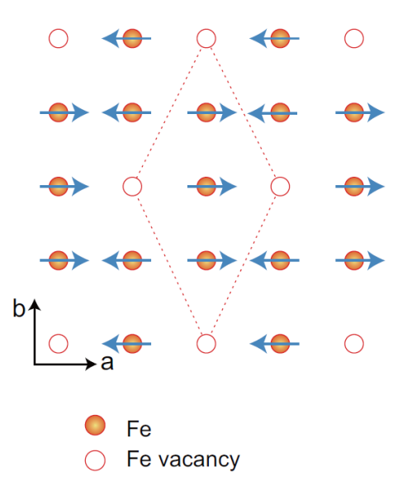
A New Direction for Iron-Based Superconductors
Scientific Achievement
Single-crystal neutron diffraction is a powerful means of determining magnetic structures, and here it is used to show the parent phase of superconductors in the K_{x}Fe_{2-y}Se₂ family has a novel magnetically ordered semiconducting ground state.
Significance and Impact
This research opens new avenues for comprehending the magnetism of iron-based superconductors and sets a new direction in the search for magnetic high-temperature superconductors.
Research Details
Superconductivity was introduced by electron doping, which suppresses the stripe AF order, leading to a magnetic phase diagram similar to those of cuprates and iron pnictides.
Neutron diffraction was used to study the structure, magnetic order, and stoichiometry of single crystals of K_{x}Fe_{2-y}Se₂ compounds.
Stripe-type magnetic order and rhombus iron vacancy order of semiconducting K_{0:85}Fe_{1:54}Se₂. The red dashed line marks the 2 × 4 rhombus iron vacancy order.
J. Zhao, H. Cao, E. Bourret-Courchesne, D.-H. Lee, R. J. Birgeneau, Physical Review Letters 109, 267003 (2012).
Work was performed at the ORNL HFIR Four-Circle Diffractometer.
Notes:
Identifying the parent compound of a high-temperature superconductor (HTSC) and understanding its magnetic and structural properties are important because the fluctuations of the magnetic order could trigger the Cooper pairing that gives rise to superconductivity.
Spectroscopy and microscopy have suggested that the nature of the parent compound of the recently discovered K-Fe-Se HTSC could be insulating, semiconducting, or even metallic. Neutron diffraction reveals a semiconducting antiferromagnetic (AF) phase with a rhombus iron vacancy order, with a magnetic order the same as the stripe AF order of the iron pnictide parent compounds. When the root (5 x 5) block AF phase coexists with superconductivity, it suppresses the stripe AFM order. This suggests that the new semiconducting magnetic ordered phase is the true parent phase of this superconductor. The researchers conjecture that the superconducting state is derived from the newly discovered magnetic phase upon electron doping. The semiconducting AF discovered in this research provides a new direction for finding magnetic HTSCs.
This research was supported by the Scientific User Facilities Division, Office of Basic Energy Sciences, US Department of Energy, and by the Miller Institute for Basic Research in Science.

