Slide 1
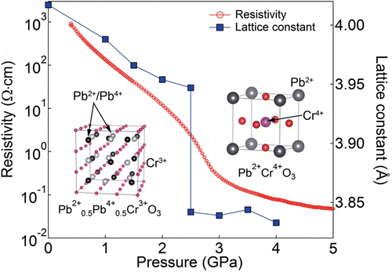
Melting of unexpected charge glassy state leads to a pressure induced metal-insulator transition
Scientific Achievement
PbCrO₃ shown to have Pb⁴⁺ and Pb²⁺ ions that form an unexpected charge glassy state, explaining a large volume collapse and metal-insulator transition.
Significance and Impact
A metal to insulator transition in integer or half integer charge systems can be regarded as a crystallization of charges. The insulating state tends to have a glassy nature when randomness or geometrical frustration exists. However, this charge glass state was realized in a perovskite compound PbCrO₃, which has been of interest for almost 50 years, without inhomogeneity or triangular arrangements in the charge system. From this state a pressure induced melting of charge glass and simultaneous Pb–Cr charge transfer causes an insulator to metal transition and ∼10% volume collapse.
Research Details
Neutron, x-ray and scanning microscope measurements provided structural and valence details.
Density functional theory calculations supported the results.
Applying pressure causes a dramatic volume collapse accompanied by a insulator to metal transition. This is revealed as being due to a melting of a charge glassy state that results in an intermetallic charge transfer. This change was found to alter the valence in the material from Pb²⁺_{0.5}Pb⁴⁺Cr³⁺O₃ to Pb²⁺Cr⁴⁺O₃. This valence change occurs since Pb is a so-called valence skipper, i.e. it goes directly from 2+ to 4+ and cannot form a 3+ state. This characteristic is utilized in lead batteries.
The research conducted at ORNL's Spallation Neutron Source was sponsored by the Scientific User Facilities Division, Office of Basic Energy Sciences, US Department of Energy. Experiments were performed at the ORNL High Flux Isotope Reactor’s HB-2A and HB-1 instruments.
R. Yu, H. Hojo, T. Watanuki, M. Mizumaki, T. Mizokawa, K. Oka, H. Kim, A. Machida, K. Sakaki, Y. Nakamura, A. Agui, D. Mori, Y. Inaguma, M. Schlipf, K. Z. Rushchanskii, M. Ležaić, M. Matsuda, J. Ma, S. Calder, M. Isobe, Y. Ikuhara, and M. Azuma, Journal of the American Chemical Society 137 12719 (2015).

