Slide 1
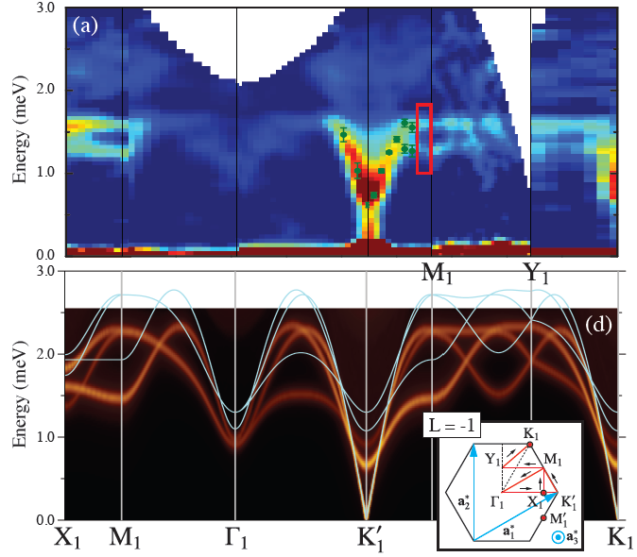
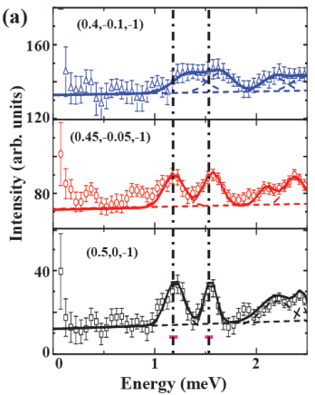
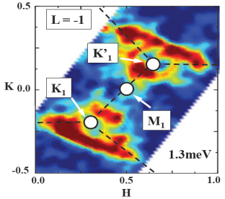
The ordered low-dimensional frustrated magnets challenge the nonlinear spin-wave theories
(c)
Scientific Achievement
Results on an ordered low dimensional frustrated magnet suggest a new theoretical framework is needed for adequate description.
Significance and Impact
The S=1/2 triangular-lattice Heisenberg antiferromagnet, Ba₃CoSb₂O₉, is a typical system to study the combination of the frustration, quantum fluctuations and low dimensionality. In this context, the authors confirm the 120°order in the ab-plane at zero-field and determine the exchange constants of the quasi-2D XXZ Hamiltonian. More importantly, they reveal that the semiclassical treatment is inadequate to explain the observed magnon decay and the associated line broadening, thereby pointing to a need for developing an alternative theoretical framework. Research Details
The magnetic structure was confirmed by neutron diffraction.
The exchange and anisotropy parameters were determined by inelastic neutron scattering with a quasi-2D spin Hamiltonian.
The observed magnon decay and the broadening dispersions reveal that a new theoretical framework is needed.
(b)
(d)
a-b The inelastic neutron scattering measurements and nonlinear spin-wave simulation of the spectra of Ba₃CoSb₂O₉ as a function of the momentum and energy transfer at T = 1.5K. c The constant-q scans near M₁ point showing the broadened magnon line-widths and their decay. In addition, the two-magnon continuum was observed.
d Constant-energy cut at 1.3 meV, showing the triangular lattice shape associated with the zone boundary excitation.
The research conducted at ORNL's Spallation Neutron Source and High Flux Isotope Reactor was sponsored by the Scientific User Facilities Division, Office of Basic Energy Sciences, US Department of Energy. Experiments were performed at the ORNL High Flux Isotope Reactor’s HB1A, HB1, HB3A, and CG4C, and Spallation Neutron Source’s CNCS instruments.
J. Ma, Y. Kamiya, Tao Hong, H. B. Cao, G. Ehlers, W. Tian, C. D. Batista, Z. L. Dun, H. D. Zhou, and M. Matsuda, Static and Dynamical Properties of the Spin-1/2 Equilateral Triangular-Lattice Antiferromagnet Ba₃CoSb₂O₉. Physical Review Letters (in press).

