Slide 1
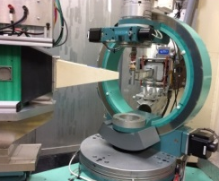
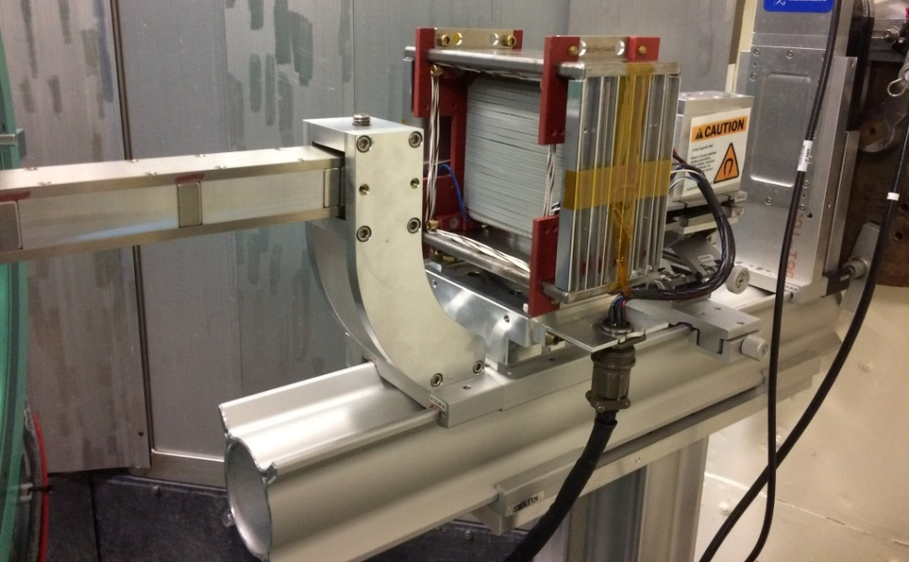
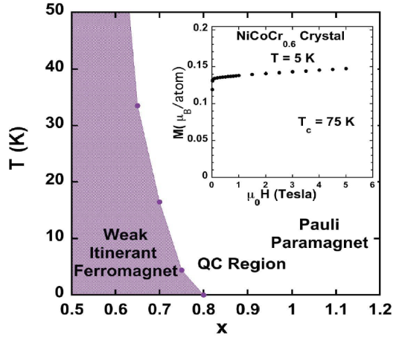
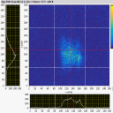
Weak Itinerant Ferromagnetism Detected by Polarized Neutron Diffraction
NiCoCr_{0.6} Effective sample mass ~20 mg
Observed ordered ferromagnetic moment: 0.11(1) μ_{B}/atom
HB-3A
Phase diagram
Mounted
crystal
Collimator with guide field
flipper
Scientific Importance
The behavior of matter near a quantum critical point (QCP) is one of the most exciting and challenging areas of physics research, for example, high-Tc superconductivity is linked to the proximity of a QCP. Although significant progress has been made in understanding quantum critical behavior in low dimensional magnetic insulators, the situation in metallic systems is much less clear. Brian Sales’ group recently reported a discovery of a QCP in an itinerant magnet NiCoCr_{x}, which is a medium entropy alloy. Weaker ferromagnetism from itinerant electrons exists when the doping moves the system closer to the QCP region. To detect weak ferromagnetic signals requires the use of polarized neutron techniques.
S-bender supermirror polarizer
Achievement
High neutron polarization ratio (>95%) has been achieved at the HFIR HB-3A single crystal neutron diffractometer. This is the first use of this capability on an experiment approved through the General User program. We succeeded in detecting a weak itinerant ferromagnetic moment of 0.11(1)μ_{B}/atom on a NiCoCr_{0.6} crystal with an effective mass of 20 mg.
Future development
The current polarized neutrons have a long wavelength of 2.54 angstrom, which limits the q coverage that is important for constructing a magnetization density map. The future development of PND at HB-3A will focus on the thermal beams (1.546 angstrom and 1.005 angstrom neutrons).
Huibo Cao (QCMD)
Andrew Christianson (QCMD)
Brian Sales (MSTD)
Hongbin Bei (MSTD)
Ke Jin (MSTD)

