Slide 1
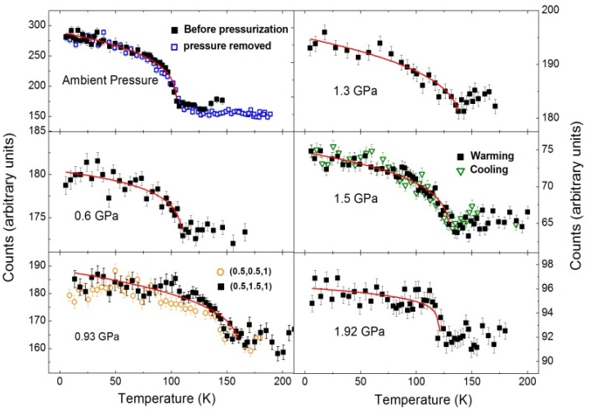
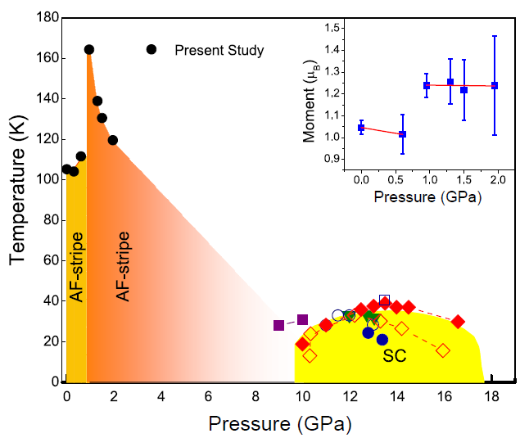
Orbital selective Mott transition observed in a quasi-1D Fe-based superconductor
Scientific Achievement
Neutron diffraction has revealed that two iron based ladder compounds, CsFe₂Se₃ and BaFe₂S₃, exhibit highly contrasting responses to hydraulic pressure despite their identical crystal structure and similar magnetic structures. The magnetic order in CsFe₂Se₃ stays unchanged up to 2 GPa, while that in BaFe₂S₃ undergoes a rather abrupt enhancement around 1 GPa both in transition temperature and ordered moment. Such unusual change bear the signature of an orbital-selective Mott transition.
Significance and Impact
The antiferromagnetic phase in Fe-based compounds is so richly faceted that its microscopic origin still eludes a unified description. Significant variation of the ordered magnetic moment and the underlying degree of electron correlations lie at the heart of the heated dispute. Theoretical models have considered correlation effects in terms of an incipient Mott picture that may be orbital dependent. This is the first time such orbital-selective Mott transition has been observed in a single compound with the help of external pressure. This finding in the quasi-1D superconductor can narrow down the theoretical scope in determining the universal physics that drives the diverse magnetism in Fe-compounds.
“Magnetic precursor of the pressure-induced superconductivity in Fe-ladder compound”.
Songxue Chi, Yoshiya Uwatoko, Huibo Cao, Yasuyuki Hirata, Kazuki Hashizume, Takuya Aoyama, and Kenya Ohgushi Phys. Rev. Lett. 117, 047003 (2016)
Top: The temperature variation of the magnetic peak intensities at different pressures
Bottom: Pressure-temperature phase diagram. The inset shows the size of the ordered moment as a function of pressure
Work performed at ORNL’s HFIR instruments HB-3A and HB-2C, DOE Office of Science User Facilities under the US-Japan Cooperative Program in Neutron Scattering
Notes:
A. Banerjee, C. A. Bridges, J.-Q. Yan, A. A. Aczel, L. Li, M. B. Stone, G. E. Granroth, M. D. Lumsden, Y. Yiu, J. Knolle, S. Bhattacharjee, D. L. Kovrizhin, R. Moessner, D. A. Tennant, D. G. Mandrus, and S. E. Nagler, “Proximate Kitaev Quantum Spin Liquid Behaviour in a Honeycomb Magnet,” Nature Materials (2016). DOI: 10.1038/nmat4604.
http://www.nature.com/nmat/journal/vaop/ncurrent/abs/nmat4604.html
ABSTRACT
Quantum spin liquids (QSLs) are topological states of matter exhibiting remarkable properties such as the capacity to protect quantum information from decoherence. Whereas their featureless ground states have precluded their straightforward experimental identification, excited states are more revealing and particularly interesting owing to the emergence of fundamentally new excitations such as Majorana fermions. Ideal probes of these excitations are inelastic neutron scattering experiments. These we report here for a ruthenium-based material, α-RuCl₃, continuing a major search (so far concentrated on iridium materials) for realizations of the celebrated Kitaev honeycomb topological QSL. Our measurements confirm the requisite strong spin–orbit coupling and low-temperature magnetic order matching predictions proximate to the QSL. We find stacking faults, inherent to the highly two-dimensional nature of the material, resolve an outstanding puzzle. Crucially, dynamical response measurements above interlayer energy scales are naturally accounted for in terms of deconfinement physics expected for QSLs. Comparing these with recent dynamical calculations involving gauge flux excitations and Majorana fermions of the pure Kitaev model, we propose the excitation spectrum of α-RuCl₃ as a prime candidate for fractionalized Kitaev physics.

