Slide 1
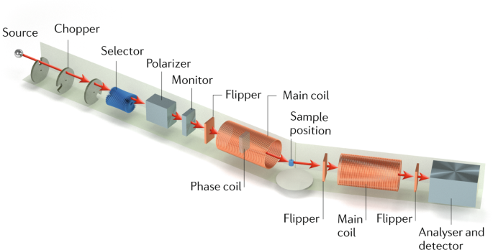
A, b, c’s of Neutron Spin Echo

Slide 2
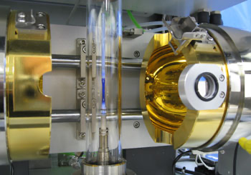

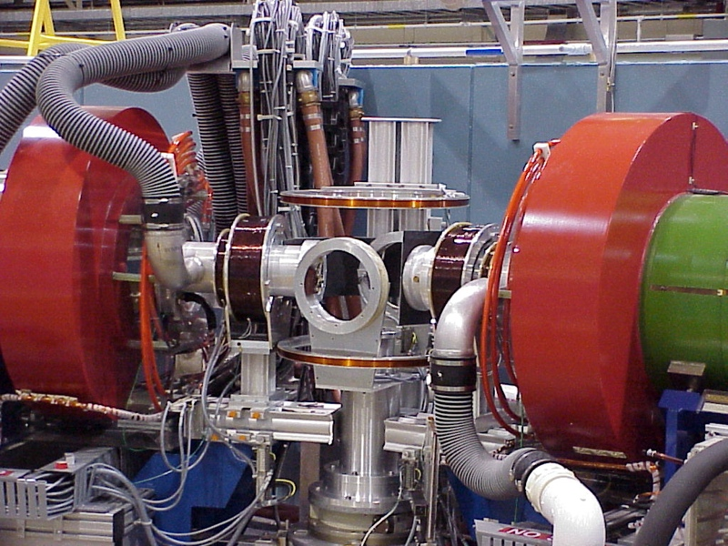
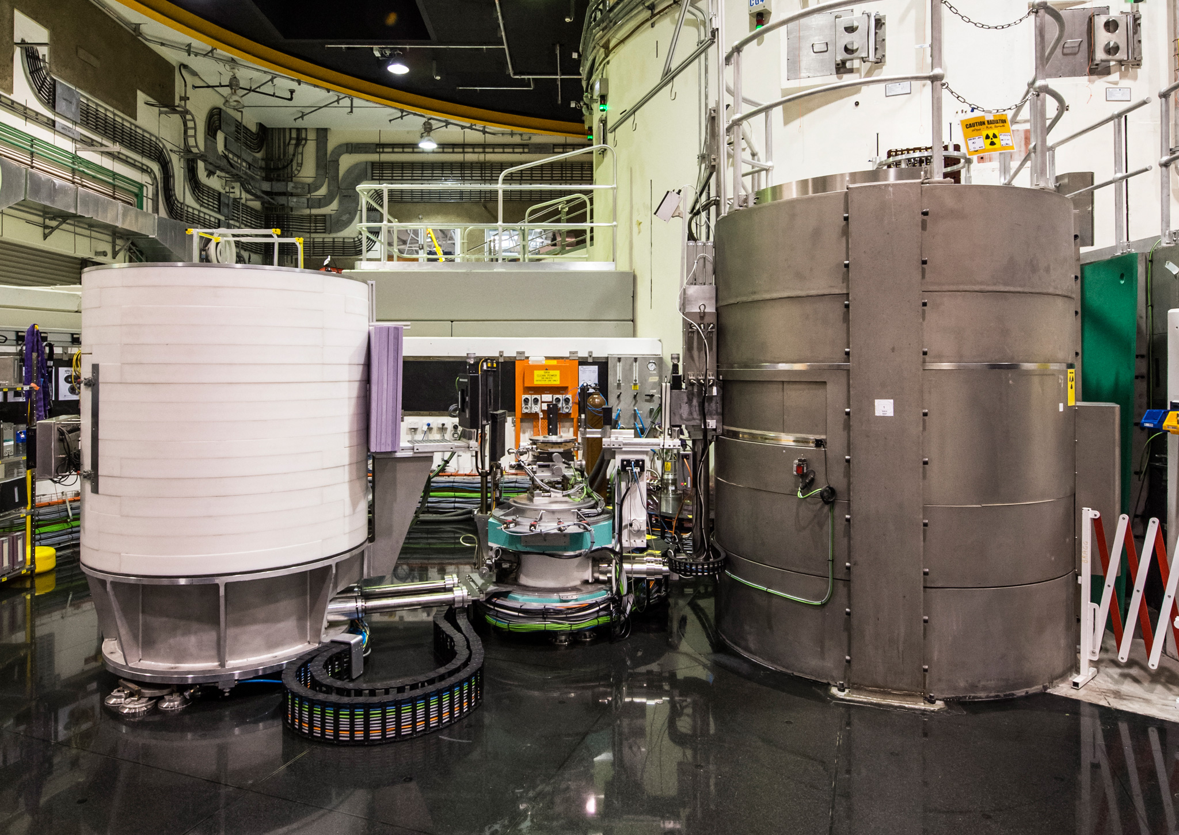
How did I get here
Postdocs (1996-1999)
McMaster University
BD Gaulin
Los Alamos
In John Sarrao’s Lab
Crystal Growth
Neutron and Muon studies
PhD 1991
University of Warwick
Crystal Growth
Back to USA
Via SSLab in China (2019/2020)
Staff positions (1999-2013)
NRC, NIST [BNL, Indiana U]
Neutron Scattering Scientist
Staff positions (2013/18)
NSRRC
Built/Commissioned 3-axis

Slide 3




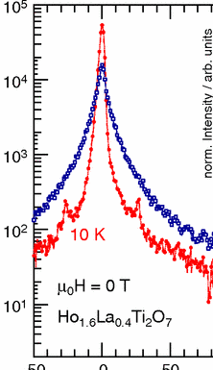
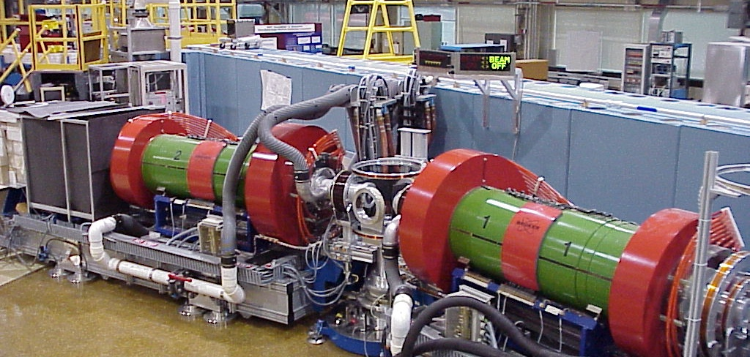




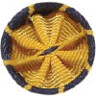



My Path
1996
1999
2008
2018
2019
2023
1998
2002
2013
2020
2026
Fellow
AAAS
Fellow
Notes:
On a timeline,
Highlight a few other events that highlights my standing in the community
1st – Fellowships at IOP and APS
2nd RMP in disordered materials and Nature reviews Physics in QENS.
As mentioned earlier, my academic life stated in the UK, at Warwick University, recently ranked the 7th best physics department in the UK. I did postdocs at McMaster and Los Alamos before deciding that Neutron Scattering, and the National Lab environment was best for me.
I took a staff position at the NRC in 1999 when a new research reactor in Canada looked promising.
In 2002 I joined BNL, stationed at NIST leading the Brookhaven-NIST Scientific Alliance. This was renewed once by BES but didn’t go further and I changed from TAS and measuring phonons and magnons to NSE.
This quasielastic technique was relatively new in the USA and I was charged to build a community. At the end of my time at NIST, I led a $2M project to relocate and upgrade this machine, which required working with a diverse group of people and we successfully completed the project on time and under budget resulting in a much improved instrument ~4times more efficient and opening up more research possibilities to the community.
An opportunity arose next came by to lead a mini-neutron group in Australia for Taiwan. Here I had ~12 direct reports, operated a triple axis, but had team members on 4 other machines. I managed a neutron promotion office in Taiwan and had a Research Professorship at NTU, their best academic institute.
Before Joining ORNL in 2020, I did a short stint in China where I was working with ex ORNL people to build up a Materials laboratory with an eye on using the neighbouring Chinese Spallation Source.
Over this 20+ year career, although employed to assist users, I always found a way to maintain a research program, so I found money, mentored students, and drove a science program in disordered magnets.
On this timeline I also mark two major recognitions of my science productivity and service to the community, first elected as a fellow of the IOP in the UK and then a few years ago at the APS, for my outstanding contributions to the understanding of frustrated magnetism using neutron beams, publishing efforts and service to the APS. Another sign of my standing in the community was being commissioned to write a RMP in Nature rev Physics

Slide 4

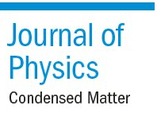

Professional Leadership
Frustrated Magnetism
@IIP Brazil
HFM 2016
NS school
in Brazil
Crystal
Growth
Initiative
Lead the
Brookhaven/NIST
Alliance
(Outstation)
FECS
EiC
1999
2006
2013
2019
1996
2002
2011
2012
2018
Build a
NSE community
& developed
Magnetic Echo in USA
Neutron Scattering Group Leader in Australia
Rebuild the
Magnetic neutron
scattering program
Built a
Quantum material lab @SSL
Notes:
More important for this position is my previous Leadership roles
From the beginning, leading small teams around an instrument
But also organizing international conferences, that are not always local, Great communication skills
EiC for 7 years. Lead the journal through choppy waters dealing with JIF and open access issues
Most recently I have focused on CLIMATE issues. helped establish a unit of the APS focusing on Early Career Scientists and
then establishing the Inclusion, Diversity, and Equity Alliance by bringing together EDI groups together and recognizing best practices and relaying them to people hoping to establish such groups in their institute.
More important for this position is my previous Leadership roles. From rebuilding neutron programs at Chalk River with 1-2 postdocs and technical support, to creating a new programs at NIST and Australia (5-15 direct reports), Team building and strong collaborative efforts were important for these positions. ~2 years ago, I joined MSTD at a difficult time, but I believe I have lead the Section very well, kept moral as high as possible and enabled researchers to get on with what they do best, and want to do.
Outside of my employment, I ran a section and was eventually the Editor in Chief of the Journal of Physics Condensed Matter, working closely with the publishing house and distinguished academics to position the journal for an ever changing academic world, increase its reputation in the community and satisfy the publishing house desires.
I’ve also organised workshops, schools and conferences. Not always locally, requiring excellent team work to make sure things proceed smoothly.
More recently, I’ve volunteered considerably at the APS. Working with the APS staff and the community I was involved in the creation of the Forum for Early Career Scientists, to support researchers from the postdoctoral times to their first “real” job ~~ up to tenure.
I was awarded an APS IF grant and helped establish IDEA, a wellness and diversity based group, brings together EDI groups from around the country and suggests best practices to those looking to set up their own local group.

Slide 5
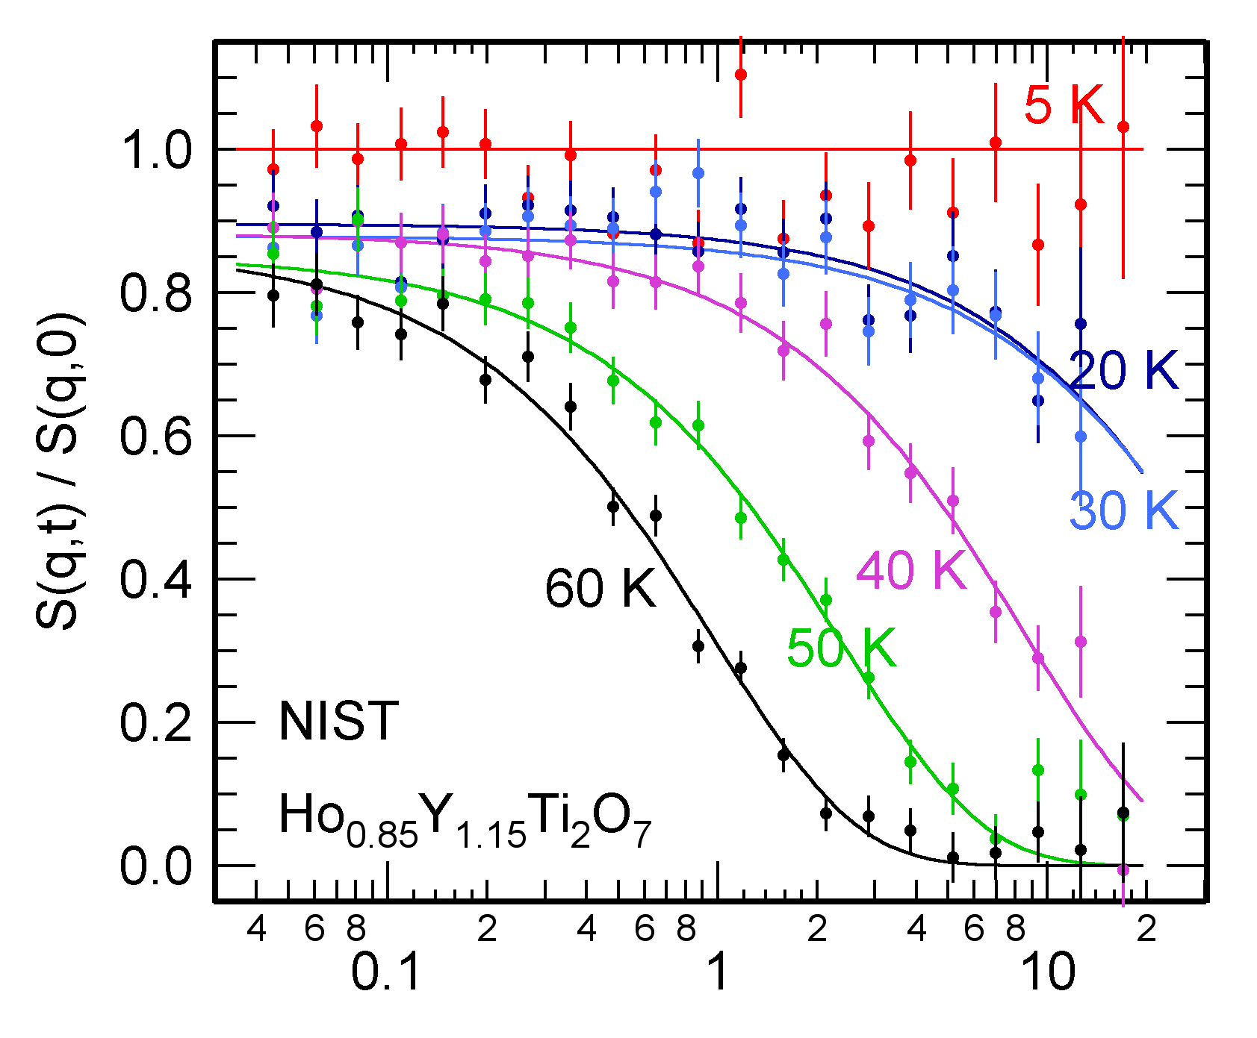


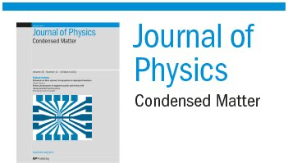

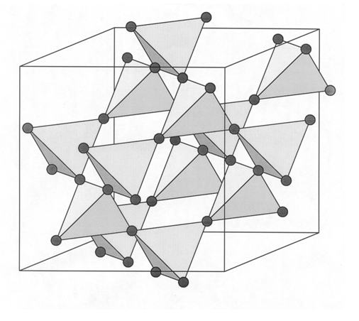
Personal Highlights
Frustrated Magnetism@IIP Brazil
HFM 2016
2011
2012
IDEA
Crystal
Growth
Initiative
FECS
Lead the
Brookhaven/NIST
Alliance
EiC
1999
2006
2013
2019
1996
2002
NSE & develop
Magnetic Echo in USA
Neutron Scattering Group Leader in Australia
Magnetic neutron
scattering program
Built a
Quantum material lab in China

Slide 6
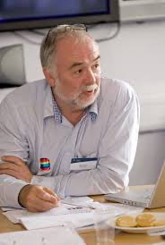

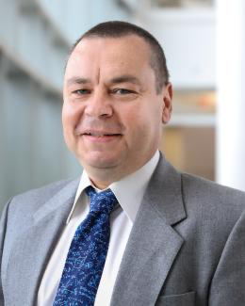
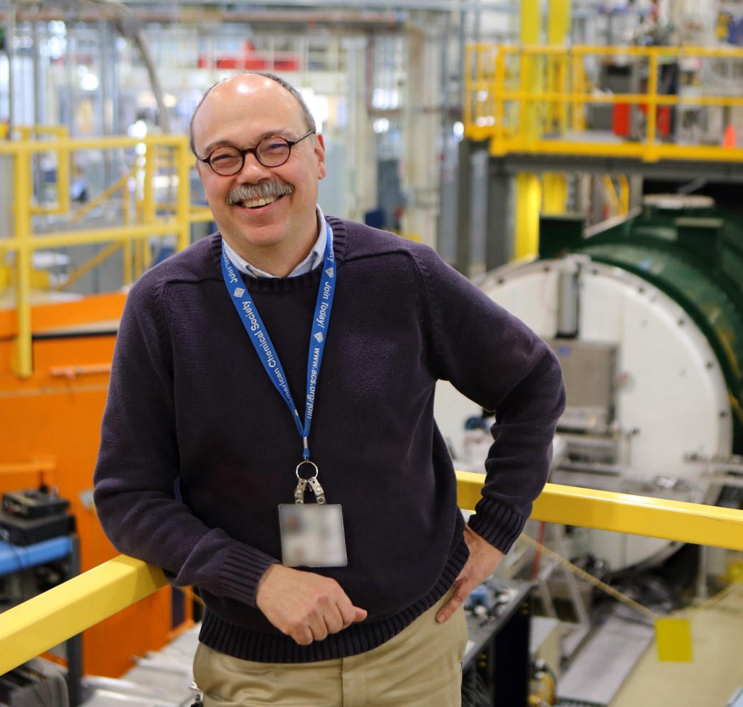
Network of Mentors
Don Paul
BD Gaulin
& many Students
Georg Ehlers
Dan Neumann and
many @ NCNR

Slide 7
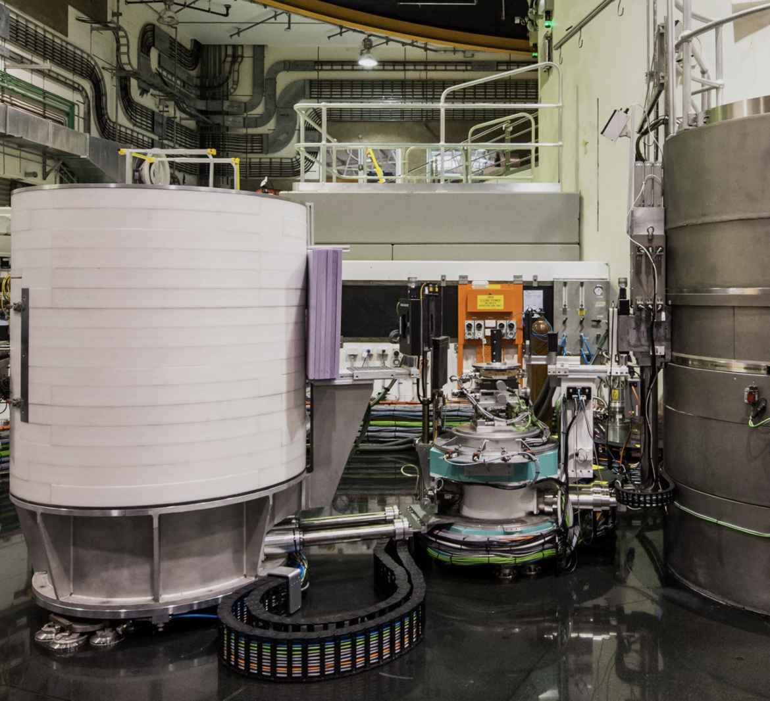
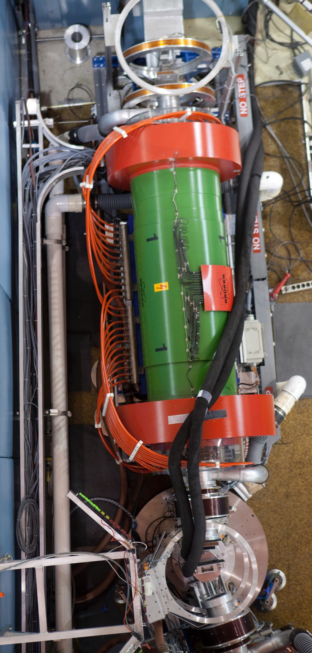
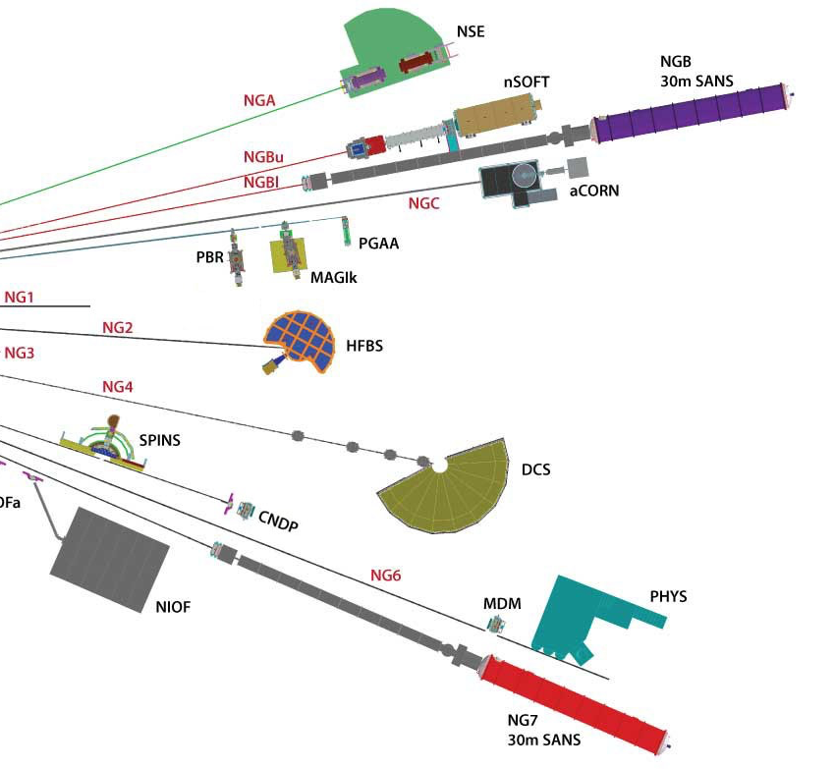
Enough about
me
Back to the Incredible Neutron

Slide 8
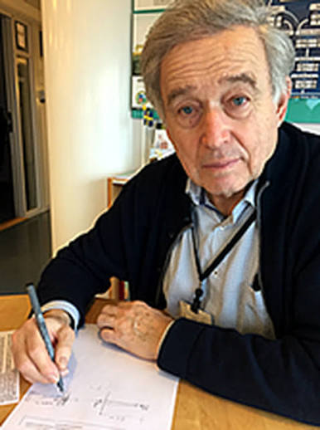
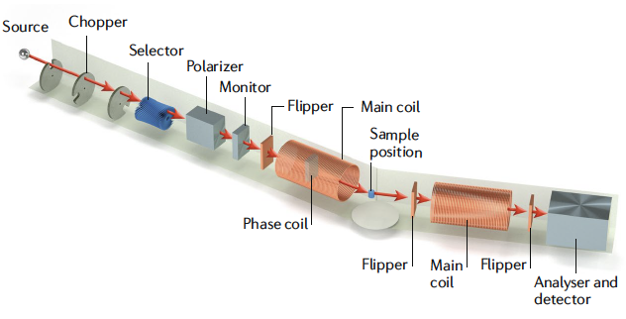
Neutron Spin Echo
made popular by Jülich Scientists
Another form of Quasi-elastic scattering

Slide 9
Simple Take Home
NG-5 NSE
Time (ns)

Slide 10
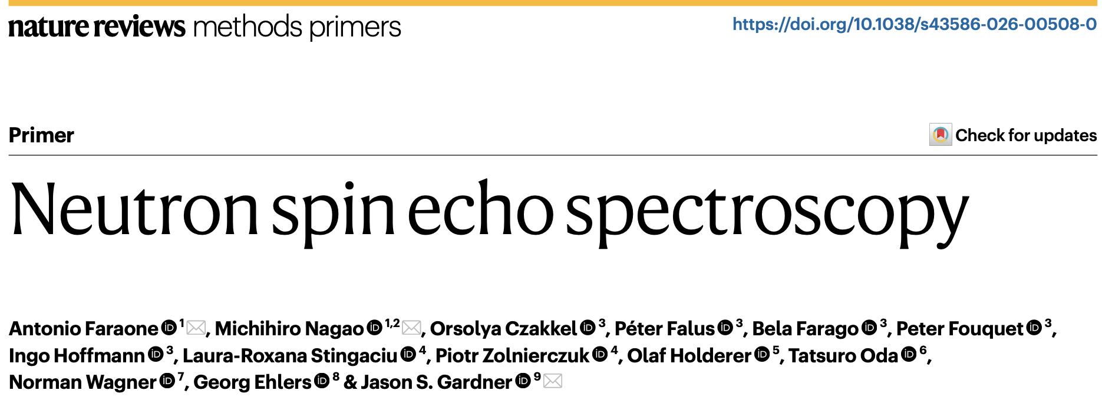

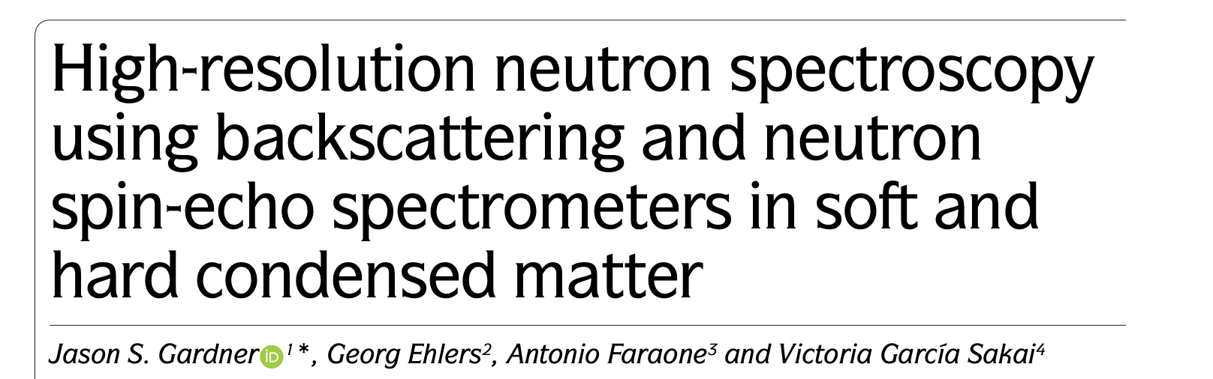
Nat Rev Methods Primers 6, 54 (2026).
New, Easy to read start
Nature Reviews Physics, 2, 103 (2020).

Slide 11
Deeper Reading
Stephen Lovesey: Theory of Neutron Scattering from Condensed Matter, Vol. 2, Clarendon Press, Oxford, 1986.
F. Mezei (Ed.): Neutron Spin-Echo, Lecture Notes in Physics 128, Springer, Heidelberg, 1980.
F. Mezei, C. Pappas, T. Gutberlet (Eds.): Neutron Spin-Echo Spectroscopy (2nd workshop), Lecture Notes in Physics 601, Springer, Heidelberg, 2003.
D. Richter, M. Monkenbusch, A. Arbe, and J. Colmenero, “Neutron spin echo in polymer systems” Adv. in polym. Sci, 174, 1 (2005).
C. Pappas, G Ehlers and F. Mezei, "Neutron-Spin-Echo Spectroscopy and Magnetism” Neutron Scattering from Magnetic Materials, Chapt 11 p/521 (2006
B. Farago, “Recent developments and applications of NSE in soft matter” Curr. Opin. Colloid Interface Sci., 14, 391 (2009).
I. Hoffmann, “Neutrons for the study of dynamics in soft matter systems” Colloid. Polym. Sci., 292, 2053 (2014).

Slide 12
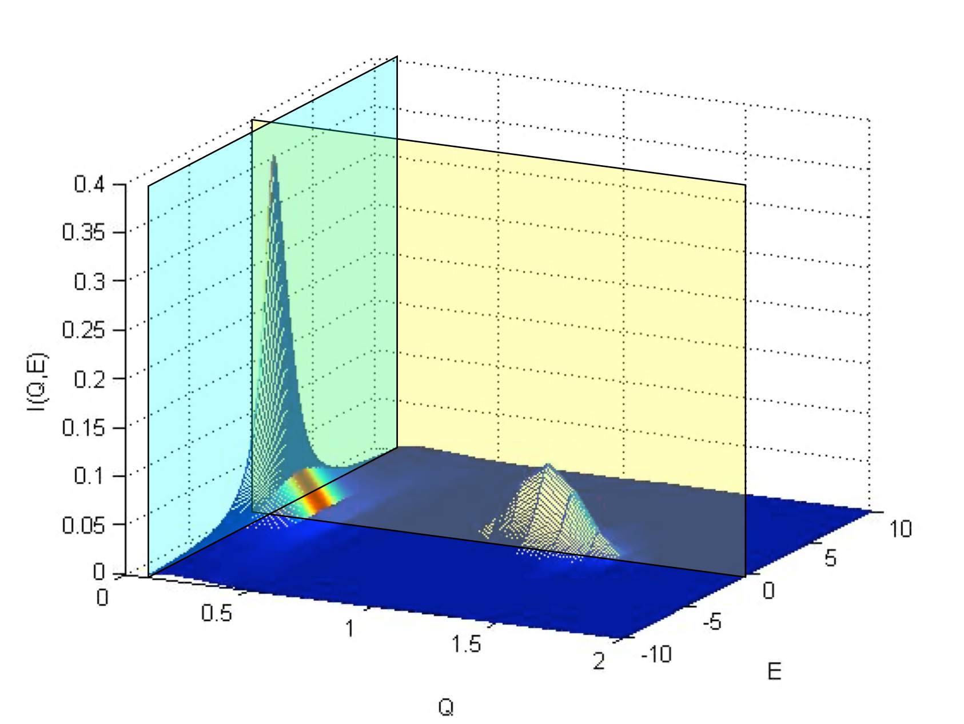
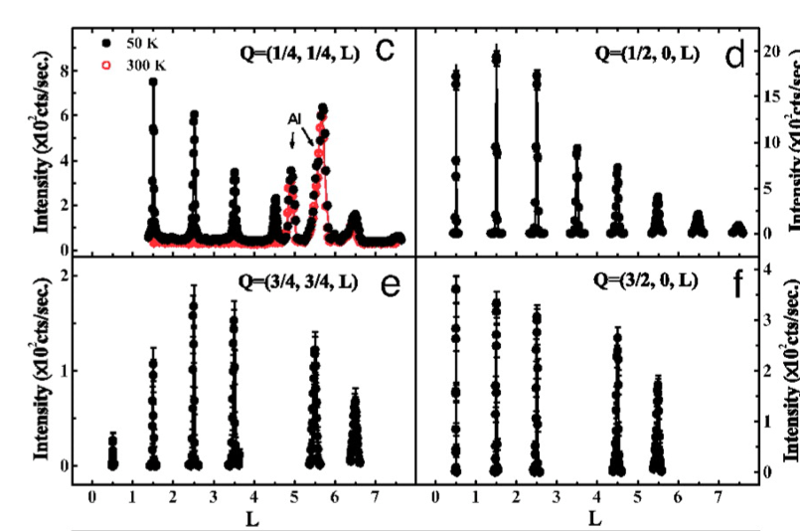
Glucose
HoMnO3
URu2Si2
Pr0.5Ca0.5MnO4

Slide 13


elastic scattering
elastic scattering
Elastic
quasi-elastic scattering
inelastic scattering
Excitation: the neutron interacts with an oscillation which has a finite energy transfer
c.f. Natural Modes, SHO
Relaxation: the neutron interacts with the system which finds a new equilibrium state.
c.f. Diffusion, Brownian Motion

Slide 14


Time domain measurements
  Energy domain Time domain
FT
FT
Quasielastic scattering or relaxation processes are well studied in the time domain

Slide 15
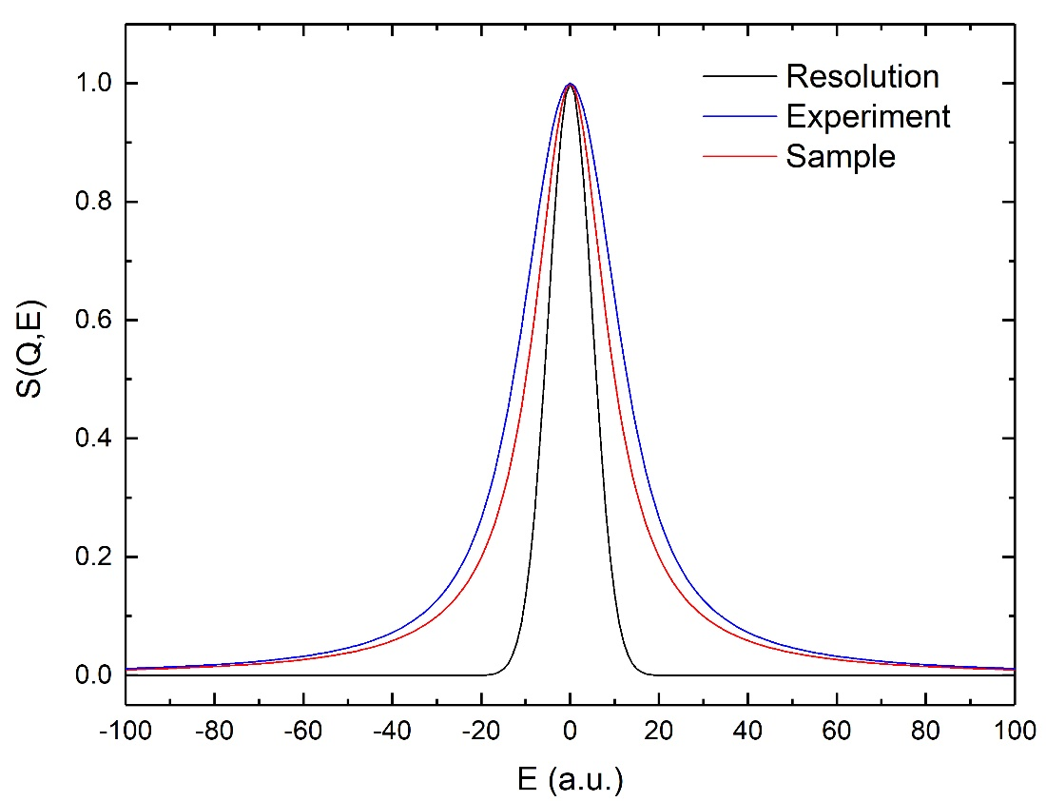
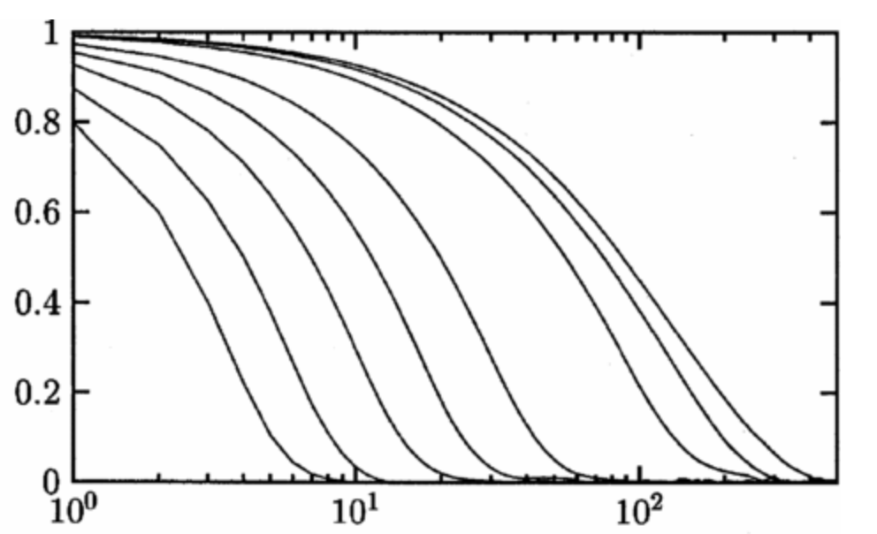
How can we do better? TIME
Higher flux,
Quicker experiment
Low flux,
Slow experiment
Resolution
Resolution
I(Q,t)/I(Q,0)
Time (ns)
BUT, is you approach the
Instrument resolution (Slower)
interpretation gets difficult
BUT, better E- resolution allows
us to measure (Slower) things

Slide 16
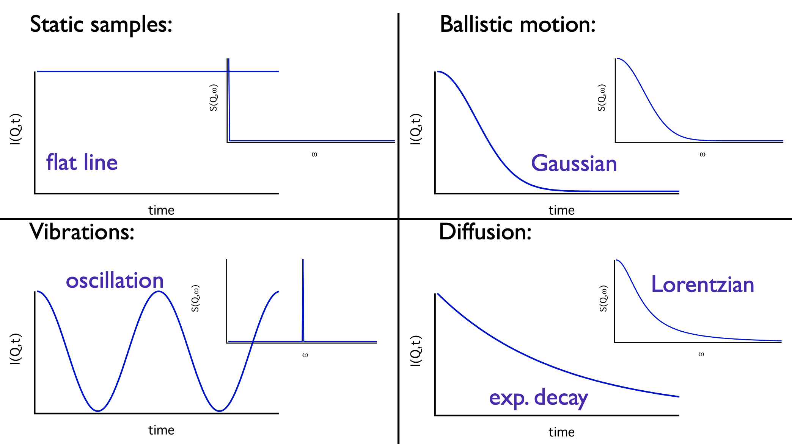
Mathematically more basics
I(Q,t)/I(Q.0)
I(Q,t)/I(Q.0)
I(Q,t)/I(Q.0)
Quasielastic scattering or relaxation processes are well studied in the time domain

Slide 17
Time domain measurements
  Energy domain Time domain
F. Mezei, G Drabkin, and A Ioffe, Polarimetric neutron spin echo, Physica B, 297 (1) 9-13 (2001)

Slide 18
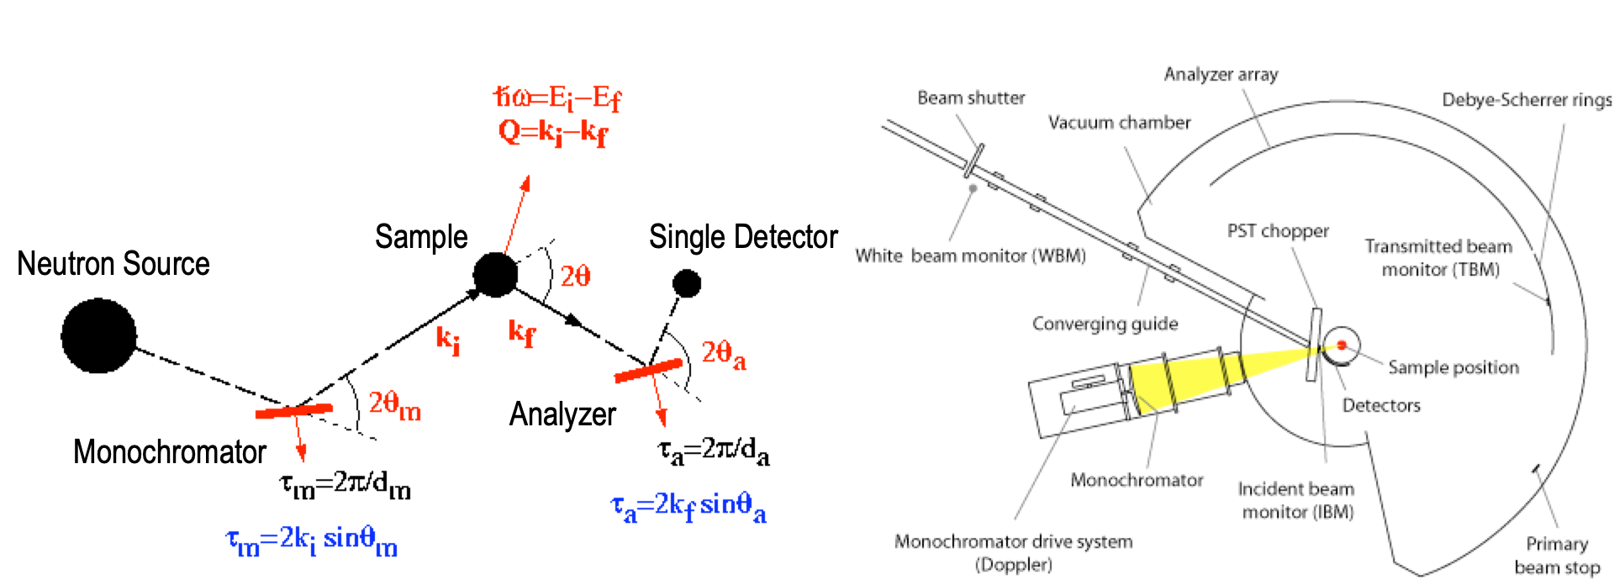
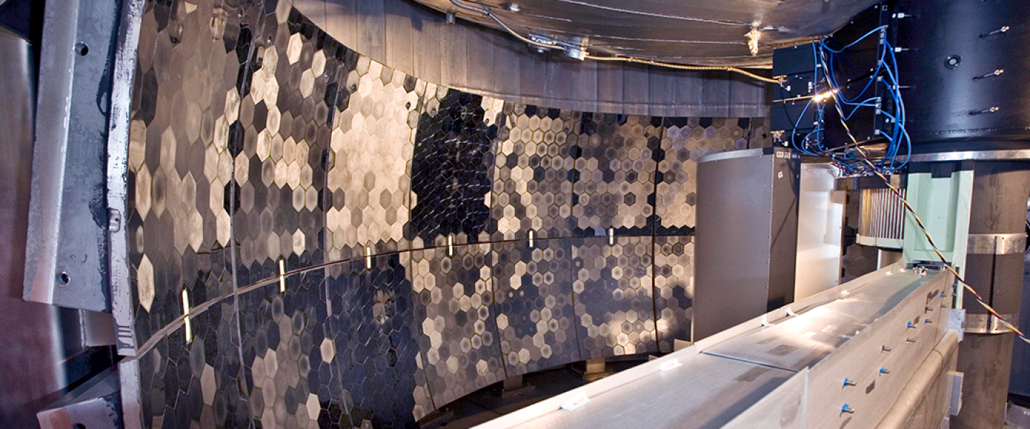
So Far, you have learnt
10² μeV
10⁰ μeV

Slide 19
The Idea of Neutron Spin Echo
NSE Breaks the Relationship between Intensity & Resolution
Traditional Instruments – use collimators, monochromators, choppers etc to define both k_{i} and k_{f} in order to define E and Q accurately
NSE – measure the difference between appropriate components of k_{i} and k_{f} (measures the energy change)
NSE – use the neutron’s spin polarization to encode the difference between components of k_{i} and k_{f} -- up next
NSE – can use poor monochromatization to increase signal intensity, while maintaining great energy resolution

Slide 20
Neutron Precession
S
ω_{L}
B
Neutron Properties
Mass, m_{n} = 1.675×10⁻²⁷ kg
Spin, S = 1/2 [in units of h/(2π)]
Gyromagnetic ratio γ =g_{n}μ_{n}/[h/(2π)] =
1.832×10⁸ s⁻¹T⁻¹ (29.164 MHz T⁻¹)
S
In a Magnetic Field
• The neutron experiences a torque from a magnetic field B perpendicular to its spin direction.
• Precession with the Larmor frequency:
N

Slide 21
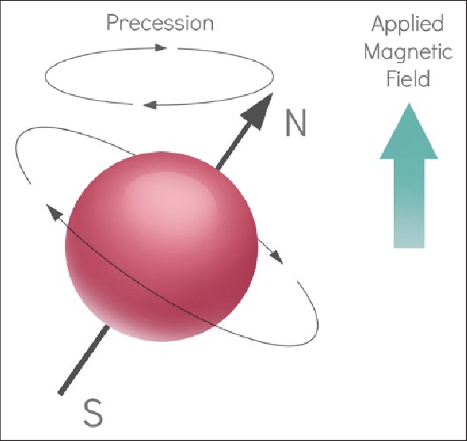
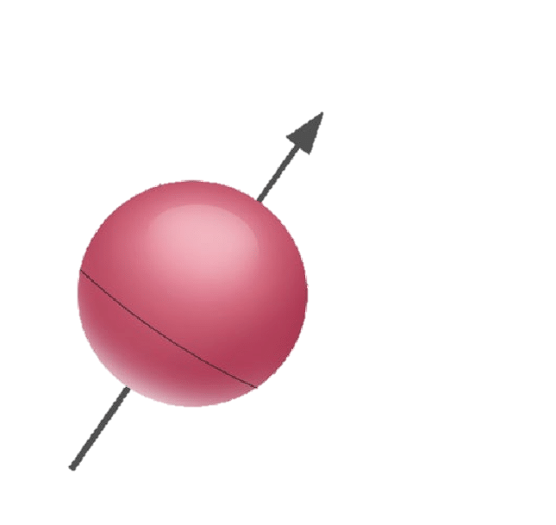
Spin in a Field
Torque

Slide 22
Please use your imagination
Velocity

Slide 23
Please use your imagination
SAMPLE

Slide 24
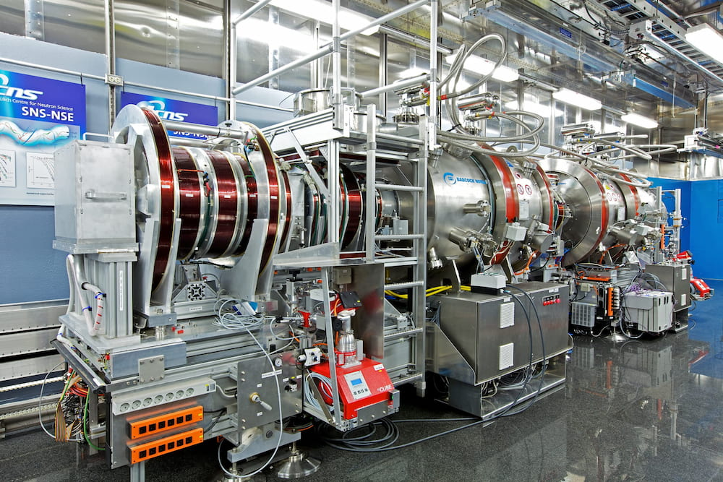
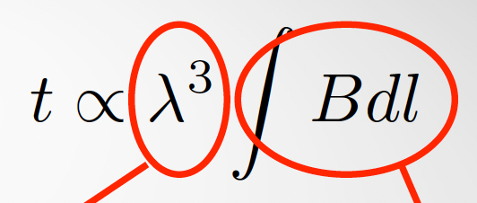
Spin Echo Principle
v. strong
wavelength
dependence
Field
Integral
from Solenoids
J.S. Gardner, G. Ehlers, A. Faraone, and V. Garcia-Sakai “High-resolution neutron spectroscopy using backscattering and neutron spin-echo spectrometers
in soft and hard condensed matter” Nature Reviews Physics, 2, 103 (2020).

Slide 25
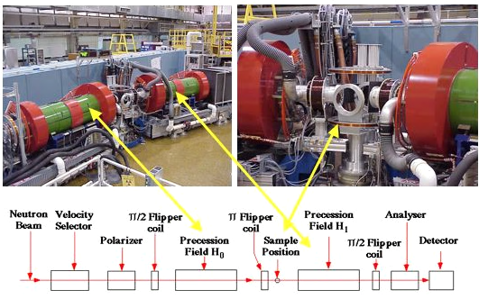
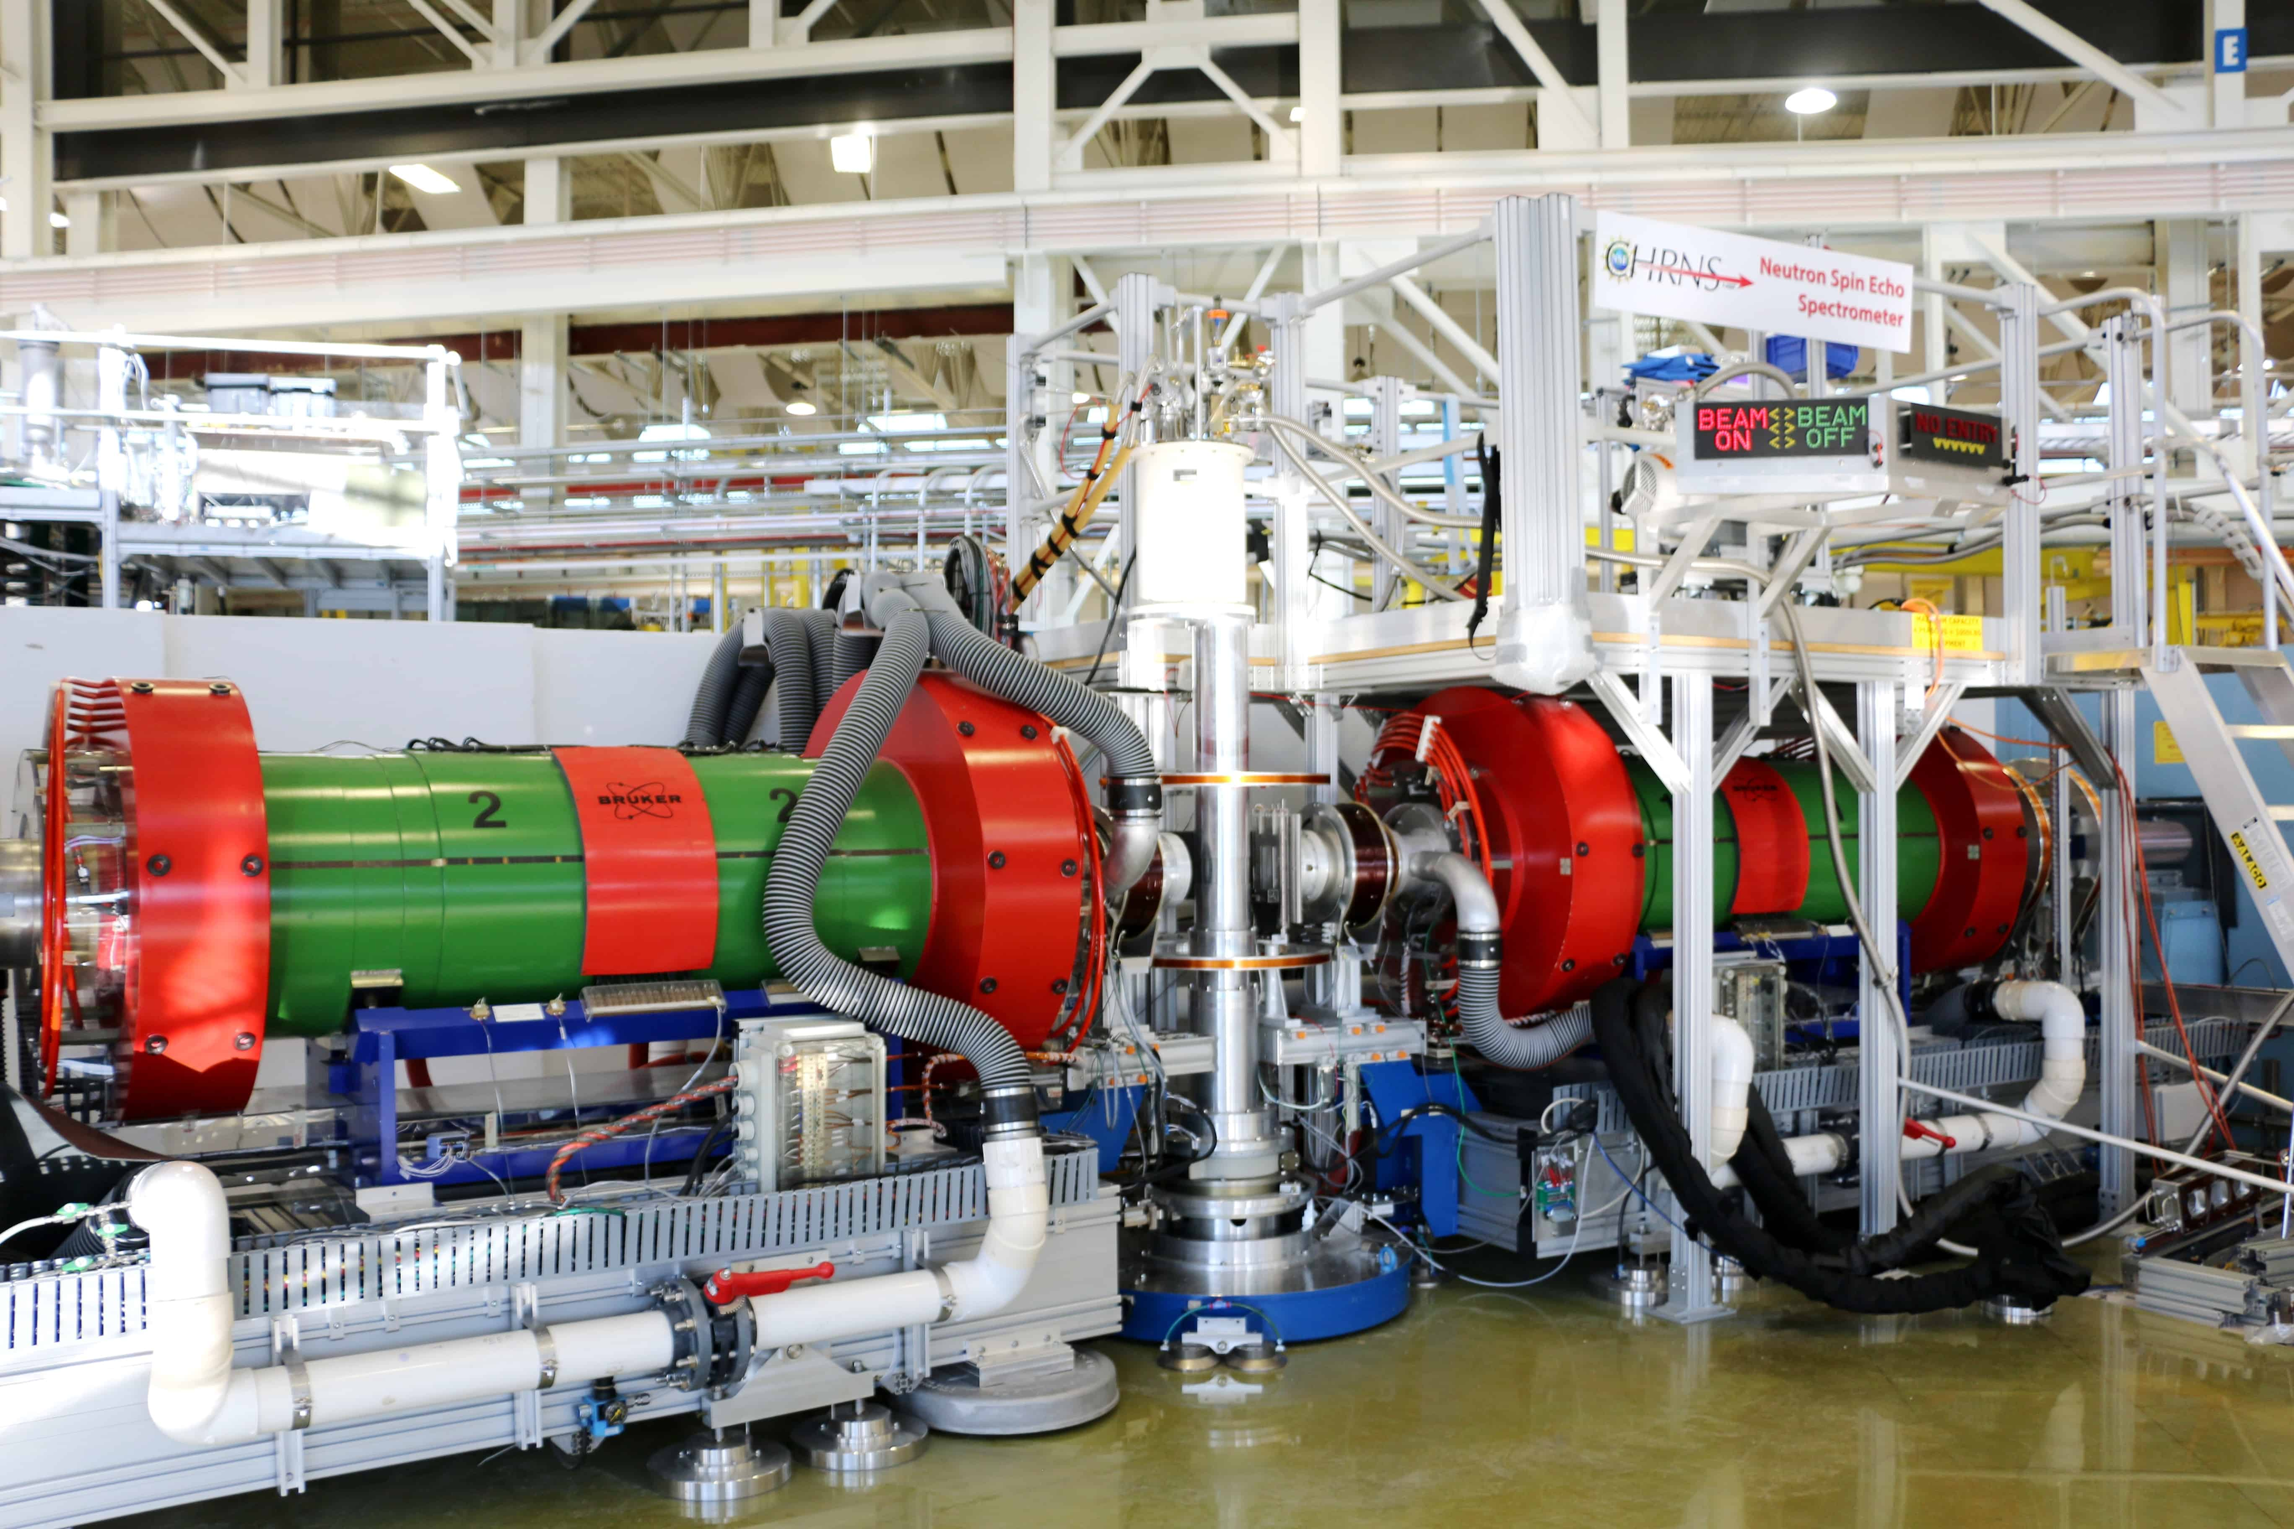
Main Components

Slide 26
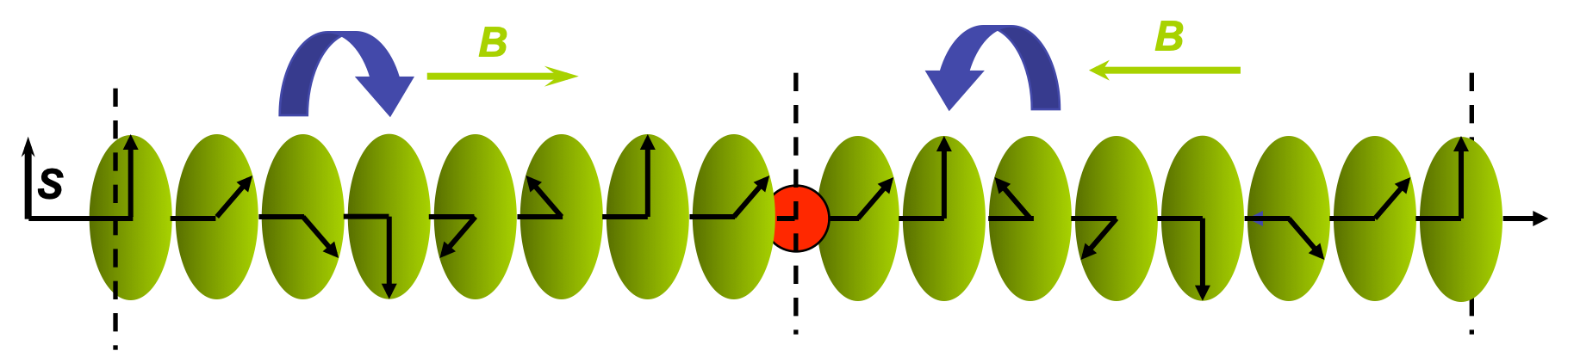
SINGLE Wavelength ELASTIC Scatter

Slide 27
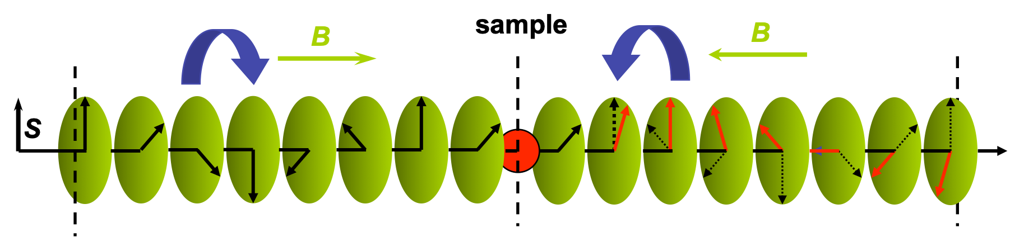
SINGLE Wavelength Scatter
Elastic on black,
Inelastic in red

Slide 28
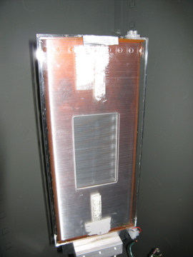
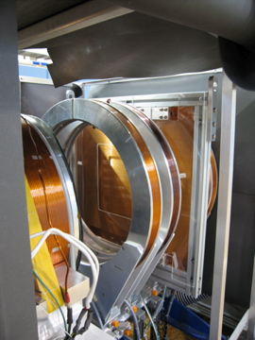
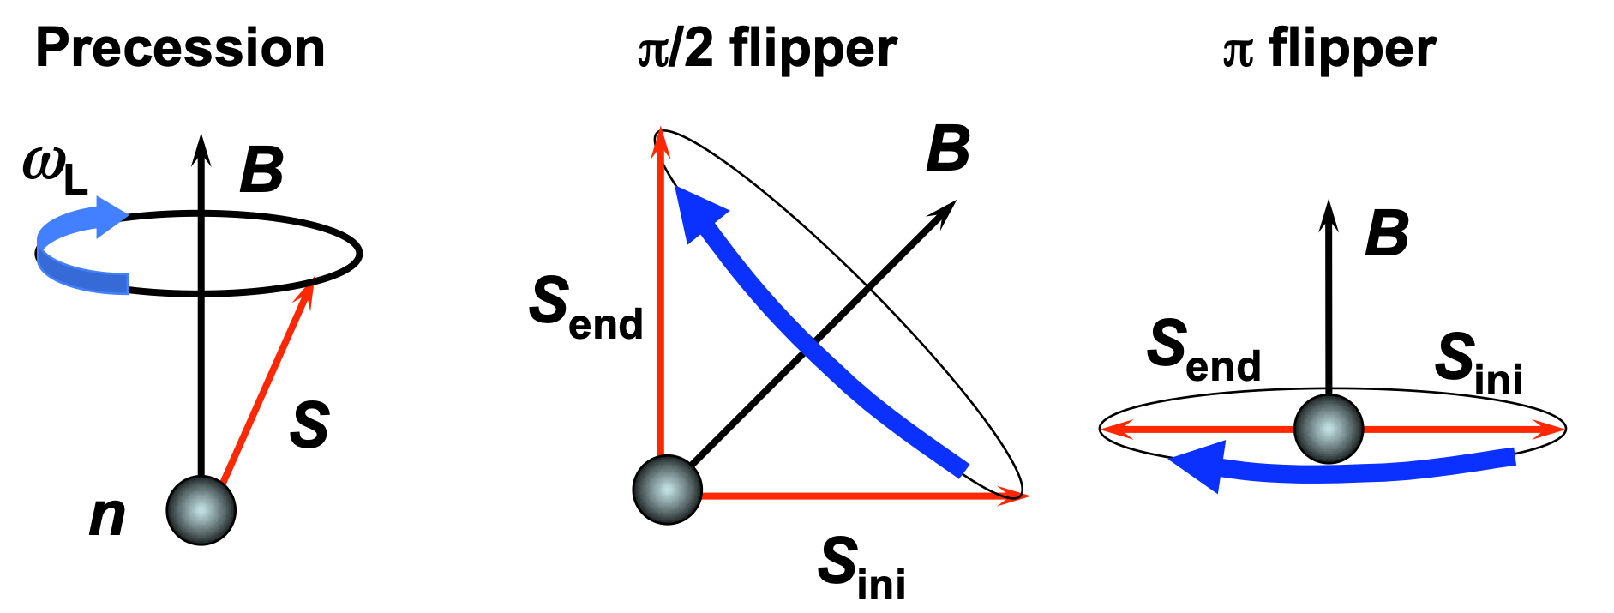
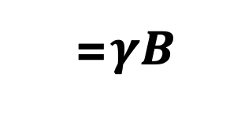
= $γB$
flipper (π or π/2)

Slide 29
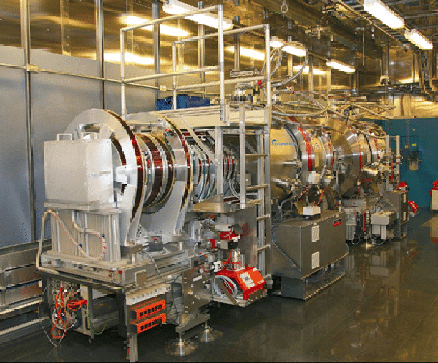
Standard Detector, BUT you can imagine bigger

Slide 30
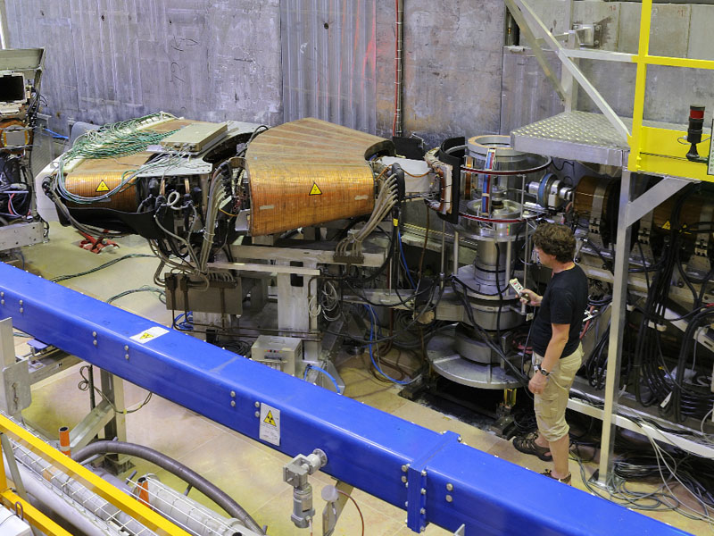
Wide Angle (30 deg)

Slide 31
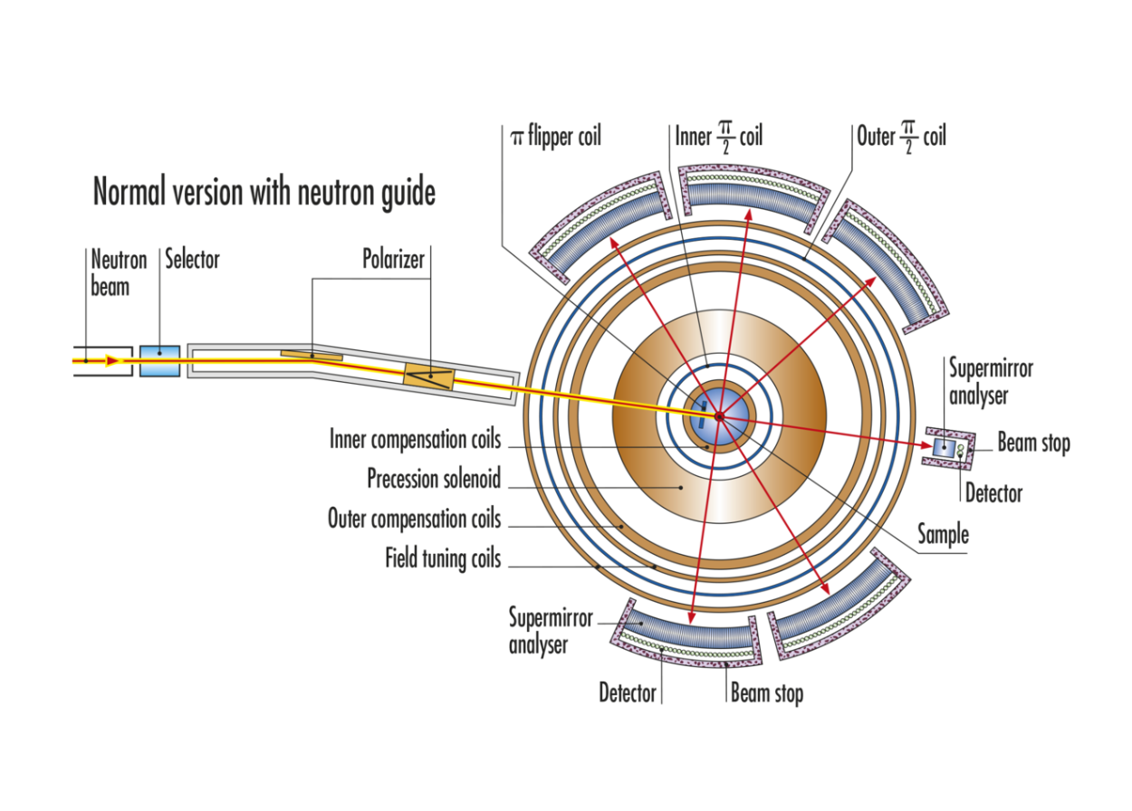
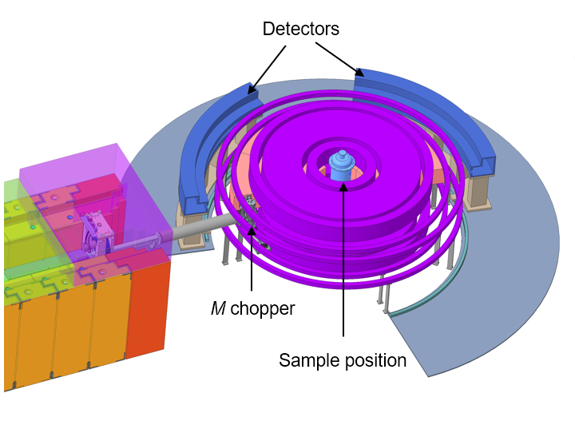
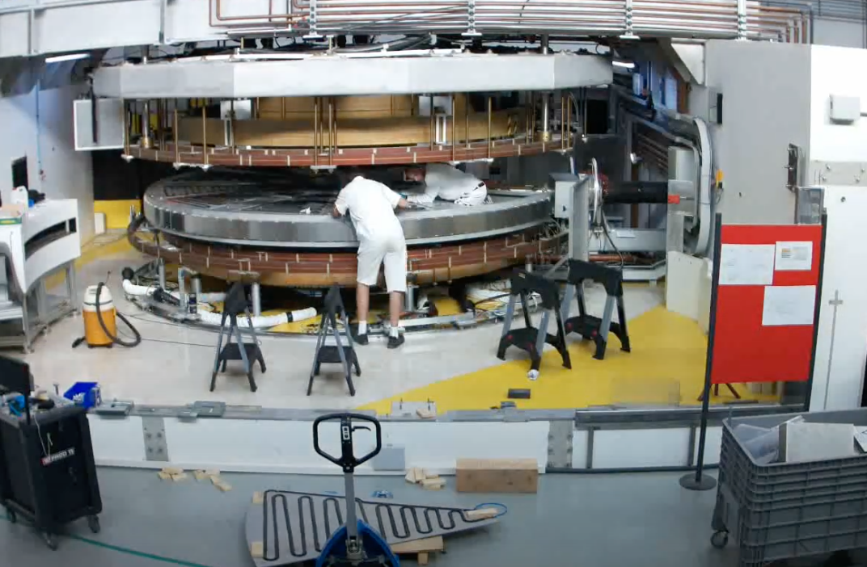
140 deg
120 deg
USA Dream
WASP / Expasne

Slide 32
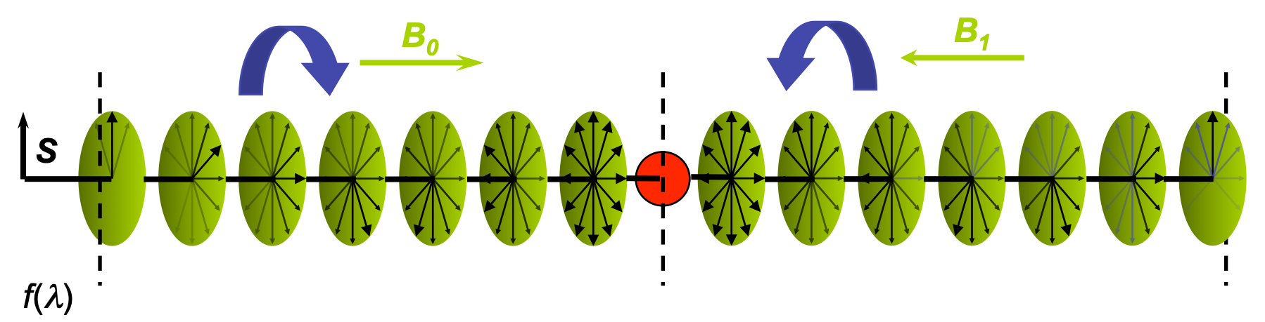
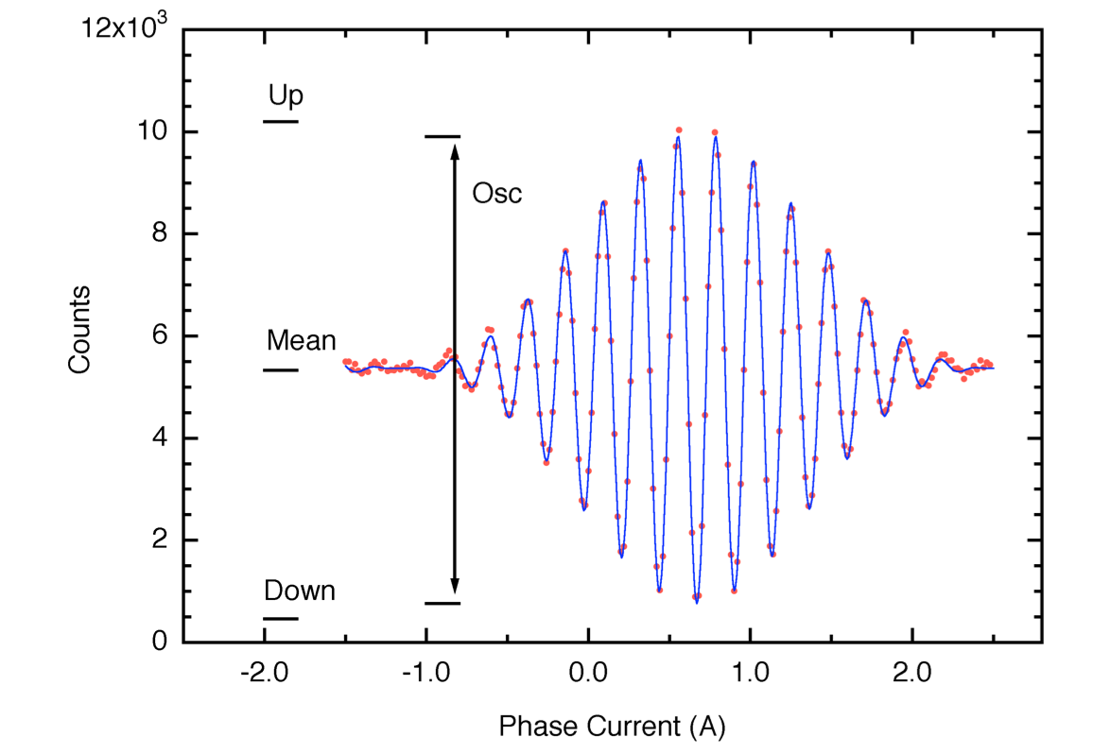
What do we actually do?
Phase Coil

Slide 33
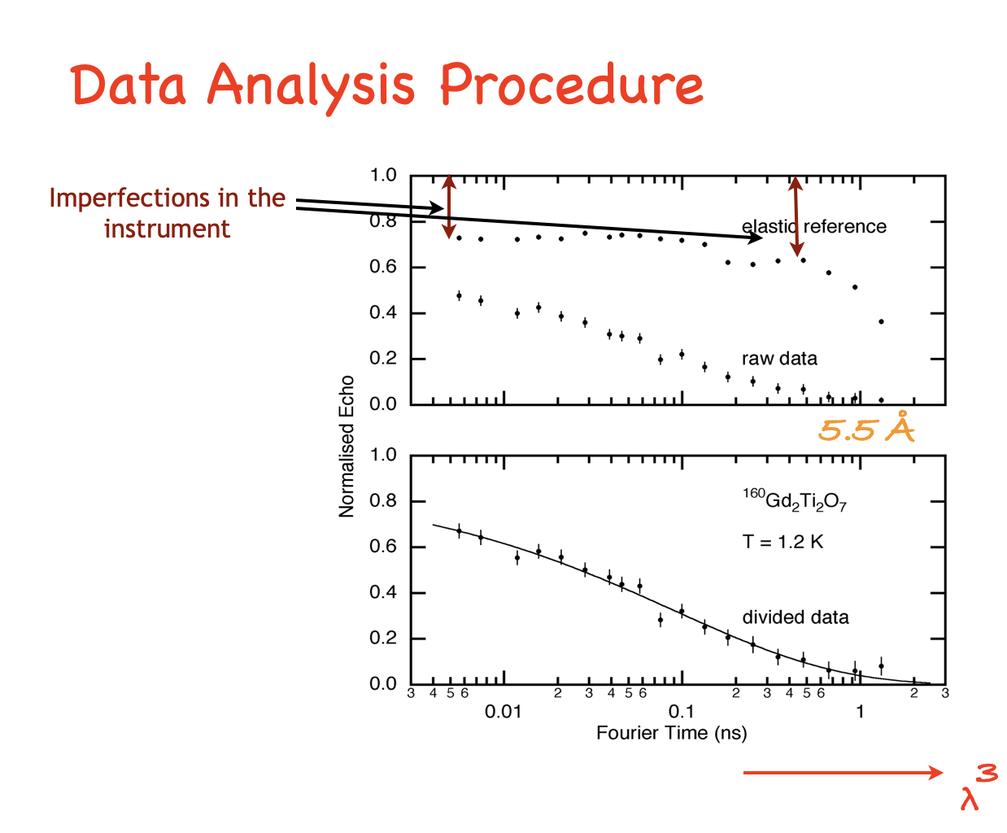
polarisation
Norm. In SF

Slide 34
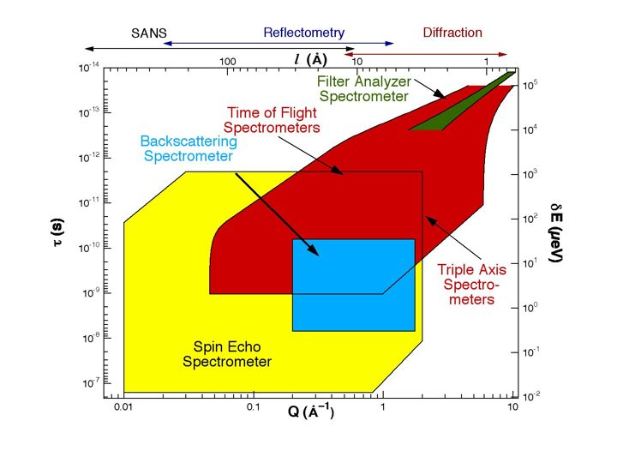
Now some Science
Slower Motion resolved
Hydrogen modes
Spin Waves
Lattice Vibrations
Molecular Motion
Aggregate motion in Polymers and Biological Systems
Diffusion Modes
Glassy Dynamics
Tunneling Spectroscopy

Slide 35
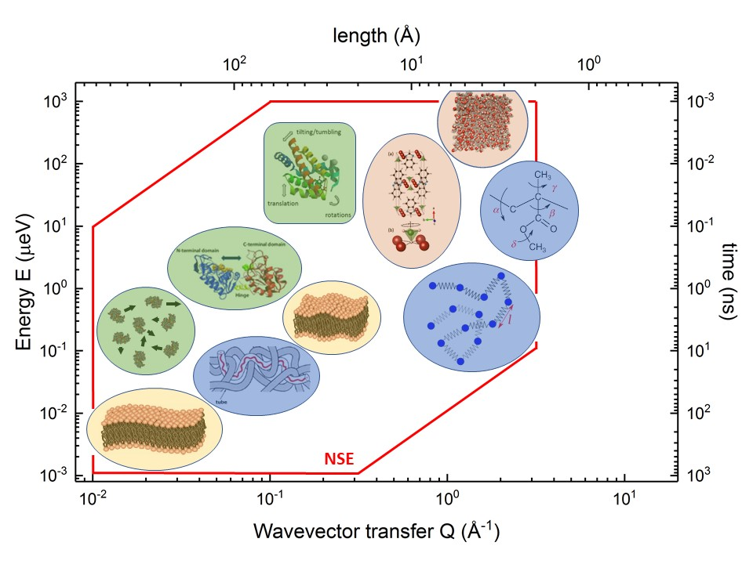
NSE Science
Coherent Dynamics
  Density Fluctuations corresponding to some SANS pattern
  Diffusion
  Shape Fluctuations (Internal Dynamics)
  Liquid and Glassy Systems
  Polymer Dynamics
Incoherent Dynamics
  Single particle
  motion of H atoms
Paramagnetic Dynamics
  Spin Glasses

Slide 36

NSE Soft matter Science
Coarse grained polymer models, such as the bead-spring model
Sub domain motion
fluctuations with respect to each subdomain of a large protein
Membrane height fluctuations
Microemulsions or biologically relevant membranes.

Slide 37


Not to be encouraged, but
is at the heart of NSE
Sci Reports 8 16400 (2018)
J Phys Cond Matt 18 R231 (2006)
m-Toluidine_{d9}
Polarized Analysis
Rem. Barry on Wednesday

Slide 38


Disordered
systems
Like
Glasses
Mezei, Solid State Comm.
45, 411 (1983)
Pappas, Solid State Comm.
68 054431, 2003

Slide 39

Why we still need to do better
RM Pickup et al., PRL 102 097202 (2009)

Slide 40

Glass forming Liquids
P. Luo … A. Faraone and YZ, Nature Comm. 13 2092 (2022)
Multiple relaxation processes.

Slide 41



Electrolytes
Understanding the mechanisms of ionic diffusion is important for the design of new energy storage materials
C Do, et al PRL 111 018301 (2013)
ChemSusChem, Vol 11, 3512-3523
Incoherent signal weak, Q dependence Critical

Slide 42


Cell functionality
Cholesterol regulates critical cell functions, including antibiotic resistance, by controlling how the membranes bend or withstand mechanical stresses.
MD used to interpret the data
S Chakraborty et al., PNAS 117 (36) 21896-21905 (2020).

Slide 43



Spin ice
J Phys Cond Matt 15 L9 (2003)
– Q and t dependence proved Nature paper wrong

Slide 44

Thank you

Slide 45
EXTRAS

Slide 46


Spin Liquid – Very Dynamic never flat line
JSG et al., Phys Rev B, 68, 180401 (R) 2003

Slide 47



Spin ice – Combine BS and a.c susceptibility
J Phys Cond Matt 20 235206 (2008)

Slide 48
Partial Order
– flat but not 1, still faster dynamics
J Phys Cond Matt 18 R231 (2006)

Slide 49

The Future – Tof overlaps with NSE
Fantastic Background and calibration of two instruments,
incredible error bars.

Slide 50


The NSE Spurions - Direct Echo

Slide 51
For those still awake
NSE studies dynamics in the ps to ns time range (4 orders of magnitude in time!), over lengthscales from tens of Ås to fractions of an Å.
It covers the largest lengthscales and longest timescales of all neutron spectrometers.
NSE works in the time domain. The instrumental resolution can be simply divided out.
Full PA analysis - isotope effect (H/D) and/or magnetism
NSE works by encoding the neutron speed in its spin state. Do not depolarize the neutron beam.
NSE is count limiting. Large samples and/or significant scattering intensities are required.

