Slide 1
Powder Diffraction
26th National School on Neutron and X-ray Scattering
Cora Lind-Kovacs
Department of Chemistry & Biochemistry
The University of Toledo, Toledo, OH
Cora.lind@utoledo.edu

Slide 2
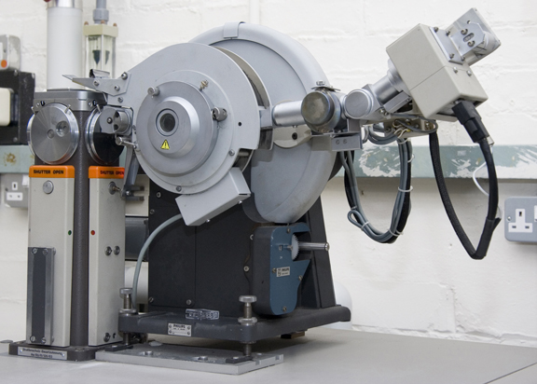
History of Powder Diffraction
Discovery of X-rays: Roentgen, 1895 (Nobel Prize 1901)
Diffraction of X-rays: von Laue, 1912 (Nobel Prize 1914)
Diffraction laws: Bragg & Bragg, 1912-1913 (Nobel Prize 1915)
Powder diffraction: Developed independently in two countries:
  Debye and Scherrer in Germany, 1916
  Hull in the United States, 1917
Original methods: Film based
First commercial diffractometer:
Philips, 1947 (PW1050)
  Detectors and optics have improved a
  lot, but basic design remains similar!
http://www.msm.cam.ac.uk/xray/images/pdiff3.jpg

Slide 3
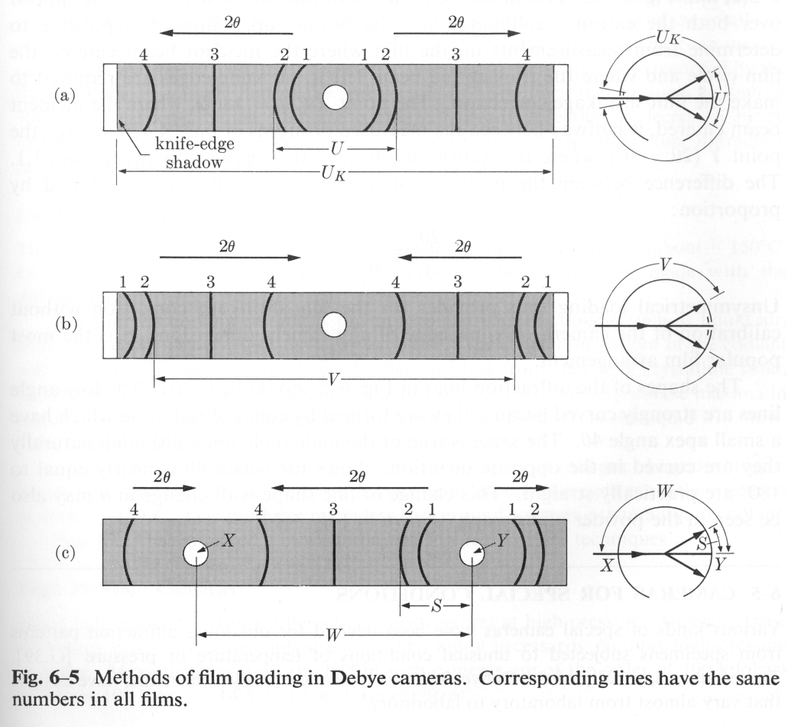
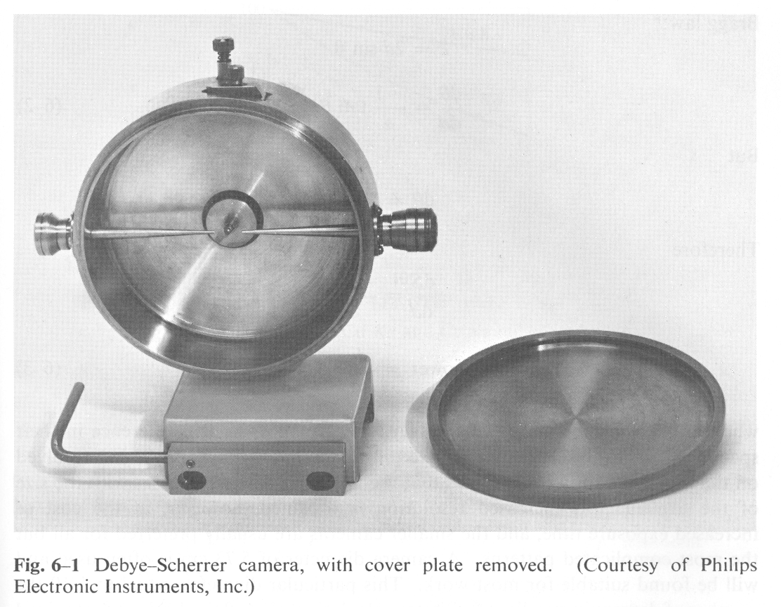
Original Powder Setups
Oldest method: Debye-Scherrer camera
  Capillary sample surrounded by cylindrical film
  Simple, cheap setup
Cullity; “Elements of X-ray Diffraction”

Slide 4
Physical Basis of Powder Diffraction
Powder diffraction obeys the same laws of physics as single crystal diffraction
Location of diffraction peaks is given by Bragg’s law
  2d sinθ = nλ
Intensity of diffraction peaks is proportional to square of structure factor amplitude
  ·exp[-8π²⟨u²⟩(sin²(θ)/λ²]

Slide 5
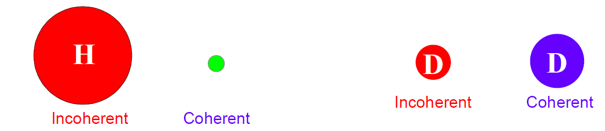
Neutrons: Coherent and Incoherent Scattering
For X-ray diffraction, we are generally only concerned with coherent elastic scattering
For neutron powder diffraction, we unfortunately need to be aware of incoherent scattering as well
  Phase is lost during incoherent scattering
  Contributes to background
  Less of an issue for single crystal experiments, but can be very significant for powder experiments
  H is one of the worst culprits (not D!) – talk to beamline scientist what their setup can tolerate!

Slide 6
Goal of crystallography: Get structure
Single crystal experiments
  Grow crystals (often hardest step)
  Collect data (usually easy, both access and setup)
  Determine unit cell (very easy for good quality single crystal)
  Reduce data and solve (=determine approximate structure) (often easy)
  Optimize structure (=refinement) (requires some care)
Powder experiments
  Prepare powder sample (often easy)
  Collect data (usually easy, but easy to make mistakes, too!)
  Determine unit cell (can be very hard)
  “Solve structure” (can be even harder – requires expert knowledge!)
  Optimize structure – Rietveld refinement (requires considerable care)

Slide 7
What is a Powder?
A perfect powder sample consists of an infinite number of small, randomly oriented crystallites
  Note that this is the underlying definition for many quantitative analysis methods!
  In real life, the number is of course not infinite, but should be large to give good averaging
  Small particle size: 1-5 μm is ideal
“Powder samples” can come in many different forms:
  Loose powders
  Films, sheets, blocks, wires…
  Basically any “polycrystalline” sample can be used in PXRD – if it is not a single crystal, it is considered a “powder sample”

Slide 8
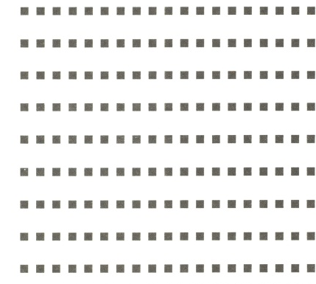
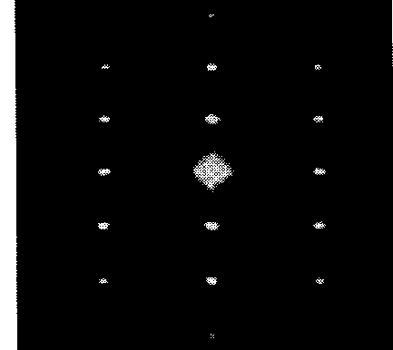
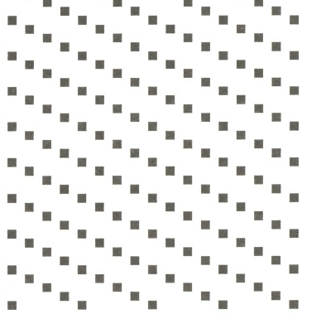

Observations from Single Crystals
For a single crystal, there is one orientation in real space, resulting in one orientation of the reciprocal lattice
  reciprocal lattice points are resolved and will result in diffraction intensity when they touch the Ewald sphere
  Rotating the crystal rotates the reciprocal lattice
Real space Reciprocal space
Real space Reciprocal space

Slide 9
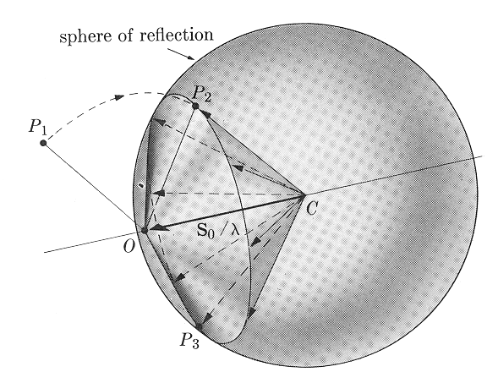
Observations from Powders
A powder sample consists of many crystallites with random orientations
  we get many overlapping reciprocal lattices, resulting in a “sphere” of reciprocal lattice points that fulfill the Bragg condition at a given 2θ
  the sphere will intersect the Ewald sphere in a circle
  we will observe “powder rings”
Cullity; “Elements of X-ray Diffraction”

Slide 10
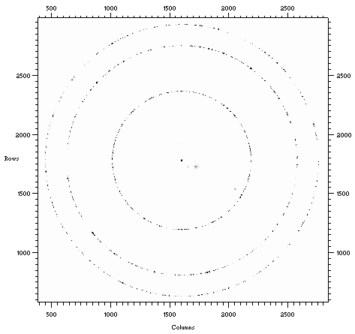
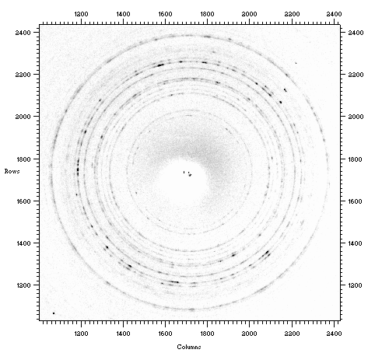
Somewhere in Between
Anything from “several single crystals” to “almost homogeneous” is possible!
Often referred to as “graininess problem” (e.g., not enough grains in the beam).
Can result in non-random integrated intensities.

Slide 11
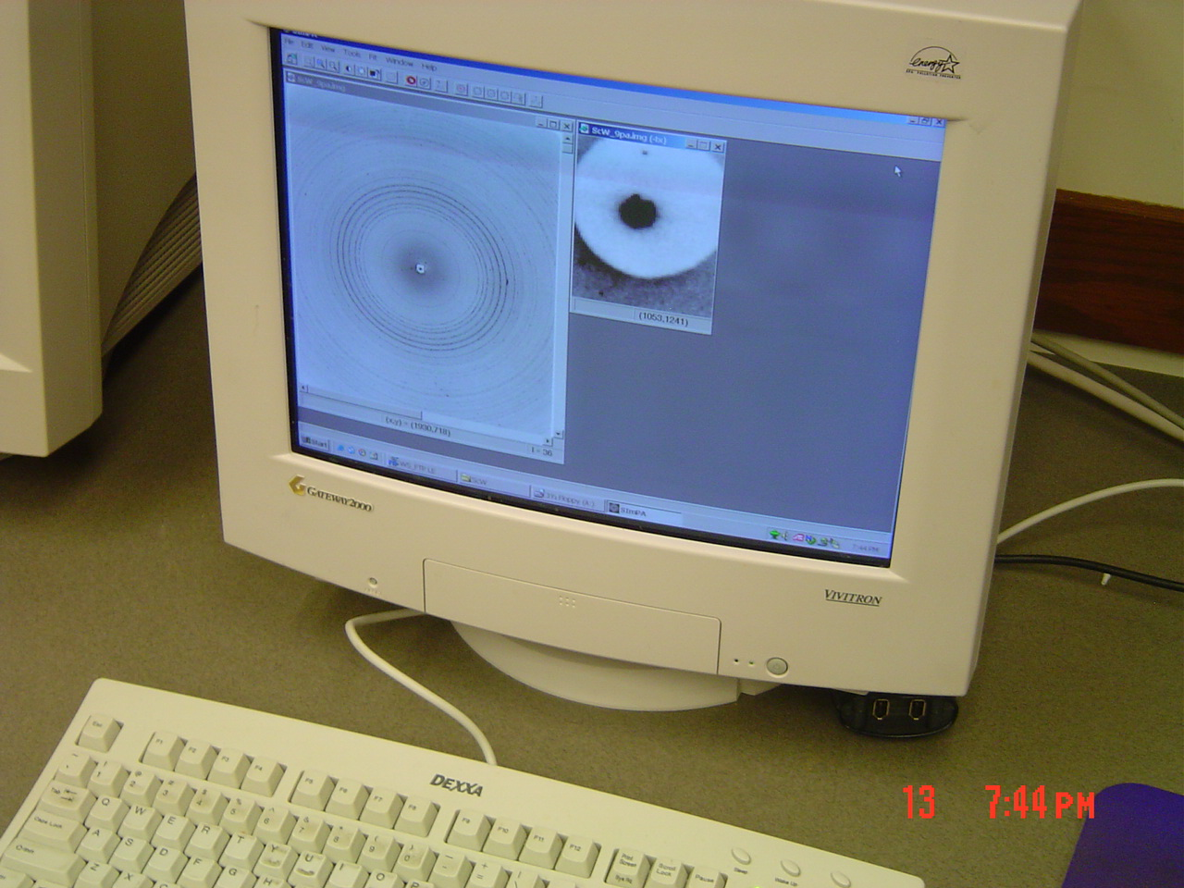
Powder Data Display
6000
5000
4000
3000
2000
1000
0
1
1.5
2
2.5
3
3.5
4
4.5
5
Picture of reflective monitor was taken with camera before “print screen” was common – elliptical shape is due to angle of camera to avoid reflection!
Q
Q = 4π sinθ / λ

Slide 12
Why Use Powder Diffraction?
Originally, powder diffraction was mainly used for phase identification
Advantages over single crystal methods: Can be used on ANY sample
  If you can mount it, you can measure it!
For some materials, single crystal growth is difficult or impossible
  Powder methods are the only option
“Real life samples” rarely come as single crystals: Engineering materials, formulations etc.
  Powder diffraction can be used on mixtures of compounds
  Peak shape analysis gives insights into size, stress and defects

Slide 13
Powder crystallography before Rietveld
Primary strategy: AVOID when it comes to structure determination!
  There was no straightforward way to deal with data
  Had to manually integrate intensities
  Overlapping reflections were a big problem
    Usually discarded
    Alternative: Rewriting of single crystal software to refine using sums of overlapped reflections
Powder pattern simulation was more common
  Relatively straightforward
  Conclusions drawn based on similarities between patterns (e.g., isostructural compounds)
    Visual comparison
Main use of powder diffraction was for phase identification

Slide 14
Experimental Setup
Any diffraction experiment requires choice of:
  Radiation source
  Sample mount
  Detector
In addition, there are different optical/physical components both before and after the sample
  Incident beam configuration
  Diffracted beam configuration
Note that while certain setups work for many samples, there is NO “one-size-is-optimal-for-all” setup!

Slide 15
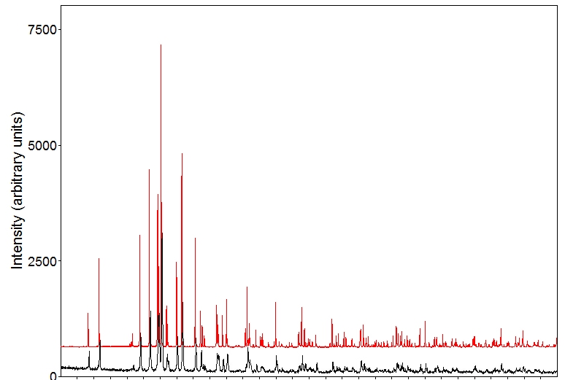
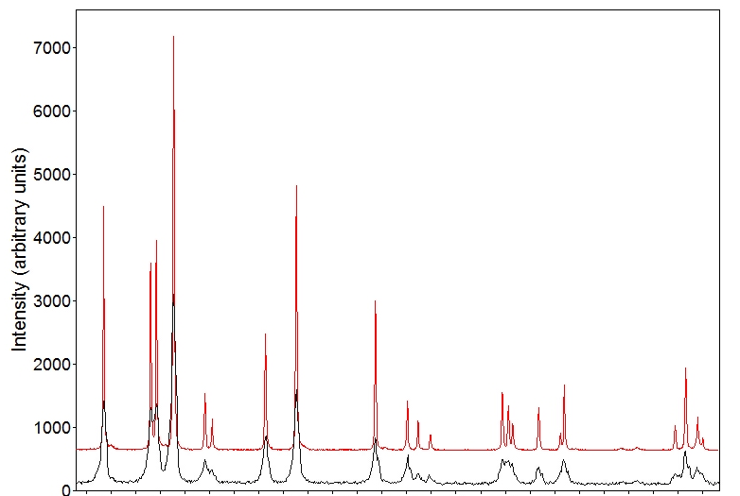
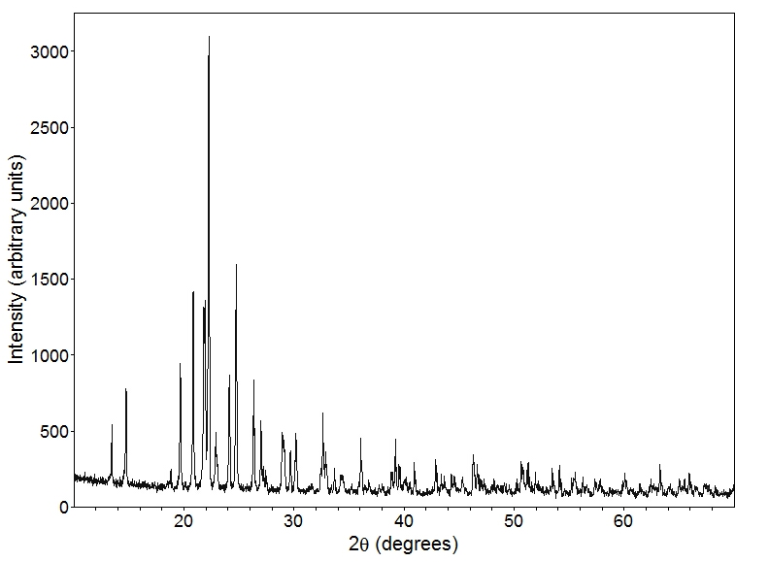
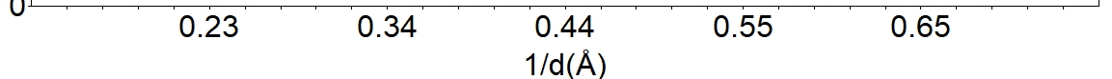
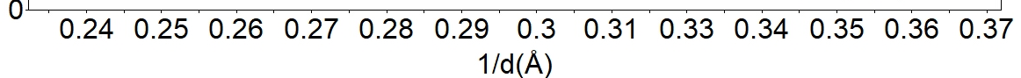
Instrument Setup Determines Data Quality
What do you want from your data?
What resolution do you need to achieve it?
Do you have to worry about errors?

Slide 16
Radiation Sources
X-ray tube
  Lab X-ray source, low flux
  Line source with white background
  Most commonly used method (most accessible)
Synchrotron radiation
  High flux
  White, tunable radiation
  Very good resolution achievable
Neutrons from nuclear reactor or spallation source
  Most expensive method
  Scattered by nuclei instead of electron cloud

Slide 17
Choice of Instrument
In many cases, a well-aligned laboratory x-ray will do
  Resolution is often sample limited (line broadening)
For samples with closely spaced lines (due to symmetry or large unit cell), synchrotron radiation may be necessary
  Tunable wavelength (lines can be spaced out)
  Better instrument resolution
  Larger accessible d-spacing range (commonly sample limited)
  Absorption problems can be avoided
Neutron diffraction can be useful especially for better locating light atoms or distinguishing atoms with similar Z, or for magnetic structures

Slide 18
What is a synchrotron?
Linear accelerator
Booster Ring
e⁻
+
electron bunches
Synchrotron Ring

Slide 19
Synchrotron Radiation
To keep electrons on a circular path: Constant acceleration necessary (bending magnets)
Acceleration of particles produces radiation
Emission of white radiation in X-ray region
Emission properties can be modified by the use of insertion devices like wigglers and undulators

Slide 20
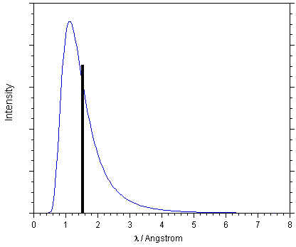
Neutron Diffraction: Reactor Sources
Experimental setup very similar to lab X-ray diffraction
Large samples needed
  low intensity beams
No form factor fall-off gives good quality data at small d-spacings
  but d_{min} is often similar to a lab X-ray experiment
Typical monochromator cut at ~1.5 Å for T = 300 K

Slide 21
Spallation Source – TOF Experiments
Neutrons are particles with mass, so wavelength and speed are correlated (de Broglie)
Data are plotted as a function of t (TOF)
Detectors are combined in “banks” at fixed angles
  Each detector bank collects an entire diffraction pattern
  Accessible d-spacing range depends on angle of bank
with
so
Notes:
L: 9-100m, L1: 1-2m

Slide 22
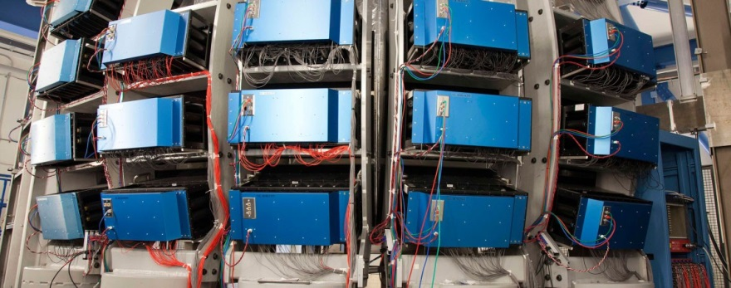
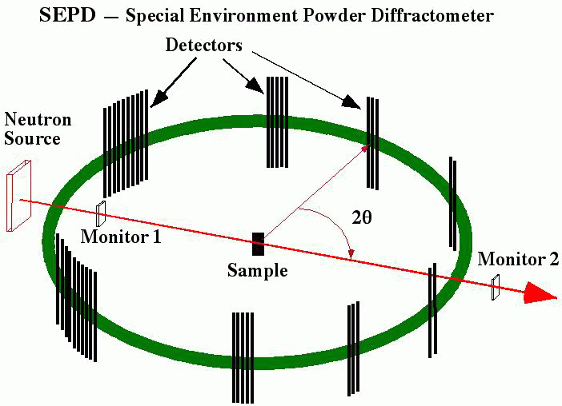
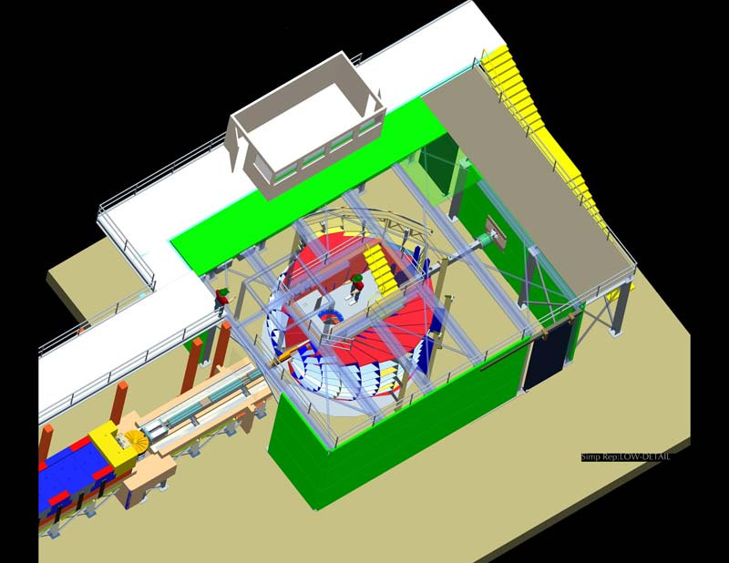
Neutron TOF Powder Instruments
Earlier TOF neutron instrument at IPNS (SEPD), and modern instrument at SNS (POWGEN)
POWGEN
Notes:
L: 9-100m, L1: 1-2m

Slide 23
Modern Use: What Information Can We Get From Powder Diffraction Data?
Phase identification (qualitative phase analysis)
  Most important/frequent use of PXRD
  Qualitative analysis tool
  Search pattern against database to identify phases present
    Starting materials, known target compounds, likely impurities
    Assumption: The material, or an isostructural material, is in the database
Phase fraction analysis (quantitative phase analysis)
  Applied to mixtures of two or more crystalline phases
  Compare intensities of selected peaks of all phases
    Theoretically only requires one peak/phase, but better with multiple peaks
  Accurate analysis requires standardization
    Mix known quantities of two phases in several different ratios
  Caution: Possibility of amorphous components

Slide 24
What Information Can We Get From Powder Diffraction Data? (Cont’d)
Lattice parameters
  Two modes of analysis:
    Accurate lattice parameters for a compound of known structure
    Unit cell determination for an unknown compound through indexing
  ACCURATE peak positions are crucial!
Rietveld refinement (structural analysis)
  Least squares based minimization algorithm to obtain the best fit between a structural model and a powder pattern
  Starting model necessary to apply this method
  Applicable to simple and complicated structures, single phase and multi-phase samples
    Automatically gives phase fractions and lattice parameters from ALL peaks
  Requires good data for meaningful results

Slide 25
What Information Can We Get From Powder Diffraction Data? (Cont’d)
Structure Determination from Powder Data (SDPD)
  Powder diffraction is subject to the same laws of physics as single crystal diffraction, but data overlap
  Careful analysis can allow determination of unknown structures
  Usually done with high quality synchrotron and/or neutron data
  Requires excellent data and sound crystallographic knowledge!
Phase transition behavior
  In situ diffraction experiments
    Temperature-induced phase transitions
    Pressure-induced phase transitions
    Kinetic studies
    Studies in different gases, or in operando
    Requires specialized setups

Slide 26
What Information Can We Get From Powder Diffraction Data? (Cont’d)
Line shape analysis
  Width of Bragg peaks is inversely related to crystallite size
    Often used for crystallite size estimates for nanoparticles
    Requires use of a standard to determine instrument contribution first
  Microstrain (nonuniform strain) also results in peak broadening
    Due to atomic disorder, dislocations, vacancies etc.
    Different angular dependence than size effects
    Residual stress can be determined
  Defects like stacking faults and antiphase boundaries also affect line shape
Texture analysis
  Epitaxial growth in thin films
  Preferred orientation
    Qualitative and quantitative measurements possible

Slide 27
Extracting Information from the Diffractogram
All diffractograms contain three pieces of information:
  Peak positions
  Peak intensities
  Peak shapes
Each of these can be used to extract qualitative or quantitative information from the data
Single crystal experiments are only concerned with peak positions and intensities, whereas powder diffraction also analyzes peak shapes to extract microstructural information from samples
  Often not important to get crystal structure, but can be crucial to understand behavior of “real life materials”!

Slide 28
Peak Positions
Peak positions can be used to obtain the following pieces of information:
  Unit cell dimensions
    d-spacing is related to unit cell constants
    Could be a refinement of a know starting cell or a determination “from scratch” by indexing
  Possible space groups
    Look at systematic absences – “no peak” is information, too!
  Qualitative phase analysis
    What’s in the sample?
    Approximate peak positions sometimes suffice for this
Notes:
Discuss sources of error: zero, (lambda), height, transparency

Slide 29
Standards
A standard can be used to check the alignment of a diffractometer
  Many different materials commercially available
    SiO₂, Si, CeO₂, LaB₆, Al₂O₃…
  Sold through independent vendors (e.g., NIST) or provided by diffractometer company
Easiest to use standards come as pressed solids
  No sample preparation, for Bragg Brentano: Sample height is predefined
Experimentally determine peak positions of the standard, then compare to certified values to construct a calibration curve
  Allows for correction of data collected under same conditions
  Also used to determine instrument constants/wavelength at beamlines

Slide 30
Internal Standards
A standard can also be mixed with your powder sample
  Called internal standard
You can use any material that is available as a powder and has well-established lattice constants
If you are planning to refine a model for your data, a model for your internal standard can be refined at the same time
  Constrain standard to known lattice constants, refine sources of peak position errors, which also apply to your sample
Choose a standard with similar absorption properties as your sample
  This allows you to account best for ALL sources of error
    E.g., sample transparency, absorption

Slide 31
Peak Intensities
Peak intensities contain information about the following:
  Positions and types of atoms
  Site occupancy of atoms
  Atomic displacement parameters
    Often referred to as “temperature factors”
Accurate intensities are necessary for:
  Quantitative phase analysis
  Rietveld (structural) refinement
  Structure solution from powder data
Use integrated peak intensities to eliminate line broadening effects!
Experimental setup also influences peak intensities
  Lorentz-Polarization factor, absorption…
So does the sample itself
Notes:
Next: Sources of error

Slide 32
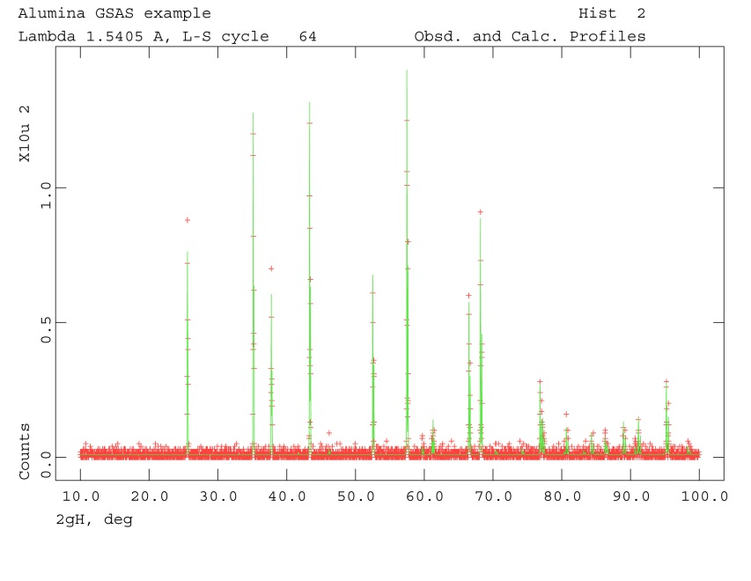
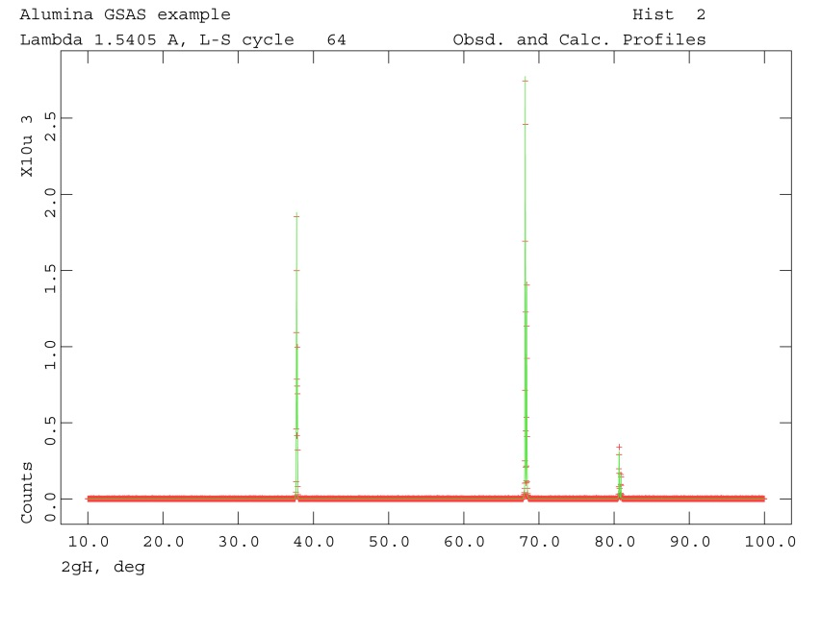
Preferred Orientation
Some samples do not show random intensities
  Some orientations are over- or underrepresented
In severe cases, only some lines are observed, others are absent
Preferred orientation can be desired
  E.g., epitaxial film
Generally problematic and undesirable for powder data analysis

Slide 33

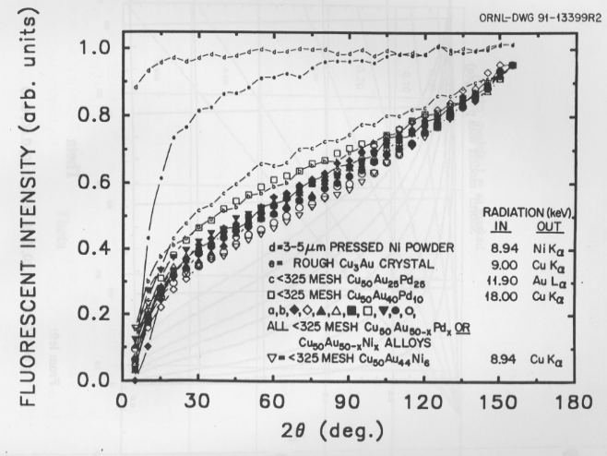
Surface Roughness Effects (Microabsorption Problem)
This is problematic for Bragg-Brentano setups; e.g., most of your lab diffractometers
http://www.osti.gov/bridge/servlets/purl/5062229-1CKCM6/5062229.PDF
Notes:
325 mesh = < 44 micron

Slide 34
Peak Shapes
Peak shapes are affected by the following:
  Crystallite size
    Significant effects for cystallites below 100 nm
  Microstrain
    Microstrain can lead to a “range” of lattice parameters due to strain
  Ordered defects
    Stacking faults, antiphase boundaries
  Instrument
    Finite source size
    Axial divergence
    Slits
    Detector resolution
Isotropic or anisotropic peak broadening can result
For quantitative analysis, a standard with no crystallite size or strain broadening must be used to determine the instrumental contribution

Slide 35
Examples of Peak Shapes
Notes:
True Voigt: Convolution of G and L, but messy math, slow computing. Thus generally a PV is used. Works pretty well.

Slide 36
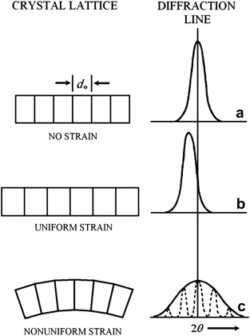
Sample Related Peak Broadening
Crystallite size:
  Diffraction from an infinite crystal would give infinitely sharp peaks (delta function)
  Finite repeat leads to broadening
  Can be used to calculate crystallite size (Scherrer equation), B = FWHM in radians
    For lab instrument: B_{size} = 0.9 λ/(t cos(θ))
  Instrument broadening must be accounted for to get meaningful, qualitative results!
    B²_{measured} = B²_{instrument} + B²_{size}
Strain broadening:
  Results in distribution of lattice constants
    More shift at higher angles – proportional to tan(θ)
Both effects can be isotropic or anisotropic!
  Anisotropic effects are generally hkl dependent
Notes:
B in radians; t is crystallite size

Slide 37
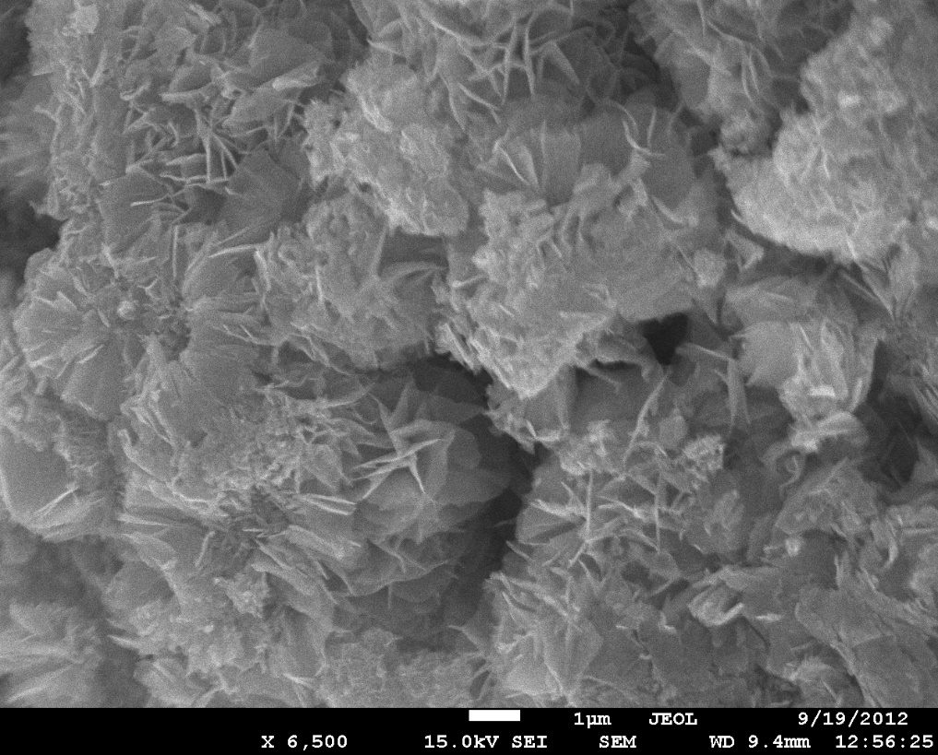
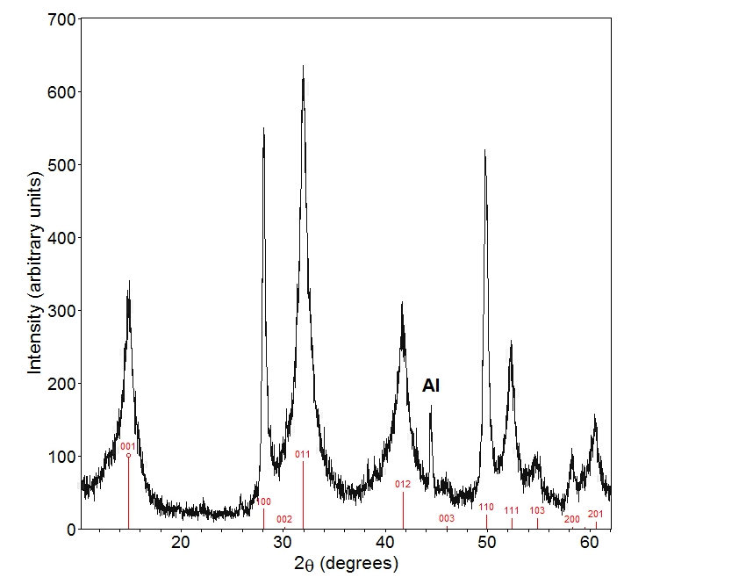
Sample related peak broadening

Slide 38
Powder Diffraction Detector Options
Powder X-ray diffraction can use 0D, 1D or 2D detectors
Area (2D) detectors allow for very fast data collection
  On high intensity synchrotron beamlines, a dataset can be collected in a fraction of a second!
  Tradeoff with respect to resolution
  Often used for parametric studies when speed of data collection is most important
Point (0D) and strip (1D) detectors allow for very high resolution data
  A single crystal analyzer can be mounted between the sample and a point detector
  Data collection speed can be improved by using multiple detectors
  Example: 11-BM high resolution diffractometer at APS

Slide 39
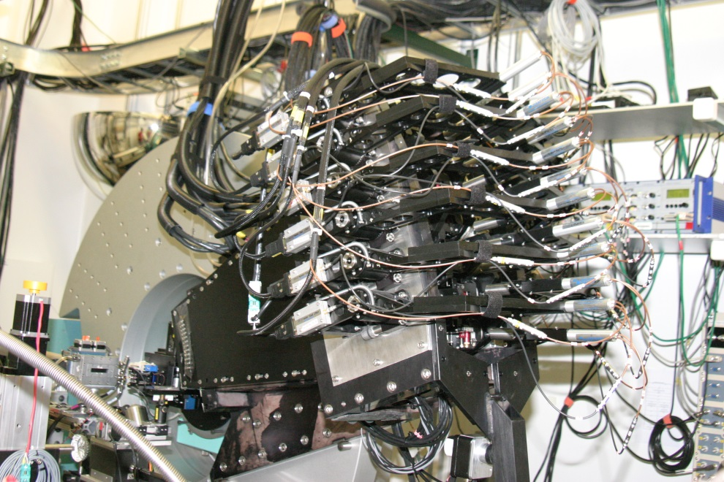
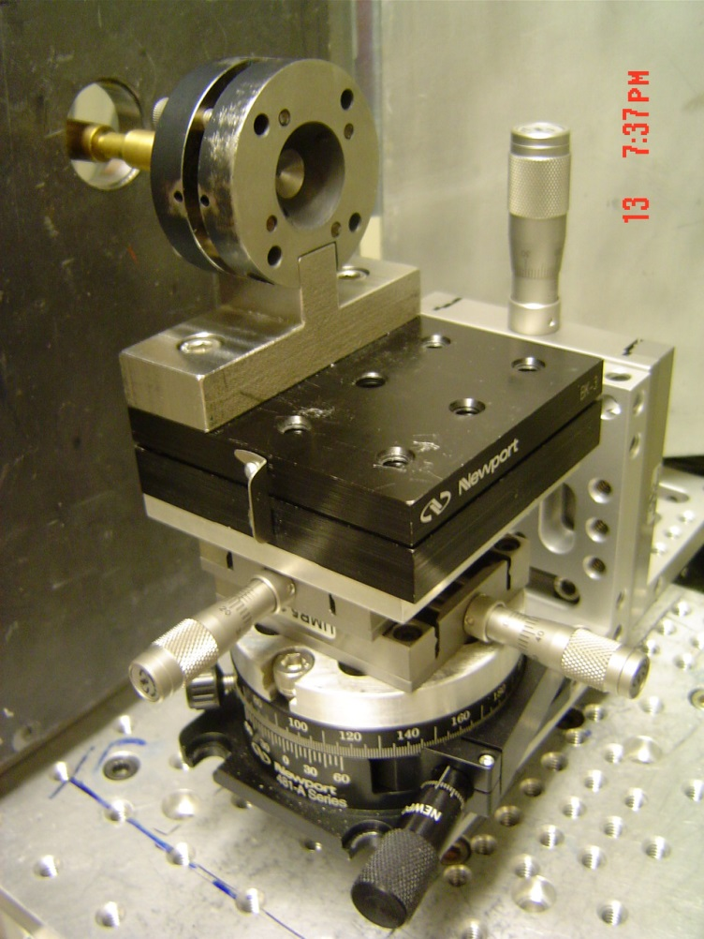
Powder Diffraction Detector Options
2D detector (CHESS B2) and 1D detector array (APS 11-BM)

Slide 40
Powder Pattern Analysis Beyond Search/Match
As stated previously, early use of powder methods, and most common use today, was for phase ID
1966-1969: Hugo Rietveld introduced a whole pattern fitting approach for neutron data
  Nowadays known as “Rietveld method”
  Soon applied to X-ray data (1977)
  Became more feasible with increasing computer power
  “Routine” powder tool by now
The Rietveld method can be used to verify structures, determine accurate lattice parameters, microstructural sample characteristics, phase fractions in mixtures etc.

Slide 41
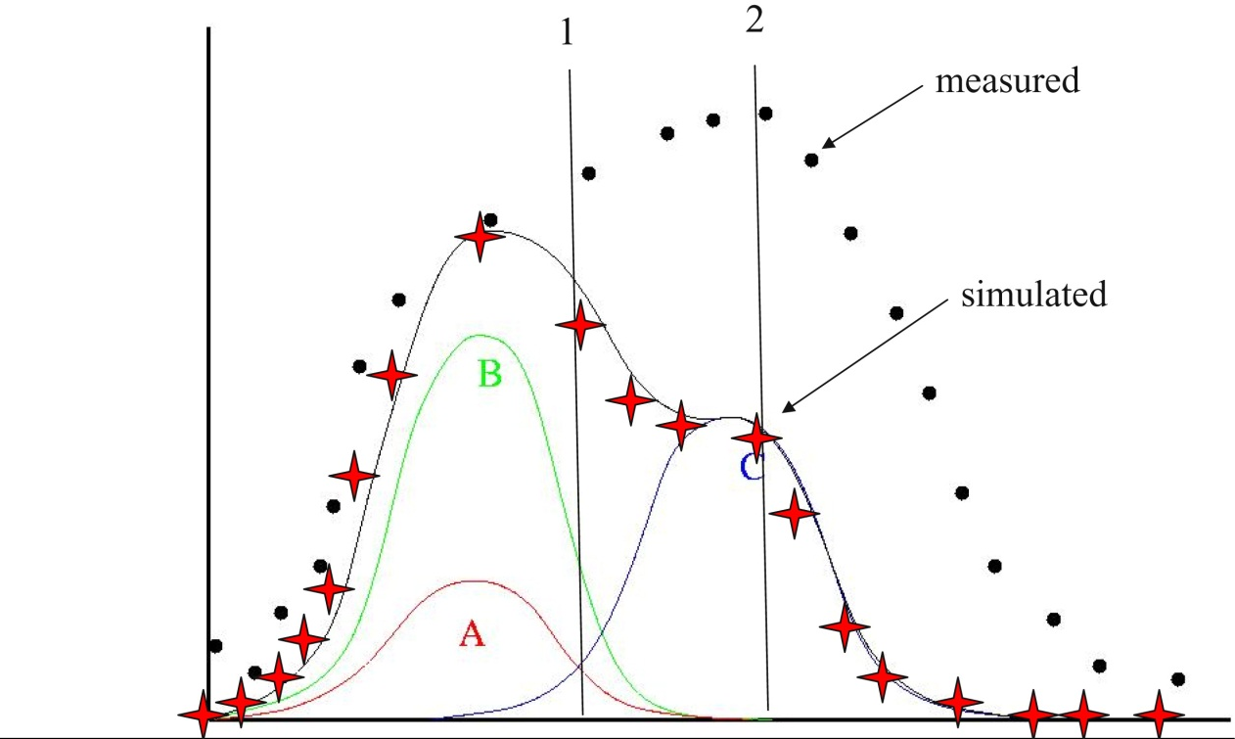
Major Breakthrough: Overlapped Reflections
Rietveld witnessed the power of introducing computers into crystallography during his dissertation (1961-1964)
He realized that computers can handle individual datapoint intensities, which allowed calculation of |F_{hkl}| even for overlapped reflection!

Slide 42
What is the Rietveld Method?
Least squares based minimization algorithm to obtain the best fit between a structural model and a powder pattern
  Demanding, as equations involved are non-linear
  User decides which parts of the model can be varied
Each point in the pattern can be regarded as an observation
  “No Bragg intensity” tells you something about your material, too!
Full pattern fitting
  In contrast to single crystal data, “experiment dependent parameters” must be fitted as well: Background, peak shape – sample and instrument contributions, lattice constants, …
Requires an approximate starting model
Good data are needed!

Slide 43
Parameters in Rietveld Refinements
Structural variables
  Atom positions, fractional occupancies, atomic displacement parameters (ADPs)
  Only these parameters are refinable in most single crystal software
Profile parameters
  Background
  Peak shape, including width and asymmetry
  Unit cell constants
  Wavelength
  Diffractometer zero point
  Sample height and transparency
Correction terms
  Absorption
  Extinction
  Surface roughness
  Preferred orientation

Slide 44
Possibilities
Works for simple and complicated structures
  Thanks to today’s computing power, fast even for complicated structures
Can be used to refine several phases as well as mixed occupancies
  Use of internal standard possible – excellent lattice constants!
  Quantitative analysis of mixture or versus a standard (amorphous content, too)
  Non-stoichiometry/partial occupancy can be refined
Refinement of several data sets together
  X-ray and neutron data
  Several different wavelengths => changes scattering contrast between atoms
Engineering properties
  Residual strain
  Preferred orientation

Slide 45
Limitations
Determination of absolute structure from powder data is impossible due to precise overlap of hkl and -h-k-l reflections
Parameters can sometimes be correlated
For limited data, constraints or restraints can be necessary
  Restrain bond distances or bond angles
  Constrain composition if known
The method only works if you have a good starting model!
  Otherwise, divergence might be observed
  A local instead of a global minimum may be found
  YOU need to judge the refinement – no simple rules of thumb for R-values etc. or cif file and checkcif!

Slide 46
Useful Resources
CCP14: Free software including tutorials and examples http://www.ccp14.ac.uk/
  Unfortunately no longer maintained due to lack of funding
Rietveld mailing list
http://www.mail-archive.com/rietveld_l@ill.fr/
GSAS & GSAS-II tutorials https://www.aps.anl.gov/Education/Powder-Diffraction-Educational-Materials
R. A. Young; “The Rietveld method”
  Comprehensive text including history, description of several Rietveld programs, as well as details about certain parameters (e.g. background modeling, peak shapes, pattern decomposition…)
…and many more good books!
Your best resource for national lab data: Your beamline scientist!

