Slide 1
Atomic Pair Distribution Function (PDF) Analysis 2017 Neutron and X-ray Scattering School
Katharine Page
Advanced Diffraction Group
Chemical and Engineering Materials Division Oak Ridge National Laboratory
pagekl@ornl.gov

Slide 2
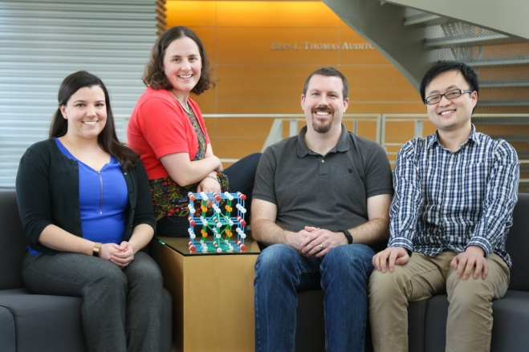


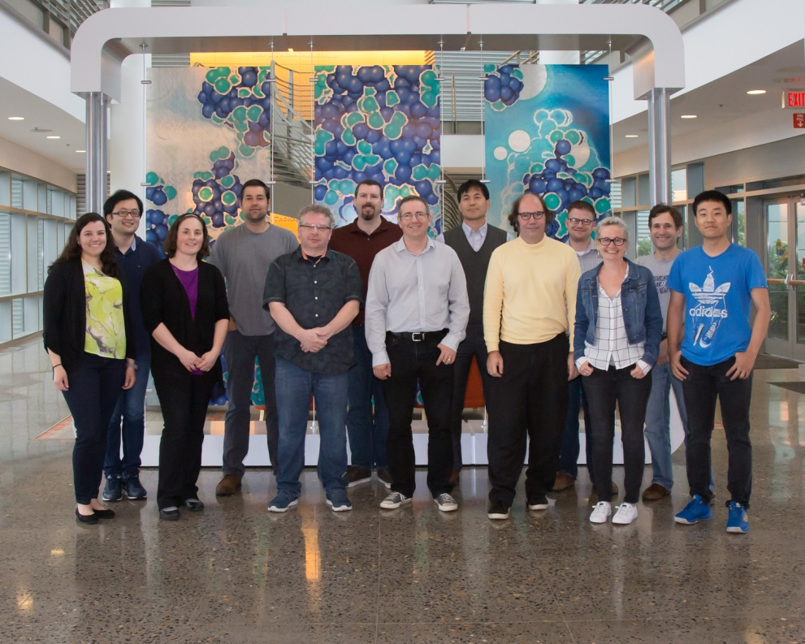
About Me
Tedi-Marie Usher, Katharine Page,
Daniel Olds, and Jue Liu
Spallation Neutron Source,
Oak Ridge National Laboratory
BES Early Career Research Program
BES Scientific User Facility Division
2008 Olympic Trials
BS in Chemical Engineering University of Maine, 2004
PhD in Materials, UC Santa Barbara, 2008
Director’s Postdoctoral Fellow, Los Alamos National Laboratory (LANL), 2009/2010
Scientist, Lujan Neutron Scattering Center, LANL 2011-2014
Scientist, Chemical and Engineering Materials Division, Oak Ridge National Laboratory (ORNL), 2014-present
Advanced Diffraction Group
Group Leader: Matthew Tucker

Slide 3
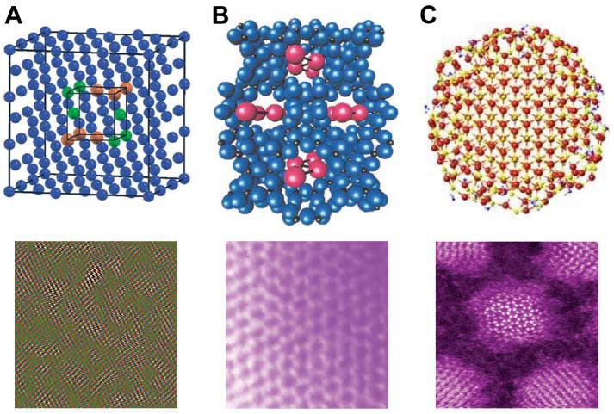
What is a local structure?
Disordered materials: The interesting properties are often governed by the defects or local structure
Non crystalline materials: Amorphous solids and polymers
Nanostructures: Well defined local structure, but long-range order limited to few nanometers (poorly defined Bragg peaks)
S.J.L. Billinge and I. Levin, The Problem with Determining Atomic Structure at the Nanoscale, Science 316, 561 (2007).

Slide 4
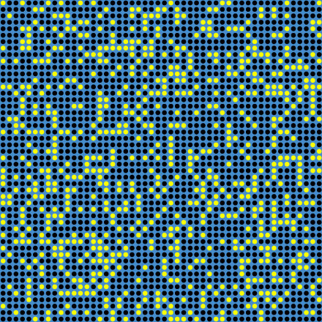
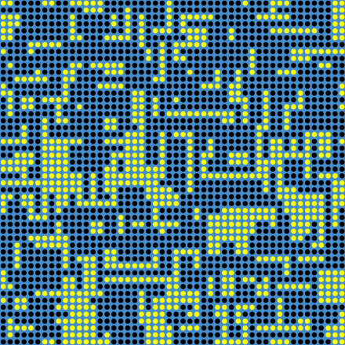
What is total scattering?
Cross section of 50x50x50 unit cell model crystal
consisting of 70% blue atoms and 30% vacancies.
Properties might depend on vacancy ordering!
Courtesy of Thomas Proffen

Slide 5
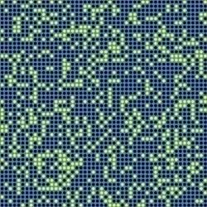
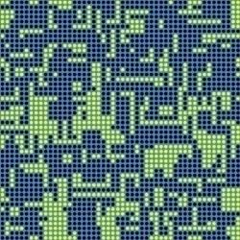
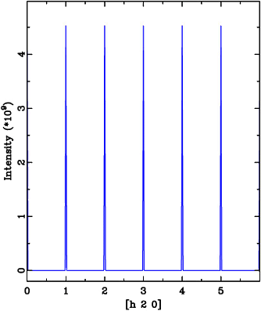
Bragg peaks are “blind”
Bragg scattering: Information about the average structure, e.g. average positions, displacement parameters and occupancies.

Slide 6
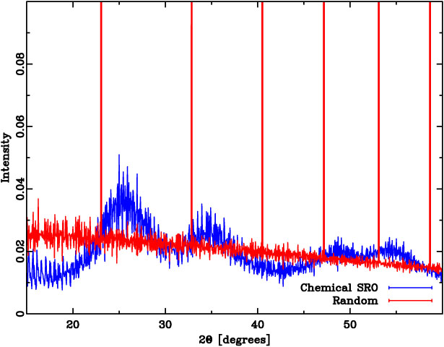
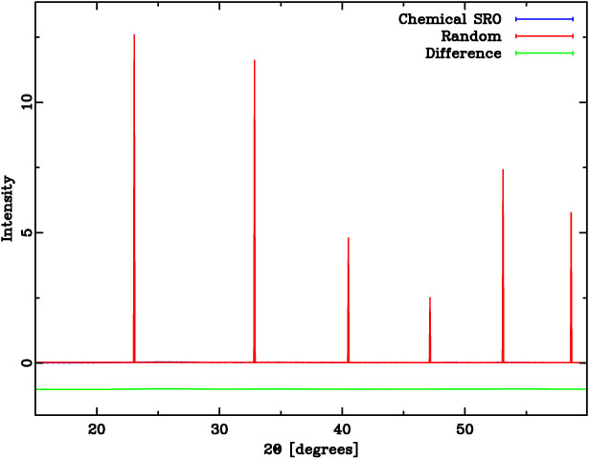
How about powder diffraction?
Courtesy of Thomas Proffen

Slide 7
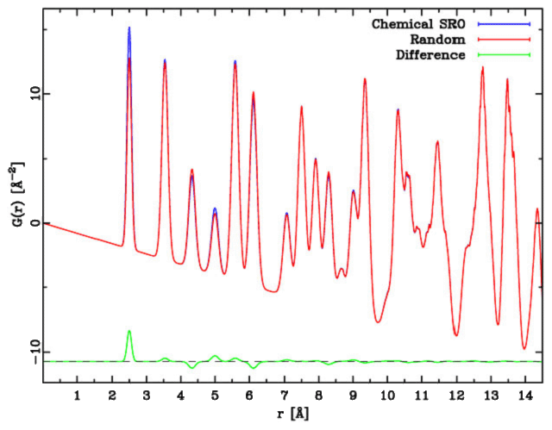
The Pair Distribution Function
The PDF is the Sine-Fourier transform of the total scattering (Bragg and diffuse) diffraction pattern
Th. Proffen, Analysis of occupational and displacive disorder using the atomic pair distribution function: a systematic investigation, Z. Krist, 215, 661 (2000).

Slide 8
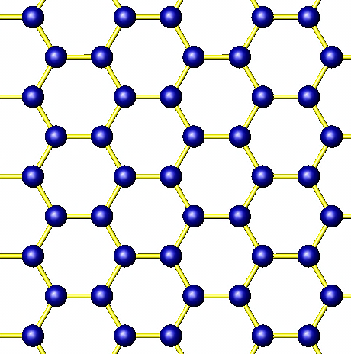
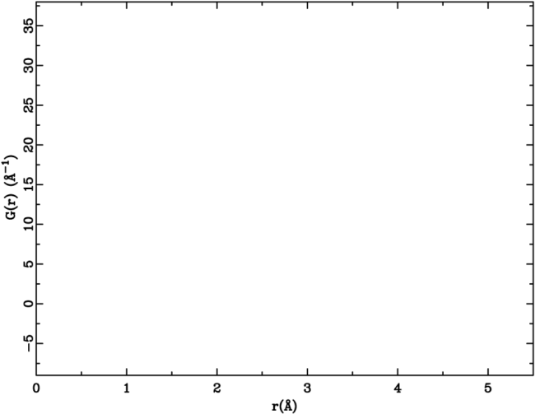
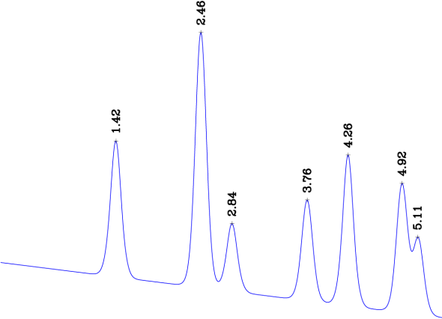
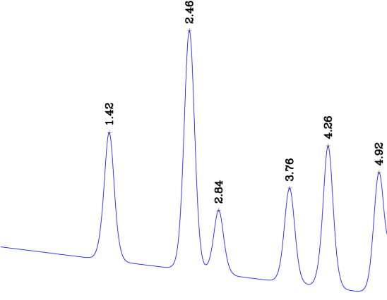
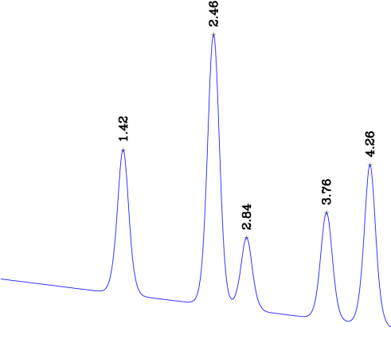
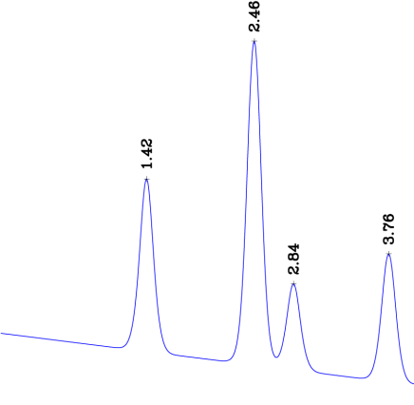
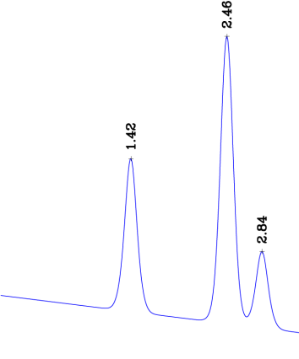
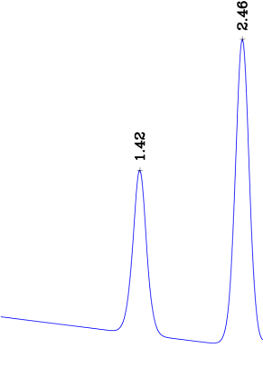
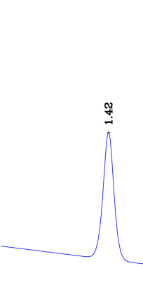
What is a PDF?
The Pair Distribution Function (PDF) gives the probability of finding an atom at a distance “r” from a given atom.
4.26Å
2.84Å
1.42Å
2.46Å
3.76Å
4.92Å
5.11Å

Slide 9
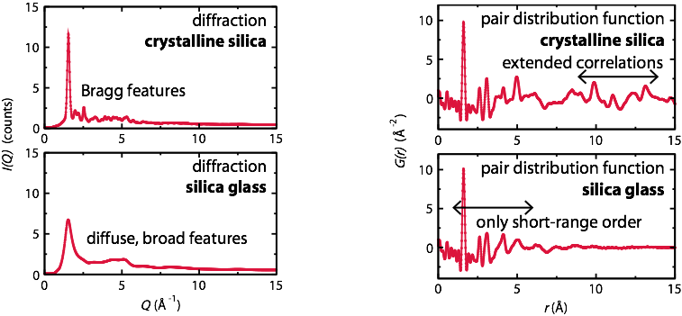
Pair Distribution Function
Sine-Fourier transform of all scattered neutron/X-ray intensity (crystalline and amorphous)
→Experimental, ensemble, real-space, atom-atom histogram

Slide 10
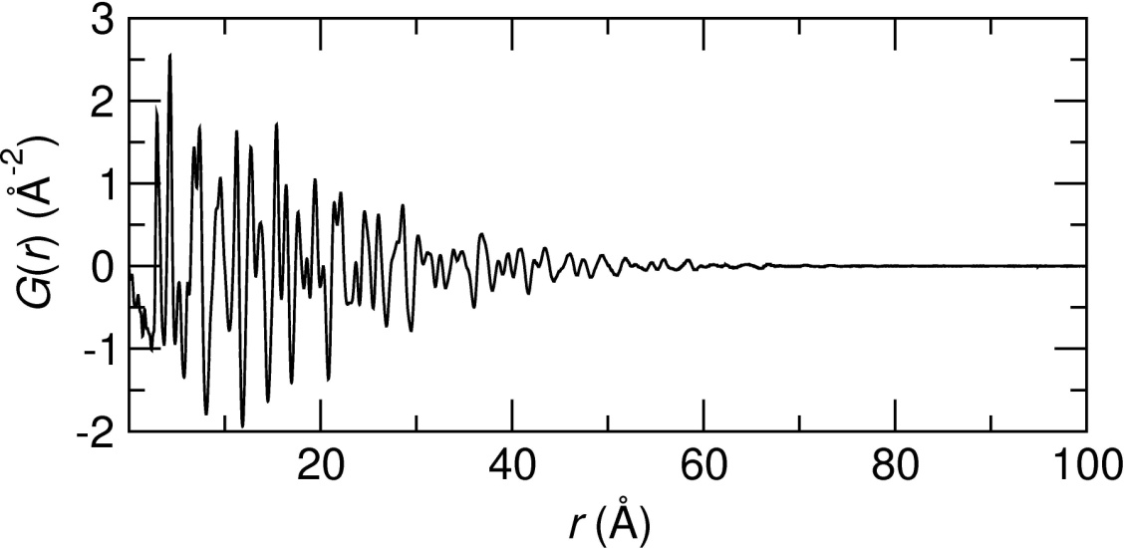
Pair Distribution Function
Inter-atomic distances
Number of next-near
neighbors (area under peak)
Particle size / correlation length scale
PDF analysis → Average and short-range structure for disordered crystalline materials, nanomaterials, and amorphous materials

Slide 11
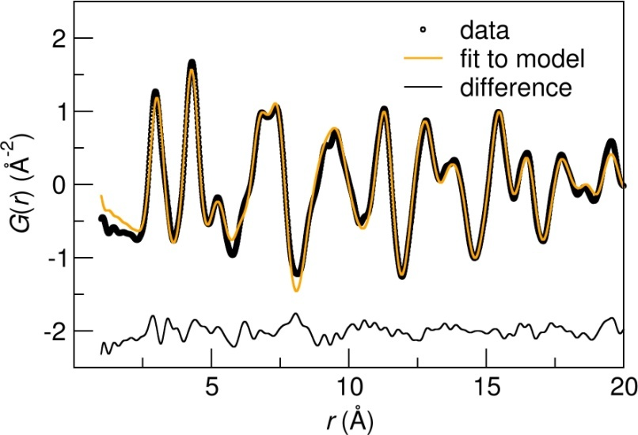
Pair Distribution Function
Quantitative analysis: fitting a model to the data over specific ranges
Inter-atomic distances
Number of next-near
neighbors (area under peak)
Particle size / correlation length scale
Atom positions
Atomic displacements
Chemical order
Chemical composition
Correlation length scale

Slide 12
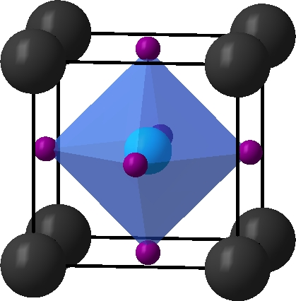
Partial PDFs
s(s+1)/2 partial structure factors characterize a system containing s species
Neutron
X-ray
SrTiO₃
Neutron and x-ray PDFs are often highly complementary!

Slide 13
What types of studies can be done with the PDF technique?

Slide 14
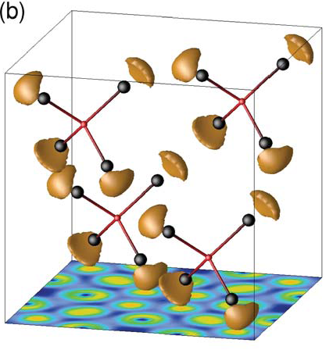
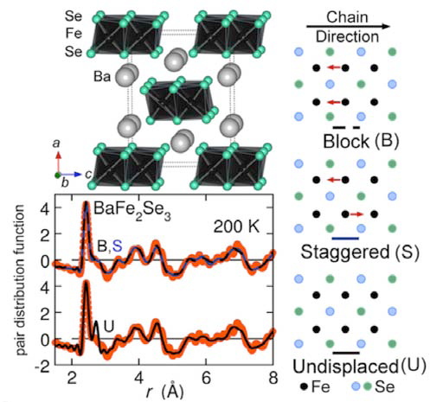
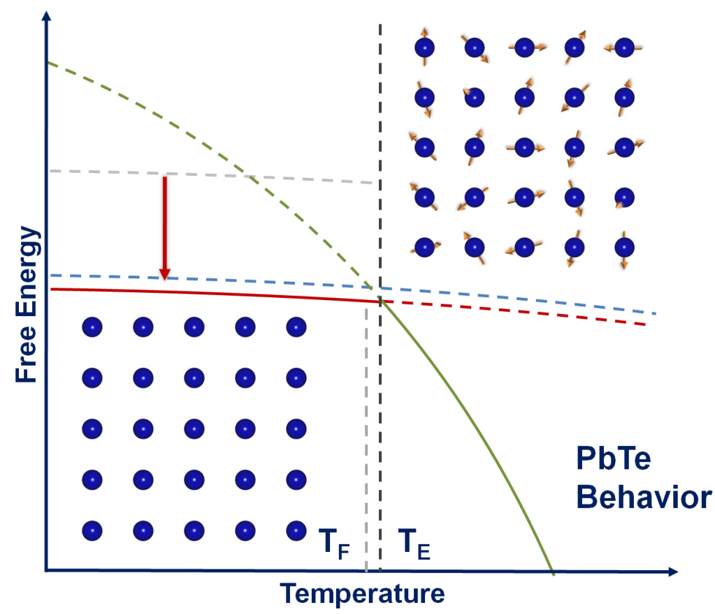
Local distortions via PDF
Local dipoles
Local Jahn-Teller distortions
Frustrated lattices
etc.
D. P. Shoemaker, et al., Reverse Monte Carlo neutron scattering study of the 'ordered-ice' oxide pyrochlore Pb₂Ru₂O_{6.5}, J. Phys.: Condens. Matter 23 (2011).
E. Bozin, et al., Entropically Stabilized Local Dipole Formation in Lead Chalcogenides, Science 330, 1660 (2010).
D. Louca, et al., Suppression of superconductivity in Fe pnictides by annealing; a reverse effect to pressure, Phys. Rev. B 84, 054522 (2011).

Slide 15
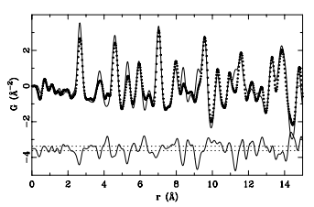
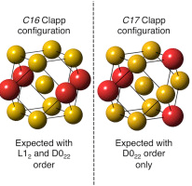
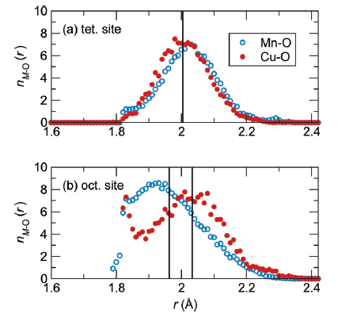
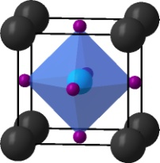
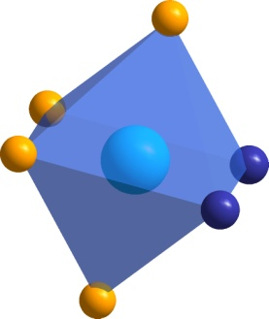
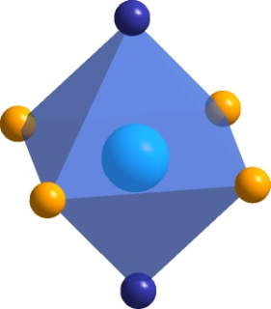
Chemical Short Range order via PDF
Th. Proffen, V. Petkov, S. J. L. Billinge, and T. Vogt, Chemical short range order obtained from the atomic pair distribution function, Z. Kristallogr. 217, (2002) 47–50.
Substitution effects
Chemical clustering
Ion-specific local environments
Vacancy ordering
Cu₃Au
D. P. Shoemaker, J. Li, and R. Seshadri, Unraveling Atomic Positions in an Oxide Spinel with Two Jahn-Teller Ions: Local Structure Investigation of CuMn₂O₄, J. Am. Chem. Soc. 131, 11450 (2009).
L.R. Owen, H.Y. Playford, H.J. Stone and M.G. Tucker, Analysis of short-range order in Cu₃Au using X-ray pair distribution functions. Acta Materialia (2017) 125, 15-26.
cis
trans
K. Page, et al., Local atomic ordering in BaTaO₂N studied by neutron pair distribution function analysis and density functional theory, Chem. Mater. 19 (2007) 4037-4042.

Slide 16
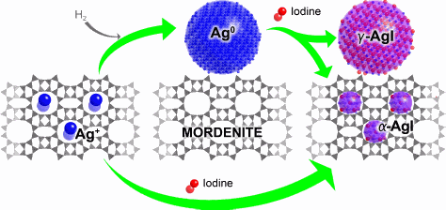
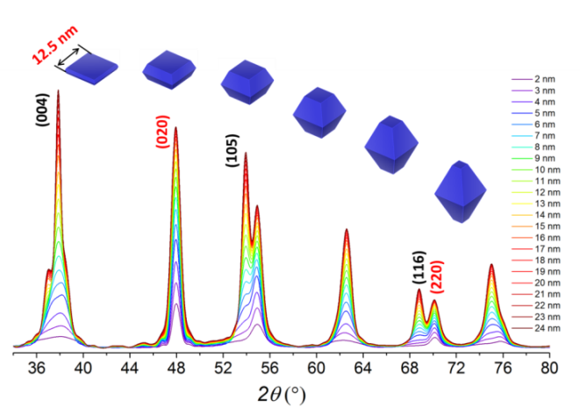
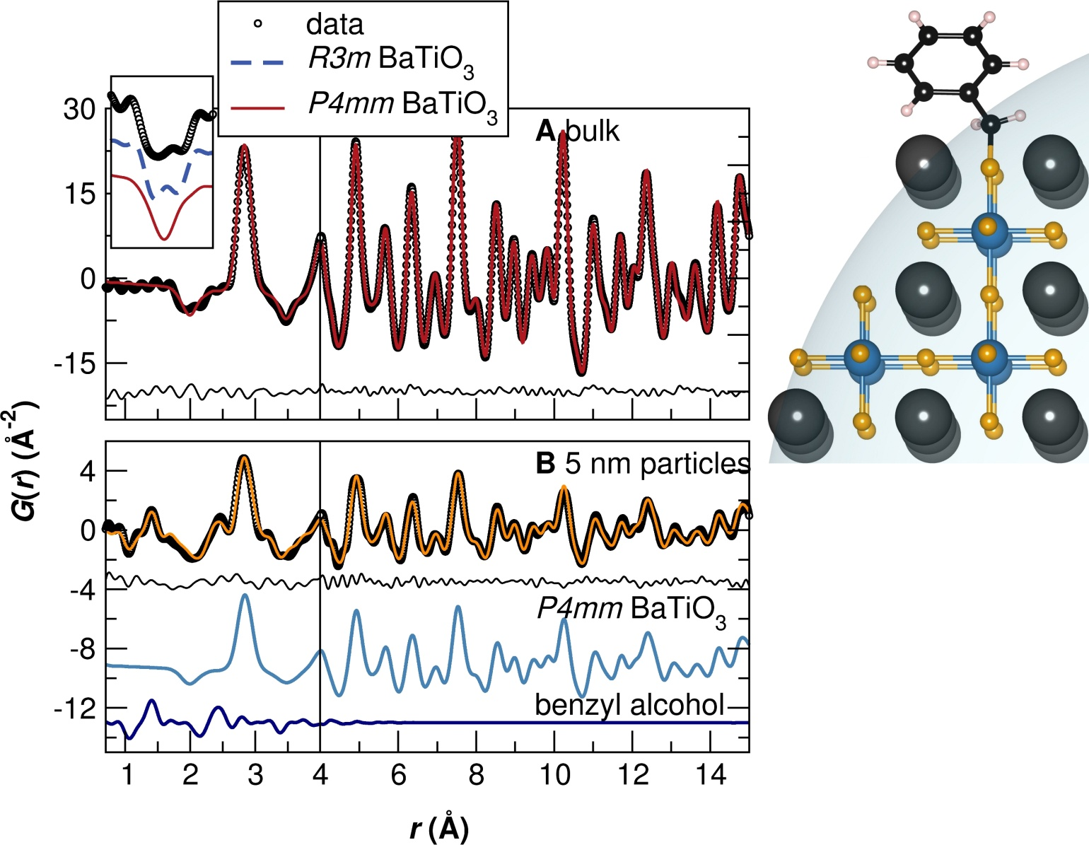
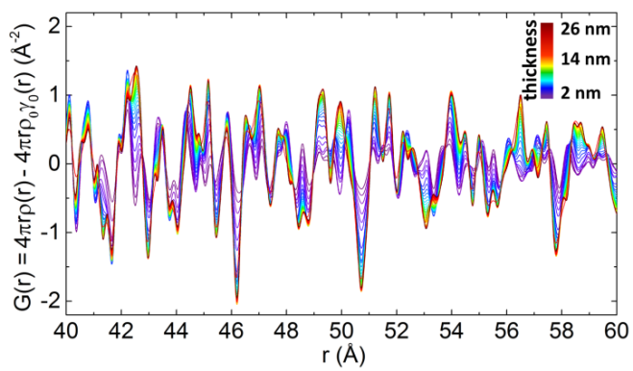
Nanomaterial structure via PDF
Finite size/shape effects
Surface/Interface structure
Nanostructure polymorphs
Growth and transformation
K. W. Chapman, P. J. Chupas, and T. M. Nenoff, Radioactive Iodine Capture in Silver-Containing Mordenites through Nanoscale Silver Iodide Formation, J. Am. Chem. Soc. 132, 8897 (2010).
J. Liu et al, Quantitative analysis of the morphology of {101} and {001} faceted anatase TiO₂ nanocrystals, Chem. Mater.
K. Page, Th. Proffen, M. Niederberger, and R. Seshadri, Probing local dipoles and ligand structure in BaTiO₃ nanoparticles, Chem. Mater. 22 (2010), 43864391.

Slide 17
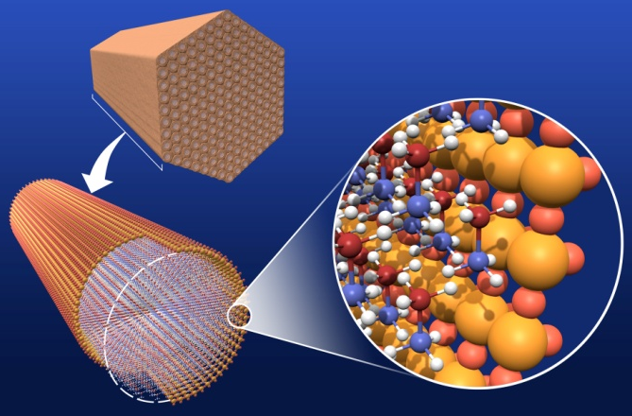
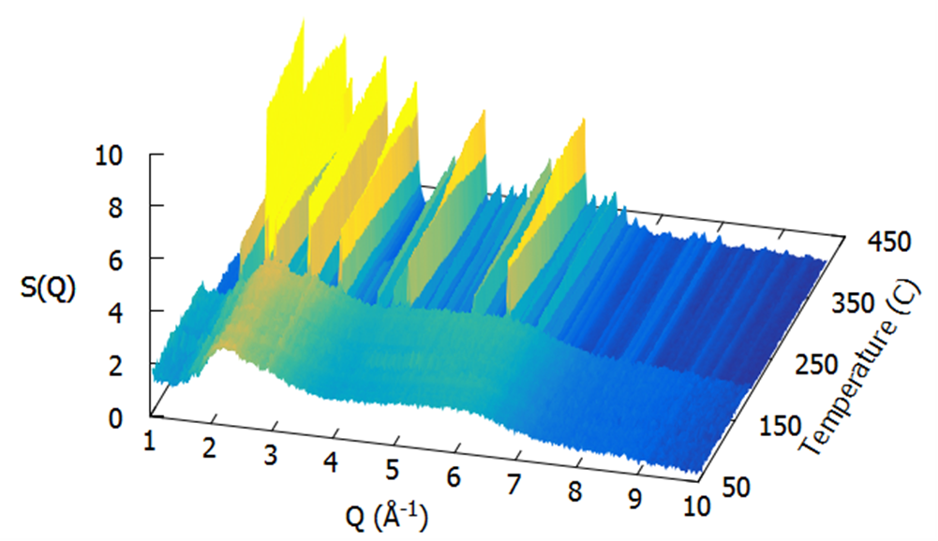
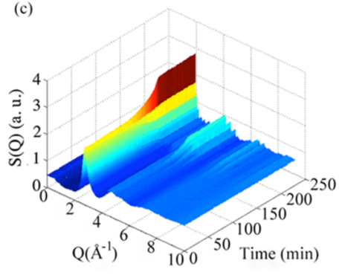
Amorphous structures via PDF
Kim, H.; Proffen, T.; Chupas, P. J.; Karkamkar, A.; Hess, N. J.; Autrey, T., Determination of structure and phase transition of light element nanocomposites in mesoporous silica: case study of NH₃BH₃ in MCM-41, J. Am. Chem. Soc. 2009, 131(38) 13749-13755.
Glasses
Liquids
Concretes
Adsorbed gases
etc.
S. Lan, X.. Wei, J. Zhou, Z. Lu, X. Wu, M. Feygenson, J. Neuefeind, X. Wang, In situ study of crystallization kinetics in ternary bulk metallic glass alloys with different glass forming abilities, Applied Physics Letters, 105 (2014) 201906.
H.-W. Wang; L. L. Daemen, M. C. Cheshire, M. K. Kidder, A. G. Stack, L. F. Allard, J. Neuefeind, D. Olds, J. Liu, and K. Page, Synthesis and structure of synthetically pure and deuterated amorphous (basic) calcium carbonates, Chem. Commun., 2017.
Notes:
Example: Ammonia borane (AB) in mesoporous silica

Slide 18
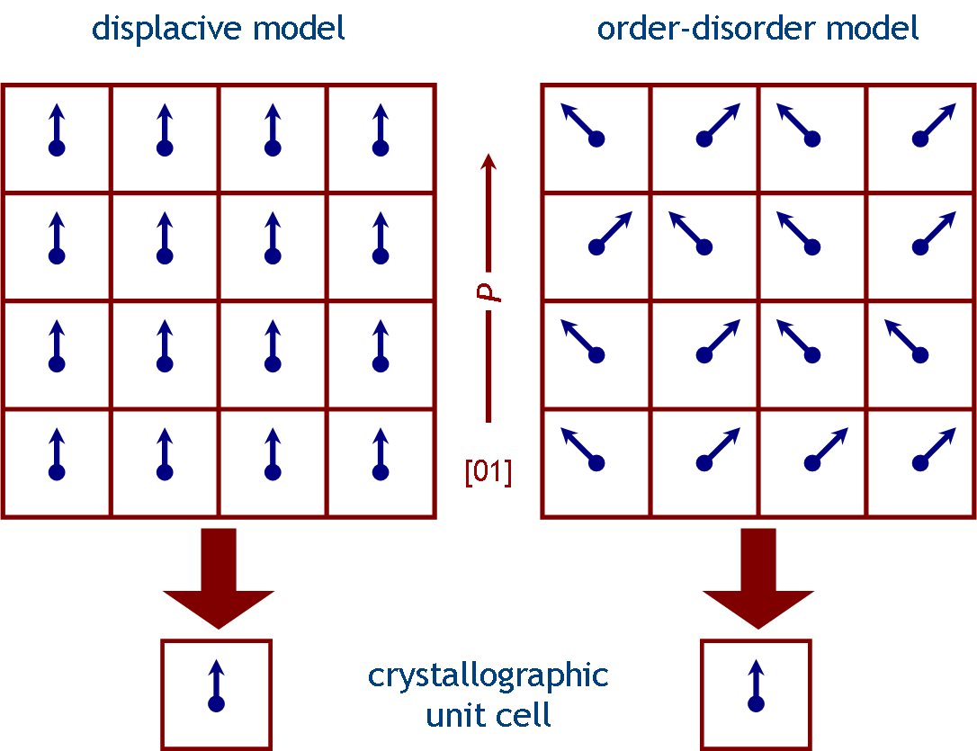
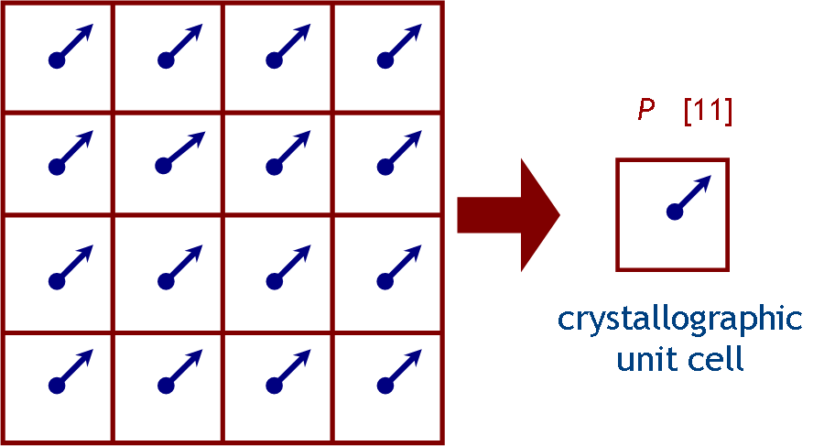
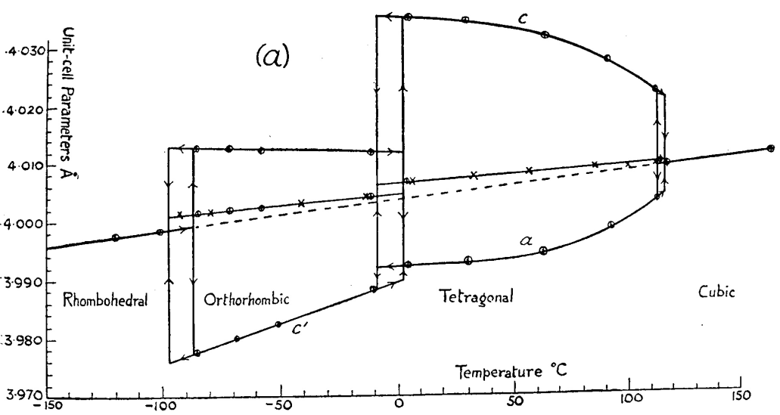
Example: Local structure in BaTiO₃
BaTiO₃: Ferroelectric oxide, a rhombohedral (R3m) ground state and a room temperature tetragonal (P4mm) structure
Displays order-disorder phenomena: room temperature local structure known to have rhombohedral pair-pair correlations

Slide 19
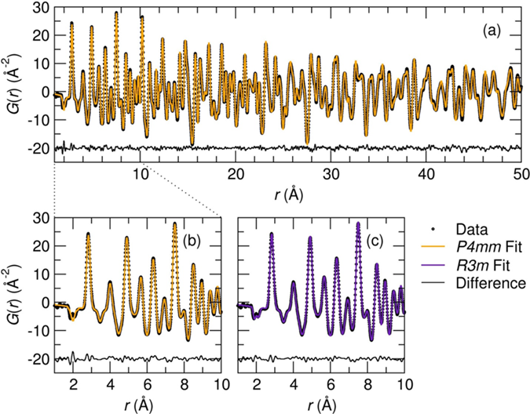
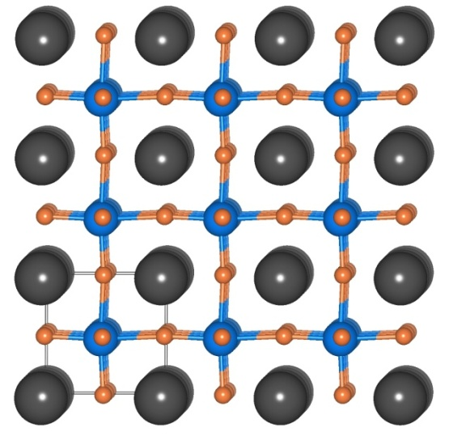
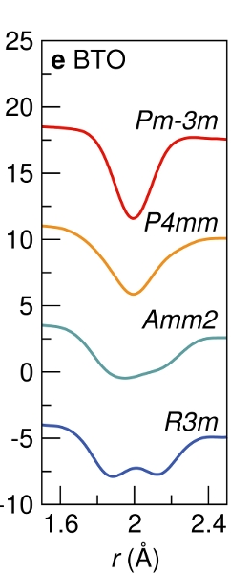
Example: Local structure in BaTiO₃
BaTiO₃: At room temperature, locally has a split (R3m) first Ti-O peak, displaying classic order-disorder behavior
K. Page, T. Kolodiazhnyi, T. Proffen, A. K. Cheetham, and R. Seshadri,, Phys. Rev. Lett. 101, 205502 (2008).

Slide 20
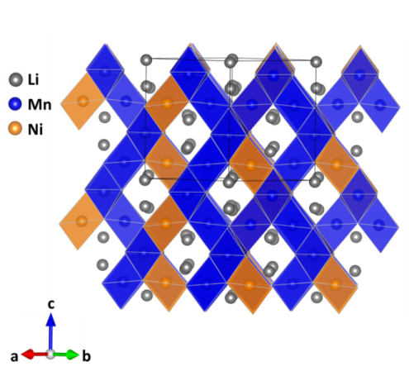
Example: High Voltage Spinel Cathode LiNi_{0.5}Mn_{1.5}O₄
High operating voltage (~4.7 V versus Li⁺/Li) and facile three dimensional lithium ionic conductivity Zhong et al., 1997; Ohzuku et al., 1999
Two distinct polymorphs are known: Ni/Mn cation ordering strongly impacts electrochemical performance Idemoto et al., 2003; Zhong et al., 1997
(1) Disordered phase (S.G. Fd-3m), where Ni/Mn are randomly distributed at the 16d site via high temperature solid state reaction
(2) Long-range cation ordered phase (S.G. P4₃32 or P4₁32) via extended post-annealing at 700 °C to 600 °C
Nature of the cation ordering and detailed mechanisms are still debated
Kunduraci & Amatucci, 2006; Kunduraci et al., 2006; Kim et al., 2004; Ma et al., 2010; Moorhead-Rosenberg et al., 2015

Slide 21
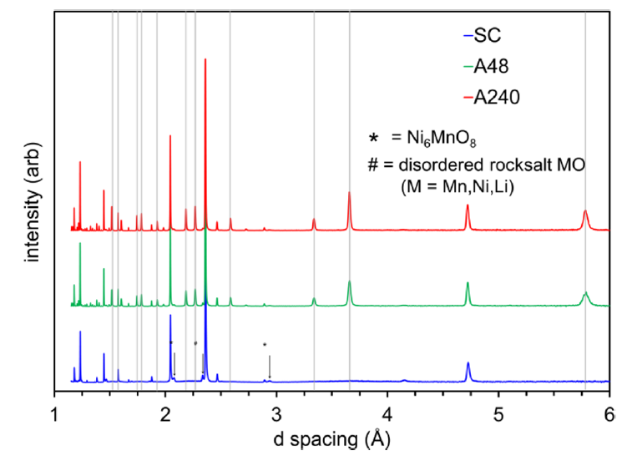
Example: High Voltage Spinel Cathode
Cation ordering examined at the POWGEN Beamline, SNS
Slow Cooled (SC): 8 hours at 900°C, 1.5°C/min cooling
Fast Cooled (FC): 8 hours at 900°C, 5°C/min cooling
Annealed (A48): 48 hours at 700°C
Annealed (A240): 240 hours at 700°C
Ni/Mn ordering: large nuclear scattering length contrast between nickel (b = 10.3 fm) and manganese (b = -3.73 fm).
Moorhead-Rosenberg, Z., Huq, A., Goodenough, J. B. & Manthiram, A. Electronic and Electrochemical Properties of Li1–xMn1.5Ni0.5O4 Spinel Cathodes As a Function of Lithium Content and Cation Ordering, Chem. Mater. 27, 6934-6945, 2015.

Slide 22

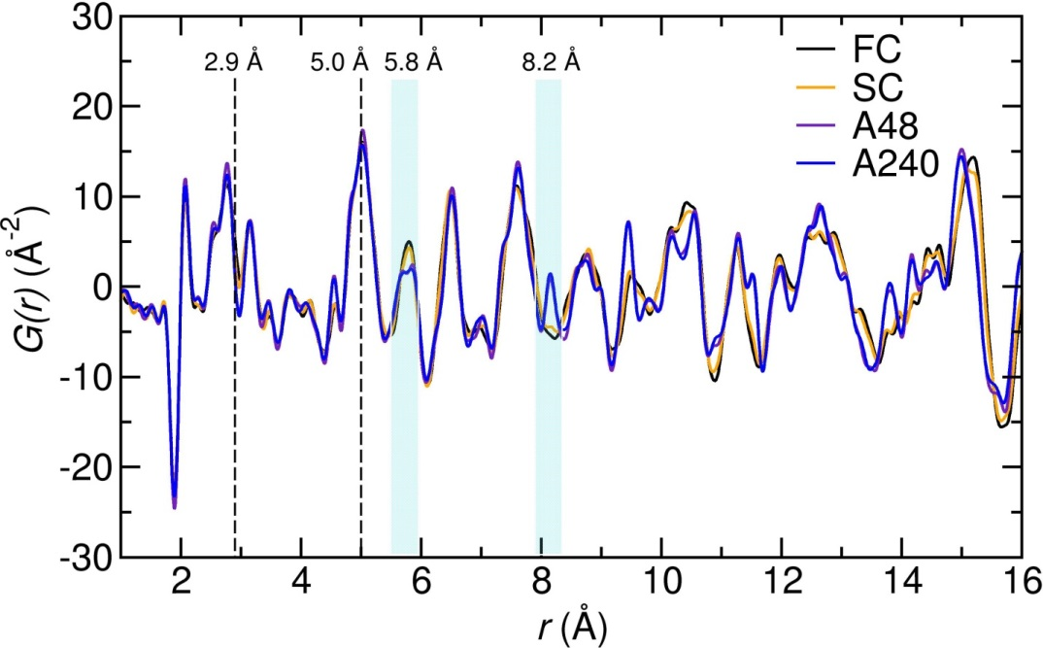
We can tell a lot by looking at PDF data
ordered LiNi_{0.5}Mn_{1.5}O₄ (S.G. P4₃32)
Local atomic structures almost identical up to 5 Å (two nearest B-site neighbors)
Sample structures diverge after that
Annealed samples: two distinguishable sets of Ni/Mn pairs at third nearest Ni/Mn neighbor distance
By fourth nearest Ni/Mn neighbor samples are very distinct
J. Liu, A. Huq, Z. Moorhead-Rosenberg, A. Manthiram, and K. Page, Nanoscale Ni/Mn ordering in the high voltage spinel cathode LiNi_{0.5}Mn_{1.5}O₄, Chemistry of Materials, 28, 19, 6817–6821, 2016.
POWGEN: 3 hours per frame, Q-range: 1 – 30 Å⁻¹

Slide 23
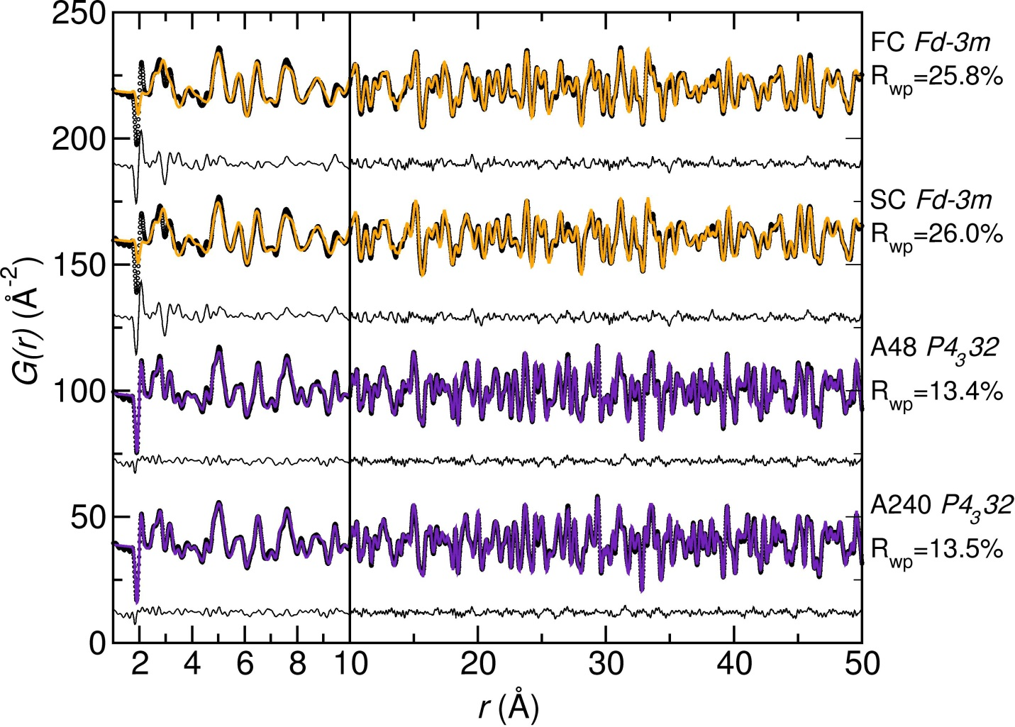
Example: High Voltage Spinel Cathode
Modeling the local structure with average structure models determined from Rietveld refinement
The first 10 Å of the non-annealed sample data (FC and SC) differ strongly from long-range structures crystallographic structures
The local atomic structures of the annealed samples (A48 and A240) are well-described by the long-range crystallographic structures
J. Liu, A. Huq, Z. Moorhead-Rosenberg, A. Manthiram, and K. Page, Nanoscale Ni/Mn ordering in the high voltage spinel cathode LiNi_{0.5}Mn_{1.5}O₄, Chemistry of Materials, 28, 19, 6817–6821, 2016.

Slide 24

Example: High Voltage Spinel Cathode
Modeling the local structure with alternate models
Least squares refinements of the ordered structure model (P4₃32) were carried out in a manner that 4b site (Ni site) and 12d site (Mn site) occupancies are allowed to refine simultaneously but with site multiplicity constraints
Over 1 to 5 Å range the ordered models (P4₃32) with Mn/Ni site mixing provide much better fits for local PDF profiles
Ni/Mn are locally well-ordered in the long-range “disordered” samples
But up to what length scale?
J. Liu, A. Huq, Z. Moorhead-Rosenberg, A. Manthiram, and K. Page, Nanoscale Ni/Mn ordering in the high voltage spinel cathode LiNi_{0.5}Mn_{1.5}O₄, Chemistry of Materials, 28, 19, 6817–6821, 2016.

Slide 25

Example: High Voltage Spinel Cathode
Fit the PDFs within a 4.5 Å “box” in 1 Å steps (a “box-car” refinement)
5% site mixing in the A48 and A240 patterns throughout the entire range
FC and SC samples are nearly fully disordered at pair distances beyond 15.5 Å
fully disordered
Spinel cathode materials are distinguished by their unique correlation length scales for chemical short range ordering
fully ordered

Slide 26



Example: SnO₂ Nanocrystals
~2 nm SnO₂ (cassiterite) nanocrystals capped with H₂O/OH or D₂O/OD groups
TGA suggests 2 steps dehydration.
How many layers of water are at the surface?
How is water bonded to surfaces?
What are the dynamics of dehydration?
H.-W. Wang, D. J. Wesolowski, T. Proffen, L. Vlcek, W. Wang, L. F. Allard, A. I. Kolesnikov, M. Feygenson, L. M. Anovitz, and R. L. Paul, Structure and stability of SnO₂ nanocrystals and surface-bound water species, J. Am. Chem. Soc., 135, 6885-6895, 2013.

Slide 27


In situ Dehydration at NOMAD, SNS
Example: SnO₂ Nanocrystals
Starting with full coverage
Blue lines: 22 and 50 ºC - L₁ +L₂ +L₃
Green lines: 50 to 350 ºC (with 50 ºC increments) - L₁ +L₂
Black lines: 400 to 850 ºC ( with 50 ºC increments) – SnO₂ grain growth
22 ºC
850 ºC
H.W. Wang, et al, J. Am. Chem. Soc., 2013, 135 , 6885–6895.

Slide 28




MD and PDF
MD: hydration layer only
Data is compared to Molecular Dynamics Simulation PDFs for nonhydroxylated and hydroxylated models:
Box size: 41 x 41 x 23 Å³ ; 2592 atoms; # density = 0.068 Å⁻³; U_{iso} = 0.003 Å²
L₁ +L₂ +L₃ : 41 x 41 x 8 Å³
L₁ +L₂ : 41 x 41 x 6 Å³
L₁ : 41 x 41 x 2.5 Å³
MD: SnO₂ + hyd. layer (hydroxylated model)
1
2
0.068
Observed PDF
3
1
5
7
9
6
8
4
0.084
0.068

Slide 29


Example: SnO₂ Nanocrystals
Single phase model:
SnO₂ bulk structure, refined particle size = ~47 Å
L₁ +L₂ +L₃
L₁ +L₂
L₁ +0.5L₂
R_{w} : 0.45
R_{w} : 0.25
R_{w} : 0.23
Two phase model: SnO₂ bulk + layered MD water structure
L₁ +L₂ +L₃
L₁ +L₂
L₁ +0.5L₂
R_{w} : 0.25
R_{w} : 0.20
R_{w} : 0.20

Slide 30


Example: SnO₂ Nanocrystals
L₁ +L₂ +L₃
L₁ +L₂
L₁ +0.5L₂
H.-W. Wang, D. J. Wesolowski, T. Proffen, L. Vlcek, W. Wang, L. F. Allard, A. I. Kolesnikov, M. Feygenson, L. M. Anovitz, and R. L. Paul, Structure and stability of SnO₂ nanocrystals and surface-bound water species, J. Am. Chem. Soc., 135, 6885-6895, 2013.
L₁

Slide 31
A Few Experimental Considerations

Slide 32
Total Scattering Structure Function
Structure function, determined from the scattering intensity/differential cross section:
coherent scattering
intensity (corrected)
scattering length (neutrons) or atomic form factor (x-rays)
Corrected for: Container & background scattering, self-absorption, etc.
Normalized by: Incident flux, number of atoms, square of the scattering length/form factor
For unambiguous derivation of this derivation and relationship to other forms:
C. Farrow and S. J. L. Billinge, Acta Cryst. (2009) A65, 232–239.
D. A. Keen, J. Appl. Cryst. 34 (2001) 172-177.

Slide 33

The Experimental PDF
The Sine Fourier transform of the total (Bragg and diffuse) scattering
The total scattering structure factor: S(Q)
The Pair Distribution Function (PDF): G(r)
Sine Fourier transform

Slide 34

Obtaining High Quality PDFs
High maximum momentum transfer (Q_{max})
(2) Good Q-resolution, dQ
(3) Good counting statistics
(4) Low (and stable) instrument background
An ideal measurement would have no contribution from the instrument resolution
For PDF: a wide Q range and high flux is balanced with resolution
Synchrotron sources or Spallation Neutron Sources
(high energy X-rays) (reactor neutron energies are too low)

Slide 35







Resolution Effect
Courtesy of
Phil Chater,
Diamond Light Source
Reciprocal space: Peak width, dQ
Real space: Damping with r

Slide 36







Q_{max} Effect
Courtesy of
Phil Chater,
Diamond Light Source
Δr resolution of a PDF is dominated by Q_{max}
Q = 2π/d = 4πsinθ/λ
Δr ≈ 2π/Q_{max}
Resolution is Q_{max} limited unless
AlPO₄
Q_{max} 30 Å⁻¹
Ag Kα₁, Q_{max} 22.1 Å⁻¹
Q_{max} 25 Å⁻¹
Cu Kα₁, Q_{max} 8 Å⁻¹
Q_{max} 35 Å⁻¹
Mo Kα₁, Q_{max} 17.4 Å⁻¹
B. H. Toby and T. Egami, Acta Cryst. A, 48 (1992) 336

Slide 37

Instruments at SNS for PDF studies

Slide 38




Total Scattering at the SNS
Pair Distribution Function (PDF) methods follow local atomic bonding configurations, intermediate structure, and correlation length scale- regardless of a material’s long range structure
NOMAD data collected on 100 mg of sample in a 3 mm quartz capillary in 3 hours.
high intensity diffraction and PDF for small samples and in situ studies on amorphous, nanostructured, and crystalline materials
POWGEN data collected on 10 g of sample in a 10 mm vanadium canister in 12 hours.
high resolution diffraction and PDF of crystalline materials

Slide 39



Synchrotron Total Scattering: 2D Amorphous Si Detector
P. J. Chupas, K. W. Chapman, P. L. Lee, Applications of an amorphous silicon-based area detector for high resolution, high sensitivity and fast time-resolved pair distribution function measurements, J. Appl. Crystallogr. 40, 463, 2007. http://dx.doi.org/10.1107/S0021889807007856

Slide 40
Modeling a PDF

Slide 41

Pair Distribution Function
Based on the radial distribution function (RDF):
Atomic PDF (PDFFIT notation):
S.J.L Billinge, Z. Kristallogr. Suppl.,26,17 (2007)
atomic form factors
(Z for x-rays, b for neutrons)
distance between i and j atoms
average density
sum over all atoms

Slide 42



Calculating a PDF from a Model
Calculating a PDF from an atomistic model:
Peak Width
Small model: convolution of δ(r-r_{ij}) with distribution function (PDFgui & TOPAS v6)
Large model: ensemble average of actual displacements (RMCprofile)
Termination ripples + instrumental dampening
Multiplication with step function in reciprocal space gives convolution with sin(Q_{max}r)/r in real space
…

Slide 43



Atomic PDF Modeling
Small Models: Least Squares Refinement
Up to several hundred atoms
‘Rietveld’-type parameters: lattice parameters, atomic positions, displacement parameters, etc.
Refinements as function of r-range
Large Model: Reverse Monte Carlo
20000 + atoms
Fit X-ray and neutron F(Q), G(r) , Bragg profile
Constraints utilized
Static 3-D model of the structure (a snap-shot)
Multi-level / Complex Modeling
Refine higher level parameters (not each atom)
Example nanoparticle: diameter, layer spacing, stacking fault probability
Choose minimization scheme
Emerging: ab initio and force-field based approaches
Density Functional Theory
Molecular Dynamics
PDFgui: http://www.diffpy.org/
Topas V6: http://www.topas-academic.net
RMCprofile: http://www.isis.rl.ac.uk/RMC
EPSR: http://disordmat.moonfruit.com/
DIFFEV and DISCUS: http://discus.sourceforge.net
Topas V6: http://www.topas-academic.net

Slide 44



Small Box: Software Comparison
PDFgui
+ Open Source and Free
+ GUI is Simple and User-friendly
- Slow refinement, especially for high-r
- No longer actively developed
http://www.diffpy.org/
TOPAS PDF
+ Super Fast
+ Flexible
+ Fit Bragg and PDF together
- Steeper learning curve
- Have to write your own macro
http://www.topas-academic.net

Slide 45

Large Box: Reverse Monte Carlo
RMCprofile
Atomic configurations ~600 to 20000+ atoms
Fit both X-ray and neutron F(Q)
Fit G(r)
Fit Bragg profile (GSAS ToF 1-3)
Polyhedral restraints
Coordination constraints
Closest approach constraints
Produce a static 3-D model of the structure (a snap-shot in time)
Link: http://www.isis.rl.ac.uk/RMC

Slide 46
A Few Emerging Areas

Slide 47

Magnetic PDF: mPDF
Being developed to provide direct access to long-range and short-range magnetic correlations in real space
Spin order in diluted magnetic semiconductors, spin-stripe correlations in cuprate superconductors, spin fluctuations in frustrated magnetic systems, etc.
B. A. Frandsen, X. Yang, and S. J. L. Billinge, Magnetic pair distribution function analysis of local magnetic correlations Acta Cryst. A 70, 3–11, 2014.
B. A. Frandsen and S. J. L. Billinge Magnetic structure determination from the magnetic pair distribution function (mPDF): ground state of MnO, Acta Cryst. A, 3, 325-334, 2015.
A. L. Goodwin, M. G. Tucker, M. T. Dove, and D. A. Keen, Magnetic structure of MnO at 10 k from total neutron scattering data, Phys. Rev. Lett. 96, 047209, 2006.
J. A. M. Paddison and A. L. Goodwin, Empirical magnetic structure solution of frustrated spin systems, Phys. Rev. Lett. 108, 017204, 2012.

Slide 48



Field-Dependent PDF
X-ray total scattering measured while static electric fields (0 to ~4 kV/mm) are applied to Na_{½}Bi_{½}TiO₃ polycrystalline ceramic samples
Bi³⁺ reorientation observed at high electric field
11-ID-B, APS
Q within
10° || E
Q
η
X-rays
Q within
10° $⊥$ E
E
T.-M. Usher, I. Levin, J.E. Daniels, and J.L. Jones, Scientific Reports 5, 14678 (2015)

Slide 49
When Should You Pursue PDF Studies of a Crystalline Material?
You have modeled everything you can in reciprocal space
You suspect the local structure may differ from the long-range structure
Why Would You Suspect a Distinct Local Structure?
Maybe…
You find signatures of disorder through complementary methods
An average structure model fails to explain observed material properties
A theoretical study proposes an alternate structure to the one globally observed
Lots of experience with a materials family or structural archetype

Slide 50
Some Resources and Programs
Data Collection
Data Extraction
PDFgetN: http://pdfgetn.sourceforge.net
PDFgetX2/X3: http://www.pa.msu.edu/cmp/billinge-group/programs/PDFgetX2/ http://www.diffpy.org/products/pdfgetx3.html
Data Modeling
PDFgui: http://www.diffpy.org/
RMCprofile: http://www.isis.rl.ac.uk/RMC
DISCUS/DIFFEV: http://discus.sourceforge.net
Neutron: http://neutronsources.org
Gudrun: http://disordmat.moonfruit.com/
EPSR: http://disordmat.moonfruit.com/
Topas Academic: http://www.topas-academic.net
ADDIE: ADvanced DIffraction Environment: coming soon from ORNL!
X-ray: http://www.lightsources.org

Slide 51



References & Reviews
S.J.L. Billinge and I. Levin, The Problem with Determining Atomic Structure at the Nanoscale, Science 316, 561 (2007). http://dx.doi.rog/10.1126/science.1135080
T. Egami and S. J. L. Billinge, Underneath the Bragg peaks: structural analysis of complex materials, Pergamon Press Elsevier, Oxford, England, 2003.
D. A. Keen, Derivation of commonly used functions for the pair distribution function, technique J. Appl. Cryst. 34 (2001) 172-177.
R. Neder and Th. Proffen, Diffuse Scattering and Defect Structure Simulation, Oxford University Press, 2008.
M. G. Tucker, M. T. Dove, and D. A. Keen, Application of the reverse Monte Carlo method to crystalline materials, J. Appl. Cryst. 34, 630-638 (2001).
D. A. Keen and A. L. Goodwin, The crystallography of correlated disorder, Nature 521, 303–309, 2015. http://dx.doi.org/10.1038/nature14453
H. Y. Playford, L. R. Owen, I. Levin, and M. G. Tucker, New insights into complex materials using Reverse Monte Carlo modeling, Annual Review of Materials Research, 44, 429-449, 2014. http://dx.doi.org/10.1146/annurev-matsci-071312-121712

Slide 52
Summary
Atomic PDF from total (Bragg and diffuse) scattering data gives access to:
Amorphous and nanomaterial structure
Departure from long range (average structure)
Displacements
Chemical short range order
Interstitials/vacancies
Correlation length scale of features (size)
Structure ⇔ property relationships
Use multiple data sets (e.g. x-ray and neutron data, diffraction and PDF) to characterize complex materials
High-resolution instruments open the door to medium-range order investigations

Slide 53

Questions?
pagekl@ornl.gov

