Slide 1
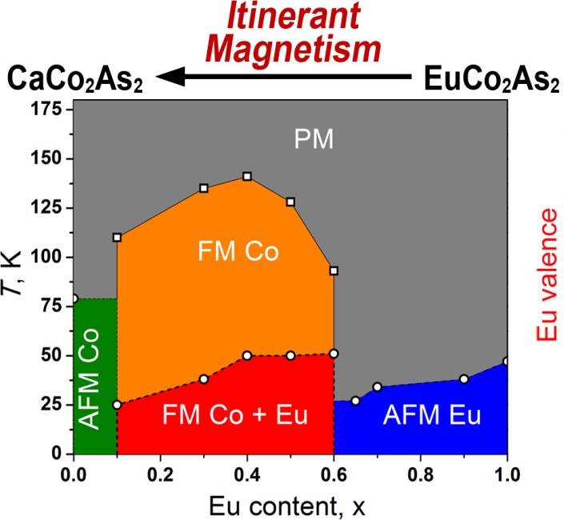
Controlling Magnetic Order by Chemical Compression
Scientific Achievement
Magnetic properties of Ca_{1–x}Eu_{x}Co₂As₂ vary from itinerant (3d) antiferromagnetism of Co in CaCo₂As₂ to the combination of itinerant (3d, Co) and localized (4f, Eu) ferromagnetism in the intermediate range to localized (4f) antiferromagnetism in Eu-rich samples.
Significance and Impact
This work demonstrates diverse mechanisms of magnetic ordering in the CaCo₂As₂–EuCo₂As₂ realized by chemical compression. This concept can be applied to vary properties of other itinerant magnets guided by theoretical predictions.
Research Details
The magnetic ground states of Ca_{1–x}Eu_{x}Co₂As₂ were determined by neutron diffraction.
The chemical compression of Eu sites leads to mixed valence that was confirmed by XANES and XMCD.
The changes in the crystal structure and magnetism were justified by band structure calculations.
The work performed at High Flux Isotope Reactor’s HB-2A and HB-3A instruments, Oak Ridge National Laboratory was sponsored by the Scientific User Facilities Division, Office of Basic Energy Sciences, U.S. Department of Energy.
Tan, X., Yaroslavtsev, A., Cao, H., Geondzhian, A., Menushenkov, A., Chernikov, R., Nataf, L., Garlea, O.V., Shatruk, M., Controlling magnetic ordering in Ca_{1–x}Eu_{x}Co₂As₂ by chemical compression. Chemistry of Materials 28, 7459–7469 (2016).

