Slide 1
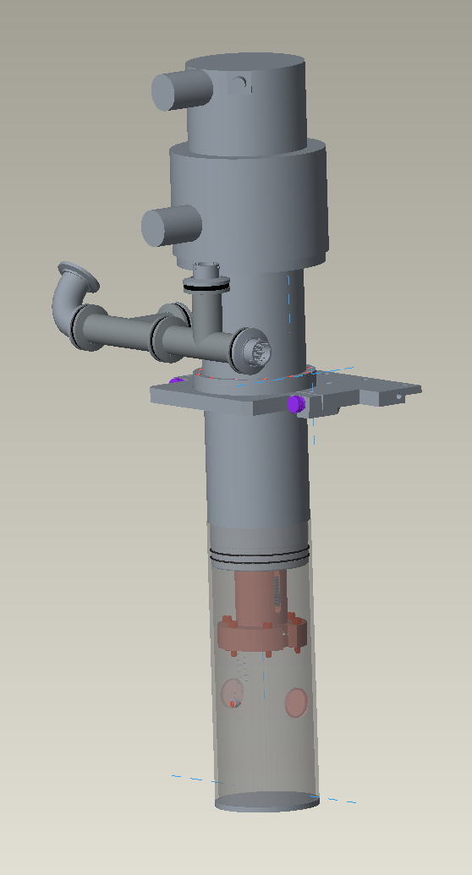
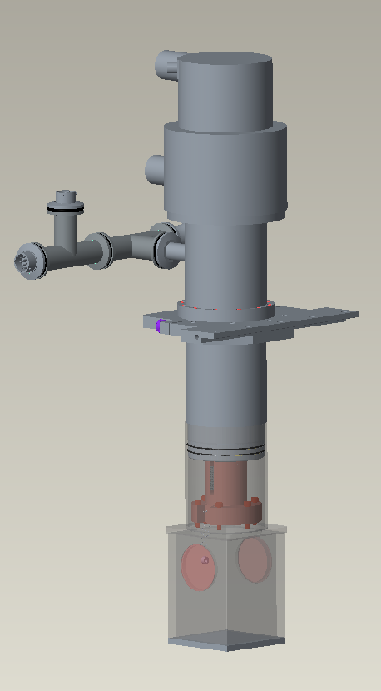
1” X 1MM
SAPPHIRE WINDOWS
Ø3” I.D. ANULAR OVC
CCR-026 BL4A SINGLE STAGE SUMITOMO 20k CCR
6X Ø.201 THRU ON A Ø2.500” B.C. EQUALLY SPACED MOUNTING HOLES FOR #10-32 UNF-2B SCREW
2” X 2MM
SAPPHIRE WINDOWS
3” INNER SQUARE OVC

Slide 2
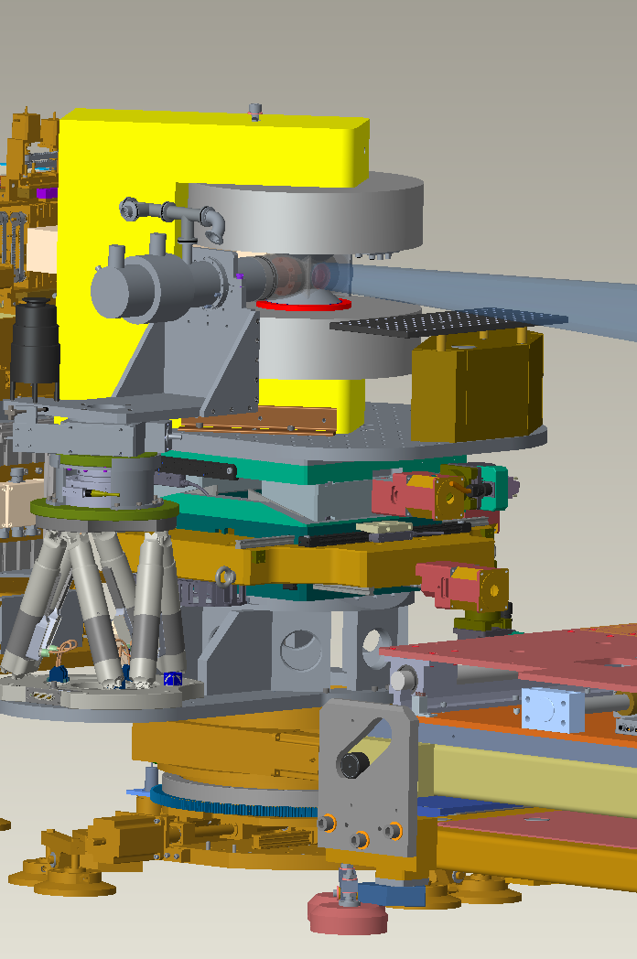
CCR-026 BL4A SINGLE STAGE SUMITOMO 20k CCR
INSTALLED AT BEAM LINE

Slide 3
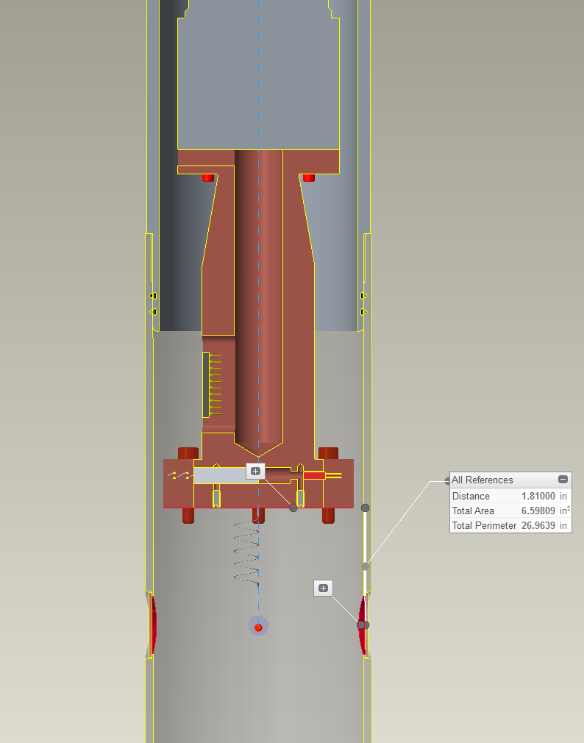
CCR-026 BL4A SINGLE STAGE SUMITOMO 20k CCR
CROSS SECTION VIEW OF ANULAR OVC OPTION
QUICK SLIP ON
OVC CAN
10 PINS FOR
VDC CONTROL
CAPABILITY
CALIBRATED
CERNOX FOR
TEMP. CONTROL
100W CARTRIDGE
HEATER
B.C.
CALIBRATED
CERNOX FOR
SAMPLE MOUNT
Ø3.25” ID

Slide 4
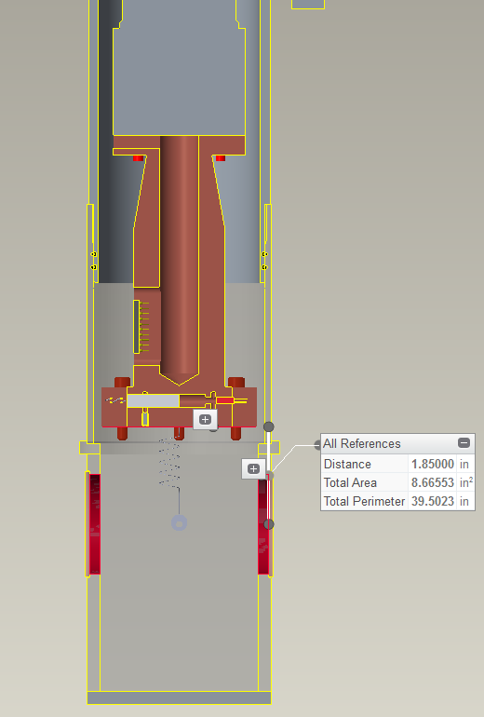
CCR-026 BL4A SINGLE STAGE SUMITOMO 20k CCR
CROSS SECTION VIEW OF ANULAR OVC OPTION
QUICK SLIP ON
OVC CAN
10 PINS FOR
VDC CONTROL
CAPABILITY
CALIBRATED
CERNOX FOR
TEMP. CONTROL
100W CARTRIDGE
HEATER
B.C.
CALIBRATED
CERNOX FOR
SAMPLE MOUNT
3” SQUARE INNER

