Slide 1
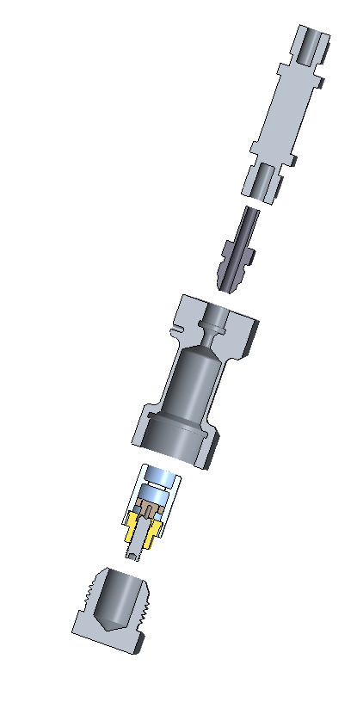
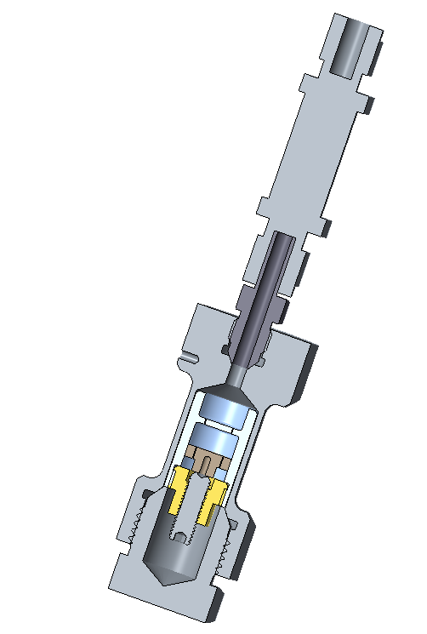
Clamp pressure cell within gas pressure cell
Clamp pressure cell
Gas pressure cell

Slide 2
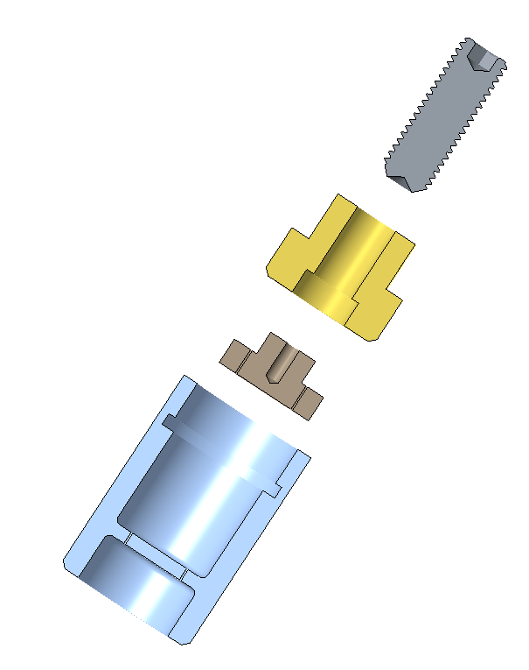
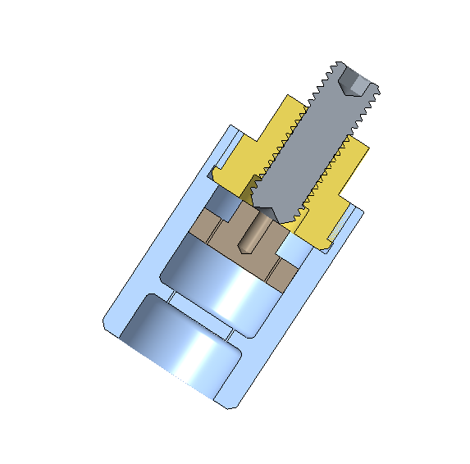
Clamp pressure cell
¼-28 UNF-2
Set screw
5/8-18 UNF-2
Locking nut
Cap
Body
2-56 UNC-2B
Diameter .500
Chamber height .75

Slide 3
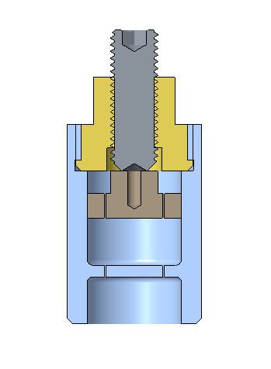
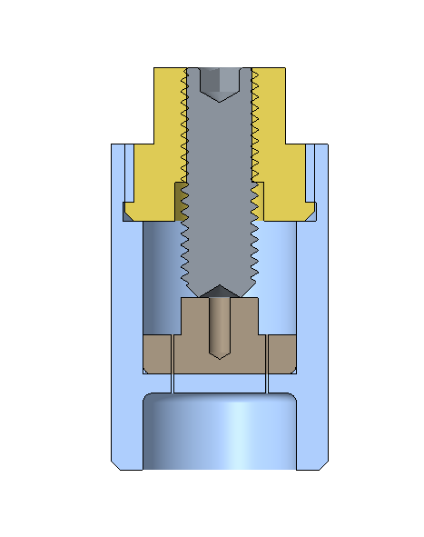
When cap is .25 inch from bottom set screw will be .25 inch from top nut
When cap is flush with bottom set screw will be flush with top nut
.25
.25

