Slide 1
Polarization / CCR Cart
Polarization CCR tipping analysis

Slide 2
Polarization CCR tipping analysis
The cart will be analyzed for two conditions.
  CCR extended
  CCR retracted
  Adding counterweight 20x17x4.5 inches, 433lbs
The cart wheels will be oriented to worst case scenario
Analysis done per UL 1678
Conclusion:
CCR extended and retracted analysis
  The cart is unstable to transport with CCR.
  Cart did not pass side loading criteria or 10° incline.
  Dynamic was acceptable
Added counterweight
  To stabilize the cart a 433 lb counterweight would need to be added to bottom of cart.
  With the counterweight all criteria is met per UL 1678
  The cart would need to be reanalyzed for the added weight
  Lift analysis would need to be reviewed

Slide 3
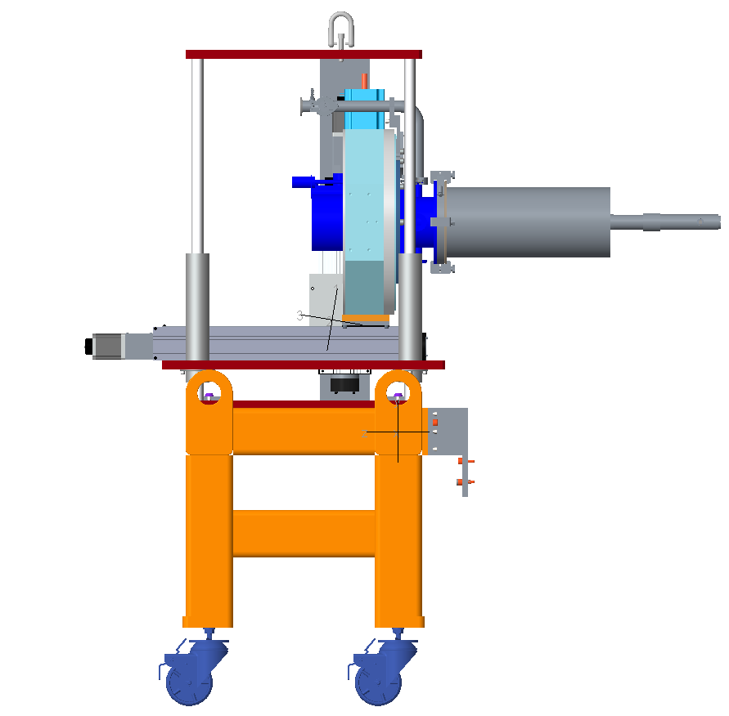
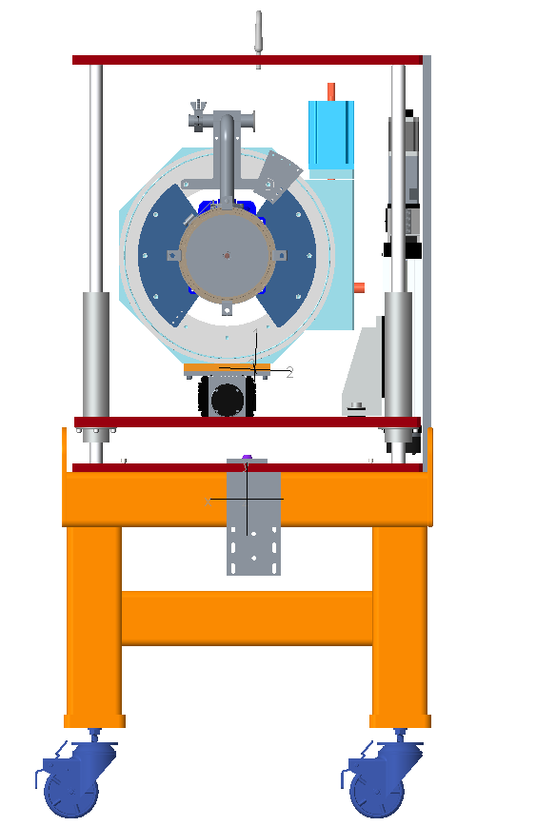
Cart with CCR extended out
Fore-Aft
Side to Side
Center Of
Gravity
15.18°
6.75°
22.21°
20.33°
32.732
12.128
3.872
13.367
8.883

Slide 4
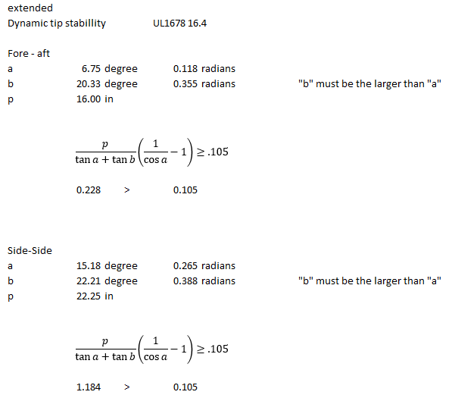
Dynamic tip stability
OK
OK

Slide 5
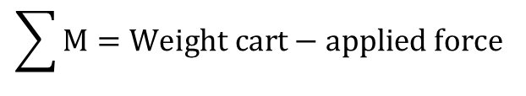
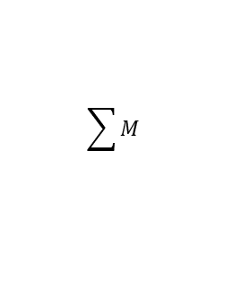

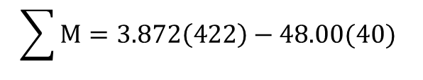
Tipping due to side loading
UL 1678 16.5.3
Will only analyze worst case, where the CG is closest to the side.
40 lbs
48.00
$$\sum{M=Weight cart−applied force}$$
$$\sum{M=3.872\left(422\right)−48.00(40)}$$
32.732
$$0=1633.98 in lbs−1920.00 in lbs$$
$$1633.98in lbs<1920.00 in lbs$$
Cart will tip from applied force
$$\sum{M}$$
12.128
3.872
422 lbs

Slide 6
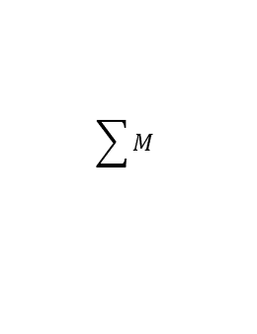
Tipping due to incline of 10°
The center of gravity is beyond point “M” and would tip over.
Center of gravity
Incline plane 10°
$$\sum{M}$$
422 lbs

Slide 7
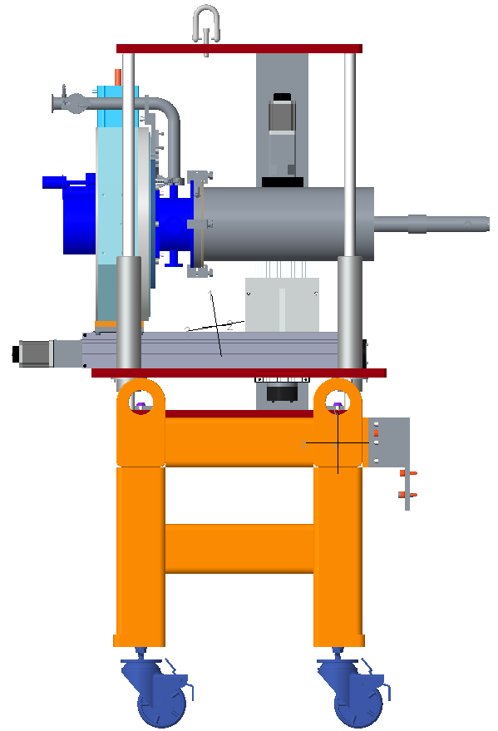
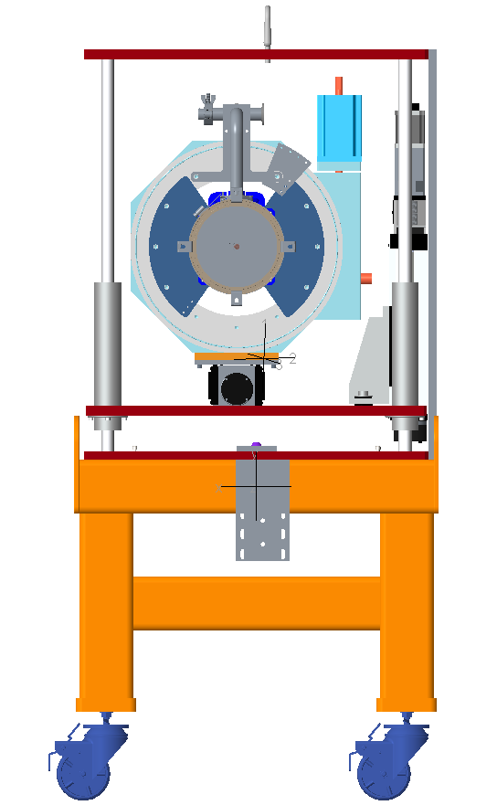
Cart with CCR retracted in
Fore-Aft
Side to Side
Center of
gravity
19.49°
7.69°
15.18°
22.21°
32.732
4.418
11.582
13.367
8.883

Slide 8
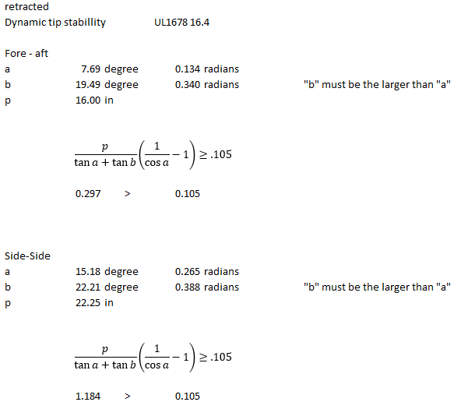
Dynamic tip stability
OK
OK

Slide 9
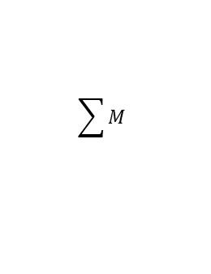
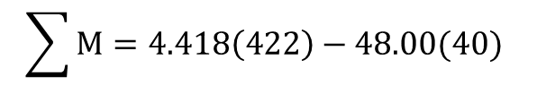
Tipping due to side loading
UL 1678 16.5.3
Will only analyze worst case, where the CG is closest to the side.
40 lbs
$$\sum{M=Weight cart−applied force}$$
$$\sum{M=4.418\left(422\right)−48.00(40)}$$
48.00
$$0=1864.40 in lbs−1920.00 in lbs$$
$$1864.40 in lbs<1920.00 in lbs$$
$$\sum{M}$$
Cart will tip from applied force
4.418
11.582

Slide 10
Tipping due to incline of 10°
The center of gravity is beyond point “M” and would tip over.
$$\sum{M}$$
Incline plane 10°
422 lbs

Slide 11
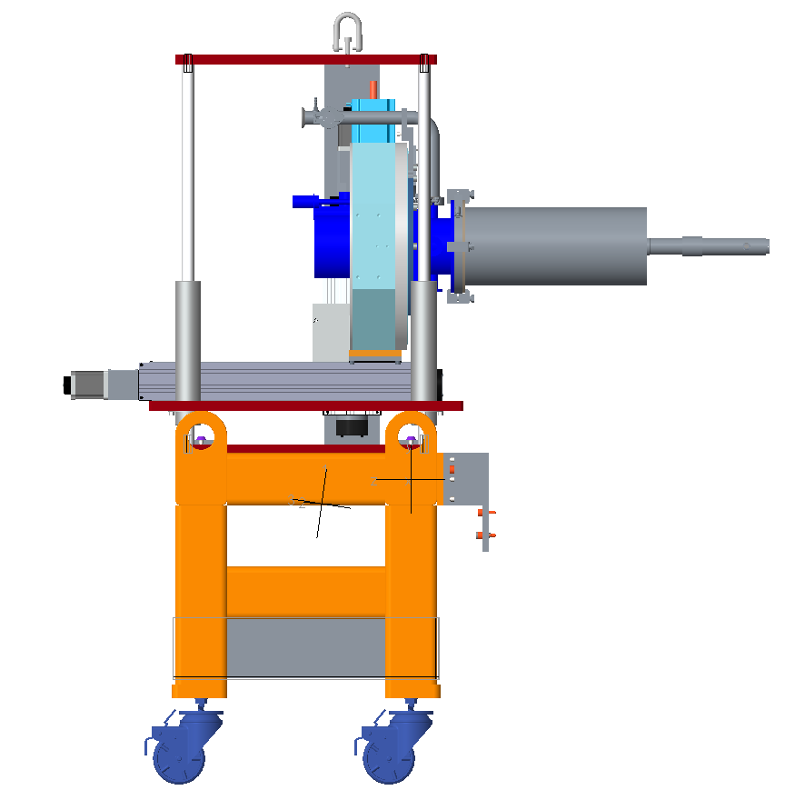
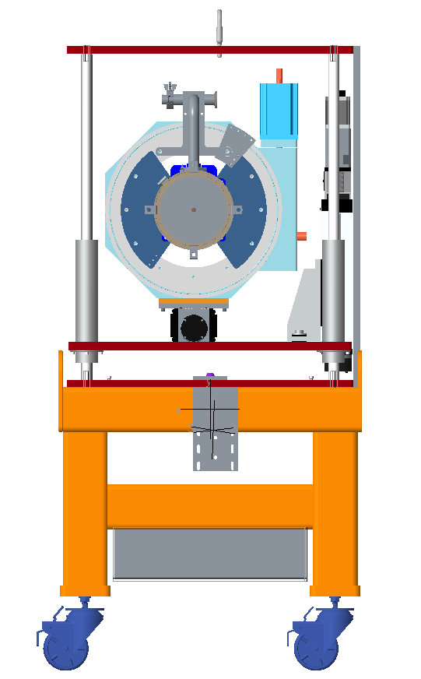
Cart with CCR extended out and counterweight
Fore-Aft
Side to Side
13.40°
26.98°
31.43°
23.17°
21.41
10.898
5.102
13.086
9.164
counterweight

Slide 12
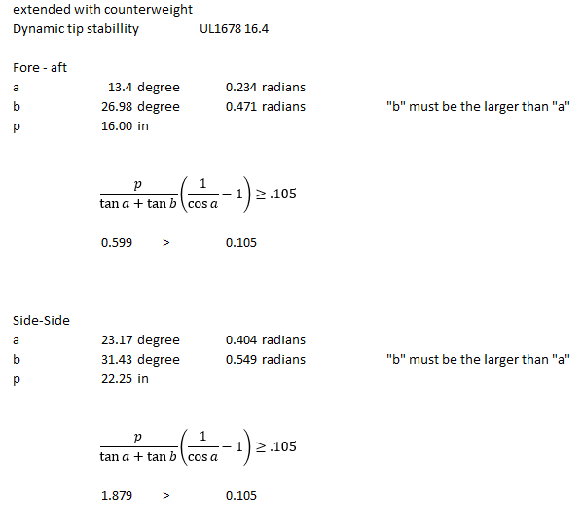
Dynamic tip stability
OK
OK

Slide 13
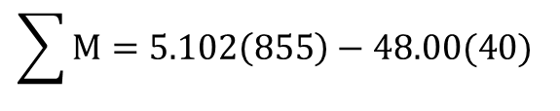
Tipping due to side loading
UL 1678 16.5.3
Will only analyze worst case, where the CG is closest to the side.
40 lbs
48.00
$$\sum{M=Weight cart−applied force}$$
$$\sum{M=5.102\left(855\right)−48.00(40)}$$
$$0=4362.21 in lbs−1920.00 in lbs$$
$$4362.21 in lbs>1920.00 in lbs$$
Cart will not tip from applied force
$$\sum{M}$$
10.898
5.102

Slide 14
Tipping due to incline of 10°
The center of gravity is behind point “M” and would not tip over.
10.898
$$\sum{M}$$
5.102
855 lbs

