Slide 1
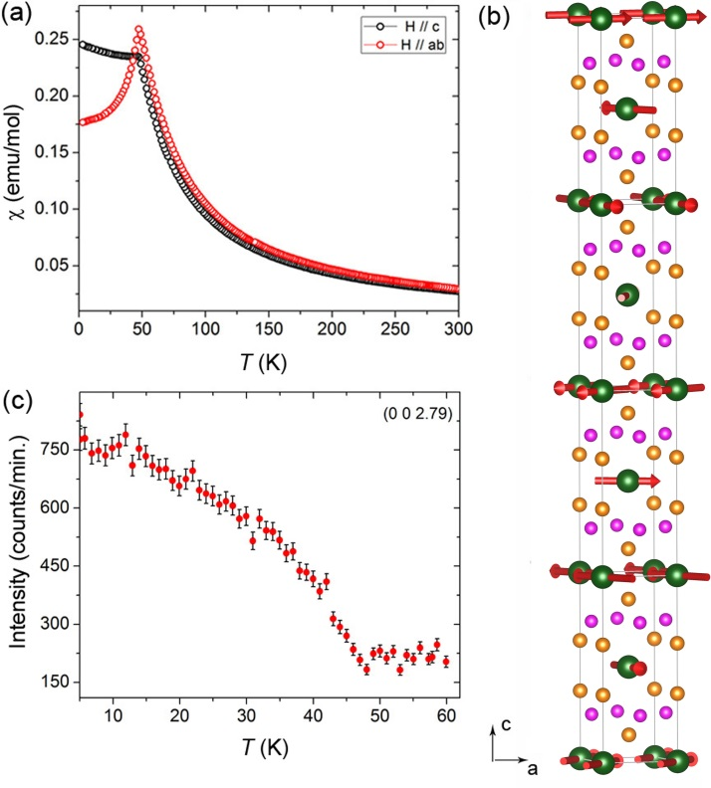




Localized to Strongly Correlated Electron Transition in EuCo₂As₂
Scientific Achievement
The mixed valence state of Eu has been induced by high-pressure in EuCo₂As₂ accompanied with a change of magnetic ordering. Neutron diffraction revealed an incommensurate magnetic order for the Eu sub-lattice and no magnetic order for Co sub-lattice at ambient pressure.
Significance and Impact
This work demonstrates the highly sensitive nature of itinerant magnetism in ACo₂As₂ (A = Eu, Ca) to electronic doping and physical/chemical pressure.
Research Details
The magnetic order was found for Eu sub-lattice but no magnetic order for Co sub-lattice. The Eu has a fully ordered moment at 7 μ_{B}. Neutron diffraction was successful on a heavy neutron absorbing element (natural Eu) containing crystal with a size of 0.4 mm³.
EuCo₂As₂
EuCo₂As₂: (a) Magnetic susceptibility vs. temperature under magnetic fields along the c-axis and ab-plane. (b) Temperature dependence of the magnetic peak intensity at (0, 0,2.79) . (c) Nuclear and magnetic structure determined by neutron diffraction.
Tan, X., Gilberto Fabbris, Daniel Haskel, A. A. Yaroslavtsev, Huibo Cao, C. M. Thompson, Kirill Kovnir, A. P. Menushenkov, R. V. Chernikov, V. O. Garlea, Michael Shatruk, A transition from localized to strongly correlated electron behavior and mixed valence driven by physical or chemical pressure in ACo₂As₂ (A = Eu, Ca). Journal of the American Chemical Society 8, 2724–2731 (2016).
The work performed at High Flux Isotope Reactor’s HB2A and HB3A instruments, Oak Ridge National Laboratory was sponsored by the Scientific User Facilities Division, Office of Basic Energy Sciences, U.S. Department of Energy (DOE)

